Slide 1
Alkım's C210 Project: Financial Analysis and Prediction 📊

Slide 2

Introduction

Slide 3
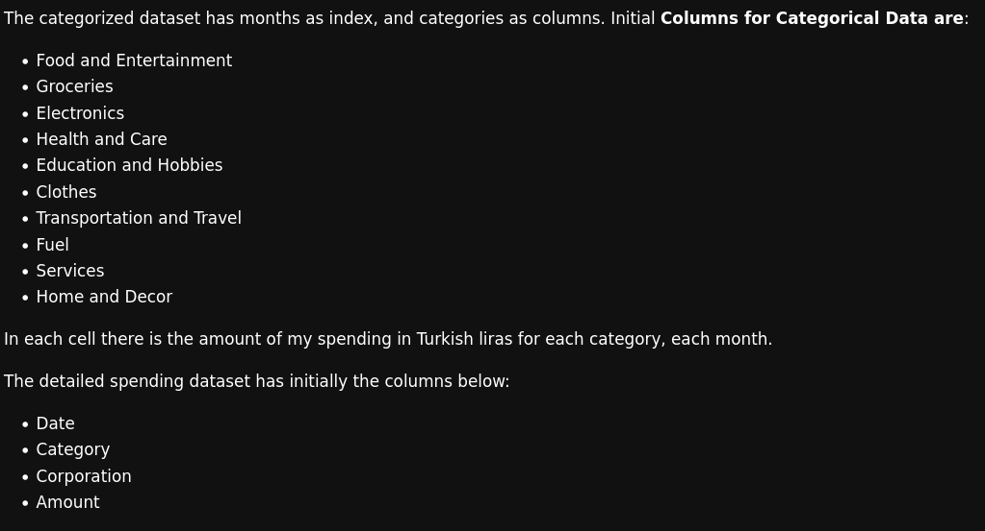
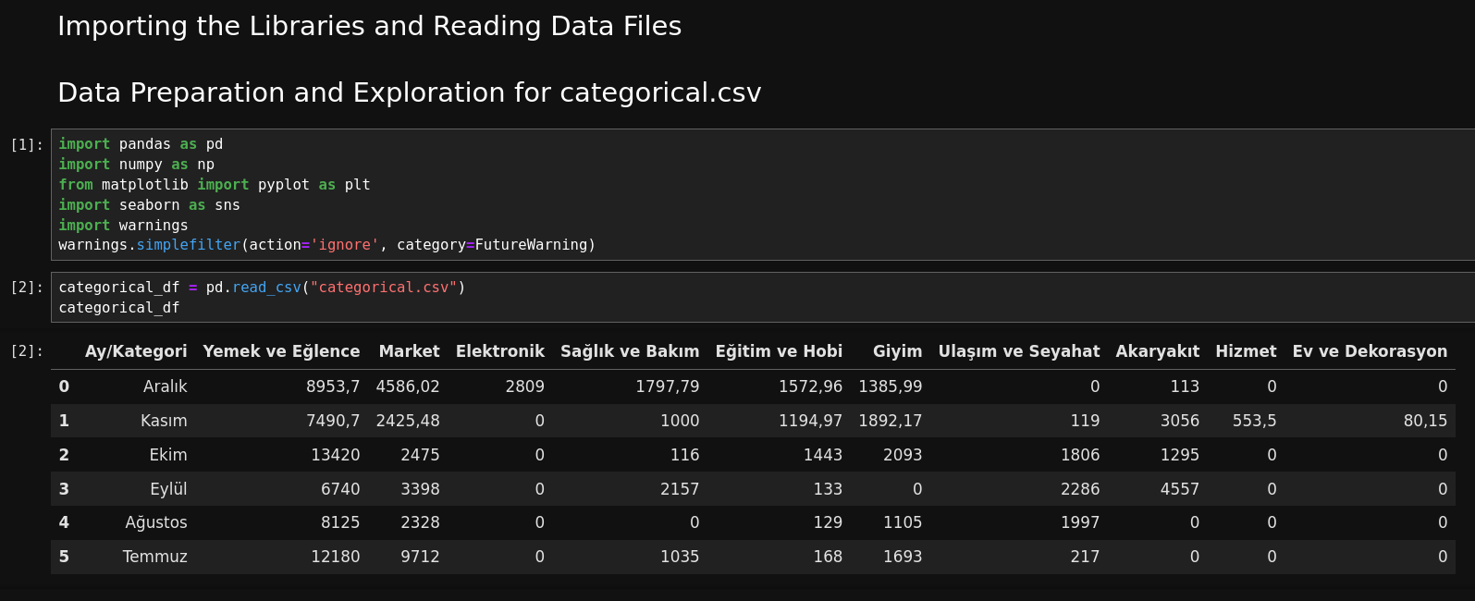

Slide 4
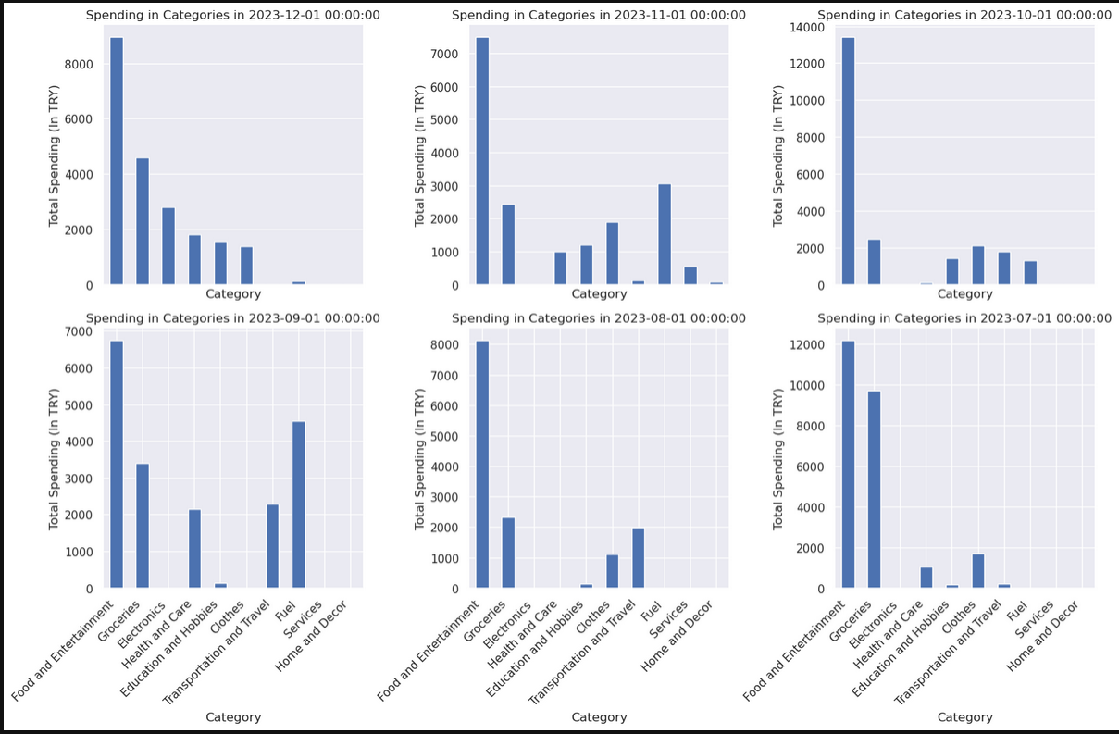
Spending Each Month

Slide 5
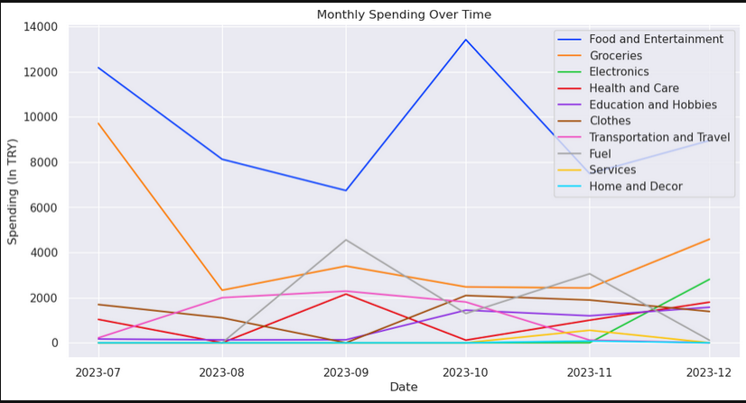
Monthly Spending Over Time Graph

Slide 6
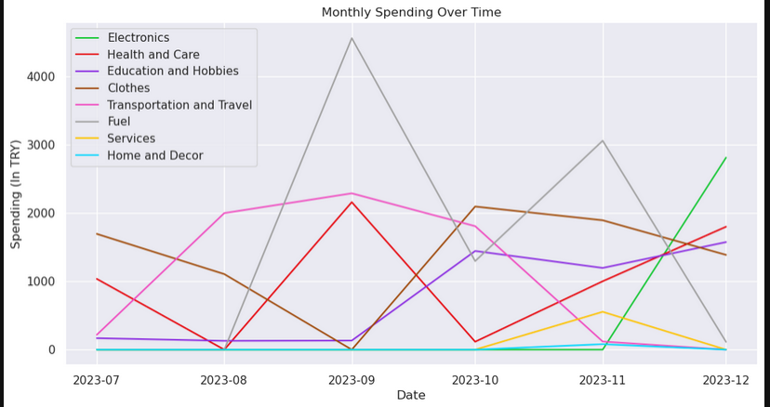
Monthly Spending Over Time (Zoom)

Slide 7
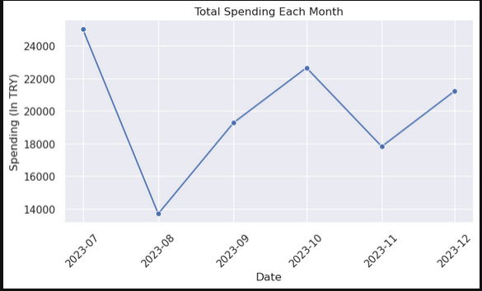
Total Spending Each Month

Slide 8

Our data (categorical_df)

Slide 9
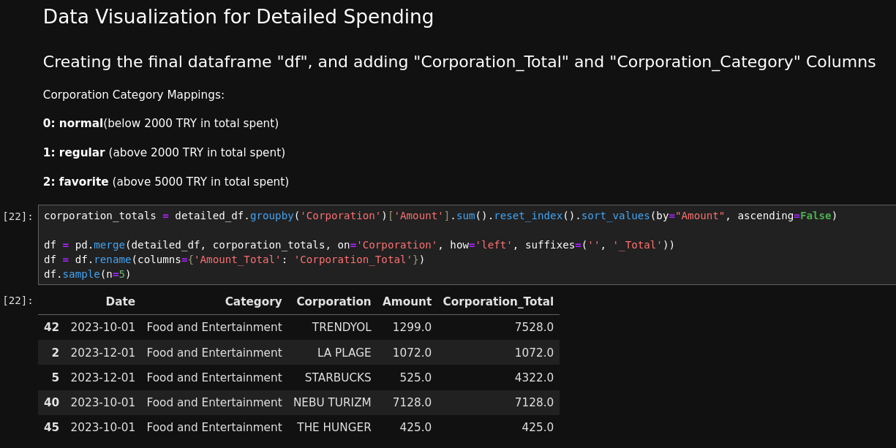

Slide 10
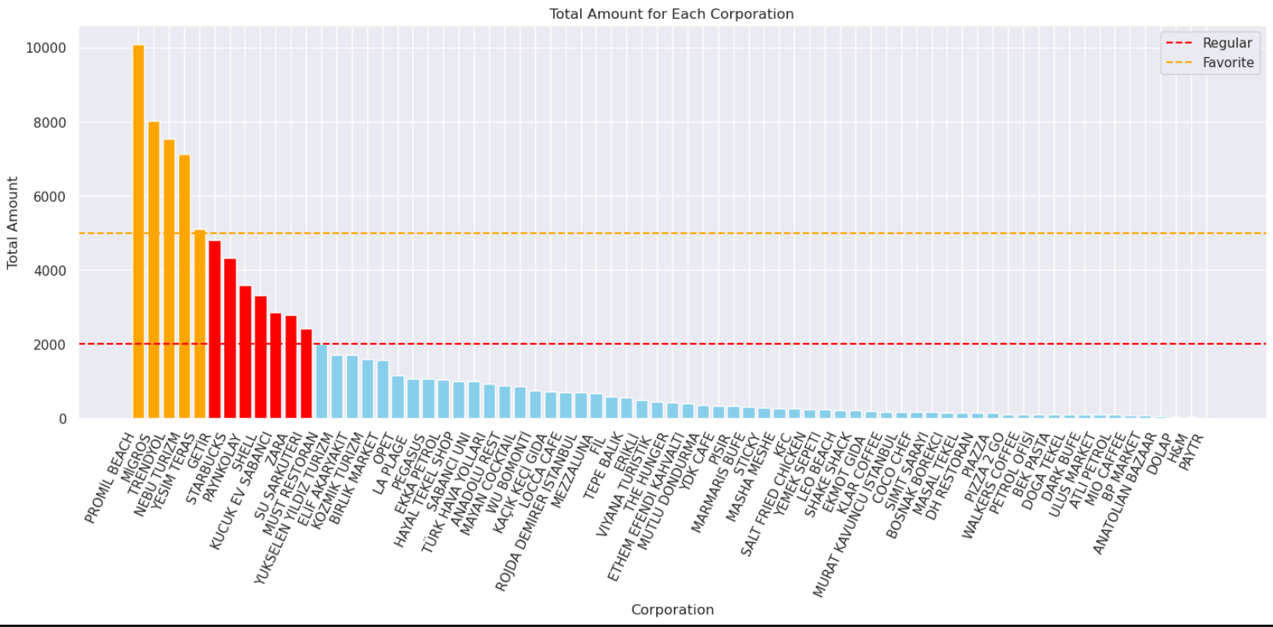

Slide 11
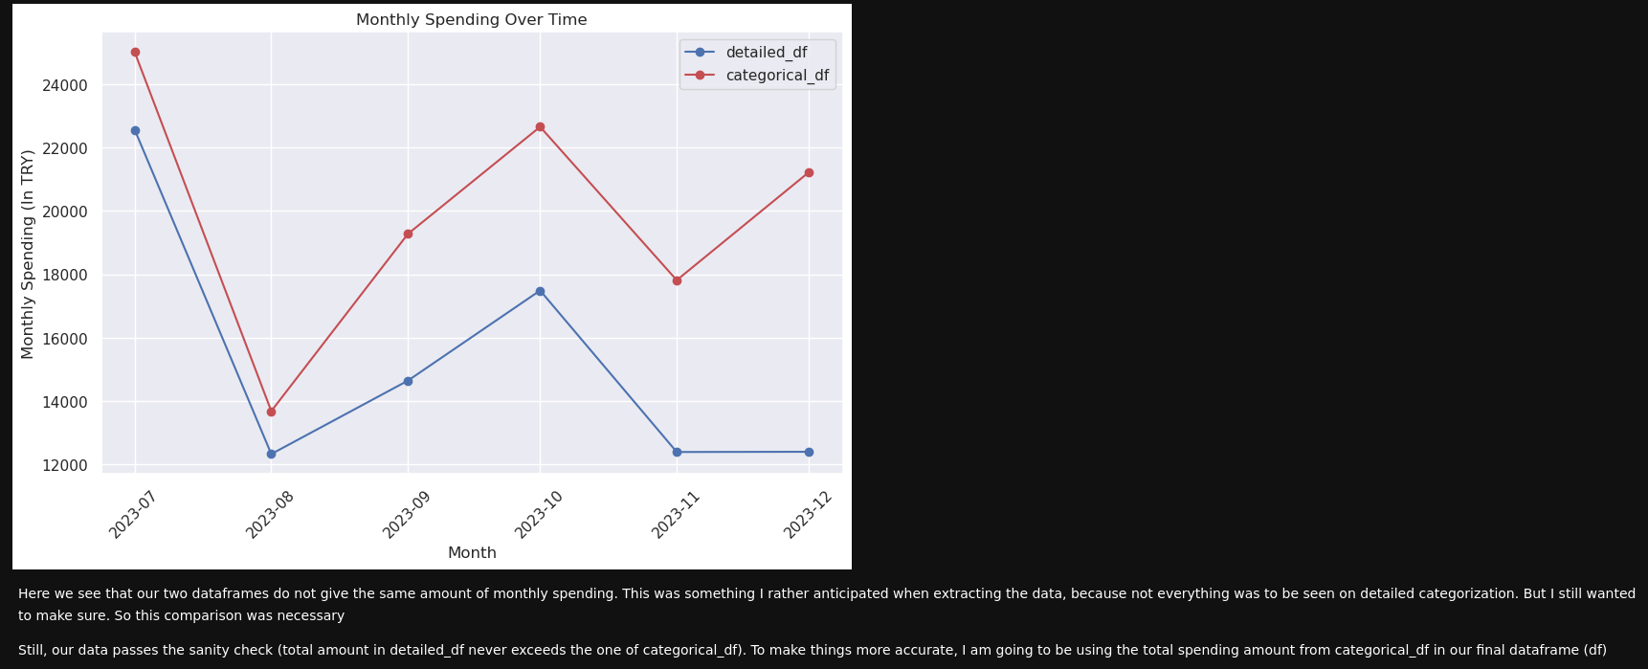

Slide 12
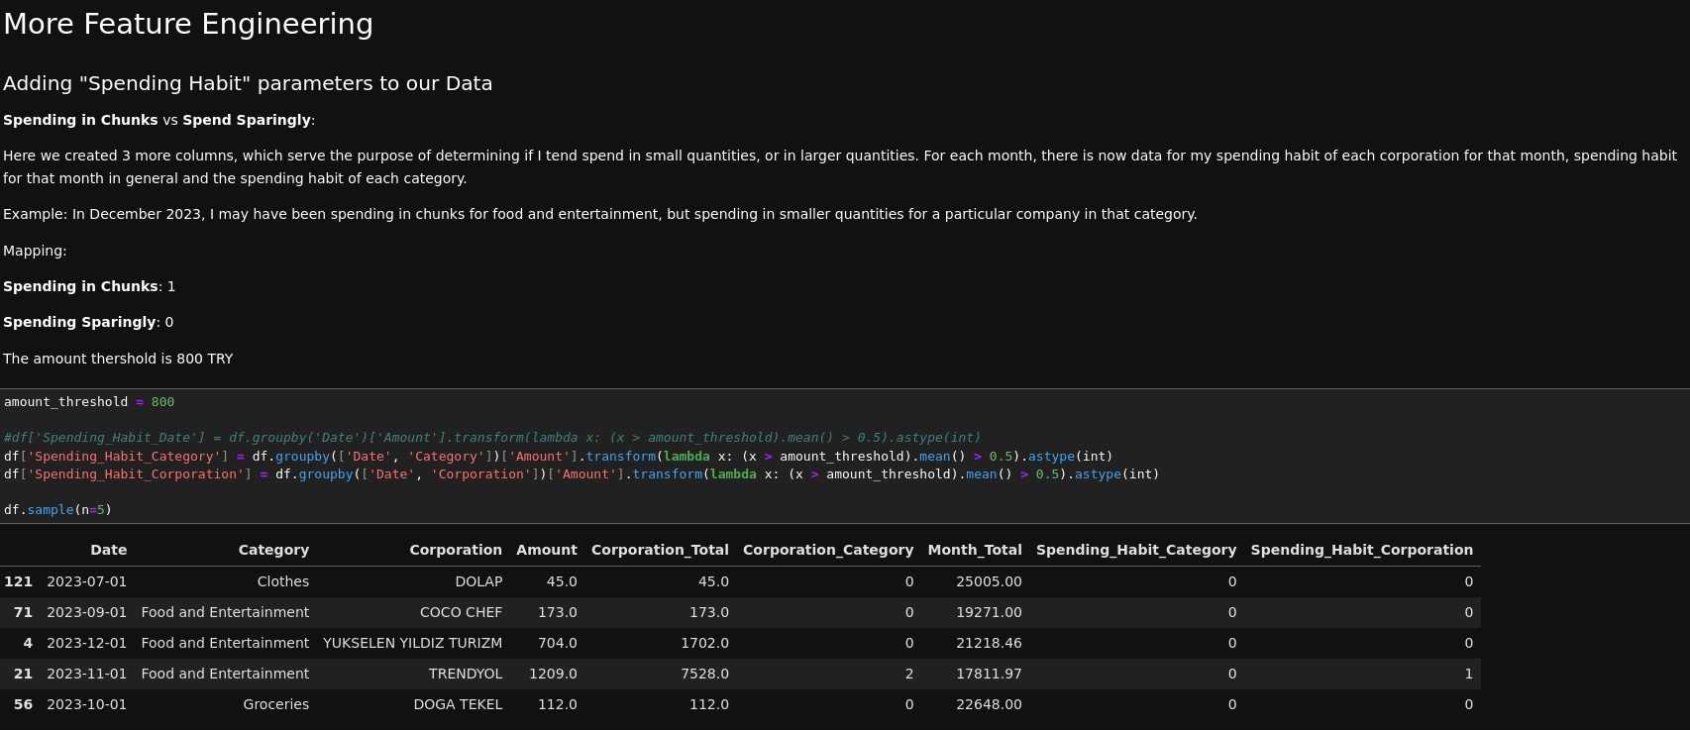

Slide 13

Feature Engineering Cont.

Slide 14
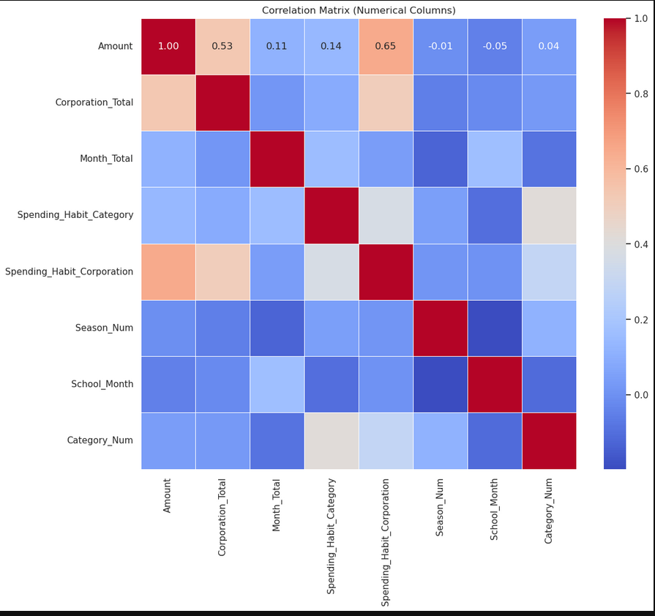

Slide 15

Finding Strongly Correlated Features

Slide 16
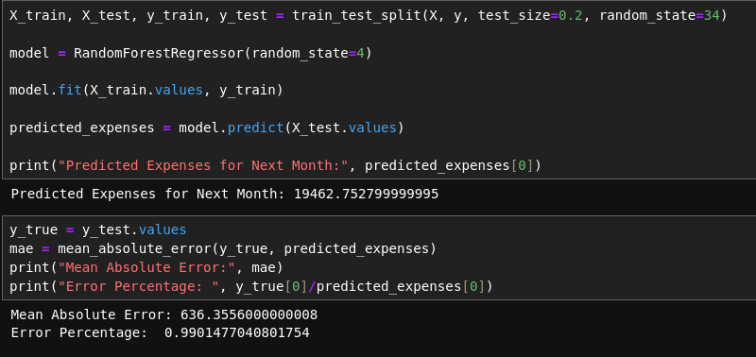
Training and Testing an RF model

Slide 17
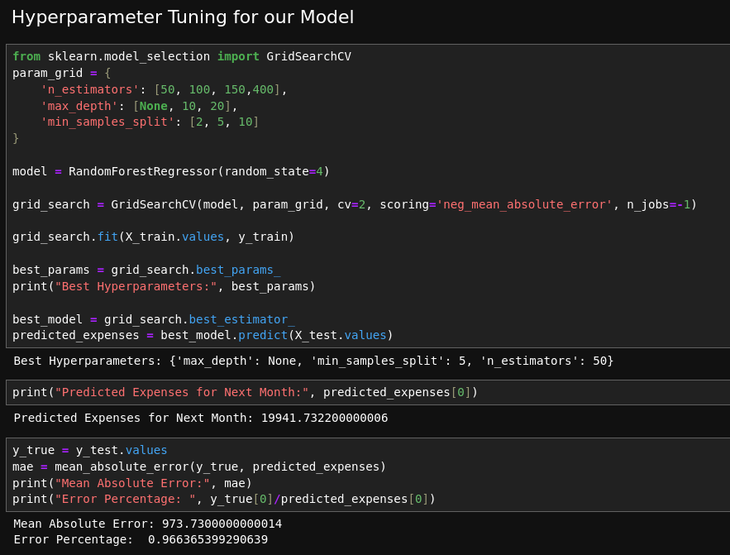

Slide 18


Slide 19
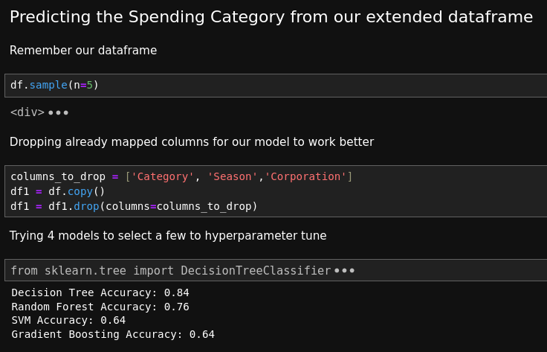

Slide 20



Slide 21
Thank you!

