Slide 1
ACTIVE LISTENING AND ENGAGEMENT

Slide 2
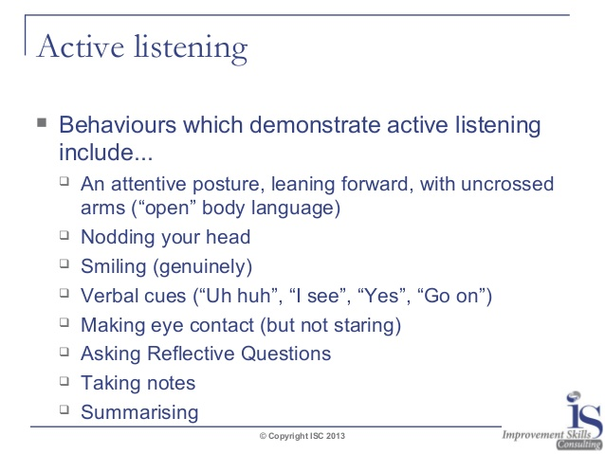
What is it…

Slide 3
Types of interviews
In Person
Phone & Video
Solo
SMILE!
Be Well Groomed and Dressed
Group
Panel
Directly Respond to the Person Who Asked the Question
Make Sure You Have Good Reception
Avoid Background Noise, Visuals and Distractions
Frame Your Face
SMILE!
Test the Platform Being Used

Slide 4

Before the interview
WHAT TO RESEARCH
WHERE TO FIND IT
Mission Statement and Vision
Current Accounts and Projects
Possible Expansions
Clients and Employees
Community Involvement
Position Details / Job Description
Interviewers Background
LinkedIn
Sales Team
News
Company Website
Social Media
This Photo by Unknown Author is licensed under CC BY-ND

Slide 5

So, Tell Me About Yourself
An elevator pitch, elevator speech, or elevator statement is a short description of yourself that explains who you are and your experience in a way that the listener can understand it in a short period of time
This Photo by Unknown Author is licensed under CC BY-NC-ND

Slide 6
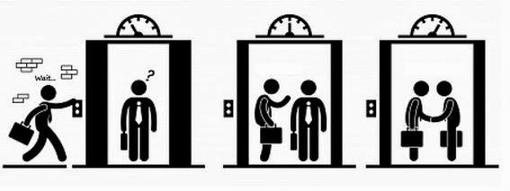
Parts of the Pitch
Title of Position You Want
What You Did
The Company You Did it For
Your Role Within the Company
Brief List of Duties
Summary of Prior Experience (if relevant)
Three Strengths You Are Bringing to the Table
Customized Closing

Slide 7
STEPS FOR INTERVIEWING SUCCESSFULLY
Before the Interview: Practice Mock Interviews, Research the Company, Learn your Profile, Organize your Portfolio
During the Interview: Stay Confident, Use the STAR Method, Ask Questions and Refer to the Portfolio
After the Interview: Remember the Thank You Follow-up

Slide 8
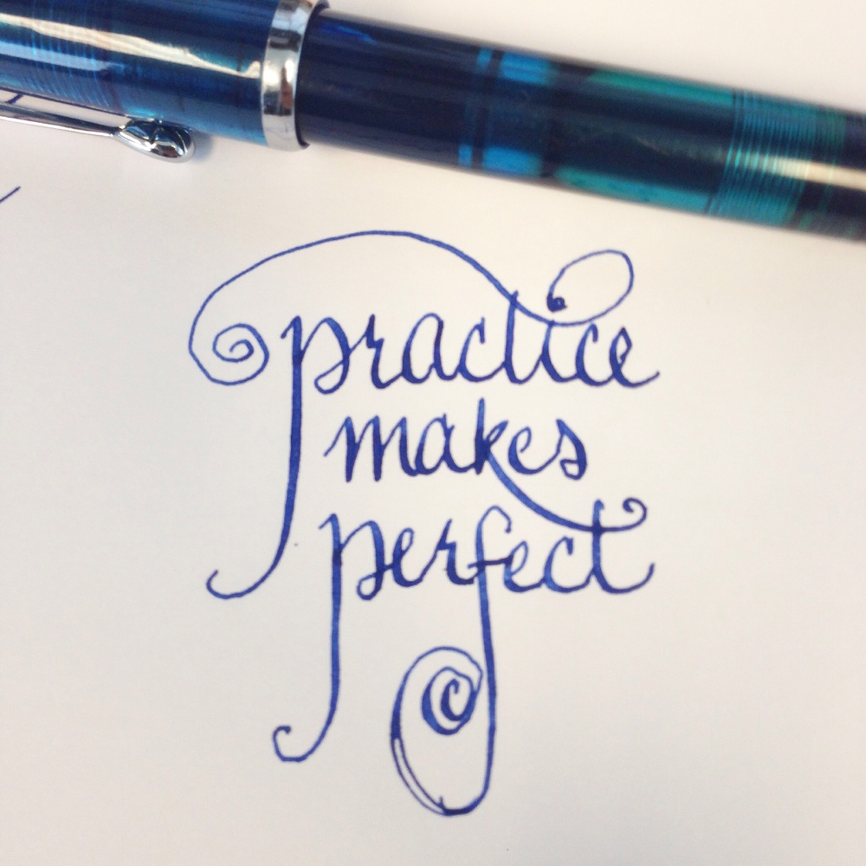
Tools to use before the interview
Soft Skills Sessions
Tech Prep
Elevator Pitch Practice
Mock Interviews
Write out answers to common questions to practice
TOOLS TO USE DURING THE INTERVIEW
Marketing profile for reference
Job description for reference
Skype (notes from CDM and Tech)
STAR Method
This Photo by Unknown Author is licensed under CC BY

Slide 9
Be a star interviewee
What is the STAR Method?
Notes:
Answered covered on the next two slides

Slide 10
S
A
T
R
Notes:
Use this page to provide a breakdown of what each letter stands for and the types of examples to use
S - Situation
T – Task
A – Action
R – Result
This method is used to offer the most details to the interviewer without overloading them with information, and it also helps you format your answers so you are able to provide a clear and concise response.

Slide 11

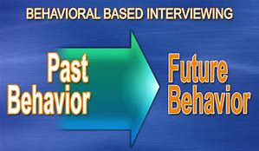
Interview styles
Behavior - Based
Provide an Example From a Time In Your Past When You Demonstrated A Particular Skill
These Questions Are Based on the Idea that Past Performance is a Strong Indicator of Future Performance
Situational
You Will Be Asked About a Hypothetical Situation and How You Think You Would Handle It
These Questions Are Designed to Look at Your Communication and Problem Solving Skills, As Well As, Your Ability to Think On Your Feet
Ask Clarifying Questions to Get The Big Picture of the Situation Prior to Answering

Slide 12
EXAMPLES
Tell me about how you worked effectively under pressure.
I had been working on a key project that was scheduled for delivery to the client in 60 days. My supervisor came to me and said that we needed to speed it up and be ready in 45 days, while keeping our other projects on time. I made it into a challenge for my staff, and we effectively added just a few hours to each of our schedules and got the job done in 42 days by sharing the workload. Of course, I had a great group of people to work with, but I think that my effective allocation of tasks was a major component of the success of the project.
Tell me about a time when you made a mistake? How did you handle it?
Once I misquoted the fees for a particular type of membership to the club where I worked. I explained my mistake to my supervisor, who appreciated my coming to him, and my honesty. He told me to offer to waive the application fee for the new member. The member joined the club despite my mistake, my supervisor was understanding, and although I felt bad that I had made a mistake, I learned to pay close attention to the details so as to give accurate information in the future.
Notes:
Have consultants come up and do a breakdown of where they see each letter in the example.
S - I had been working on a key project that was scheduled for delivery to the client in 60 days.
T - My supervisor came to me and said that we needed to speed it up and be ready in 45 days, while keeping our other projects on time.
A - I made it into a challenge for my staff, and we effectively added just a few hours to each of our schedules
R - Got the job done in 42 days by sharing the workload
-----------------------------------------------------------------------------------------------------------------------------------------------
S - Once I misquoted the fees for a particular type of membership to the club where I worked.
T - He told me to offer to waive the application fee for the new member
A – Followed supervisors suggestion
R - The member joined the club despite my mistake, my supervisor was understanding, and although I felt bad that I had made a mistake, I learned to pay close attention to the details so as to give accurate information in the future

Slide 13
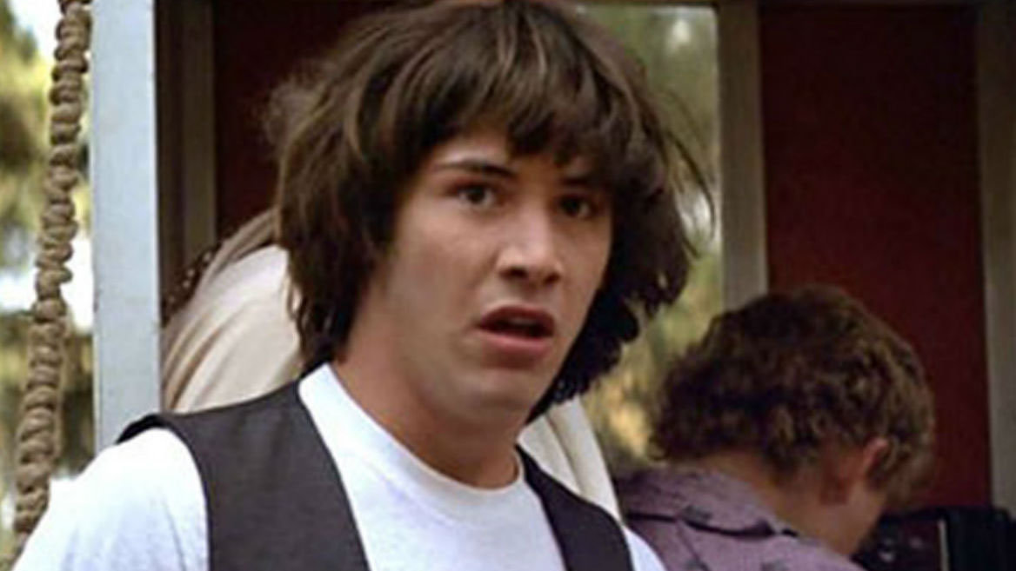
What To Do If You Need A Moment To Answer
MY MIND HAS GONE COMPLETELY BLANK
Relate the question to your marketing profile
You should have a copy with you to refer to
Buy Time
Ask the interviewer to repeat the question, or repeat it back to them to get “clarification”
Ask for Time
It’s not always ideal, but based off your rapport with the interviewer you can ask for a few seconds to come up with a great example

Slide 14
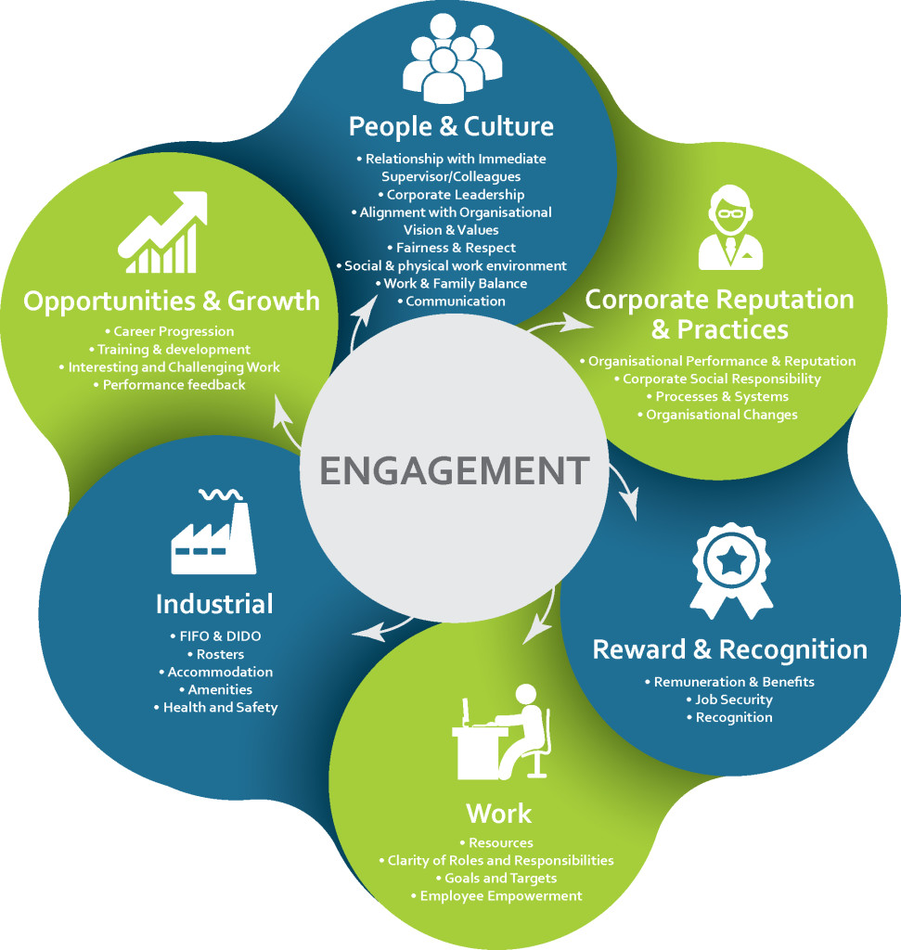
Why is engagement important?
What did you take from this presentation and documents I sent?
What parts of this presentation are you comfortable with?
What area do you feel will be a struggle for you?
Tech and I are here to see you succeed!!

Slide 15
