Slide 1


AirBnB Business Insights
DataThonians July 16, 2022

Slide 2
Contents
01
Optimal Choice Algorithm
02
HiPro Spots
03
Season Profitability Maximization
04
Analysis of Qualitative & Quantitative Data
Developing of Choice Algorithm
Mapping of the promising neighbourhoods
Next Steps
Defining most profitable season
Recommendations

Slide 3
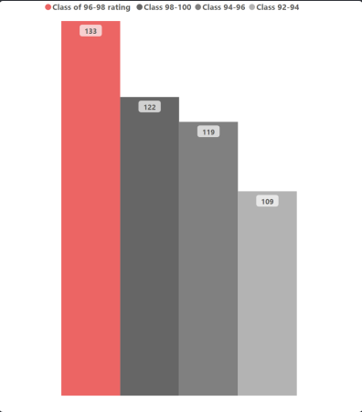
01
Optimal Choice Algorithm
F(x) =
Rating (average) + Weight of class * Rating (average),
where: Weight of class =
Reviews of Class
Total Reviews

Slide 5
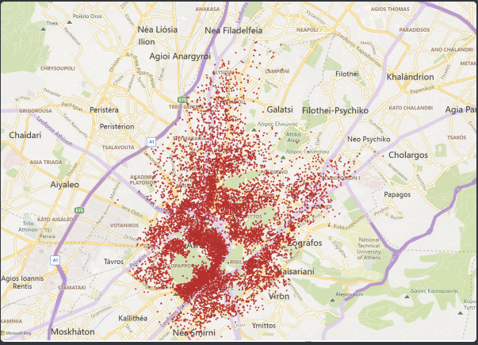
02
HiPro Spots
All Spots

Slide 6
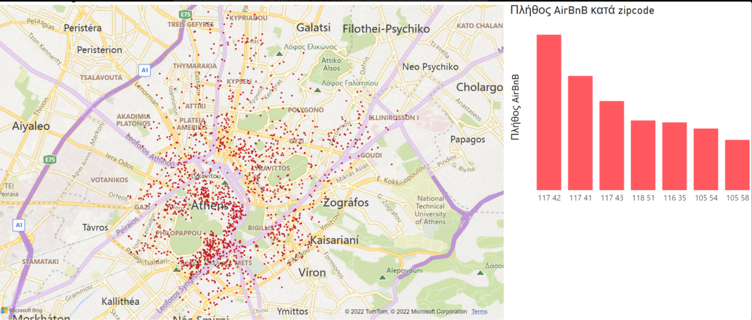
Most in Demand Zip Codes

Slide 7
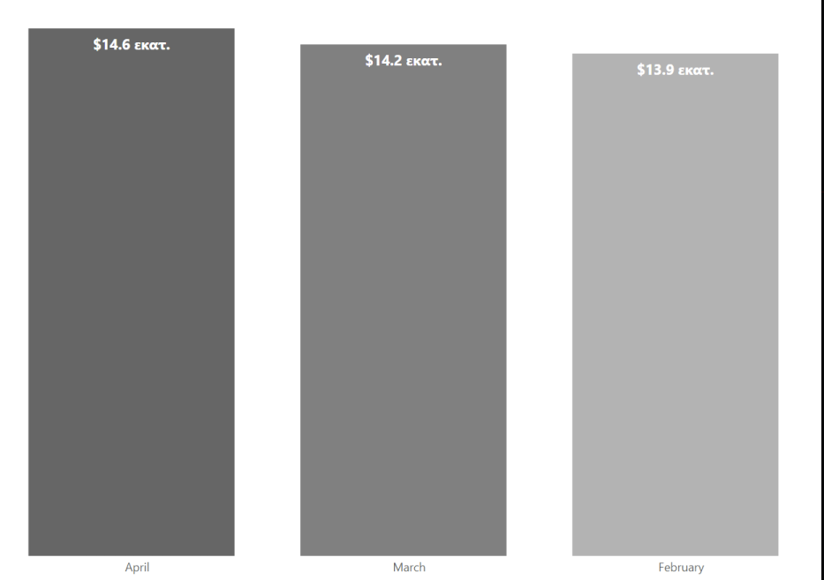
03
Season Profitability Maximization

Slide 8
Next Steps
04
1st Step
3rd Step
Include Customers ID → Define Target Market
Specific Data on Bookings → Profitability per listing
And keep Booking!
2nd Step
4th Step
Specific Data on Customers (e.g. Demographics, Interests etc)
To predict and suggest future trends on specific HiPro Spots

Slide 9



“Belong Everywhere!”
Adapt Everywhere!

