Slide 1
Local Agentic AI CDC Mortality Tracker & Analyzer
Fetches real-time CDC public health mortality data (public dataset)
Uses a local LLM (TinyLlama) to
Parse & clean raw data
Analyze & summarize trends
Suggest clear, actionable health recommendations based on trends
Fully local execution: No API calls beyond downloading the public dataset.
Governed model + governed dataset (ethical by design) Both the model (TinyLlama, Apache 2.0 license) and the dataset (CDC public data) are open, transparent, and privacy-safe.

Slide 2
Description
I built a local agentic AI pipeline that monitors and analyzes real-time public health mortality data from the CDC. The system consists of:
Data Fetcher Agent: Pulls and formats CDC’s open data (in JSON format)
Trend Analyzer Agent: Uses TinyLlama(Apache 2.0) to summarize key trends (e.g., increases/decreases in cases)
Advisor Agent: Provides easy-to-understand health advice (e.g., “High-risk groups should consider getting a flu shot.”)
I used Python + Transformers to run TinyLlama locally and connected the agents using CrewAI for multi-step orchestration.
The core challenges were:
Converting messy JSON into prompts suitable for the LLM
Running everything fully offline to ensure privacy & governance
Keeping latency low using local inference

Slide 3
Why I Chose to Create It
I wanted to solve a real-world, high-impact problem, making public health data easier for people to understand.
Many AI demos focus on chatbots or generic Q&A, but I chose something actionable and community-focused: giving people near real-time insights into flu outbreaks, especially important post-pandemic.
I also wanted to showcase that AI can be both powerful and privacy-friendly. This project runs entirely locally, no cloud dependencies, using open data and a governed, ethical model. It demonstrates AI’s potential to work responsibly, securely, and under the user’s full control.

Slide 4
How Did an Agentic Framework Help?
The agentic framework made the solution modular, reusable, and easy to extend.
Instead of writing one big script, I split responsibilities into clear roles:
The Data Fetcher Agent focuses only on collecting & cleaning data.
The Trend Analyzer Agent specializes in interpreting the data.
The Advisor Agent provides human-understandable health recommendations.
This mirrors how real-world teams work: specialists collaborating, each with a defined task.
Using CrewAI’s orchestration made it easy to:
Chain tasks step-by-step,
Debug/optimize each agent independently,
Swap in new agents (e.g., replace TinyLlama with LLaMA later if needed)
It also encouraged clear prompt engineering, because each agent needed a focused prompt, which improved LLM performance and reliability. Note: TinyLlama is a small, local model, ideal for lightweight NLP tasks. For deeper insights, it can be swapped for larger models like LLaMA or GPT-based APIs.

Slide 5
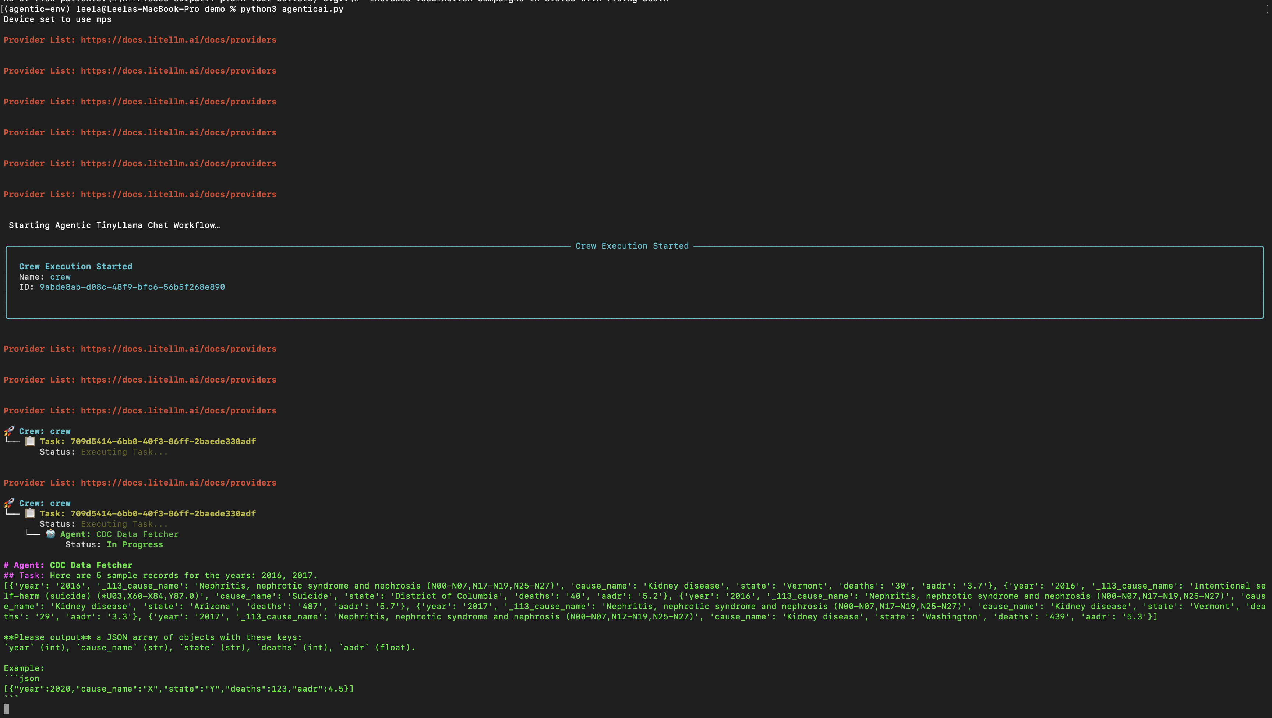
Application Execution Logs and Results:

Slide 6
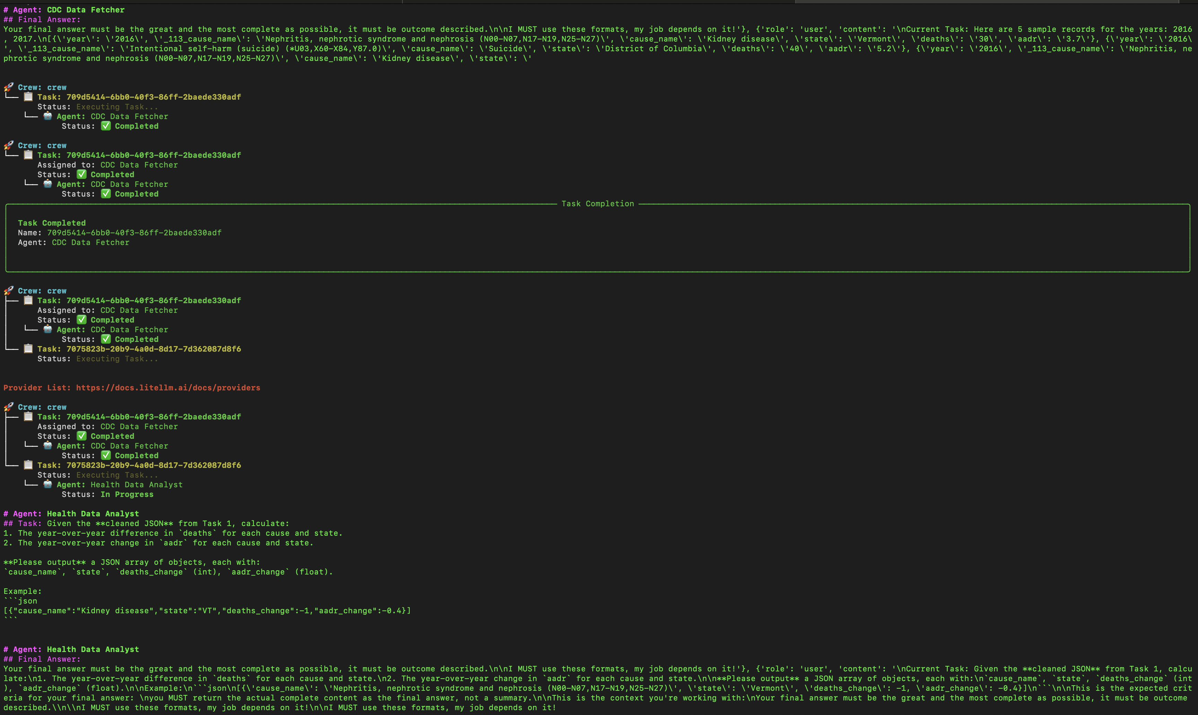

Slide 7
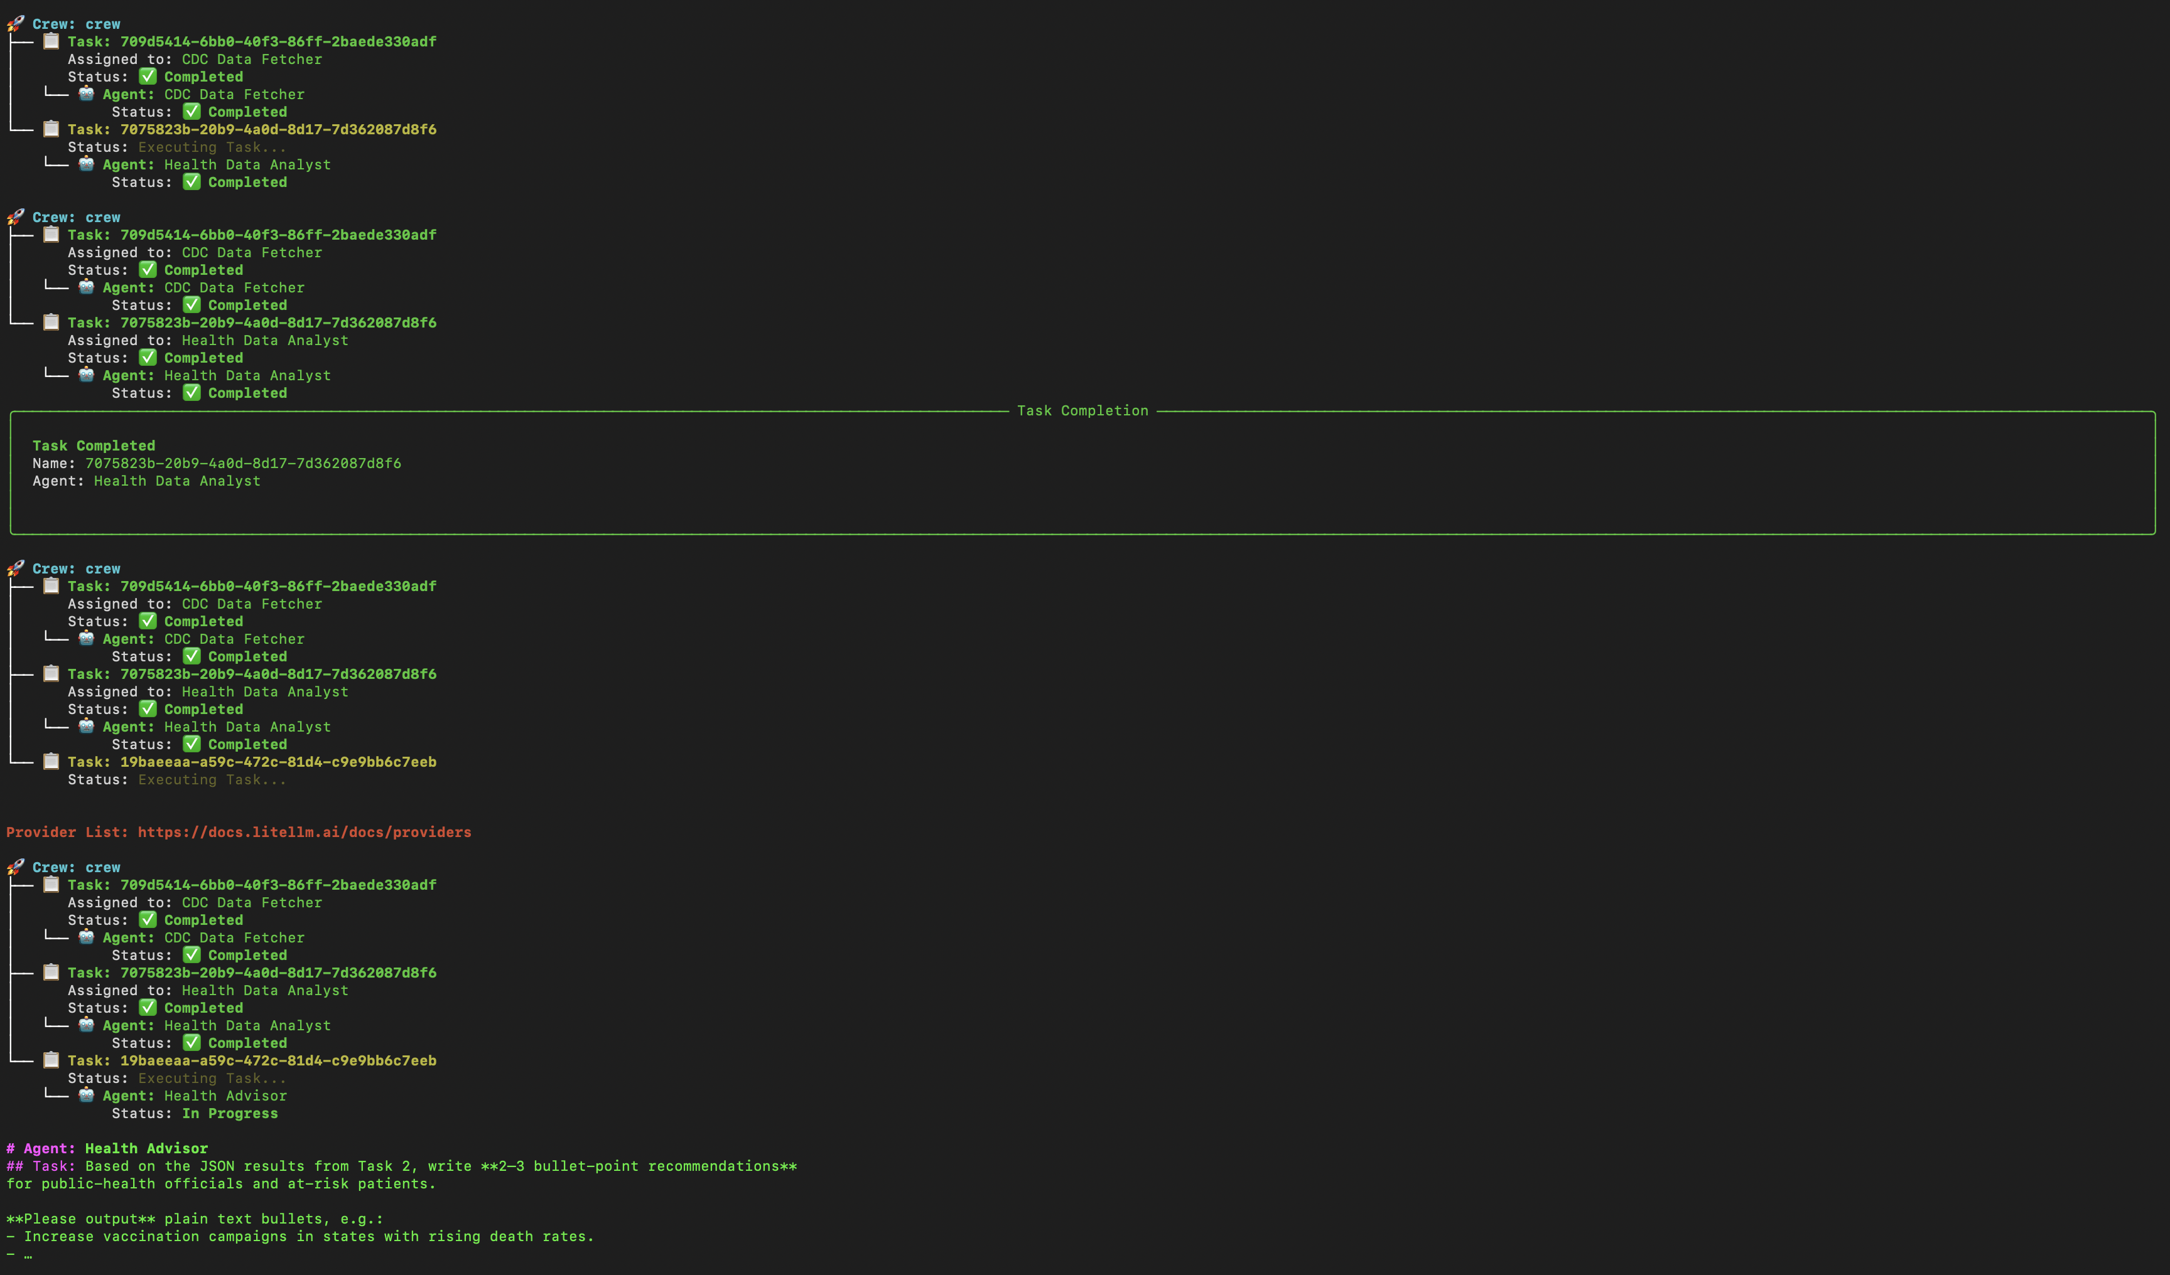

Slide 8
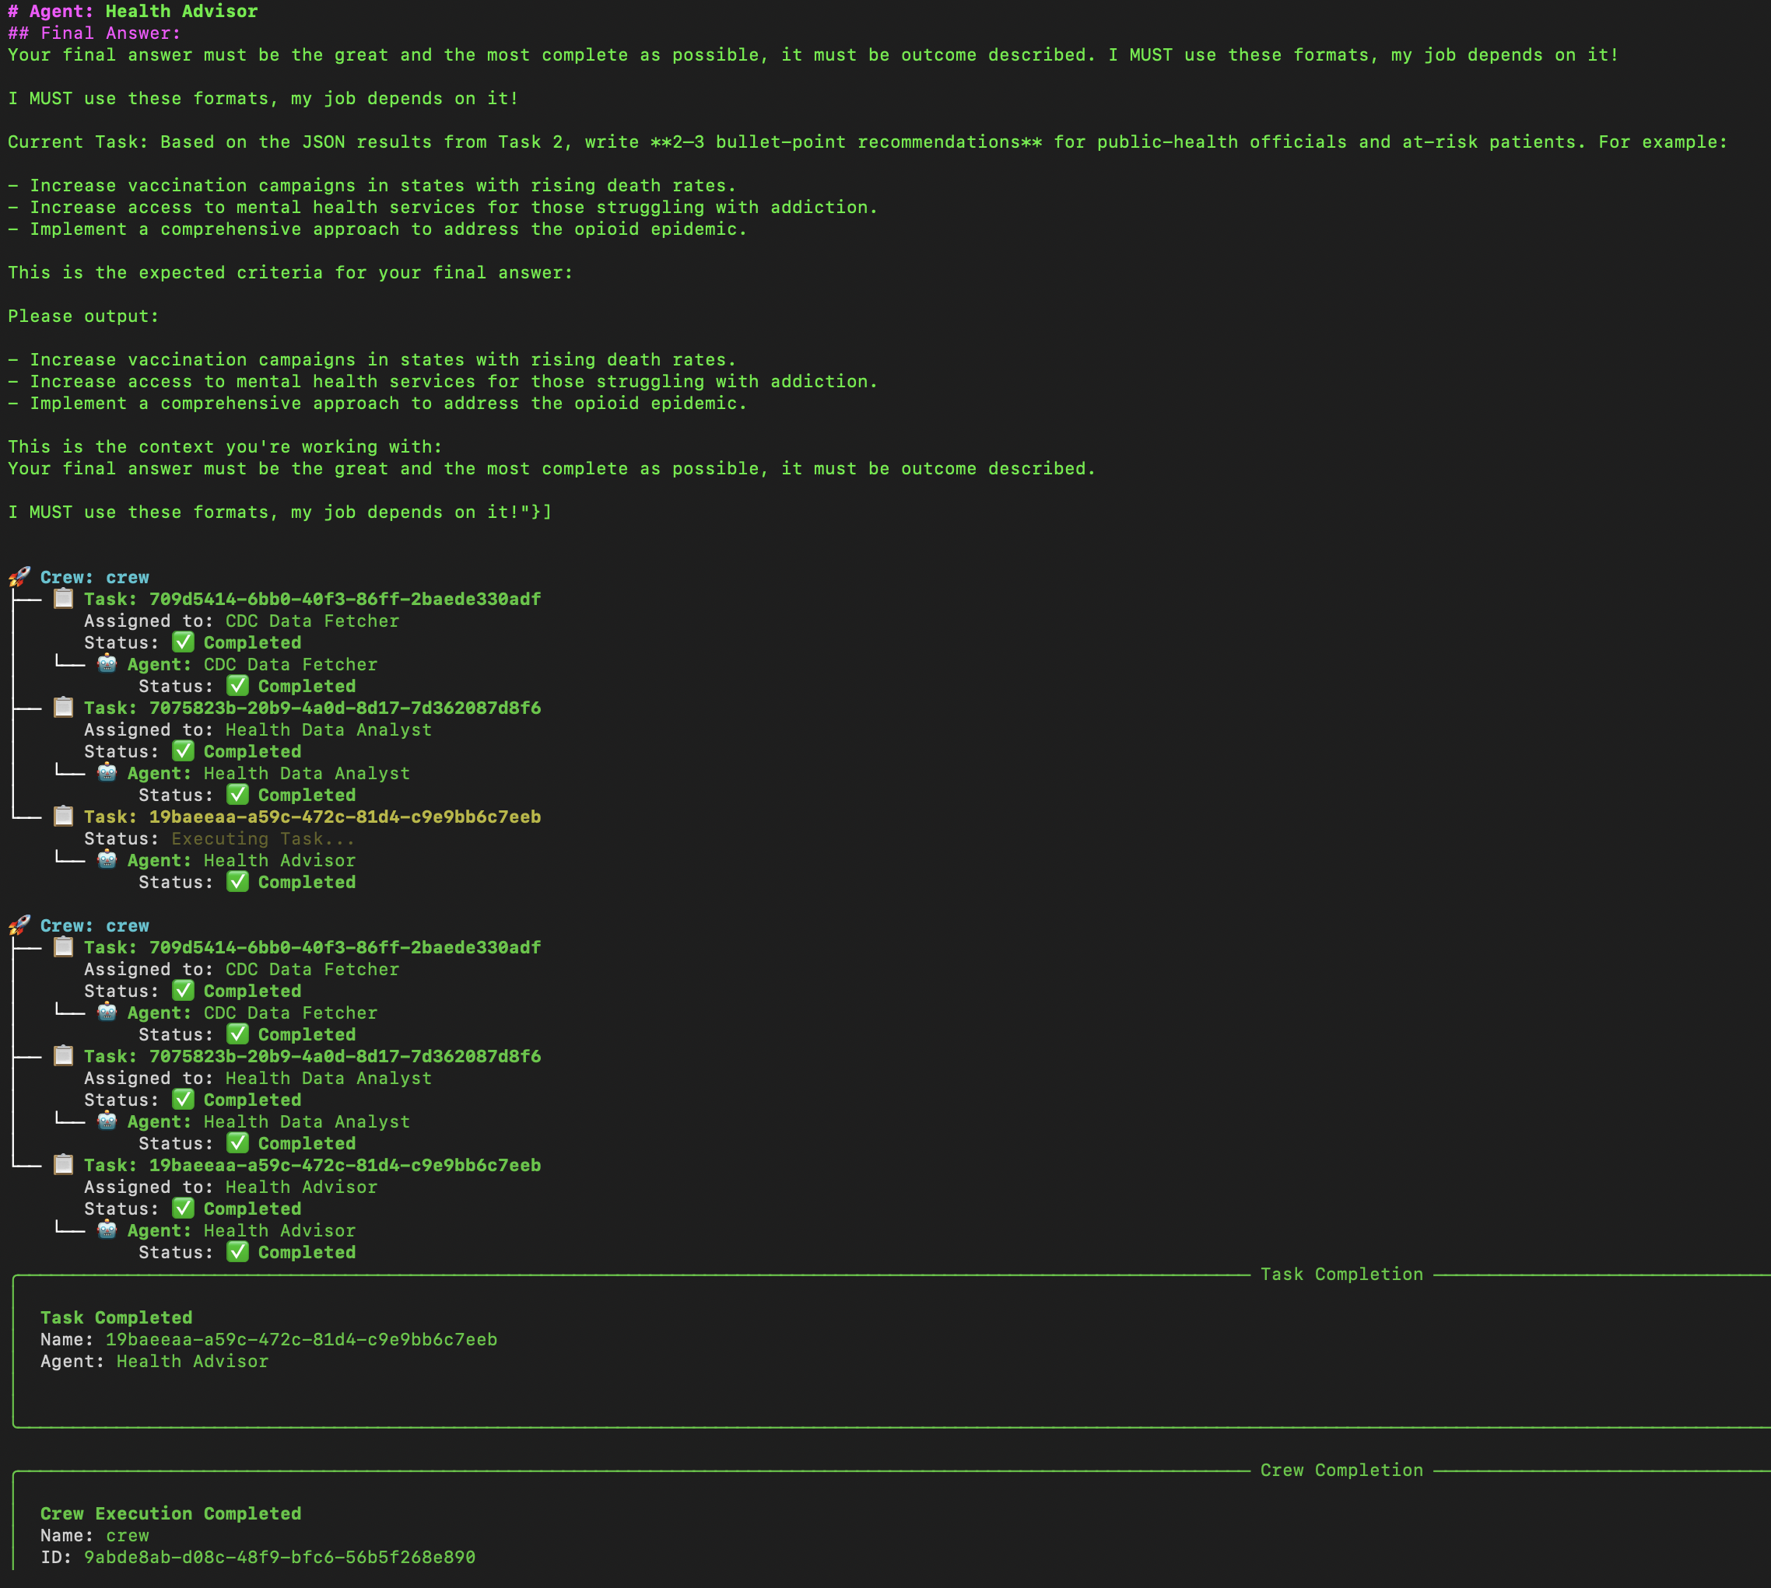

Slide 9
