Slide 1

Access to observation data
Sensor Web Enablement (OGC - SWE) is a suite of standard encodings and web services that enable:
Discovery of sensors, processes, and observations
Tasking of sensors or models
Access to observations and observation streams
Publish-subscribe capabilities for alerts
Robust sensor system and process descriptions
For examples some specifications:
SensorML : models and schema for describing sensors characteristics (location, ...)
O&M : models and schema for encoding sensors observations
SOS : interface to access sensor information (SensorML) and sensor observations (O&M)

Slide 2
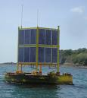

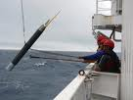


In situ sensors (some examples)
Time series
Tide gauges
Fixed buoys
Profiles
Argo floats
CTD
XBT
Trajectories
TSG
Drifting buoys
...

Slide 3
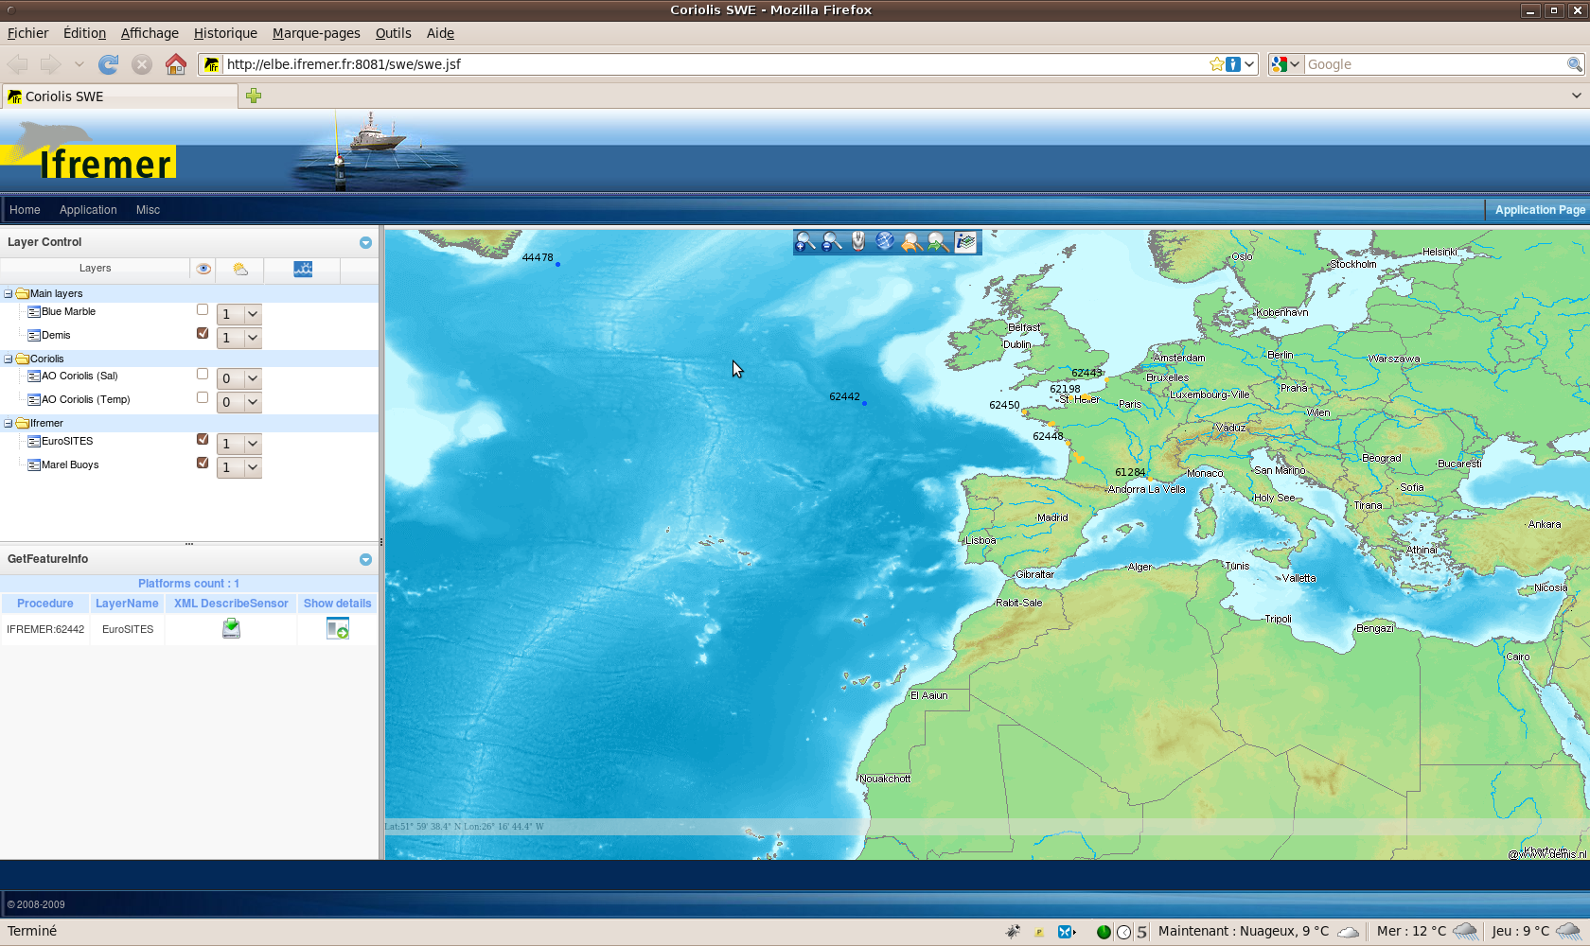
Example : Time Series

Slide 4
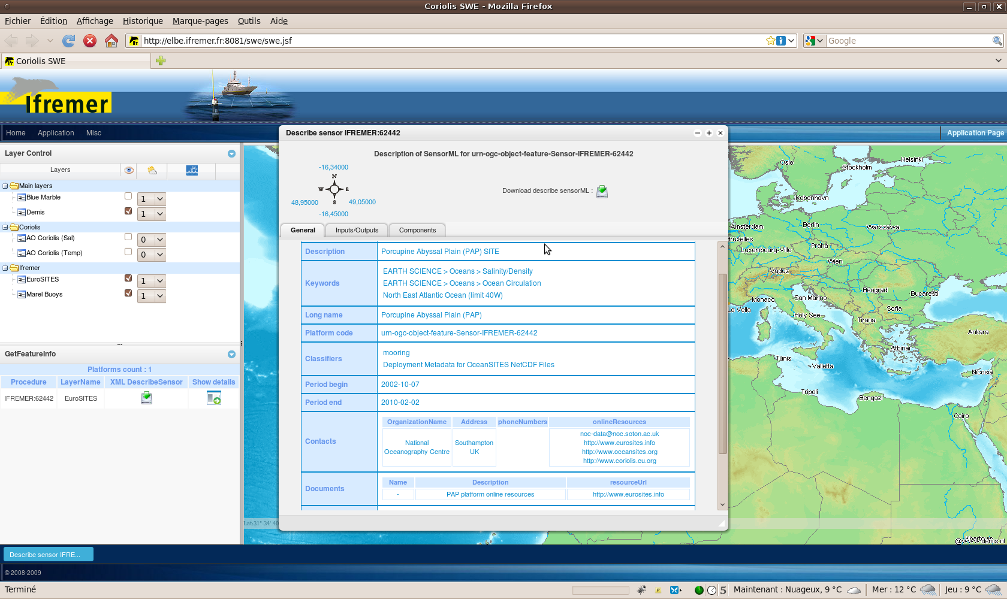
Example : Time Series (DescribeSensor)

Slide 5
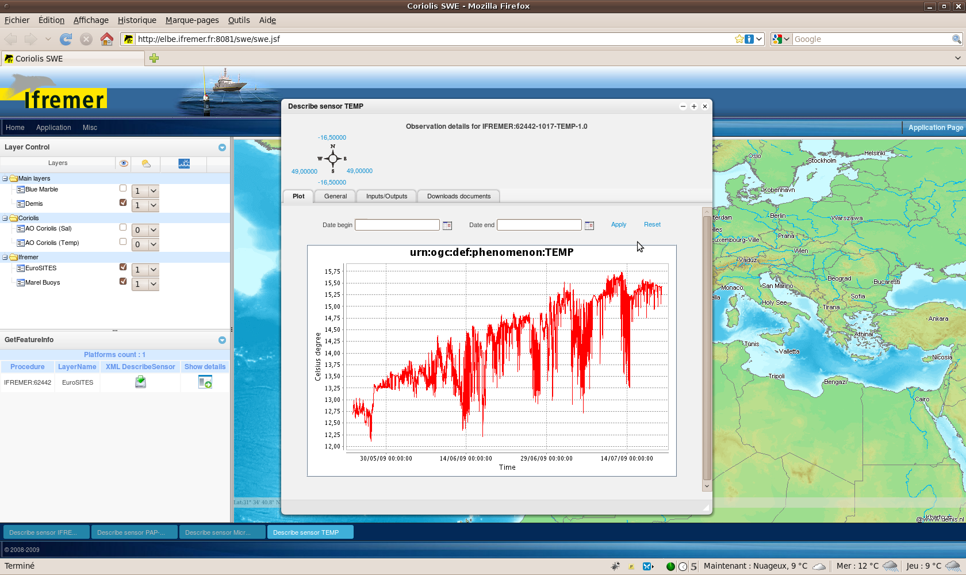
Example : Time Series (GetObservation)

