Slide 1
PSM 2 FINAL PRESENTATION
AI-Powered Real-Time Pothole Detection & Risk Assessment for Micro-Mobility
Student: Muhammad Al Ieqbal Nur Haqiemi Bin Abdul Khalid (B032310536)
Supervisor: Ts. Dr. Wan Mohd Ya'akob Wan Bejuri
Faculty of Artificial Intelligence and Cyber Security (FAIX), UTeM

Slide 2
1. INTRODUCTION & PROBLEM
Vulnerabilities in Current Micro-Mobility Safety
1. Mechanical Vulnerability
E-scooters use small 8.5" rigid wheels with no suspension. A 2" pothole represents 20% of wheel diameter, sending direct impact forces to rider arms & causing sudden lockup falls.
2. Static Navigation Limits
Standard tools (Google Maps, Waze) provide static route planning but lack real-time localized surface defect warnings, leaving riders unaware of immediate road degradation.
3. Reactive Existing Systems
Current research uses smartphone accelerometers which are purely reactive—logging impact telemetry only AFTER a crash occurs, failing pre-impact avoidance.

Slide 3
2. SYSTEM IMPLEMENTATION
Three-Tier Architecture & High-Speed Edge Pipeline
Modular Three-Tier Architecture
• Presentation Layer:
Flutter Live Record Scan HUD, Interactive OpenStreetMap History Tab, & Settings Panel.
• Logic & Inference Layer:
Asynchronous Dart Isolate executing single-pass YUV frame conversion + INT8 TFLite Interpreter.
• Persistence Layer:
Local JSON file storage (`rides.json` & `settings.json`) ensuring 100% offline rider privacy.
Single-Pass YUV Stride Sampling (~5ms)
• Eliminates 3-pass bitmap memory copies (YUV -> RGB -> Rotate -> Resize).
• Directly samples 416x416 RGB matrix in 1 single pass (~102,000 iterations vs 920,000).
• Keeps `ResolutionPreset.medium` for a sharp HD camera stream preview while running fast INT8 inference (~25ms).

Slide 4
2. SYSTEM IMPLEMENTATION
Kinetic Risk Assessment Algorithm
Dynamic Velocity-Scaled Risk Index (RI) Formula
RI = (S_detected / S_threshold) * (V_current / V_limit)^2 * 100%
1. Kinetic Energy Scaling: Squaring the velocity ratio (V_current / V_limit)^2 mirrors kinetic energy (E_k = 0.5 * m * v^2), recognizing that hitting a pothole at 20 km/h is 4x more destructive than at 10 km/h.
2. Wheel Constant Calibration: S_threshold calibrates for vehicle geometry (8.5" for e-scooters vs 26" for bicycles).
3. Multi-Sensory Alerting: When Risk Index > 75%, HUD flashes semi-transparent red overlay and triggers variable-frequency audio warning beeps.

Slide 5
3. EXPERIMENTAL RESULTS (CORE FOCUS)
Quantitative Model Evaluation (Table 5.1)
Model Scale | Input Size | Precision | Recall | mAP@50 | mAP50-95 | Size | Latency
YOLOv8 Nano (INT8 Retrained) | 416x416 | 92.8% | 92.2% | 95.8% | 59.4% | 3.1 MB | ~25 - 30 ms
YOLOv8 Small (Baseline) | 320x320 | 84.0% | 88.0% | 92.0% | 53.1% | 22.4 MB | ~45 - 55 ms
YOLOv8 Medium | 320x320 | 82.5% | 86.4% | 90.7% | 51.2% | 52.1 MB | ~95 - 120 ms
Key Takeaways:
• YOLOv8 Nano INT8 is the overall winner: Highest mAP@50 (95.8%), highest Precision (92.8%), smallest footprint (3.1 MB), and fastest speed (~25 ms).
• Precision increased by +8.8% over baseline, proving false positive suppression!

Slide 6
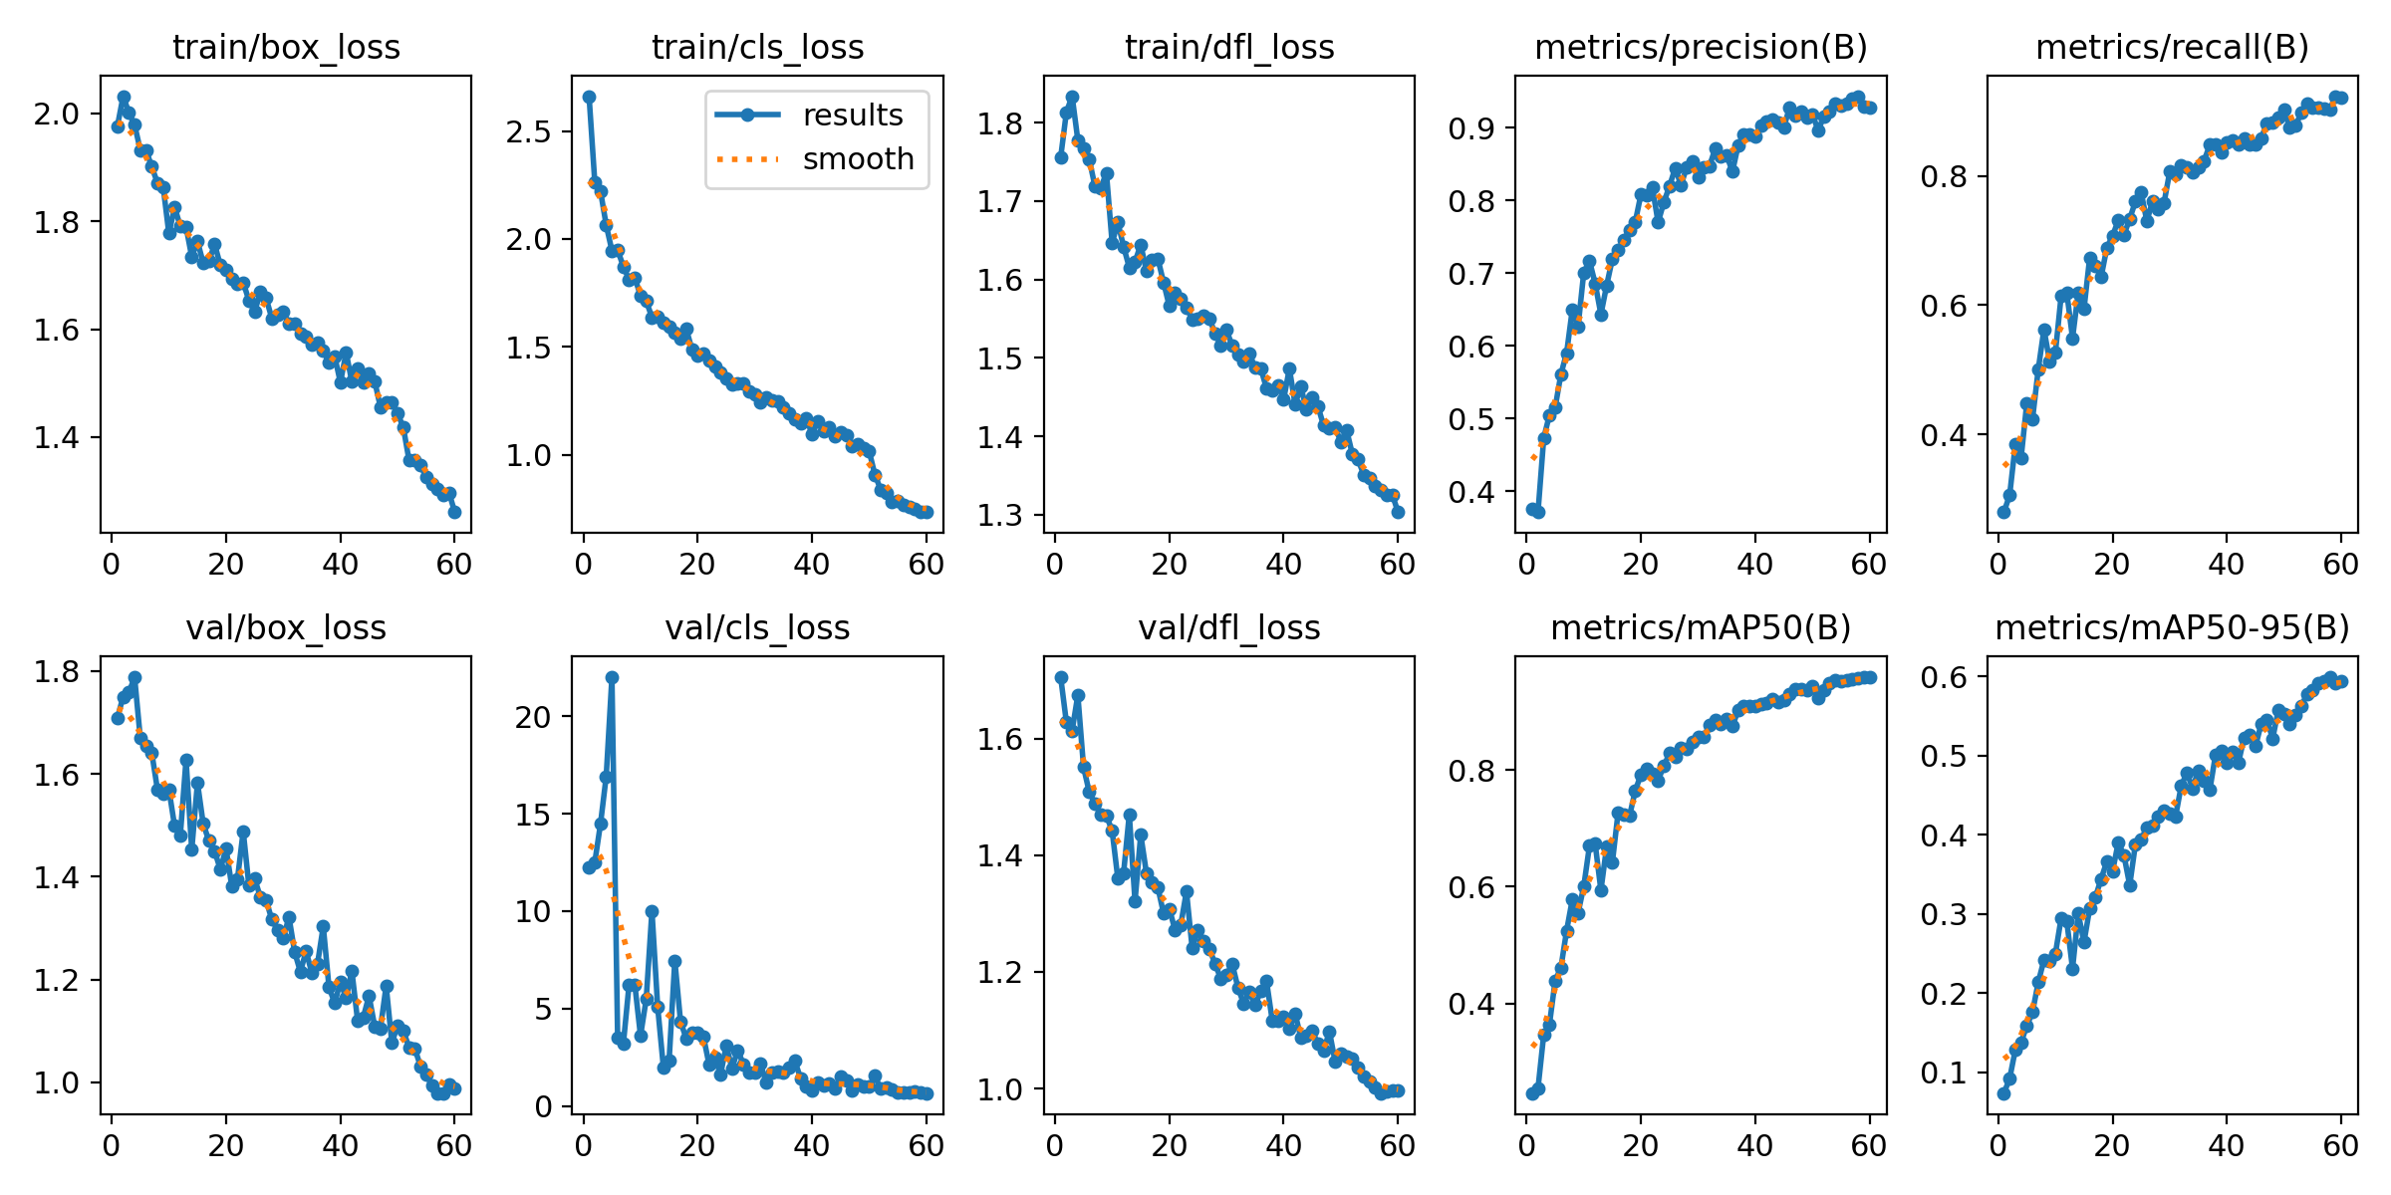
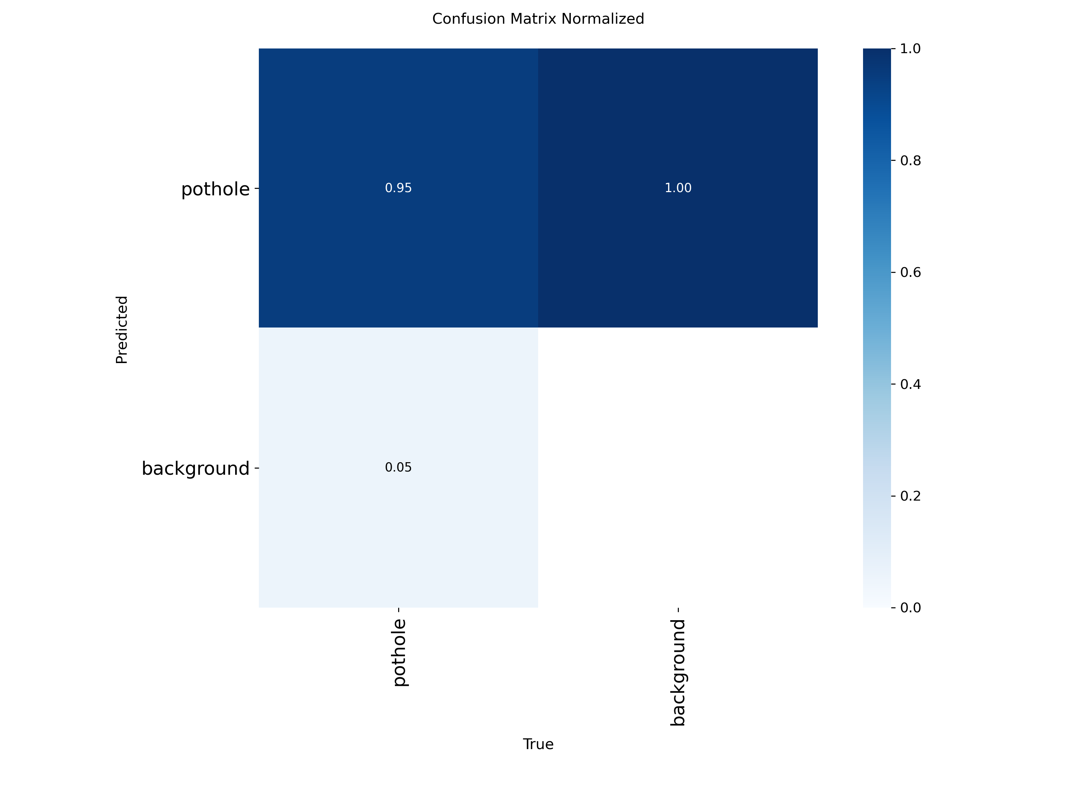
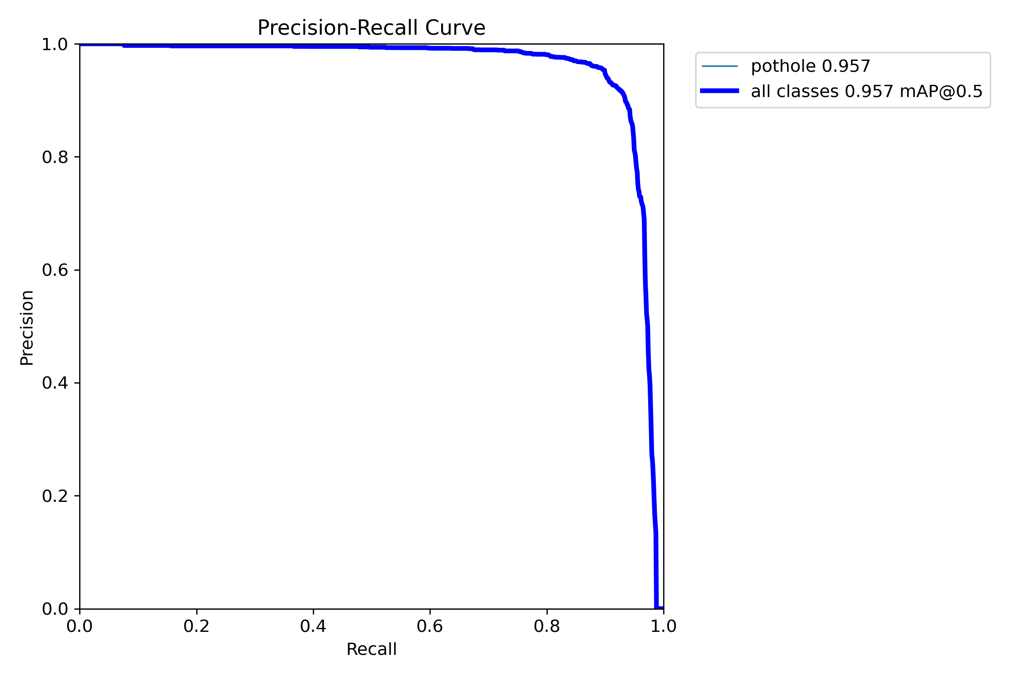
3. EXPERIMENTAL RESULTS
Training Loss Curves & Evaluation Metrics
Left: Training Loss & mAP Curves (60 Epochs) | Center: Normalized Confusion Matrix | Right: Precision-Recall Curve (mAP50 = 0.958)

Slide 7
3. EXPERIMENTAL RESULTS
False Positive Suppression (Hard Negative Mining & Horizon ROI Filter)
1. Hard Negative Mining
• Integrated 31 unannotated background images (handbags, backpacks, tile floors, clean asphalt) into dataset.
• In YOLO, unannotated images act as explicit negative samples that penalize false positive activations on non-pothole textures.
• Precision increased from 84.0% to 92.8% (+8.8% gain!).
2. Horizon Region-of-Interest (ROI) Masking
• Applied ground-plane filter in Flutter app (`yMin < 0.35`).
• Ignores upper 35% of camera frame (chest level, upper room, sky).
• Handbags or clothing held up high are automatically filtered out with 0% false alarm risk!

Slide 8
3. EXPERIMENTAL RESULTS
Detection Distance Optimization (416x416 Resolution)
Extending Lookahead Distance to 6–8 Meters
• Optical Limitation at 320x320: At 10m distance, a 30cm pothole occupies only 8x8 pixels (too small for reliable YOLO detection).
• Resolution Scaling to 416x416: Increases spatial feature pixel density by ~1.7x. Small distant potholes occupy 14x14 pixels, extending reliable lookahead range from 3–4m up to 6–8m ahead.
• Resolution-for-Capacity Optimization: Uses higher resolution on lightweight Nano model (3.0M params) without exceeding 30 ms real-time latency threshold!

Slide 9
4. DEMONSTRATION & TESTING
Black-Box Functional Testing (Table 5.2)
Test ID | Functional Requirement | Expected Outcome | Status
TC-01 | Camera Stream & HUD Initialization | Renders live 30 FPS camera preview | PASS
TC-02 | Local TFLite Model Inference | Draws bounding box with class confidence | PASS
TC-03 | GPS Speed & Risk Index Alerting | Triggers red screen flash & warning beeps >75% risk | PASS
TC-04 | Session Persistence & Map Rendering | Saves ride JSON & plots colored pins on OpenStreetMap | PASS

Slide 10
5. CONCLUSION
Project Contributions & Future Work
Summary of Accomplishments
1. Academic Contribution: Validated INT8-quantized YOLOv8 edge performance on resource-constrained mobile hardware with 95.8% mAP@50 and 92.8% Precision.
2. Practical Safety Utility: Delivered a fully offline, privacy-preserving Android app with proactive speed-scaled risk warnings for vulnerable road users.
3. Future Work: Expand dataset for multi-class defects (cracks, utility covers), integrate cloud map crowdsourcing, and combine camera vision with accelerometer sensor fusion.

