Slide 1


Food – Body Connection

Slide 2



Target audience
Health practitioners to provide app to patients
Dietician
Naturopath
Herbalist
Doctor
Any individual with chronic symptoms unable to pin down causes

Slide 3
Goals
Design a secure web based app
User can register/login
User can log:
allergens exposed to
symptoms
User can extract meaningful information from logged data

Slide 4



System Architecture Overview
Frontend is a static web app (GitHub):
Send requests to an API
Render responses
Backend (FastAPI):
Handles authentication
Stores and analyses data
Database (AWS RDS):
Stores structured health data (PostgreSQL)
Is never accessed directly by the frontend

Slide 5
SQL Database
Users
User ID
Email
Password Hash
Created At
Symptoms
Symptom ID
User ID
Symptom Name
Symptom Group
Allergens
Allergen ID
User ID
Allergen Name
Symptom Log
Symptom Log ID
User ID
Date / Time
Symptom ID
Symptom Intensity
Allergen Log
Allergen Log ID
User ID
Date / Time
Allergen ID
Quantity
Unit ID
Units
Unit ID
Unit Name
Unit Conversion

Slide 6
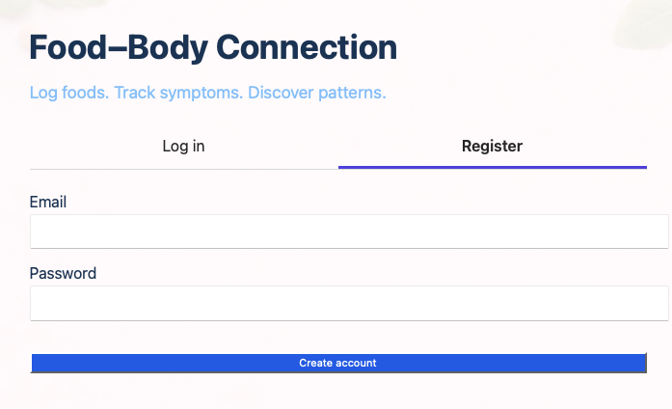
Logging in
Users
User ID
Email
Password Hash
Created At

Slide 7
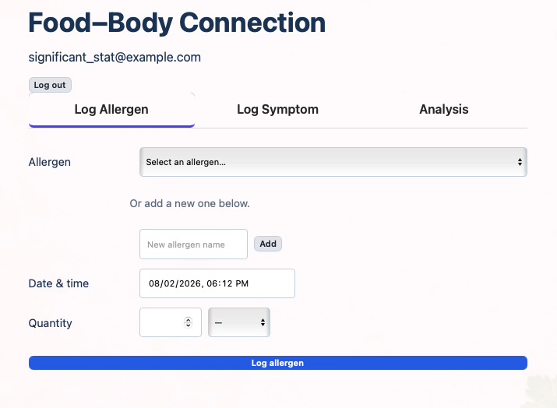
Logging an exposure to an allergen
Allergen Log
Allergen Log ID
User ID
Date / Time
Allergen ID
Quantity
Unit ID

Slide 8
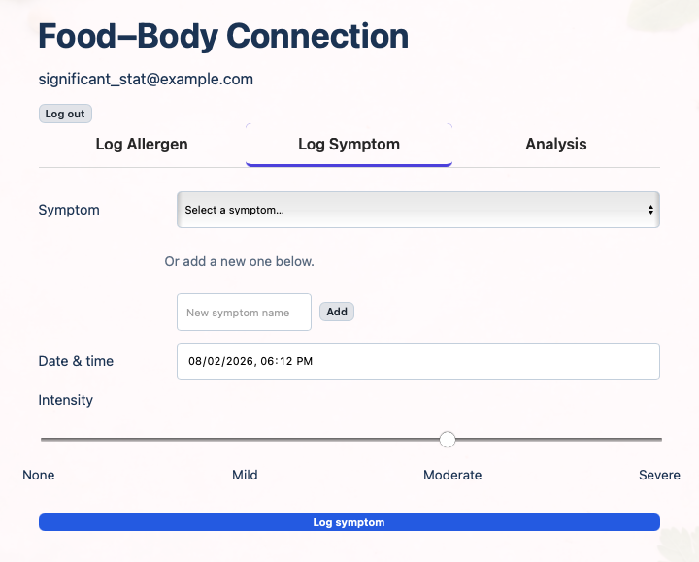
Logging a symptom
Symptom Log
Symptom Log ID
User ID
Date / Time
Symptom ID
Symptom Intensity

Slide 9
Analysis - Goals
User to gain a sense of their data
User to discover most likely allergen triggering symptoms
User to dive deeper into a particular allergen, time window and grouped symptoms
Risk assessment of allergen
Time series visual aid
Dose – response analysis

Slide 10
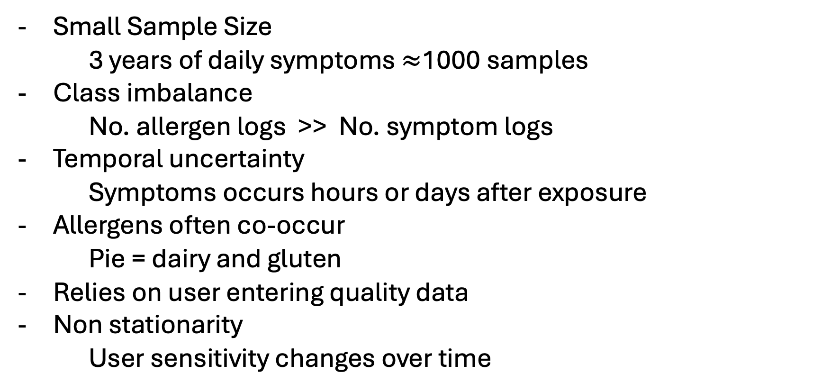
Analysis - Challenges
Small Sample Size
3 years of daily symptoms $≈$1000 samples
Class imbalance
No. allergen logs >> No. symptom logs
Temporal uncertainty
Symptoms occurs hours or days after exposure
Allergens often co-occur
Pie = dairy and gluten
Relies on user entering quality data
Non stationarity
User sensitivity changes over time

Slide 11
Model choice
Model | Binary Outcome | Interpretable | Stable & Reproducible | Handles Correlated Exposures | Fast | Overall Fit
Logistic Regression (L1/L2) | ✅ | ✅✅ | ✅✅ | ✅ | ✅✅ | ✅✅✅ BEST
Linear Probability Model | ✅ | ✅✅ | ✅✅ | ⚠️ | ✅✅ | ❌
Bernoulli Naive Bayes | ✅ | ⚠️ | ✅✅ | ❌ | ✅✅ | ❌
Fisher Exact Test | ✅ | ✅ | ✅✅ | ❌ | ✅✅ | ❌
Single Decision Tree | ✅ | ⚠️ | ❌ | ✅ | ✅ | ❌
Random Forest | ✅ | ❌ | ❌ | ✅ | ❌ | ❌
Gradient Boosting | ✅ | ❌ | ❌ | ✅ | ❌ | ❌
Bayesian Logistic Regression | ✅ | ✅ | ⚠️ | ✅ | ❌ | ❌
Kernel SVM (RBF) | ✅ | ❌ | ❌ | ✅ | ❌ | ❌
Neural Networks | ✅ | ❌ | ❌ | ✅ | ❌ | ❌

Slide 12
Linking allergens and symptoms
Features
Coefficients
Allergens
Logistic Regression Model
Odds Ratio
Target
Symptoms present
Metrics
Modelling Techniques
AUC ROC
Recall
Sample size
Confidence intervals
Collinearity warning
Regularisation (L1 or L2) – mitigates collinearity and overfitting
Nested cross validation – unbiased and stable performance
Class weighting – accounts for class imbalance

Slide 13
Deep Dive into Modelling Technique
Goal
Identify allergens most strongly associated with symptom occurrence
⟺
allergens with the largest positive logistic regression coefficients (highest odds ratios)

Slide 14
Deep Dive into Modelling Technique
Model selection & fitting
Evaluate multiple exposure–symptom time windows to account for delayed responses
Assess class imbalance using the proportion of symptom events
Fit a regularized logistic regression model:
Penalties: L1 and L2
Regularization strength: C ∈ {0.1,1,10}
Select the best model using AUC ROC values
Use 5-fold cross-validation to estimate:
Mean AUC ROC (discrimination)
Mean recall (sensitivity to symptom events)

Slide 15
Deep Dive into Modelling Technique
Outputs
Odds ratios for each allergen (OR=e^{β})
identifying allergens with the highest odds of symptom occurrence
Model reliability metrics:
AUC ROC
Recall
Sample size
Collinearity indicator
Confidence intervals for odds ratios using bootstrap resampling

Slide 16
Validation: Synthetic User and Data
Goal: Evaluate allergen–symptom models using data with known causal relationships.
Causal allergens: Dairy, Peanuts, Shellfish
Intensity: Peanuts include a dose–response effect
Tests whether models detect real associations

Slide 17
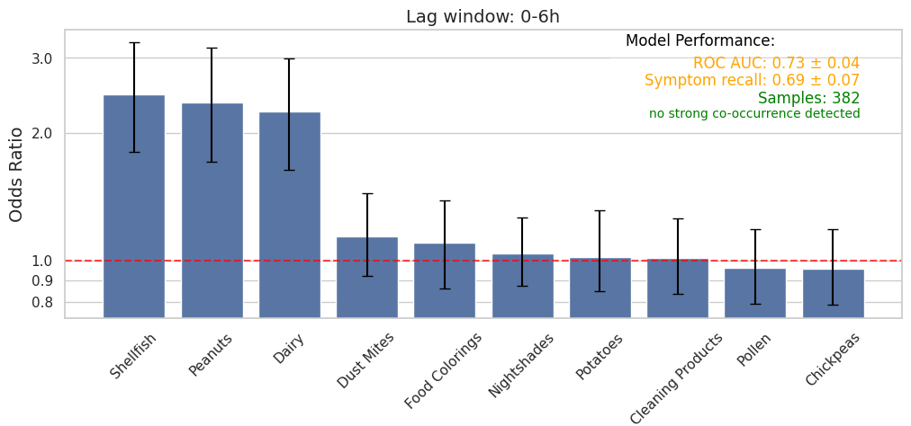
Validation: Synthetic User and Data

Slide 18
Exploring the App Further
food_body_connection

Slide 19
Summary: Food – Body Connection App
Target audience:
Health practitioners and individuals with chronic symptoms linked to allergens
User Benefit:
Makes hidden food–body connections visible
Empowers users to make informed dietary and lifestyle choices
Key Features:
Track exposures and symptoms
Analyze relationships: Identify correlations between exposures and symptoms.
Insights & reports: Odds ratios, intensity charts, and personalized summaries.
Architecture:
Frontend: Static web app (GitHub Pages) → sends requests to API
Backend: FastAPI → handles authentication, data storage, analysis
Database: PostgreSQL on AWS RDS → structured health data

Slide 20



Future Work
Analysis:
Test for regular cycles in symptom occurrence
Introduce a new table – food, which automatically allocates allergens
Option to email reports
Another form displaying raw data users can edit / delete logs
Introduce analysis on selected dates
Allow users to log multiple allergens / symptoms per event
Architecture
Move to alternative system – long term
https://alkohout.github.io/food_body_connection/dashboard.html
https://github.com/alkohout/food_body_connection
https://www.linkedin.com/in/alisonkohout/

