Slide 1
Test with ALINA N = 494, merging across runs

Slide 2
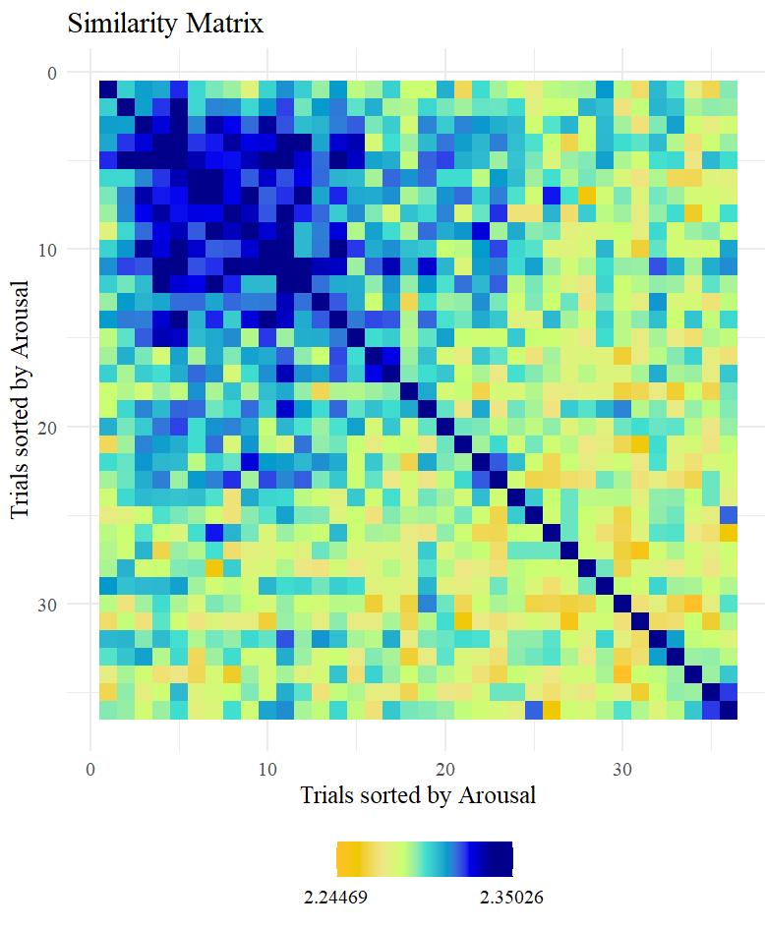
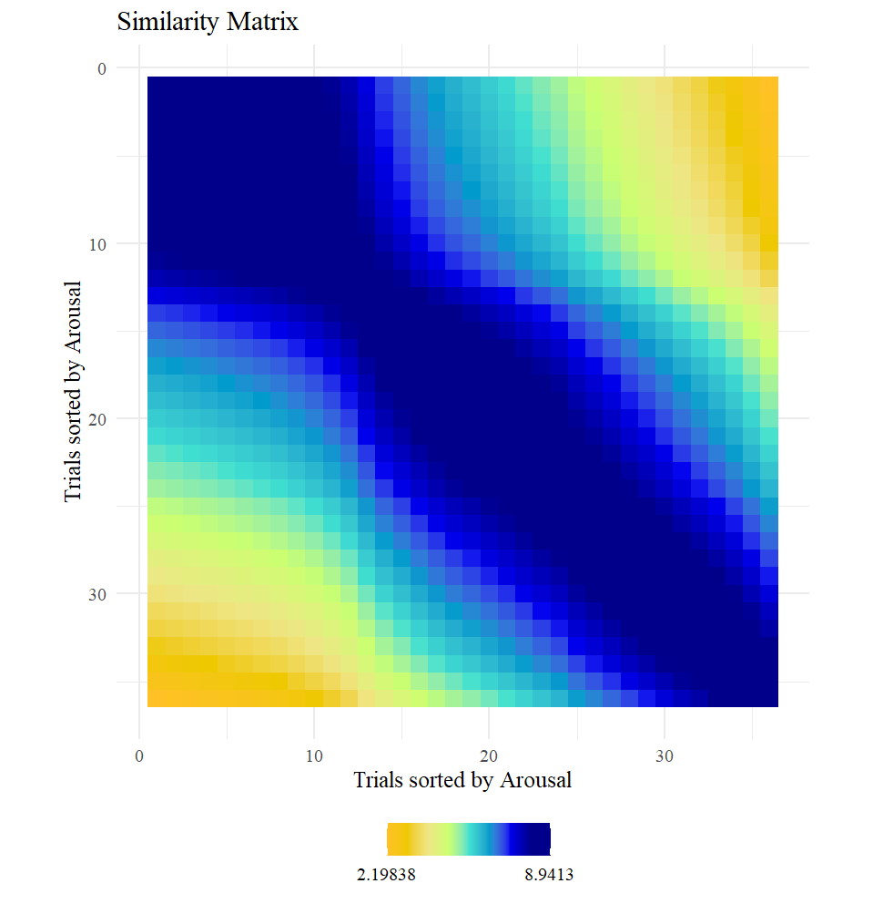
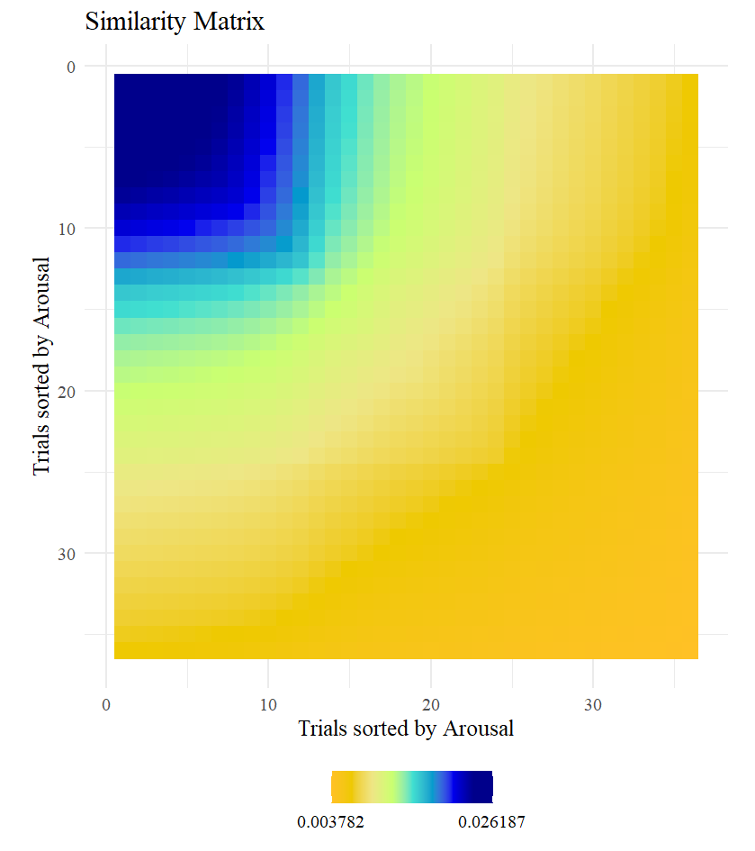
RSM based on Amplitudes
RSM based on Arousal Ratings
RSM based on Arousal invAK

Slide 3
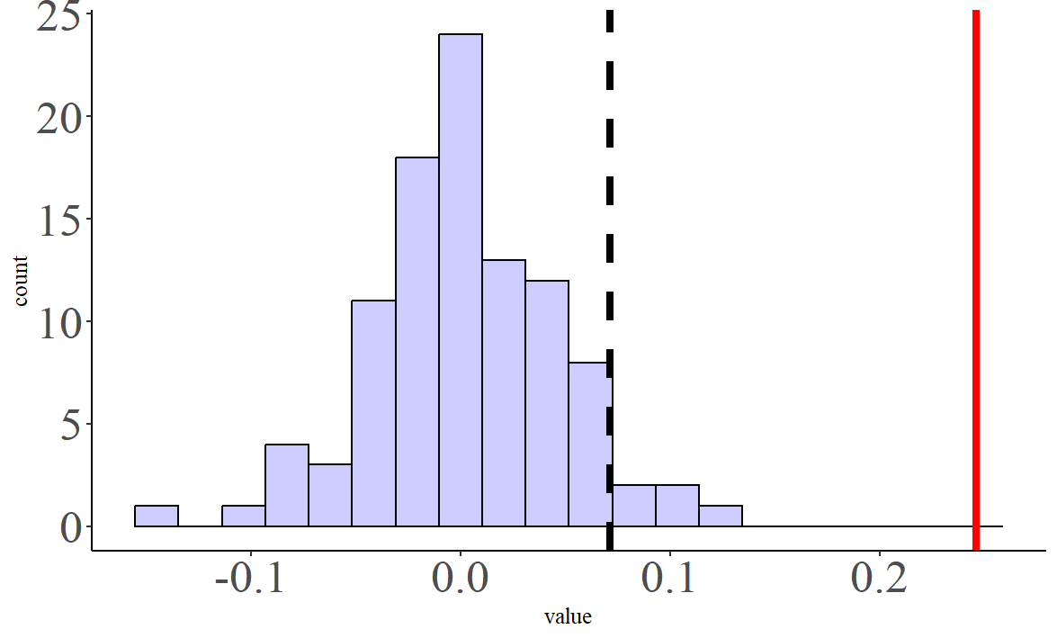
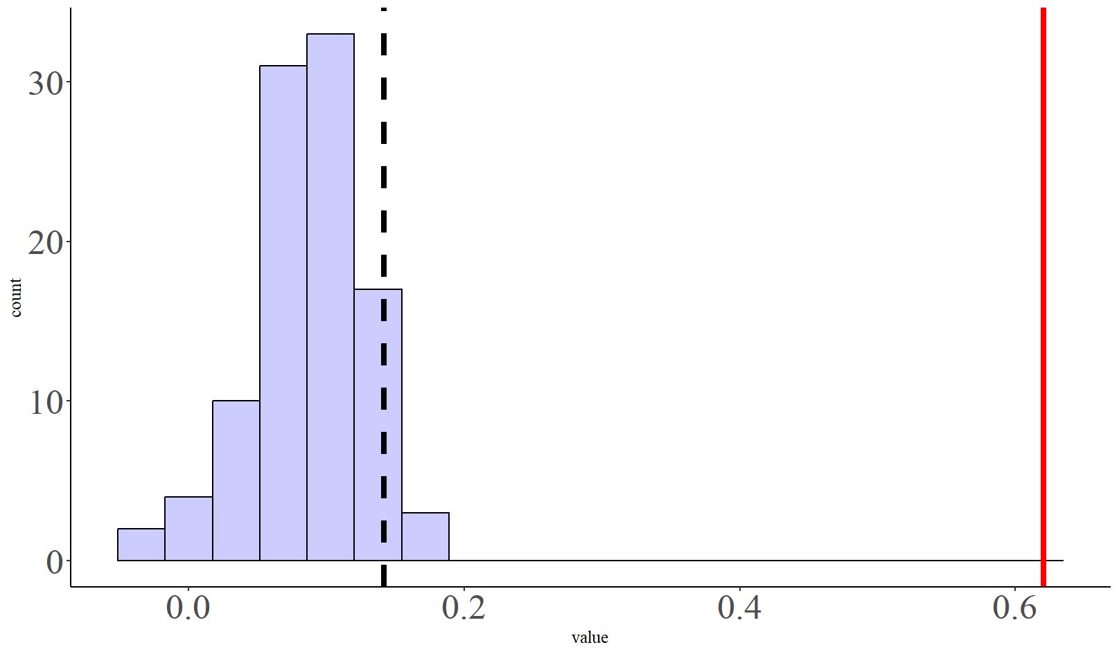
Comparison of correlation matrices: Alina N = 494
RSM based on Arousal Ratings NN
RSM based on Amplitudes
RSM based on Amplitudes
RSM based on Arousal Ratings
inv AK

Slide 4
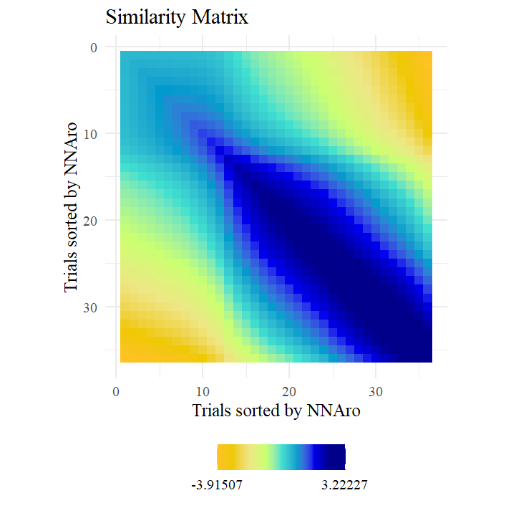
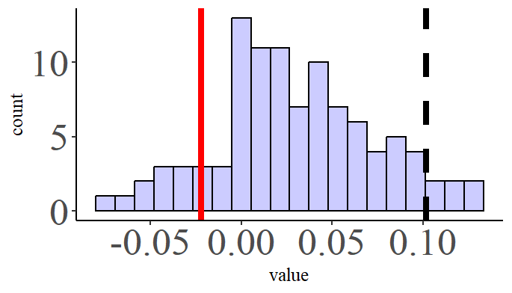
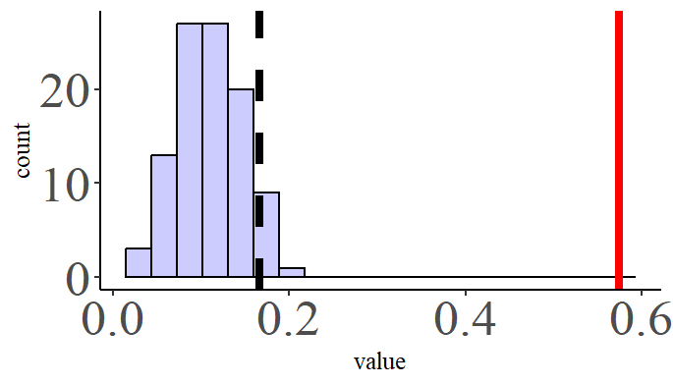
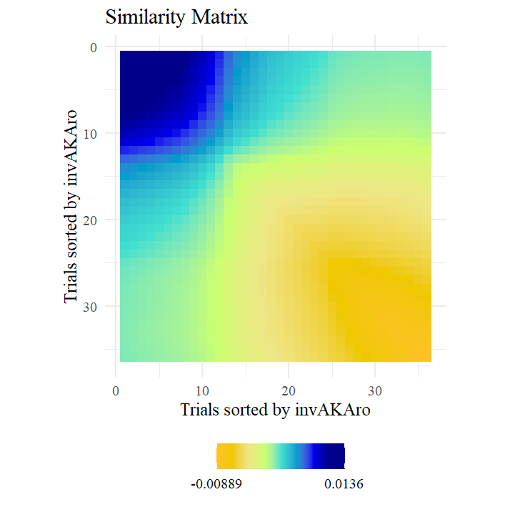
Comparison of correlation matrices regression Models: Alina N = 494
RSM based on Arousal Ratings NN
RSM based on Amplitudes
RSM based on Amplitudes
RSM based on Arousal Ratings
inv AK

Slide 5
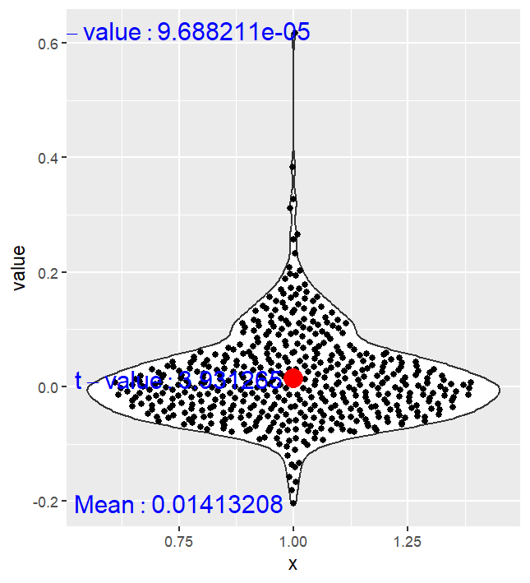
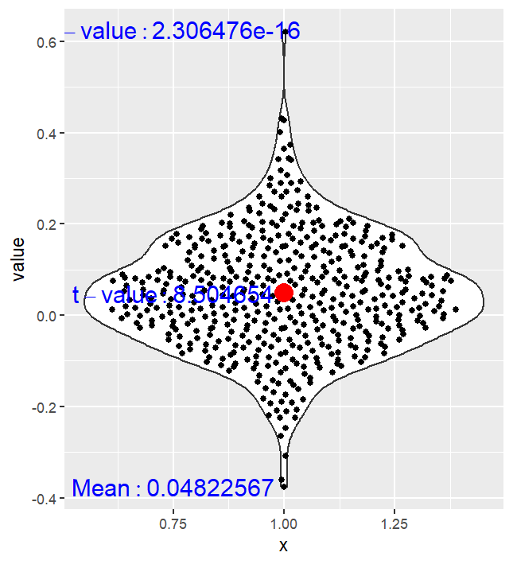
MATRIX COMPARISON AT AN INDIVIDUAL LEVEL: Imagery
RSM based on amplitudes
Vs.
RSM based on Arousal Ratings
RSM based on amplitudes
Vs.
RSM based on Arousal Ratings invAK

Slide 6
ISC Scores
Data Matrices represent the relationship across participants based on Correlation of the SCR and invAK model of subjective arousal ratings.
Rows and columns are sorted by participants’ scores in a specific questionnaire
Model matrices represent the scores of the questionnaires the relationship across participants based on the questionnaire scores
(sometimes the axis are wrongly names (trials should be VP))

Slide 7
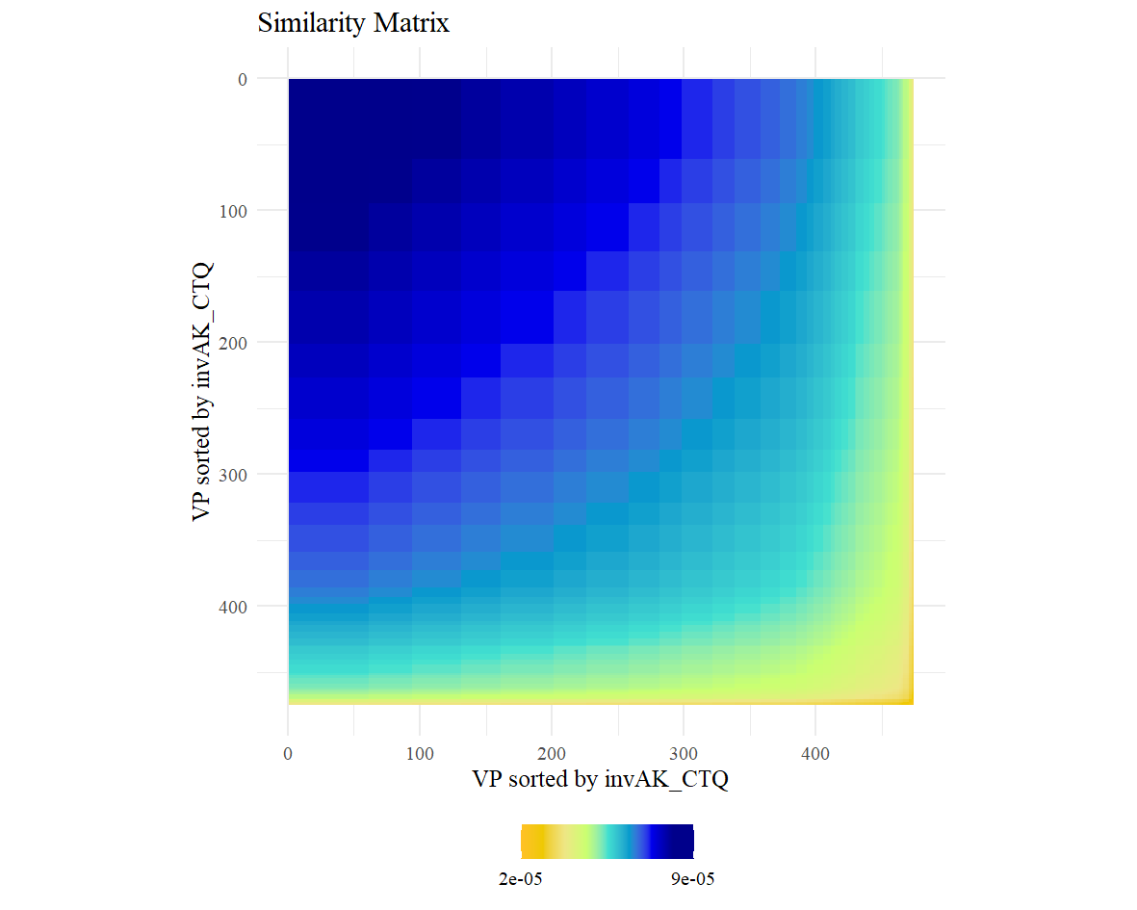
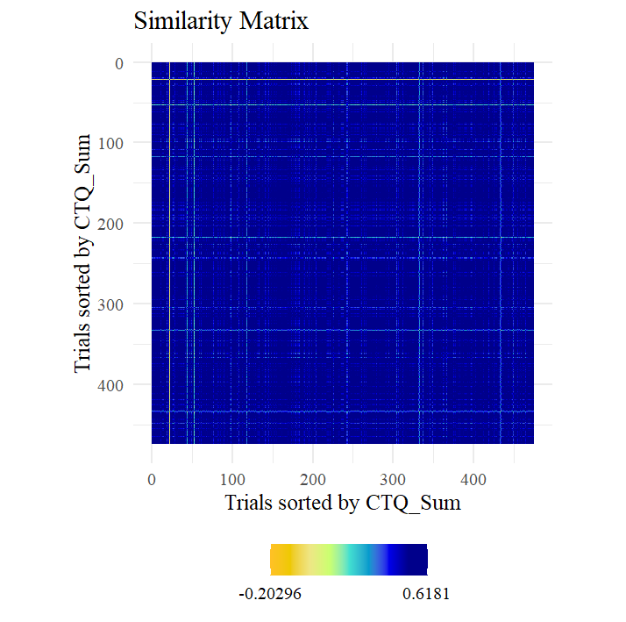
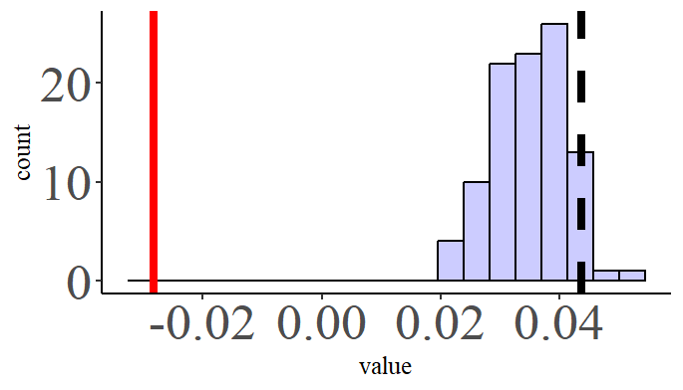
Participants sorted by CTQ Scores
ISC based on SCR-invAK RSMs Correlation. RSM based on single values
InvAK model of CTQ scores

Slide 8
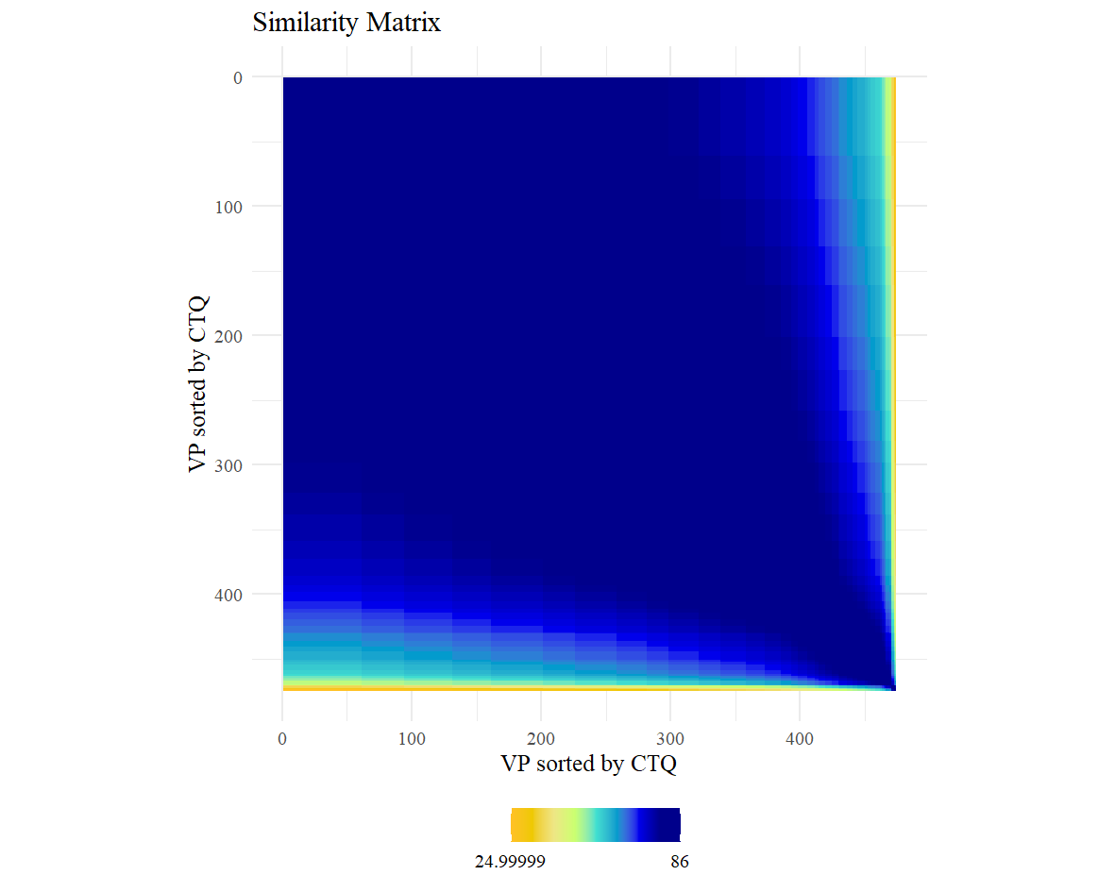
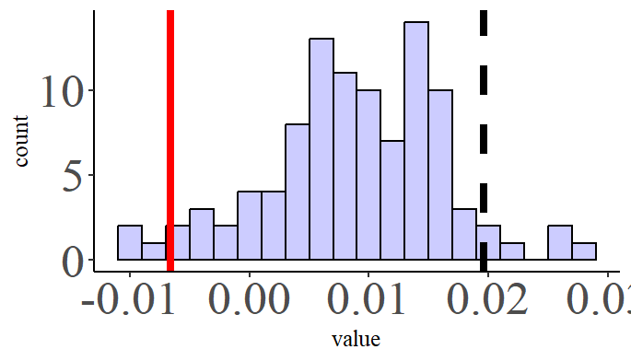
Participants sorted by CTQ Scores
ISC based on SCR-invAK RSMs Correlation. RSM based on single values
NN model of CTQ scores

Slide 9
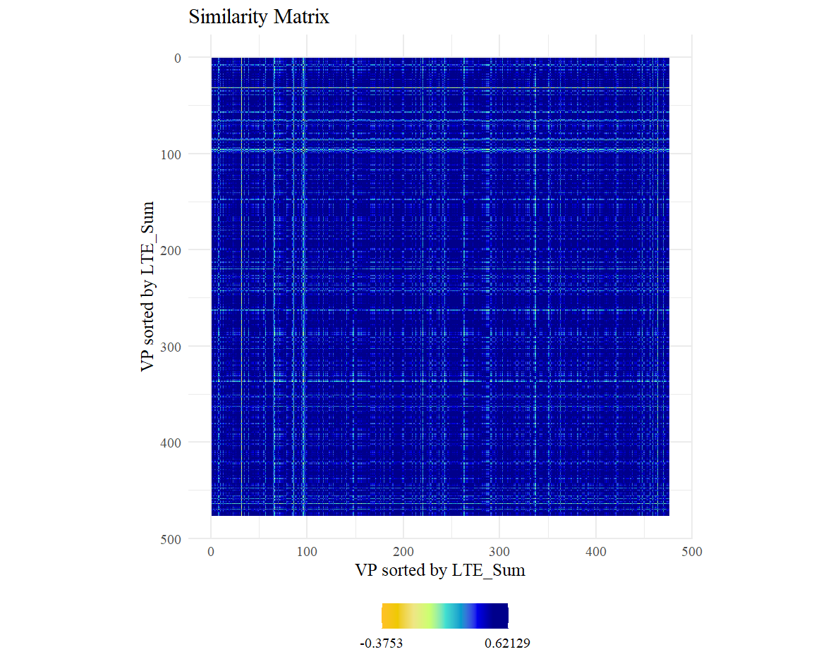
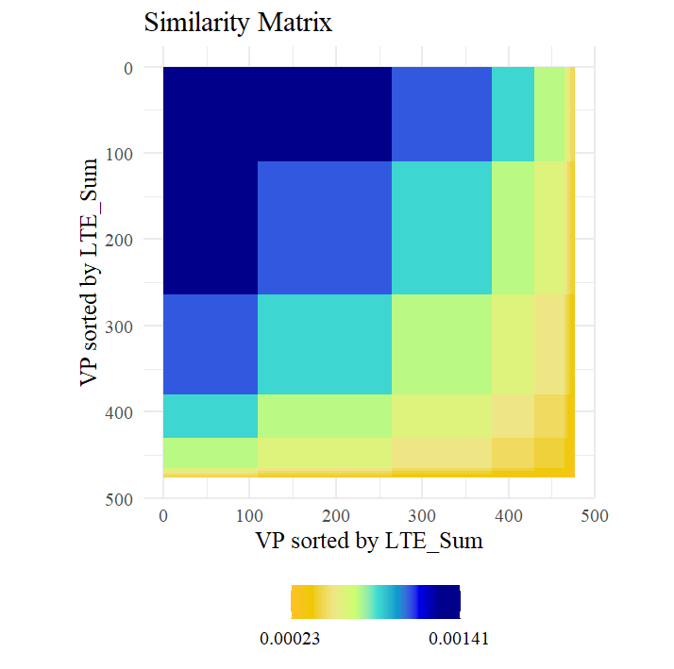
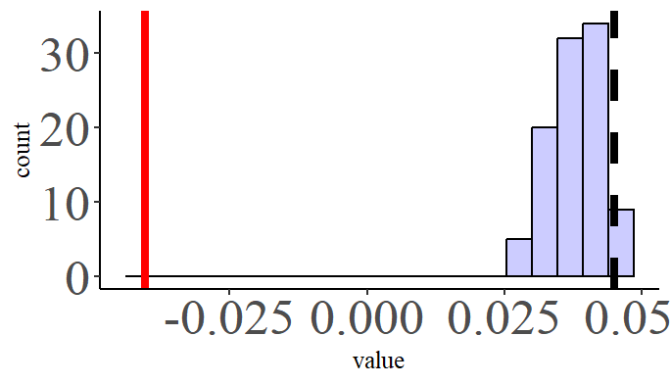
Participants sorted by LTE Scores
ISC based on SCR-invAK RSMs Correlation. RSM based on single.
InvAK model of LTE scores

Slide 10
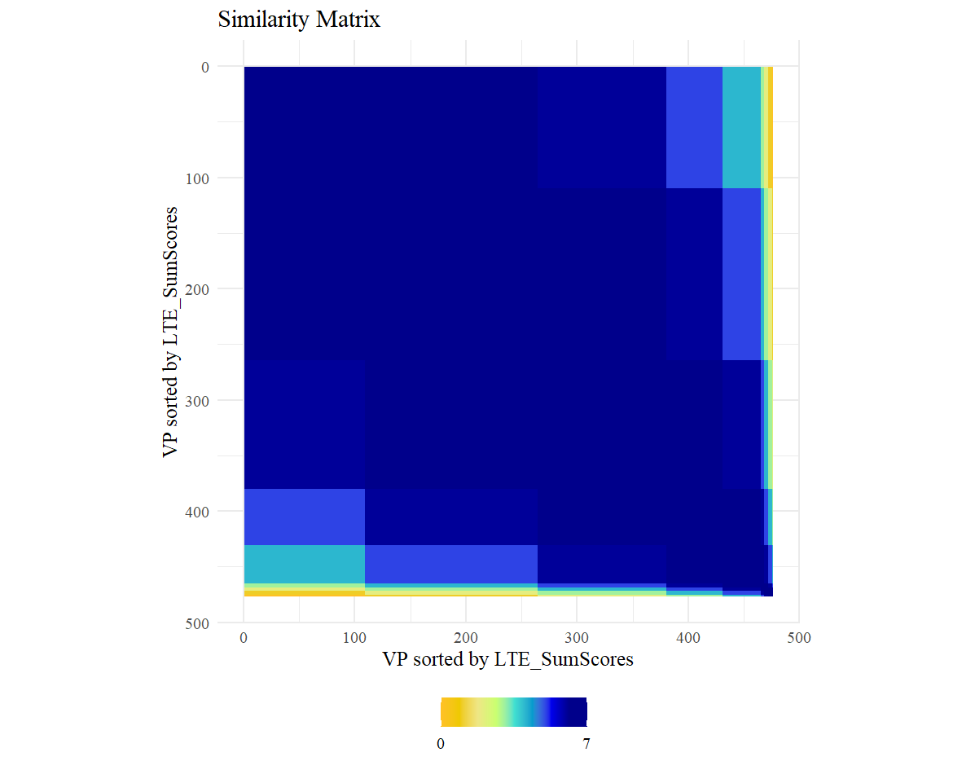
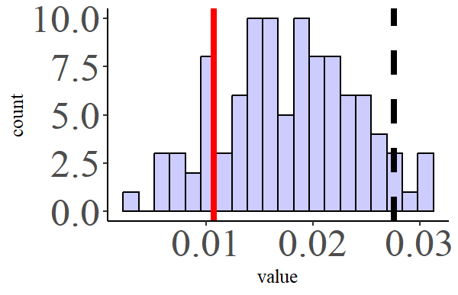
Participants sorted by LTE Scores
ISC based on SCR-invAK RSMs Correlation. RSM based on single values
NN model of LTE scores

Slide 11
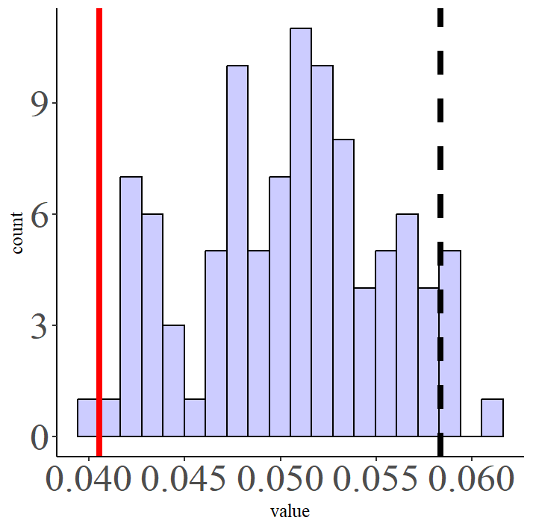
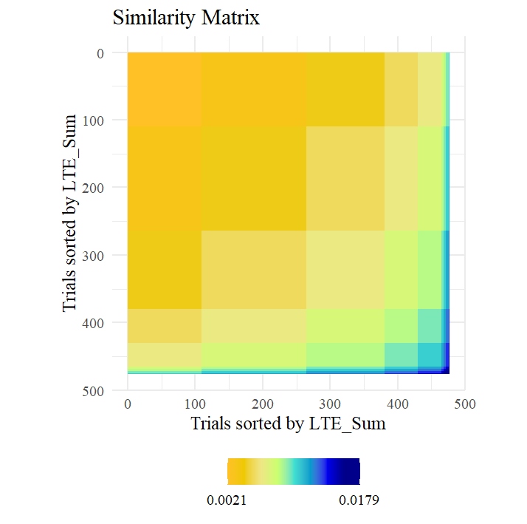
Participants sorted by LTE Scores
ISC based on SCR-invAK RSMs Correlation.
AK model of LTE scores

Slide 12

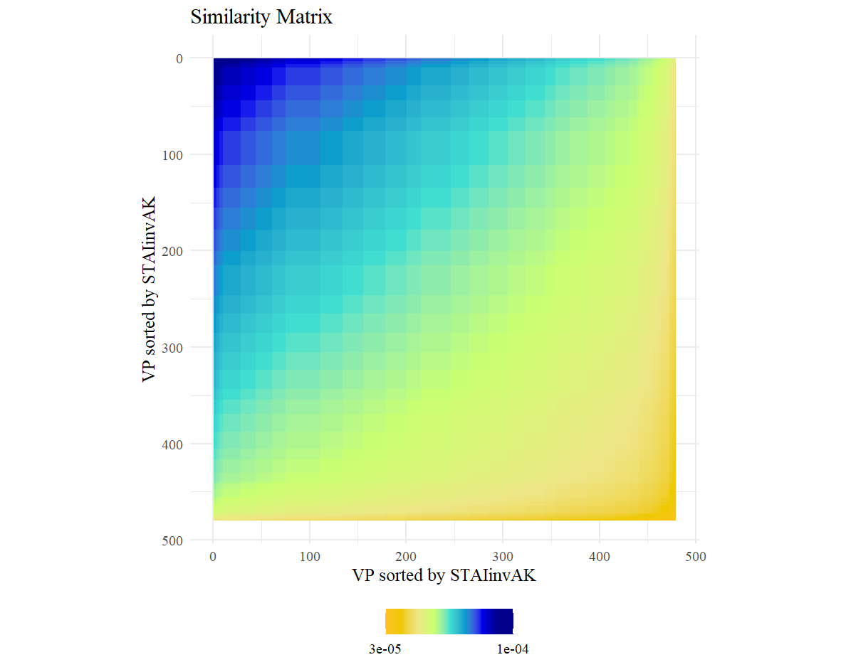
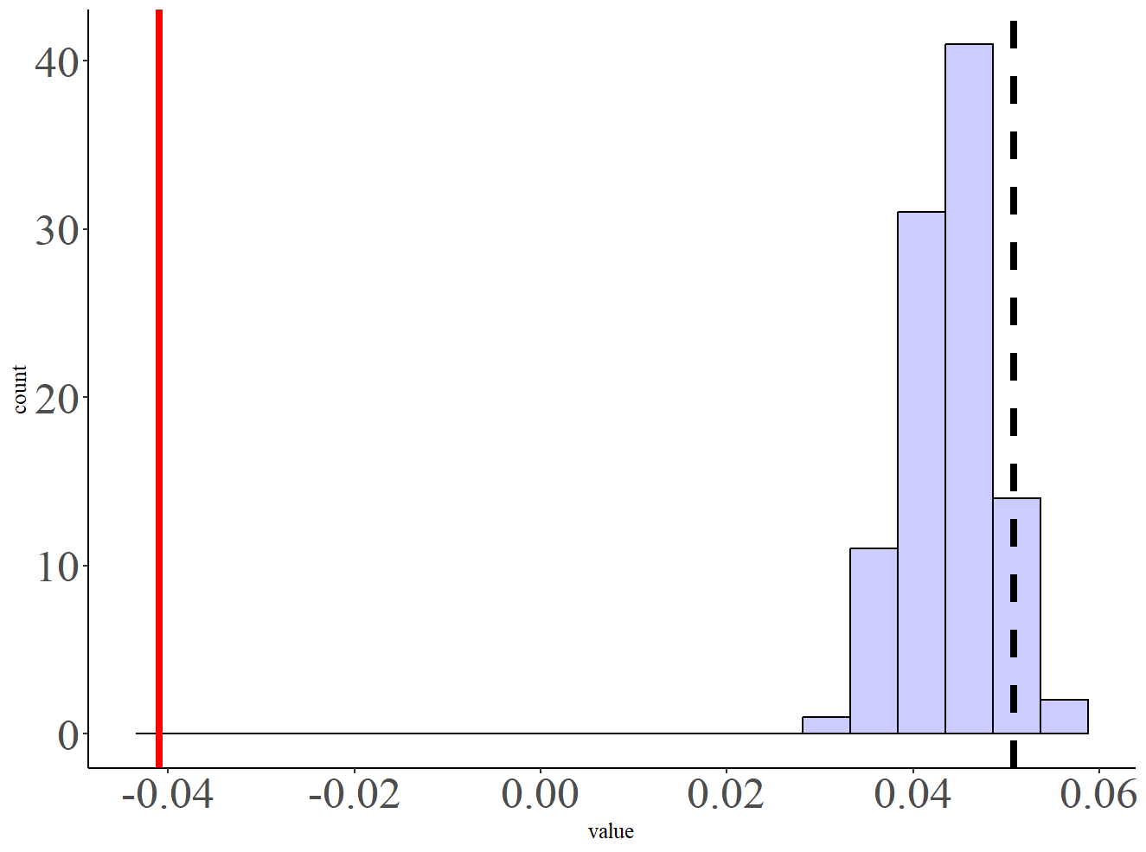
Participants sorted by STAI Scores
ISC based on SCR-invAK RSMs Correlation.
InvAK model of STAI scores

Slide 13
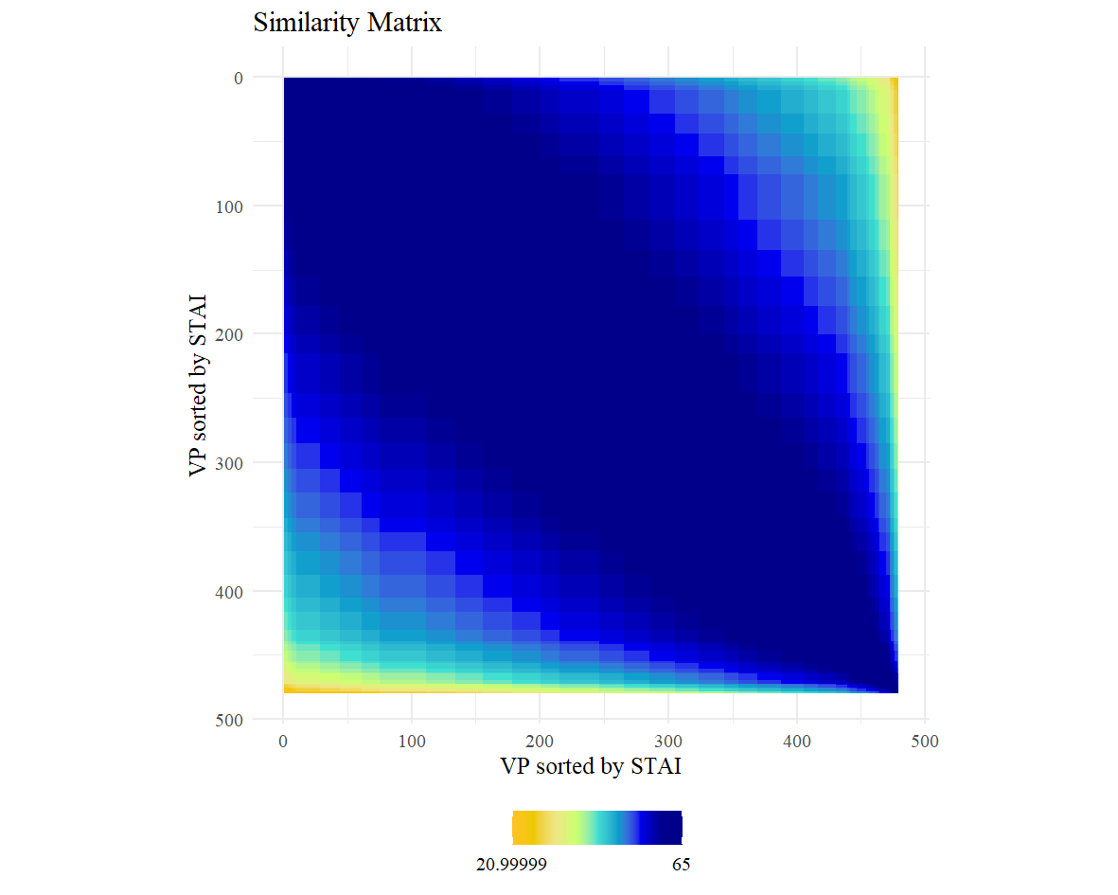
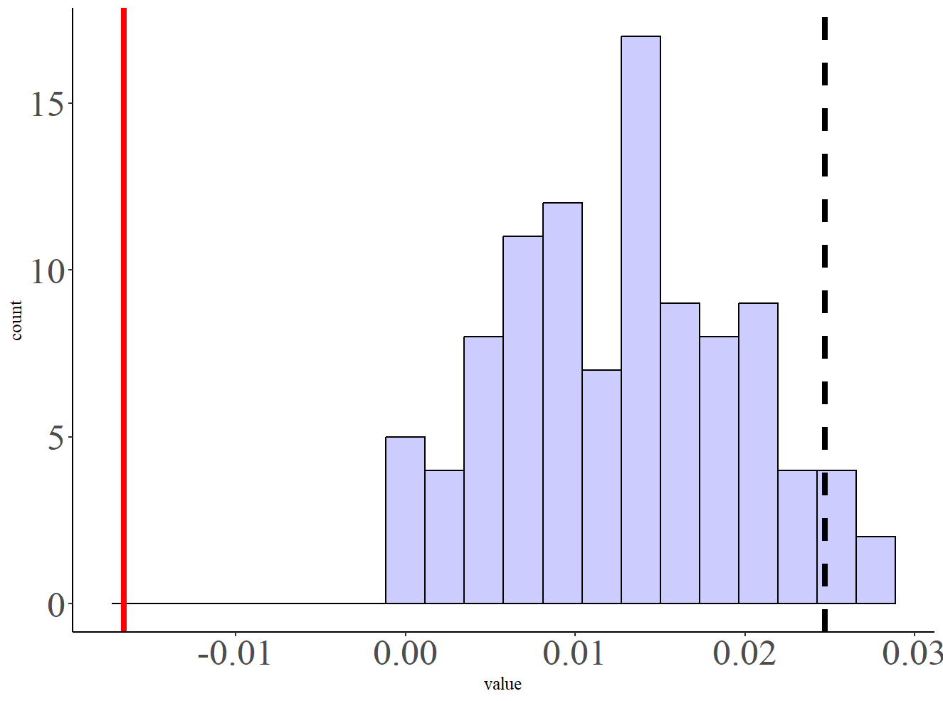
Participants sorted by STAI Scores
ISC based on SCR-invAK RSMs Correlation.
NN model of STAI scores

Slide 14
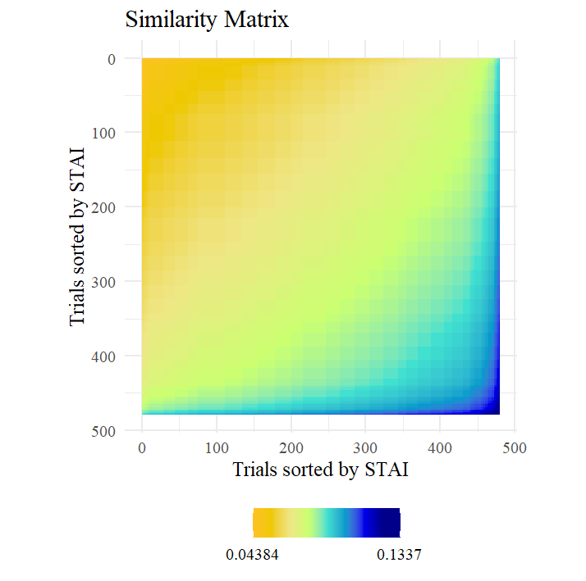
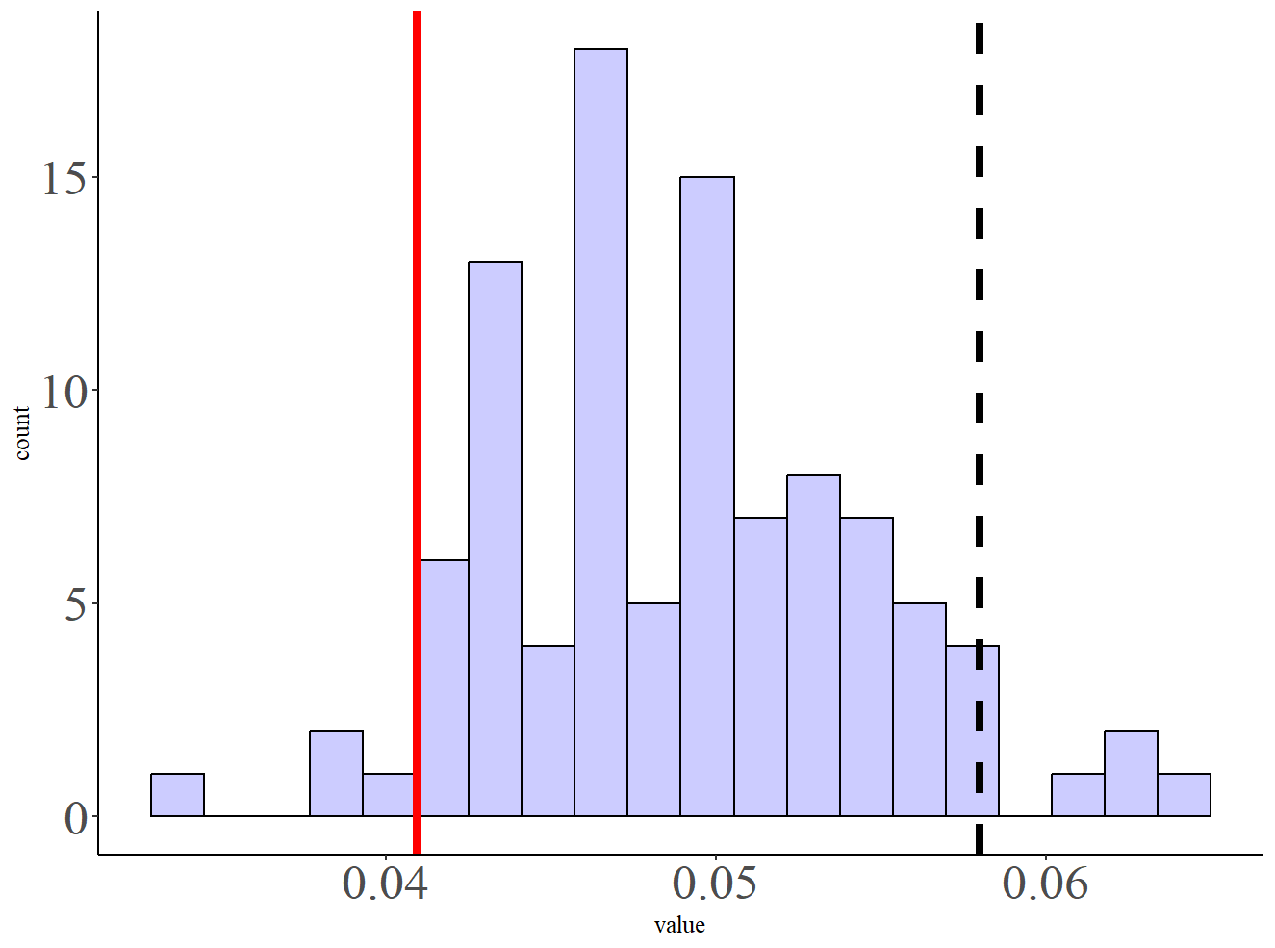
Participants sorted by STAI Scores
ISC based on SCR-invAK RSMs Correlation.
AK model of STAI scores

Slide 15

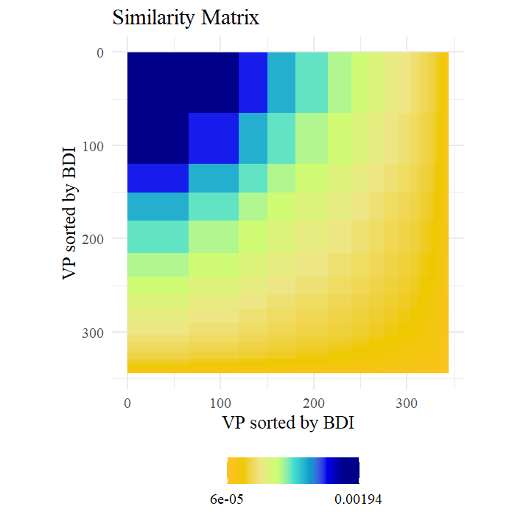
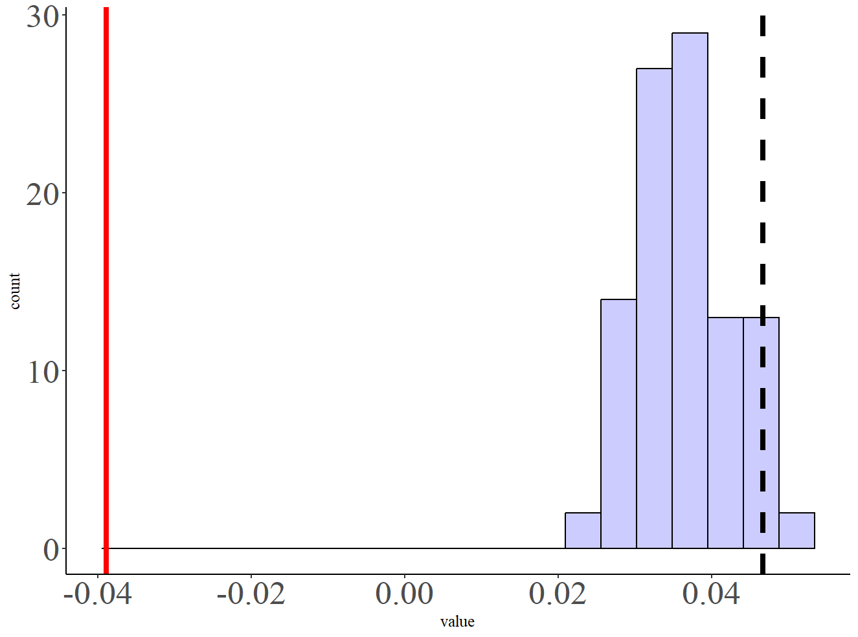
Participants sorted by BDI Scores
ISC based on SCR-invAK RSMs Correlation.
InvAK model of BDI scores

Slide 16
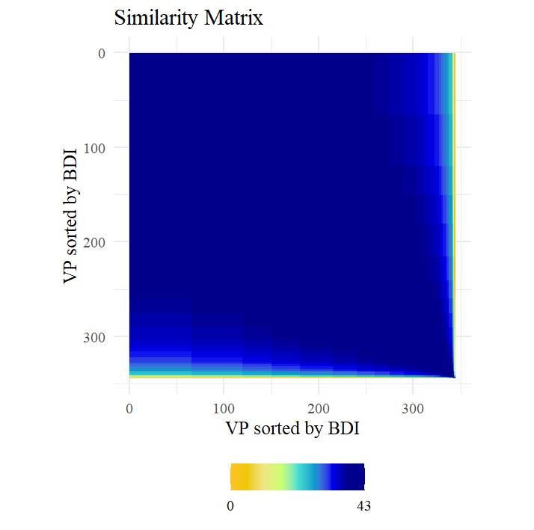
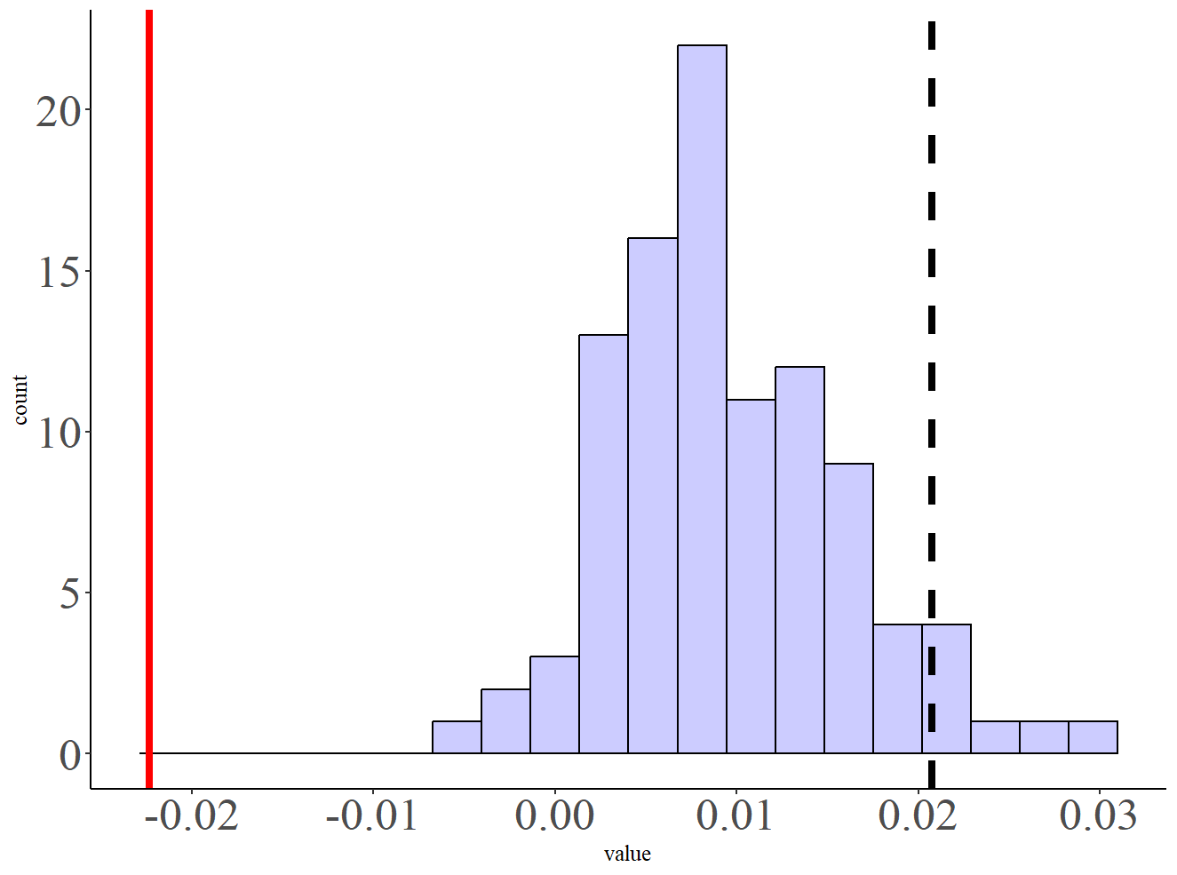
Participants sorted by BDI Scores
ISC based on SCR-invAK RSMs Correlation.
NN model of BDI scores

Slide 17
Test with ALINA N = 281, merging across runs without non responders (criterion based on Koppold’s et al., 2022; more than 66% missing)

Slide 18
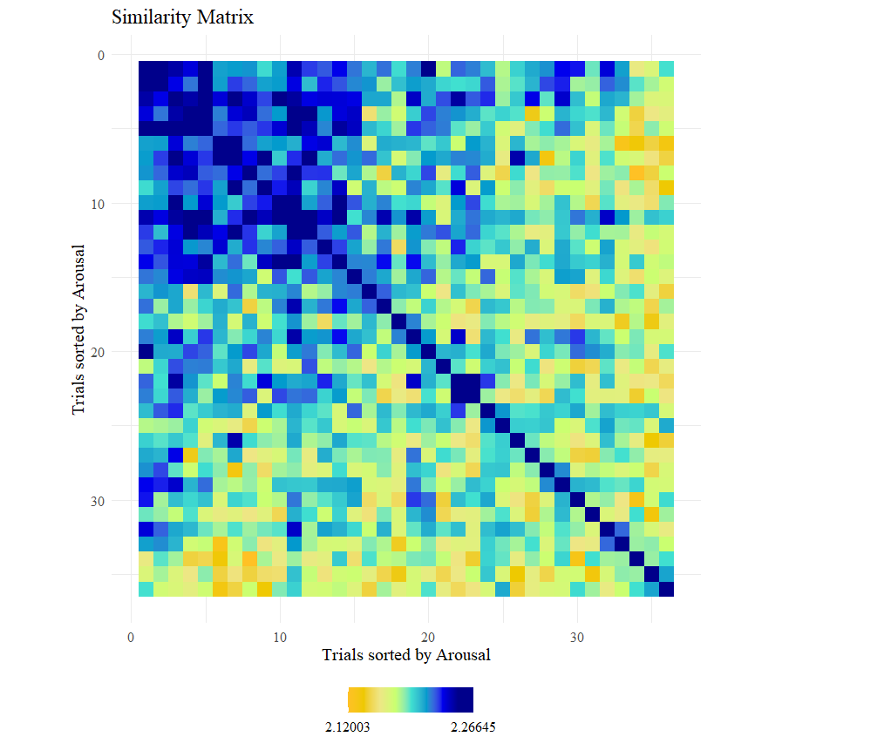
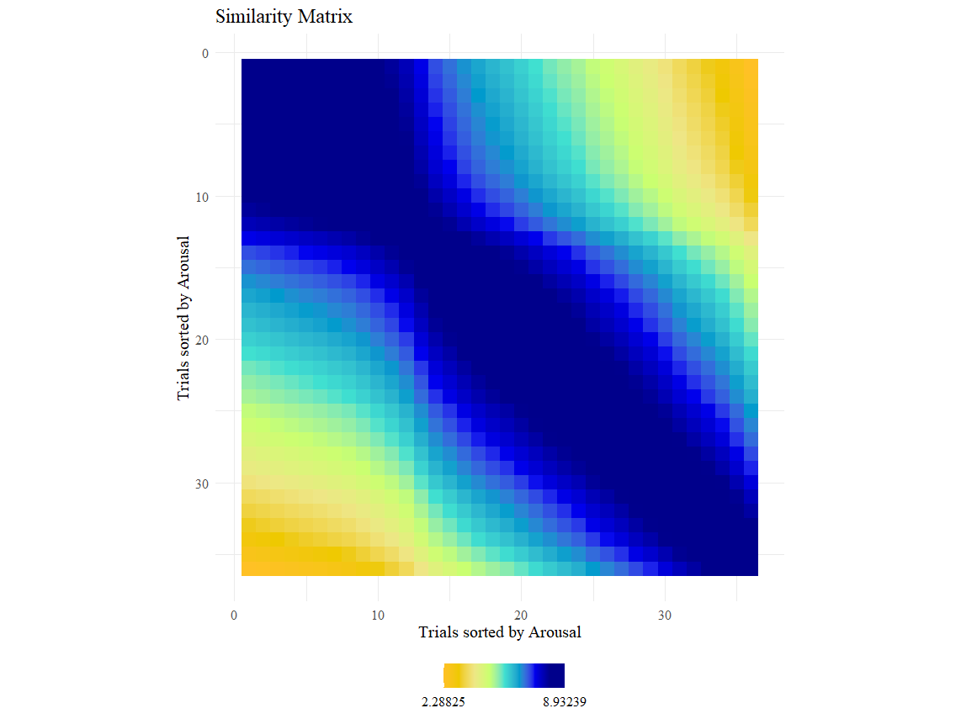
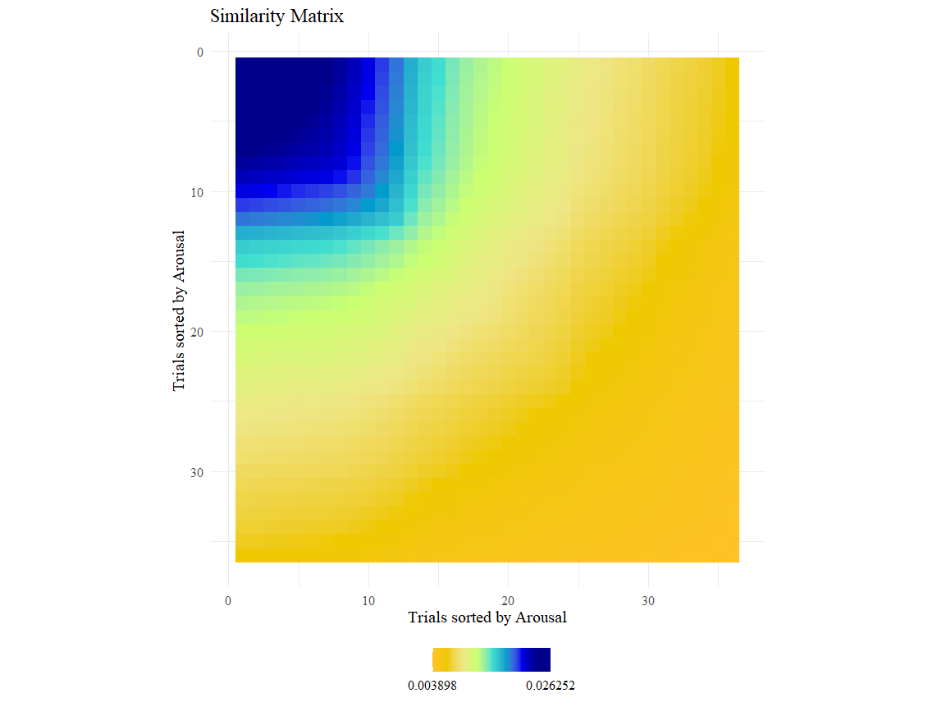
RSM based on Amplitudes
RSM based on Arousal Ratings
RSM based on Arousal invAK

Slide 19
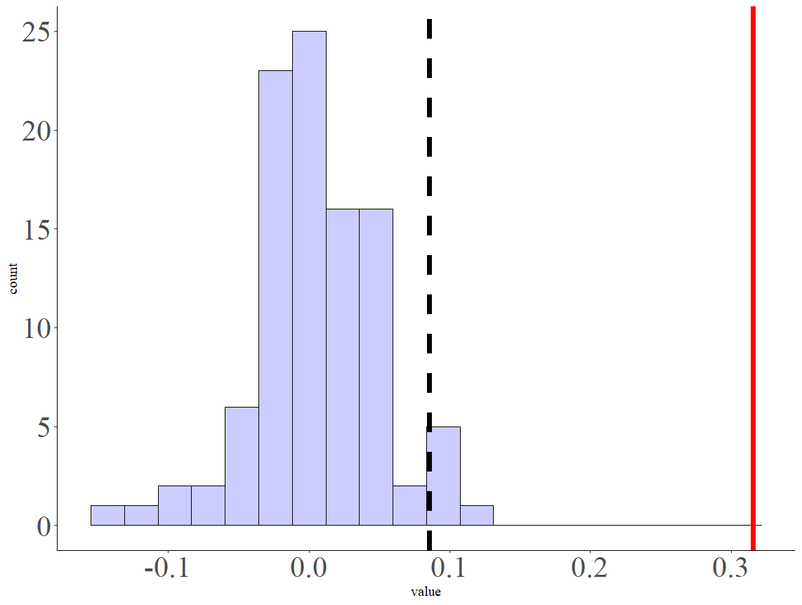
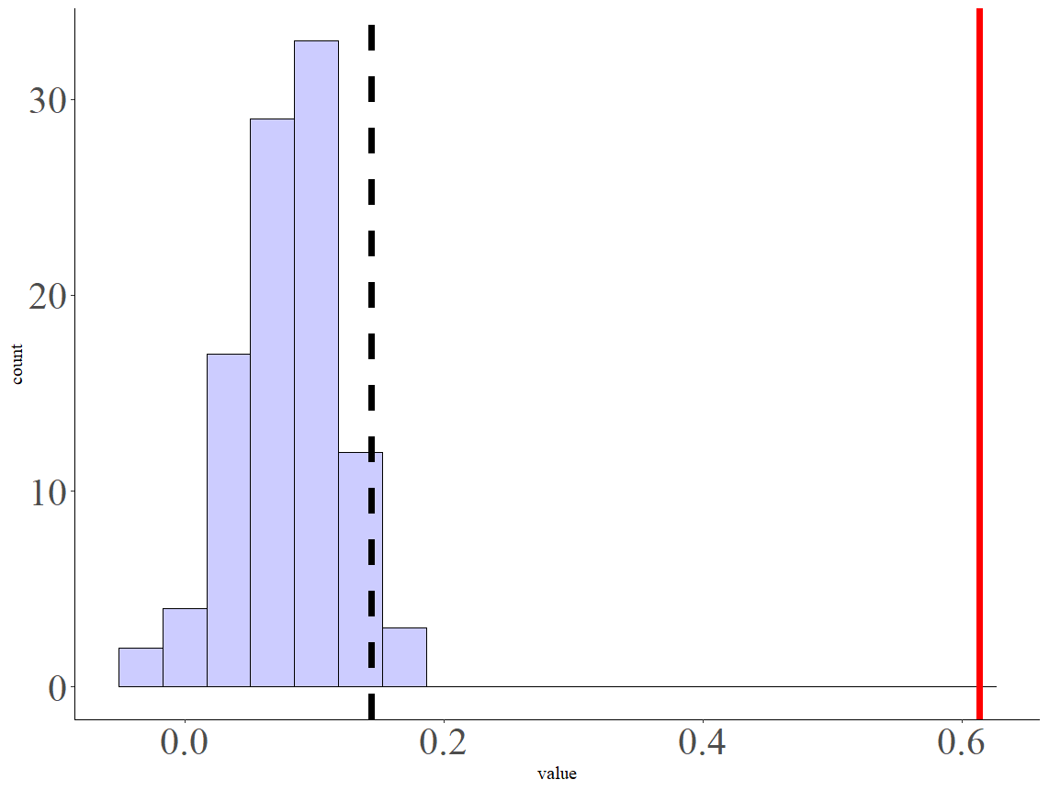
Comparison of correlation matrices: Alina N = 281
RSM based on Arousal Ratings NN
RSM based on Amplitudes
RSM based on Amplitudes
RSM based on Arousal Ratings
inv AK

Slide 20
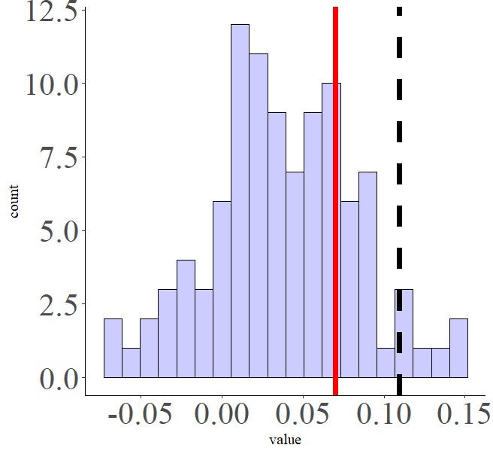
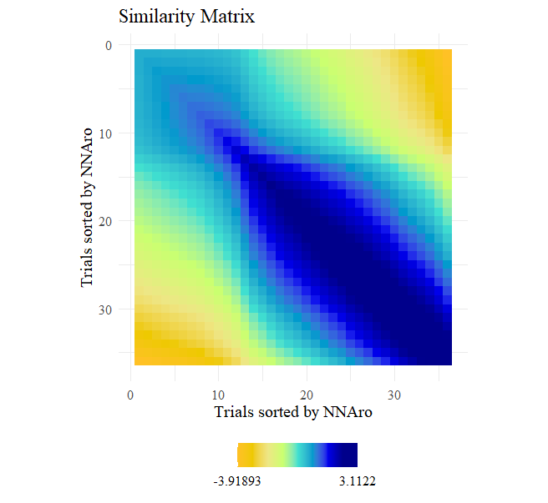
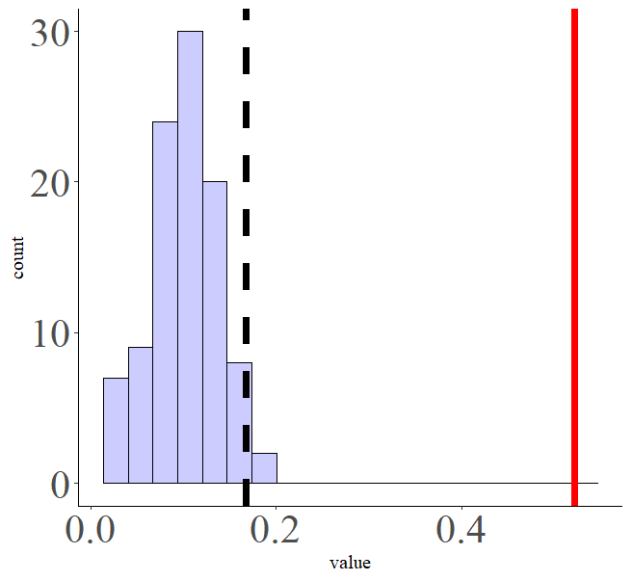
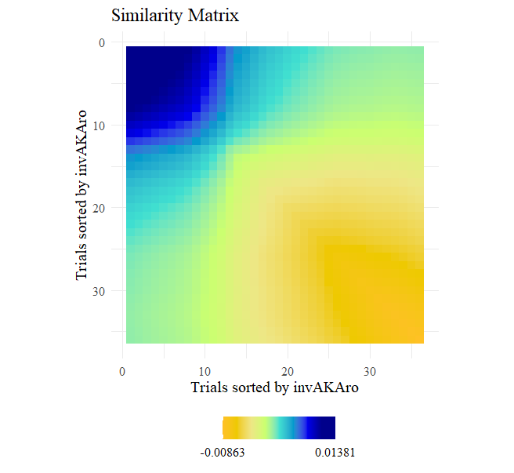
Comparison of correlation matrices regression Models: Alina N = 281
RSM based on Arousal Ratings NN
RSM based on Amplitudes
RSM based on Amplitudes
RSM based on Arousal Ratings
inv AK

Slide 21
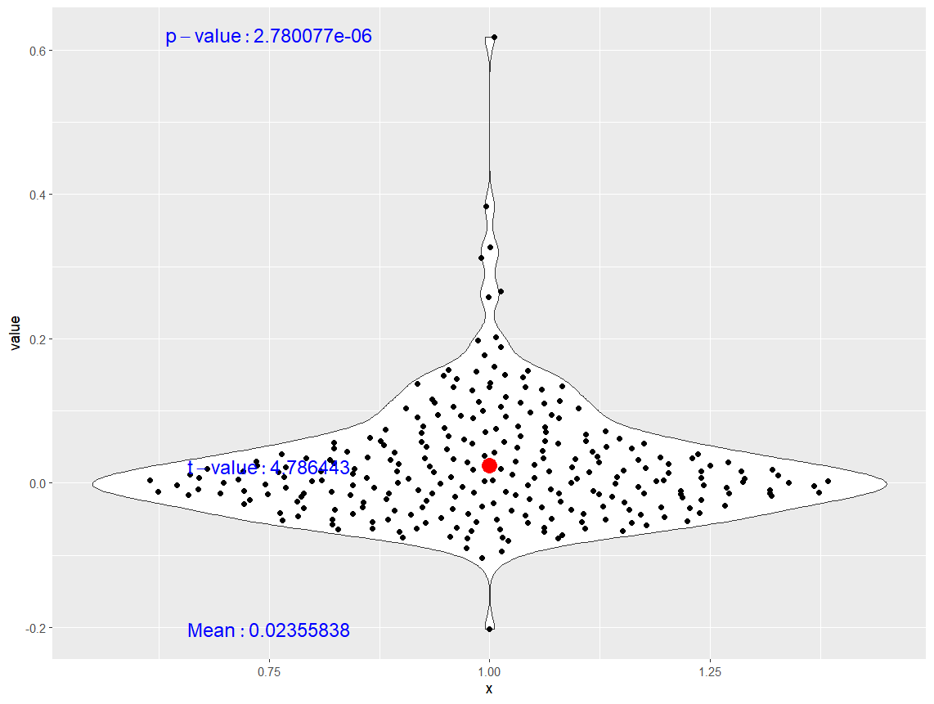
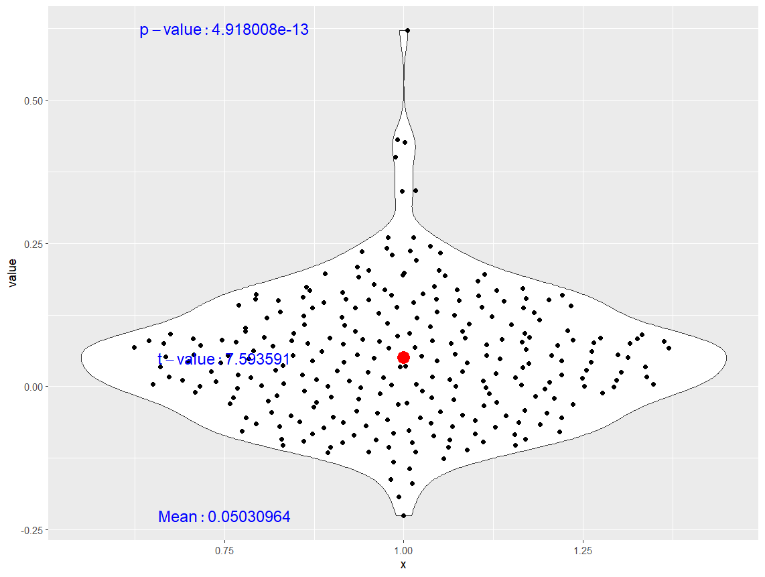
MATRIX COMPARISON AT AN INDIVIDUAL LEVEL: Imagery
RSM based on amplitudes
Vs.
RSM based on Arousal Ratings
RSM based on amplitudes
Vs.
RSM based on Arousal Ratings invAK

Slide 22
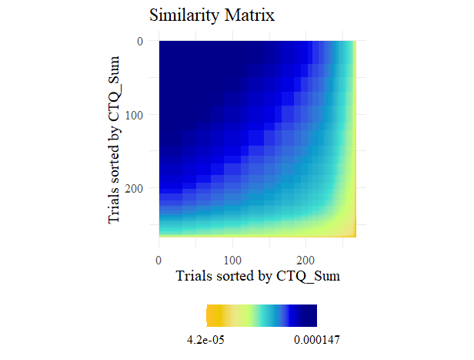
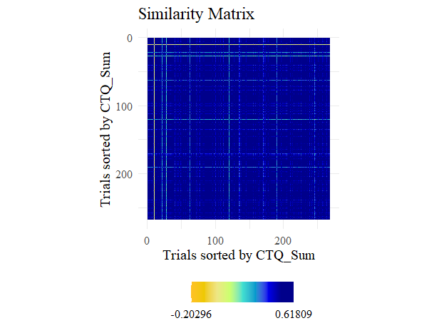
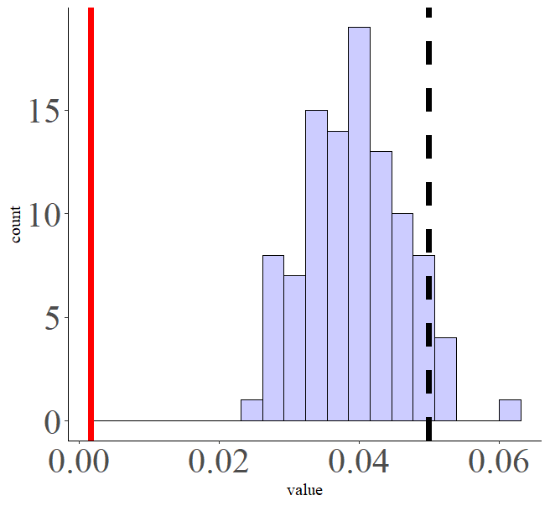
Participants sorted by CTQ Scores
ISC based on SCR-invAK RSMs Correlation. RSM based on single values
InvAK model of CTQ scores

Slide 23
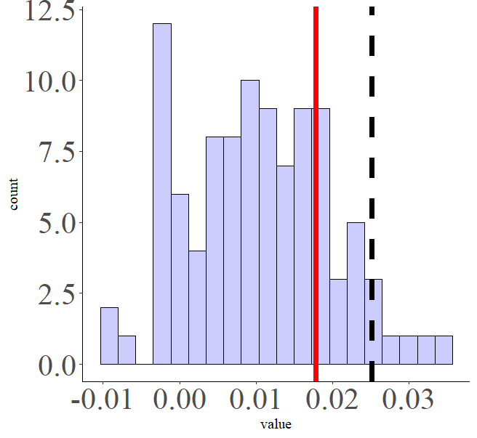
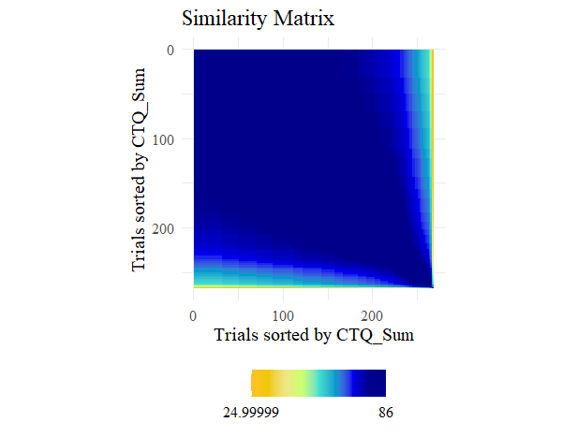
Participants sorted by CTQ Scores
ISC based on SCR-invAK RSMs Correlation. RSM based on single
NN model of CTQ scores

Slide 24
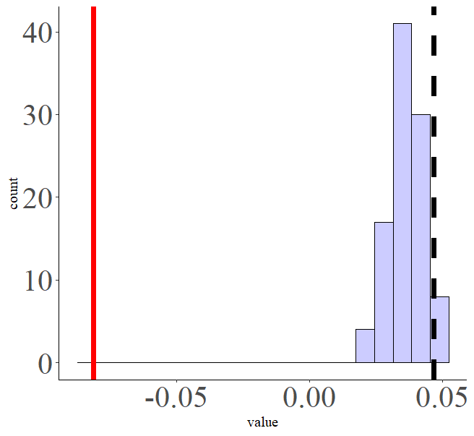


Participants sorted by LTE Scores
ISC based on SCR-invAK RSMs Correlation. RSM based on single values
InvAK model of LTE scores

Slide 25


Participants sorted by LTE Scores
ISC based on SCR-invAK RSMs Correlation. RSM based on single values
NN model of LTE scores

Slide 26



Participants sorted by LTE Scores
ISC based on SCR-invAK RSMs Correlation.
AK model of LTE scores

Slide 27



High and low on LTE N 50 per group
Low in LTE
High in LTE
Low in LTE
Wo outlier

Slide 28



Participants sorted by LTE Scores wo outliers Correlation > .30
ISC based on SCR-invAK RSMs Correlation.
AK model of LTE scores
Significant relationship found with outliers seems to be driven by outliers

Slide 29



Participants sorted by STAI Scores
ISC based on SCR-invAK RSMs Correlation
invAK model of STAI scores

Slide 30


Participants sorted by STAI Scores
ISC based on SCR-invAK RSMs Correlation.
NN model of STAI scores

Slide 31


Participants sorted by STAI Scores
ISC based on SCR-invAK RSMs Correlation.
AK model of STAI scores

Slide 32



Participants sorted by BDI Scores
ISC based on SCR-invAK RSMs Correlation.
invAK based on BDI

Slide 33


Participants sorted by BDI Scores
ISC based on SCR-invAK RSMs Correlation. RSM based on single value
NN based on BDI

Slide 34


Participants sorted by BDI Scores
ISC based on SCR-invAK RSMs Correlation. RSM based on single value
AK based on BDI

Slide 35
Exploratory analysis based on High and low groups (N= 50) on LTE scores

Slide 36







High and low on LTE N 50 per group
Low in LTE
Wo outlier
Low in LTE
High in LTE

Slide 37




High and low on LTE N 50 per group
Low in LTE
Wo outlier
Low in LTE
High in LTE

Slide 38




Comparison of correlation matrices regression High in LTE N = 50
RSM based on Arousal Ratings NN
RSM based on Amplitudes
RSM based on Amplitudes
RSM based on Arousal Ratings
inv AK

Slide 39




Comparison of correlation matrices regression Low in LTE N = 50
RSM based on Arousal Ratings NN
RSM based on Amplitudes
RSM based on Amplitudes
RSM based on Arousal Ratings
inv AK

Slide 40
More exploratory analysis
Does the similarity index (SCR-invAK model on arousal ratings) modulate the effects of category on SCR amplitudes?
If so it would indicate that the similarity index explains beyond category and might be an indicative index of the SCR in passive picture viewing tasks.
ISC based on SCR values (i.e., vector) and relate the relationship of this vector across participants to relationship across participants on questionnaire scores.

Slide 41



Does the similarity index (SCR-invAK model on arousal ratings) modulate the effects of category on SCR amplitudes?
Strong evidence in favor of the interaction Category: Correlation

