Slide 1


Comparing RSM construction method of SCR in relation to Arousal

Slide 2
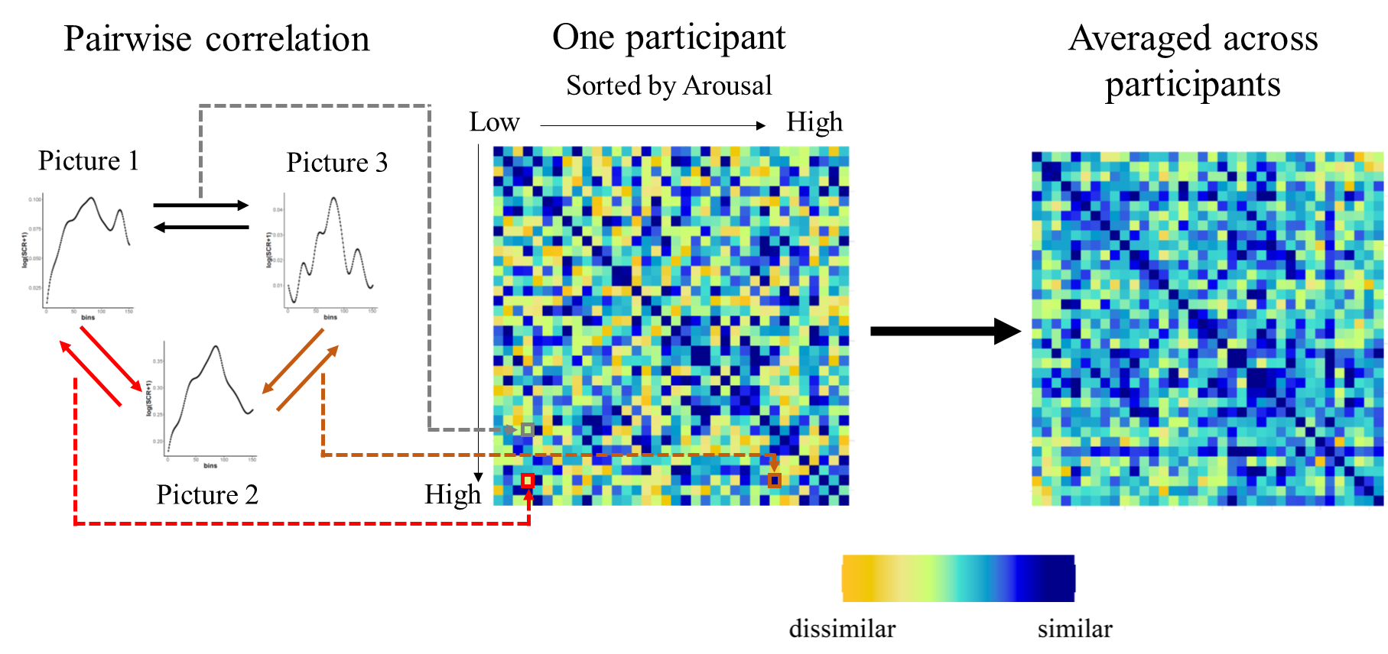
RSMs based on SCR Vectors
Similitudes are based on
Spearman or Pearson correlation values

Slide 3
RSMs based on SCR amplitudes
.08 µS
.05 µS
.12 µS
Similitudes are based on:
MaxValue- abs(Amplitude 1 – Amplitude 2):

Slide 4
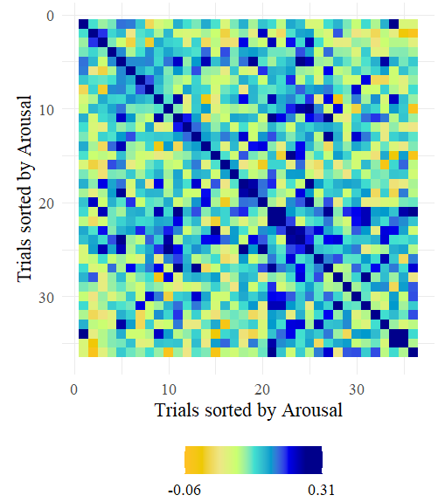
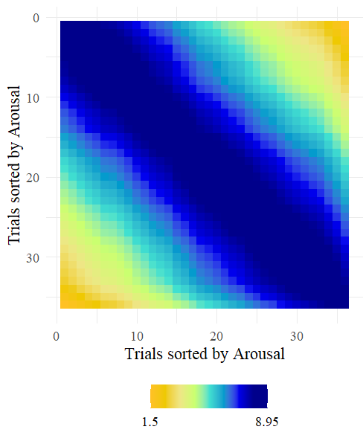
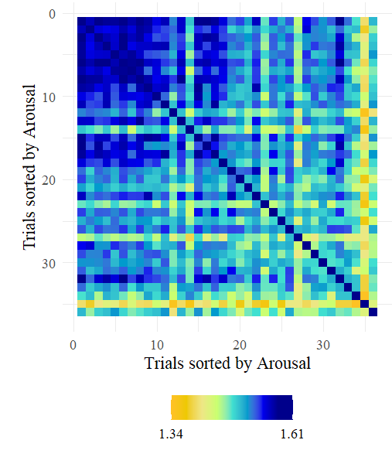
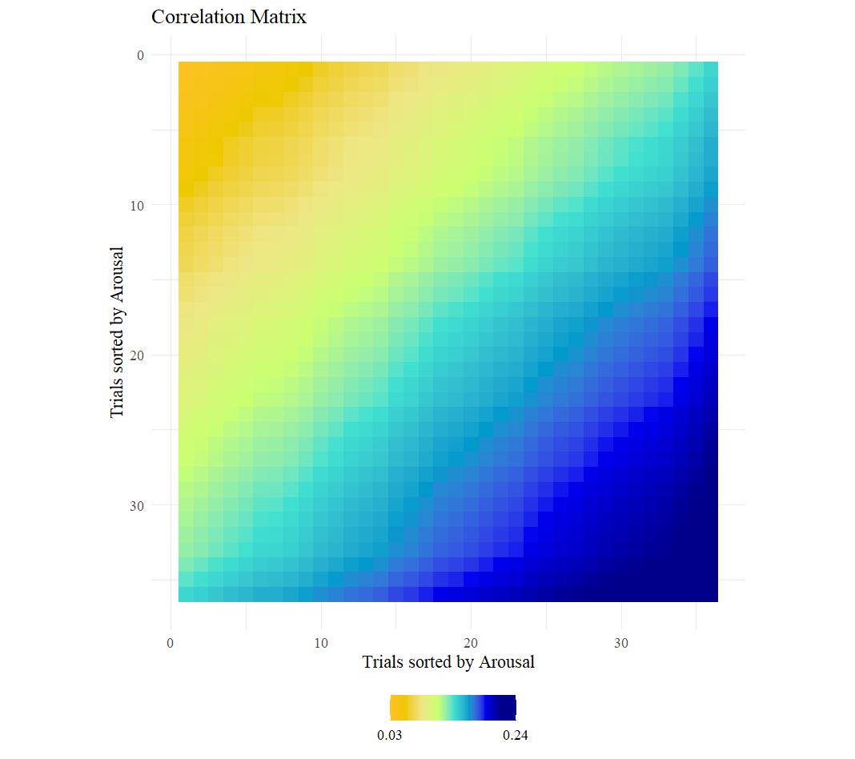
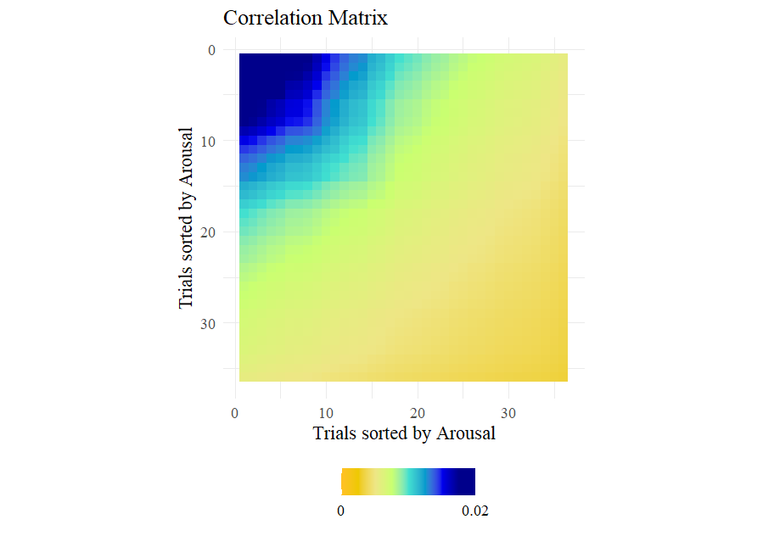
Comparison of correlation matrices: Passive Picture Viewing Task
RSM based on Arousal Ratings
RSM based on vector
RSM based on Amplitudes (log)
RSM based on Arousal Ratings AK and invAK
AK: mean(Amplitude1,Amplitude2)/Nvariables
invAK: 1/AK

Slide 5
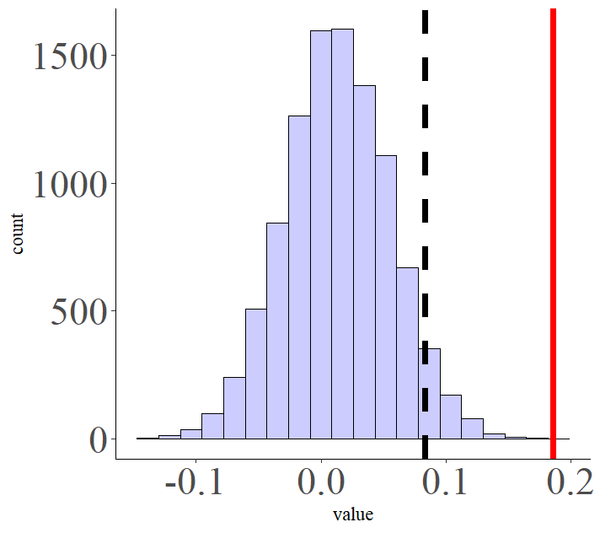
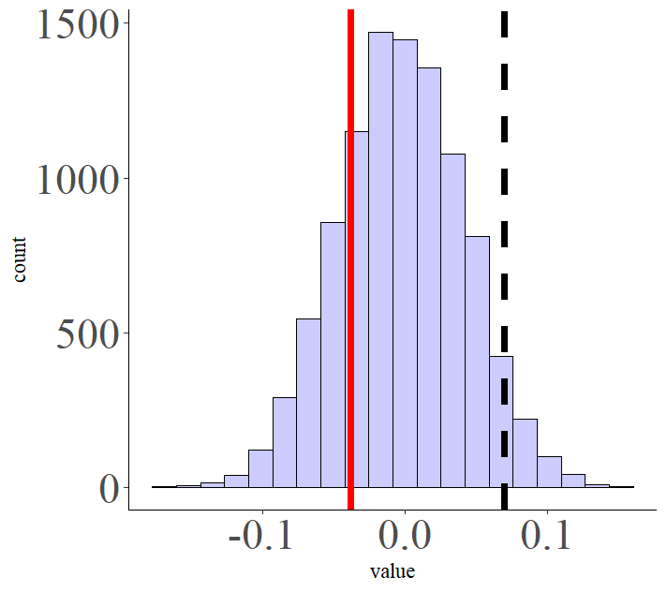
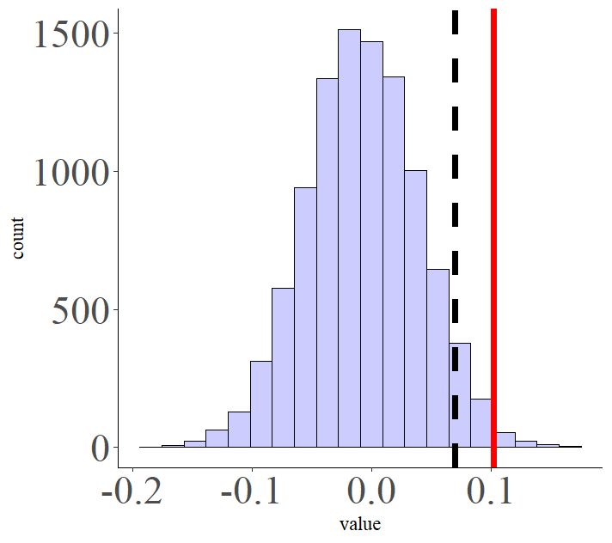
Comparison of correlation matrices: Passive Picture Viewing Task
RSM based on vector
RSM based on Arousal Ratings
RSM based on vector
RSM based on Amplitudes
RSM based on Amplitudes
RSM based on Arousal Ratings

Slide 6
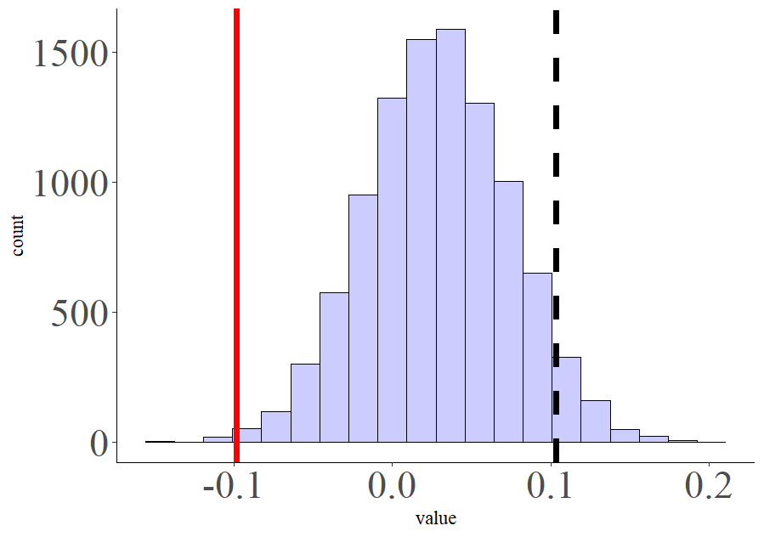
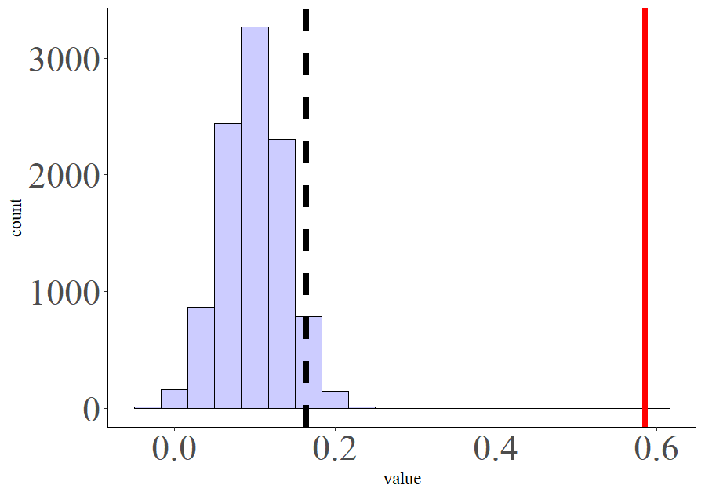
Comparison of correlation matrices: Passive Picture Viewing Task
RSM based on vector
RSM based on Arousal Ratings
invAK
RSM based on Amplitudes
RSM based on Arousal Ratings
InvAK

Slide 7
MATRIX COMPARISON AT AN INDIVIDUAL LEVEL
RSM based on SCR
RSM based on arousal ratings
rho
Matrix Comparison for each participant

Slide 8
MATRIX COMPARISON AT AN INDIVIDUAL LEVEL
Matrix Comparison for each participant
VP | rho
VP01 | .03
VP02 | .05
VP03 | .001
VP04 | -.03
VP05 | .04
VP06 | .045
VP07 | .08
If correlation is larger than 0 (one sample t-test) then there is evidence for a positive relationship between variables

Slide 9
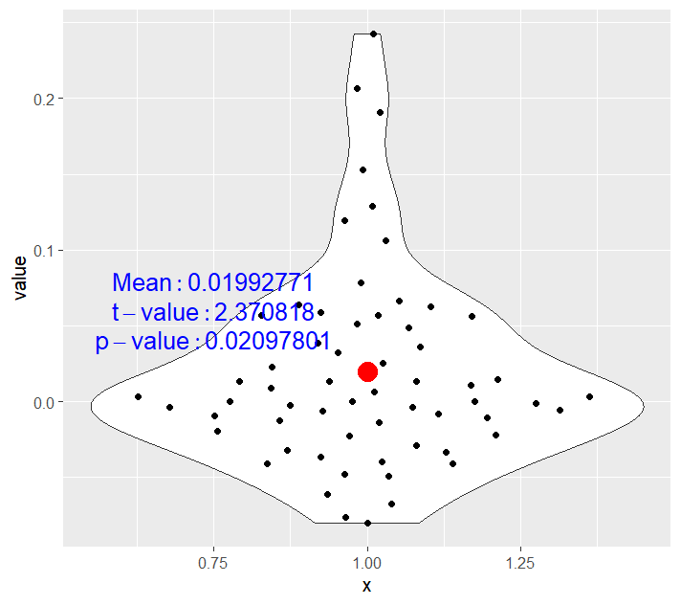
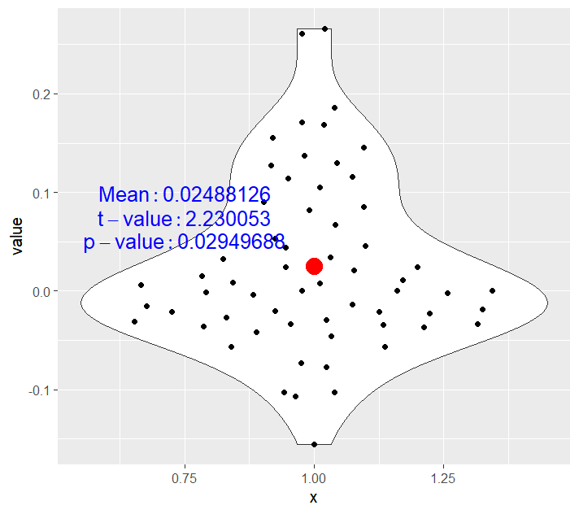
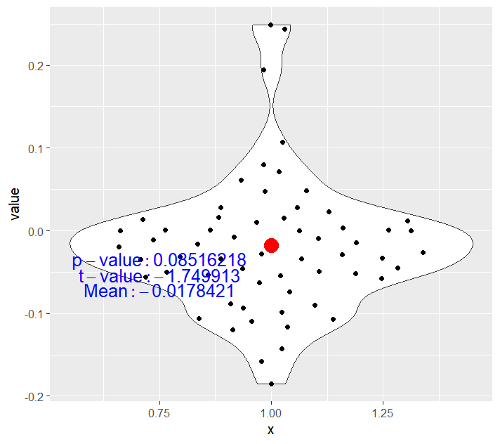
MATRIX COMPARISON AT AN INDIVIDUAL LEVEL: PPV
RSM based on Vector
Vs.
RSM based on Arousal Ratings
RSM based on amplitudes
Vs.
RSM based on Arousal Ratings
RSM based on vector
Vs.
RSM based on Amplitudes

Slide 10
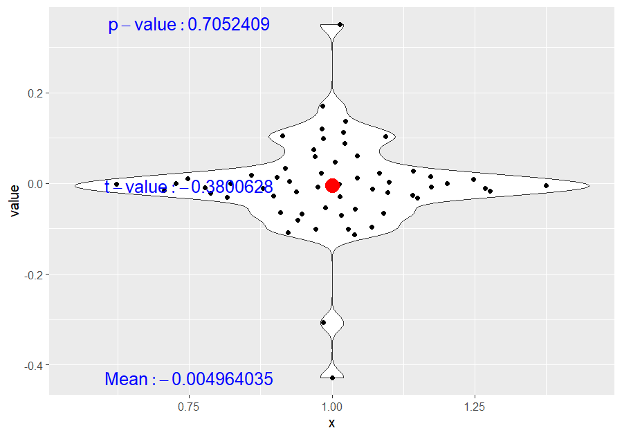
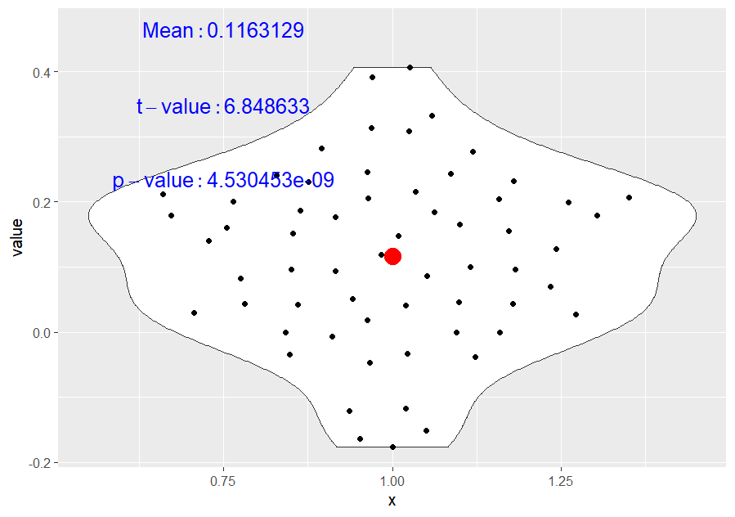
MATRIX COMPARISON AT AN INDIVIDUAL LEVEL: PPV
RSM based on Vector
Vs.
RSM based on Arousal Ratings invAK
RSM based on amplitudes
Vs.
RSM based on Arousal Ratings invAK

Slide 11
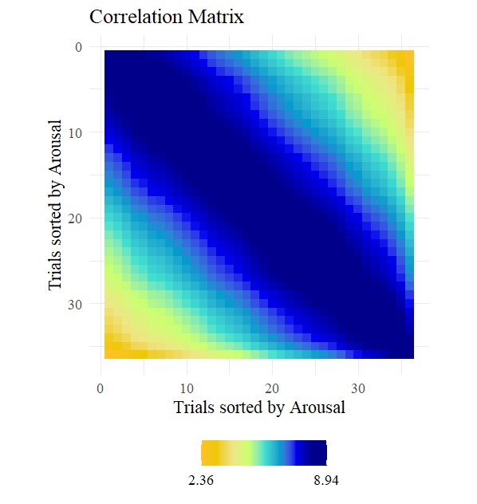
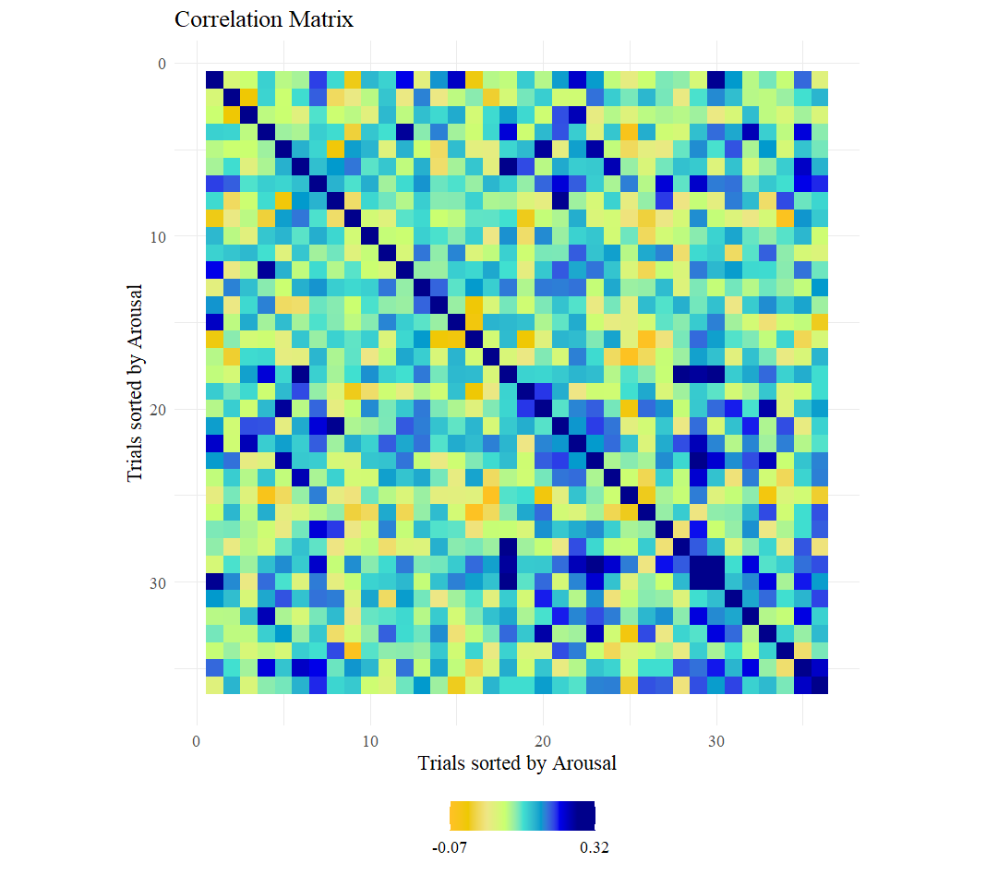
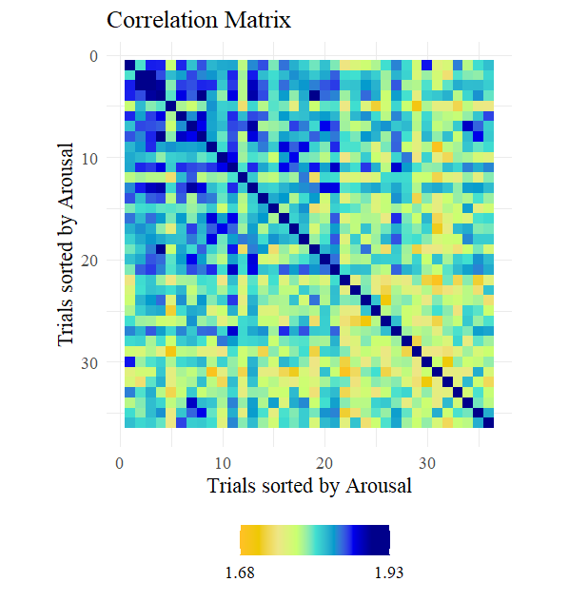
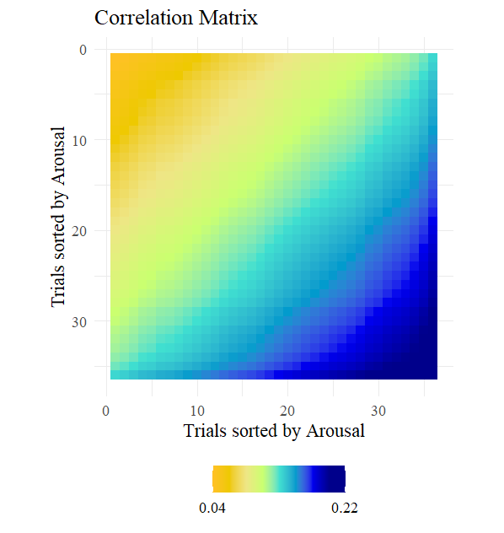
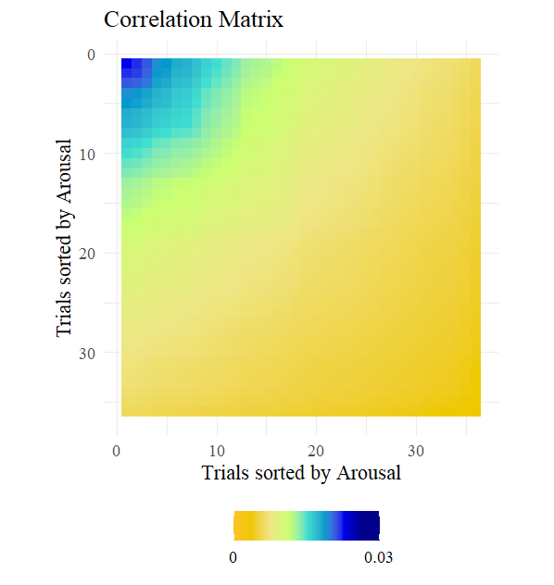
Comparison of correlation matrices: Passive Sound Listening Task
RSM based on Arousal Ratings
RSM based on vector
RSM based on Amplitudes
RSM based on Arousal Ratings AK and invAK

Slide 12
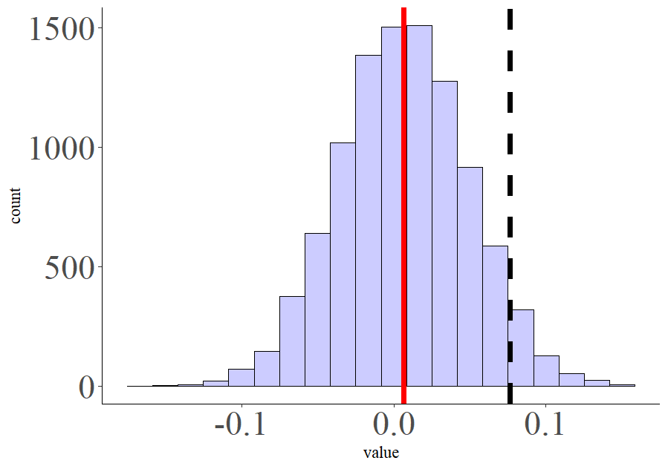
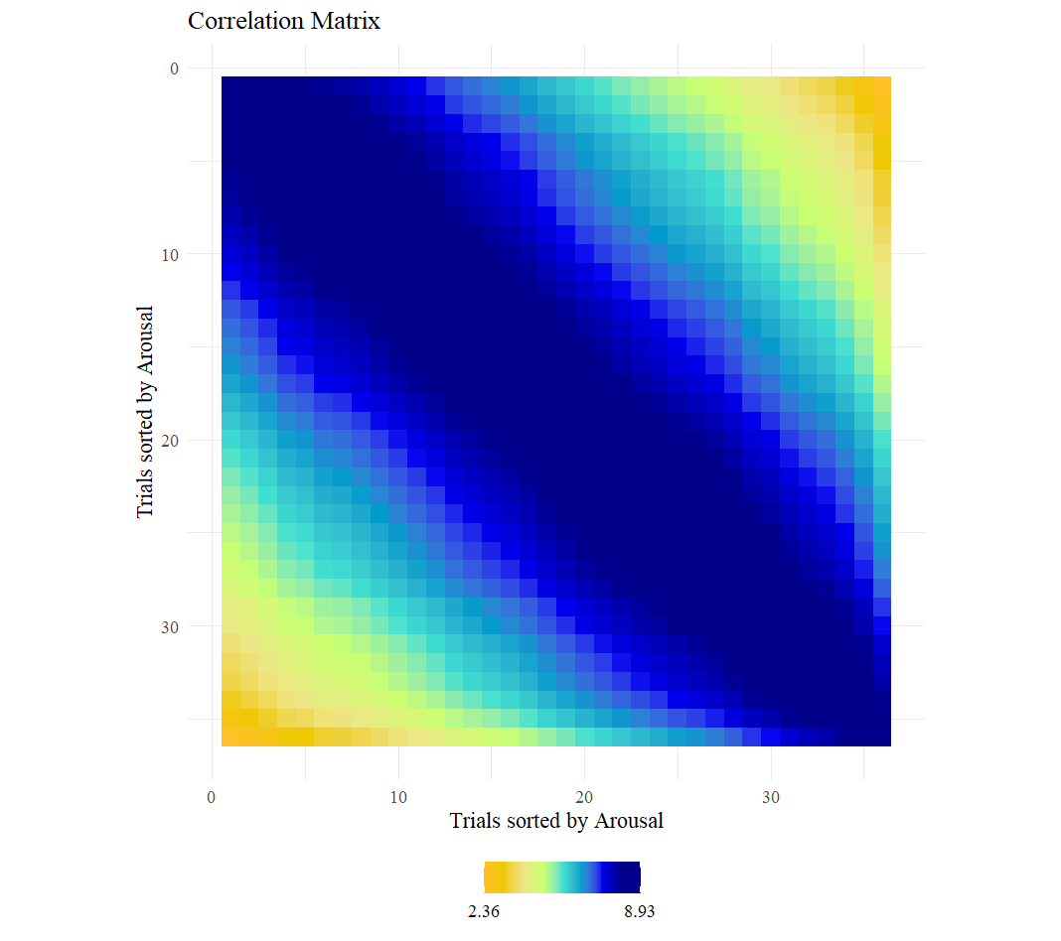
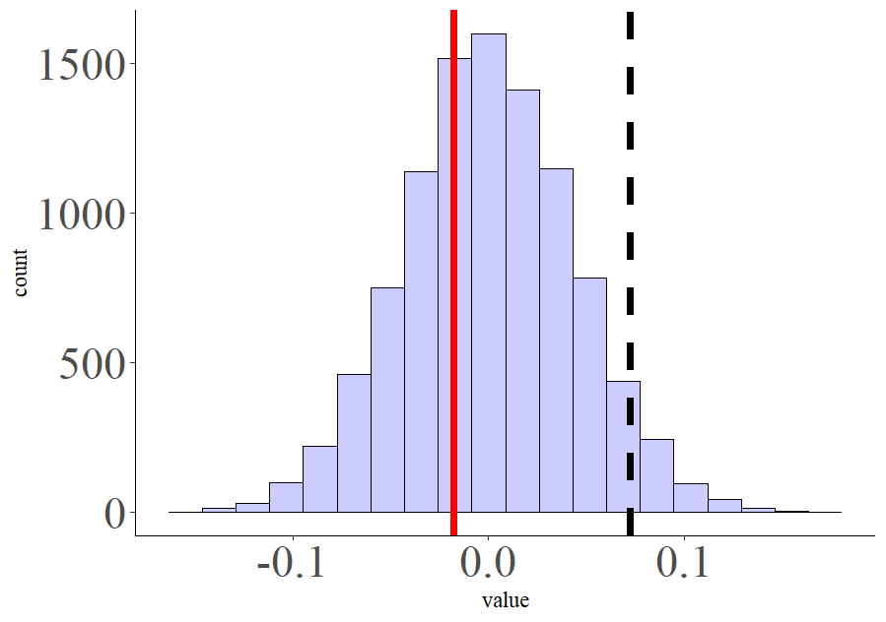
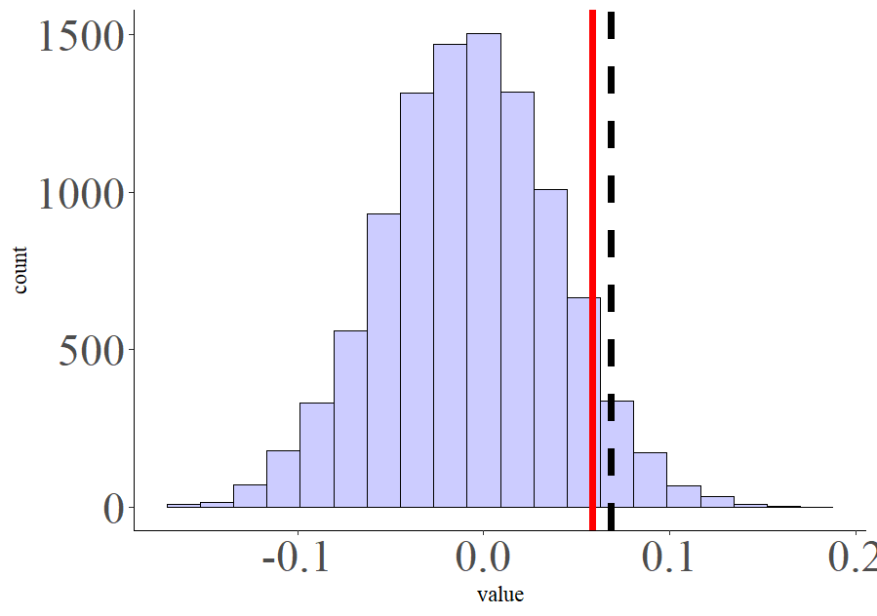
Comparison of correlation matrices: Passive Sound ListeningTask
RSM based on vector
RSM based on Arousal Ratings
RSM based on vector
RSM based on Amplitudes
RSM based on Amplitudes
RSM based on Arousal Ratings

Slide 13
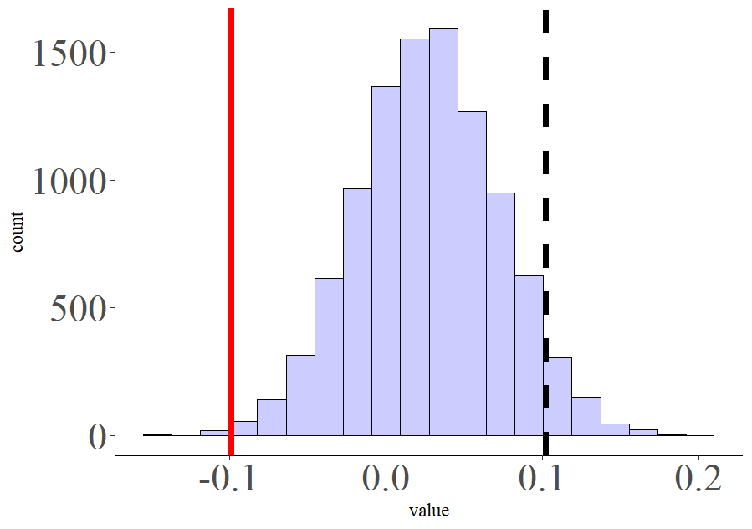
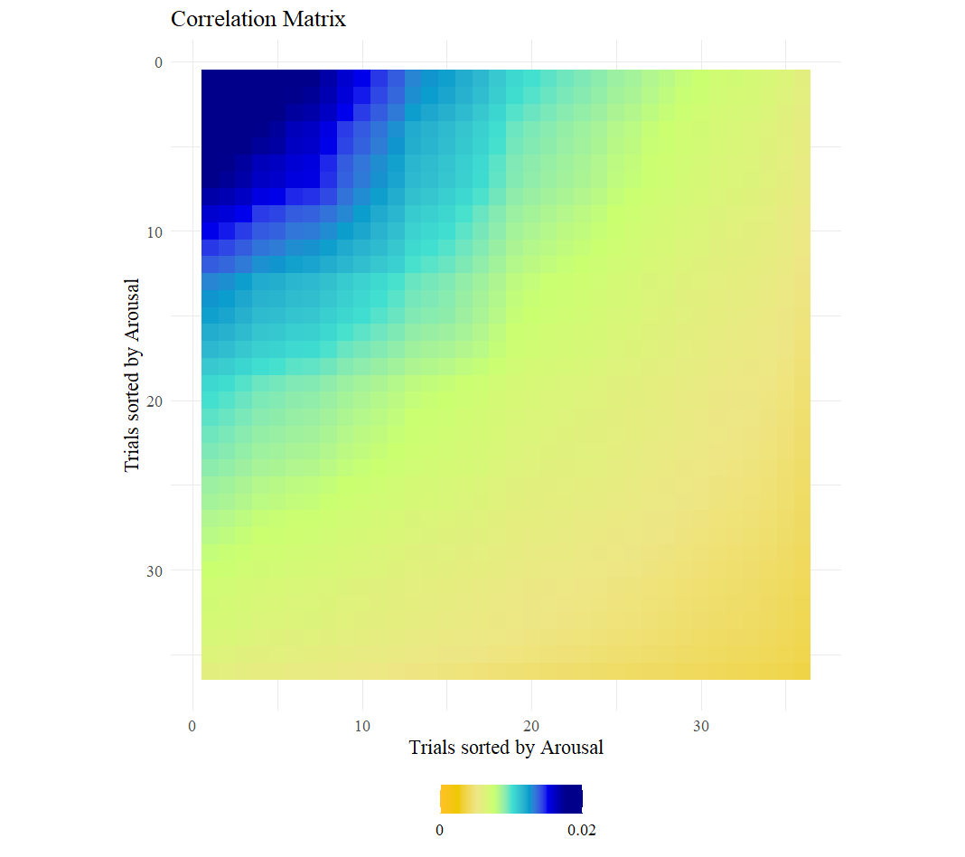
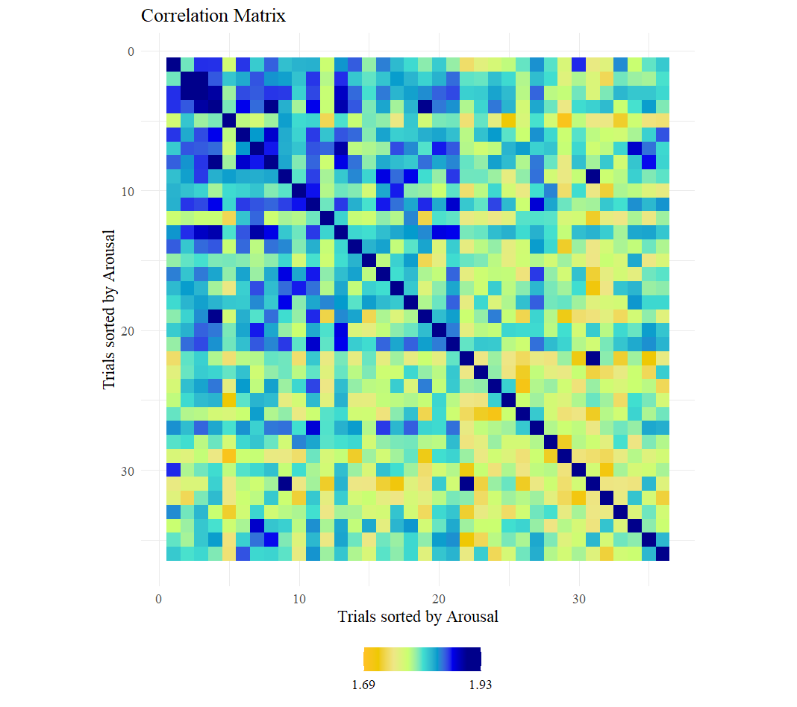
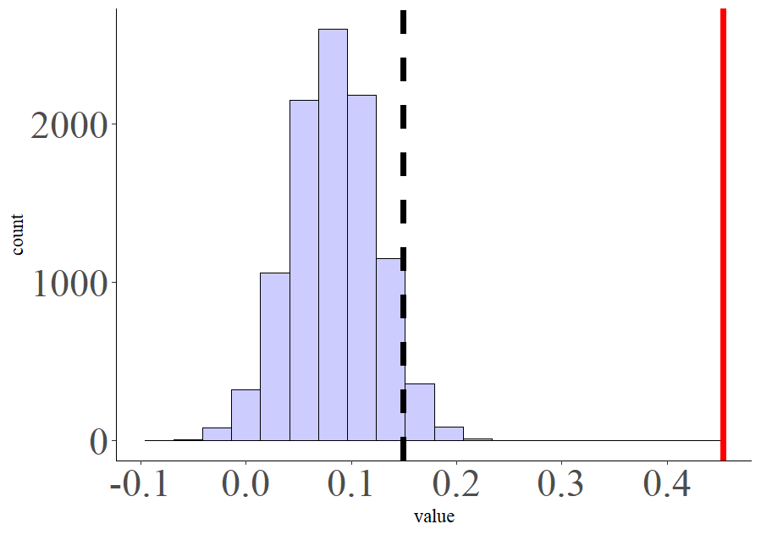
Comparison of correlation matrices: Passive Sound ListeningTask
RSM based on vector
RSM based on Arousal Ratings invAK
RSM based on Amplitudes
RSM based on Arousal Ratings
inv AK

Slide 14
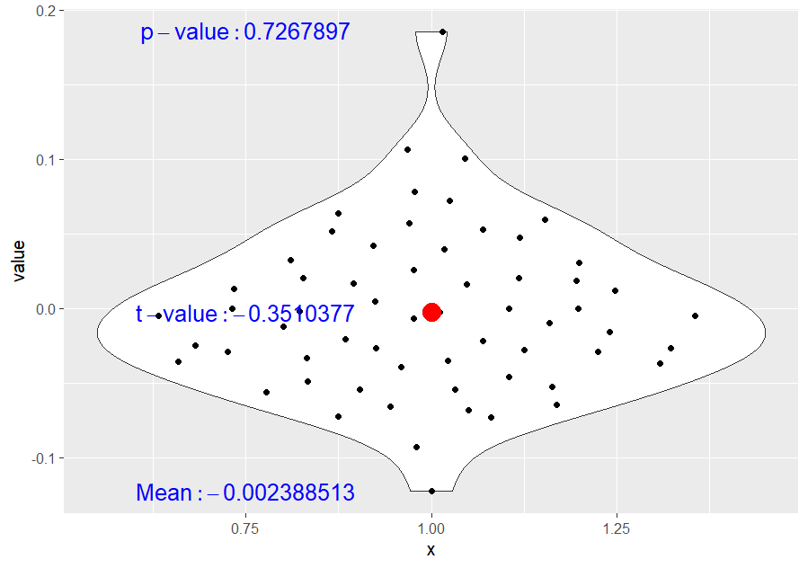
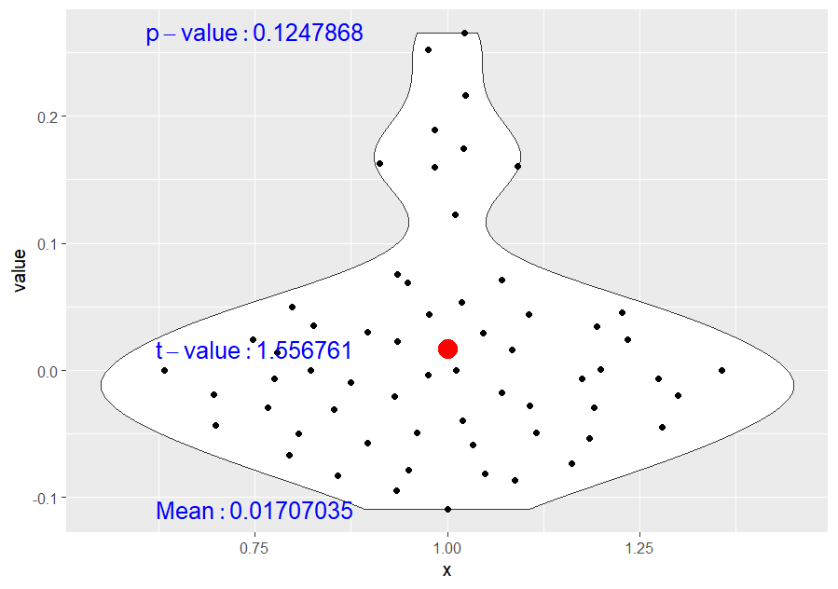
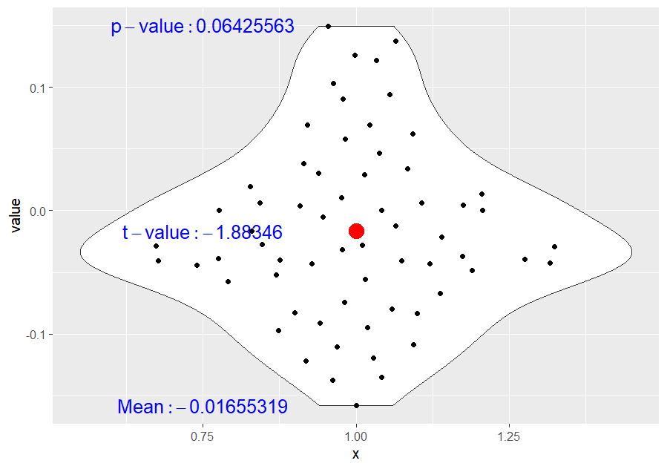
MATRIX COMPARISON AT AN INDIVIDUAL LEVEL: PSL
RSM based on Vector
Vs.
RSM based on Arousal Ratings
RSM based on amplitudes
Vs.
RSM based on Arousal Ratings
RSM based on vector
Vs.
RSM based on Amplitudes

Slide 15
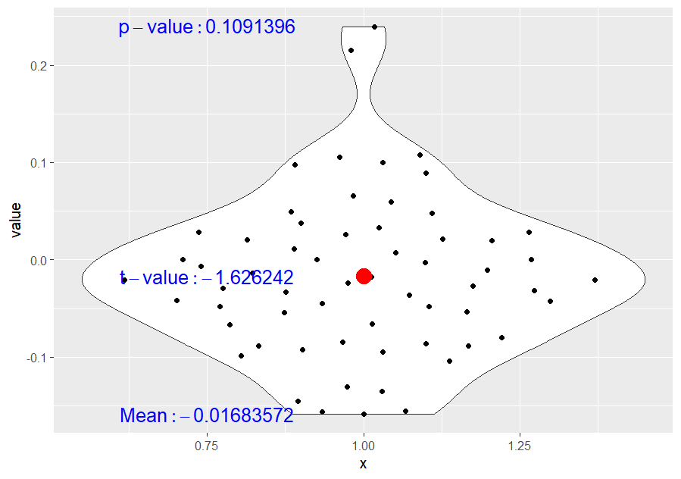
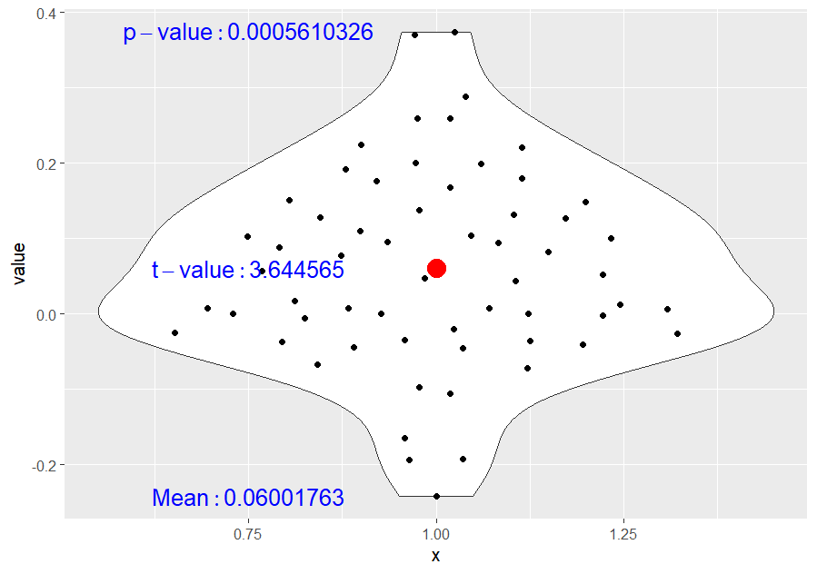
MATRIX COMPARISON AT AN INDIVIDUAL LEVEL: PSL
RSM based on Vector
Vs.
RSM based on Arousal Ratings invAK
RSM based on amplitudes
Vs.
RSM based on Arousal Ratings invAK

Slide 16
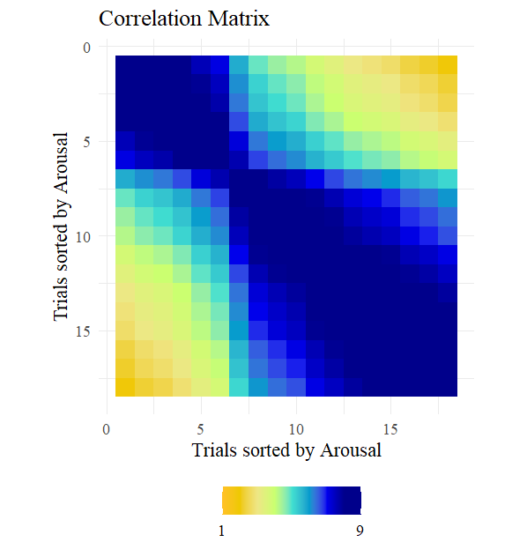
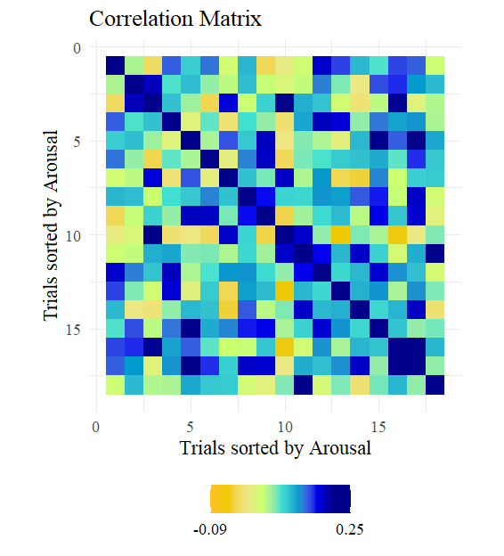
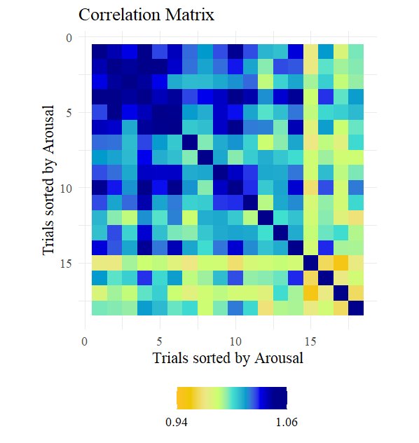
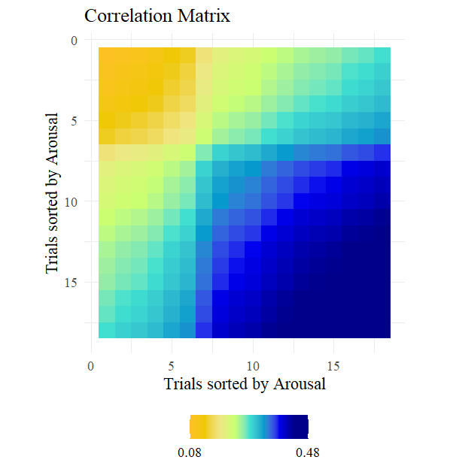
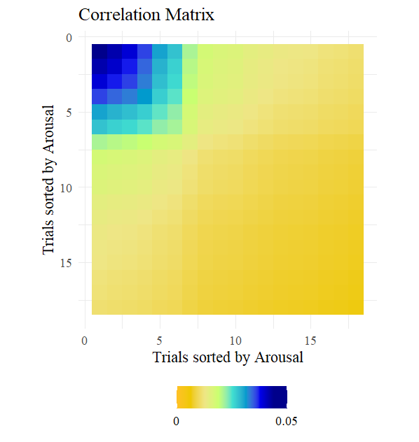
Comparison of correlation matrices: Imagery Task
RSM based on Arousal Ratings
RSM based on vector
RSM based on Amplitudes
RSM based on Arousal Ratings AK and invAK

Slide 17
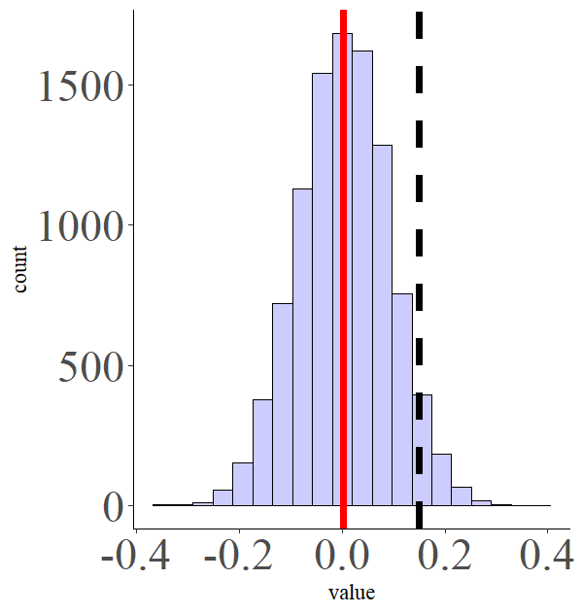
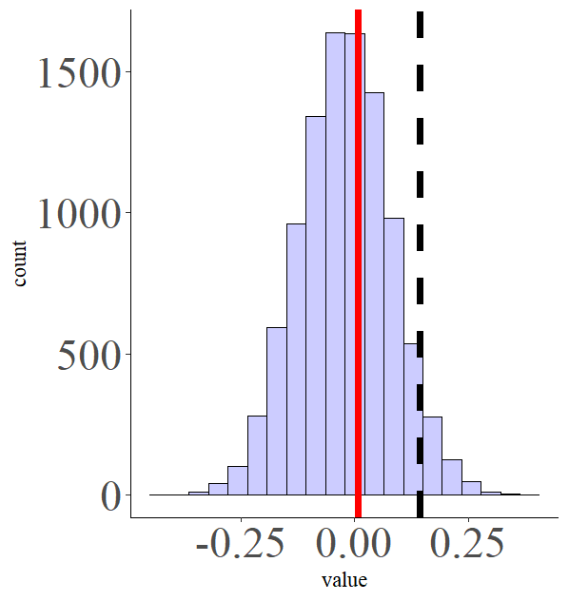
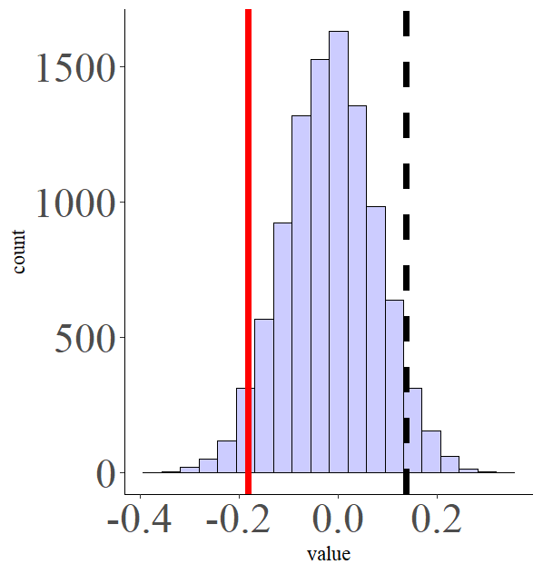
Comparison of correlation matrices: Imagery Task
RSM based on vector
RSM based on Arousal Ratings
RSM based on vector
RSM based on Amplitudes
RSM based on Amplitudes
RSM based on Arousal Ratings

Slide 18
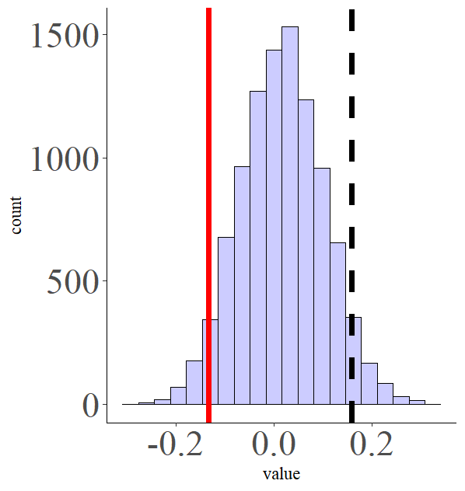
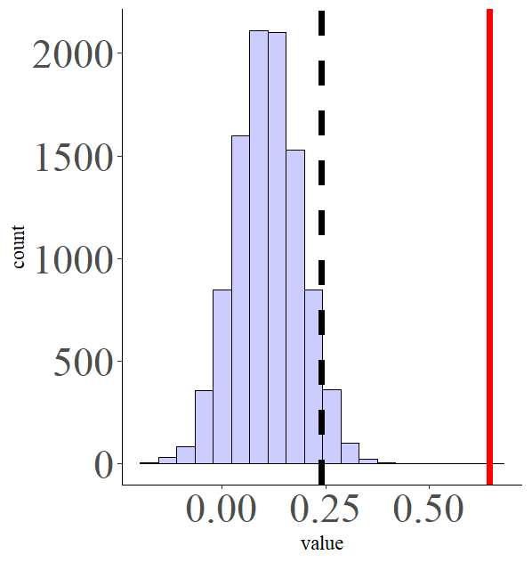
Comparison of correlation matrices: Imagery
RSM based on vector
RSM based on Arousal Ratings invAK
RSM based on Amplitudes
RSM based on Arousal Ratings
inv AK

Slide 19
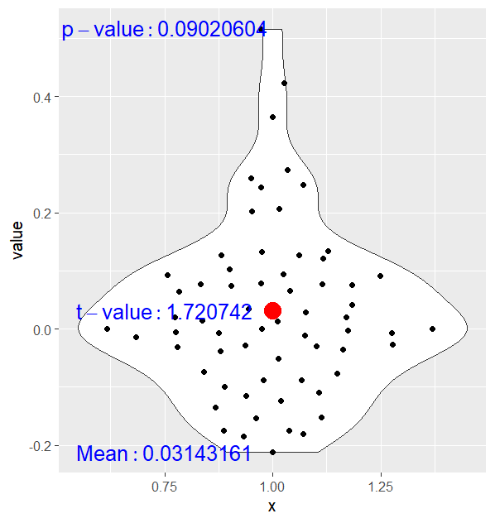
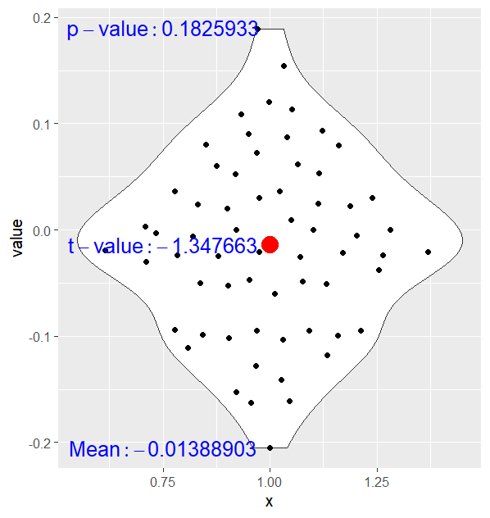
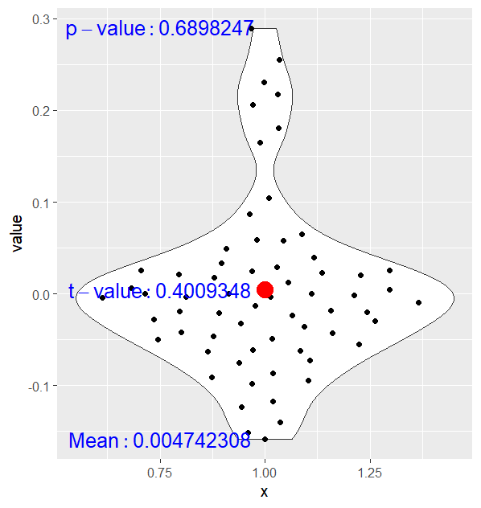
MATRIX COMPARISON AT AN INDIVIDUAL LEVEL: Imagery
RSM based on Vector
Vs.
RSM based on Arousal Ratings
RSM based on amplitudes
Vs.
RSM based on Arousal Ratings
RSM based on vector
Vs.
RSM based on Amplitudes

Slide 20
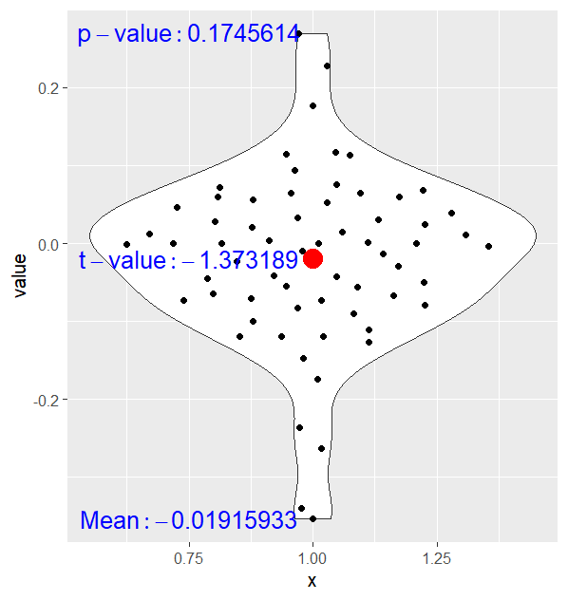
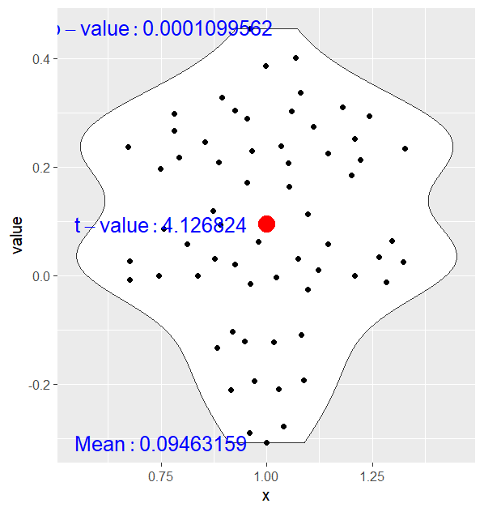
MATRIX COMPARISON AT AN INDIVIDUAL LEVEL: Imagery
RSM based on Vector
Vs.
RSM based on Arousal Ratings invAK
RSM based on amplitudes
Vs.
RSM based on Arousal Ratings invAK

Slide 21
Test with Alina’s data, = 252

Slide 22
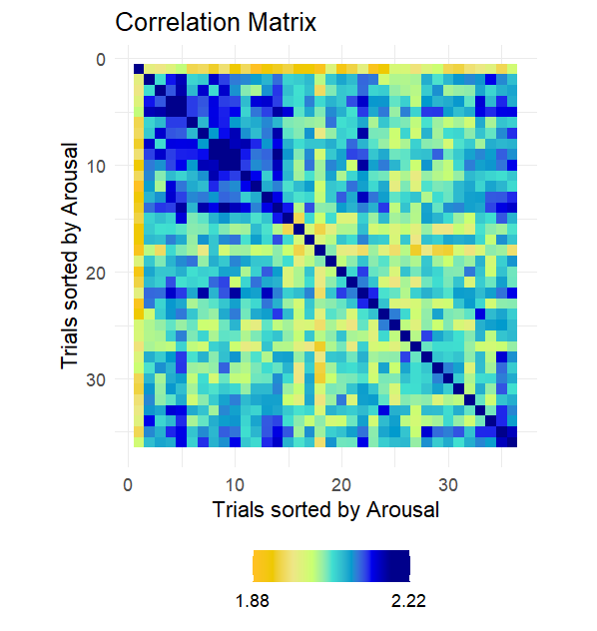


RSM based on Amplitudes
RSM based on Arousal Ratings
RSM based on Arousal invAK

Slide 23


Comparison of correlation matrices: Imagery
RSM based on Amplitudes
RSM based on Arousal Ratings NN
RSM based on Amplitudes
RSM based on Arousal Ratings
inv AK

Slide 24


MATRIX COMPARISON AT AN INDIVIDUAL LEVEL: Imagery
RSM based on amplitudes
Vs.
RSM based on Arousal Ratings
RSM based on amplitudes
Vs.
RSM based on Arousal Ratings invAK

Slide 25
Test with Alina’s data merging dataframes modified based on image presentation 1

Slide 26
1. SCR, n = 494

Slide 27



RSMSingleValue(PicBehavArosVAlina,nVariables,CharContainingNumberFromVector,VariableType,sortType, MaxValue) Warning message: In doTryCatch(return(expr), name, parentenv, handler) : restarting interrupted promise evaluation
RSM based on Amplitudes
RSM based on Arousal Ratings
RSM based on Arousal invAK

Slide 28

Are these typos? Did I change it correctly?
Major error
Notes:
done

Slide 29


Comparison of correlation matrices: Imagery
RSM based on Amplitudes
RSM based on Arousal Ratings NN
PermutationTest(SCR_SingleAlina_corr_prep_all,BehavioralSingleAlina_corr_prep_all,VariableOriginal,VariableModel,nPermutations,seedPer)
A permutation Test was was conducted to compare SCR_Vector and ArousalRatings. The relation between both RMS was: 0.18. The permutation test with percentil 95 was 0.08, the relationship had a p-value of 0. the BF10 index was: 6.2
Line: 765
RSM based on Amplitudes
RSM based on Arousal Ratings
inv AK
PermutationTest(SCR_SingleAlina_corr_prep_all,BehavioralSingleAlina_invAK_corr_prep_all,VariableOriginal,VariableModel,nPermutations,seedPer)
A permutation Test was was conducted to compare SCR_Vector and ArousalRatings. The relation between both RMS was: 0.38. The permutation test with percentil 95 was 0.14, the relationship had a p-value of NA. the BF10 index was: 46.97
Line: 767

Slide 30


MATRIX COMPARISON AT AN INDIVIDUAL LEVEL: Imagery
RSM based on amplitudes
Vs.
RSM based on Arousal Ratings
RSM based on amplitudes
Vs.
RSM based on Arousal Ratings invAK

Slide 31
Test with Alina’s data merging dataframes modified based on image presentation 1,2 average

Slide 32
1. SCR, n = 493

Slide 33


RSM based on Amplitudes
RSM based on Arousal Ratings
RSM based on Arousal invAK

Slide 34


Comparison of correlation matrices: Imagery
RSM based on Amplitudes
RSM based on Arousal Ratings NN
A permutation Test was was conducted to compare SCR_Vector and ArousalRatings. The relation between both RMS was: 0.33. The permutation test with percentil 95 was 0.07, the relationship had a p-value of NA. the BF10 index was: 33.49
RSM based on Amplitudes
RSM based on Arousal Ratings
inv AK
A permutation Test was was conducted to compare SCR_Vector and ArousalRatings. The relation between both RMS was: 0.71. The permutation test with percentil 95 was 0.15, the relationship had a p-value of NA. the BF10 index was: 130.94

Slide 35


MATRIX COMPARISON AT AN INDIVIDUAL LEVEL: Imagery
RSM based on amplitudes
Vs.
RSM based on Arousal Ratings
RSM based on amplitudes
Vs.
RSM based on Arousal Ratings invAK

Slide 36
2. EMG, n = 401 association with TAmplitudes +valence rating image presentation + probe: mixed

Slide 37




RSM based on Valence invAK
RSM based on TAmplitudes
RSM based on Valence Ratings
RSM based on Valence
AK

Slide 38



Comparison of correlation matrices: Imagery
RSM based on TAmplitudes
RSM based on Valence Ratings NN
A permutation Test was was conducted to compare SCR_Vector and ValenceRatings. The relation between both RMS was: 0.07. The permutation test with percentil 95 was 0.12, the relationship had a p-value of 0.3281. the BF10 index was: -3.54
RSM based on Valence Ratings
invAK
RSM based on TAmplitudes
RSM based on Valence Ratings
AK
A permutation Test was was conducted to compare SCR_Vector and ValenceRatings. The relation between both RMS was: 0.38. The permutation test with percentil 95 was 0.16, the relationship had a p-value of NA. the BF10 index was: 19.2

Slide 39



MATRIX COMPARISON AT AN INDIVIDUAL LEVEL: Imagery
RSM based on Tamplitudes
Vs.
RSM based on Valence Ratings
RSM based on Tamplitudes
Vs.
RSM based on Valence Ratings invAK
RSM based on Tamplitudes
Vs.
RSM based on Valence Ratings AK

