Slide 1
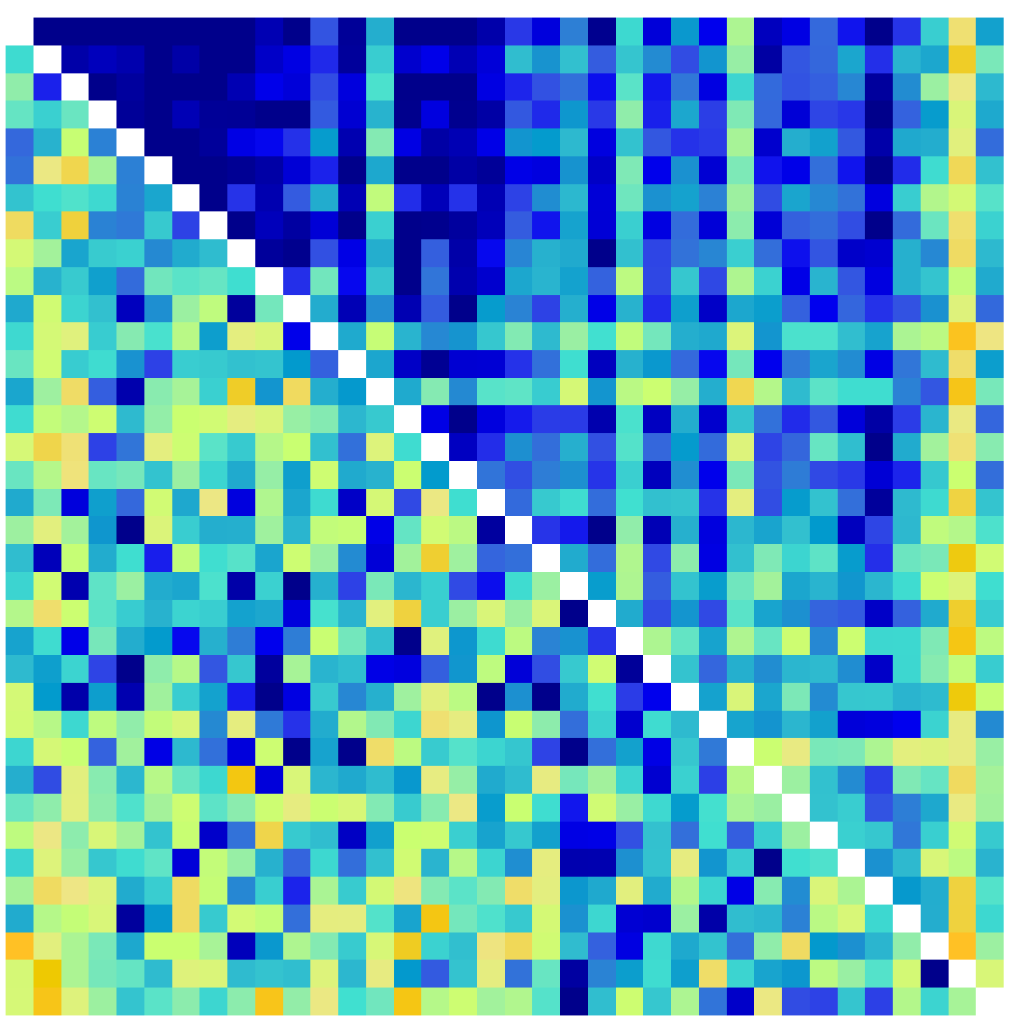
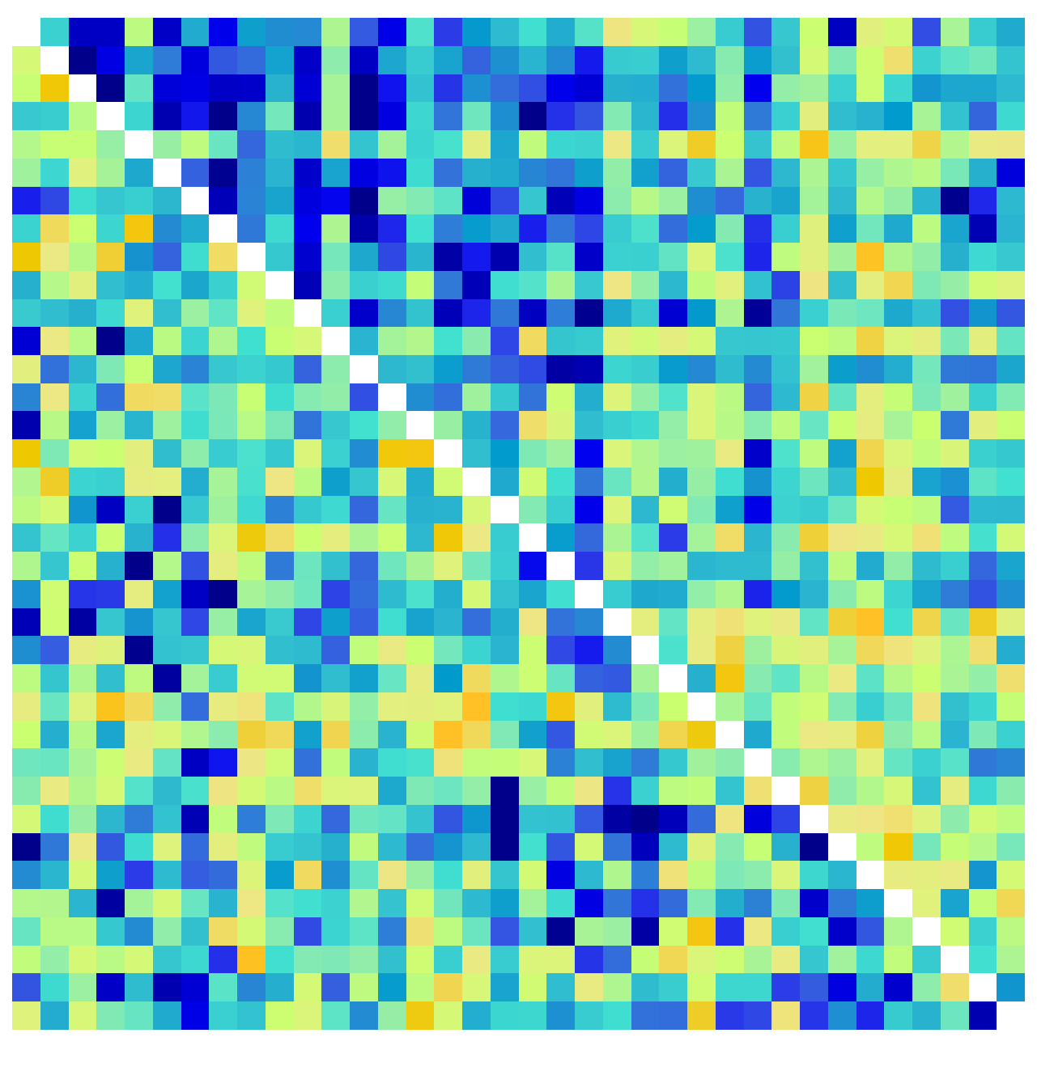
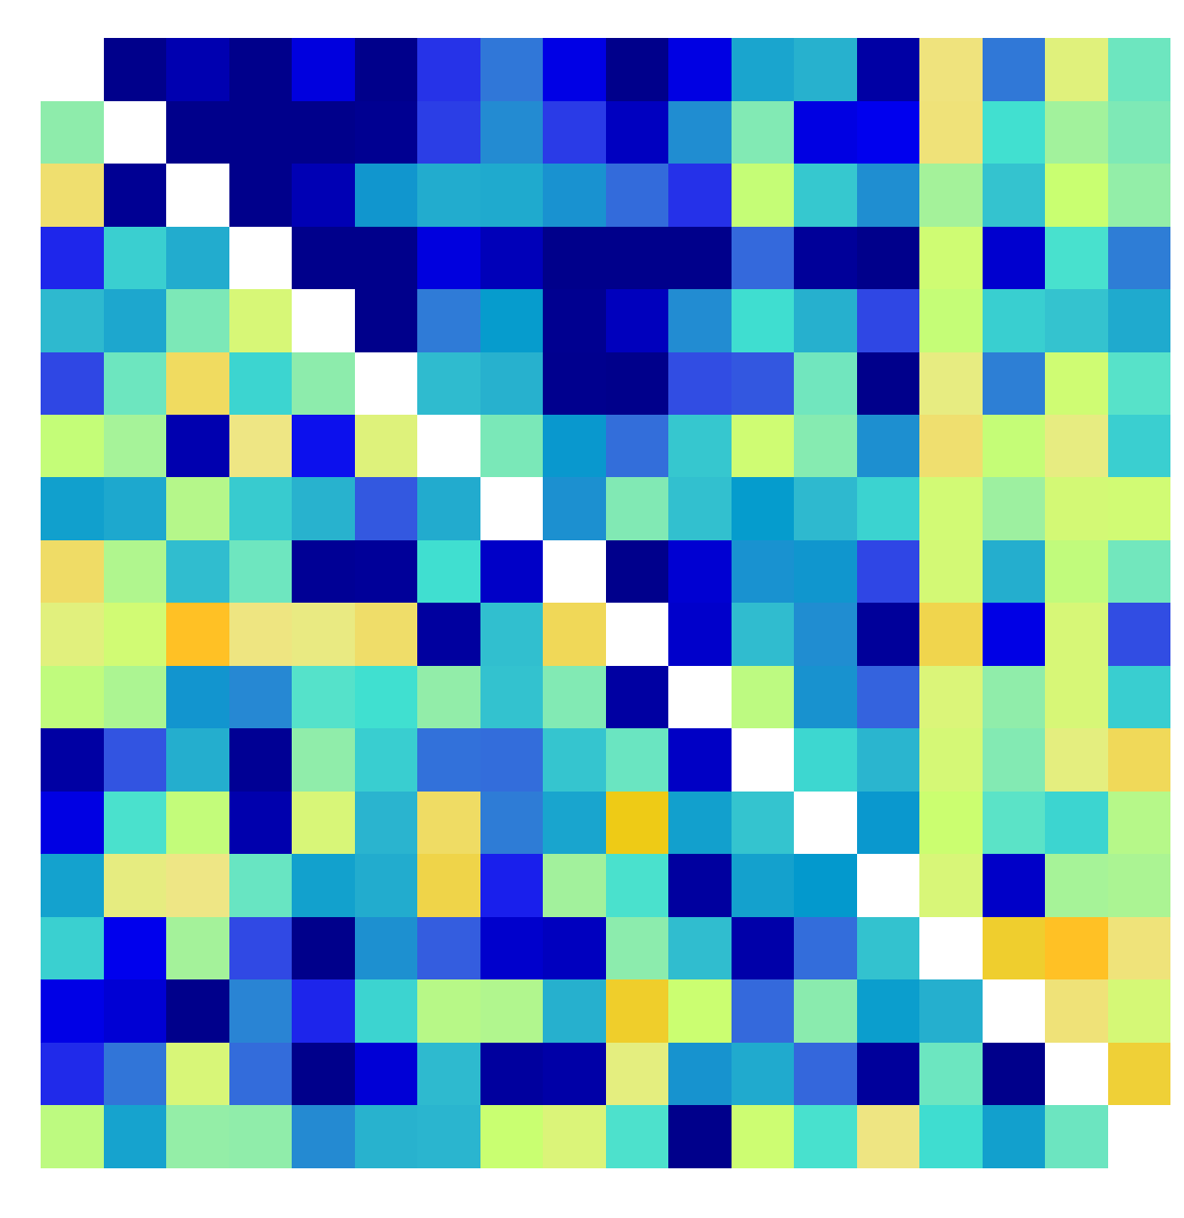
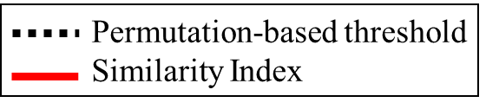
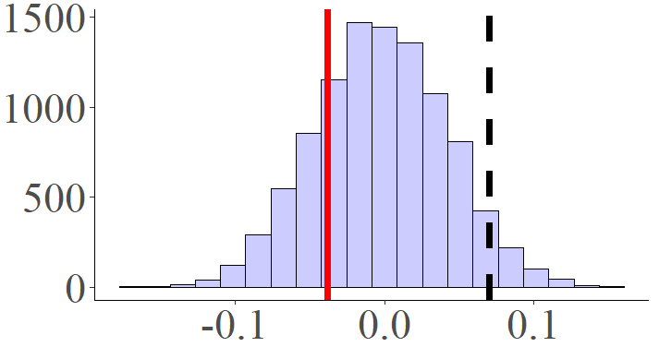
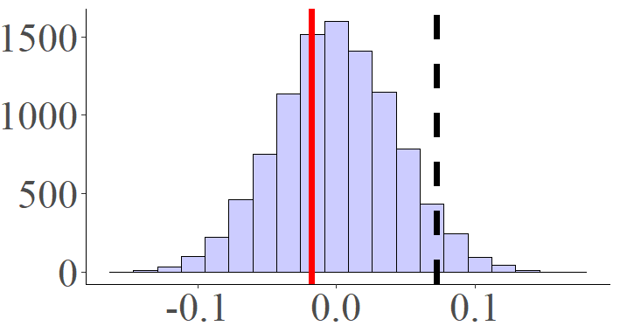
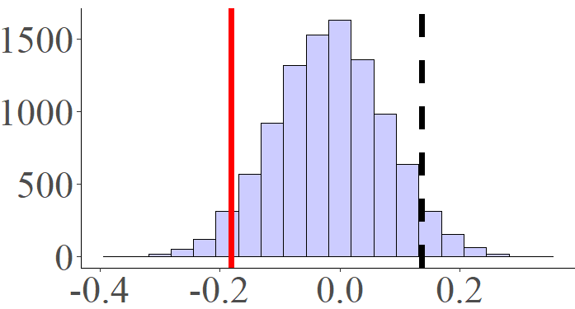
Permutation-based threshold
Similarity Index
PPV Task
PSL Task
I Task
Low
High
Sorted by Arousal
High
Permutations
Similarity Index
Similarity Index
Similarity Index

Slide 2
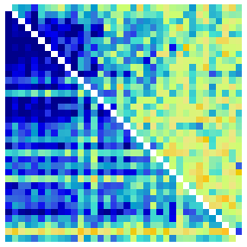
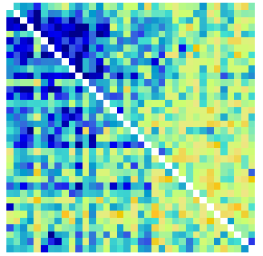
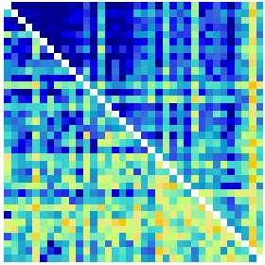
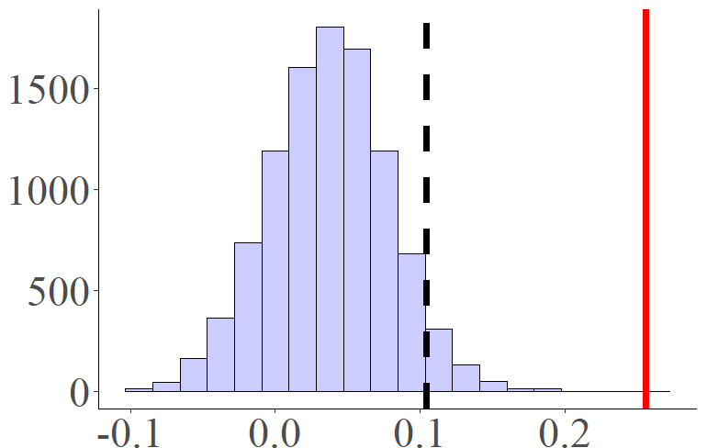
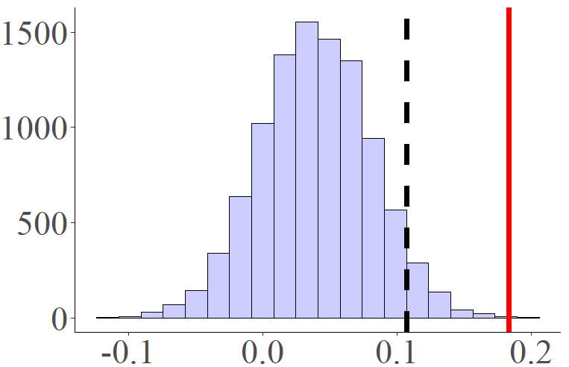
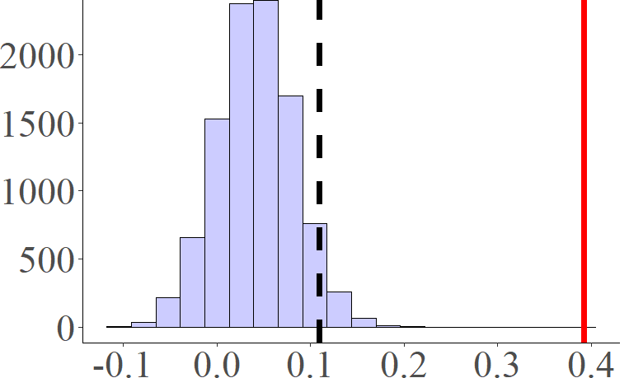
A
Low
High
B
C
Sorted by Arousal
High
Permutations
Similarity Index
Similarity Index
Similarity Index

Slide 3
Koppold et al., 2023

Slide 4
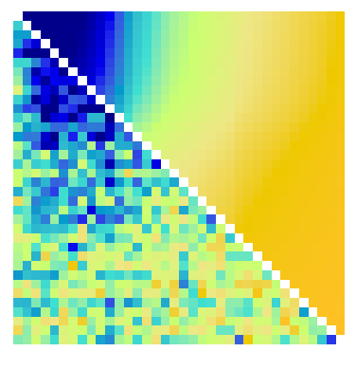
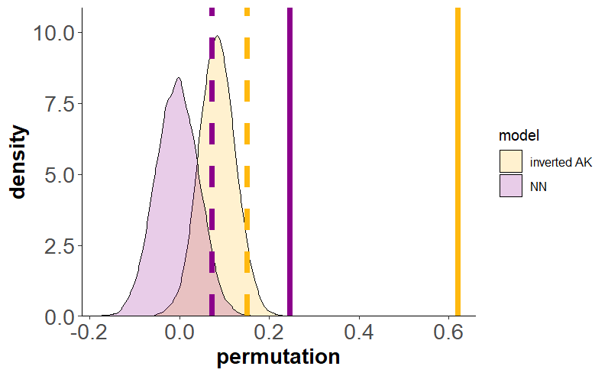
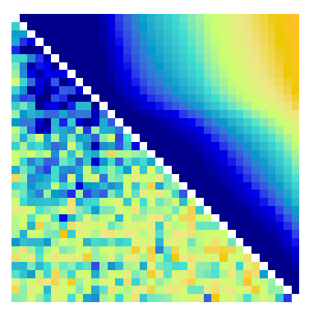
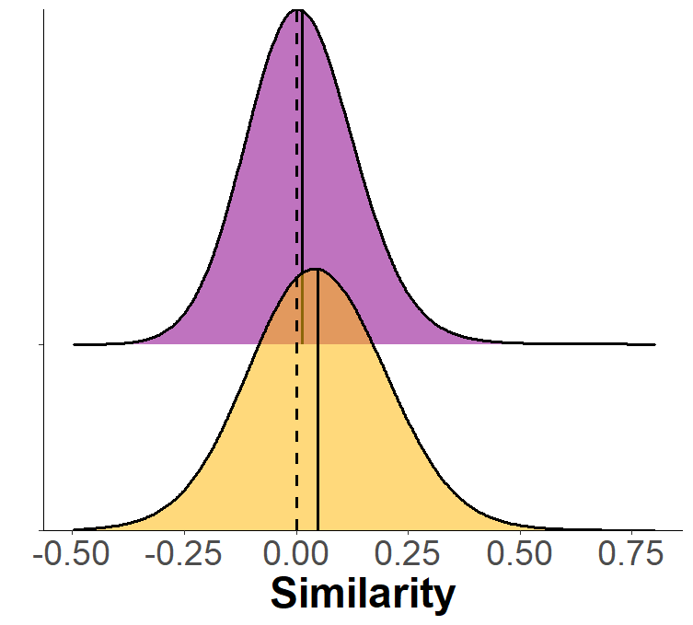
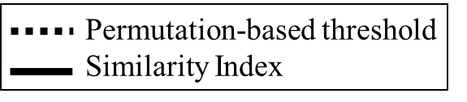
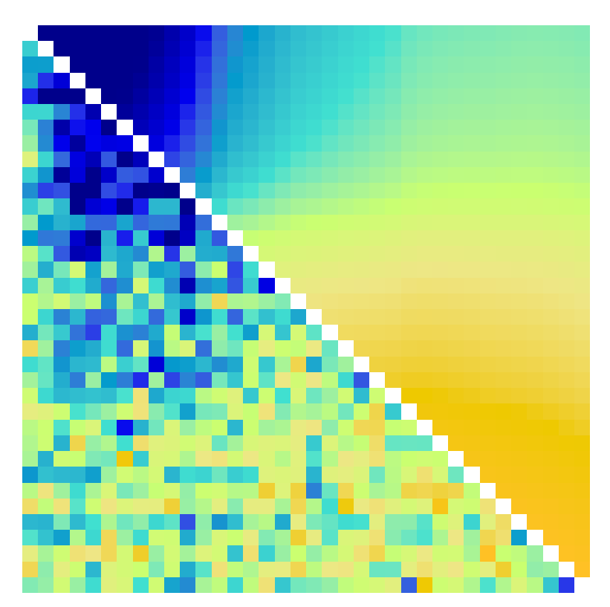
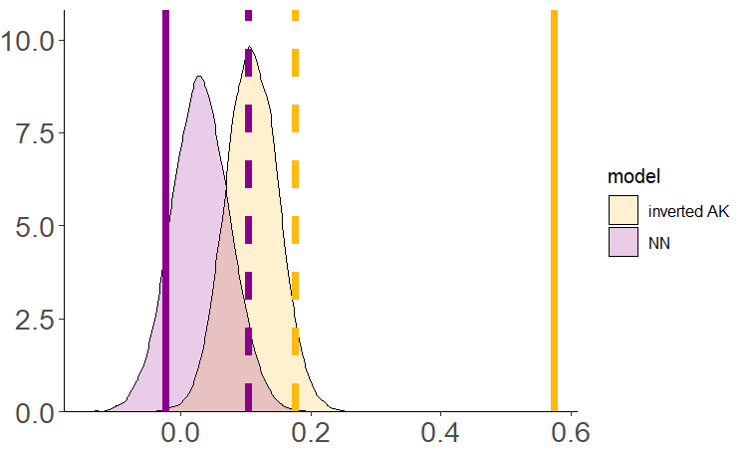
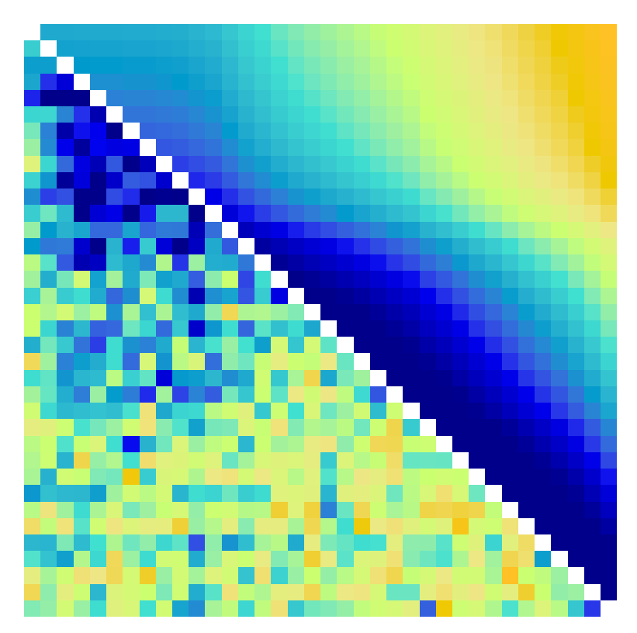
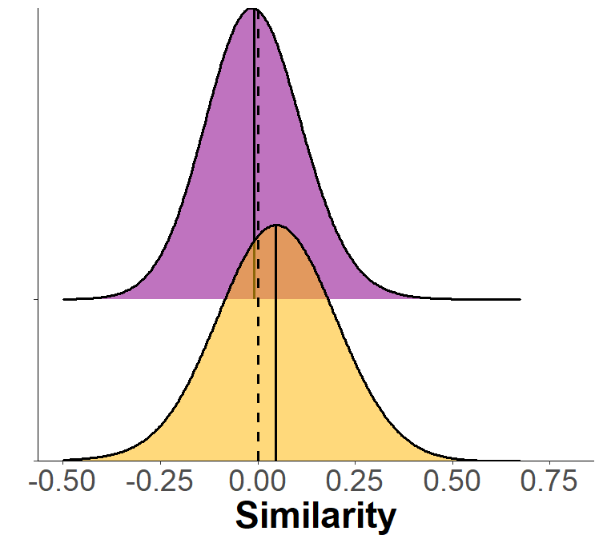
Permutation-based threshold
Similarity Index
RSM of SCR (low diagonal) & Inverted AK model
RSM of SCR (low diagonal) & NN model
Low
High
Inverted AK
NN
Sorted by Arousal
High
B
Inverted AK
NN

Slide 5
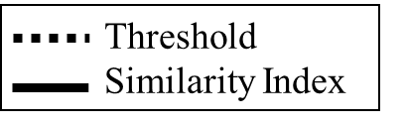

Threshold
Similarity Index
Inverted AK
NN
A
High
C
Low
Sorted by Arousal
Density
High
Similarity Index
B
D
Similarity Index

Slide 6
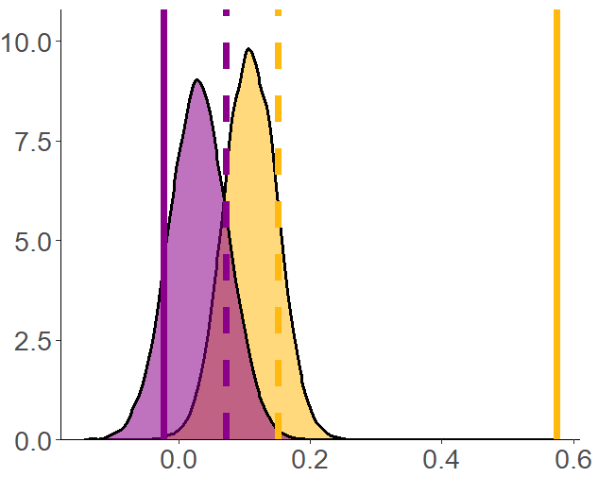
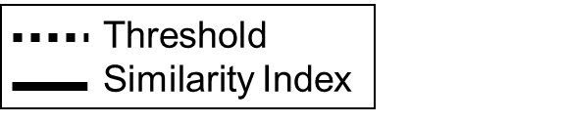

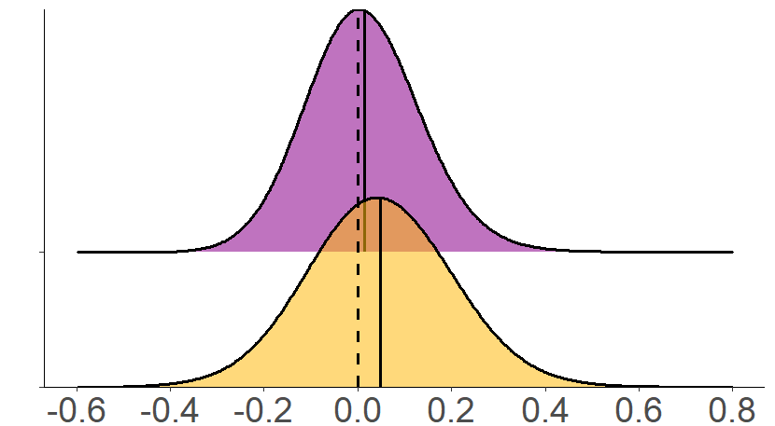
Threshold
Similarity Index
Permutation-based threshold
Similarity Index
NN
Inverted AK
A
C
Low
High
Sorted by Arousal
Density
High
B
D
Low
Sorted by Arousal
Models
High
Similarity Index

Slide 7
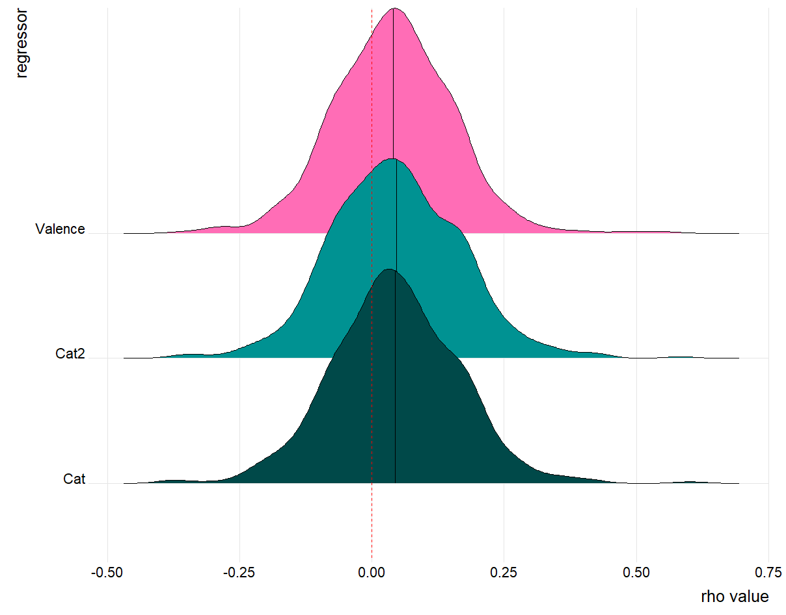
Permutation-based threshold
Similarity Index
A
Low
High
C
Inverted AK
NN
Sorted by Arousal
High
B
D

Slide 8
PPV Ventura-Bort et al., 2022

Slide 9
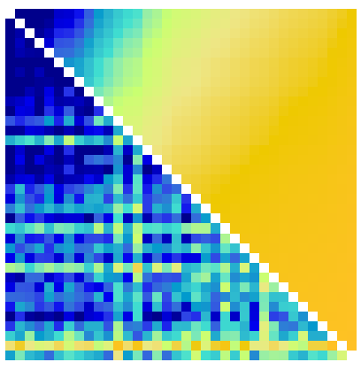
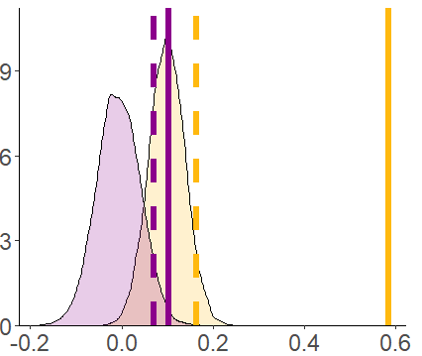
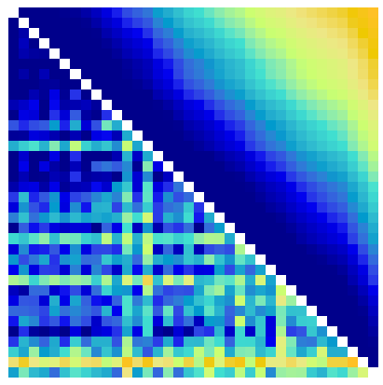
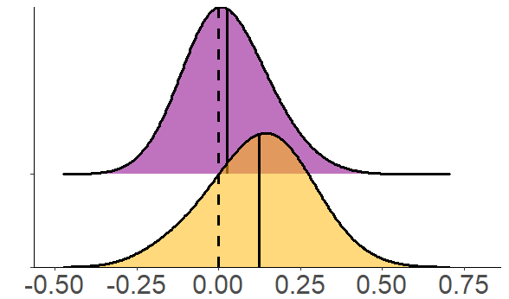
A
Low
High
C
Sorted by Arousal
Density
High
Similarity Index
B
D
Similarity Index

Slide 10
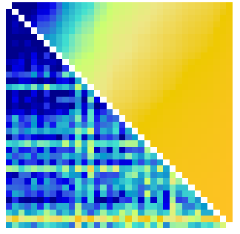
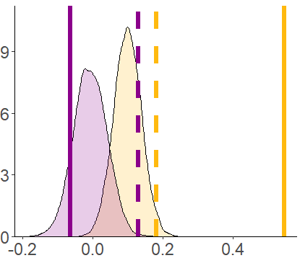
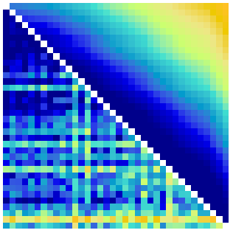
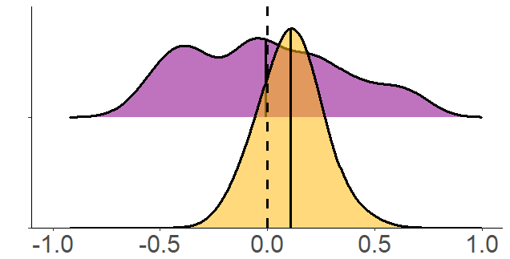
A
Low
High
C
Sorted by Arousal
Density
High
Similarity Index
B
D
Similarity Index

Slide 11
PSL Ventura-Bort et al., 2022

Slide 12
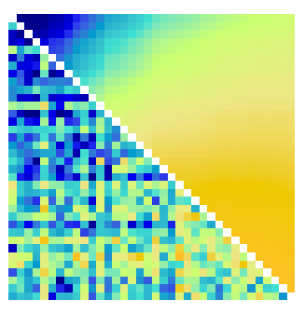
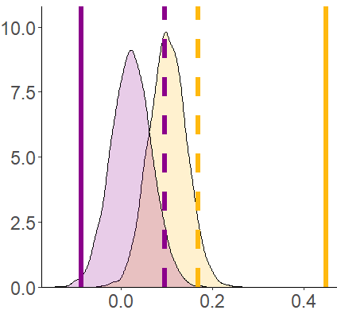
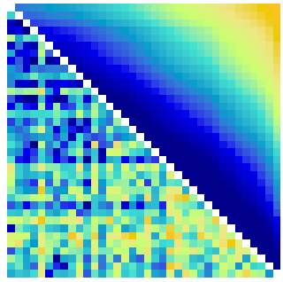
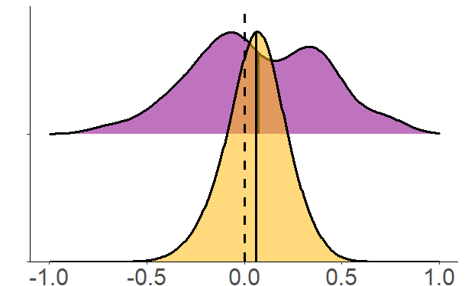
A
Low
High
C
Sorted by Arousal
Density
High
Similarity Index
B
D
Similarity Index

Slide 13
I Ventura-Bort et al., 2022

Slide 14
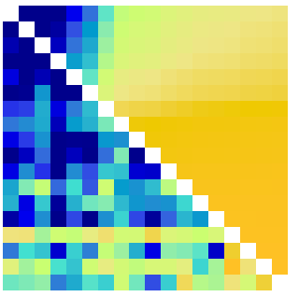
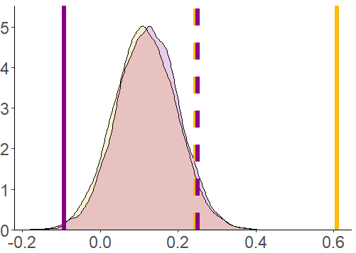
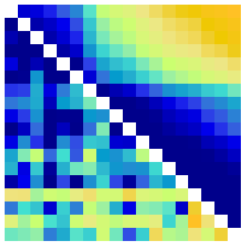
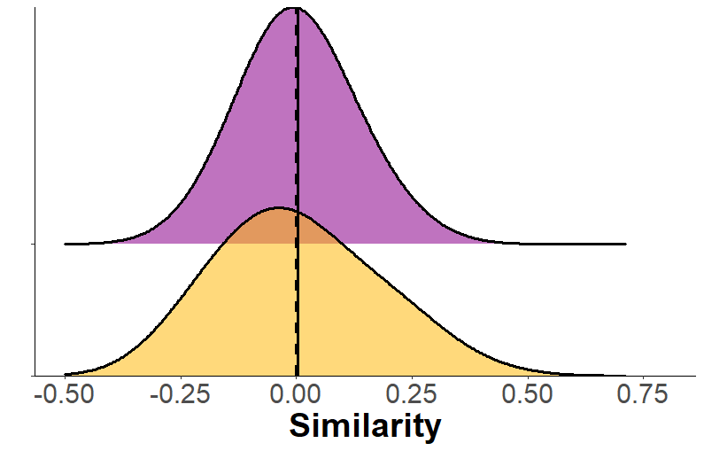
A
Low
High
C
Sorted by Arousal
Density
High
Similarity Index
B
D
Similarity Index

Slide 15
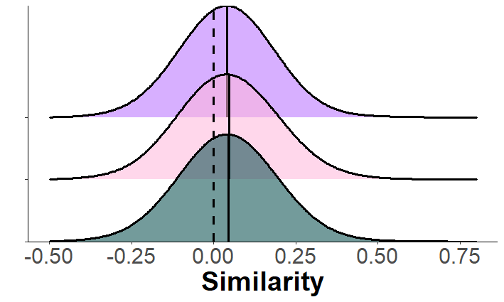
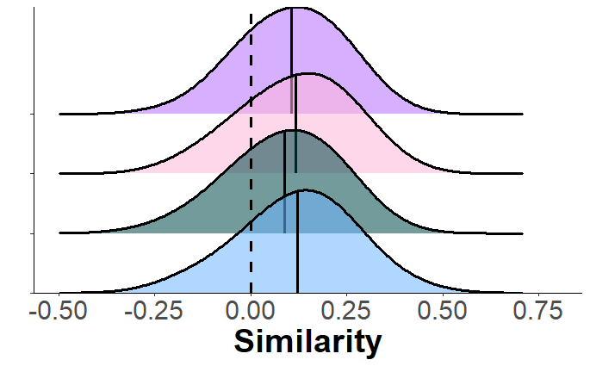
A
B
PPV from discovery sample
PPV from replication sample
Valence-based dimensional
Arousal-based categorical
Valence-based categorical
Time-based
B

Slide 16
Ventura-Bort pPV Startle

Slide 17
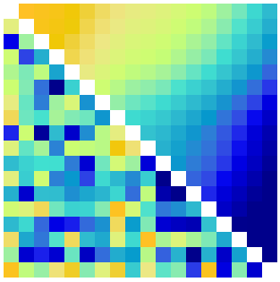
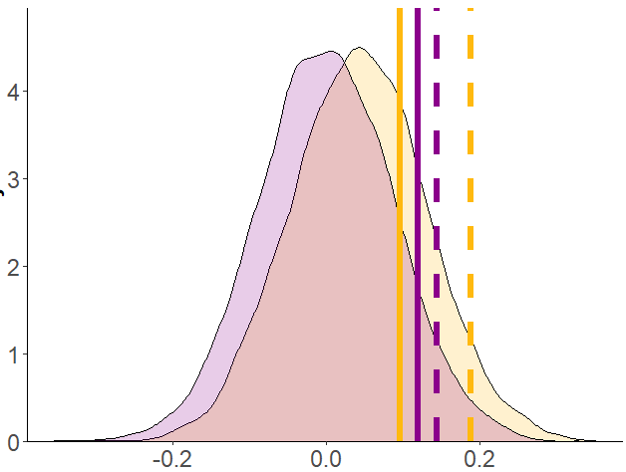
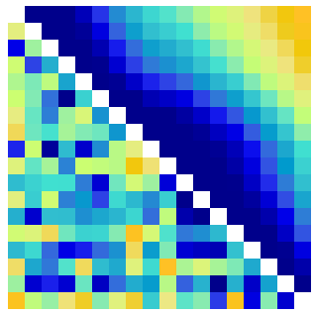
A
Low
High
C
Sorted by Valence
Density
High
Similarity Index
B
D
AK
NN
Similarity Index

Slide 18
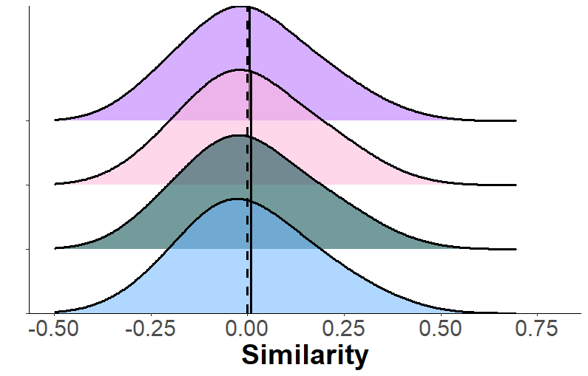
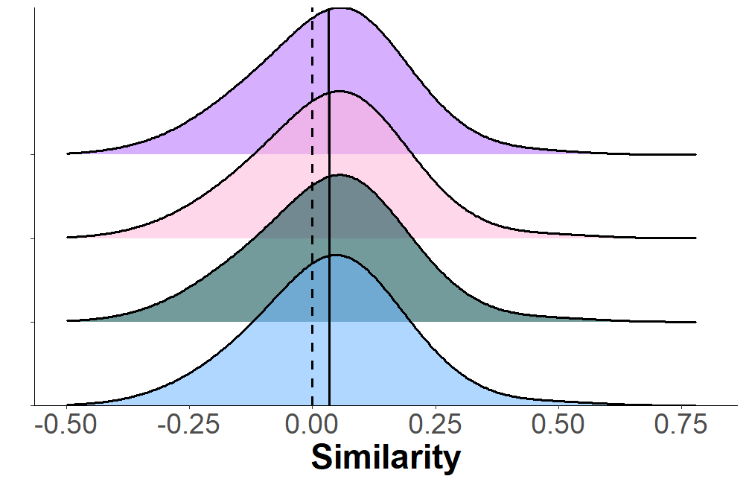
PPV from discovery sample
PPV from replication sample
PSL from replication sample

Slide 19
Ventura-Bort PSL Startle

Slide 20




A
Low
High
C
Sorted by Valence
Density
High
Similarity Index
B
D
AK
NN
Similarity Index

Slide 21
Ventura-Bort I Startle

Slide 22




A
Low
High
C
Sorted by Valence
Density
High
Similarity Index
B
D
AK
NN
Similarity Index

Slide 23

EMG

Slide 24




Threshold
Similarity Index
Permutation-based threshold
Similarity Index
NN
Inverted AK
A
C
Low
High
Sorted by Valence
Density
High
NN
AK
B
D
Low
Sorted by Valence
Models
High
Similarity Index

