Slide 1


Comparing RSM construction method of SCR in relation to Arousal

Slide 2
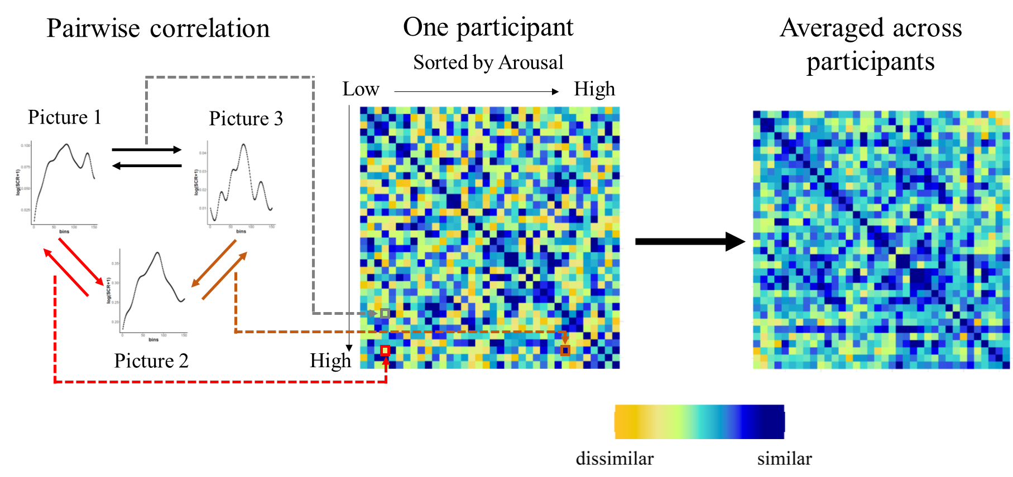
RSMs based on SCR Vectors
Similitudes are based on
Spearman or Pearson correlation values

Slide 3
RSMs based on SCR amplitudes
.08 µS
.05 µS
.12 µS
Similitudes are based on:
MaxValue- abs(Amplitude 1 – Amplitude 2):

Slide 4
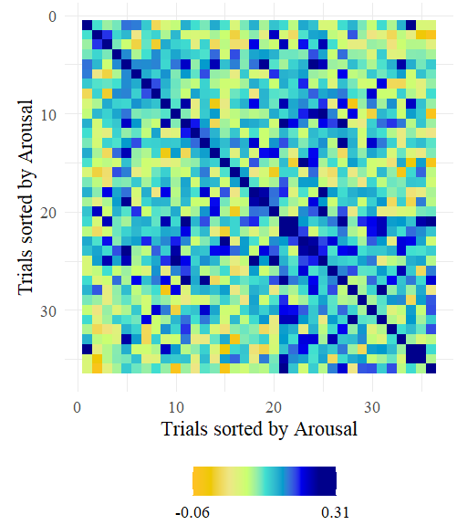
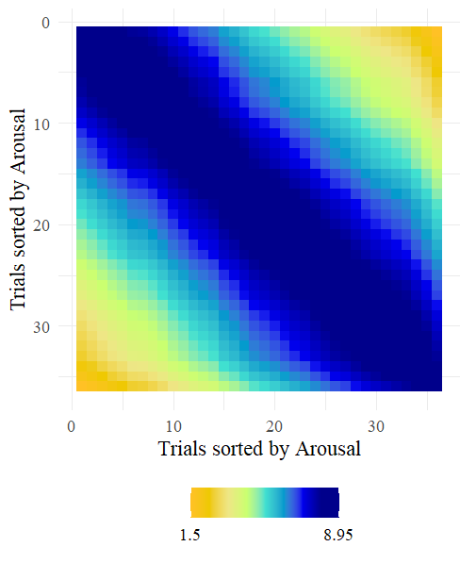
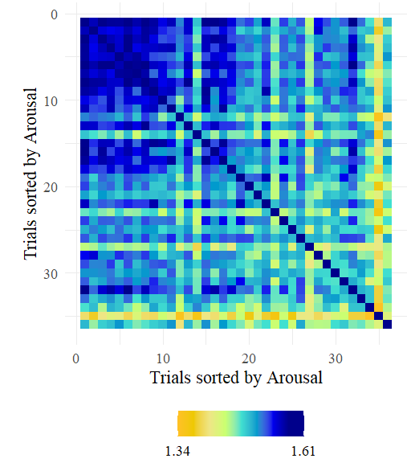
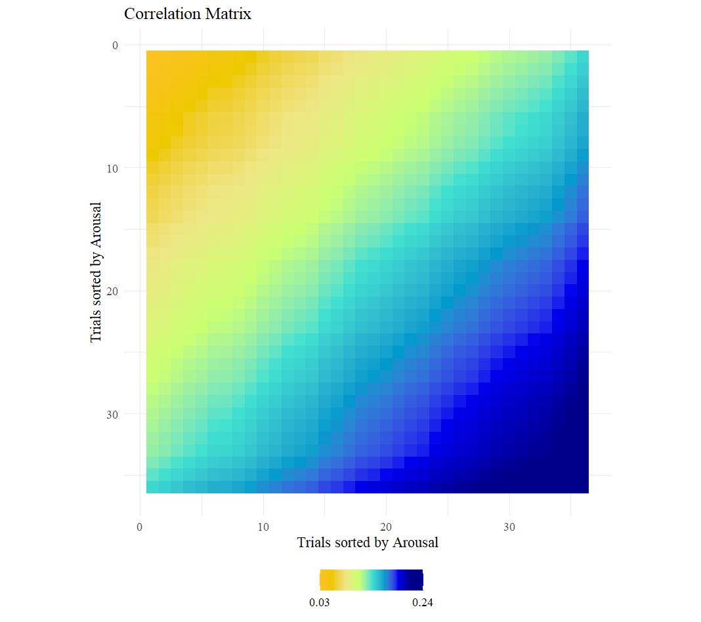
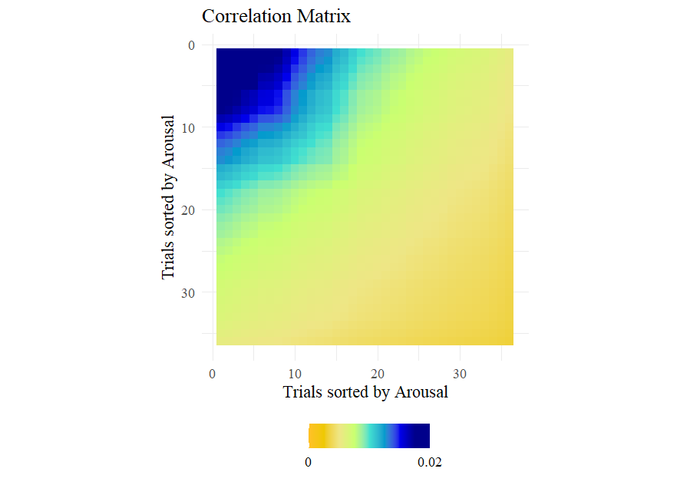
Comparison of correlation matrices: Passive Picture Viewing Task
RSM based on Arousal Ratings
RSM based on vector
RSM based on Amplitudes (log)
RSM based on Arousal Ratings AK and invAK
AK: mean(Amplitude1,Amplitude2)/Nvariables
invAK: 1/AK

Slide 5
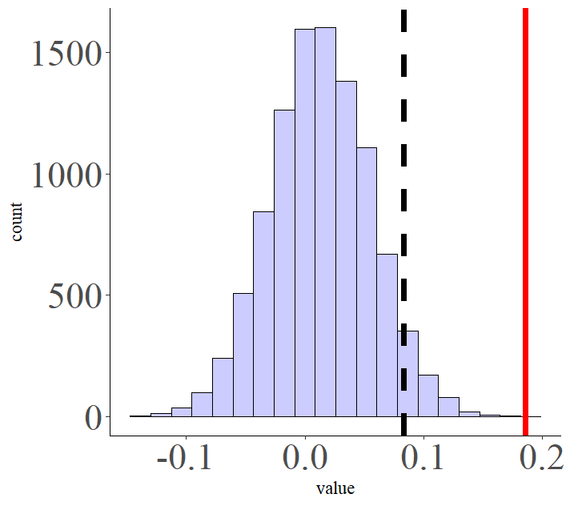
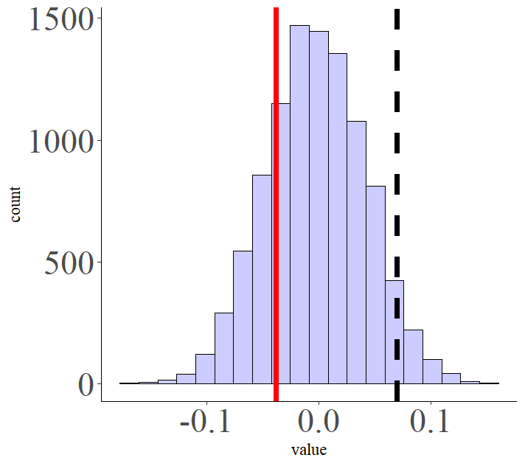
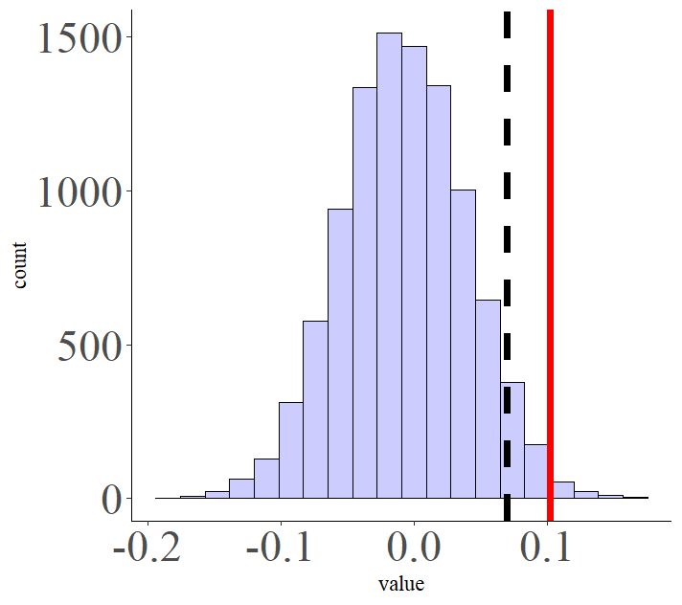
Comparison of correlation matrices: Passive Picture Viewing Task
RSM based on vector
RSM based on Arousal Ratings
RSM based on vector
RSM based on Amplitudes
RSM based on Amplitudes
RSM based on Arousal Ratings

Slide 6
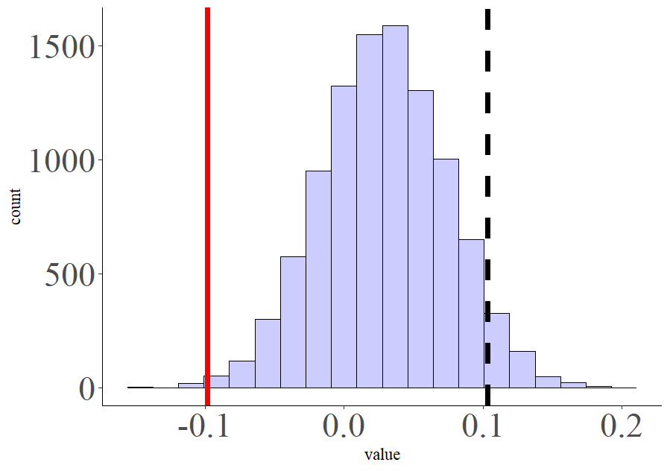
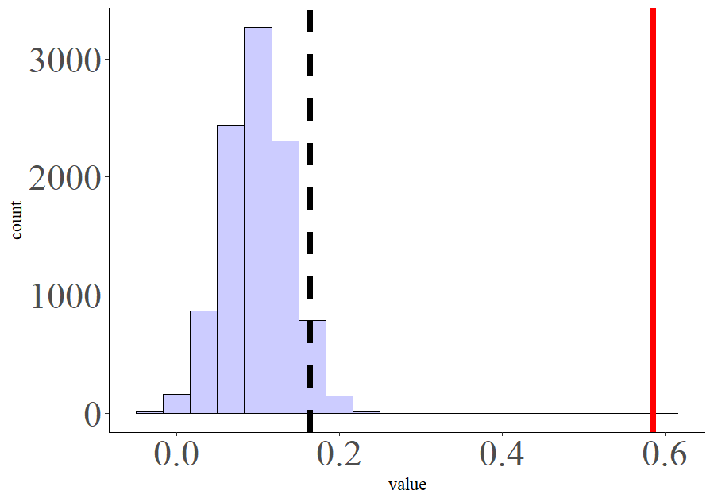
Comparison of correlation matrices: Passive Picture Viewing Task
RSM based on vector
RSM based on Arousal Ratings
invAK
RSM based on Amplitudes
RSM based on Arousal Ratings
InvAK

Slide 7
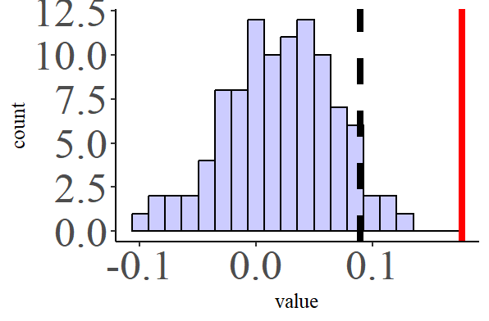
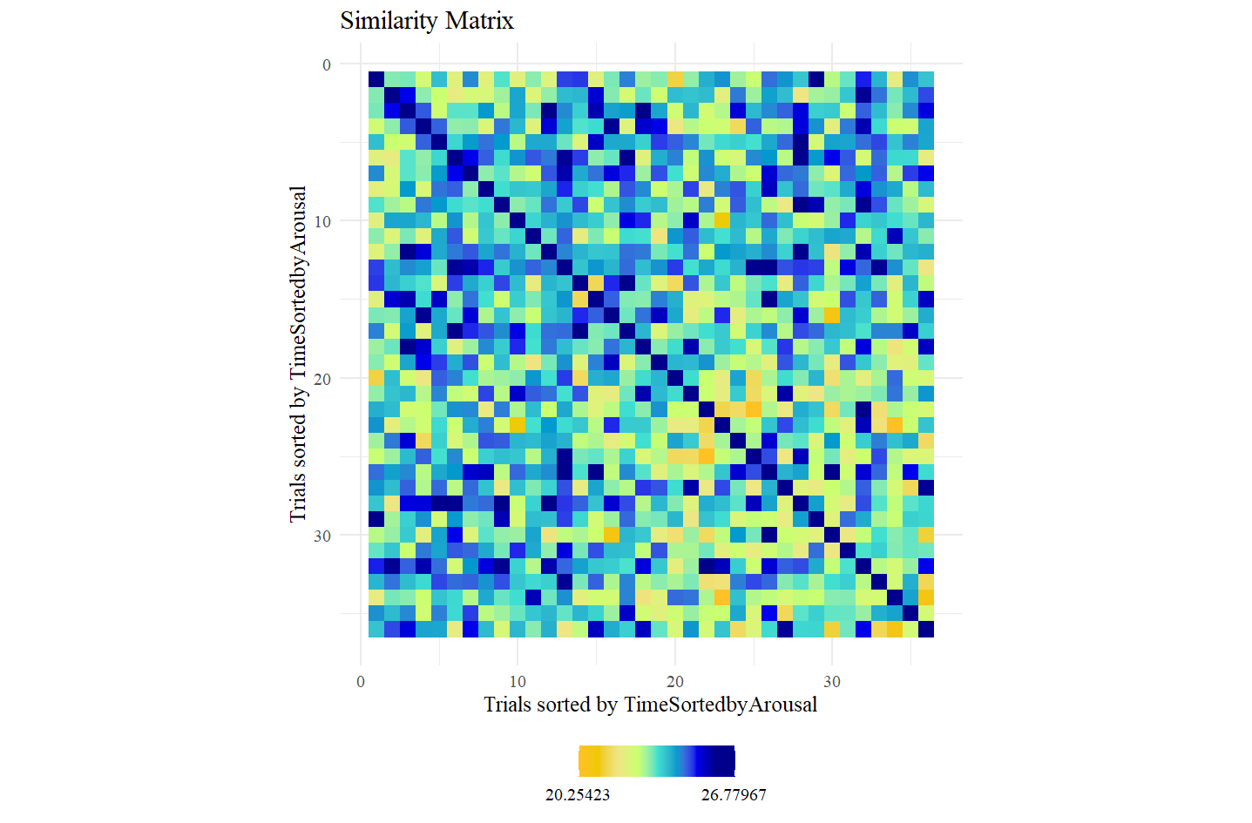
Other Models: Model Time

Slide 8
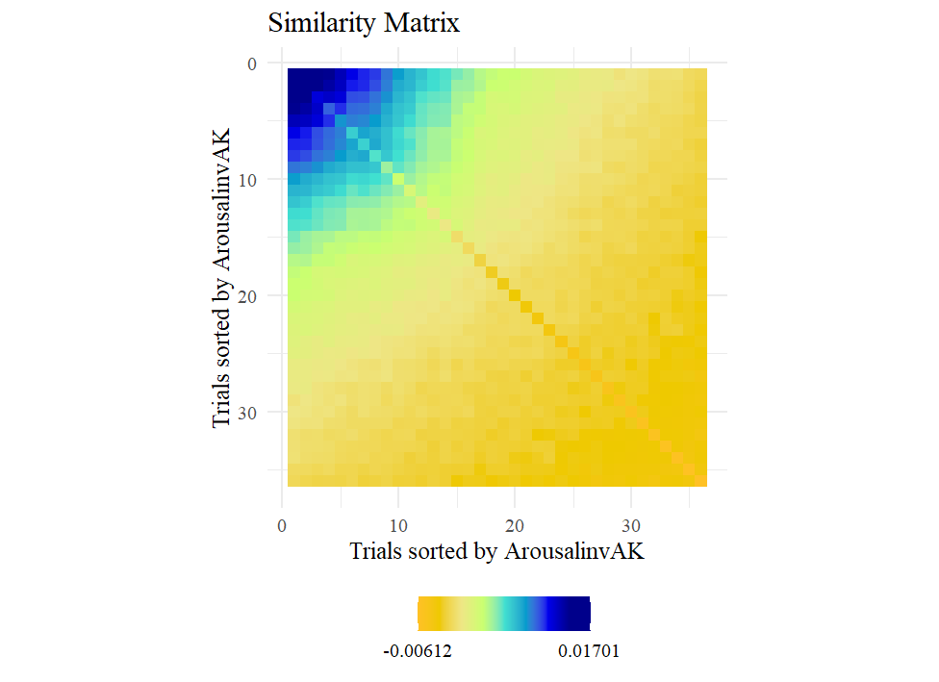
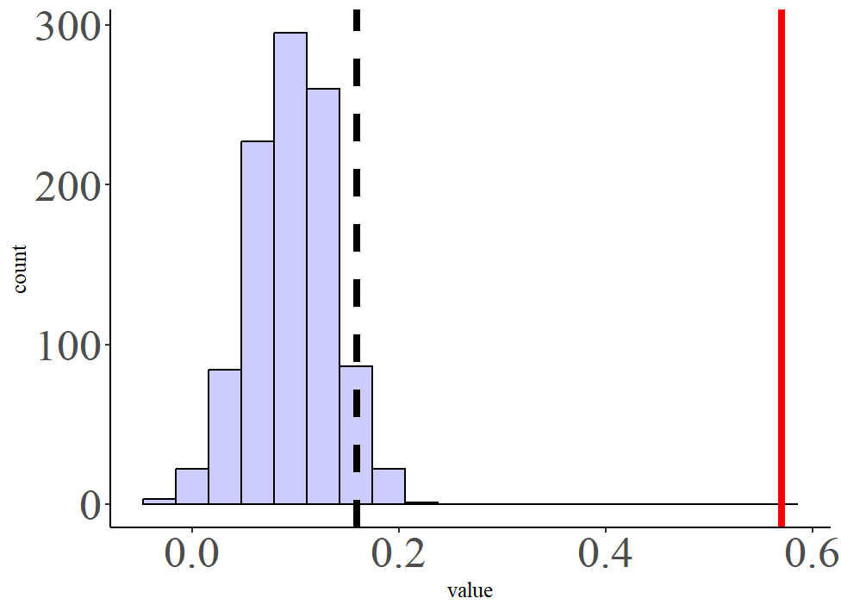
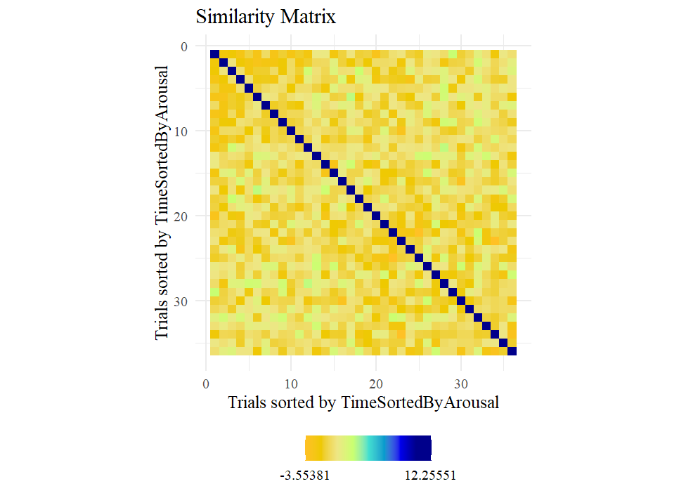
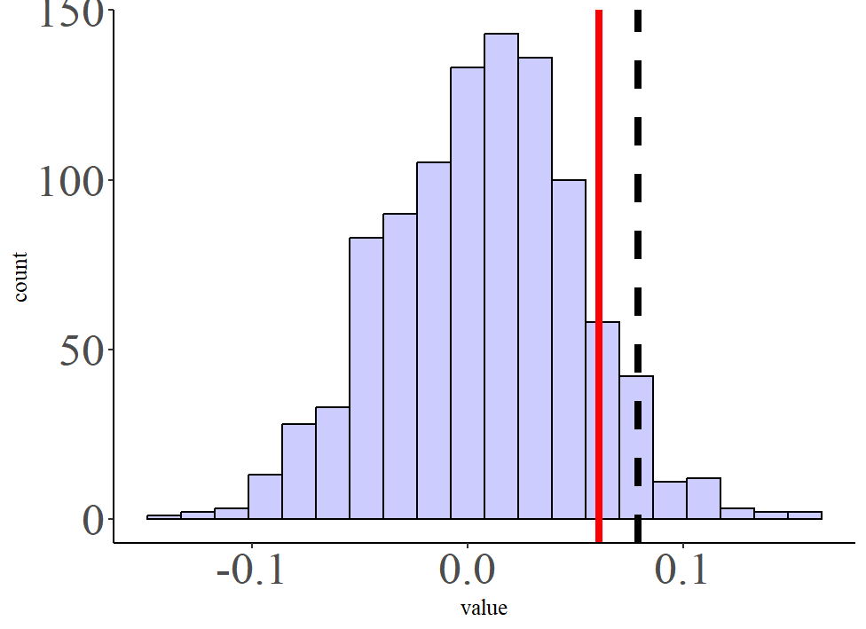
Regressing Arousal and Time

Slide 9
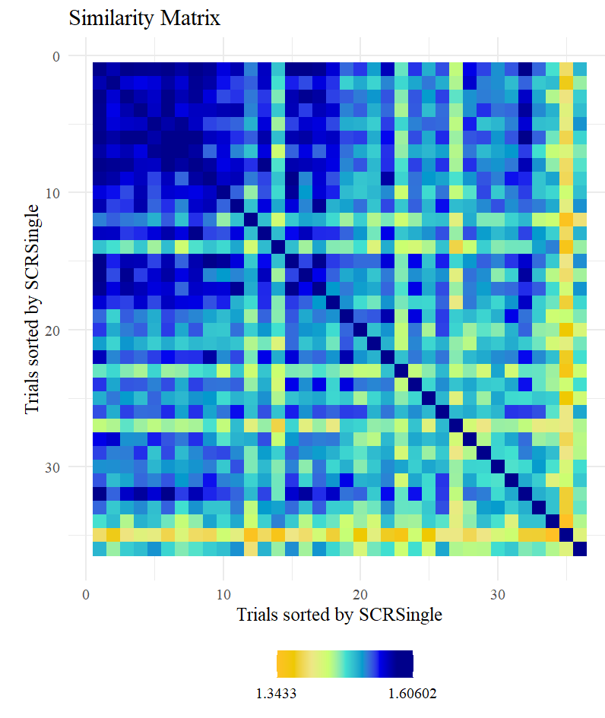
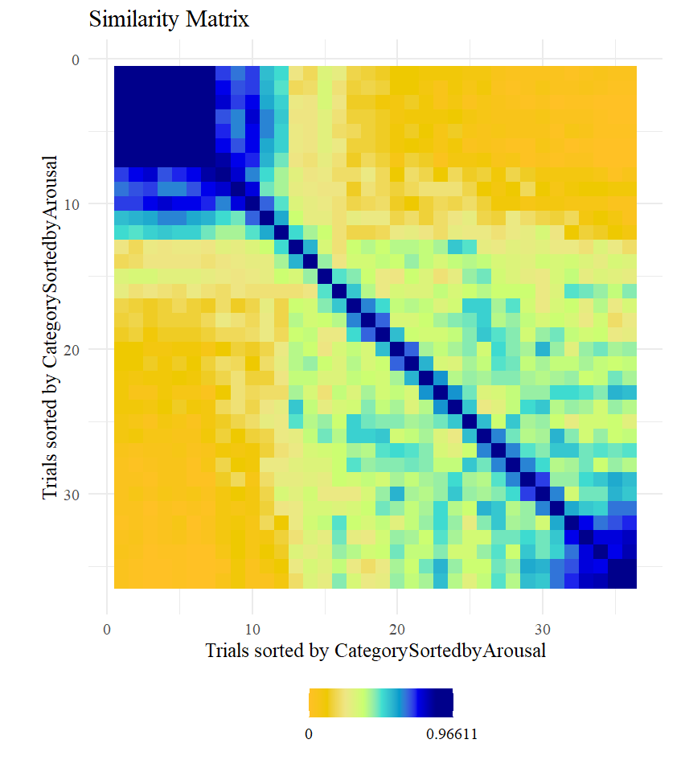
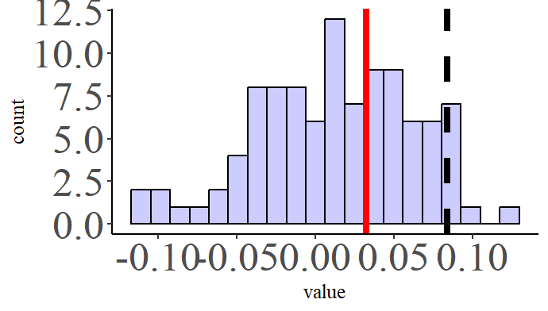
Model Category

Slide 10
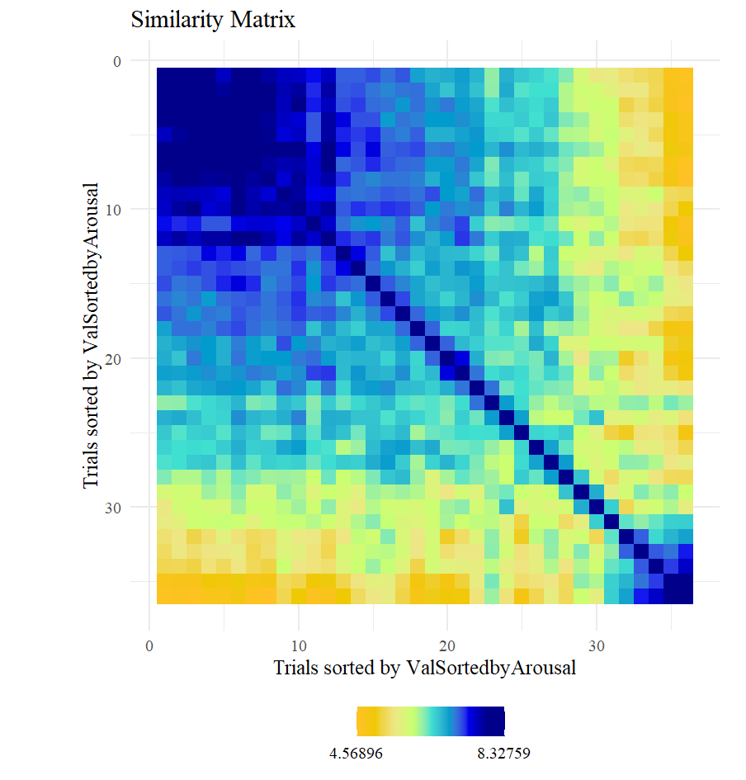
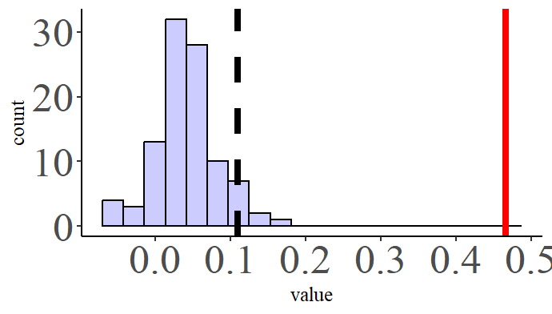
Model Valence

Slide 11
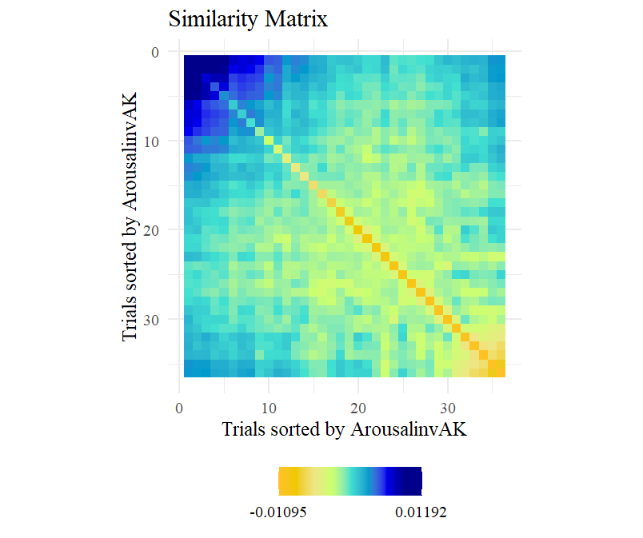
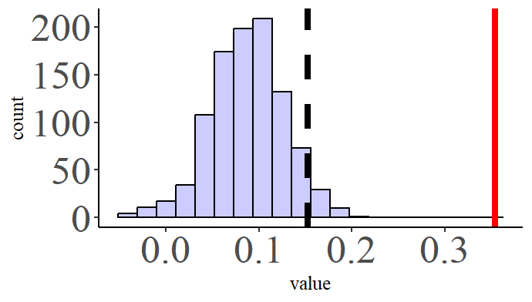
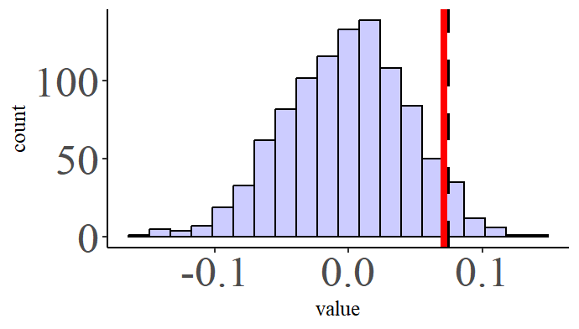
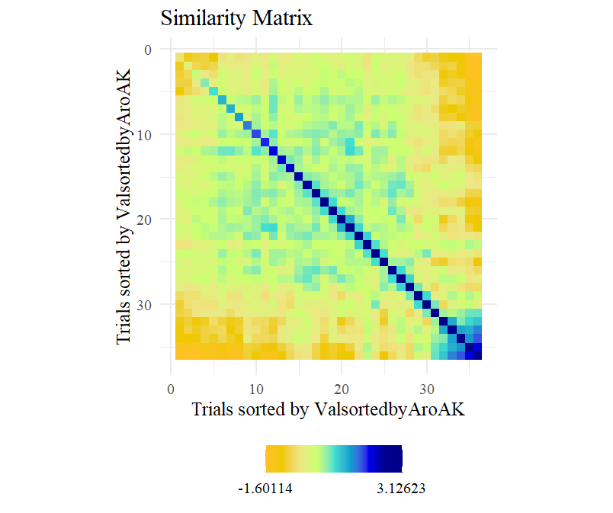
Regressing Arousal and Valence

Slide 12
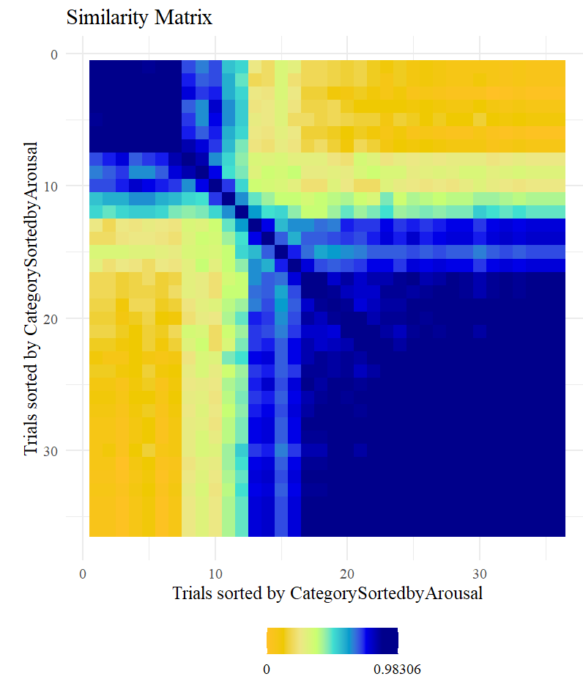
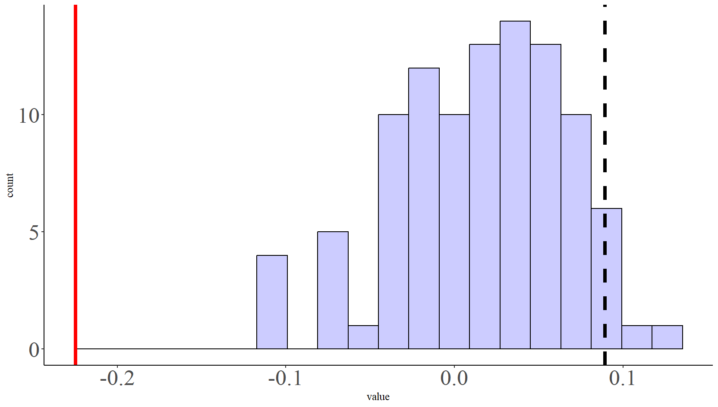
Model Category2 arousing non-arousing

Slide 13
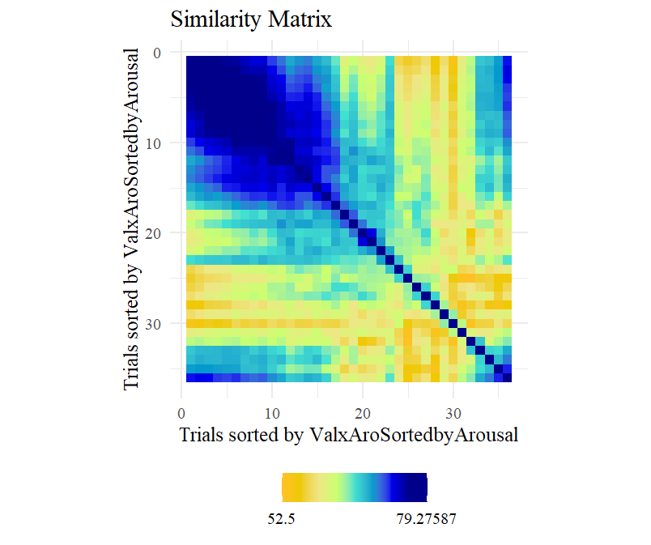
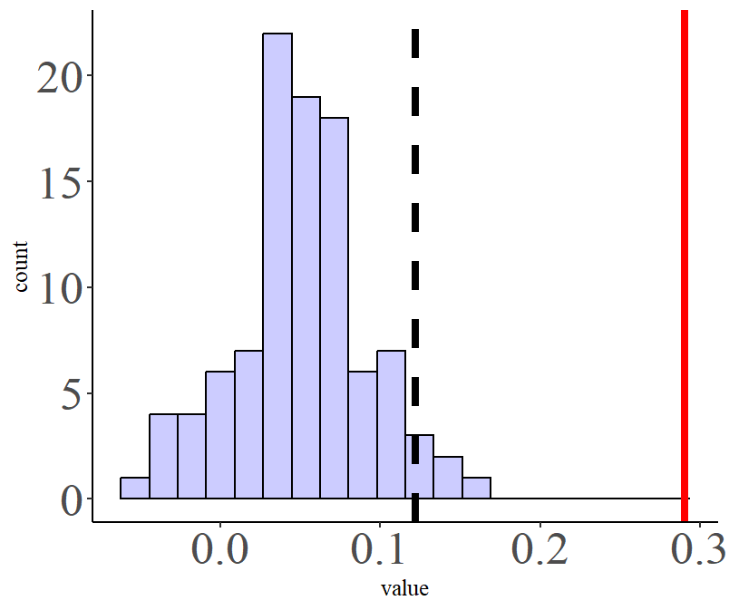
Model Valence x Aro

Slide 14
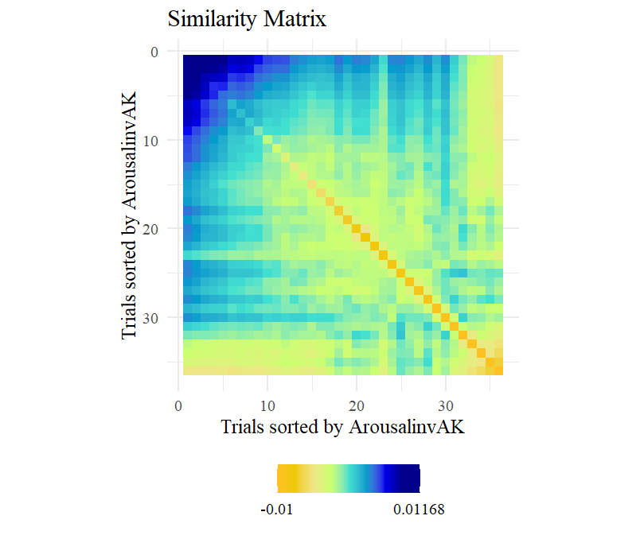
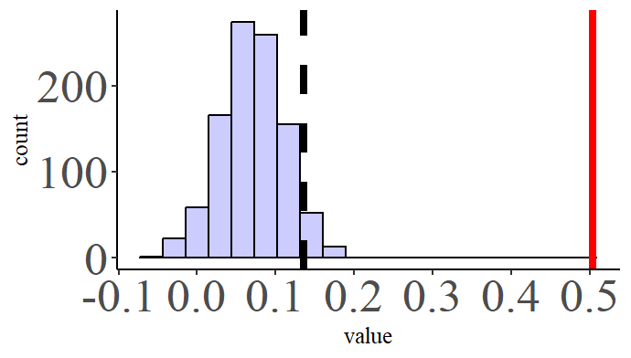
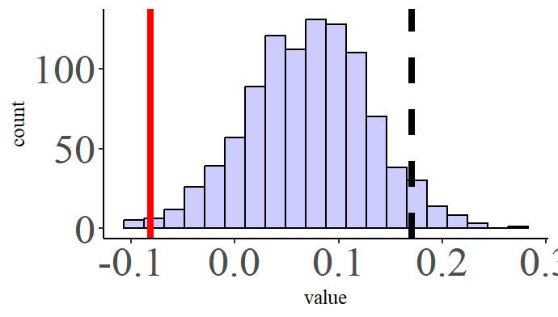
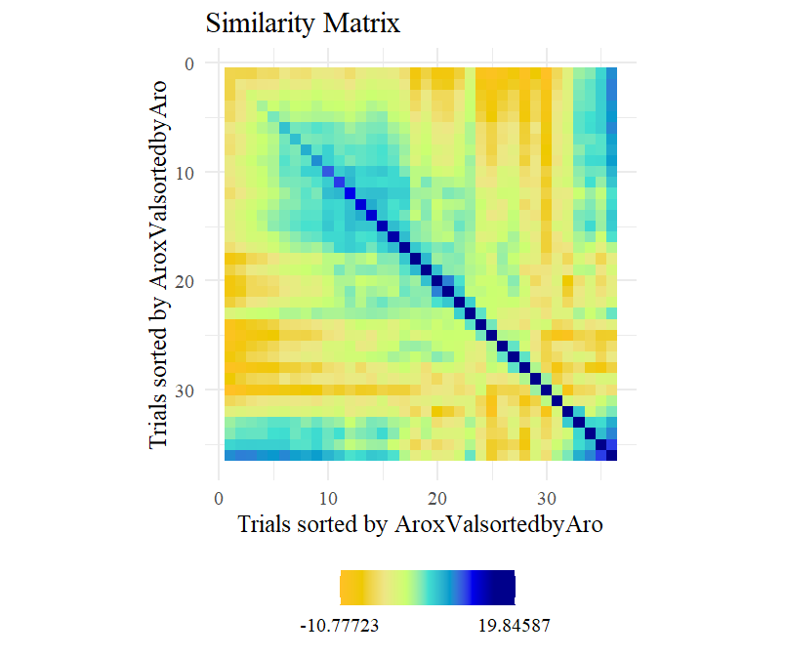
Regressing ArousalinvAK and ValxAro

Slide 16
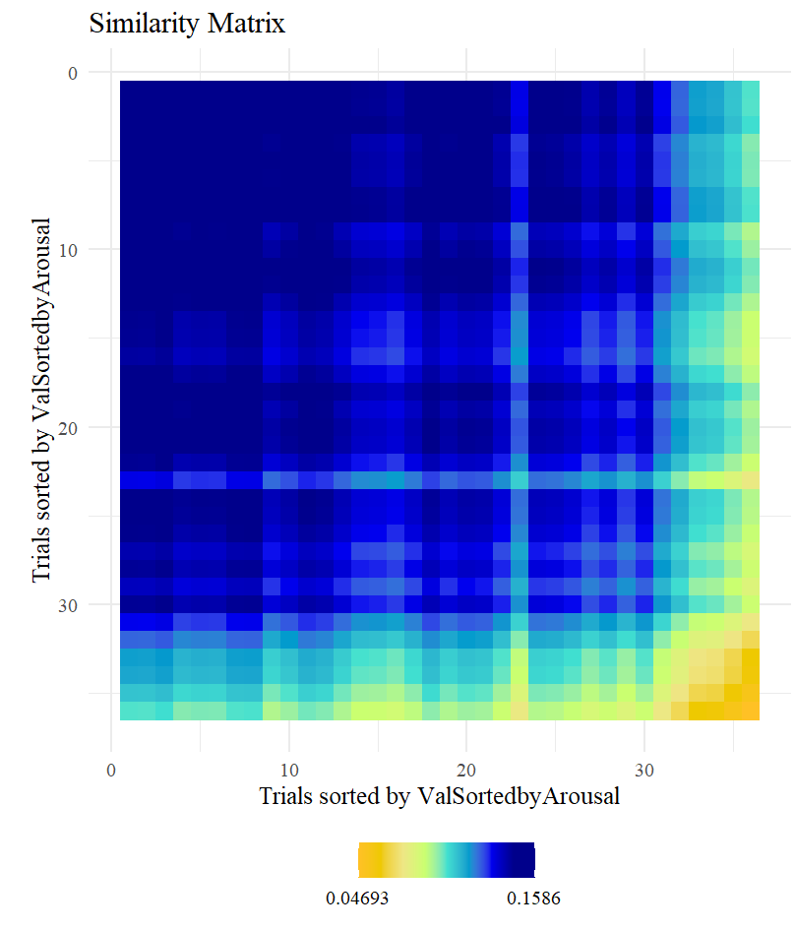
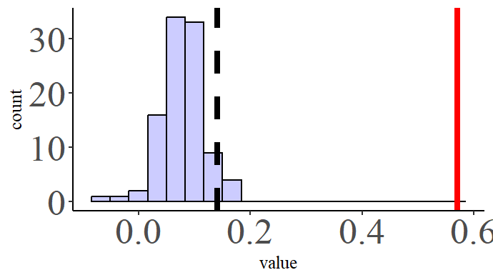
Model Valence AK

Slide 17
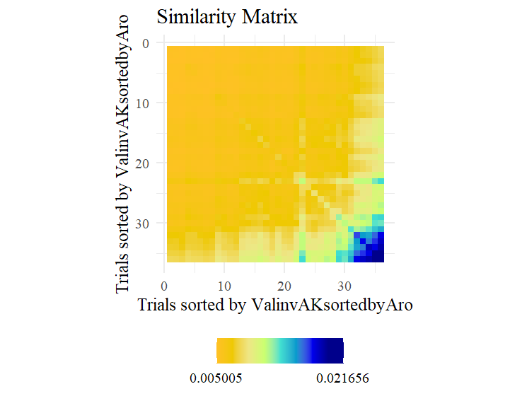
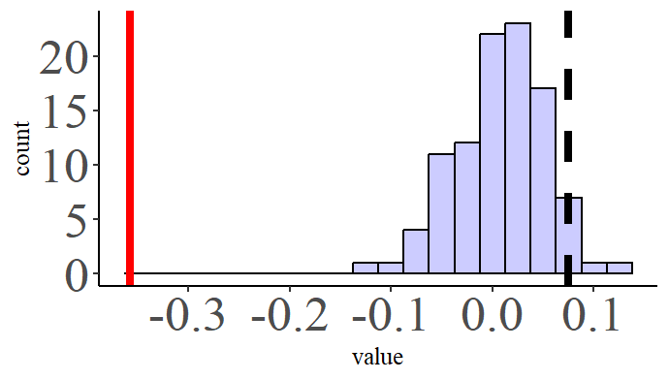
Model Valence invAK

Slide 18
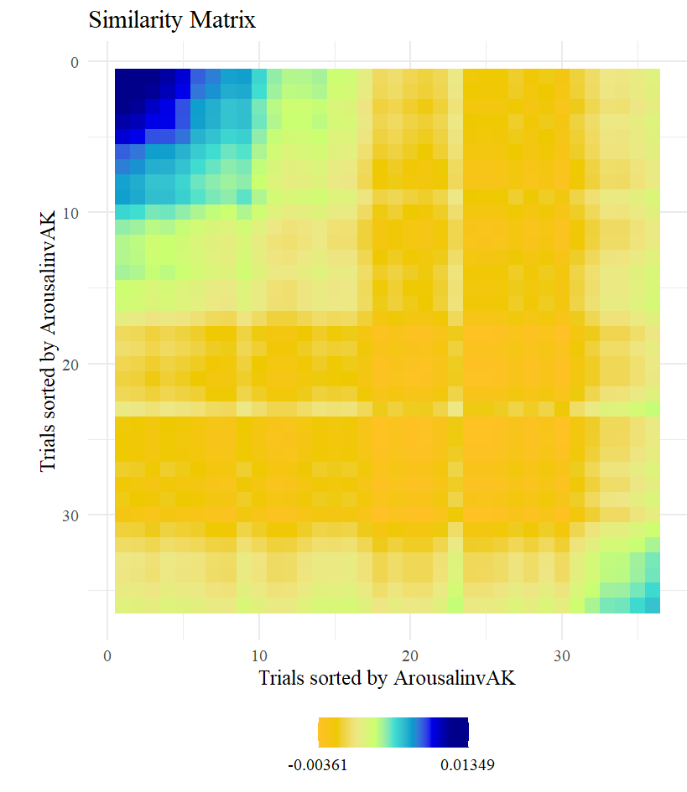
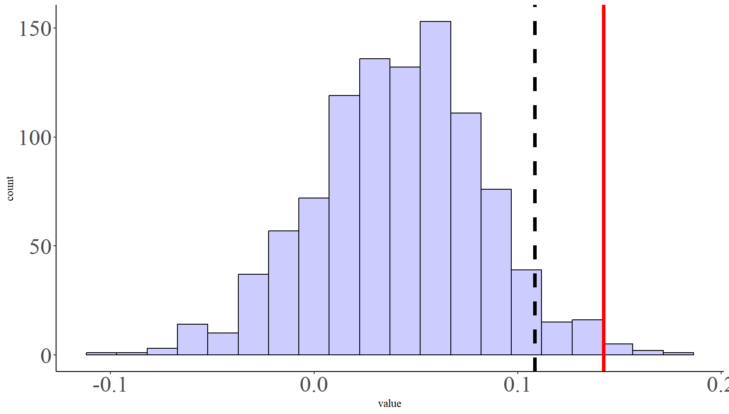
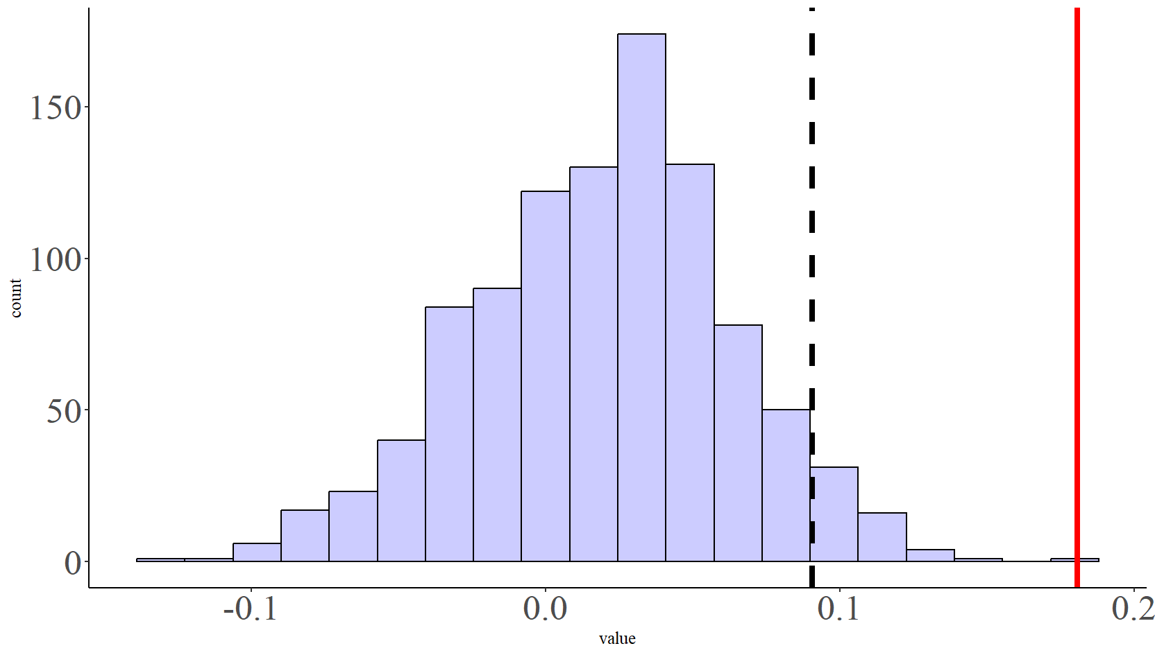
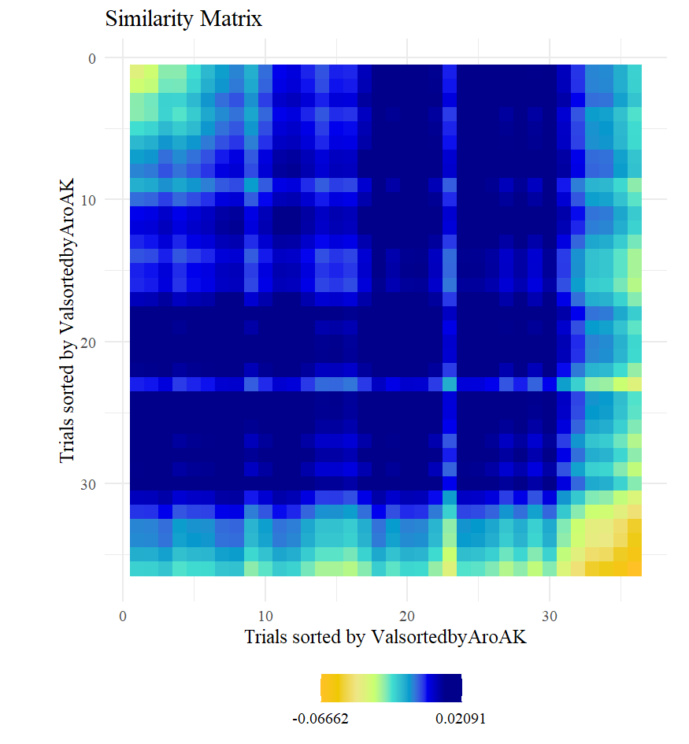
Regressing Arousal and Valence

