Slide 1

Center of Experimental Medicine
Department of Systems Neuroscience
Data Transformation
Meeting #2 poll results, decisions & teams
01-09-2023
Alina Koppold
al.koppold@gmail.com

Slide 2
to be discussed today
poll results n = 19
1
poll results n = 19
2
next steps
3
team structure
& regular meeting

Slide 3
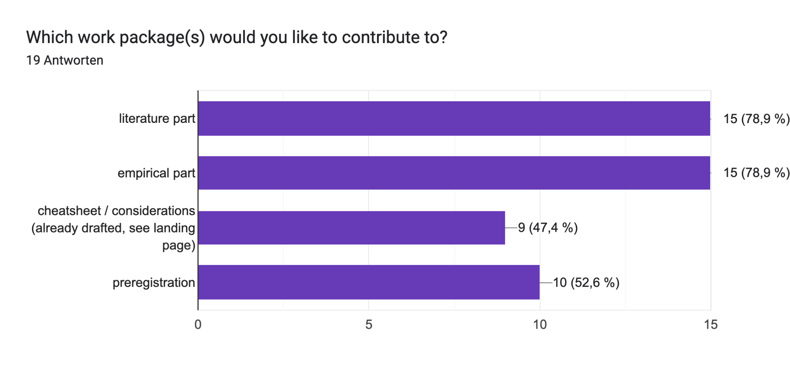
Contribution to work-packages

Slide 4
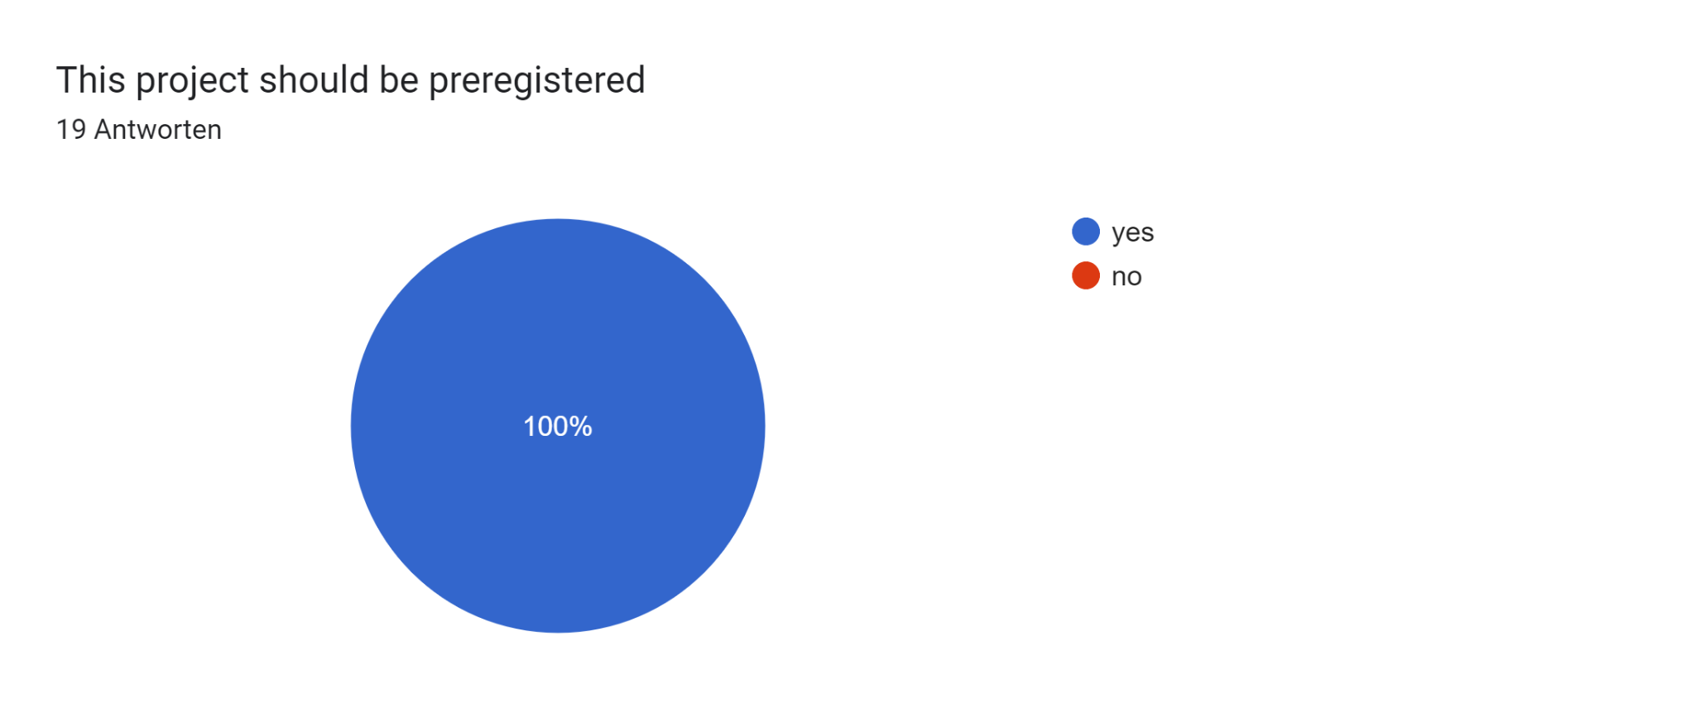
decision 1
preregistration: yes
Notes:
all parts on one prereg
or prereg literature part and empirical part / cheat sheet separately

Slide 5
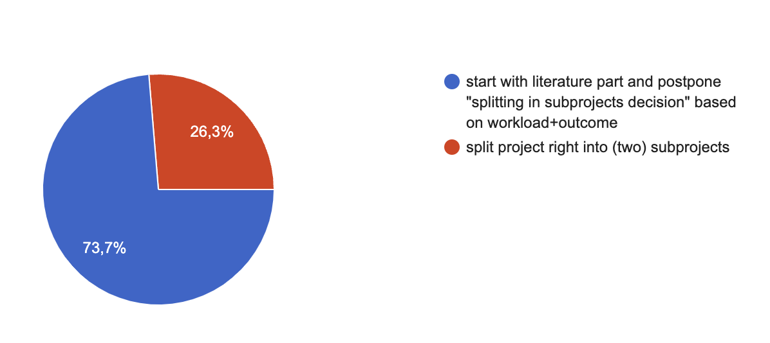
decision 2
splitting decision postponed
Splitting the project into two subprojects?

Slide 6
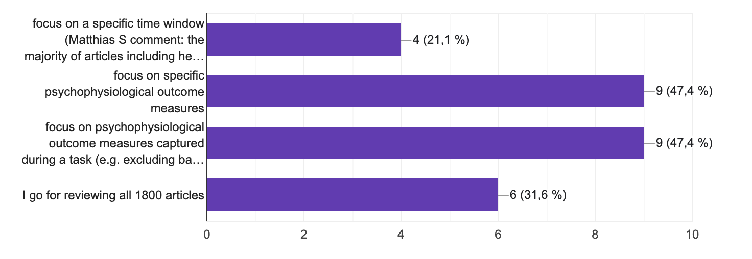
decision 3
exclusion of resting state/ baseline measurements; hair/ saliva cortisol
Setting the scope of the literature part

Slide 7
decision 3
which phy. outcome measures? heart rate / + variability, skin conductance (response/level), Eye?, surface EMG (orbicularis oculi muscle, corrugator), less common measures (e.g. body sway)
Setting the scope of the literature part
Notes:
HR (BPM) HRV EMG SCR SCL EYE TRACKING PUPIL SIZE saliva cortisol hair cortisol body sway respiration corrugator

Slide 8
2
next steps
3
team structure
& regular meeting
team preregistration: remain in zoom after this meeting for organising the next steps
team empirical part + cheatsheet: meet soon
discuss the preparation of the database and
extension of the cheatsheet draft
regular big group meeting in the beginning of each month?
*** end
Notes:
extension of the draft e.g. how to handle outliers?

