Slide 1

Pipeline of analyzing RNA-seq data
based on DESeq
Aleksandra Kurowska
Setting Bioinformatics Pipelines
30th January 2024, KAUST

Slide 2

RNA-seq pipeline
Quality Control
Alignment
Annotation
Expression quantification
Data transformation
Differential expression
Functional enrichment
Visualization
fastq files

Slide 3
RNA-seq pipeline
Quality Control
Alignment
Annotation
Expression quantification
Data transformation
Differential expression
Functional enrichment
Visualization
Pre-processing
fastq files
Adapter trimming
Read quality filter
Read length filter
Genes annotation from a database
Mapping to a reference genome
Count matrix

Slide 4
RNA-seq pipeline
Quality Control
Alignment
Annotation
Expression quantification
Data transformation
Differential expression
Functional enrichment
Visualization
Processing in R with DESeq
fastq files

Slide 5

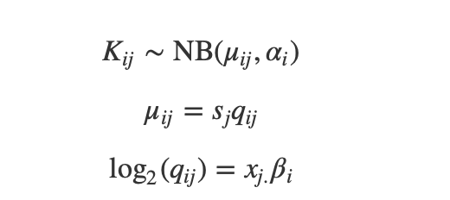


RNA-seq pipeline
Quality Control
Alignment
Annotation
Expression quantification
Data transformation
Differential expression
Functional enrichment
Visualization
Processing in R with DESeq
fastq files
1
Raw count matrix
2
estimation of size factors sj by estimateSizeFactors
estimation of dispersion αi by estimateDispersionsnegative
binomial GLM fitting for βi and Wald statistics by nbinomWaldTest
Generalized linear model GLM
3
overcoming the heteroskedasticity (variance of log fold changes depending on mean count) for genes with low count
Log fold change shrinkage for visualization and ranking
Notes:
Counts Kij for gene i, sample j are modeled using a negative binomial distribution with fitted mean μij and a gene-specific dispersion parameter αi. The fitted mean is composed of a sample-specific size factor sj and a parameter qij proportional to the expected true concentration of fragments for sample j. The coefficients βi give the log2 fold changes for gene i for each column of the model matrix X.

Slide 6

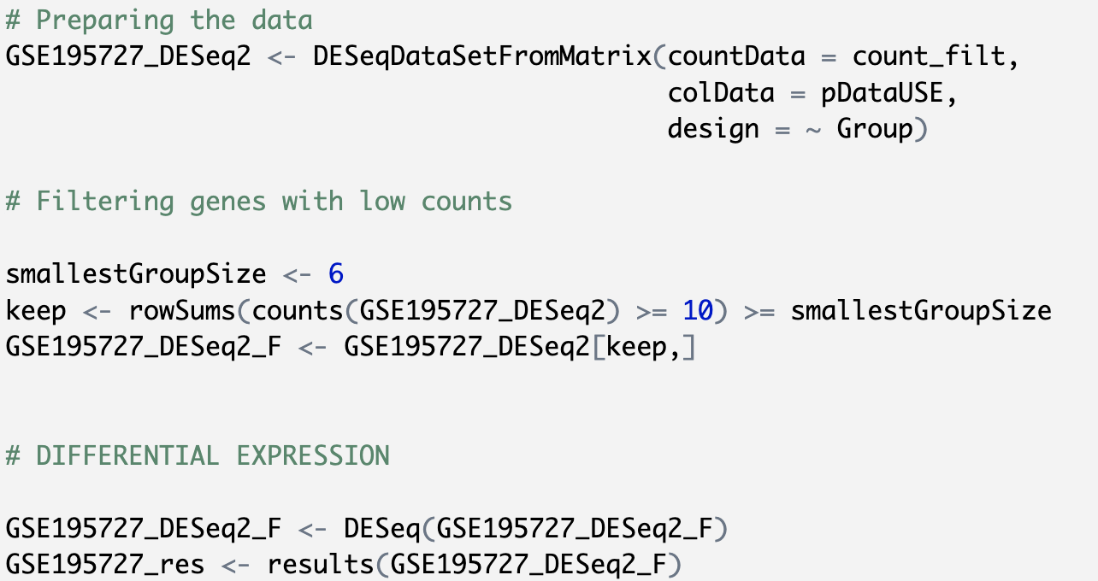
RNA-seq pipeline
Quality Control
Alignment
Annotation
Expression quantification
Data transformation
Differential expression
Functional enrichment
Visualization
Processing in R with DESeq
fastq files
1
Raw count matrix
2
estimation of size factors sj by estimateSizeFactors
estimation of dispersion αi by estimateDispersionsnegative
binomial GLM fitting for βi and Wald statistics by nbinomWaldTest
Generalized linear model GLM
3
overcoming the heteroskedasticity (variance of log fold changes depending on mean count) for genes with low count
Log fold change shrinkage for visualization and ranking

Slide 7
RNA-seq pipeline
Quality Control
Alignment
Annotation
Expression quantification
Data transformation
Differential expression
Functional enrichment
Visualization
Processing in R with DESeq
fastq files
1
Raw count matrix
2
estimation of size factors sj by estimateSizeFactors
estimation of dispersion αi by estimateDispersionsnegative
binomial GLM fitting for βi and Wald statistics by nbinomWaldTest
Generalized linear model GLM
3
overcoming the heteroskedasticity (variance of log fold changes depending on mean count) for genes with low count
Log fold change shrinkage for visualization and ranking

Slide 8
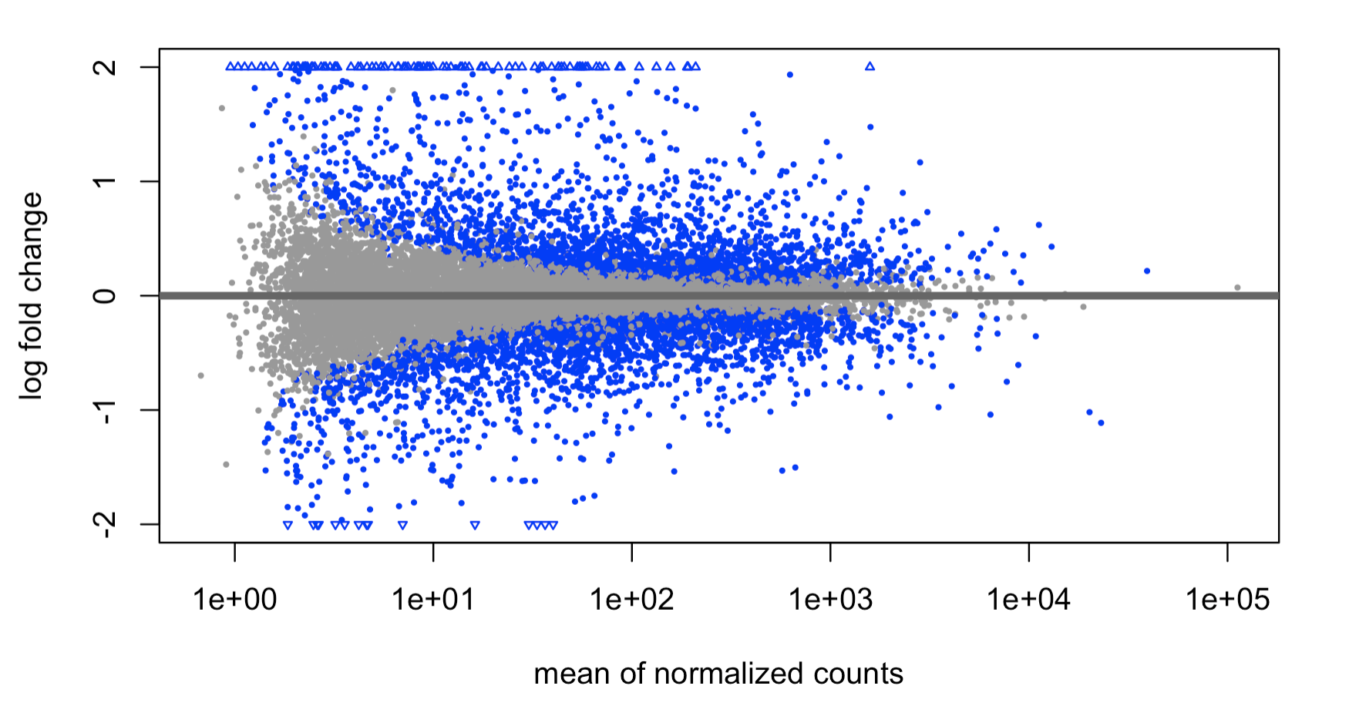
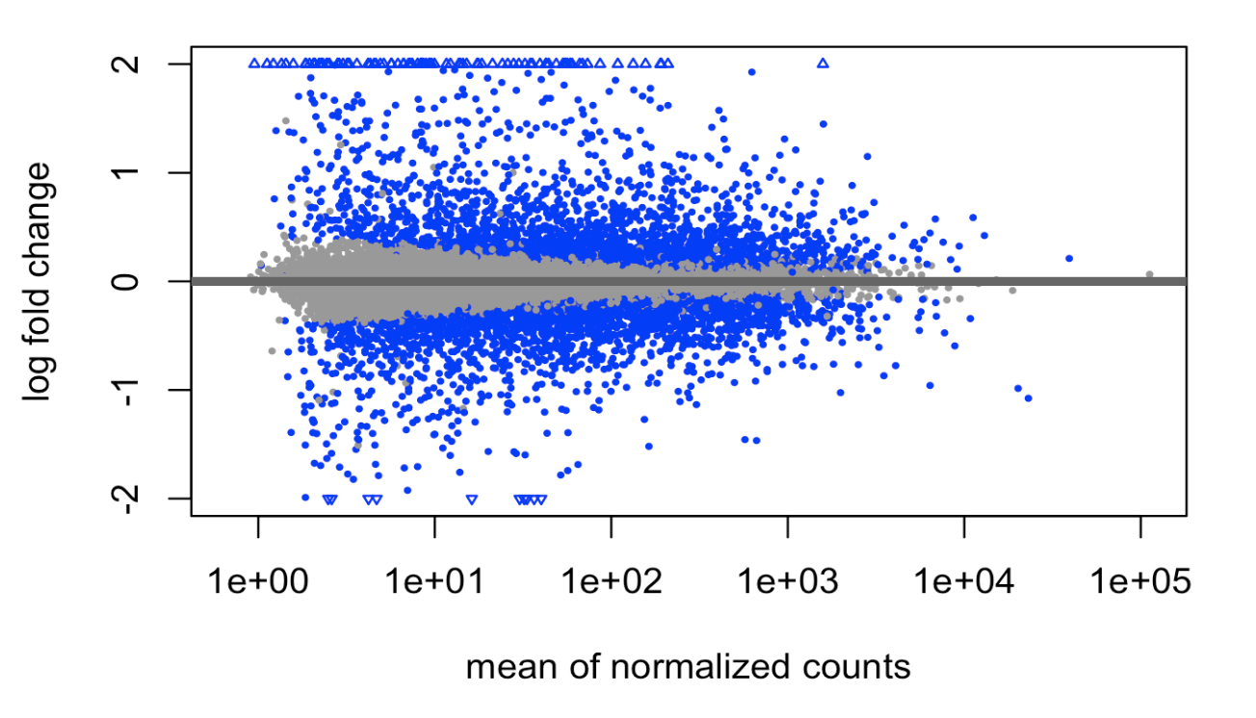
RNA-seq pipeline
The DESeq2 package uses a Bayesian procedure to moderate (or “shrink”) log2 fold changes from genes with very low counts and highly variable counts, as can be seen by the narrowing of the vertical spread of points on the left side of the MA-plot.
Quality Control
Alignment
Annotation
Expression quantification
Data transformation
Differential expression
Functional enrichment
Visualization
Processing in R with DESeq
fastq files
1
Raw count matrix
MA plot before and after shrinkage
2
estimation of size factors sj by estimateSizeFactors
estimation of dispersion αi by estimateDispersionsnegative
binomial GLM fitting for βi and Wald statistics by nbinomWaldTest
Generalized linear model GLM
3
overcoming the heteroskedasticity (variance of log fold changes depending on mean count) for genes with low count
Log fold change shrinkage for visualization and ranking
Notes:
The log2 fold change for a particular comparison is plotted on the y-axis and the average of the counts normalized by size factor is shown on the x-axis.

Slide 9



RNA-seq pipeline
Quality Control
Alignment
Annotation
Expression quantification
Data transformation
Differential expression
Functional enrichment
Visualization
Processing in R with DESeq
fastq files
1
Compressing differences for the low count genes for which the data provide little information about differential expression.
variance stabilizing transformations
regularized logarithm
Count transformation
2
Visualization
3
Clustering

Slide 10
RNA-seq pipeline
Quality Control
Alignment
Annotation
Expression quantification
Data transformation
Differential expression
Functional enrichment
Visualization
Processing in R with DESeq
fastq files
1
variance stabilizing transformations
regularized logarithm
Count transformation
2
Visualization
3
In the above function, we specified blind = FALSE, which means that differences between the variables in the design will not contribute to the expected variance-mean trend of the experiment.
Clustering

Slide 11
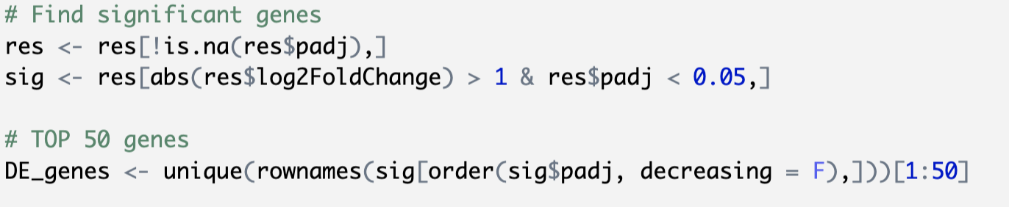
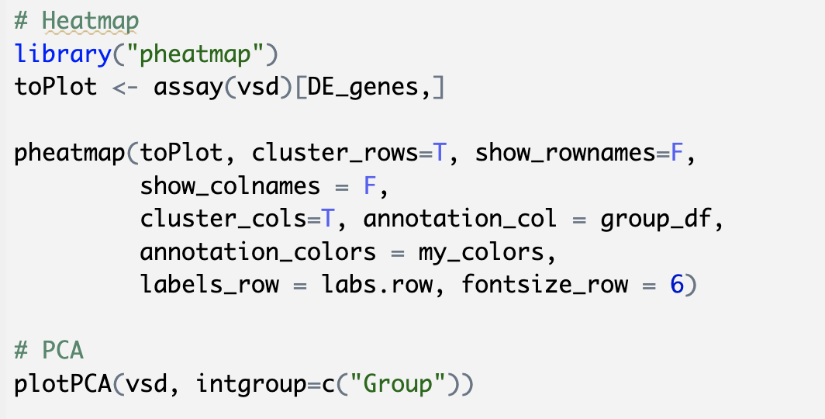
RNA-seq pipeline
Quality Control
Alignment
Annotation
Expression quantification
Data transformation
Differential expression
Functional enrichment
Visualization
Processing in R with DESeq
fastq files
1
variance stabilizing transformations
regularized logarithm
Count transformation
2
Visualization
3
Clustering

Slide 12
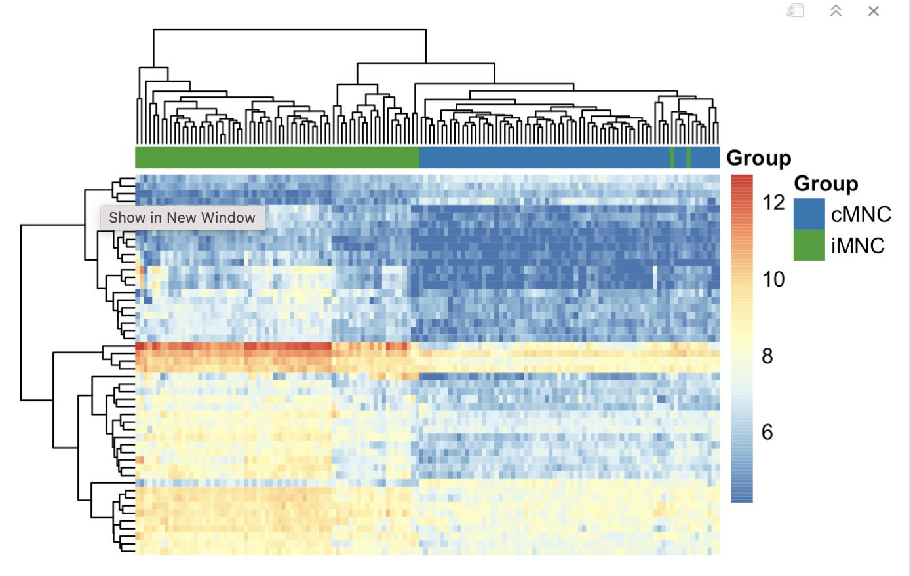
RNA-seq pipeline
Quality Control
Alignment
Annotation
Expression quantification
Data transformation
Differential expression
Functional enrichment
Visualization
Processing in R with DESeq
fastq files
1
variance stabilizing transformations
regularized logarithm
Count transformation
2
Visualization
3
Clustering

Slide 13
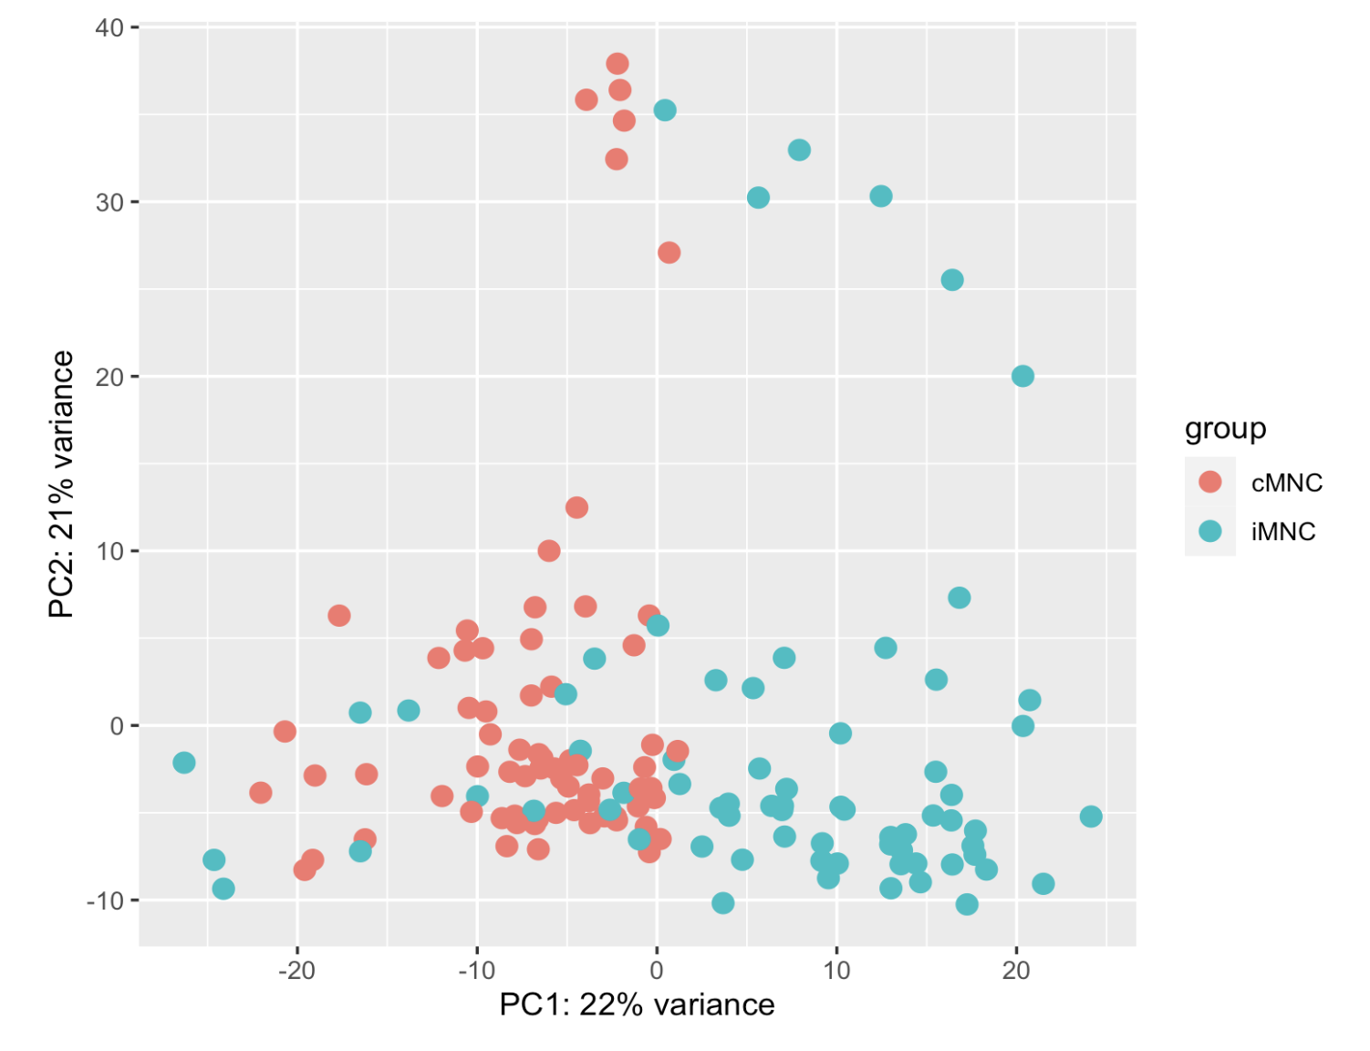
RNA-seq pipeline
Quality Control
Alignment
Annotation
Expression quantification
Data transformation
Differential expression
Functional enrichment
Visualization
Processing in R with DESeq
fastq files
1
variance stabilizing transformations
regularized logarithm
Count transformation
2
Visualization
3
Clustering

Slide 14
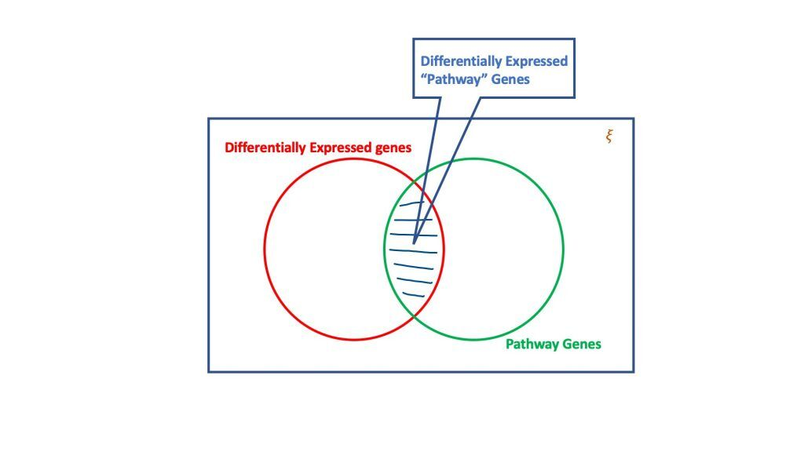
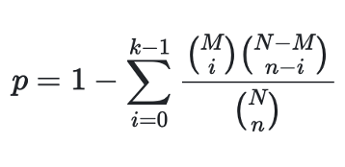
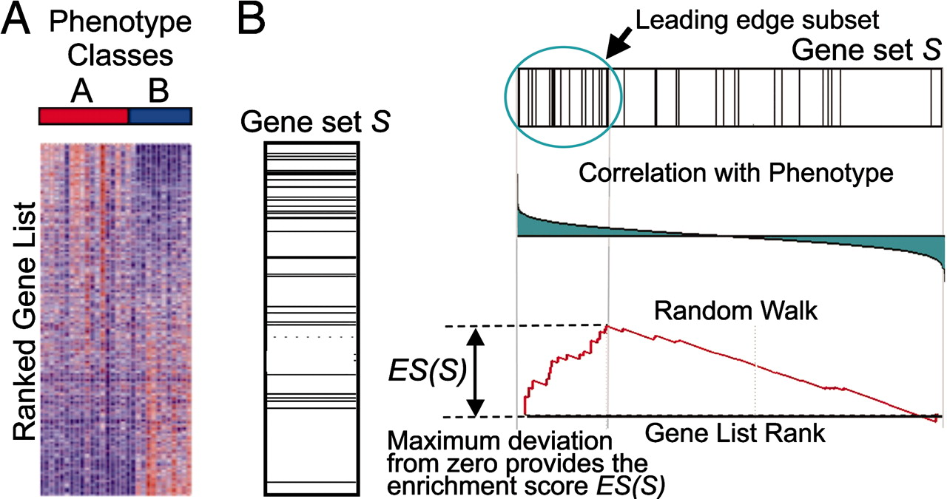
RNA-seq pipeline
Quality Control
Alignment
Annotation
Expression quantification
Data transformation
Differential expression
Functional enrichment
Visualization
Processing in R
fastq files
1
Over-representation analysis
2
Gene Set Enrichment Analysis

Slide 15
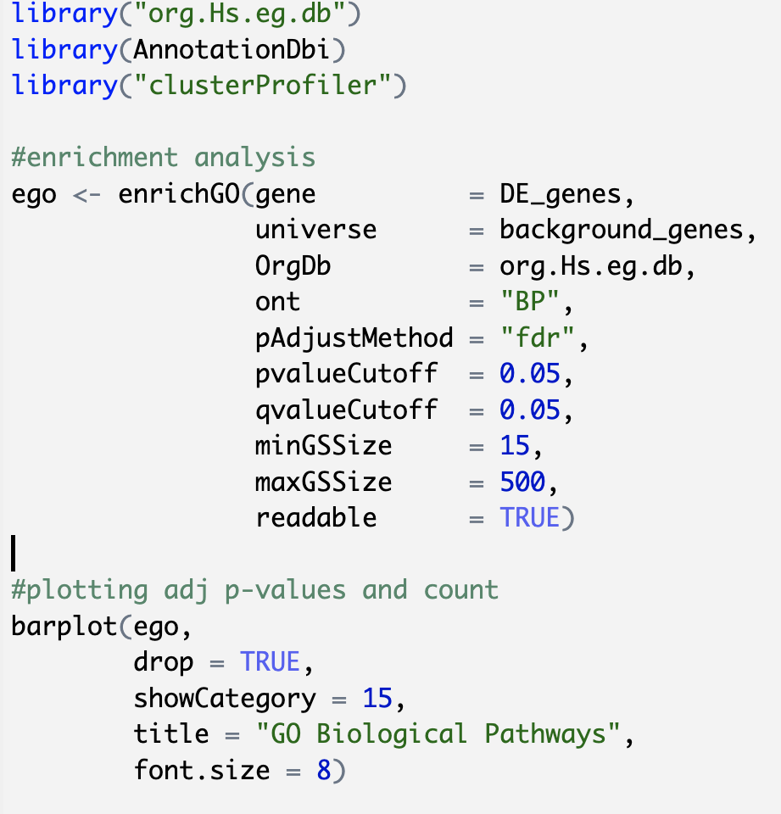
RNA-seq pipeline
Quality Control
Alignment
Annotation
Expression quantification
Data transformation
Differential expression
Functional enrichment
Visualization
Processing in R
fastq files
1
Over-representation analysis
2
Gene Set Enrichment Analysis

Slide 16
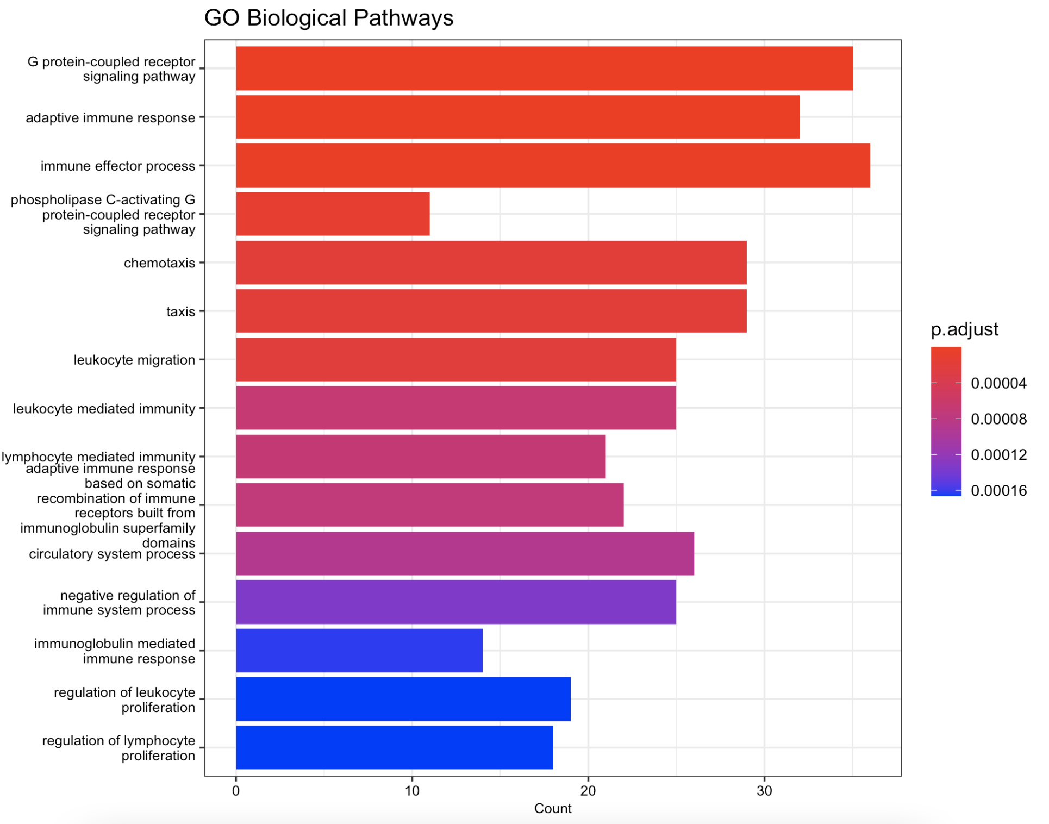
RNA-seq pipeline
Quality Control
Alignment
Annotation
Expression quantification
Data transformation
Differential expression
Functional enrichment
Visualization
Processing in R
fastq files
1
Over-representation analysis
2
Gene Set Enrichment Analysis

Slide 17
References
Love, M.I., Huber, W. & Anders, S. Moderated estimation of fold change and dispersion for RNA-seq data with DESeq2. Genome Biol 15, 550 (2014). https://doi.org/10.1186/s13059-014-0550-8

