Slide 1


Slide 2

What is the author attempting to do?

Slide 3
RNN

Slide 4
CNN

Slide 5
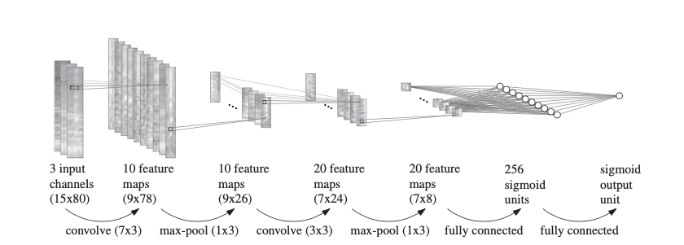
Why CNN?

Slide 6
How did they implement it?

Slide 7
How did they implement it?

Slide 8
How did they implement it?

Slide 9
How did they implement it?

Slide 10
How did they implement it?

Slide 11

What did they achieve?

Slide 12
What did they achieve?
90.3 % F-measure
Previous state-of-the-art was 87.3%

Slide 13
What did they learn?

Slide 14
What did they learn?
- Pitched Onsets
- Percussive Onsets

Slide 15
Limitations and Improvements

Slide 16
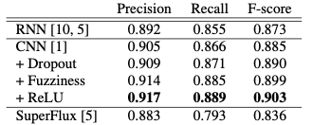
Limitations and Improvements

