Slide 1
Lab 5 Accessibility with Cognitive Impairments
Rochester Institute of Technology
Accessible Learning Labs
Funded By the NSF

Slide 2
Lab Overview
This lab introduces cognitive accessibility challenges. The user will be introduced to common cognitive impairments and what difficulties a person with said impairment would experience
During the exercise portion, the user will be brought through certain scenarios that are inaccessible or difficult for those with cognitive impairments to work through. The user will then make changes to improve the accessibility for that scenario

Slide 3
Education Learning Objectives
Upon completion of this lab, participants will have achieved the following learning objectives:
Knowledge of user significance, characteristics, and needs: Recognize the significance of the population that has cognitive impairments, the types of cognitive impairments that exist, and their needs for accessible software
Exposure to and analysis of poorly accessible design: Examine a software application that doesn’t properly accommodate accessibility for those who are cognitively impaired
Apply solutions to solve access problems: Use knowledge of accessibility design solutions to construct corrective measures to allow previously inaccessible software to become accessible to appropriate parties
Develop further empathy: Relate to individuals who experience difficulties with cognitive impairment

Slide 4
Lab Contents
Reading
Exercise
Reinforcement
Quiz
Discussion
Notes:
A lot of software isn’t built with accessibility in mind
Lack of accessibility material that is easily adoptable

Slide 5

Reading
Statistics
As many as 11% of the US population experiences cognitive disabilities, including difficulty concentrating, memory, or making decisions
One in five, or 20% of the US population suffers from dyslexia
ADHD effect 4.4% of US adults
Examples and Symptoms of Cognitive Impairment
Attention Deficit Hyperactive Disorder (ADHD) and Dyslexia are common forms of cognitive impairment
Common challenges include difficulty understanding content, remembering how to complete tasks, maintaining focus while completing a task, and mental processing speed
Tips for Usability
Offering an alternative method for signing in that doesn’t rely on remembering a password
Displaying frequently used control for easy accessibility

Slide 6
Exercise Start
In the following exercise, you will explore a series of cognitive antipatterns difficult for those who suffer from cognitive impairment
After each antipattern, you’ll be given the opportunity to edit the code to make it more accessible
Once completed, you will the final product that is now cognitive impairment accessible
Good luck!
Notes:
Self-encapsulated educational accessibility material

Slide 7
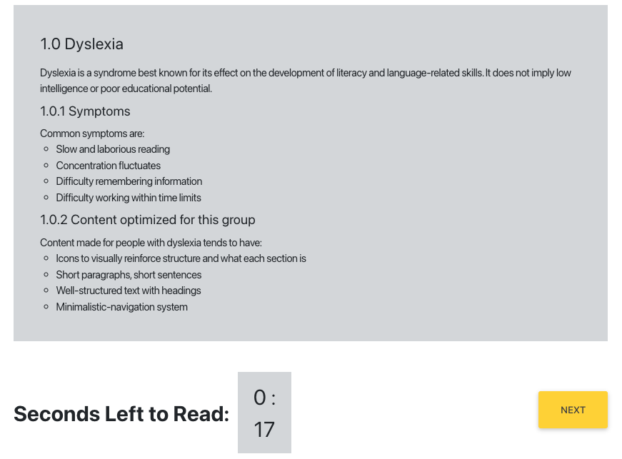
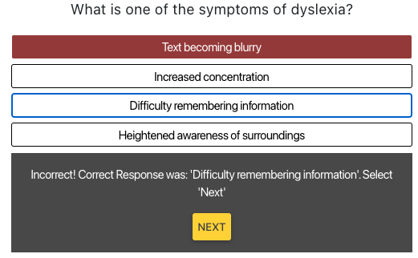
Exercise 1 Round 1
In the first exercise, you are must read the pictured text in under 25sec. For someone without a cognitive impairment, this is a fairly simple task
Next, you are asked a question pertaining to the information you just read
Notes:
Self-encapsulated educational accessibility material

Slide 8
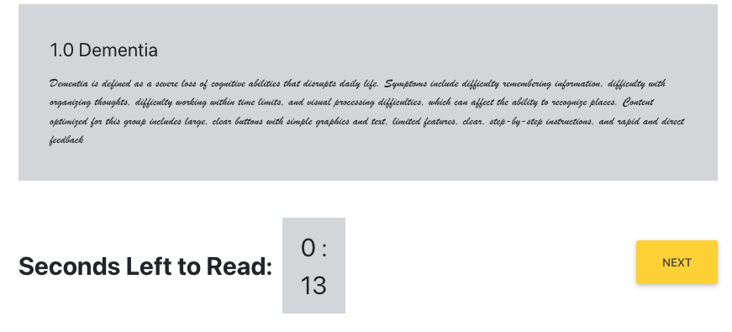
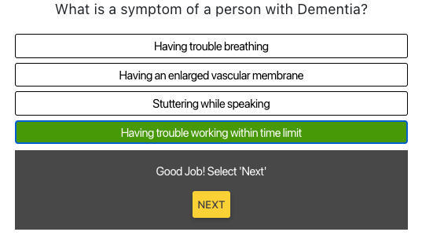
Exercise 1 Round 2
You are given another piece of text to both read and remember, this time instead of a lot of text, the text is in cursive, making speed reading difficult
You are once again asked to answer a question pertaining to the text you just read
Notes:
Self-encapsulated educational accessibility material

Slide 9
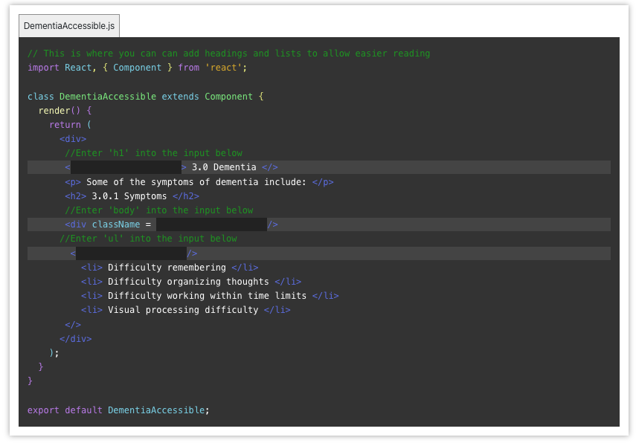
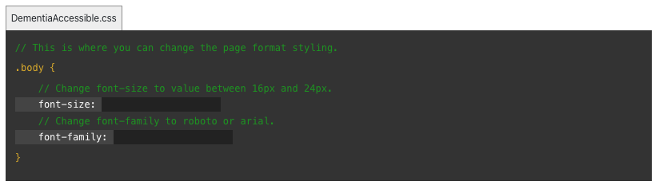
Exercise 1 Repair
You are now given the opportunity to update the code in order to make the reading sections more accessible for someone who may have a cognitive impairment
Adding the header, body, and ul (unordered list) into the specified sections will allow for better differentiation between reading sections. Editing the font size and font family for the reading sections also makes for an easier reading experience

Slide 10
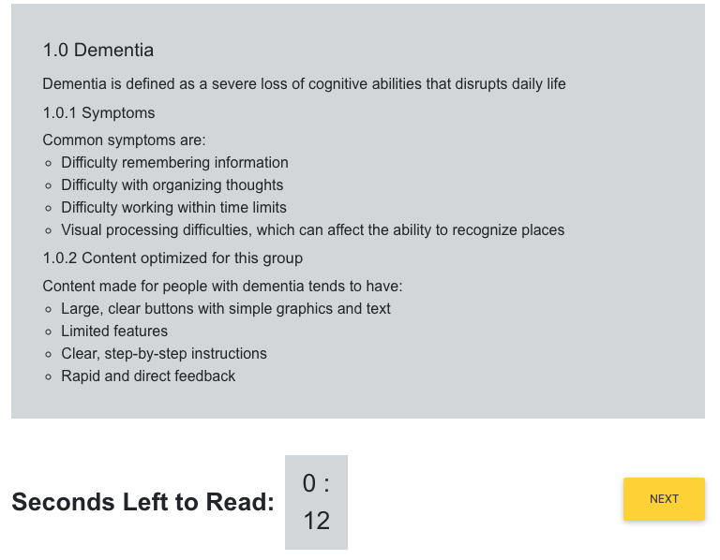
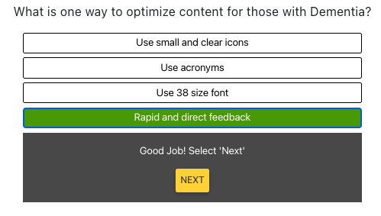
Exercise 1 Round 3 (Post-Repair)
With the newly implemented header styling, enlarged font and simpler font family, the reading experience should be faster and easier to remember

Slide 11
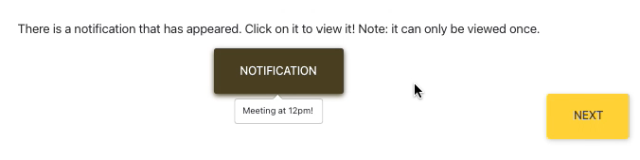
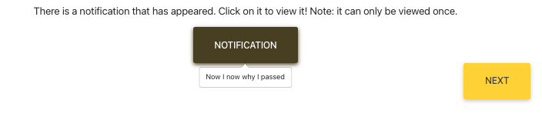
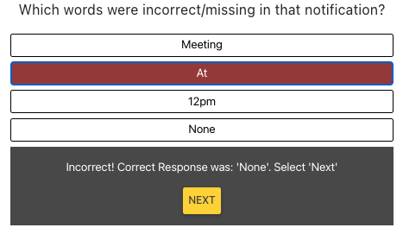
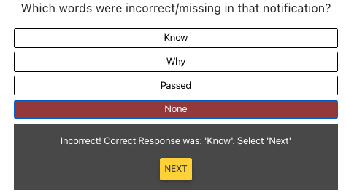
Exercise 2 Round 1
In the next exercise, you are given a notification button to press. However, the notification is only visible for a few second. For someone with a cognitive impairment, it’s not enough time to properly read and digest if there were any errors
Next, you are asked a question if any of the following words were missing from the notification
Notes:
Self-encapsulated educational accessibility material

Slide 12
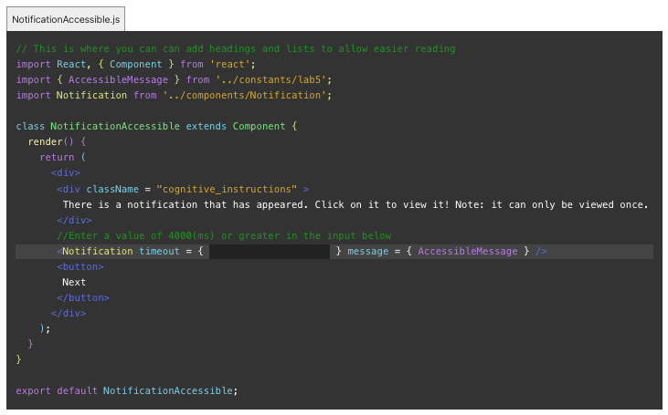
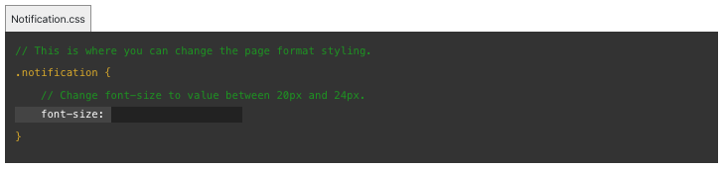
Exercise 2 Repair
You are now given the opportunity to update the code in order to make the notification more accessible for someone who may have a cognitive impairment
Edit the length of the timeout in order to give the user more time to view the notification popup, as well as increasing the size of the font size

Slide 13
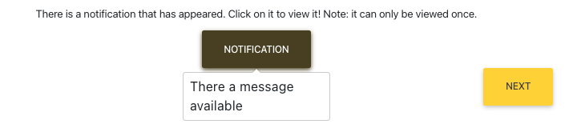
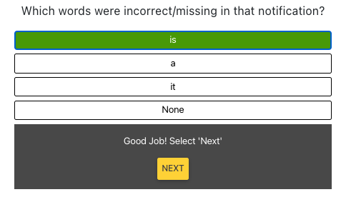
Exercise 2 Round 2 (Post-Repair)
With the newly implemented timeout length and enlarged font, the user now has ample time to view and commit the message to memory

Slide 14
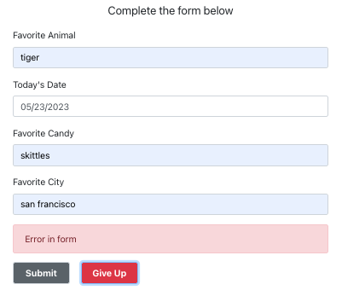
Exercise 3 Round 1
In the final exercise, you are given a form to fill out, however, there is no specified way for the user to input the data for “Today’s Date”, therefore presenting a flawed cognitive form design
Notes:
Self-encapsulated educational accessibility material

Slide 15
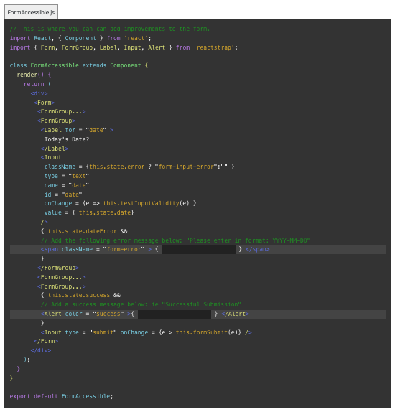
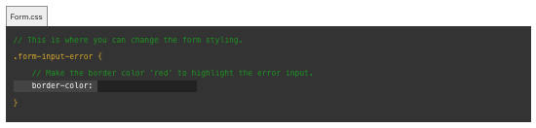
Exercise 3 Repair
You are now given the opportunity to update the code in order to give the user the desired way to input today’s date
You are also afforded the opportunity to update the popup stating that there was a successful submission of the form, as well as the alert color if the date is submitted incorrectly

Slide 16
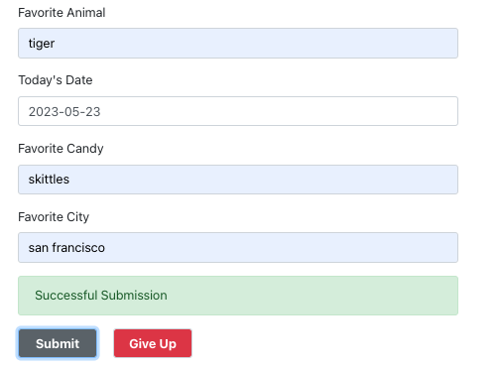
Exercise 3 Round 2 (Post-Repair)
With the newly implemented “Successful Submission” popup, specified date submission details, and error alert color, the user can now easily and properly submit the form

Slide 17
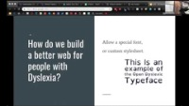
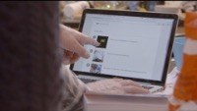
Reinforcement
Now that you have completed the exercise, watch the following reinforcement videos in order to develop a deeper understanding of the importance of accessible software development for those who suffer from a cognitive impairment

Slide 18
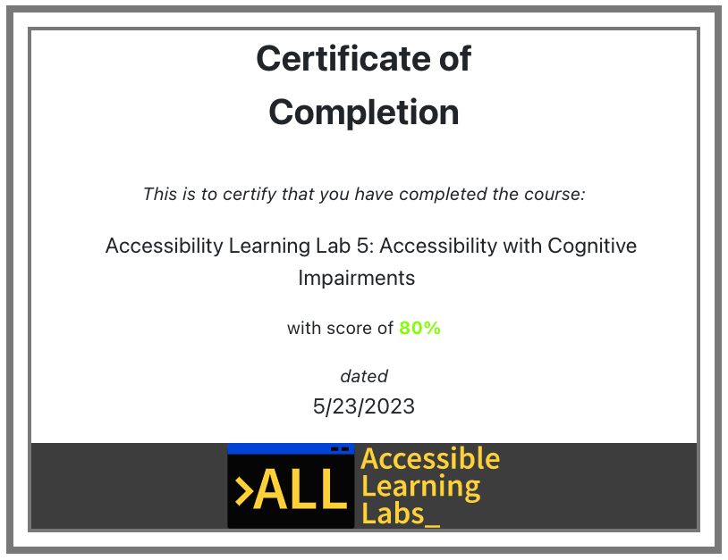
Quiz
You will now go through and complete a 5-question quiz in order to test your knowledge on the reading material, exercise, and reinforcement videos you just experienced
At the end, you will be given your score and a certificate that you have completed the lab

Slide 19
Post-Lab Discussion
The exercise you just completed demonstrated how minor changes can lead to big impacts for individuals with their respective disabilities
What are some other ways we can help those who suffer from suffer from a a cognitive impairment in software?
Do you feel like you now have a deeper responsibility to improve accessibility for those who may suffer from this disability?

Slide 20

Thank you! Any questions?
Rochester Institute of Technology
Accessible Learning Labs
Funded By the NSF
Contact Information
Professor Daniel Krutz
daniel.krutz@rit.edu
This material is based upon work supported by the National Science Foundation under grants #1825023, #2111152, #2145010

