Slide 1
Lab 1 Accessibility to Sound and Speech
Rochester Institute of Technology
Accessible Learning Labs
Funded By the NSF

Slide 2
Lab Overview
The following lab explores the perceivable accessibility principle in regards to sound and speech. This principle states that information and elements of the interface must be presented to users in ways they can perceive without loss of information.
The lab demonstrates how having only audio cues for a certain objective makes the software inaccessible for users who are deaf or hard of hearing.

Slide 3
Education Learning Objectives
Upon completion of this lab, participants will have achieved the following learning objectives:
Knowledge of user significance, characteristics, and needs: Recognize the significance of the population that is deaf and hard of hearing and their needs for accessible software
Exposure to and analysis of poorly accessible design: Examine a software application that doesn’t properly accommodate accessibility for people with difficulties with sound and speech
Apply solutions to solve access problems: Use knowledge of accessibility design solutions to construct corrective measures to allow previously inaccessible software to become accessible to appropriate parties
Develop further empathy: Relate to individuals who experience difficulties with accessibility to sound and speech

Slide 4
Lab Contents
Reading
Exercise
Reinforcement
Quiz
Discussion
Notes:
A lot of software isn’t built with accessibility in mind
Lack of accessibility material that is easily adoptable

Slide 5

Reading
WCAG Accessibility Standard
s
Accessibility standards ensure equal access to government technology applications.
Section 508 of the rehabilitation act outlines necessary components for accessibility.
Section 508.C & D emphasize alternative approaches for audio cues and WCAG AAA standards and is crucial to the success of web applications.
Validators like AChecker analyze webpages for compliance with accessibility standards.
Failure to make software accessible can violate the ADA, as seen in the NAD vs Netflix lawsuit.
Why are WCAG standards important?
Software developers have a professional responsibility to uphold ethical codes and promote inclusivity.
Alternative approaches to audio cues are vital for equal access to the internet.

Slide 6
Exercise Start
In the following exercise, you will be asked to play a simple game (please turn on sound)
4 boxes will appear on your screen, with one containing treasure
If you select the treasure box, you will earn points based on speed of selection
There is a hint box that will alert you that a hint is available through an audio cue, but will cost you points
Try to find the treasure as many times as possible to get the highest score possible!
Notes:
Self-encapsulated educational accessibility material

Slide 7
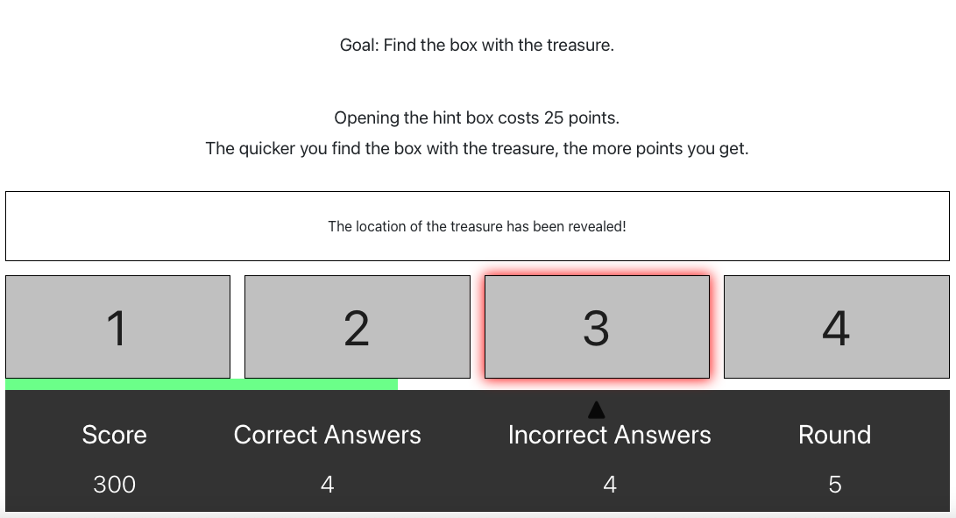
Exercise Round 1
Without a hearing impairment, the game is fairly easy, as you listen for the audio cue to alert you that a hint is available
Notes:
Self-encapsulated educational accessibility material

Slide 8
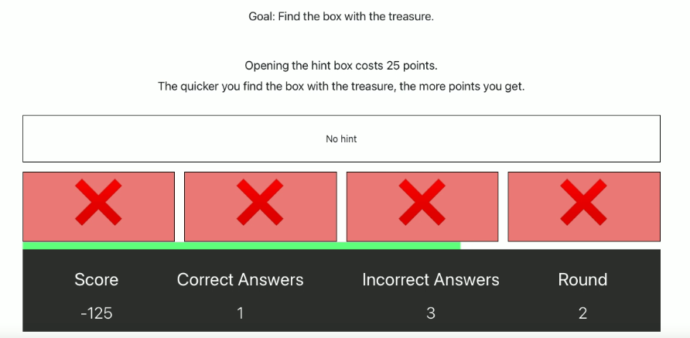
Exercise Round 2
Lets play that game again, but now you will experience it as though you suffered from deafness or were hard of hearing
As you can see the game is much more difficult when you can’t hear the audio cue

Slide 9
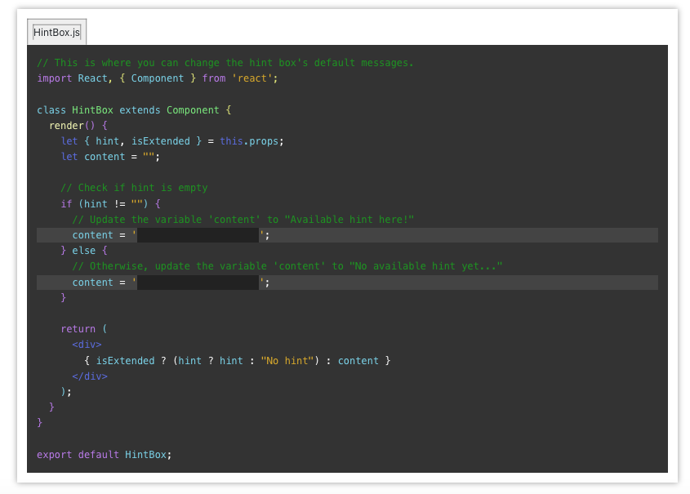
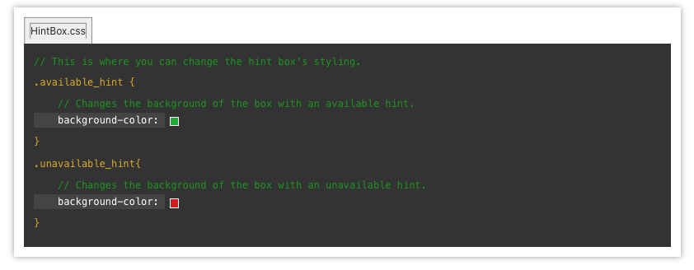
Exercise Repair
You are now given the opportunity to update the code in order to make the game more accessible for those who are hard of hearing
Edit the hint box so that it will alert the user whether or not there is a hint based on a visual cue such different colors and explicit labeling

Slide 10
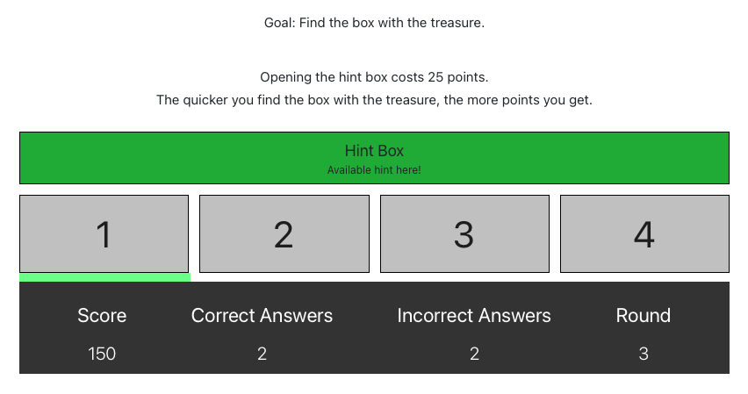
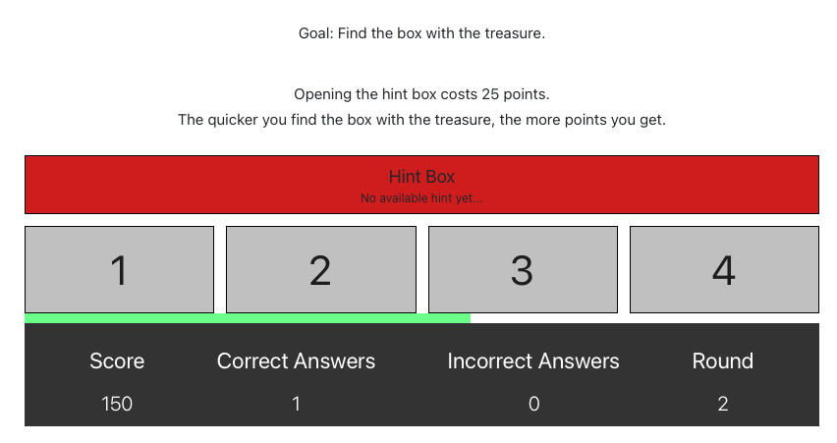
Exercise Round 3 (Post-Repair)
With the newly implemented visual cues, even without audio, you can now clearly see when a hint is available vs when a hint is not available

Slide 11
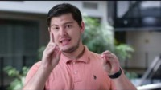
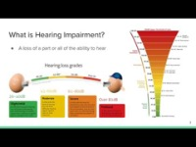
Reinforcement
Now that you have completed the exercise, watch the following reinforcement videos in order to develop a deeper understanding of the importance of accessible software development for those who are hard of hearing

Slide 12
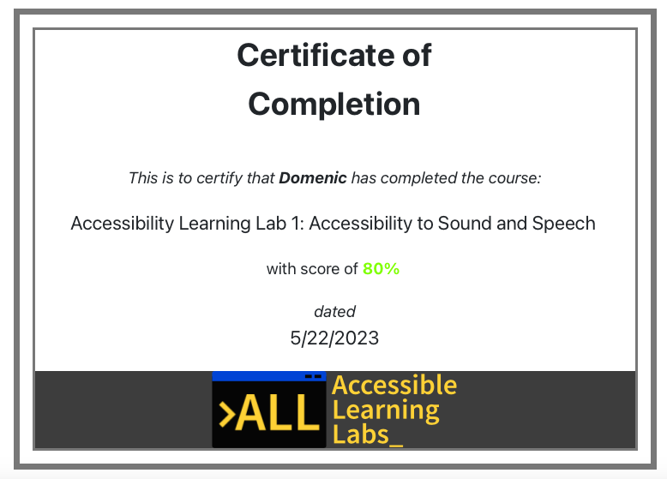
Quiz
You will now go through and complete a 5-question quiz in order to test your knowledge on the reading material, exercise, and reinforcement videos you just experienced
At the end, you will be given your score and a certificate that you have completed the lab

Slide 13
Post-Lab Discussion
The exercise you just completed demonstrated how minor changes can lead to big impacts for individuals with their respective disabilities
What are some other ways we can help those who suffer from suffer from deafness and hard of hearing in software?
Do you feel like you now have a deeper responsibility to improve accessibility for those who may suffer from this disability?

Slide 14

Thank you! Any questions?
Rochester Institute of Technology
Accessible Learning Labs
Funded By the NSF
Contact Information
Professor Daniel Krutz
daniel.krutz@rit.edu
This material is based upon work supported by the National Science Foundation under grants #1825023, #2111152, #2145010

