Slide 1
Lab 2 Accessibility to Color Blindness
Rochester Institute of Technology
Accessible Learning Labs
Funded By the NSF

Slide 2
Lab Overview
This lab explores accessibility issues involving color blindness. This will be introduced to the user through a simulated color blind lens. The user will then be asked to navigate through the exercise once with the lens activated and once without.
The user will then be asked to implement accessible colors that will allow every user to have the same experience

Slide 3
Education Learning Objectives
Upon completion of this lab, participants will have achieved the following learning objectives:
Knowledge of user significance, characteristics, and needs: Recognize the significance of the population that is colorblind, the types of colorblindness that they have, and their needs for accessible software
Exposure to and analysis of poorly accessible design: Examine a software application that doesn’t properly accommodate accessibility for those who are colorblind
Apply solutions to solve access problems: Use knowledge of accessibility design solutions to construct corrective measures to allow previously inaccessible software to become accessible to appropriate parties
Develop further empathy: Relate to individuals who experience difficulties with accessibility to colorblindness

Slide 4
Lab Contents
Reading
Exercise
Reinforcement
Quiz
Discussion
Notes:
A lot of software isn’t built with accessibility in mind
Lack of accessibility material that is easily adoptable

Slide 5
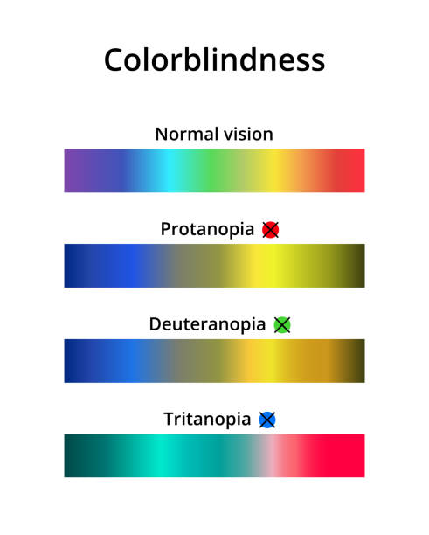
Reading
Statistics
1 in 12 men (8% of the global population) and 1 in 200 women have a color vision deficiency
There is currently no cure for color blindness
Four Main Types of Color Vision Deficiency
Protanomaly
Reduced sensitivity to red light
Difficulty distinguishing reds, greens, browns, and oranges
Confusion between blues and purples
Deuteranomaly
Reduced sensitivity to green light
Difficulty distinguishing reds, greens, browns, and oranges
Confusion between blues and purples
Tritanomaly
Reduced sensitivity to blue light
Difficulty distinguishing blue and yellow, violet and red, and blue and green
Very rare
Monochromacy
Reduced sensitivity to red light
Difficulty distinguishing reds, greens, browns, and oranges
Confusion between blues and purples

Slide 6
Exercise Start
In the following exercise, you will be asked to play a simple game
A circle in the center of the screen will change between 3 different colors
Only click the circle when it is red, and not when it is green or beige
You will have 15 seconds to click the correct colored circle as many times as possible to get a high score!
Good luck!
Notes:
Self-encapsulated educational accessibility material

Slide 7
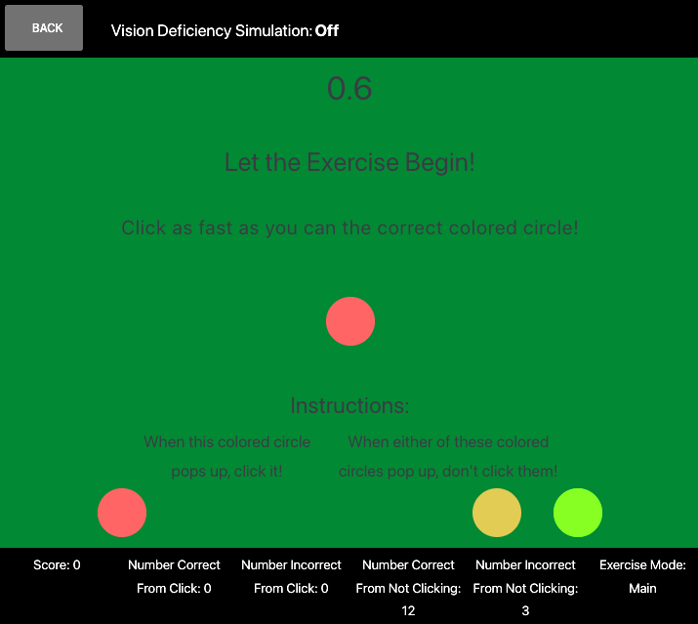
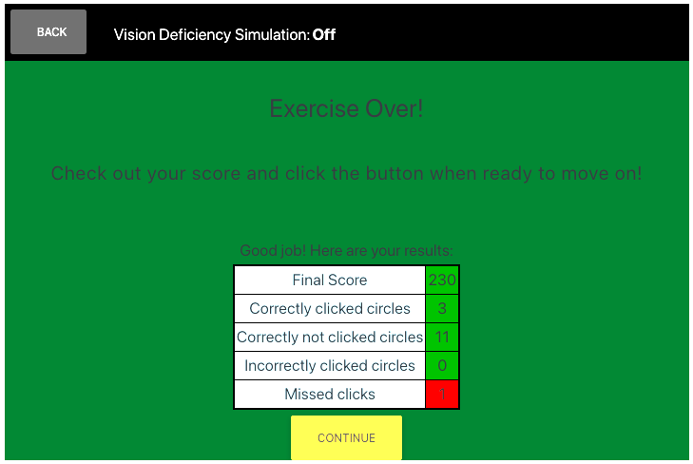
Exercise Round 1
Without a color vision deficiency, the game is easy, as you are able to differentiate between the colored circles easily, making a high score attainable
Notes:
Self-encapsulated educational accessibility material

Slide 8
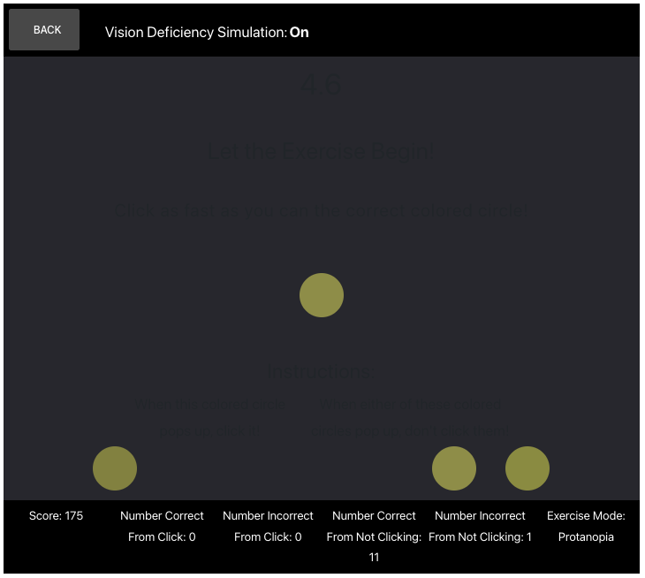
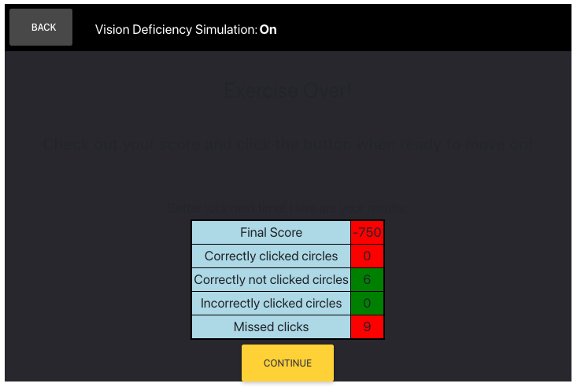
Exercise Round 2
Lets play that game again, but now you will experience it as though you suffered from a color vision deficiency
As you can see, the game is far more difficult now that you cannot tell the different between the circle’s colors

Slide 9
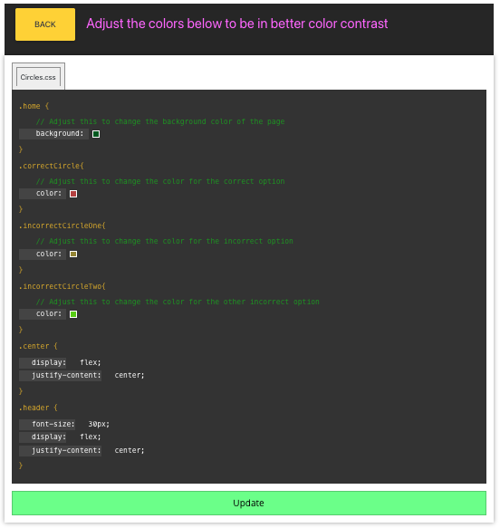
Exercise Repair
You are now given the opportunity to update the code in order to make the game more accessible for those who suffer from a color vision deficiency
Edit the colors of the circles, the background and the font in order to create more contrasting colors that make it easier for someone with a color deficiency to play the game

Slide 10
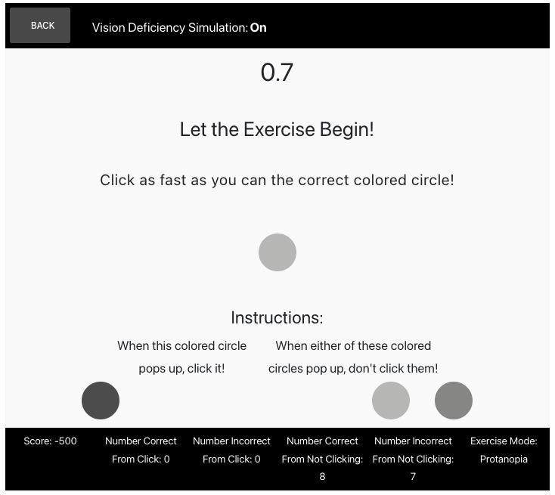
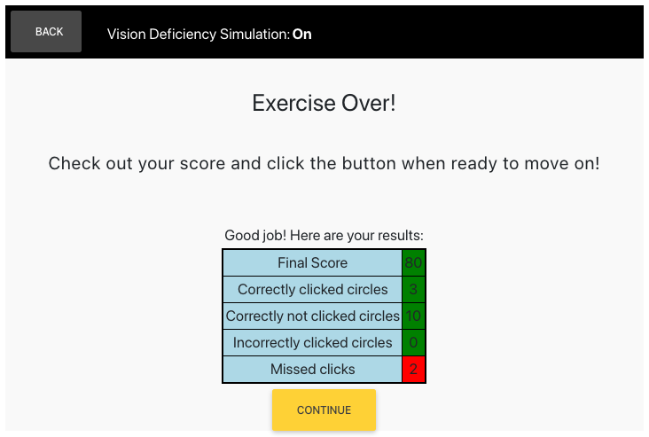
Exercise Round 3 (Post-Repair)
With the newly implemented contrasting color palette, it is now much easier to differentiate between the different colored circles, ensuring a higher overall score

Slide 11
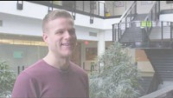
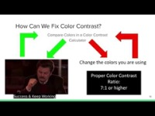
Reinforcement
Now that you have completed the exercise, watch the following reinforcement videos in order to develop a deeper understanding of the importance of accessible software development for those who suffer from a color vision deficiency

Slide 12
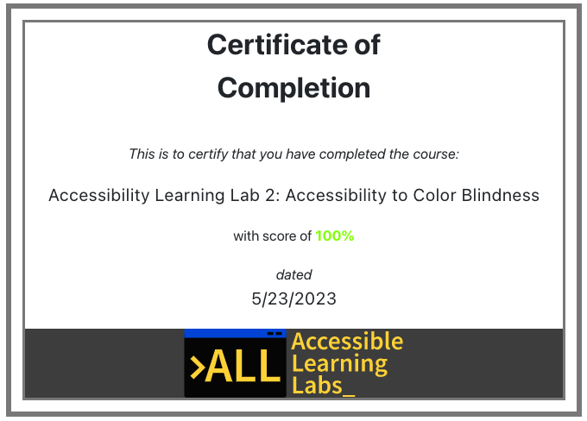
Quiz
You will now go through and complete a 5-question quiz in order to test your knowledge on the reading material, exercise, and reinforcement videos you just experienced
At the end, you will be given your score and a certificate that you have completed the lab

Slide 13
Post-Lab Discussion
The exercise you just completed demonstrated how minor changes can lead to big impacts for individuals with their respective disabilities
What are some other ways we can help those who suffer from suffer from a color vision deficiency in software?
Do you feel like you now have a deeper responsibility to improve accessibility for those who may suffer from this disability?

Slide 14

Thank you! Any questions?
Rochester Institute of Technology
Accessible Learning Labs
Funded By the NSF
Contact Information
Professor Daniel Krutz
daniel.krutz@rit.edu
This material is based upon work supported by the National Science Foundation under grants #1825023, #2111152, #2145010

