Slide 1
Lab 3 Accessibility with Screen Readers
Rochester Institute of Technology
Accessible Learning Labs
Funded By the NSF

Slide 2
Lab Overview
This lab will introduce the different types of visual impairments and the importance of creating software that is accessible to these users by utilizing screen readers. Participants will learn how to design a screen-reader friendly interface.
In the exercise portion of the lab, they will encounter a non-inclusive interface that is not screen-reader friendly and will learn how to implement an interface that is navigable by screen readers.

Slide 3
Education Learning Objectives
Upon completion of this lab, participants will have achieved the following learning objectives:
Knowledge of user significance, characteristics, and needs: Recognize the significance of the population that has visual impairments and their needs for accessible software
Exposure to and analysis of poorly accessible design: Examine a software application that doesn’t properly accommodate accessibility for those who are visually impaired
Apply solutions to solve access problems: Use knowledge of accessibility design solutions to construct corrective measures to allow previously inaccessible software to become accessible to appropriate parties
Develop further empathy: Relate to individuals who experience difficulties with accessibility to screen readers

Slide 4
Lab Contents
Reading
Exercise
Reinforcement
Quiz
Discussion
Notes:
A lot of software isn’t built with accessibility in mind
Lack of accessibility material that is easily adoptable

Slide 5

Reading
Statistics
Almost 80% of all visual impairments are preventable or curable
An estimated 285 million people suffer from visual impairment, with 39 million completely blind
People 50 and over account for 82% of the blind
Examples of Visual Impairment
Diabetic Retinopathy, childhood blindness, corneal opacities, Glaucoma, Trachoma, Cataracts, Age-Related Macular Degeneration (AMD)
Tips for Usability
Use many headings/subheadings
Keep text short
Increase button & font size
Include “Skip” links
Limit the use of popups

Slide 6
Exercise Start
In the following exercise, you will be asked to play a simple game
There will be four images presented on the screen
You will be asked to select one of the four images that contains the specified image contents
You will then be tasked with the same exercise, however you will now experience it as though you are blind
Good luck!
Notes:
Self-encapsulated educational accessibility material

Slide 7
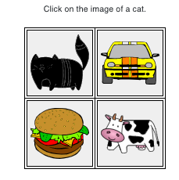
Exercise Round 1
Find and clicking the cat was incredibly easy as you were able to differentiate between images of the car, the burger, the cow, and the cat.
Notes:
Self-encapsulated educational accessibility material

Slide 8
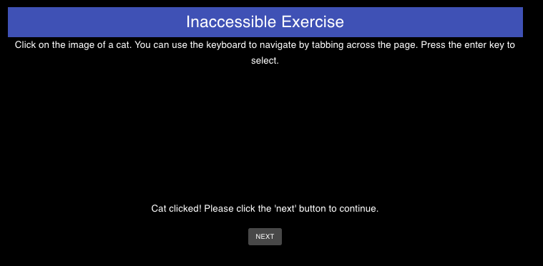
Exercise Round 2
Let’s play that game again, but now you will experience it as though you suffered from a visual impairment
You can no longer see the images that were on the screen, and the screen reader is not programed to inform the user of what each image contains when clicked on

Slide 9
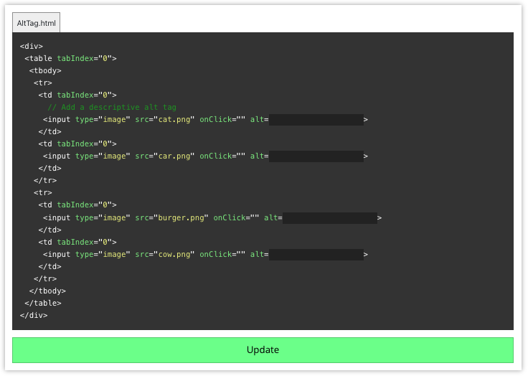
Exercise Repair
You are now given the opportunity to update the code in order to make the game more accessible for those who suffer from a visual impairment such as blindness
Edit the alt-tags in the code block to match with their corresponding image contents so someone who experiences visual impairment will know what is contained in each image when clicked

Slide 10
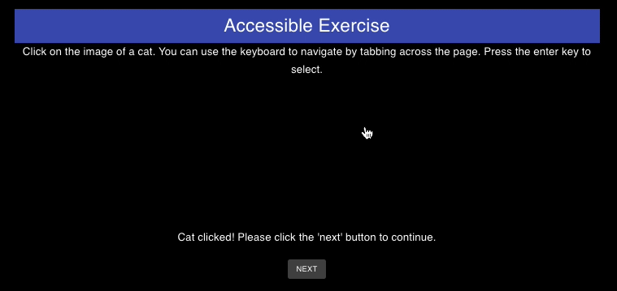
Exercise Round 3 (Post-Repair)
With the newly implemented alt-tags, your computer’s screen reader will now alert the user of what each image contains instead of generic phrases like “Image 1”, etc.

Slide 11
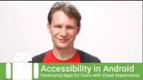
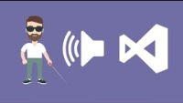
Reinforcement
Now that you have completed the exercise, watch the following reinforcement videos in order to develop a deeper understanding of the importance of accessible software development for those who suffer from a visual impairment

Slide 12
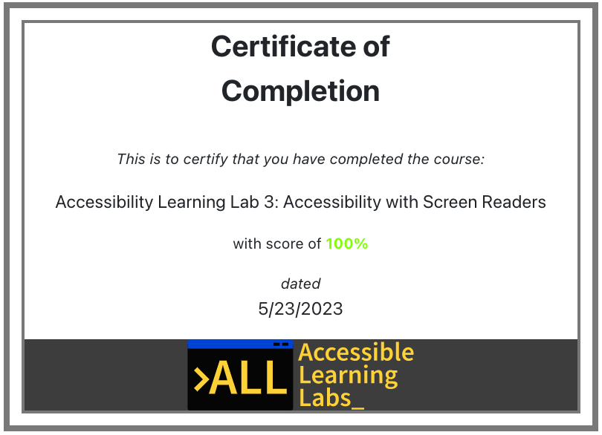
Quiz
You will now go through and complete a 5-question quiz in order to test your knowledge on the reading material, exercise, and reinforcement videos you just experienced
At the end, you will be given your score and a certificate that you have completed the lab

Slide 13
Post-Lab Discussion
The exercise you just completed demonstrated how minor changes can lead to big impacts for individuals with their respective disabilities
What are some other ways we can help those who suffer from suffer from a visual impairment in software?
Do you feel like you now have a deeper responsibility to improve accessibility for those who may suffer from this disability?

Slide 14

Thank you! Any questions?
Rochester Institute of Technology
Accessible Learning Labs
Funded By the NSF
Contact Information
Professor Daniel Krutz
daniel.krutz@rit.edu
This material is based upon work supported by the National Science Foundation under grants #1825023, #2111152, #2145010

