Slide 1
Lab 4 Accessibility to Dexterity
Rochester Institute of Technology
Accessible Learning Labs
Funded By the NSF

Slide 2
Lab Overview
This lab gives an overview of dexterity impairments and the effects they can have on a person’s ability to use software. In addition, the lab gives several examples of web standards related to dexterity accessibility. Users are immersed in an environment that simulates the experience of a user with a dexterity impairment by having to click a small, moving button.
The user then updates the code to make the button large enough to follow accessibility guidelines. Additionally, users also experience filling out a form using only their keyboard. The user then makes updates to the code to make the form accessible to those with dexterity impairments.

Slide 3
Education Learning Objectives
Upon completion of this lab, participants will have achieved the following learning objectives:
Knowledge of user significance, characteristics, and needs: Recognize the significance of the population that has dexterity impairments, the types of dexterity impairments they have, and their needs for accessible software
Exposure to and analysis of poorly accessible design: Examine a software application that doesn’t properly accommodate accessibility for with dexterity impairments
Apply solutions to solve access problems: Use knowledge of accessibility design solutions to construct corrective measures to allow previously inaccessible software to become accessible to appropriate parties
Develop further empathy: Relate to individuals who experience difficulties with accessibility to dexterity

Slide 4
Lab Contents
Reading
Exercise
Reinforcement
Quiz
Discussion
Notes:
A lot of software isn’t built with accessibility in mind
Lack of accessibility material that is easily adoptable

Slide 5
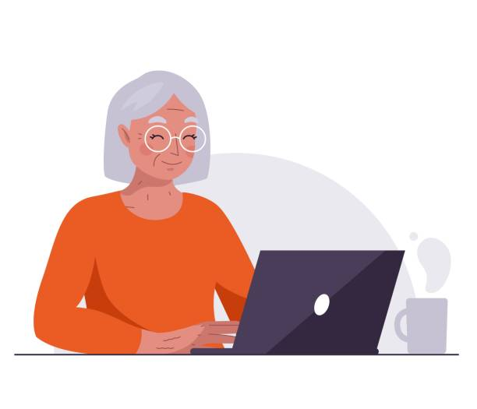
Reading
Statistics
Many dexterity impairments exist, but all limit fine motor control and movement
Approximately 16.3% of the US adult population suffer from mobility impairment
Examples of Dexterity Impairment
Spinal cord injury
Loss or damage of limb
Cerebral palsy
Muscular Dystrophy
Multiple Sclerosis
Spina bifida
Amyotrophic Lateral Sclerosis (ALS)
Arthritis
Parkinson’s Disease

Slide 6
Exercise Start
In the following exercise, you will experience 3 difference exercises
Each exercise will display different usability issues for those who suffer from dexterity impairment
The first will present a small, moving button that you will be tasked with clicking
In the second exercise, you will be tasked with navigating and filling out a form page without the use of a mouse
In the third, you will be tasked with creating a usable hint button that the user can reach using the tab button
Notes:
Self-encapsulated educational accessibility material

Slide 7
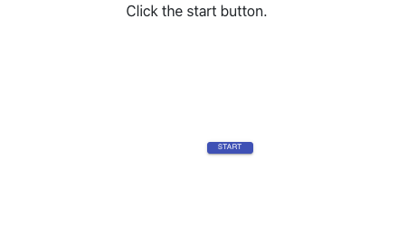
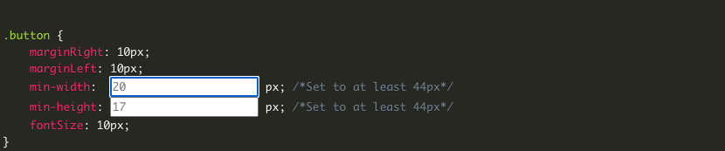
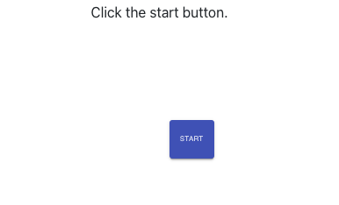
Exercise 1
As you just experienced, a small button can be extremely hard to click if you have difficulty in controlling the mouse (the moving button simulates poor motor control)
As outlined in WGAC 2.55 Target Guideline, buttons must be a minimum of 44 x 44px
You are now tasked with updating the size of the button in the code block
As you can see, the newly dimensioned button is easier to click when moving
Notes:
Self-encapsulated educational accessibility material

Slide 8
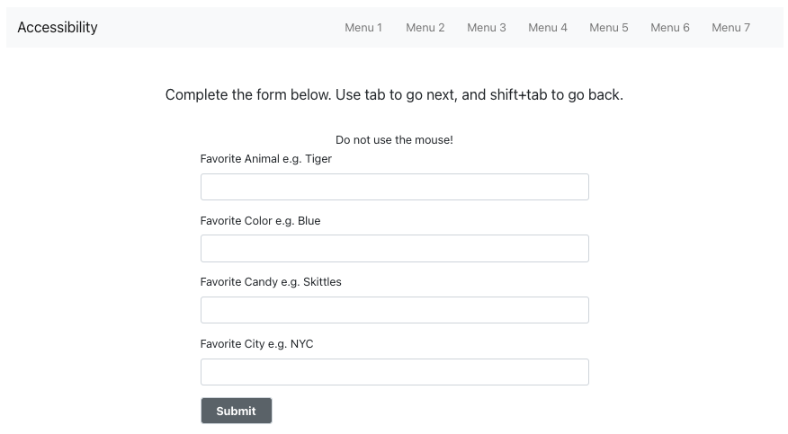
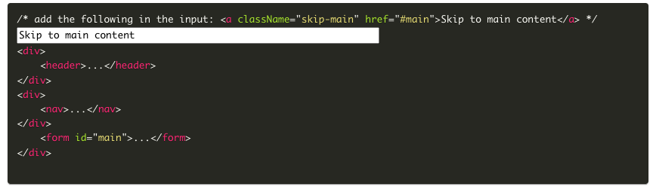
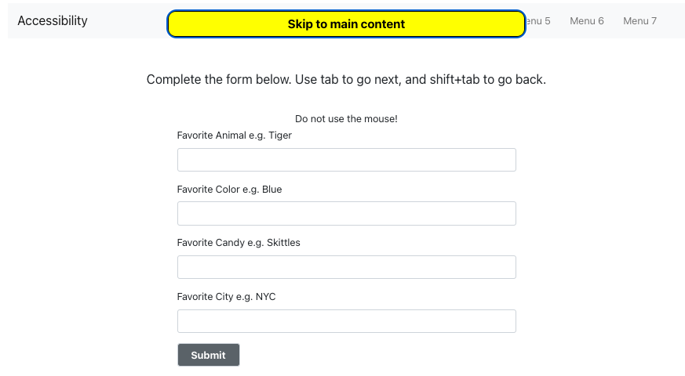
Exercise 2
In the next exercise, you are now unable to use the mouse to navigate the form, and you must use the tab button navigate
It’s not necessarily difficult, but can be tedious to navigate through every option on a page in order to reach the desired action
According to WGAC 2.4.1: Bypass Block Guidelines, create a button that will allow the user to skip straight to the form, bypassing the nav-bar buttons

Slide 9
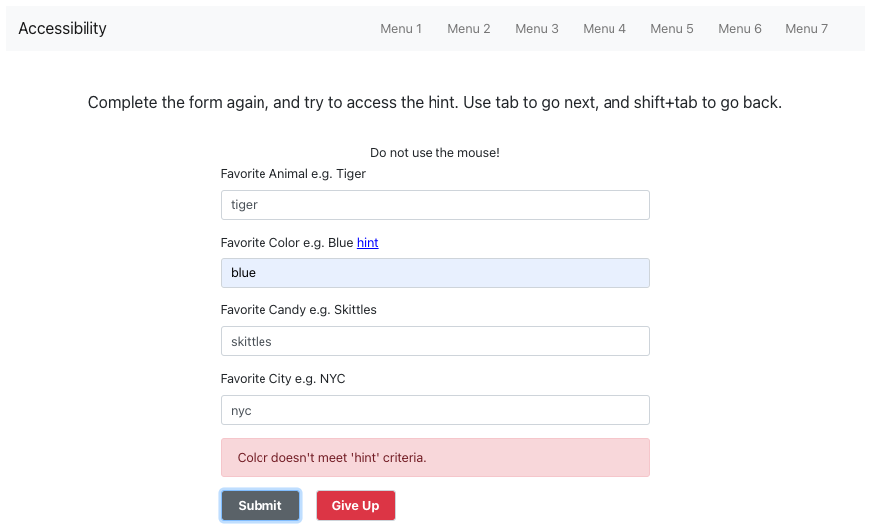
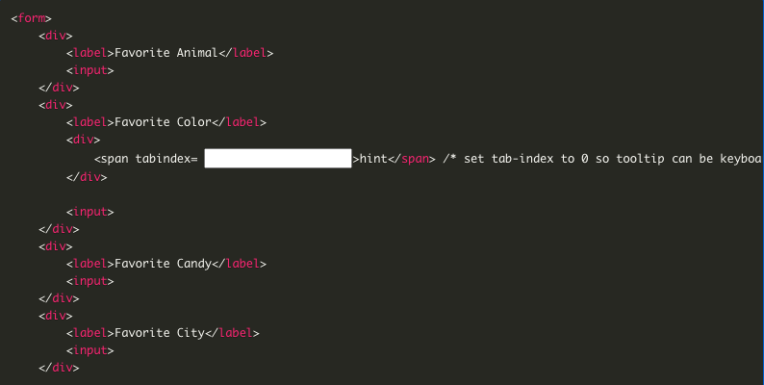
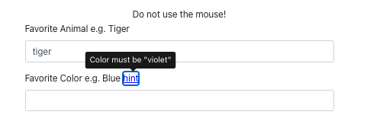
Exercise 3
In this exercise, there is an inaccessible hint button that gives the user the specified color that will allow the user to properly complete the form
By editing the tab index to 0, it will allow the hint button to now be accessible by using the tab button
As you can see the specified color from the hint button is violet, allowing the user to complete the form

Slide 10


Reinforcement
Now that you have completed the exercise, watch the following reinforcement videos in order to develop a deeper understanding of the importance of accessible software development for those who suffer from a dexterity impairment

Slide 11
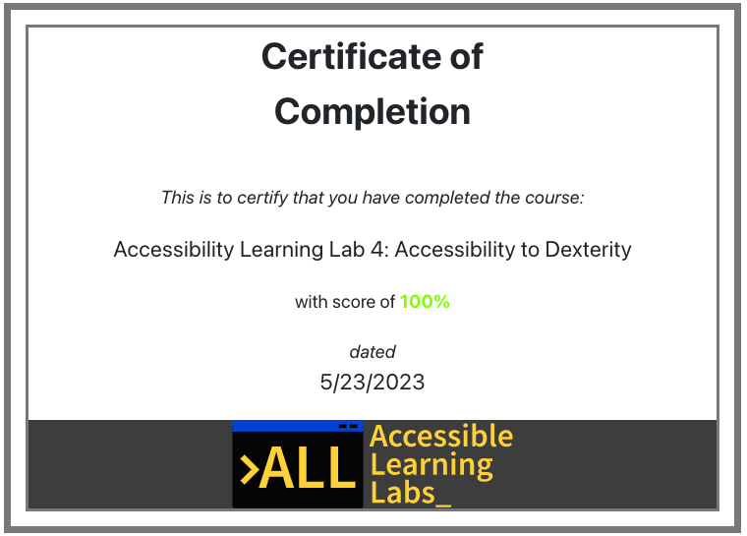
Quiz
You will now go through and complete a 5-question quiz in order to test your knowledge on the reading material, exercise, and reinforcement videos you just experienced
At the end, you will be given your score and a certificate that you have completed the lab

Slide 12
Post-Lab Discussion
The exercise you just completed demonstrated how minor changes can lead to big impacts for individuals with their respective disabilities
What are some other ways we can help those who suffer from suffer from a loss of fine motor control in software?
Do you feel like you now have a deeper responsibility to improve accessibility for those who may suffer from this disability?

Slide 13

Thank you! Any questions?
Rochester Institute of Technology
Accessible Learning Labs
Funded By the NSF
Contact Information
Professor Daniel Krutz
daniel.krutz@rit.edu
This material is based upon work supported by the National Science Foundation under grants #1825023, #2111152, #2145010

