Slide 1
Lab 6 Ethics of AI
Rochester Institute of Technology
Accessible Learning Labs
Funded By the NSF

Slide 2
Lab Overview
This lab introduces the ethics behind AI. The user will be introduced to what goes into the development of an AI and what needs to be done to make it ethical.
The exercise portion will bring the user through multiple scenarios where the AI has a bias against certain groups. The user will then be asked about the issues bias brings and asks the user to make changes to the AI.

Slide 3
Education Learning Objectives
Upon completion of this lab, participants will have achieved the following learning objectives:
Recognize different ethical challenges in AI
Practice consideration of ethics in a AI-related scenario
Diagnose ethical implications of choices made by AI
Assess impact and determine appropriate response to ethical scenarios

Slide 4
Lab Contents
Reading
Exercise
Reinforcement
Quiz
Discussion
Notes:
A lot of software isn’t built with accessibility in mind
Lack of accessibility material that is easily adoptable

Slide 5
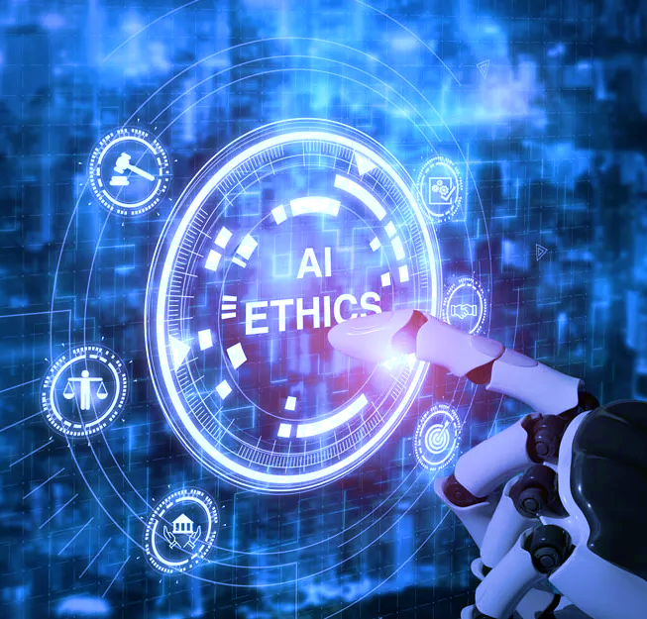
Reading
What is AI?
Artificial Intelligence (AI) studies human thought processes for task completion.
AI processes data using advanced algorithms to identify patterns or features.
AI algorithms are designed by humans and lack the ability to simulate human emotion.
AI does not have an IQ as it is not applicable to computers.
AI is currently used with big data to analyze user data and improve company practices for customer service.
Common Uses of AI
Self-driving cars, online shopping, streaming services and chatbots, cybersecurity/surveillance, surgery analytics and diagnosing diseases
A.C.L.U. vs Clearview AI
Clearview AI created a database with approximately 3 billion facial images obtained illegally without consent and supplied data to private companies and law enforcement
Clearview AI settled and agreed to limit image release to third-parties and implemented an opt-out option for the public regarding search results

Slide 6
Exercise Start
In the following exercise, you will be applying to work at a company called “MegaCorp”
During this process, you will experience an AI-powered candidate screening process
Unfortunately, the following AI has an issue that causes it to build bias against certain candidates
Once you’ve completed your own survey, you will receive a hiring decision
Good luck!
Notes:
Self-encapsulated educational accessibility material

Slide 7
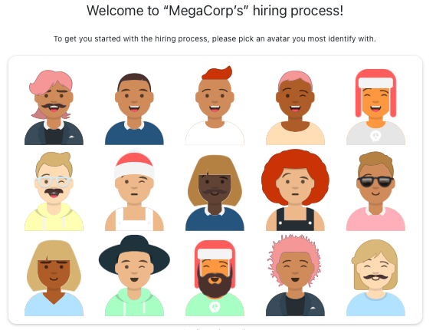
Exercise Part 1
First, select your avatar that you will use as your candidate photo
Notes:
Self-encapsulated educational accessibility material

Slide 8
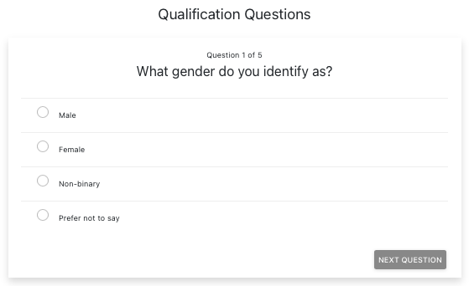
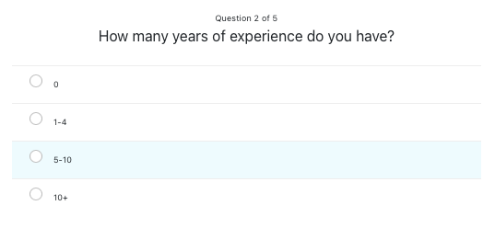
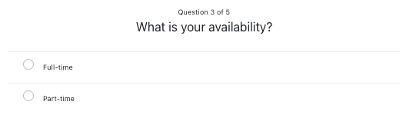
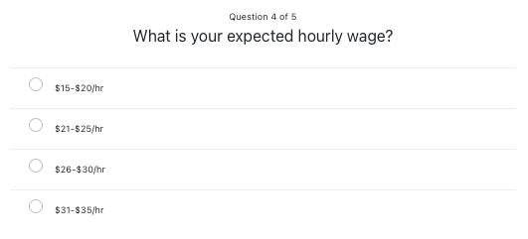
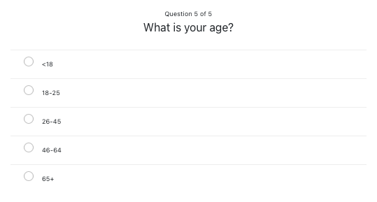
Exercise Part 1
Now, you will answer 5 ”Qualification Questions” that will determine your eligibility for the role and help the AI decide whether you’re qualified for the position

Slide 9
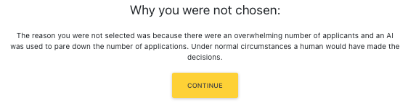
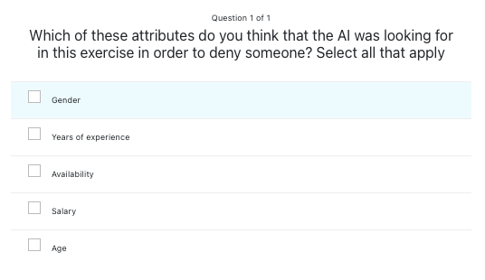
Exercise Part 1
Unfortunately, you are not chosen for the position, and are simply given an explanation that the AI made the decision instead of a human
Next, you are given a survey asking what you believe the reason was why you were not chosen

Slide 10
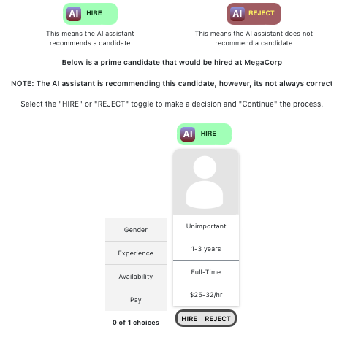
Exercise Part 2
In this portion of the exercise, you are now the hiring manager for MegaCorp, and will be handling the decision-making process with an AI assistant instead of a fully autonomous AI hiring bot.
You are given certain qualities the company is looking for in candidates
If the AI makes an error, you will be able to see it

Slide 11
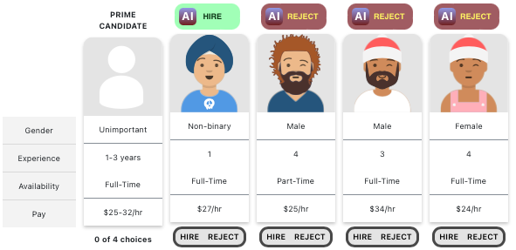
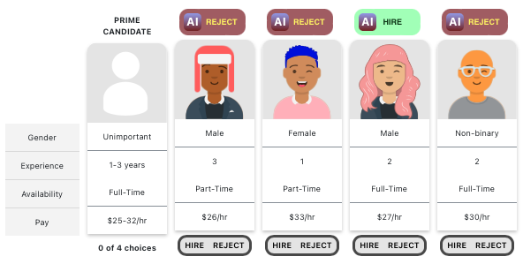
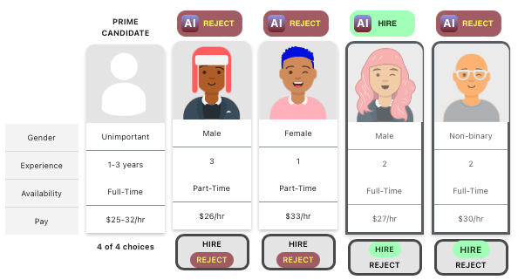
Exercise Part 2
You will now experience 4 rounds consisting of 4 candidates in each round
Above each candidate is the AI hiring recommendation based on preferred candidate qualities, and you are given the opportunity to hire based on your opinion as the hiring manager

Slide 12
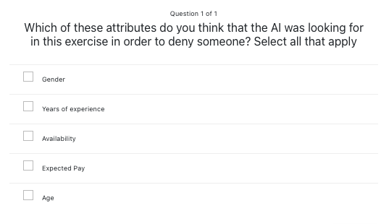
Exercise Part 2
As you just saw, the AI was incorrect on multiple candidates’ qualifications. Why do you think that is?

Slide 13
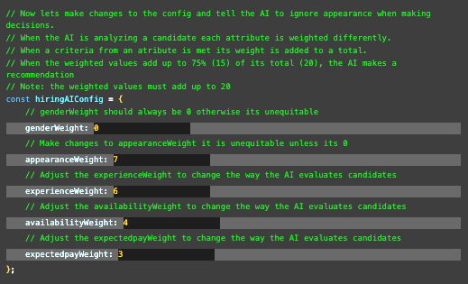
Exercise Repair
It was none of the listed reasons. The AI had been previously written to have a bias against candidates who wore hats or glasses
Obviously, this isn’t fair for potential candidates. Edit the code block to remove the weight (measure of bias) given to candidate appearance and update the following weights so that they add up to 20

Slide 14
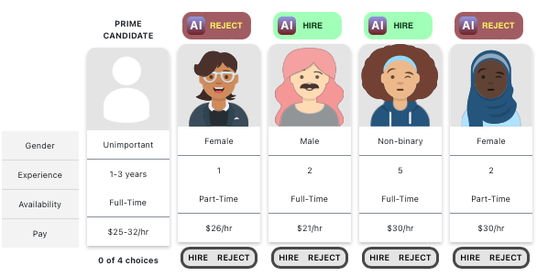
Exercise (Post-Repair)
With the newly updated weights in the AI, the decision making should no longer be biased against candidates wearing hats or glasses
The AI will now decide based on the weights of candidate experience, pay expectation and availability

Slide 15


Reinforcement
Now that you have completed the exercise, watch the following reinforcement videos in order to develop a deeper understanding of the importance of ethical AI

Slide 16
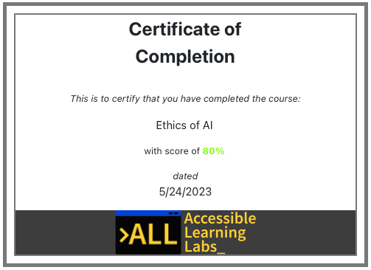
Quiz
You will now go through and complete a 5-question quiz in order to test your knowledge on the reading material, exercise, and reinforcement videos you just experienced
At the end, you will be given your score and a certificate that you have completed the lab

Slide 17
Post-Lab Discussion
How do you feel about AI and the violation of ethics that can occur if they are not properly developed or maintained?
What are some other way we can help keep AI from becoming biased against certain groups of people?
Where do you think implementation of AI could be most beneficial and where can it be most harmful?

Slide 18

Thank you! Any questions?
Rochester Institute of Technology
Accessible Learning Labs
Sponsored By the NSF
Contact Information
Professor Daniel Krutz
daniel.krutz@rit.edu
This material is based upon work supported by the National Science Foundation under grants #1825023, #2111152, #2145010

