Slide 1
Lab 7 AI Cybersecurity
Rochester Institute of Technology
Accessible Learning Labs
Funded By the NSF

Slide 2
Lab Overview
This lab will provide participants with a fundamental understanding of the core aspects of autonomous systems through a cybersecurity lens, which is a significant area of application for AI and Machine Learning
To strengthen this understanding, the participant will progress through a simulation of an autonomous system that will modify the access of sensitive files when security threats are present in the system

Slide 3
Education Learning Objectives
Upon completion of this lab, participants will have achieved the following learning objectives:
Recognize foundational components of a cybersecuritry-focused autonomous system
Use provided elements to demonstrate basic cybersecurity-focused autonomous systems in actions
Compose a minor alteration to an existing cyber security-focused autonomous system and assess its impacts
Recognize and identify the ethical impact of cyber security-focused autonomous system

Slide 4
Lab Contents
Reading
Exercise
Reinforcement
Quiz
Discussion
Notes:
A lot of software isn’t built with accessibility in mind
Lack of accessibility material that is easily adoptable

Slide 5

Reading
What is Cybersecurity?
Cybersecurity is the use of technology to protect systems, data, devices, and applications from cyber attacks and cyber crimes
Cybersecurity systems aim to protect those technologies from any malware that may attempt to exploit them
Why is Cybersecurity Important?
Cyber crime is a growing business, accounting for a loss of approx. one trillion dollars in 2020
Common cyber attacks include viruses, identity theft, password hacking, pop-up ads, and email phishing schemes
Machine learning can make cybersecurity simpler, cheaper, and more effective if properly developed
Fundamentals of Machine Learning
Supervised Learning
When machines are trained with labeled training data to predict output. There are two types of supervised learning: Regression and Classification
Unsupervised Learning
When machines are left alone and use algorithms to find hidden patterns in unlabeled data without human involvement
Two types of unsupervised learning tasks: Clustering and Association

Slide 6
Exercise Start
In the following exercise, you will observe a simulation of an autonomous cybersecurity system
5 files will be displayed, containing file name, sensitive content, sensitivity level, and access status
The system will simulate 10 rounds of the AI blocking a malware program from breaking in
When the simulation has ended, you will view the results, then determine the AI’s problem
Once you have fixed the AI, you will take a brief quiz testing your knowledge on utility equations
Notes:
Self-encapsulated educational accessibility material

Slide 7
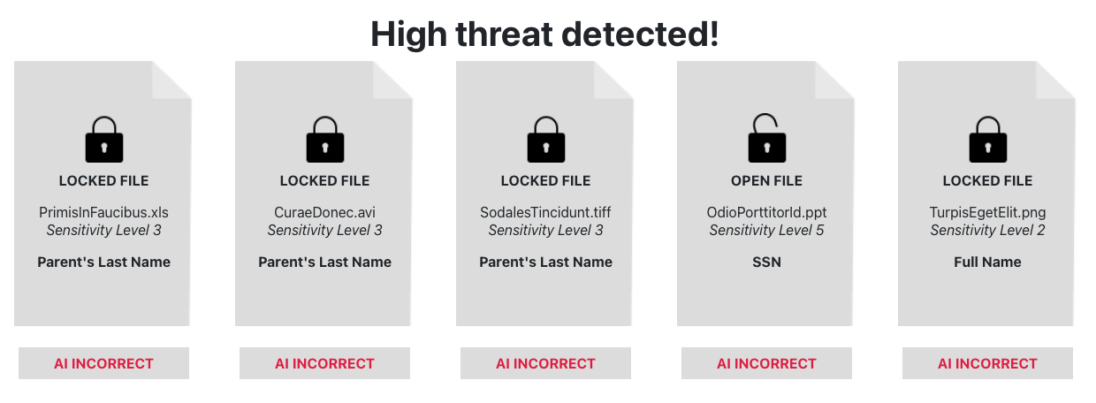
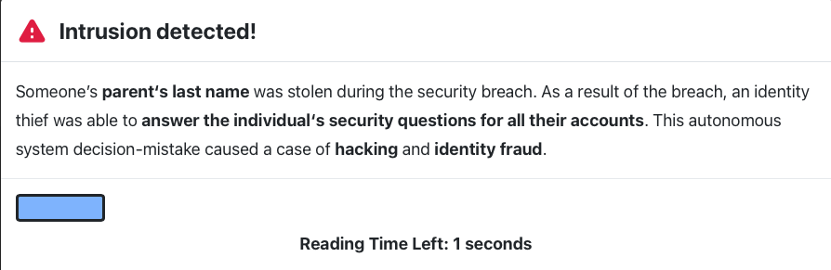
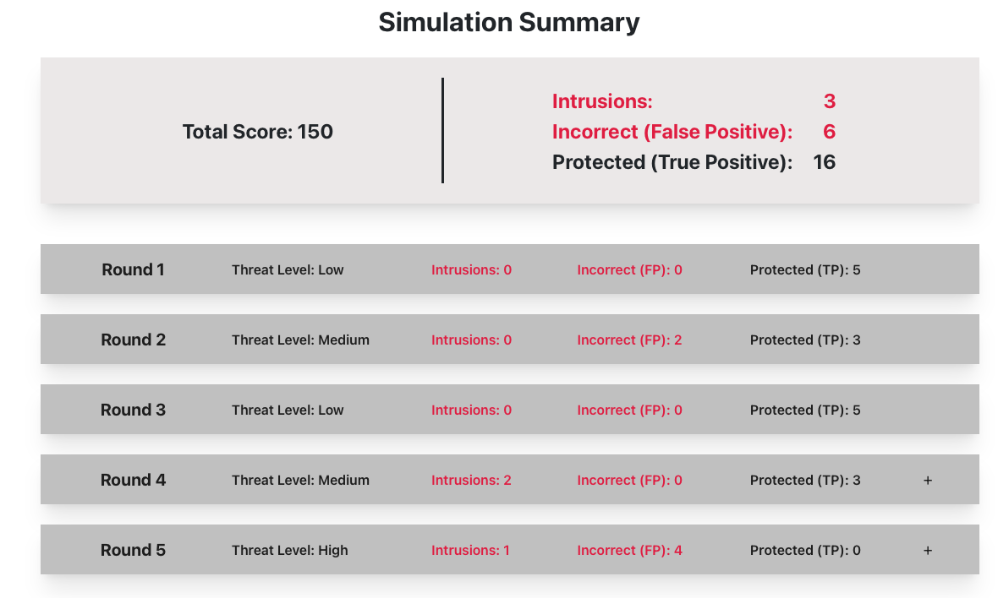
Exercise
The current AI is poorly designed, and allows for the cyber criminal to break into multiple files.
This is due to the AI only using one piece of sensitive information to determine file sensitivity.
Notes:
Self-encapsulated educational accessibility material

Slide 8

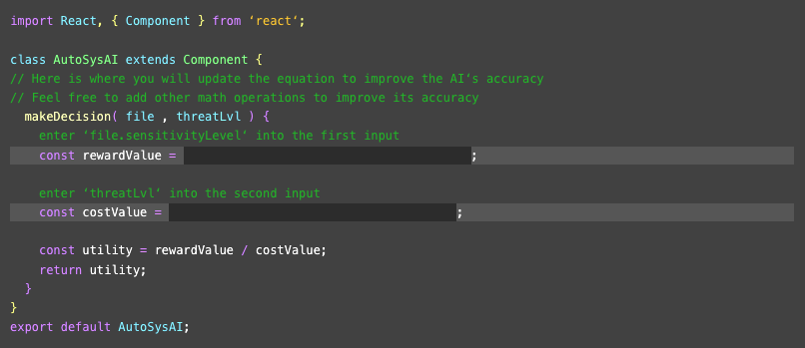
Exercise Repair
You will now create a utility equation that will improve the accuracy with which it scans and determines files sensitivity. I will be calculated by dividing the reward value by the cost value.

Slide 9
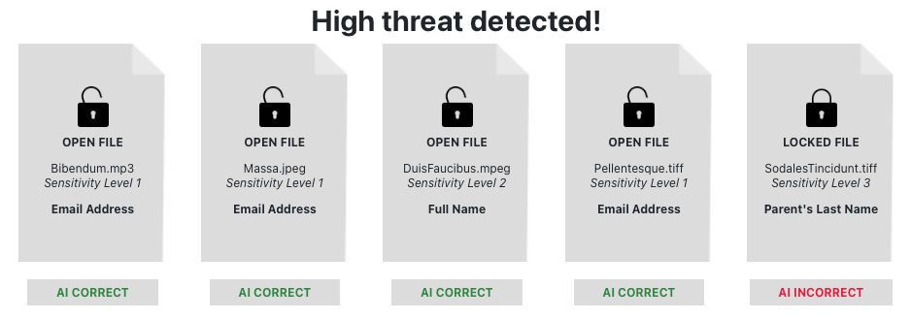
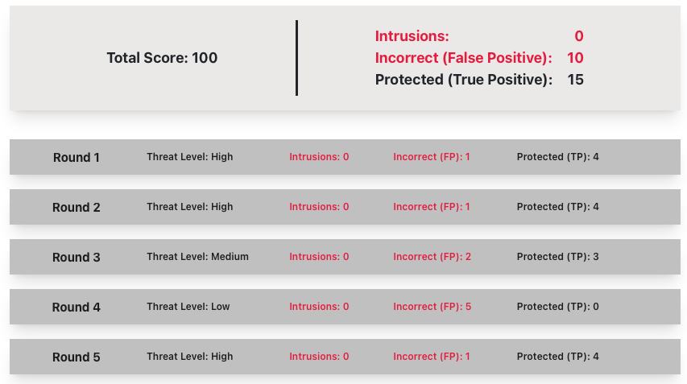
Exercise Round 2 (Post-Repair)
As you can see, the AI was able to properly identify and protect more files than the the version without the utility equation and did not allow any intrusions. It was especially effective when faced the higher threat level.

Slide 10


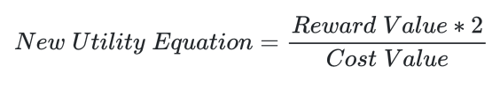
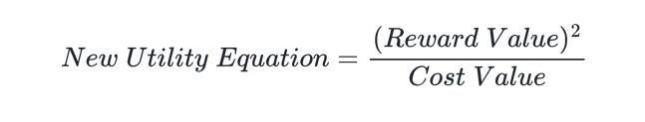
Utility Equation Quiz
As was discussed prior, utility equation are a vital part of machine learning that assigns values to certain actions that an AI system can take. You will now take a brief quiz to test your understanding about how differing utility equations can affect an autonomous system and whether is improves or reduces the AI’s accuracy.

Slide 11



Reinforcement
Now that you have completed the exercise, watch the following reinforcement videos in order to develop a deeper understanding of machine learning and autonomous systems

Slide 12
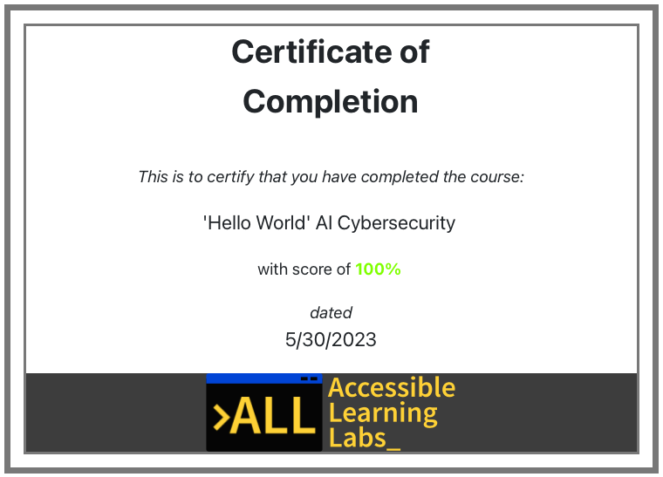
Quiz
You will now go through and complete a 5-question quiz in order to test your knowledge on the reading material, exercise, and reinforcement videos you just experienced
At the end, you will be given your score and a certificate that you have completed the lab

Slide 13
Post-Lab Discussion
How can ML/AI enhance cybersecurity defense?
What are potential risks involved with implementing ML/AI in cybersecurity?
Are there any ethical implications to consider when deploying autonomous systems into cybersecurity?

Slide 14

Thank you! Any Questions?
Rochester Institute of Technology
Accessible Learning Labs
Funded By the NSF
Contact Information
Professor Daniel Krutz
daniel.krutz@rit.edu
This material is based upon work supported by the National Science Foundation under grants #1825023, #2111152, #2145010

