Slide 1
INTRO / THE AVENGERS / MARCUS
We worked as an IT team for 5 weeks
WHO WE ARE
AT A GLANCE
5 weeks
Marcus Weeks
Team leader · Intro and cyber security
of client work
Charlie Broughton
The studio's computers · Conclusion
2 clients
Sorena Golbarg Lisar
Pizza program and network
an architecture studio and a pizza shop
Nah'Kajsha Reid
Live demo
THE AVENGERS • INTRODUCTION
01

Slide 2
INTRO / WHAT WE DID / MARCUS
Two clients, four jobs
01
Computers
12 workstations across 4 job roles, priced and checked with SQL.
NORTHWEST ARCHITECTURE STUDIO
02
Ordering program
Built in Flowgorithm, tested, fixed and retested until every test passed.
PENNINE PIZZA WORKS
03
Office network
Built in Filius, with all 8 network tests passing.
NORTHWEST ARCHITECTURE STUDIO
04
Online safety guide
A report on passwords, two-factor login, phishing and safe devices.
EVERYDAY USERS
THE AVENGERS • INTRODUCTION
02

Slide 3
INTRO / HAND-OVER / MARCUS
UP NEXT
Charlie Broughton
The studio's new computers · MP1 Computing
THE AVENGERS • INTRODUCTION
03

Slide 4
MP1 / COMPUTING / CHARLIE
A workstation built for 3D visualisation
THE WORKLOAD
Rendering, large 3D models and high-resolution textures
BUDGET / PER WORKSTATION
£3,750.00
Allocated budget
PROCESSOR
AMD Ryzen 9 9950X · 16 cores
GRAPHICS
NVIDIA RTX 5070 Ti · 16 GB VRAM
£3,445.21
MEMORY
64 GB DDR5 · 6000 MHz
SQL-reported workstation cost
STORAGE
2 TB NVMe SSD
DISPLAY
AOC U27B3A · 27-inch 4K IPS
£304.79 remaining
NORTHWEST ARCHITECTURE STUDIO • 3D VISUALISATION SPECIALIST
04
Notes:
Our first mini project was for the Northwest Architecture Studio, which needed workstation computers for different job roles.
My role focused on building a PC suitable for use by a 3D Visualisation Specialist. This job involves rendering, working with large 3D models and using high-resolution textures, so the computer needed to be powerful enough to handle demanding workloads.
I selected a Ryzen 9 9950X processor, an RTX 5070 Ti graphics card with 16 gigabytes of video memory, 64 gigabytes of RAM and a 2-terabyte NVMe SSD. I also selected a 4K monitor to help with detailed visual work.
The allocated budget was £3,750 per workstation. Our SQL database reports a total cost of £3,445, leaving £305 within the budget.

Slide 5
MP1 / COMPUTING / CHARLIE
Why each component was selected
01
CPU · Ryzen 9 9950X
16 CPU cores support demanding workloads and improve performance in rendering software that uses multiple cores.
02
GPU · RTX 5070 Ti
Dedicated graphics processing supports 3D visualisation; 16 GB VRAM accommodates complex scenes and high-resolution texture data.
03
RAM · 64 GB, 6000 MHz
Capacity for large 3D projects and assets, while allowing demanding applications and supporting software to run together.
04
Storage · 2 TB NVMe SSD
Room for large project files, with faster loading and saving than traditional hard drives.
05
Monitor · AOC U27B3A 4K IPS
4K resolution helps inspect fine visual detail, and IPS technology provides wide viewing angles for reviewing work.
NORTHWEST ARCHITECTURE STUDIO • 3D VISUALISATION SPECIALIST
05
Notes:
The components were chosen based on what the job actually needs, rather than simply choosing expensive hardware.
The processor's 16 cores help with demanding tasks such as multi-core rendering. The graphics card supports 3D visualisation, and its 16 gigabytes of video memory help accommodate complex scenes and detailed textures. The 64 gigabytes of RAM allow large projects and multiple demanding applications to run together.
The 2-terabyte SSD provides storage for large project files and helps with loading and saving. Finally, the 4K IPS monitor provides detailed resolution for reviewing visual work. Overall, the aim was to balance performance with the workstation's budget.

Slide 6
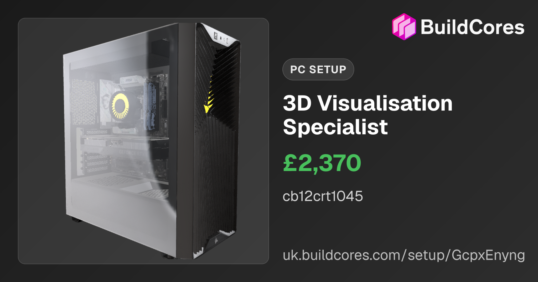
MP1 / COMPUTING / CHARLIE
Original BuildCores evidence
SQL TOTAL
3D Visualisation Specialist
£3,445.21
The BuildCores displayed total was incomplete. The SQL database calculates £3,445.21 from the hardware costs recorded in the database.
NORTHWEST ARCHITECTURE STUDIO • 3D VISUALISATION SPECIALIST
06
Notes:
This slide shows the original BuildCores evidence for my workstation.
The displayed BuildCores total was incomplete, so I used the hardware costs recorded in our SQL database to calculate the reported workstation total. That's why the figure shown in the SQL total box differs from the amount displayed in the BuildCores image.
It's important to distinguish between the original build evidence and the total calculated from the records in our database.

Slide 7
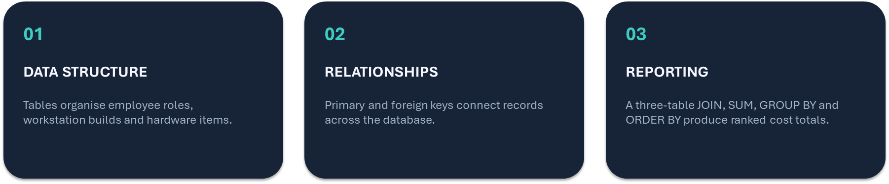
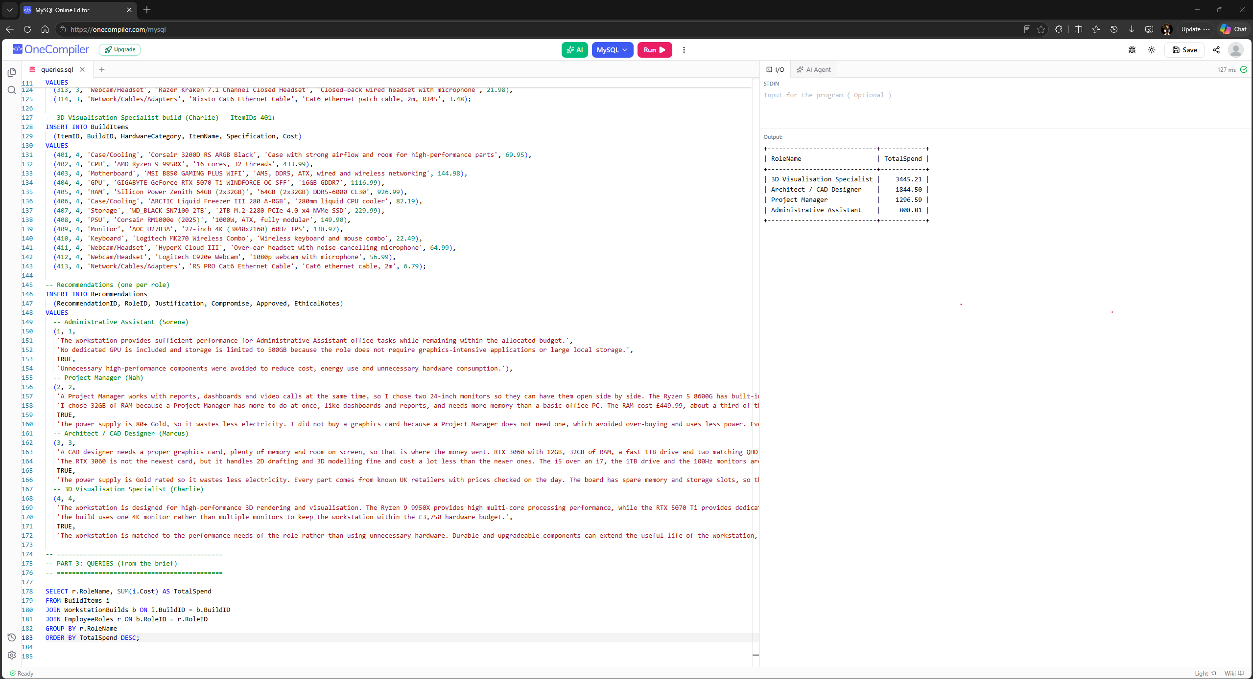
MP1 / COMPUTING / CHARLIE
SQL evidence: querying workstation costs
HOW THE QUERY WORKS
JOIN
Links hardware items, builds and roles
SUM
Calculates total hardware cost
GROUP BY
Produces one total per role
ORDER BY
Ranks the totals highest first
SQL RESULT £3,445.21
NORTHWEST ARCHITECTURE STUDIO • 3D VISUALISATION SPECIALIST
07
Notes:
To check the costs, I used an SQL query that joins the hardware items, workstation builds and employee roles tables.
The JOIN combines the related information. SUM adds the hardware costs together, GROUP BY produces a separate total for each role, and ORDER BY sorts those totals from highest to lowest.
For the 3D Visualisation Specialist, the query returns £3,445. This demonstrates how the database can turn the stored hardware information into a useful cost report.

Slide 8
MP1 / COMPUTING / CHARLIE
Workstations for the whole studio
ROLE
PCS
COST PER PC
BUDGET PER PC
UNDER BY
ALL 12 WORKSTATIONS
£21,132.53
Architect / CAD Designer
5
£1,844.50
£2,500.00
£655.50
total cost
3D Visualisation Specialist
2
£3,445.21
£3,750.00
£304.79
Administrative Assistant
3
£808.81
£950.00
£141.19
4 of 4
Project Manager
2
£1,296.59
£1,300.00
£3.41
roles under their budget per PC
SQL joins the build, hardware item and role tables to give one total per role. Budgets from the assessment brief, page 4.
NORTHWEST ARCHITECTURE STUDIO • WHOLE STUDIO
08
Notes:
Although my individual role focused on 3D visualisation, the overall project covered four workstation roles across the studio.
The SQL results show £1,845 for the Architect or CAD Designer, £3,445 for the 3D Visualisation Specialist, £809 for the Administrative Assistant and £1,297 for the Project Manager.
The different totals reflect the different recorded hardware requirements for each role. The database makes it possible to compare these costs and assess them against the allocated budget of £3,750 per workstation.
This completes my part of the Computing project. I'll now hand over to Sorena, who will cover the pizza ordering program and the studio network.

Slide 9
MP1 / HAND-OVER / CHARLIE
UP NEXT
Sorena Golbarg Lisar
The pizza program and the studio network · MP2 and MP3
THE AVENGERS • HAND-OVER
09

Slide 10
MP2 / SOFTWARE ENGINEERING / SORENA
What the program does
FOUR STEPS
HOW THE PROGRAM IS ORGANISED
01
Customer details
Main calls, in order:
Name, address and phone number
1. getCustomerDetails()
2. getPizzas()
02
Choose pizzas
3. choosePizzas()
Up to 6, each with a size and toppings
4. getDelivery()
03
Delivery
5. calcTotals()
Yes or no, delivery costs £2.50
6. displayBill()
04
The bill
Helper: pizzaPrice(), the price of one pizza, used by 3 functions
Every pizza, the discount and the total
PENNINE PIZZA WORKS • ORDERING PROGRAM
10
Notes:
It takes the customer's details, lets them order up to six pizzas, works out the price and prints a bill.
برنامه مشخصات مشتری رو می‌گیره، تا ۶ تا پیتزا سفارش می‌گیره، قیمت رو حساب می‌کنه و فاکتور چاپ می‌کنه.
I split the program into functions, and the Main function calls them in order.
برنامه رو به چند تا تابع تقسیم کردم و تابع Main اونا رو به ترتیب صدا می‌زنه.

Slide 11
MP2 / SOFTWARE ENGINEERING / SORENA
Every input is checked, then the total is worked out
EVERY INPUT IS CHECKED
WORKING OUT THE TOTAL
Name, address, phone
Cannot be blank
Subtotal
A for loop adds up pizzaPrice() for every pizza
Number of pizzas
1 to 6
−
Discount
10% if the subtotal is over £20, rounded to the nearest penny
Pizza size
0, 1 or 2
+
Delivery
£2.50 if the customer chose Y, otherwise £0
Toppings
0 or more
Delivery
Y or N
=
Total
What the customer pays
Each check is a while loop: it shows the message and asks again until the input is valid.
Small £3.25 · Medium £5.50 · Large £7.15
PENNINE PIZZA WORKS • ORDERING PROGRAM
11
Notes:
In Main, I declare the arrays and set the prices: Small £3.25, Medium £5.50 and Large £7.15.
The topping prices are stored in an array, where the index is the number of toppings.
توی Main آرایه‌ها رو تعریف می‌کنم و قیمت‌ها رو می‌ذارم: Small £3.25، Medium £5.50، Large £7.15.
قیمت تاپینگ‌ها توی یه آرایه‌ست که شماره‌ی هر خونه همون تعداد تاپینگه.
The getCustomerDetails function asks for the name, address and phone number, and doesn't allow any of them to be blank.
If something is left blank, a while loop shows "This cannot be blank, try again!" and asks again.
The getPizzas function asks how many pizzas the customer wants, and only accepts a number from 1 to 6.
The choosePizzas function asks for the size (0 to 2) and the number of toppings for each pizza, and rejects invalid inputs.
The getDelivery function asks if the customer wants delivery, and only accepts Y or N.
تابع getCustomerDetails اسم، آدرس و شماره تلفن رو می‌گیره و اجازه نمی‌ده هیچ‌کدوم خالی بمونه.
اگه چیزی خالی وارد بشه، یه حلقه‌ی while پیغام «This cannot be blank, try again!» رو نشون می‌ده و دوباره می‌پرسه.
تابع getPizzas تعداد پیتزا رو می‌پرسه و فقط عدد ۱ تا ۶ قبول می‌کنه.
تابع choosePizzas برای هر پیتزا سایز (۰ تا ۲) و تعداد تاپینگ رو می‌گیره و ورودی‌های اشتباه رو رد می‌کنه.
تابع getDelivery می‌پرسه مشتری ارسال می‌خواد یا نه، و فقط Y یا N قبول می‌کنه.
The pizzaPrice function works out the price of each pizza, and an if statement makes four or more toppings all cost £2.50.
The calcTotals function uses a for loop to add up the price of all the pizzas.
If the order is over £20, it gets a 10% discount, and delivery adds £2.50.
I round the discount to the nearest penny before working out the total, so the bill is never even 1p out.
تابع pizzaPrice قیمت هر پیتزا رو حساب می‌کنه، و با یه if، چهار تاپینگ یا بیشتر همه £2.50 حساب می‌شن.
تابع calcTotals با یه حلقه‌ی for قیمت همه‌ی پیتزاها رو جمع می‌زنه.
اگه جمع سفارش بالای £20 باشه، ۱۰٪ تخفیف می‌خوره و ارسال هم £2.50 اضافه می‌کنه.
تخفیف رو قبل از جمع کل تا نزدیک‌ترین پنی گرد می‌کنم تا فاکتور حتی یه پنی هم اشتباه نشه.

Slide 12
MP2 / SOFTWARE ENGINEERING / SORENA
Example bill and testing
========== BILL ==========
Number of pizzas: 3
Pizza 1: Small, 0 topping(s) - £3.25
Pizza 2: Large, 0 topping(s) - £7.15
Pizza 3: Large, 4 topping(s) - £9.65
Subtotal: £20.05
Discount: -£2.01
Delivery: £0.00
TOTAL: £18.04
£18.04
18
total, because the £2.01 discount is rounded before the total is worked out
tests run by Nah against the design
v1
First full version
v2
After testing
Before this fix, the same order came out 1p wrong on the bill.
v3
Matching the design
PENNINE PIZZA WORKS • ORDERING PROGRAM
12
Notes:
Finally, the displayBill function shows the bill: the name, address, phone number, number of pizzas, the price of each pizza, the discount, delivery and the total.
در آخر تابع displayBill فاکتور رو نشون می‌ده: اسم، آدرس، تلفن، تعداد پیتزا، قیمت هر پیتزا، تخفیف، هزینه‌ی ارسال و جمع کل.
Nah tested the program with 18 tests, and we fixed the problems that came up in versions 2 and 3.
For example, we fixed a rounding bug that made a £20.05 order 1p out, and we changed the error messages to match the design exactly.
Nah برنامه رو با ۱۸ تا تست امتحان کرد و ما مشکلاتی که پیدا شد رو توی نسخه‌ی ۲ و ۳ درست کردیم.
مثلاً یه باگ گرد کردن داشتیم که سفارش £20.05 رو یه پنی اشتباه حساب می‌کرد، و پیغام‌های خطا رو هم دقیقاً مثل طراحی کردیم.

Slide 13
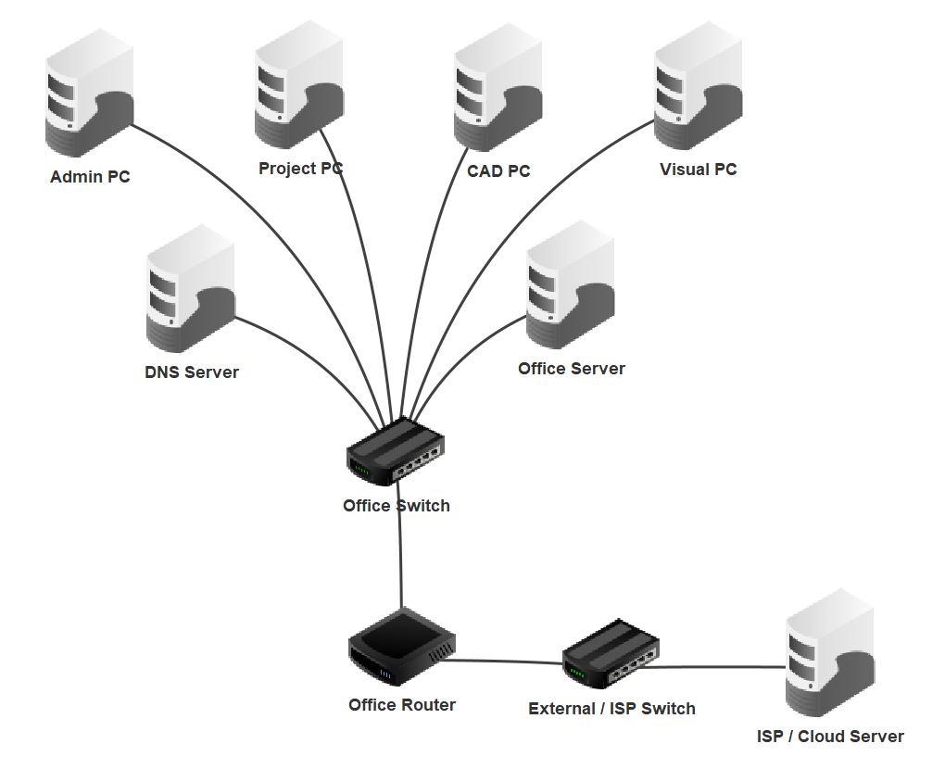
MP3 / NETWORKING / SORENA
The studio's network
THE JOB
Connect 4 staff PCs, an office server and a DNS server, and reach an outside cloud service.
Office LAN
192.168.10.0/24
Office Router
192.168.10.1 and 203.0.113.1
Outside network
203.0.113.0/24
DNS Server
turns names into IP addresses
NORTHWEST ARCHITECTURE STUDIO • OFFICE NETWORK
13
Notes:
Next, the network we built for the studio in Filius, for Mini Project 3.
The job was to connect the studio's 4 staff PCs, an office server and a DNS server, and let them reach an outside cloud service.
[Point at the top of the picture] The 4 PCs, the DNS Server and the Office Server all plug into the Office Switch. That's the office network, the LAN, on 192.168.10.
[Point at the bottom] The Office Router joins the office to the outside network on 203.0.113. The cloud server sits out there. It stands in for the internet.
Every office PC uses the router as its gateway, so anything leaving the office goes through it.
The DNS Server turns names into IP addresses, so staff can type a name like cloud.archstudio.example instead of a number.

Slide 14
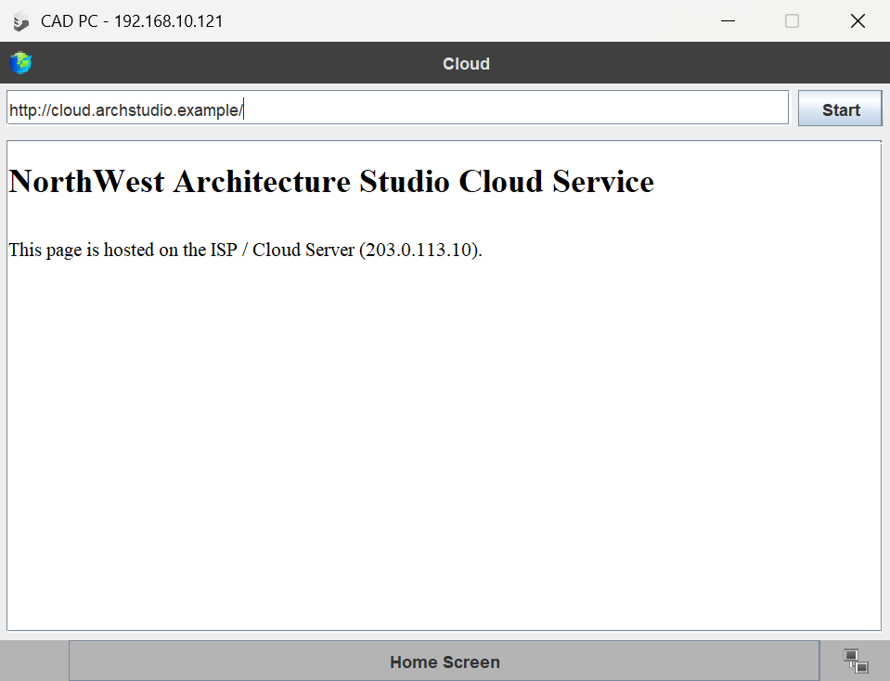
MP3 / NETWORKING / SORENA
Proof: all 8 tests passed
TESTS FROM THE CAD PC
1
Ping another PC
Pass
2
Ping the Office Server
Pass
3
Ping the DNS Server
Pass
4
Intranet page by IP address
Pass
5
Intranet page by name
Pass
6
Ping the cloud server
Pass
7
Cloud page by IP address
Pass
8
Cloud page by name
Pass
Test 8: the cloud page opened by name
NORTHWEST ARCHITECTURE STUDIO • OFFICE NETWORK
14
Notes:
We ran every test from the CAD PC, and all 8 passed.
Tests 1 to 3 were pings inside the office: to another PC, the Office Server and the DNS Server. Each one got 4 out of 4 replies.
Tests 4 and 5 opened the office intranet page, first by its IP address and then by its name. Opening it by name shows DNS works.
Test 6 pinged the cloud server through the router.
[Point at the picture] Tests 7 and 8 opened the cloud page by IP and by name. This is test 8.
We also found a fault. The cloud server had no web server, so tests 7 and 8 would have failed. We installed the web server, wrote its page and switched it on, and then both tests passed.
That's my part. Now Marcus will talk about staying safe online.

Slide 15
MP3 / HAND-OVER / SORENA
UP NEXT
Marcus Weeks
Staying safe online · MP4 Cyber security
THE AVENGERS • HAND-OVER
15

Slide 16
MP4 / CYBER SECURITY / MARCUS
Why people get hacked
THE PROBLEM
OUR GUIDE · 4 TOPICS
43%
01
Password hygiene
Marcus
of UK businesses found a breach or attack in the last 12 months
02
Two-factor authentication
Charlie
(DSIT, 2025)
22%
03
Phishing
Sorena
of the breaches Verizon studied started with stolen or compromised logins
04
Safe use of devices
Nah
(Langlois, 2025)
THE AVENGERS • CYBER SECURITY AWARENESS
16

Slide 17
MP4 / CYBER SECURITY / MARCUS
Password hygiene: what to do
DO
DON'T
REAL CASE
Three random words, or 15+ characters
(NCSC, N.D.a; NIST, 2025)
A different password for every account
(NCSC, N.D.b)
Use a password manager
(NCSC, N.D.b)
Turn on 2-step verification
(NCSC, N.D.b)
Rely on swaps like “P@ssw0rd”
(NCSC, 2021a)
Reuse passwords, even tweaked ones
(Das et al., 2014)
Change them on a set schedule
(NIST, 2025)
Rely on a password alone
(NCSC, N.D.b)
23andMe
£2.31m
fine from the ICO
An attacker used logins stolen in other breaches to reach 155,592 UK people's data.
(ICO, 2025)
THE AVENGERS • CYBER SECURITY AWARENESS
17

Slide 18
MP4 / HAND-OVER / MARCUS
UP NEXT
Nah'Kajsha Reid
Our work, running live · Live demo
THE AVENGERS • CYBER SECURITY AWARENESS
18

Slide 19
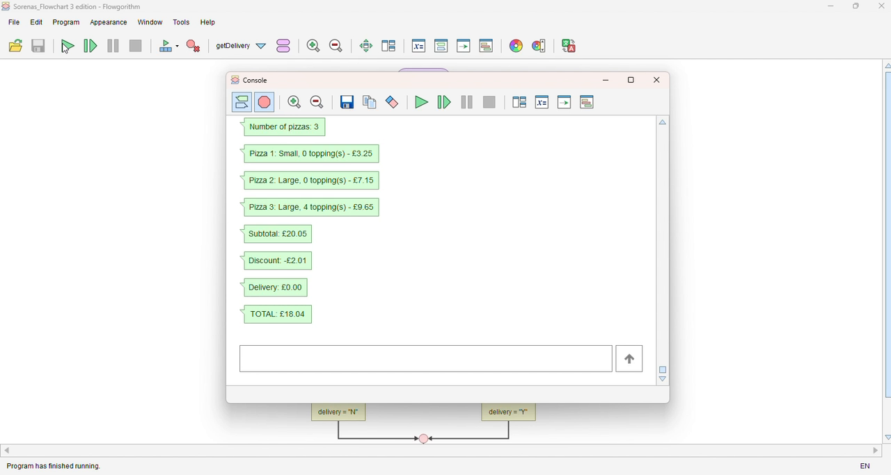
LIVE DEMO / NAH
Live demo: the pizza program running
THE AVENGERS • LIVE DEMO (PRE-RECORDED)
19

Slide 20
LIVE DEMO / HAND-OVER / NAH
UP NEXT
Charlie Broughton
What we learned · Conclusion
THE AVENGERS • HAND-OVER
20

Slide 21
CONCLUSION / FOUR PROJECTS, ONE TEAM / CHARLIE
Conclusion: what we learned
01
02
03
04
Computing
Pizza program
Networking
Cybersecurity
Matched workstation hardware to role requirements and budgets using BuildCores and SQL
Improved the program through versions and testing, fixing a rounding bug
Designed and simulated the office network, passing all eight tests
Explained practical ways to protect accounts, devices and everyday users
AI AND VERIFICATION
OUR BIGGEST LESSON
AI can support learning and problem-solving, but its output must be checked against requirements, tests and reliable sources.
Build it. Test it. Verify it.
Reliable solutions need teamwork, evidence and critical thinking.
THE AVENGERS • CONCLUSION
21
Notes:
Thanks, Nah.
Over the last five weeks, we've worked on four different projects, but they all showed us how computing can be used to solve real problems.
In our first project, we planned workstations for the Northwest Architecture Studio. We used BuildCores to select suitable hardware and SQL to organise the data and calculate the costs for all four job roles. This showed us the importance of matching technical requirements to a budget.
Our second project was the Pennine Pizza Works ordering program. We developed and improved the program through different versions, using testing to identify problems and make the program more reliable. The rounding bug was an example of why checking the output matters, even when a program appears to work.
For our third project, we designed and simulated the studio's office network using Filius. The network passed all eight tests, helping us demonstrate that the devices and connections were working as intended.
Finally, our cybersecurity awareness project focused on helping everyday users stay safer online. We covered topics such as password security, two-factor authentication, phishing and safe device use. This showed us that computing isn't just about building systems; it's also about protecting the people who use them.
We also considered how AI could support our work. AI can help explain unfamiliar concepts, suggest ideas and assist with drafting or troubleshooting, but its output cannot simply be assumed to be correct. We still need to check suggestions against our assignment requirements, test our programs and network, verify our SQL results, and use reliable sources for cybersecurity information. The responsibility for checking the final work remains with us.
Overall, our biggest lesson was that a solution isn't finished just because we've built it. It needs to meet the requirements, be tested and produce results we can explain and trust. Across all four projects, we developed our technical skills, problem-solving and teamwork.
Thank you for listening. We're happy to answer any questions.

