Slide 1
Programming Merit badge
© 2022 Benjamin Davis

Slide 2
What is programming?

Slide 3
What is programming?
How do we tell a computer what to do?
Instructions?
Language?
A step-by-step recipe

Slide 4
What Are We learning?
How did programming come to be?
What is a programming language? And what are some examples?
Why do we program?
What is intellectual property?
How do we program?
How do we make a living programming?

Slide 5
Safety First!

Slide 6
Safe Programming
Computers are powerful machines.
Make sure the computer is in good working order and the cables aren’t damaged
Keep liquids away from the computer
Looking for help
Even the best programmers use the internet to look for help
Cyber-chip and common sense

Slide 7
Safe Programming
Repetitive Strain Injuries
Lots of typing or repetitive motions can place strain on joints
Like tennis elbow, but from programming
How do we prevent it?
Take breaks
Stretch
Eye Strain
Long term focus and staring at a computer monitor can cause headaches and other issues
How do we mitigate the effects?
Take breaks

Slide 8
A Brief History of computers

Slide 9
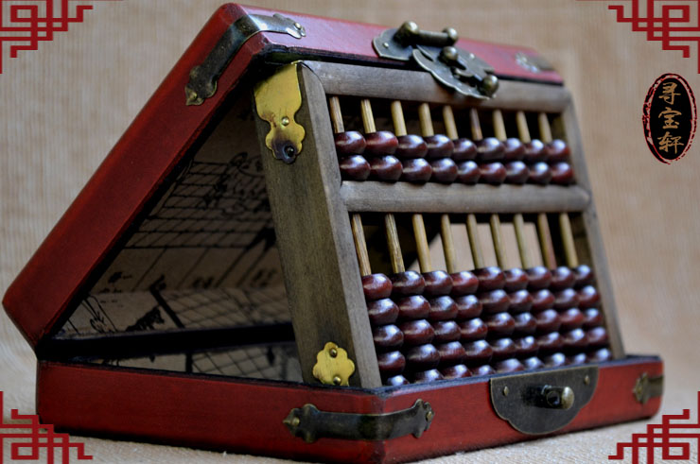
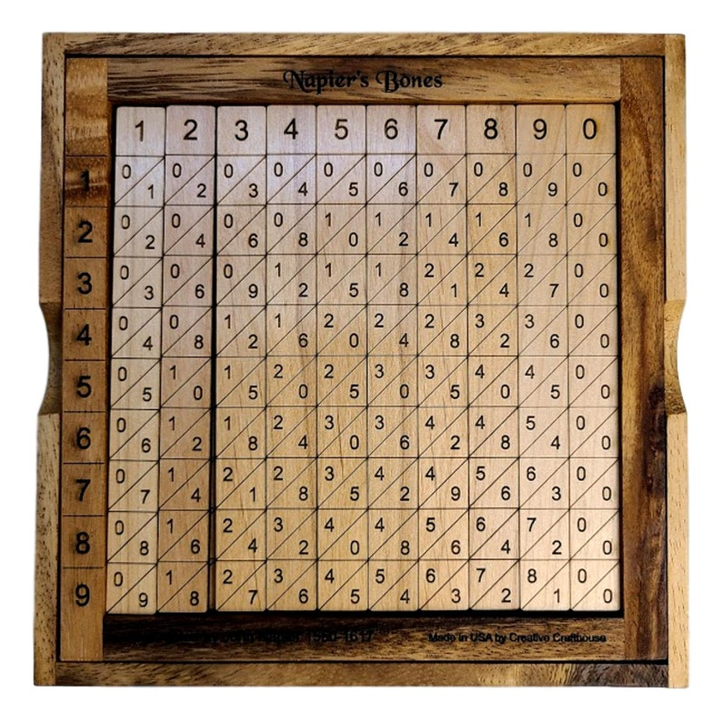
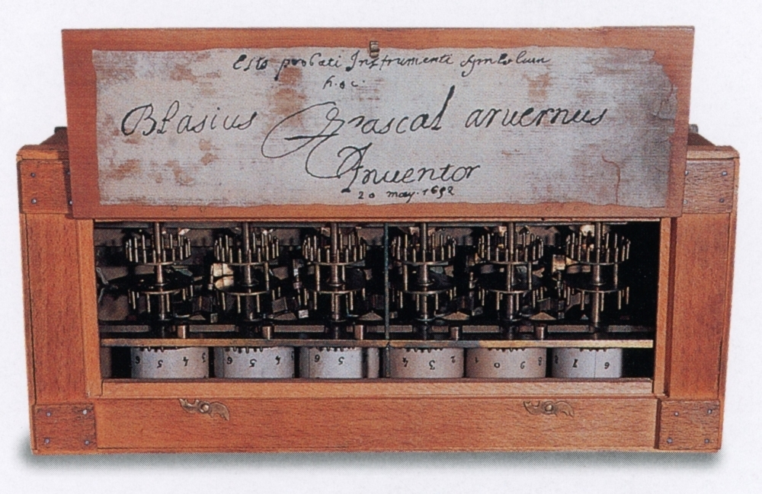
Earliest Computers
Abacus
Napier’s Bones
Pascaline

Slide 10
An origin of Terms
Where do we get the term “Computer”?
In the early 20th century people (mostly women) performed complex calculations by hand
They were called computers
When these calculations could be done via electronics the term followed

Slide 11
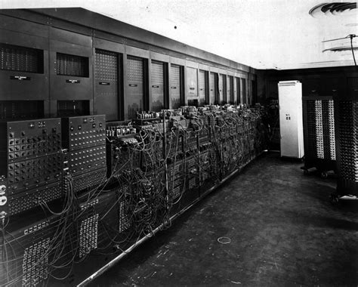
First Electronic computers
Room sized
Vacuum tubes, cables, and punch cards
First identifiable programming
Electronic Numerical Integrator and Computer (ENIAC)

Slide 12
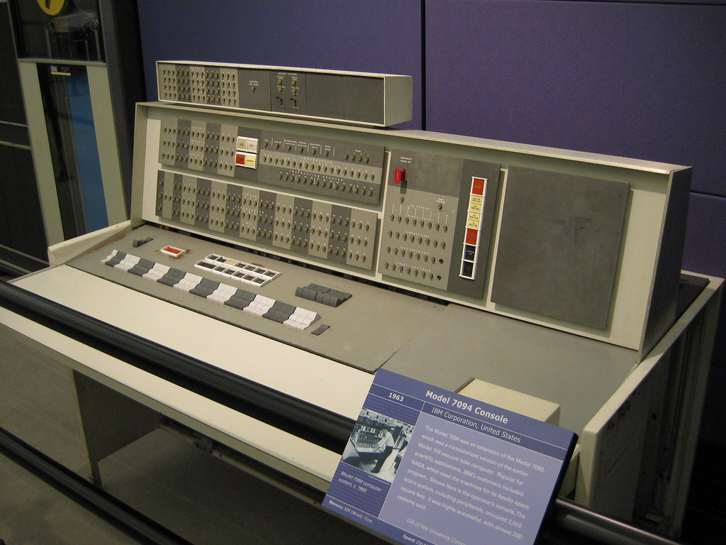
First Transistor computers (Late 50’s)
Used transistors rather than vacuum tubes
Punch cards
First identifiable programming languages
IBM 1620, IBM 7094, CDC 1604, CDC 3600

Slide 13
A Brief History of Programming

Slide 14
Types of Programming Languages
Machine Language
Assembly Language
Imperative and Declarative

