Slide 1
RailGuard
Track Geometry Defect Detection, Based upon SIH problem statement SIH25020(2025)
A low-cost automated prototype for real-time detection of gauge widening and cross-level track anomalies
01
Introduction & Problem Statement
02
Real-World Evidence
03
Objectives & System Design
04
Engineering & Build
05
Software & Validation
06
Dashboard, Timeline & Future Scope
1

Slide 2
01
Introduction & Problem Statement
2

Slide 3
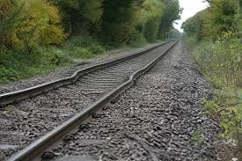
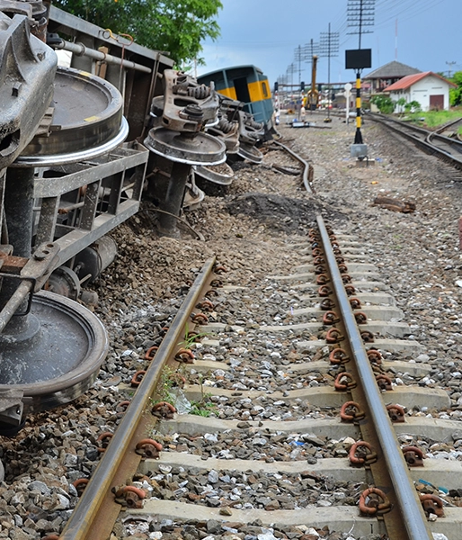
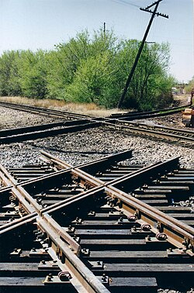
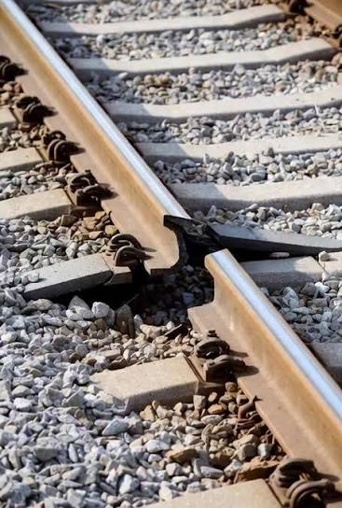
Problem Statement & Background
1
Derailment Risk
2
Gauge Widening
Track geometry defects account for a major share of freight and passenger train derailments globally.
Rails spread apart beyond permissible tolerances, risking catastrophic wheel drop between structural rails.
3
Cross-Level / Twist
4
Inspection Gaps
Elevation asymmetry between rails over short distances causes vehicle dynamic instability.
Manual track inspection is periodic, labour-intensive, and prone to gaps between maintenance cycles.
3

Slide 4
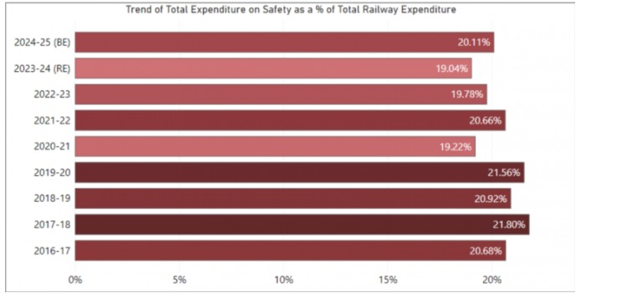
The Defect Is Often Small. The Consequence Isn't.
16
700+
2,93,030cr+
Accidents / derailments
Rail & weld failures
Track-safety allocation
linked to deficient track maintenance across selected zones, per national audit findings.
combined rail fractures and weld failures recorded across the same audited sections.
In the financial year(2026-27) the government of Indian government allocated this money for track safety allocation.
Source: centre of financial accountability
4

Slide 5
What a Rail Defect Can Look Like
SCHEMATIC OVERVIEW · USE THE MODEL TRACK TO RECREATE CONTROLLED DEFECTS
Gauge Widening:
Cross-Level / Twist:
Rails spread apart beyond the standard gap, increasing derailment risk at the widened section.
One rail sits higher than the other, or the track twists over a short distance.
Broken Rail :
Track Geometry Anomaly:
A fracture or separation forms in the running rail, often starting from a hidden flaw.
General alignment or geometry deviation along a stretch of track.
5

Slide 6
02
Real-World Evidence
6

Slide 7
When Track Defects Became Real Derailments
DOCUMENTED CASES:
Rail Failure / Old Flaw
Rail Fracture
A passenger express derailed after several coaches came off the track, resulting in fatalities. The audit record attributed the accident to rail failure from a pre-existing flaw, and noted overdue deep screening and gaps in track-recording coverage.
A passenger express derailed after a rail fracture; multiple coaches left the track and passengers were injured. The audit estimated a multi-crore figure in asset damage; the final safety investigation report was still pending.
Joint / Rail Fracture
Fatigue Crack → Rail Break
Several rear coaches of an express service derailed after a fracture near a rail joint, injuring passengers. Follow-up ultrasonic flaw-detection surveys found numerous additional defective welds and rails nearby.
A rail break was traced to a fatigue crack that started at clustered material inclusions and grew to critical length. The investigating authority recommended exploring real-time monitoring of track health.
7

Slide 8
International Cases & Research Sources
International Cases
Sources Referenced
A UK rail-accident investigation into a freight-train derailment at a station identified gauge widening as a contributing factor.
An Australian transport-safety investigation into a separate freight derailment identified rail-head fracture and gauge-widening evidence as contributing causes.
National Comptroller & Auditor General (CAG) audit report
Commissioner of Railway Safety (CRS) action-taken report
Press Information Bureau (PIB) releases
PRS Legislative Research analysis
UK Rail Accident Investigation Branch (RAIB)
Australian Transport Safety Bureau (ATSB)
8

Slide 9
Government Spending on Railway Safety
SAFETY-RELATED RAILWAY FIGURES — NOT A DEFECT-SPECIFIC BUDGET
Safety-related expenditure / budget (₹ crore)
Track infrastructure safety
Reported allocation in the tens of thousands of crores for the latest budget year.
Track renewals
Tens of thousands of kilometres of track renewed in recent years nationally.
9

Slide 10
03
Objectives & System Design
10

Slide 11
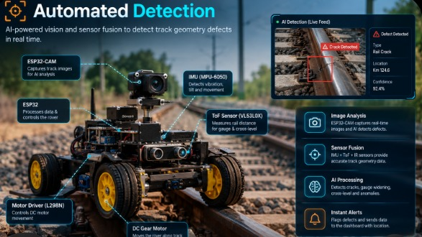
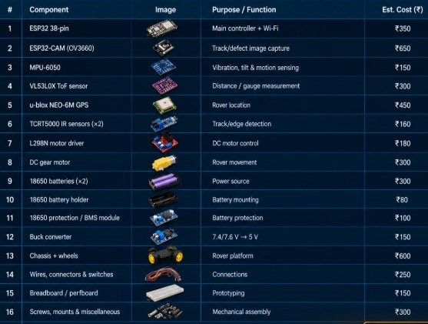
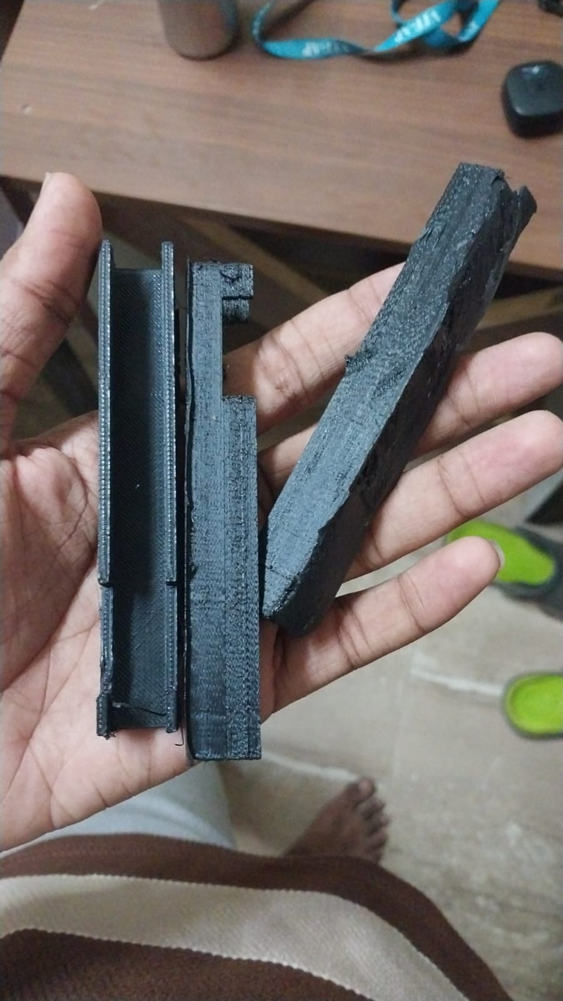
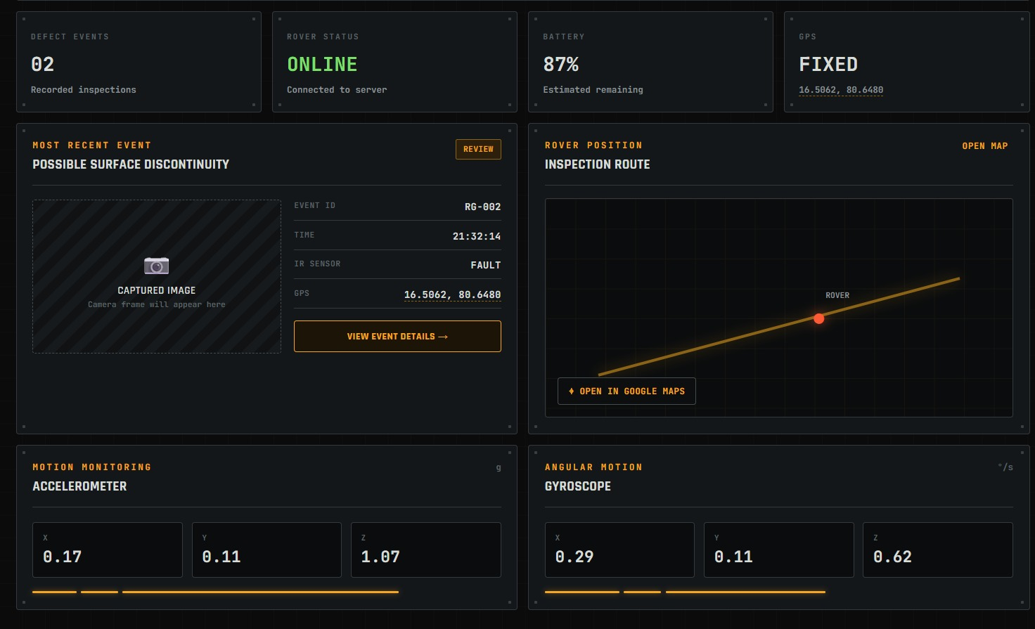
Project Objectives & Scope
1
2
3
4
Automated Detection
Low-Cost Design
3D-Printed Testbed
Live Web Dashboard
Build a scaled motorized cart that detects gauge-widening and cross-level/twist anomalies in real time.
Use off-the-shelf microcontrollers and accessible sensors to keep the build within a modest student budget.
Design a modular 3D-printed test track with calibrated defect zones for repeatable validation.
Host an on-board WiFi web server providing real-time telemetry to any laptop or phone.
11

Slide 12
System Architecture
1
2
3
Mechanical Layer
Sensing & Compute
Presentation Layer
Modular 3D-printed interlocking track with known defect sections. Rolling chassis with flanged wheels driven by a constant-speed DC gear motor.
Microcontroller with integrated WiFi. Dual distance sensors (gauge) + 6-DOF IMU (tilt) + rotary encoder (position).
On-board HTTP web server serving a live HTML dashboard. Real-time fault mapping shows the precise track location of flagged anomalies.
12

Slide 13
System Working Principle
Constant Speed Traversal The motorized cart moves along the track while the position sensor tracks cumulative displacement from the origin.
1
Continuous Gauge Measurement Opposing distance sensors measure the inward distance to each rail flange; the sum deviation indicates gauge widening or narrowing.
2
Cross-Level / Tilt Profiling The IMU measures roll angle in real time to calculate elevation difference across the left and right rails.
3
Real-Time Threshold Evaluation Sampled values are compared against programmed baseline ranges; out-of-bound readings trigger defect flags with distance coordinates.
4
Telemetry Stream Defect records are instantaneously updated to the local web dashboard for remote inspection.
5
13

Slide 14
04
Engineering & Build
14

Slide 15
Methodology Justification
Why Deterministic Threshold Logic?
Key Advantages for Capstone Scope
Track gauge and cross-level tilt are physical, scale-invariant geometric dimensions. Physical safety limits apply directly regardless of scale or AI classification models.
Direct, deterministic numeric comparison eliminates black-box model uncertainty and ensures reliable execution.
Zero Training Data Needed — Eliminates the requirement for thousands of labelled dataset images.
Deterministic Verification — Every flagged defect is traceable to physical mathematical bounds.
Low Computational Overhead — Runs efficiently on microcontrollers without dedicated AI hardware accelerators.
15

Slide 16
Bill of Materials & Budget
Category | Component | Qty | Function | Est. Cost (Rs.)
Structure | 3D-Printed Track & Cart Chassis (PLA) | 1 set | Modular defect track & rolling body | ~800 – 1,000
Compute | WiFi Microcontroller (ESP32)+Camera+ESP32 | 2 | Sensor reading, decision logic & web server | ~1000
Sensing | Distance Sensors + IMU + Encoder+MPU6050+VL53L0X+GPS(module)+TCRT5000+IR | 8 | Gauge measurement, tilt profiling & position tracking | ~3000
Drive & Power | Geared Motor, Driver & Battery Pack | 1 set | Propulsion, power management & regulation | ~600 – 700
 |  |  | Total Estimated Build Cost | ~Rs.4,500-5000
.
16

Slide 17
Hardware & Circuit Design
⚡
⚡
⚡
Power Isolation Architecture
Signal Conditioning
Noise Decoupling
Separate power rails for motor power and sensor/compute logic, sharing a common ground — prevents inductive motor voltage spikes from resetting the microcontroller.
Resistor voltage dividers adjust sensor logic levels to match the microcontroller's 3.3V GPIO input tolerances, preventing pin degradation.
Decoupling capacitors suppress electrical noise to ensure stable sensor readings during active motor drive.
17

Slide 18
05
Software & Validation
PRESENTED BY PRESENTER 5
18

Slide 19
Firmware & Calibration Approach
Calibration Sketch (Stage 1)
Full Detection Firmware (Stage 2)
Uploaded first — prints raw sensor readings (distance sum, roll angle) to a serial monitor so real baseline and tolerance values can be measured directly from the printed track.
Baseline noise is recorded on a clean section; peak deviation is recorded by rolling slowly across each known defect section.
Reads both distance sensors and the IMU on a fixed sampling interval
Tracks cumulative cart position from encoder pulses
Flags a timestamped, positioned defect when a reading exceeds tolerance
Drives the motor at a constant speed for repeatable traversal
Hosts its own WiFi access point and serves the live dashboard
19

Slide 20
Software Execution Flow
1. Calibration
2. Sampling
3. Comparison
4. Dashboard Log
Upon power-up on a known standard segment, baseline gauge and roll-angle values are sampled and saved.
High-frequency sampling of left/right distance sensors, 6-axis accelerometer/gyroscope, and wheel encoder pulses during movement.
Evaluation against programmed tolerance bounds for both gauge deviation and roll deviation.
When an anomaly exceeds limits, an event with the exact track position is logged and pushed to the web UI.
→
→
→
20

Slide 21
Validation & Testing Approach
Test Stage | Simulated Condition | Expected Response | Pass Criterion
Clean Track | Nominal track without defects | Continuous position updating; zero false anomaly flags | 100% true-negative rate
Gauge Defect | Track segment with artificial gauge widening | Flags gauge-widening defect at correct track position | Positional error < 15mm
Cross-Level Defect | Track section with single-rail elevation dip | Flags cross-level/twist anomaly on live dashboard | Correct tilt magnitude detected
Repeatability | 5 consecutive full-track runs | Identical defect locations logged consistently | High repeatability index
21

Slide 22
06
Dashboard, Timeline & Future Scope
23

Slide 23
The Live Web Dashboard
What It Shows
Why It Matters
Dashboard — track status, defect counter, battery, GPS, latest event
Alerts — full event log with ID, time, type, IR state, GPS, status
Images — camera-capture gallery for each detected abnormality
Sensors — live accelerometer & gyroscope telemetry, IR indicator
Location — GPS map view with a direct Google Maps link
Settings — telemetry, notification & upload toggles
Hosted directly by the microcontroller's own WiFi access point — no internet needed. The page auto-refreshes so a reviewer watching the dashboard during a live run can see a defect appear, get logged with its exact position, and be pinned on a map in real time.
A “simulate defect” control lets the team demonstrate the alert flow on demand, and a toast-notification system highlights every new event as it happens.
24

Slide 24
Scalability & Future Scope
↗
↗
↗
↗
Full-Scale Deployment
Optical Crack Scanning
GPS & Cellular Telemetry
Energy Harvesting
Mounting inspection pods on revenue train bogies for continuous commercial track scanning.
Integrating IR surface scanners paired with high-speed camera triggers to capture rail-head micro-fractures.
Replacing the local WiFi dashboard with a GSM/GPS module for cloud-based centralized dispatching.
Harnessing wheel-rotation axle generators for continuous, self-powered autonomous operation.
26

Slide 25
Thank You
RailGuard: Track Geometry Defect Detection
27

