Slide 1

EDA on Crypto Currency(Coin Market Cap) Analysis
Presented By
Praveen Allada

Slide 2
Project Overview
Objective:-
The objective of this project is to perform Exploratory Data Analysis (EDA) on cryptocurrency market data sourced from CoinMarketCap. The analysis provides insights into market structure, price distributions, liquidity, and dominance of leading cryptocurrencies.

Slide 3
Problem Statement
The global cryptocurrency market is vast and highly volatile, with thousands of assets differing in price, market capitalization, trading activity, and stability.
Investors, analysts, and policymakers face challenges in:
Identifying the most influential cryptocurrencies (e.g., Bitcoin, Ethereum).
Understanding the distribution and concentration of market capitalization across assets.
Assessing liquidity through 24h trading volumes.
Measuring short-term volatility using metrics such as 24h Change.
Comparing stablecoins vs. non-stablecoins in terms of market share.
Notes:
The crypto market is highly volatile, with assets differing in price, market cap, liquidity, and stability. Key insights focus on identifying leaders (Bitcoin, Ethereum), analyzing market share distribution, and comparing stablecoins vs. non-stablecoins.

Slide 4
Project Objectives – Web Scraping
Automate data extraction from websites using Python libraries (requests, BeautifulSoup).
Collect structured data (e.g., product details, cryptocurrency metrics, job listings) from unstructured web sources.
Handle pagination and dynamic content to ensure complete and accurate data retrieval.
Store scraped data into formats like CSV, Excel, or databases for further analysis.
Perform data cleaning and preprocessing to make raw scraped data analysis-ready.
Enable real-time or periodic updates to track changes in the scraped data (e.g., price fluctuations, new listings).
Support analytics and decision-making by creating a reliable dataset for visualization and insights.

Slide 5
Dataset Overview
Source: CoinMarketCap (scraped via API/pagination)
Name : Crypto Currency Name
Symbol : Short code for Crypto Currency
Price : Price of Crypto Currency
Market Cap : Total Market Capitalization
24h Change(%) : Crypto Currency change percentage in last 24 hours
7d Change(%) : Crypto Currency change percentage in last 7 days
Volumne 24h : Total trading volume of crypto currency in last 24 hours
Circulating Supply: Available crypto coins to public

Slide 6
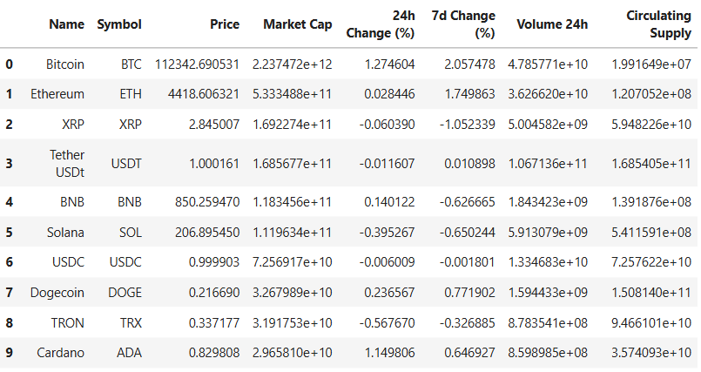
Dataset Overview

Slide 7
Descriptive Statistics
Central Tendency
Mean of Price : - $120.5056
Median of Price :- $0.0996
Mean of Market Cap : - 3248246410.1696($3.25 Billions)
Median of Market Cap :- 45246960.7794($0.0452 Billions)
Standard Deviation of Price :- $ 3257.6319
Variance of Price :- 10612165.8906 ($10.61 Millions)

Slide 8
Quartiles(Q1,Q2,Q3) & IQR
Q1(25%) : 0.020224
Q2(50%) : 0.099640
Q3(75%) : 0.601950
Interquartile Range (IQR) : Q3 – Q1 :- 0.5817256375363037

Slide 9
Skewness & Kurtosis
Skewness of Price : 34.1659
Here Skewness of price is greater than 0
It is a positively skewed because most of the coins are cheap but Bitcoin and Ethereum are costly while comparing with others coins
Kurtosis of Price : 1177.4971
Kurtosis of Price greater than 3 so it is called Leptokurtic.
Here we have more outliers than normal.

Slide 10
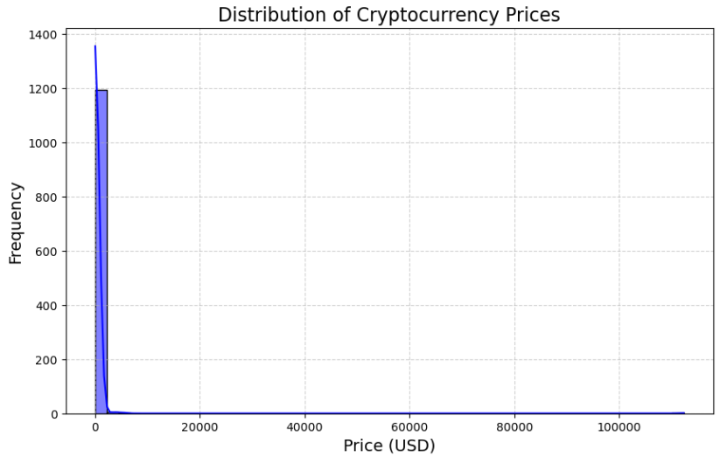
Histogram + KDE distribution plot for Price
Right-Skewed Distribution
The histogram shows a heavy concentration of coins priced at the lower end.
The KDE curve confirms this with a steep peak on the left and a long tail stretching right, indicating a positive skew.
Interpretation: Most cryptocurrencies are low-priced, but a few (like Bitcoin, Ethereum) are extremely high, pulling the average up.
Notes:
Name: Histogram of Cryptocurrency Prices with KDE
Purpose: To show the distribution of cryptocurrency prices across different ranges.
Insight:
Most cryptocurrencies are priced very low (clustered near zero).
Only a few have very high prices, which creates a right-skewed distribution (positive skewness).
This highlights the imbalance: the majority of tokens are cheap, while a few (like Bitcoin) dominate the higher price range.

Slide 11
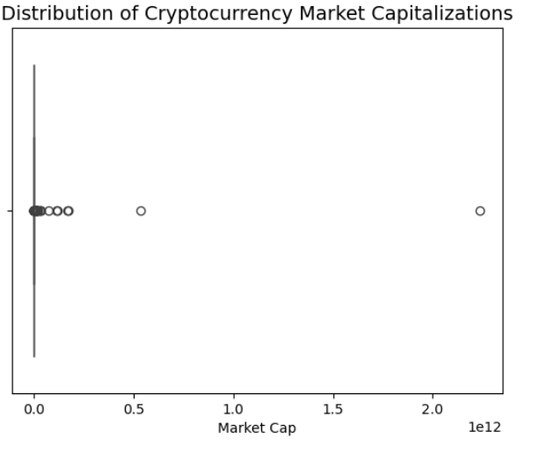
Univariate Analysis
Here we used Market Cap column for univariate Analysis
Here we find extreme right skew
Here most of the coins price range between low cap range but BitCoin and Ethereum prices are too high
Notes:
Chart Type : Box Plot of Cryptocurrency Market Capitalizations
Purpose: To show the distribution, median, quartiles, and outliers in the data.
Insight: Most cryptocurrencies have very small market capitalizations clustered near zero, while a few (like Bitcoin, Ethereum) are extreme outliers with very high market caps.

Slide 12
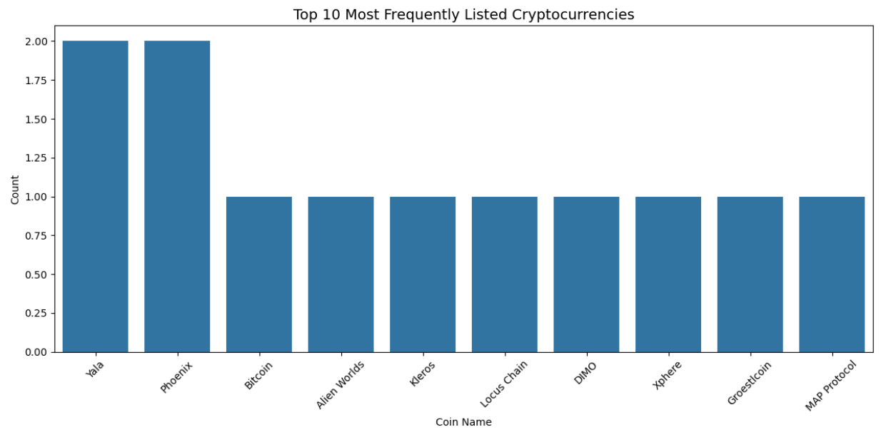
Univariate Analysis
Exchange Strategy: Coins with high listing frequency may be part of a broader strategy to increase visibility across platforms, possibly indicating marketing pushes or partnerships.
Brand Recognition: Frequent listings often correlate with strong branding. These coins may have memorable names, active communities, or viral appeal.
Notes:
Chart Type: Histogram/Bar Distribution
Explanation: Market Cap is extremely right-skewed. Most coins are low-cap, while Bitcoin and Ethereum dominate the top end.

Slide 13
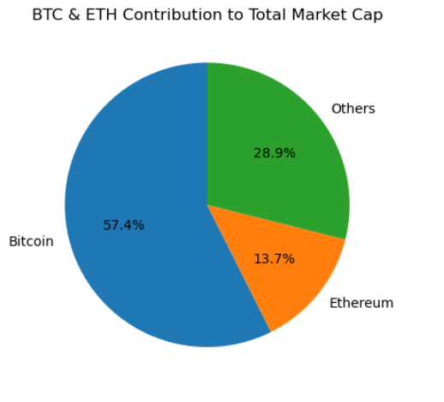
Univariate Analysis(Proportion Analysis)
BitCoin occupy 57.4% of Market
Etherium occupy 13.7% of Market
Other Coins 28.9% rest of the Market
Notes:
Chart Type: Pie Chart
Explanation:
Bitcoin = 57.4% of total market cap
Ethereum = 13.7%
Other coins = 28.9% → Shows BTC dominance in crypto market.

Slide 14
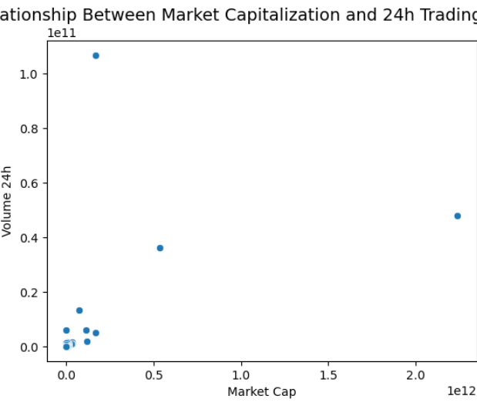
Bivariate Analysis
Positive Correlation
The scatter plot shows a general upward trend: coins with higher market caps tend to have higher 24h trading volumes.
Clustered Low-Cap Coins
Interpretation: Most cryptocurrencies are small-cap and lightly traded.
Outliers
These are likely your top-tier coins (Bitcoin: $2.24T, Ethereum: $533B).
Notes:
Chart Type: Scatter Plot
Explanation:
Positive correlation: Higher market cap coins have higher 24h volumes.
Clusters: Most coins are small-cap & lightly traded.
Outliers: BTC & ETH dominate volume and cap.

Slide 15
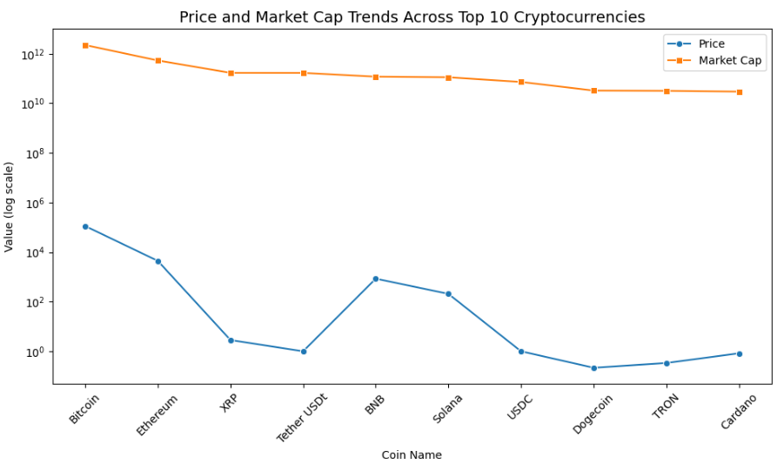
Bivariate Analysis
Spot coins with high market cap but low price (e.g., stablecoins).
Compare how price and market cap scale across coins
Spot coins with high market cap but low price (e.g., stablecoins)
Identify coins where price and market cap rise together (e.g., BTC, ETH).

Slide 16
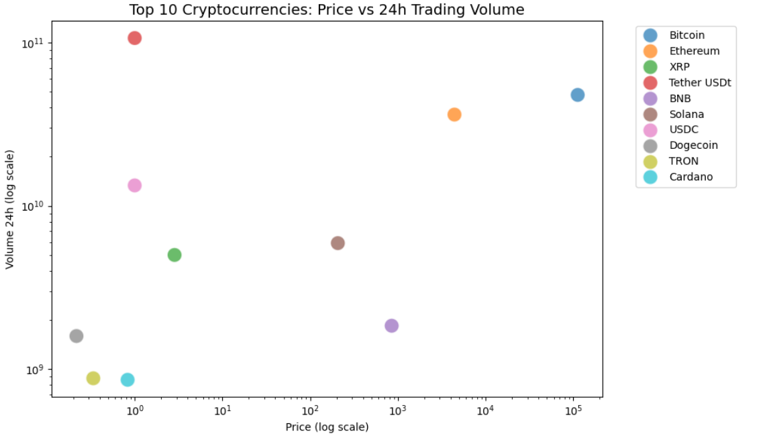
Bivariate Analysis
Coins like BTC and ETH will appear in the upper-right quadrant (high price, high volume).
Stablecoins like USDT and USDC will cluster around low price but high volume.
This chart helps compare liquidity and valuation across the top players.
Notes:
Chart Type: Scatter Plot
Explanation: Coins like BTC & ETH appear in upper-right quadrant (high price & high cap). Stablecoins (USDT, USDC) = low price but high market cap, showing different market behavior.

Slide 17
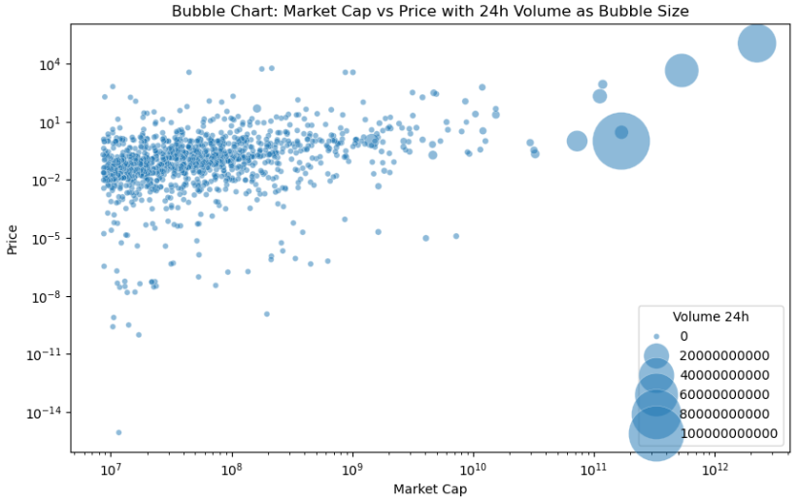
Multivariate Analysis
Bitcoin dominates: It holds 57% of the total market cap—more than half the entire crypto space.
Ethereum follows: With 13.7%, it’s the second-largest but far behind Bitcoin.
Price distribution is skewed: Most coins are priced low, with a few high-value outliers pulling the average up.
Notes:
Chart Type: Bubble Plot (log-log scaling)
Explanation: Shows relationship between Market Cap & Price, with bubble size = trading volume.
Some coins with moderate market cap but very high volume = speculative or hype-driven.
BTC & ETH dominate both price and cap.

Slide 18
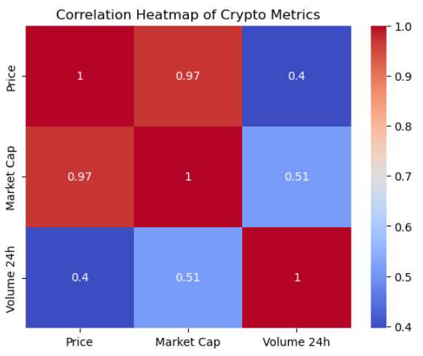
Multivariate Analysis
Price & Market Cap: Strong correlation (0.97) higher-priced coins tend to have larger market caps.
Market Cap & Volume 24h: Moderate correlation (0.51) — bigger coins are generally traded more.
Price & Volume 24h: Weak-to-moderate correlation (0.40) — price doesn’t always drive trading volume.
Notes:
Chart Type: Heatmap
Explanation:
Price ↔ Market Cap = Strong correlation (0.97)
Market Cap ↔ Volume 24h = Moderate correlation (0.51)
Price ↔ Volume 24h = Weak-to-moderate (0.40) → Bigger coins usually have higher caps and prices, but volume is not always aligned.

Slide 19
Insights
1. Bubble Chart Analysis: Market Cap vs Price
Log-log scaling reveals exponential relationships between market cap and price.
Volume (24h) as bubble size shows that high-volume coins aren't always the most expensive or valuable by market cap.
Some coins with moderate market cap have disproportionately high trading volumes, suggesting speculative interest or short-term hype.
2. Correlation Heatmap
Strong positive correlation between Market Cap and Price: Larger market cap coins tend to have higher prices.
Volume (24h) shows a weaker correlation with both Price and Market Cap, indicating that trading activity doesn’t always align with valuation.

Slide 20
Recommendations
Time-Series Analysis
Add historical trends to see how correlations evolve over time.
Identify coins with consistent growth vs. those driven by short-term spikes.
Segment Coins by Market Behavior
Create clusters based on volume, price, and market cap to identify:
Stable coins (high market cap, low volume fluctuation)
Speculative coins (low market cap, high volume)
Emerging coins (moderate price, rising volume)

Slide 21

THANK YOU

