Slide 1
Maven 2 – The powerful buildsystem
a presentation for EL4J developers by Martin Zeltner (MZE)
November 2007

Slide 2

Agenda
Introduction
Installation
Concepts
Where to find …
Daily usage
Advanced usage
5’
5’
40’
5’
30’
25’

Slide 3
Introduction
Maven intro
Maven is a software project management and description tool. Based on the concept of a project object model (POM), Maven can manage a project's build, reporting and documentation from a central project description.
Vision: The POM contains all metadata about a project: source code and documentation repositories, involved persons, release descriptions, all dependencies, reports we are interested in, how to build, deploy and test applications, what the project website contains, …
In the context of this presentation, when we talk of Maven we mean Maven 2.
License
The Apache Software License, Version 2.0
Homepage
http://maven.apache.org
Our recommended Version
2.1-SNAPSHOT
  We use a self-built version with the bug fix for: http://sourceforge.net/project/showfiles.php?group_id=147215
CAVEAT: when upgrading do a rm –r M2_REPO/org/apache/maven

Slide 4

Maven 2 – The powerful build system
  1. Installation
Concepts
Where to find …
Daily usage
Advanced usage

Slide 5
Installation
Prerequisites
JDK 5 or higher
JDK installed and JAVA_HOME set, javac available
Cygwin
http://www.cygwin.com/
Installation steps
Follow the steps of the README.txt in the convenienceZip from
http://sourceforge.net/project/showfiles.php?group_id=147215 Use the newest convenience.zip if possible!
Verify that maven and Java is correctly installed by launching
./checkInstallation.sh in cygwin
Demo?

Slide 6
Optional steps
Install subversion
Download and install the Subversion tool, as described under http://intranet/Business_Process/Utilities/Subversion/Subversion.php EL4J
Checkout the sources of EL4J
Choose a location where to checkout the new EL4J (internal and external stuff) configured for Maven 2 (i.e. D:/Projects/EL4J) and create this directory path. We name this path EL4J_ROOT.
Open a command line in EL4J_ROOT and execute
svn checkout https://svn.sourceforge.net/ svnroot/el4j/trunk/el4j external

Slide 7
Maven 2 – The powerful build system
1. Installation
  2. Concepts
Where to find …
Daily usage
Advanced usage

Slide 8
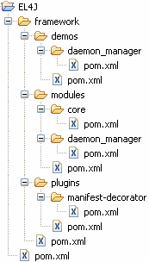
Concepts - Inheritance
Every “pom.xml” file contains Maven configuration. (In Maven 1 this file had the name “project.xml”. )
Here, the project “EL4J” contains the “root pom” (meaning that it has no parent pom). It has one sub-module, the “framework”.
The “framework” itself is also a project, depends on “EL4J” and has the three modules “plugins”, “modules” and “demos”. And so on …

Slide 9
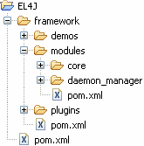
Concepts – Merging of pom files (is implicit)
pom.xml
effective pom
pom merger
pom.xml
pom.xml

Slide 10
Concepts – Properties
A property is an important concept in Maven. A property is a name- value pair (e.g. el4j-home = c:/Projects/EL4J/checkout )
Properties can be set in various ways (lowest to highest precedence)
File ~/.m2/settings.xml (you can also set a specific file on mvn cmd line (with –s))
In the properties section of pom.xml files (can be inherited from parent)
In profiles (in the global settings or in pom.xml files)
On the command line with the prefix –D (e.g. –Dname=value). These properties will actually be standard Java System Properties. When looking up a maven property, java system properties are always checked first.
How to access properties
In the normal strings of the pom.xml files you can always refer to a property via
${name} where name is the name of the property
When certain files are copied, a filter applies, i.e. occurences of properties in the form ${name} are replaced

Slide 11
Concepts – Properties
How to see all active properties defined?
Please refer to the help:effective-settings goal (see later)
What files are filtered when copying (in EL4J)
All files under src/main/env and src/test/env
Please refer also to the env module (it defines support for different environments)
http://el4j.sourceforge.net/plugins/maven-env-support-plugin/index.html

Slide 12
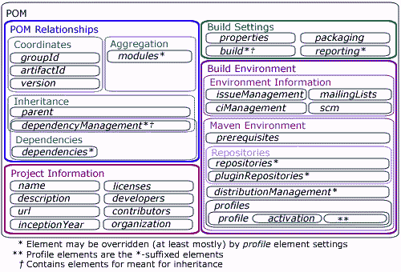
Concepts – Maven model (POM)
POM structure overview (details in next slides)
The “pom.xml” file is a schema validated xml file.

Slide 13
Concepts – Maven model (POM)
<?xml version="1.0" ... ?>
<project xmlns="http://ma..." xmlns:xsi="http://www.w3..." xsi:schemaLocation="...xsd">
<modelVersion/>
<parent>
<groupId/>
<artifactId/>
<version/>
<relativePath/>
</parent>
...
</project>
modelVersion
Currently for Maven 2 it must be set to “4.0.0”. “3.0.0” is for Maven 1.1.
parent
Optionally points to the parent pom (the parent pom must be of type pom).
relativePath
Is the location where the parent can be found (no must). Default: “../pom.xml”
groupId, artifactId, version
  see next slide…
CAVEAT: there is not automatic inheritance of the ../pom.xml . You need to explicitily configure the dependency.
Content in gray is considered less important

Slide 14
Concepts – Maven model
<project>
...
<groupId/>
<artifactId/>
<version/>
<packaging/>
...
</project>
groupId
Identifier such as “ch.elca.el4j.modules”
artifactId
Identifier such as “module-core”
version
Version identifier such as “1.2- SNAPSHOT” or “1.1.3”
packaging
The type of the current artifact (pom):
jar
Is the default. Means that this artifact contains java source files to compile.
pom
For artifacts just used as descriptor. Normal for projects that are not “leafs” of the artifact hierarchy.
Further types:
war, ear, maven-plugin

Slide 15
Concepts – Maven model
<project>
...
<build>
<sourceDirectory/>
<scriptSourceDirectory/>
<testSourceDirectory/>
<outputDirectory/>
<testOutputDirectory/>
...
</build>
...
</project>
Build (optional)
Contains the info how to build the current artifact.
sourceDirectory Contains java source files. Default: “src/main/java”
scriptSourceDirectory
Contains script files. Default: “src/main/scripts“
testSourceDirectory
Like “sourceDirectory” but for test sources. Default: “src/test/java”
outputDirectory
Where to compile java sources and copy scripts and other resources.
Default: “target/classes”
testOutputDirectory
Like “outputDirectory” but for the test part. Default: “target/test-classes”

Slide 16
Concepts – Maven model
<project>
build
defaultGoal
Is the goal to execute if no goal is defined on the command line. Goals will be explained later. There’s no global default.
resources
Points to the resource directories. Content will be copied to the “outputDirectory”.
By default: “src/main/resources”
testResources
Points to test resource directories. Their content will be copied to the “testOutputDirectory”.
By default: “src/test/resources”
directory
Top-level directory where to put built parts. Default: “target”
finalName
The name to use for built objects like jar, war
...
<build>
...
<defaultGoal/>
<resources/>
<testResources/>
<directory/>
<finalName/>
...
</build>
...
</project>
and ear. Default: ${artifactId}-${version}

Slide 17
Concepts – Maven model
<project>
build
filters
Points to property files used for filtering. Filtering was explained in the properties section.
plugins
Are the plugins to be used in this artifact. These plugins join the Maven lifecycle.
Typically plugins will not be configured here but only within the pluginManagement/plugins section.
pluginManagement
plugins
Same as the plugins before but these
plugins do not join the Maven lifecycle. Typically plugins are preconfigured here.
...
<build>
...
<filters/>
<plugins/>
<pluginManagement>
<plugins/>
</pluginManagement>
</build>
...
</project>

Slide 18
Concepts – Maven model
<project>
...
<profiles/>
<modules/>
<repositories/>
<pluginRepositories/>
...
</project>
profiles
Contains profiles that can be dynamically activated by setting a property, via a jdk version, an os type or the presence of a file. A profile contains normal pom.xml content, it can override parent pom.xml content.
modules (only for pom artifacts)
Are the child artifacts of the current artifact. (Only those will be built!)
repositories
Are the locations from where artifacts can be downloaded. These repositories are used for artifacts that are not maven plugins.
pluginRepositories
Same as “repositories” but only used to download maven plugin artifacts.

Slide 19
Concepts – Maven model
<project>
...
<dependencies/>
<dependencyManagement/>
<dependencies/>
<reporting/>
<properties/>
</project>
dependencies
Are the artifacts the current artifact depends on. Such an artifact has a scope i.e. test so it is only in classpath for testing (i.e.
JUnit). The default scope is compile,
meaning that the artifact is always in the classpath.
dependencyManagement
dependencies
Same as previous but the current artifact does not have a dependency to them. It is used to preconfigure dependencies, used in child artifacts. Analogue to “plugins” and “pluginManagement”.
reporting
Are special Maven plugins used for site generation. They join the Maven lifecycle like plugins referenced in previously shown “plugins” element.
properties
Are name-value-pairs that can be used to simplify configuration.

Slide 20
Concepts – Maven lifecycles
A lifecycle is a combination of one or more phases
Maven knows by default the following three lifecycles:
default
Is used for most activities on artifacts like performing a build.
clean
Is used to delete generated parts.
site
Is used to generate a website for the current artifact.
A lifecycle has one or more phases, and goals can be attached to a phase. When phases of the lifecycles above are started, some predefined plugin-goals are automatically executed.
More about this on the next slides…

Slide 21
Concepts – Maven lifecycles
lifecycle “default” (1)
validate initialize
Phase
Important phase
Legend
Example task that could be executed in the phase drawn above.
Validate “web.xml” file of a webapp.
generate- sources
process- sources
generate- resources
process- resources
compile
process- classes
Process commons attributes compiler.
Generate “application.xml” for EAR.
Copy filtered and unfiltered resources to classes directory.
generate-test- sources
process-test- sources
generate-test- resources
process-test- resources
test- compile
test
Execute JUnit tests.

Slide 22
Concepts – Maven lifecycles
lifecycle “default” (2)
package
pre-integration- test
integration- test
post-integration- test
Create JAR, WAR or EAR.
Start webserver and deploy webapp via the cargo plugin.
Execute web service JUnit tests.
Undeploy webapp and stop webserver.
verify
install
deploy
Install artifact into local repository.
Install artifact into remote repository.

Slide 23
Concepts – Maven lifecycles
lifecycle “clean”
pre-clean
clean
post-clean
Remove directory “target” recursive.

Slide 24
Concepts – Maven lifecycles
lifecycle “site”
pre-site
site
post-site
site-deploy
Generate Javadoc, Checkstyle reports, …
Upload the site to the SourceForge Webserver via SSH.

Slide 25
Using mvn on the command line
How to launch maven on the command line:
mvn <artifactId:goal>
: execute the goal goal
of the
artifcact id artifactId
mvn <groupId:artifactId:version:goal>
mvn <phase>
: execute up to phase <phase>
You can combine multiple goals or phases on the command line such as mvn clean install db:start

Slide 26
Concepts – Maven plugins (selection)
Short plugin list
Plugin | Description
antrun | Run a set of ant tasks from a phase of the build.
assembly | Build an assembly (distribution) of sources and binaries.
checkstyle | Generate a checkstyle report.
clean | Clean up after the build.
compiler | Compiles Java sources.
deploy | Deploy the built artifact to the remote repository.
ear | Generate an EAR from the current project.
eclipse | Generate an Eclipse project file for the current project.
ejb | Build an EJB (and optional client) from the current project.
help | Get information about the working environment for the project.
install | Install the built artifact into the local repository.
jar | Build a JAR from the current project.
javadoc | Generate Javadoc for the project.
jxr | Generate a source cross reference (analog to javadoc).
resources | Copy the resources to the output directory for including in the JAR.
site | Generate a site for the current project.
source | Build a JAR of sources for use in IDEs and distribution to the repository.
surefire | Run the Junit tests in an isolated classloader.
war | Build a WAR from the current project.
*
*
*

Slide 27
Parent inheritance vs. artifact dependencies
Two ways to “reuse” configuration: Parent inheritance
Most of the pom.xml files are “merged”
Use this for:
plugin definitions
build process definitions
Don’t use this for dependencies (you get typically “too much” when you use this for dependencies, only “single inheritance” is possible)
Dependencies to other artifacts (jars, other maven projects)
Normal transitive dependencies (A -> B, B -> C => A -> C)
 
Dependencies can have a scope (test, runtime, compile, provided) to be activated only in certain cases.
Use this for:
When you require other maven artifacts (jar/ ear/ war files).
Either: external libraries or other modules (both are treated the same!)
=>Artifact dependency provides a subset of the parent inheritance.

Slide 28
Concepts – Artifact lookup in repositories
If an artifact has a dependency to another artifact or a plugin, Maven will go through the given repositories until it finds the requested artifact.
As shown in the Maven model we can have separate repositories for plugins and their dependencies and separate repositories for all other dependencies.
In EL4J we use the “ibiblio” repository only as “pluginRepository” to prevent having unexpected dependencies.
Hierachy of Maven2 repositories:
Local Repository (i.e. D:\m2repository\)
http://repo1.maven.org/ maven2/
http://el4.elca-services.ch/ el4j/maven2repository/
http://leaffy.elca.ch/ java/maven2repository/
local
Search order
remote

Slide 29
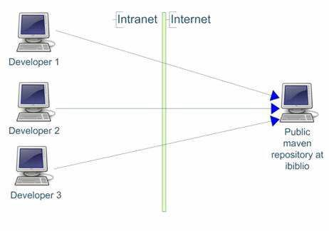
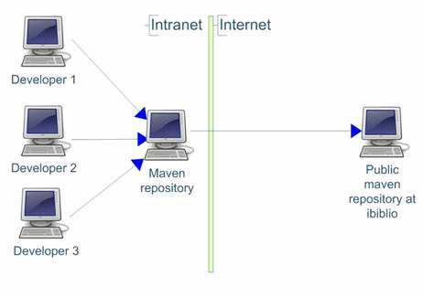
Concepts - Proximity
Proximity is a proxy for maven repositories: http://blogs.sonatype.com/jvanzyl/2007
Direct connection :
/11/21.html
Indirect connection (with Proximity):

Slide 30
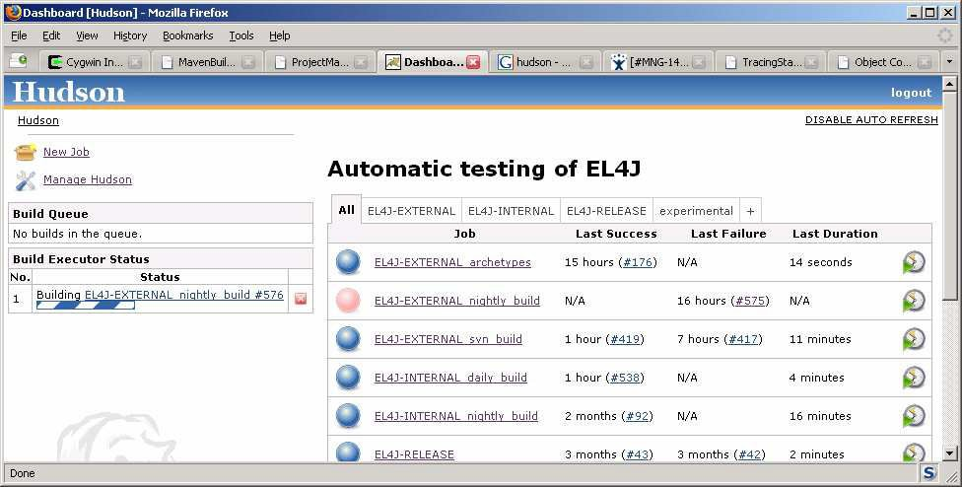
Concepts - Continuous integration with Hudson
Hudson can rebuild your project automatically:
Periodically (e.g. every night, every 2 hours)
Whenever there is a change in SVN Hudson for EL4J:
http://wiki.elca.ch/twiki/el4j/bin/view/EL4J/AutomaticBuildInfrastructure

Slide 31
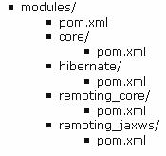
Mvnrec – recursively build a mvn project
Recursive Maven: reimplementation of the build.rec from LEAF and EL4Ant
In your project you can say:
mvnrec clean install
maven then automatically executes the phases clean and install for all the local projects your project depends on (at the end it executes the phases for your project)
Example: Let's assume you have the following directory and project structure (with the following dependencies: core   remoting_core   remoting_jaxws):
If you are currently working on the module remoting_jaxws and made also some changes in the module “core" it requires. Now, you can change to the directory /modules/remoting_jaxws and type in there
mvnrec install
mvnrec scans the directories, finds all other modules and executes the command only in the dependent projects core and remoting_core before it is executed in remoting_jaxws. The project hibernate is ignored because it's not a dependency of remoting_jaxws.

Slide 32
Mvnrec – recursively build a mvn project
Recursive Maven (ctd.)
Usage:
Options:
-ff
-b
-v
mvnrec [OPTIONS] MAVEN_COMMAND [MAVEN_COMMAND]...
fail-fast (interrupt the build at the first failure)
the default is to fail only at the end of the build (“fail at end”) force scanning of folders and creation of bootstrap-file (mvnrec caches dependencies (for better performance)) produce mvnrec debug output
In the EL4J team we are already using mvnrec a lot and are very happy with the feature!

Slide 33
Maven 2 – The powerful build system
Installation
Concepts
  3. Where to find …
Daily usage
Advanced usage

Slide 34

Resources
Documentation
Maven CheatSheet (our recommended default reference) http://wiki.elca.ch/twiki/el4j/bin/view/EL4J/MavenCheatSheet
FAQ with many ideas how to fix maven issues: http://wiki.elca.ch/twiki/el4j/bin/view/EL4J/FrequentlyAskedQuestions
Book: Better Builds with Maven – The How-To guide for Maven 2 (PD
http://www.mergere.com/m2book_download.jsp
Getting started guide of maven
http://maven.apache.org/guides/getting-started/index.html
EL4J wiki: http://wiki.elca.ch/twiki/el4j/bin/view/EL4J/MavenBuildSystem
Available plugins from Apache and Codehaus
http://maven.apache.org/plugins/index.html
http://mojo.codehaus.org/
Help
Subscribe to the very active Maven user mailing list (users@maven.apache.org).
Use Google to find help in Maven user mailing list http://www.google.ch/search?q=site:http://mail- archives.apache.org/mod_mbox/maven-users+MY SEARCH QUERY
To only get messages from 2006 just modify the URL a bit http://www.google.ch/search?q=site:http://mail- archives.apache.org/mod_mbox/maven-users/2006+MY SEARCH QUERY
F)

Slide 35
Maven 2 – The powerful build system
Installation
Concepts
Where to find …
  4. Daily usage
5. Advanced usage

Slide 36
Daily usage
cd EL4J_ROOT/external
Avoids recursion
mvn –N install
Take a look at your local repository.
mvn –N
mvn install -Dmaven.test.skip=true
cd framework/modules/core
mvn clean
Inspect content of current directory.
No phase or goal: default goal
Skip tests
mvn compile
Inspect directory target.
mvn test
mvn surefire:test
What is the difference between “mvn surefire:test” and “mvn test”?

Slide 37
Daily usage
Remove directory el4j-framework-modules from local repository (M2_REPO/ch/elca/el4j/modules).
mvn clean
mvn compile
What happens? Why?
cd ../remoting_core
mvn clean
mvn compile
What happens? Why?
cd ..
mvn –N install
cd core
mvn install -Dmaven.test.skip=true
cd ../remoting_core
mvn install -Dmaven.test.skip=true
project dependency of this example:
el4j
el4j-framework
el4j-framework- modules
module-core
cd ../core
mvn site
module- remoting_core

Slide 38
Daily usage (– answers to questions)
Certain goals of the compile phase require another project to exist. The phase clean does not require a project, but the phase compile needs other projects (it needs the compiled code in order to run).
Maven does only build other projects in certain cases! The previous slide illustrates the 2 different cases:
In the first case it works, because mvn directly looks in the direct directory or pom hierachy (but not in transitive dependencies!)
This is different from the EL4Ant behavior!
In the second case it does not work, because the dependency is not in the direct hierarchy (=subdirectory) of the artifact.
Remark: we would actually prefer the earlier EL4Ant behavior and will look into how to achive it. For now we keep the maven convention as it directly follows from some core maven hypothesis.

Slide 39
Daily usage - Eclipse
Start Eclipse with workspace
EL4J_ROOT/external/framework/workspace
Import your preferences (e.g. preferences-external.epf).
Close Eclipse.
mvn -N eclipse:add-maven-repo
-Declipse.workspace= "EL4J_ROOT/external/framework/workspace"
By this command the classpath variable M2_REPO has been added to the given workspace (you can also set the eclipse build variable M2_REPO manually).
Start Eclipse again with the same workspace.
el4j
el4j-framework
el4j-framework- modules
module-core
module- remoting_core

Slide 40
Daily usage - Eclipse
mvn eclipse:clean eclipse:eclipse
Creates the Eclipse project newly for
module-remoting_core
Import this project in opened workspace. Does the project compile in Eclipse?
cd ..
mvn eclipse:clean eclipse:eclipse
el4j
Go into Eclipse and refresh project
module-remoting_core
Does the project still compile in Eclipse?
Import project module-core in Eclipse and refresh both projects.
el4j-framework
el4j-framework- modules
Take care: if you create eclipse files (.project and .classpath) for a set of projects together, it establishes direct (=eclipse- level dependencies), if you create them individually it establishes links to the local mvn repository.
The <reactorProjectGroupIdPrefixes> parameter
fixes this.
module-core
module- remoting_core

Slide 41

Daily usage
Eclipse issues
Eclipse is just a helper for Maven, it is not a replacement!
Examples: Filtering of environment files, …
Executed tests in Eclipse can have different results than executed tests with Maven. The relevant results (for us) are the ones from Maven. There can be various causes for this behaviour:
Eclipse projects don’t separate the compile and test scopes but Maven does.
This can be dangerous i.e. if dir test resources contains Spring bean xml files in directory “mandatory”!
Maven always has dependent artifacts as jar files in its classpath. In Eclipse, depending on the execution level/directory of the “mvn eclipse:eclipse”
command, some dependencies are in classpath as jar and some directly as directory with its classes. The test classes itself are always via directory in classpath.
Eclipse has its own compiler. There are some cases
(specially Java 5 syntax) tests work if classes compiled with Eclipse compiler and don’t work if
classes are compiled with Sun’s compiler. The (for us) relevant compiler is the one from Sun.

Slide 42
Daily usage – Problem solving
A list of potential maven issues with their solution can also be found under:
http://wiki.elca.ch/twiki/el4j/bin/view/EL4J/FrequentlyAskedQuestions
mvn –N help:effective-pom
Prints the effective pom on console. You can define the parameter output to get the effective pom in a file. Example:
mvn –N help:effective-pom –Doutput=effective-pom.xml
mvn –N help:effective-settings
Prints the effective settings on the console. You can define the parameter
output to get the effective settings in a file. Example:
mvn –N help:effective-settings –Doutput=effective-settings.xml
  The settings file in the directory ~/.m2/ does override settings configured in directory M2_HOME/conf/

Slide 43
Daily usage – Missing third party artifacts
Sometimes you create an artifact and this artifact must have a dependency to a third party jar such as “spring-2.0.jar”. With the repository helper from EL4J you have the possibility to easily install this new artifact in your local repository and directly in a remote repository. The jar file must have the following name:
name-version.jar
If you have a zip that contains the java source as well, this zip must have the following name:
name-version-src.zip
The name will be the artifactId. The groupId of the artifact will be determined by taking the delta between your given library system path (libraryDirectory) and the path of where these files are located. Slashes or backslashes in this delta are replaced by dots. No leading/trailing dots are permitted. The next slide shows an example of this.

Slide 44
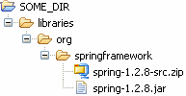
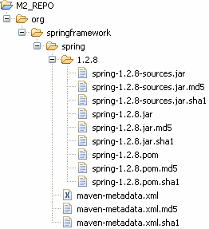
Daily usage – Missing third party artifacts
In the example on the left the following task has been executed in SOME_DIR.
mvn repohelper:install-libraries
-DlibraryDirectory=libraries
The artifact org.springframework:spring:1.2.8 is now installed in the local repository and ready for local use.
To deploy libraries to a remote server just use the goal deploy-libraries instead of install-libraries and with additional parameter repositoryId. If the repository with this id is not defined in your pom.xml (see element distributionManagement) you must in additionally add the parameter repositoryUrl or repositoryDirectory that points to the remote repository. BTW, the username and password can be saved in the settings.xml file.
In EL4J_ROOT/external/helpers/upload there are two helper artifacts to install/deploy libraries in the external and internal repository. Example: Just put your libraries in EL4J_ROOT/external/helpers/ upload/external/libraries and execute the specific goal without any parameters in EL4J_ROOT/external/helpers/
upload/external.

Slide 45





Database plugin usage
root
Launch and re-init db (of current project), block until Ctrl-C:
cd newApplication
mvn db:prepare db:block
Same without db launch
mvn db:silentDrop db:create
Applies all SQL scripts of your project and all projects it depends on.
Scripts are applied in “right” order (root leaf for creation, leaf-> root for destruction)
leaf

Slide 46
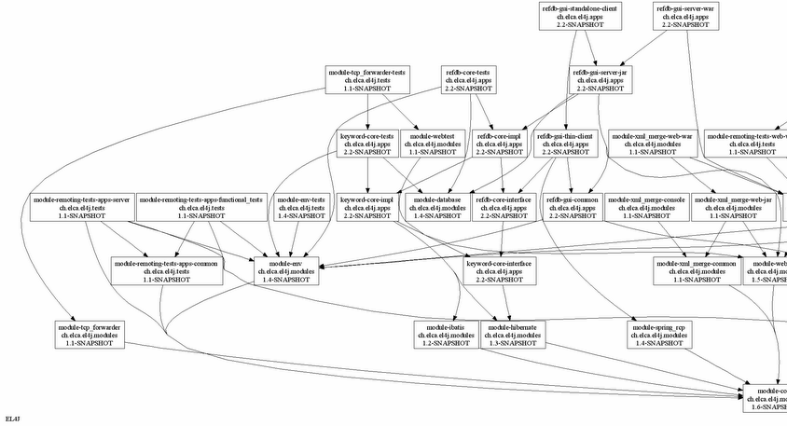
Maven Dependency Graph plugin

Slide 47
Maven Dependency Graph plugin
Display Overview over a project’s dependencies
Two goals are available:
Depgraph
Displays a singe project’s dependencies
Fullgraph
Displays the whole dependency structure for all maven projects in this and all subfolders
Uses Graphviz to draw the graph
Various configuration properties
Filter the artifacts’ name, group and version using regular expressions
Create DOT file for further processing with other tools
Example
vn d pgrap :fu graph -Ddepgraph.groupFilter="ch.elca"

Slide 48
Maven 2 – The powerful build system
Installation
Concepts
Where to find …
Daily usage
  5. Advanced usage

Slide 49
Advanced usage
cd EL4J_ROOT/external/framework/tests
mvn –N
cd remoting
mvn install
What happens? Why? Have a look at the pom.xml files.
el4j
el4j-framework
el4j-framework- tests
el4j-framework- tests-remoting
module- remoting-tests- web
Hierarchy (dependencies) of pom.xml files
module- remoting-tests- functional_tests

Slide 50
Advanced usage ( answers to questions)
It executes the functional tests:
Create jars, wars, start tomcat, deploy the war, execute functional tests, undeploy war, stop tomcat
In case tomcat does not yet exist, it is automatically downloaded (by default in the external-tools directory)

Slide 51
Advanced usage
cd EL4J_ROOT/external/framework/demos
mvn –N
cd daemon_manager
mvn install
cd controller
mvn exec:java
Which class will be executed?
el4j
el4j-framework
el4j-framework- demos
Open another command line
el4j-framework- demos-daemon_ manager
cd EL4J_ROOT/external/framework/demos/ daemon_manager/console
Take a look in the pom.xml file to know what the following commands will execute.
module-daemon_ manager-demos- common
mvn exec:java
mvn exec:java
mvn exec:java
–Dexec.args=“information”
–Dexec.args=“reconfigure”
–Dexec.args=“stop”
module- daemon_manager- demos-controller
module- daemon_manager- demos-console

Slide 52
Advanced usage (solution)
It executes the daemon manager (= the controller) on the console. You can then access the controller from remote (via the console (see the 3 actions from the previous slide))

Slide 53
Problem solving
mvn –N help:describe -DgroupId=...
–DartifactId=... -Dfull=true
Describs all goals of the given plugin (groupId & artifactId).
Example:
mvn –N help:describe -DgroupId=ch.elca.el4j.plugins
–DartifactId=maven-env-support-plugin -Dfull=true
mvn –N help:describe -DgroupId=...
–DartifactId=... –Dmojo=... -Dfull=true
Describes the given goal (aka mojo) of the given plugin. Example:
mvn –N help:describe -DgroupId=ch.elca.el4j.plugins
–DartifactId=maven-env-support-plugin
-Dmojo=resources -Dfull=true
Instead off groupId & artifactId you can use parameter plugin with format
groupId:artifactId and you can even use the plugin prefix. Examples:
mvn –N help:describe –Dplugin=repohelper
-Dmojo=deploy-libraries -Dfull=true mvn –N help:describe –Dplugin=jar
-Dmojo=sign -Dfull=true

Slide 54
Classloading and multiple JVMs
Maven uses internally the library classworlds (an improvement to the normal classloader hierachy) to organize the classpaths.
Sometimes mvn and applications launched with mvn run in 2 different JVM.

Slide 55
Maven plugins
jar
Plugins, mojos, goals and phases
Typically a java class or a bsh script
Plugin Mojo
Goal
1 1 .. n
1
is a
org.apache. maven.plugins: maven-jar- plugin
org.apache. maven.plugin. jar.JarMojo
Phase
can belong to a
package
Execution examples:
$ mvn org.apache.maven.plugins:maven-jar-plugin:jar
$ mvn jar:jar
$ mvn package
  Attention: All goals of mojos bound to phase <= “package” will be executed!

Slide 56
Plug-in development
    | A plugin artifact is like a jar artifact (= a project that generates a jar-file). The packaging of its pom must be set to maven-plugin.
  | Mojos can be annotated with Commons Attributes, so no plug-in descriptor
 | must be written.
  | A class needs to implement the interface org.apache.maven.plugin.Mojo | to
 | be a mojo.
  | Plugins of EL4J are in the directory EL4J_ROOT/external/maven/plugins
maven-checkclipse-helper-plugin
maven-env-support-plugin
maven-manifest-decorator-plugin
maven-repohelper-plugin
maven-database-plugin
maven-depgraph-plugin
maven-jaxws-plugin
maven-version-plugin
Remark: writing a plugin is quite easy!

Slide 57


Thank you for your attention
For further information please contact:
Martin Zeltner
Software Engineer
martin.zeltner <at> elca.ch
Steinstrasse 21 CH-8036 Zürich
+41 (0)44 456 32 11
Lausanne Zürich Bern Genf London Paris Ho Chi Minh City

Slide 58
Where to find …
Plugins
Use Google to find out available plugin versions
http://www.google.ch/search?q=site:ibiblio.org/maven2+MY SEARCH QUERY
Issue Management
Maven Components
http://jira.codehaus.org/browse/MNG
Other Maven Technologies and Maven Plugins
http://jira.codehaus.org/secure/BrowseProjects.jspa
  Go to categories “Maven Technologies” and “Maven 2 plugins”

Slide 59
Where to find what is inside Maven 2
Maven Wagon
http://maven.apache.org/wagon/
Maven Wagon is a transport abstraction that is used in Maven's artifact and repository handling code.
Used to down- and upload artifacts.
Protocols file, http, https, ftp, sftp, svn and scp are available.
Plexus Container
http://plexus.codehaus.org/
Plexus is similar to other inversion-of-control (IoC) or dependency injection frameworks such as the Spring Framework (http://www.springframework.org).
Used for configuration.

