Slide 1

Demystifying
By Mike Desjardins

Slide 2
To pics
●
Ins tallatio n
Shock and Awe: Comparis on with ant Pro je ct Obje ct Mo del (POM)
Inhe ritanc e and Mo dules Dependencies
Build Config uratio n
Whirlwind To ur of Plugins Life cycles
Build Pro file s
Some time s Mave n Le ts Yo u Down
●
●
●
●
●
●
●
●
●

Slide 3
About Me
●
Developed Software pro fes s ionally for about
15 years , the las t 5 with Java
Inde pendent Contrac to r/Co ns ultant Live in Po rtland, Maine
●
●
●
For the pas t s eve ral years , primary focus has been on web s e rvic es
−
−
−
Wire les s Te lecommunicatio ns Financial Se rvic es
Online Mus ic
●
We bs ite : http://mike des jardins .us Twitte r: @mdes jardins
●

Slide 4
Ins tallation
●
Re quire s JDK 1.4
Do wnload Mave n fro m http://mave n.apache.o rg /
Unzip the arc hive
●
●
●
Add the M2_ HOME enviro nment variable and point it to your ins tallation.
Make s ure JAVA_ HOME is s et and java is in your PATH.
Make s ure $M2_ HOME/bin is in your PATH.
●
●
4

Slide 5
Ant vs . Mave n
●
Bes t illus trate d by Example
We will c re ate a new trivial Hibe rnate Applic ation that re ads ro ws in a databas e table (s hown below) and outputs them to the cons ole.
●
greeting_id | greeting_text
1 | Hello
2 | Bon jour
3 | Buenos dias
4 | Kon ni chi wa

Slide 6
Example – Sourc e Code
Firs t, we will need a c las s to re pre s ent a g re eting:
@Entity
p u b l ic c la s s Greeting {
@Id @GeneratedValue(strategy=GenerationType.IDENTITY )
@Column(name="greeting_id",nullable=f a ls e ,unique=t r u e )
p r iv a t e Integer id;
@Column(name="greeting_text")
p r iv a t e String text;
@Column(name="version") @Version
p r iv a t e Integer version;
p u b l ic p u b l ic
Integer getId() { r e t u r n t h is .id; }
v o id setId(Integer id) { t h is .id = id; }
p u b l ic p u b l ic
String getText() { r e t u r n t h is .text; }
v o id setText(String text) { t h is .text = text; }
}

Slide 7
Example – Sourc e Code
Next, we will need a c las s with a s tatic main method to ac tually do s tuff...

Slide 8
Example – Sourc e Code
p u b l ic c la s s App {
p r iv a t e s t a t ic SessionFactory se ssionFactory ;
s t a t ic {
t r y {
se ssionFactory = n e w AnnotationConfiguration().configure().buildSessionFactory();
} c a t c h (Throwable t) { System.out.println("Something terrible has happened."); t.printStackTrace();
}
}
p u b l ic s t a t ic SessionFactory getSessionFactory() { r e t u r n App.se ssionFactory ; }
p u b l ic v o id run() { System.out.println("======================================================");
Criteria c = App.getSessionFactory ().openSession().createCriteria(Greeting.c la s s ); List<Greeting> greetings = c.list();
f o r (Greeting greeting : greetings) { System.out.println(greeting.getId() + ": " + greeting.getText());
}
System.out.println("======================================================");
}
p u b l ic s t a t ic v o id main(String args[]) { App app = n e w App().run());
}
8
}

Slide 9

Ant: Le t's Get Starte d!
Firs t, le t's c re ate the dire cto rie s for our pro je ct:
Mac:~/_work$
mkdir demo-ant cd demo-ant
Mac:~/_work$
Mac:~/_work/demo-ant$ Mac:~/_work/demo-ant$ cd
mkdir src lib conf target
src
mkdir com
Mac:~/_work/demo-ant/src$ Mac:~/_work/demo-ant/src$ cd com
Mac:~/_work/demo-ant/src/com$
mkdir techmaine
Mac:~/_work/demo-ant/src/com$ cd techmaine Mac:~/_work/demo-ant/src/com/techmaine$ mkdir antdemo Mac:~/_work/demo-ant/src/com/techmaine$

Slide 10
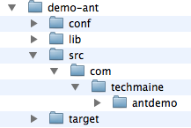
Ant: Le t's Get Starte d!
(If you’re more of a visual person)

Slide 11
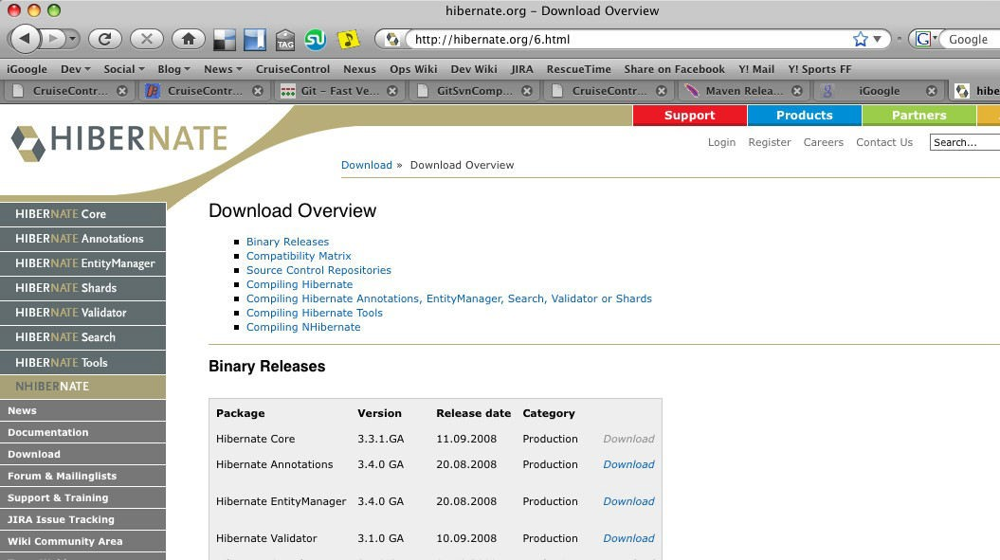
Le t's go get our jars !
1.) Visit the Hibernate Website, eventually find their download page…

Slide 12
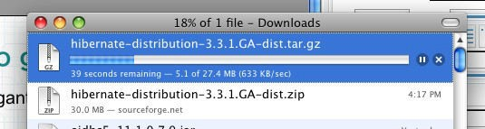
Le t's go get our jars !
2.) Download gigantic ZIP file
ZZZZZZZZZ….

Slide 13
Le t's go get our jars !
3.) Unpack the ZIP file
0 09-10-08 12:27
26428 09-10-08
1456 09-10-08
152761 09-10-08
2766130 09-10-08
31493 09-10-08
0 09-10-08
0 09-10-08
443432 06-13-08
559366 06-13-08
313898 06-13-08
13236 06-13-08
17384 08-19-08
471005 06-13-08
0 09-10-08
0 09-10-08
608376 06-13-08
0 09-10-08
475943 06-13-08
.
.
.
.
.
.
hibernate-distribution-3.3.1.GA/ hibernate-distribution-3.3.1.GA/lgpl.txt
hibernate-distribution-3.3.1.GA/hibernate_logo.gif hibernate-distribution-3.3.1.GA/changelog.txt
12:21
12:21
12:21
12:27
12:22
12:27
12:27
12:09
12:09
12:09
12:09
19:40
12:10
12:27
12:27
12:12
12:27
12:12
hibernate-distribution-3.3.1.GA/hibernate3.jar
hibernatHe-doilsytriSbuhtinonik-3e.3y.1s.!GA/hibernate-testing.jar hibernate-distribution-3.3.1.GA/lib/
hibernate-distribution-3.3.1.GA/lib/required/
hibernate-distribution-3.3.1.GA/lib/required/antlr-2.7.6.jar
Do I really need all of
hibernate-distribut
ion-3.3.1.GA/lib/required/commons-collections-3.1.jar
hibernate-d_{t}i_{h}s_{i}t_{s}rib_{s}u_{t}t_{u}io_{f}n_{f}-?3.!3?.1.GA/lib/required/dom4j-1.6.1.jar
hibernate-distribution-3.3.1.GA/lib/required/jta-1.1.jar hibernate-distribution-3.3.1.GA/lib/required/slf4j-api-1.5.2.jar hibernate-distribution-3.3.1.GA/lib/required/javassist-3.4.GA.jar hibernate-distribution-3.3.1.GA/lib/optional/
hibernate-distribution-3.3.1.GA/lib/optional/c3p0/
hibernate-distribution-3.3.1.GA/lib/optional/c3p0/c3p0-0.9.1.jar hibernate-distribution-3.3.1.GA/lib/optional/proxool/
hibernate-distribution-3.3.1.GA/lib/optional/proxool/proxool-0.8.3.jar
13

Slide 14
Next Steps
Copy the jar file s to your lib dire c to ry
Option 1: Copy Eve rything (Lazy)
Option 2: Copy only what you need
(Te dious )
Cre ate your build.xml file

Slide 15

Cre ate the build.xml
Step
Start with an empty file
1
<? x m l v e r s io n =" 1 . 0 " ? >
<p r o je c t n a m e =" a n t d e m o "
b a s e d ir =" ." >
d e f a u l t =" c o m p i le "
</ p r o je c t >

Slide 16


Cre ate the build.xml
Step
Cre ate s ome variable s
2
<!-- set global properties for this build -->
<property name="lib" value="lib"/>
<property name="src" value="src"/>
<property name="conf" value="conf"/>
<property name="target" value="target"/>
<property name="classes" value="${target}/classes"/>
build.xml

Slide 17


Cre ate the build.xml
Step
Te ll ant about all of your librarie s
<fileset id="compile.libs" dir="${lib}">
<include name="antlr-2.7.6.jar"/>
<include name="asm.jar"/>
<include name="asm-attrs.jar"/>
<include name="cglib-2.1.3.jar"/>
<include name="commons-collections-3.2.jar"/>
<include name="commons-lang-2.3.jar"/>
<include name="commons-logging-1.0.4.jar"/>
<include name="dom4j-1.6.1.jar"/>
<include name="ejb3-persistence.jar"/>
<include name="javassist.jar"/>
<include name="jboss-archive-browsing.jar"/>
<include name="jdbc2_0-stdext.jar"/>
<include name="jta.jar"/>
<include name="xml-apis.jar"/>
<include name="xercesImpl-2.6.2.jar"/>
3
<include name="hibernate3.jar"/>
<include name="hibernate-annotations.jar"/>
<include name="hibernate-commons-annotations.jar"/>
<include name="hibernate-entitymanager.jar"/>
build.xml
</fileset>
17

Slide 18
Cre ate the build.xml
Step
Te ll ant about compiling
<target name="init">
<tstamp/>
<mkdir dir="${classes}"/>
</target>
4
<target name="compile" depends="init">
<mkdir dir="${basedir}/${classes}"/>
<javac srcdir="${basedir}/${src}" destdir="${basedir}/${classes}" debug="yes"
target="1.5">
<classpath>
<fileset refid="compile.libs"/>
</classpath>
</javac>
<copy file="${basedir}/${conf}/hibernate.cfg.xml" todir="${basedir}/${classes}"/>
</target>
<target name="clean">
<delete quiet="yes" dir="${basedir}/${target}"/>
<mkdir dir="${basedir}/${target}"/>
build.xml
</target>
18

Slide 19
Cre ate the build.xml
Step
Te ll ant how to run the app
5
<fileset id="runtime.libs" dir="${lib}">
<include name="postgresql-8.2-507.jdbc3.jar"/>
</fileset>
<target name="run" depends="compile">
<java classname="com.techmaine.antdemo.App">
<classpath>
<fileset refid="compile.libs"/>
<fileset refid="runtime.libs"/>
<pathelement location="${basedir}/${classes}"/>
</classpath>
</java>
</target>
build.xml

Slide 20
Recap
We downloaded jars and dependencies ours e lves We told ant
•
•
•
•
•
•
•
•
•
The name of the jar file that we needed (Hibe rnate )
All the dependent jar file names
Whe re the jar file s we re located That it needed to compile java file s Whe re the java file s we re located Whe re it s hould put the c las s file s
Whe re it s hould put the Hibe rnate configuratio n file Ho w to run the application
Whe re the jar and c las s file s we re located (ag ain, this time for runtime )
build.xml is 75 lines , but who’s counting?
•

Slide 21
Ne xt:
The
way

Slide 22
Mave n Te rmino logy
With maven, you execute goals in plugins over the diffe re nt phas es of the build
life cycle, to gene rate artifac ts . Examples of artifac ts are jars , wars , and ears . The s e artifac ts have an artifac tId, a g ro upId, and a ve rs ion. To gethe r, thes e are called the artifac t’s “coo rdinate s .” The artifac ts s to re d in re pos ito rie s . Artifac ts are deployed to
re mote re pos ito rie s and installed into local re pos ito rie s . A POM (Pro je ct Obje ct Mo del) des c ribe s a pro je ct.

Slide 23


Cre ate a Pro je ct Dire cto ry
Mave n has a command for s tarting a pro je ct:
Step
1
mvn archetype:create \
-DgroupId=com.techmaine \
-DartifactId=demo-mvn \
-DpackageName=com.techmaine.mvndemo \
-Dversion=1.0

Slide 24
Cre ate a Pro je ct Dire cto ry
Step
1
Plugin Name
mvn archetype:create \
-DgroupId=com.techmaine \
-DartifactId=demo-mvn \
-DpackageName=com.techmaine.mvndemo \
-Dversion=1.0

Slide 25
Cre ate a Pro je ct Dire cto ry
Step
1
Plugin Name Goal
mvn archetype:create \
-DgroupId=com.techmaine \
-DartifactId=demo-mvn \
-DpackageName=com.techmaine.mvndemo \
-Dversion=1.0

Slide 26

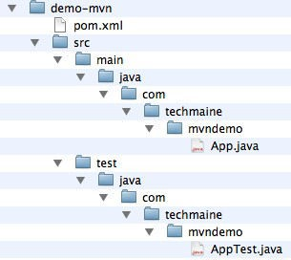
Cre ate a Pro je ct Dire cto ry
Step
Voila! Look what maven has done for you:
1

Slide 27

Set up the dependencies
Step
Open pom.xml. We need to tell maven that we have a dependency on Hibernate:
<project xmlns="http://maven.apache.org/POM/4.0.0" xmlns:xsi="http://www.w3.org/2001/XMLSchema-instance" xsi:schemaLocation="http://maven.apache.org/POM/4.0.0 http://maven.apache.org/maven-v4_0_0.xsd">
<modelVersion>4.0.0</modelVersion>
<groupId>com.techmaine</groupId>
<artifactId>demo-mvn</artifactId>
<packaging>jar</packaging>
<version>1.0</version>
<name>demo-mvn</name>
<url>http://maven.apache.org</url>
<dependencies>
<dependency>
<groupId>junit</groupId>
<artifactId>junit</artifactId>
<version>3.8.1</version>
<scope>test</scope>
2
</dependency>
</dependencies>
</project>
We’ll add the dependency here.

Slide 28
Set up the dependencies
Step
This is all we need to add:
2
<dependency>
<groupId>org.hibernate</groupId>
<artifactId>hibernate-annotations</artifactId>
<version>3.3.1.ga</version>
</dependency>
We don’t need to tell Maven about any of the jars on which Hibernate depends; Maven takes care of all of the transitive dependencies for us!

Slide 29
Set up the compiler
Step
STUPIDITY ALERT!
Maven assumes a default source version of 1.3. We need to tell it if we want 1.5. Here’s a preview of plugin configuration:
3
<build>
<plugins>
<plugin>
<groupId>org.apache.maven.plugins</groupId>
<artifactId>maven-compiler-plugin</artifactId>
<version>2.0.2</version>
<configuration>
<source>1.5</source>
<target>1.5</target>
</configuration>
</plugin>
</plugins>
</build>
29

Slide 30
Set up Hibe rnate Co nfig uratio n
Step
Create a resources directory beneath the main (and, optionally, test) directory, and put the Hibernate configuration file there.
4
•Files in the resources directory get copied to the root of the classpath when packaging occurs as part of the resource:resource goal (more on that later)
•The resources directories are automatically created for many of the archetypes, but not for the quickstart archetype that we used.

Slide 31
Pac kag e
Step
Next, package everything up before we run it.
5
To do this, invoke maven thusly:
m v n p a c k a g e
This is an alternate way to invoke maven. Instead of specifying a plugin and goal, you specify a phase (in this case, package is the phase). A phase is a sequenced set of goals. The package phase compiles the java classes and copies the resources

Slide 32
Execute
Step
Next, use the exec plugin to run our application:
6
mvn exec:exec \
-DmainClass=com.techmaine.mvndemo.App

Slide 33
Re cap
We told maven
•That we were making a “quickstart” project.
•That we depended on Hibernate Annotations.
•That we needed Java 1.5
•pom.xml was 35 lines (would have been 22 if maven defaulted to Java 1.5 instead of 1.3)

Slide 34


Recap – Why Mave n is Cool
We downloaded jars and dependencies ours elves
We told ant
•The name of the jar file that we needed
(Hibe rnate)
•All the dependent jar file names
•Where the jar files were located
•That it needed to compile java files
•Where the java file s were located
•Where it s hould put the clas s file s
•Where it s hould put the Hibernate configuration file
•How to run the application
•Where the jar and clas s file s were located (ag ain, this time for runtime)
•build.xml is 75 lines , but who’s counting?
We told maven
•That we were making a “quic ks tart” project.
•That we depended on Hibernate Annotations .
•That we needed Java 1.5
•pom.xml was 35 lines (wo uld have been 22 if maven defaulted to Java 1.5 ins tead of 1.3)

Slide 35
What can Mave n do?
Whe n you firs t download it, almos t
nothing!
Run goals
•
Run phases (col ections of goals)
•
Download Dependencies*
•
Download Plugins
•
* Actually, dependency downloads are done by a plugin, too.
But... from whe re ?

Slide 36
Configuring Mave n
Settings Files (s ettings .xml)
In ~/.m2 (pe r-us er s ettings ) and in Mave n’s ins tall dire cto ry, under conf (pe r-s ys tem s ettings )
Alte rnate location for re pos ito ry
Pro xy Configuratio n
Pe r-s e rve r authentication s ettings
Mir o rs
Download policies , for plugins and re pos ito rie s ; s naps hots and re leas es .

Slide 37
Configuring Mave n
Pro je ct Obje ct Mo del (po m.xml)
Inhe rite d – individual pro je cts inhe rit POM
attribute s fro m pare nt pro je cts , and ultimately inhe rit fro m the “S uper POM”
The Super POM is in Mave n’s ins tallation dire cto ry, embedded in the uber jar.
The Super POM defines , among lots of other things , the default locations for the plugin and jar re pos ito rie s , which is http://re po 1.maven.o rg /mave n2

Slide 38
Repos ito rie s
Lo cal - in ~/.m2/re pos ito ry
Re mote - e.g.,
http://re po 1.mave n.o rg /mave n2 or another inte rnal company re pos ito ry
(any dire cto ry re achable by s ftp will do ).
Co ntains dependencies and plugins
Can be managed by a “Repos ito ry Manag e r” like Nexus

Slide 39
The POM
De s c ribe s the pro je ct, declarative ly
Gene ral Info rmatio n - Pro je ct Co o rdinate s (g ro upId, artifac tId, Ve rs ion)
Build Settings – Configuratio n of the plugins
Build Enviro nment – We can configure diffe re nt pro file s that can be activated pro g ramatic ally
POM Relations hips – Dependencies on other pro je cts

Slide 40
Anatomy of a POM File
<p r o je c t x m ln s =h t t p :// m a v e n . a p a c h e . o r g / P O M / 4 . 0 . 0 >
<m o d e l V e r s io n >4 . 0 . 0 </ m o d e l V e r s io n >
<g r o u p Id > c o m . t e c h m a in e </ g r o u p Id >
<a r t if a c t Id >s u p e r d u p e r </ a r t if a c t >
<p a c k a g in g > ja r </ p a c k a g in g >
<v e r s io n >1 . 0 . 0 </ v e r s io n >
<n a m e >S u p e r D u p e r A m a z in g D e lu x e P r o je c t </ n a m e >
<m o d u le s >
<!-- S u b -m o d u le s o f t h is p r o je c t -->
</ m o d u le s >
<p a r e n t >
<!-- P a r e n t P O M s t u f f if a p p lic a b le -->
</ p a r e n t >
<p r o p e r t ie s >
<!-- A d -h o c p r o p e r t ie s u s e d in
</ p r o p e r t ie s >
<d e p e n d e n c ie s >
<!-- D e p e n d e n c y S t u f f -->
</ d e p e n d e n c ie s >
<b u ild >
t h e b u i ld -->
<!-- B u ild C o n f ig u r a t io n -->
<p lu g in s >
<!-- p lu g in c o n f ig u r a t io n -->
</ p lu g in s >
</ b u i ld >
<p r o f ile s >
<!-- b u i ld p r o f i le s -->
</ p r o f i le s >
</ p r o je c t >

Slide 41
Gene ral Info rmatio n
<p r o je c t x m ln s =h t t p :// m a v e n . a p a c h e . o r g / P O M / 4 . 0 . 0 >
<m o d e l V e r s io n >4 . 0 . 0 </ m o d e l V e r s io n >
<n a m e >S u p e r D u p e r A m a z in g D e lu x e P r o je c t </ n a m e >
<p a c k a g in g > ja r </ p a c k a g in g >
<g r o u p Id > c o m . t e c h m a in e </ g r o u p Id >
<a r t if a c t Id >s u p e r d u p e r </ a r t if a c t > Coordinates
<v e r s io n >1 . 0 . 0 </ v e r s io n >
<m o d u le s >
<!-- S u b -m o d u le s o f t h is p r o je c t -->
</ m o d u le s >
<p a r e n t >
<!-- P a r e n t P O M s t u f f if a p p lic a b le -->
</ p a r e n t >
<p r o p e r t ie s >
<!-- A d -h o c p r o p e r t ie s u s e d in
</ p r o p e r t ie s >
<d e p e n d e n c ie s >
<!-- D e p e n d e n c y S t u f f -->
</ d e p e n d e n c ie s >
<b u ild >
t h e b u i ld -->
<!-- B u ild C o n f ig u r a t io n -->
<p lu g in s >
<!-- p lu g in c o n f ig u r a t io n -->
</ p lu g in s >
</ b u i ld >
<p r o f ile s >
<!-- b u i ld p r o f i le s -->
</ p r o f i le s >
</ p r o je c t >

Slide 42
Pro je ct Inhe ritanc e
<p r o je c t x m ln s =h t t p :// m a v e n . a p a c h e . o r g / P O M / 4 . 0 . 0 >
<m o d e l V e r s io n >4 . 0 . 0 </ m o d e l V e r s io n >
<n a m e >S u p e r D u p e r A m a z in g D e lu x e P r o je c t </ n a m e >
<p a c k a g in g > ja r </ p a c k a g in g >
<g r o u p Id > c o m . t e c h m a in e </ g r o u p Id >
<a r t if a c t Id >s u p e r d u p e r </ a r t if a c t >
<v e r s io n >1 . 0 . 0 </ v e r s io n >
<p a r e n t >
<!-- P a r e n t P O M s t u f f if a p p lic a b le -->
</ p a r e n t >
<m o d u le s >
<!-- S u b -m o d u le s o f t h is p r o je c t -->
</ m o d u le s >
<p r o p e r t ie s >
<!-- A d -h o c p r o p e r t ie s u s e d in
</ p r o p e r t ie s >
<d e p e n d e n c ie s >
<!-- D e p e n d e n c y S t u f f -->
</ d e p e n d e n c ie s >
<b u ild >
t h e b u i ld -->
<!-- B u ild C o n f ig u r a t io n -->
<p lu g in s >
<!-- p lu g in c o n f ig u r a t io n -->
</ p lu g in s >
</ b u i ld >
<p r o f ile s >
<!-- b u i ld p r o f i le s -->
</ p r o f i le s >
</ p r o je c t >

Slide 43
Pro je ct Inhe ritanc e
What is inhe rite d?
•
Ide ntifie rs (g ro upId, artifac tId, one mus t be diffe re nt)
Dependencies Plugin, Repo rt Lis ts
Plugin Configuratio ns
•
•
•
Why Inhe rit?
•
Don’t re peat yours e lf, e.g., s eve ral pro je cts us e the s ame ve rs ion of log 4j.
Enfo rc e plugin ve rs ion ac ro s s pro je cts
•
43

Slide 44
Multimo dule Pro je cts
<p r o je c t x m ln s =h t t p :// m a v e n . a p a c h e . o r g / P O M / 4 . 0 . 0 >
<m o d e l V e r s io n >4 . 0 . 0 </ m o d e l V e r s io n >
<n a m e >S u p e r D u p e r A m a z in g D e lu x e P r o je c t </ n a m e >
<p a c k a g in g > ja r </ p a c k a g in g >
<g r o u p Id > c o m . t e c h m a in e </ g r o u p Id >
<a r t if a c t Id >s u p e r d u p e r </ a r t if a c t >
<v e r s io n >1 . 0 . 0 </ v e r s io n >
<p a r e n t >
<!-- P a r e n t P O M s t u f f if a p p lic a b le -->
</ p a r e n t >
<m o d u le s >
<!-- S u b -m o d u le s o f t h is p r o je c t -->
</ m o d u le s >
<p r o p e r t ie s >
<!-- A d -h o c p r o p e r t ie s u s e d in
</ p r o p e r t ie s >
<d e p e n d e n c ie s >
<!-- D e p e n d e n c y S t u f f -->
</ d e p e n d e n c ie s >
<b u ild >
t h e b u i ld -->
<!-- B u ild C o n f ig u r a t io n -->
<p lu g in s >
<!-- p lu g in c o n f ig u r a t io n -->
</ p lu g in s >
</ b u i ld >
<p r o f ile s >
<!-- b u i ld p r o f i le s -->
</ p r o f i le s >
</ p r o je c t >
44

Slide 45
Multimo dule Pro je cts
Not the same thing as POMinheritance!
A multimodule pro je ct builds
s ubmodules , but rare ly pro duces an artifac t its e lf
Dire cto ry s truc ture mimics module layout (e .g., if B is a s ubmodule of A, then B will be a s ubdire cto ry of A).
45

Slide 46
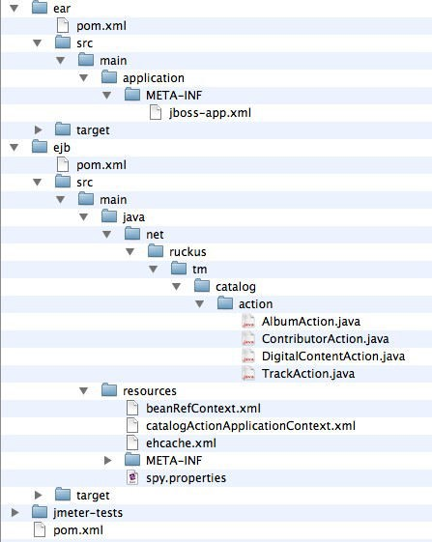
Multimo dule Pro je cts
Depends on the EJB artifact
Creates EJB jar
<p a c k a g in g >p o m <p a c k a g in g >
<m o d u le s >
46
<m o d u le >e jb </ m o d u le

Slide 47
Multimo dule: Reactor
Whe n Mave n encounte rs a multimodule pro je ct, it pulls all of the POMs into the “Re acto r”
The Re actor analyzes module inte r- dependencies to ens ure pro per
o rde ring .
If no changes need to be made, the modules are executed in the o rde r they are declare d.
Mave n then runs the goals on each module in the o rde r re ques ted.
47

Slide 48
Us e r-De fined Pro pe rtie s
<p r o je c t x m ln s =h t t p :// m a v e n . a p a c h e . o r g / P O M / 4 . 0 . 0 >
<m o d e l V e r s io n >4 . 0 . 0 </ m o d e l V e r s io n >
<n a m e >S u p e r D u p e r A m a z in g D e lu x e P r o je c t </ n a m e >
<p a c k a g in g > ja r </ p a c k a g in g >
<g r o u p Id > c o m . t e c h m a in e </ g r o u p Id >
<a r t if a c t Id >s u p e r d u p e r </ a r t if a c t >
<v e r s io n >1 . 0 . 0 </ v e r s io n >
<p a r e n t >
<!-- P a r e n t P O M s t u f f if a p p lic a b le -->
</ p a r e n t >
<m o d u le s >
<!-- S u b -m o d u le s o f t h is p r o je c t -->
</ m o d u le s >
<p r o p e r t ie s >
<!-- A d -h o c p r o p e r t ie s u s e d in
</ p r o p e r t ie s >
<d e p e n d e n c ie s >
<!-- D e p e n d e n c y S t u f f -->
</ d e p e n d e n c ie s >
<b u ild >
t h e b u i ld -->
<!-- B u ild C o n f ig u r a t io n -->
<p lu g in s >
<!-- p lu g in c o n f ig u r a t io n -->
</ p lu g in s >
</ b u i ld >
<p r o f ile s >
<!-- b u i ld p r o f i le s -->
</ p r o f i le s >
</ p r o je c t >
48

Slide 49
Us e r-De fined Pro pe rtie s
Us e r-De fined pro pe rtie s are like ant pro pe rtie s :
<p r o p e r t ie s >
<h ib e r n a t e . v e r s io n >3 . 3 . 0 . g a </ h ib e r n a t e . v e r s io n >
</ p r o p e r t ie s >
. . .
<d e p e n d e n c ie s >
<d e p e n d e n c y >
<g r o u p Id >o r g . h ib e r n a t e </ g r o u p Id >
<a r t i f a c t Id >h ib e r n a t e </ a r t i f a c t >
<v e r s io n >$ {h ib e r n a t e . v e r s io n }</ v e r s io n >
</ d e p e n d e n c y >
</ d e p e n d e n c ie s >
Example fromMav en: The Definitiv e Guide, Sonatype, O’Reilly p.266

Slide 50
Other Pro pe rtie s
Maven Properties, project.*
${project.version}
Set ings Properties, set ings.*
${settings.interactiveMode}
Environment Variables, env.*
${env.JAVA_HOME}
Java SystemProperties
${java.version}, ${os.arch}, ${user.dir}

Slide 51
Dependencies
<p r o je c t x m ln s =h t t p :// m a v e n . a p a c h e . o r g / P O M / 4 . 0 . 0 >
<m o d e l V e r s io n >4 . 0 . 0 </ m o d e l V e r s io n >
<n a m e >S u p e r D u p e r A m a z in g D e lu x e P r o je c t </ n a m e >
<p a c k a g in g > ja r </ p a c k a g in g >
<g r o u p Id > c o m . t e c h m a in e </ g r o u p Id >
<a r t if a c t Id >s u p e r d u p e r </ a r t if a c t >
<v e r s io n >1 . 0 . 0 </ v e r s io n >
<p a r e n t >
<!-- P a r e n t P O M s t u f f if a p p lic a b le -->
</ p a r e n t >
<m o d u le s >
<!-- S u b -m o d u le s o f t h is p r o je c t -->
</ m o d u le s >
<p r o p e r t ie s >
<!-- A d -h o c p r o p e r t ie s u s e d in
</ p r o p e r t ie s >
<d e p e n d e n c ie s >
<!-- D e p e n d e n c y S t u f f -->
</ d e p e n d e n c ie s >
<b u ild >
t h e b u i ld -->
<!-- B u ild C o n f ig u r a t io n -->
<p lu g in s >
<!-- p lu g in c o n f ig u r a t io n -->
</ p lu g in s >
</ b u i ld >
<p r o f ile s >
<!-- b u i ld p r o f i le s -->
</ p r o f i le s >
</ p r o je c t >
51

Slide 52
Dependencies
Mave n’s pièce de résistance
<d e p e n d e n c ie s >
<d e p e n d e n c y >
<g r o u p Id >c o m . t e c h m a in e </ g r o u p Id >
<a r t i f a c t Id >a w e s o m e -lib </ a r t i f a c t Id >
<v e r s io n >1 . 3 . 5 </ v e r s io n >
<s c o p e > c o m p i le </ s c o p e >
<o p t io n a l>f a ls e </ o p t io n a l>
</ d e p e n d e n c y >
</ d e p e n d e n c ie s >

Slide 53
Dependencies
groupId and artifactId: must be unique
<d e p e n d e n c ie s >
<d e p e n d e n c y >
<g r o u p Id >c o m . t e c h m a in e </ g r o u p Id >
<a r t i f a c t Id >a w e s o m e -lib </ a r t i f a c t Id >
<v e r s io n >1 . 3 . 5 </ v e r s io n >
<s c o p e > c o m p i le </ s c o p e >
<o p t io n a l>f a ls e </ o p t io n a l>
</ d e p e n d e n c y >
</ d e p e n d e n c ie s >

Slide 54
Dependencies
<d e p e n d e n c ie s >
<d e p e n d e n c y >
<g r o u p Id >c o m . t e c h m a in e </ g r o u p Id >
<a r t i f a c t Id >a w e s o m e -lib </ a r t i f a c t Id >
<v e r s io n >1 . 3 . 5 </ v e r s io n >
<s c o p e > c o m p i le </ s c o p e >
•1.3.5 - prefer version 1.3.5, newer
version is acceptable to resolve conflicts
<o p t io n a l>f a ls e </ o p t io n a l >•(1.3.4,1.3.9) - Any version between
</ d e p e n d e n c y >
1.3.2 and 1.3.9, exclusive
•[1.3.4,1.3.9] - Any version between
</ d e p e n d e n c ie s >
1.3.2 and 1.3.9, inclusive
•[,1.3.9] - Any version up to, and
including, 1.3.9
•[1.3.5] - Only version 1.3.5, do not
use a newer version.

Slide 55
Dependencies
<d e p e n d e n c ie s >
<d e p e n d e n c y >
<g r o u p Id >c o m . t e c h m a in e </ g r o u p Id >
<a r t i f a c t Id >a w e s o m e -lib </ a r t i f a c t Id >
<v e r s io n >1 . 3 . 5 </ v e r s io n >
<s c o p e > c o m p i le </ s c o p e >
•compile - default, packaged.
Available on compile-time and runtime CLASSPATH.
<o p t io n a l>f a ls e </ o p t io n a l >•provided - you expect the JVMor
</ d e p e n d e n c y >
app container to provide the library. Available on compile-time
CLASSPATH.
•runtime - needed to run, but not
</ d e p e n d e n c ie s >
compilation (e.g., a JDBC driver)
•test - only needed during test
execution (e.g., JUnit)

Slide 56
Dependencies
<d e p e n d e n c ie s >
<d e p e n d e n c y >
<g r o u p Id >c o m . t e c h m a in e </ g r o u p Id >
<a r t i f a c t Id >a w e s o m e -lib </ a r t i f a c t Id >
<v e r s io n >1 . 3 . 5 </ v e r s io n >
<s c o p e > c o m p i le </ s c o p e >
<o p t io n a l>f a ls e </ o p t io n a l>
</ d e p e n d e n c y >
</ d e p e n d e n c ie s >
Prevents this dependency from being included as a transitive dependency if some other project depends on this project.

Slide 57
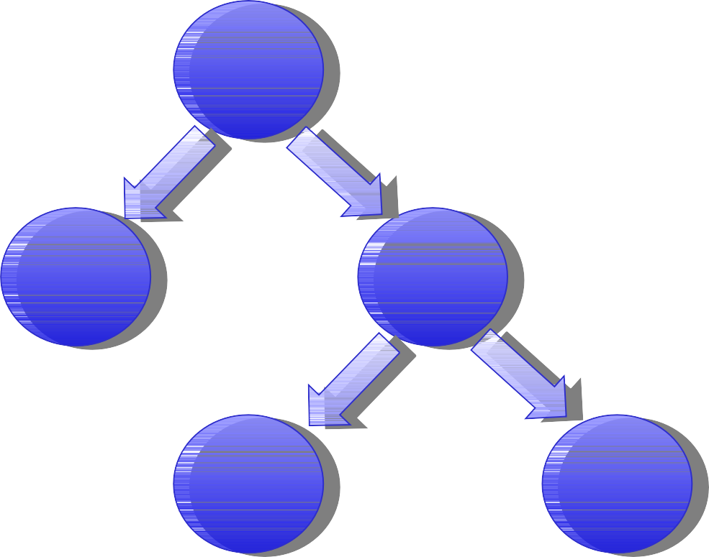
Trans itive Dependencies
A
1.0
B
1.0
C
1.0
D
1.0
E
1.0
Our project (Project “A”) depends on B and C. Project C depends on projects D and E. Thus, our project depends
on B, C, D, and E, and Maven will fetch and use these artifacts appropriately.

Slide 58
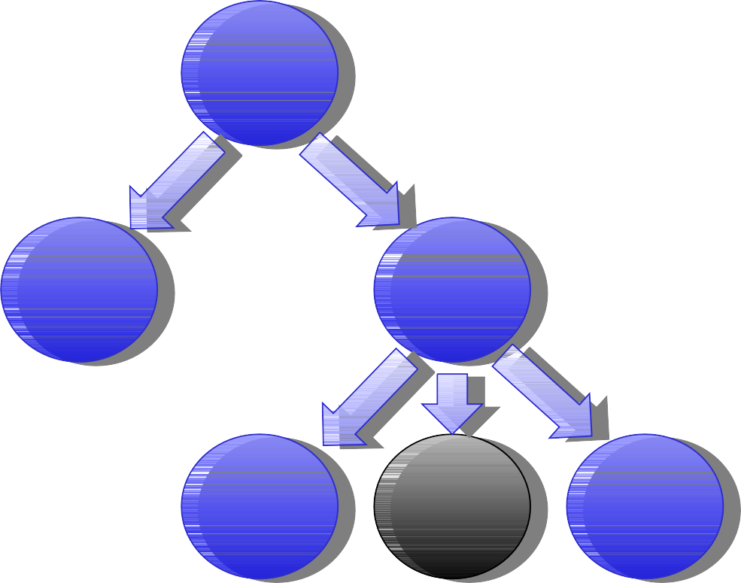
Trans itive Dependencies
A
1.0
B
1.0
C
1.0
D
1.0
B
1.1
E
1.0
Now, let’s say project C has a dependency on project B, but requires version 1.1. If project A’s POMdoesn’t
explicitly require version 1.0 or earlier, then Maven will choose version 1.1.

Slide 59
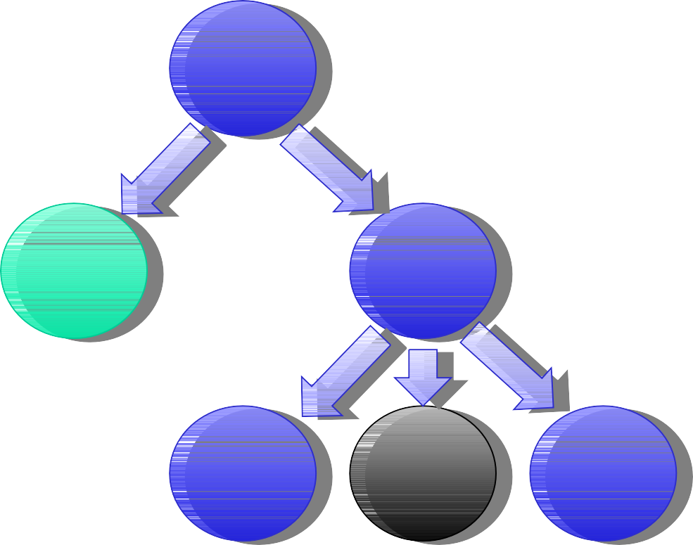
Trans itive Dependencies
A
1.0
B
[1.0]
C
1.0
D
1.0
B
[1.1]
E
1.0
Uh oh. NowProject A is saying that it must use version
1.0 of B, and only version 1.0, and project C needs version 1.1 of project B.

Slide 60
Dependency Exclus ions
One way to deal with conflicts is with exclusions
<d e p e n d e n c ie s >
<d e p e n d e n c y >
<g r o u p Id >c o m . t e c h m a in e </ g r o u p Id >
<a r t i f a c t Id >p r o je c t -b </ a r t i f a c t Id >
<v e r s io n >[1 . 0 ]</ v e r s io n >
</ d e p e n d e n c y >
<d e p e n d e n c y >
<g r o u p Id >c o m . t e c h m a in e </ g r o u p Id >
<a r t i f a c t Id >p r o je c t -c </ a r t i f a c t Id >
<e x c lu s io n s >
<e x c lu s io n >
<g r o u p Id >c o m . t e c h m a in e </ g r o u p Id >
<a r t if a c t Id >p r o je c t -b </ a r t if a c t Id >
</ e x c lu s io n >
</ e x c lu s io n s >
</ d e p e n d e n c y >
</ d e p e n d e n c ie s >

Slide 61


Dependency Manag ement
Parent POM
<dependencyManagement>
<dependencies>
<dependency>
<groupId>org.springframework</groupId>
<artifactId>spring</artifactId>
<version>2.5.5</version>
</dependency>
</dependencies>
</dependencyManagement>
Child POM
<dependencies>
<dependency>
<groupId>org.springframework</groupId>
<artifactId>spring</artifactId>
</dependency>
</dependencies>
The
d_{e}e_{le}pe_{m}nd_{e}e_{n}n_{t}cy_{a}M_{ll}a_{o}n_{w}ag_{s}em_{yo}en_{u}t
to specify version numbers of
dependencies in child POMs without
making all children dependent on a
particular library.

Slide 62
SNAPS HOT Ve rs ions
S NAPS HOT is a lite ral s tring appended to a ve rs ion numbe r, e.g., 1.2.3-
S NAPS HOT
Indic ates that a ve rs ion is “under development”
Us e if you need Mave n to keep checking for the lates t ve rs ion
Mave n re places S NAPS HOT with a UTC time s tamp befo re putting it into the re pos ito ry.

Slide 63
Build Configuratio n
<p r o je c t x m ln s =h t t p :// m a v e n . a p a c h e . o r g / P O M / 4 . 0 . 0 >
<m o d e l V e r s io n >4 . 0 . 0 </ m o d e l V e r s io n >
<n a m e >S u p e r D u p e r A m a z in g D e lu x e P r o je c t </ n a m e >
<p a c k a g in g > ja r </ p a c k a g in g >
<g r o u p Id > c o m . t e c h m a in e </ g r o u p Id >
<a r t if a c t Id >s u p e r d u p e r </ a r t if a c t >
<v e r s io n >1 . 0 . 0 </ v e r s io n >
<p a r e n t >
<!-- P a r e n t P O M s t u f f if a p p lic a b le -->
</ p a r e n t >
<m o d u le s >
<!-- S u b -m o d u le s o f t h is p r o je c t -->
</ m o d u le s >
<p r o p e r t ie s >
<!-- A d -h o c p r o p e r t ie s u s e d in
</ p r o p e r t ie s >
<d e p e n d e n c ie s >
<!-- D e p e n d e n c y S t u f f -->
</ d e p e n d e n c ie s >
<b u ild >
t h e b u i ld -->
<!-- B u ild C o n f ig u r a t io n -->
<p lu g in s >
<!-- p lu g in c o n f ig u r a t io n -->
</ p lu g in s >
</ b u i ld >
<p r o f ile s >
<!-- b u i ld p r o f i le s -->
</ p r o f i le s >
</ p r o je c t >
63

Slide 64
Build Configuratio n
The build section of the POM, broken down further:
<p r o je c t >
. . .
<b u i ld >
<f i lt e r s >
<f i lt e r >f i lt e r / m y . p r o p e r t ie s </ f i lt e r >
</ f i lt e r s >
<r e s o u r c e s >
. . .
</ r e s o u r c e s >
<p lu g in s >
. . .
</ p lu g in s >
</ b u i ld >
. . .
</ p r o je c t >
64

Slide 65
Build Configuratio n Filte rs
<p r o je c t >
. . .
<b u i ld >
<f i lt e r s >
<f i lt e r >f i lt e r / m y . p r o p e r t ie s </ f i lt e r >
</ f i lt e r s >
<r e s o u r c e s >
. . .
</ r e s o u r c e s >
<p lu g in s >
. . .
</ p lu g in s >
</ b u i ld >
. . .
</ p r o je c t >
Path to a properties file (name=value). When the resources are processed during packaging, maven will substitute any ${name} strings with the
cor esponding value fromthe properties file.

Slide 66
Build Configuratio n Res ourc es
•
The re s ourc es :re s ourc es goal copies file s fro m the re s ourc es dire c to ry to the output dire c to ry
Can pro ces s us ing filte rs
De fault locatio n src/main/resources Can be further configured:
•
•
•
<r e s o u r c e s >
<r e s o u r c e >
<d ir e c t o r y > s r c / m a in / s c r ip t s </ d ir e c t o r y >
<f i lt e r in g >t r u e </ f i l t e r in g >
<t a r g e t P a t h >b in </ t a r g e t P a t h >
<in c lu d e s >
<in c lu d e >r u n . b a t </ in c lu d e >
<in c lu d e >r u n . s h </ in c lu d e >
</ in c lu d e s >
<r e s o u r c e >
</ r e s o u r c e s >

Slide 67
Build Configuratio n Plugins
All wo rk in Mave n is pe rfo rme d by plugins
Like De pendencies , are Downloaded fro m a re pos ito ry
Becaus e they are s hare d, you often benefit fro m the fact that s omeone e ls e has alre ady built a plugin for whatever function you may need

Slide 68
Plugin Configuratio n
The plugin s ection of the POM has a configuratio n e lement whe re you can cus tomize plugin behavio r:
<b u i ld >
<p lu g in s >
<p lu g in >
<g r o u p Id >o r g . a p a c h e . m a v e n . p lu g in s </ g r o u p I d >
<a r t if a c t Id >m a v e n -c le a n -p lu g in </ a r t if a c t Id >
<v e r s io n >2 . 2 </ v e r s io n >
<c o n f ig u r a t io n >
<!-- C o n f ig u r a t io n
</ c o n f ig u r a t io n >
</ p lu g in >
</ p lu g in s >
d e t a i ls g o h e r e -->
</ b u i ld >
68

Slide 69
Plugin Config uratio n: Example
Below, we have configured the c lean plugin to delete file s ending in .txt fro m the tmp dire cto ry
<b u ild >
<p lu g in s >
<p lu g in >
<g r o u p Id > o r g . a p a c h e . m a v e n . p lu g in s </ g r o u p Id >
<a r t if a c t Id >m a v e n -c le a n -p lu g in </ a r t if a c t Id >
<v e r s io n >2 . 2 </ v e r s io n >
<c o n f ig u r a t io n >
< f i le s e t s >
<f i le s e t >
<d ir e c t o r y > t m p </ d ir e c t o r y >
<in c lu d e s >
<in c lu d e >**/ *. t x t </ in c lu d e >
</ in c lu d e s >
<f o llo w S y m l in k s > f a ls e </ f o l lo w S y m lin k s >
</ f ile s e t >
</ f i le s e t s >
</ c o n f ig u r a t io n >
</ p lu g in >
</ p lu g in s >
</ b u i ld >

Slide 70
Co re Plugins
Maven
Plugin
Whirlwind Tour
c lean - has only one goal, c lean.
De le tes the targ et dire cto ry, can be
configure d to delete other s tuff
compiler - compiles s ourc es , us es javac compiler by default.
Has a compile and tes tCompile goal.
Can be configure d to us e any executable as the compiler
deploy - uploads artifac ts to a re mote re pos ito ry

Slide 71
Co re Plugins , cont.
Maven
Plugin
Whirlwind
ins tall - ins talls the artifac t
into the
Tour
local re pos ito ry.
ins tall goal, ins tall this pro je ct’s artifac t
ins tall-file goal, ins tall a s pecific file into local re po (g ood for third-party s tuff)
s ure fire - runs all of the unit tes ts in the tes t s ourc e dire cto ry, and gene rate s re po rts .
re s ourc es - copies re s ourc es to be packaged

Slide 72
Packaging Plugins
Maven
Plugin
Whirlwind Tour
ear, e jb, jar, war
as s embly - builds a binary dis tributio n including runtime dependencies
s uppo rts zip, tar.g z, tar.bz2, jar, dir, and war fo rmats
us es “as s embly des c ripto rs ” to configure (altho ugh s eve ral pre -fab ones are available)
one of the pre -fab des c ripto rs builds
executable jar file s with all depenencies embedded

Slide 73
Utility Plugins
Maven
Plugin
Whirlwind Tour
arc hetype - builds s keleton of a wo rking
pro je ct for many diffe re nt frame wo rks
Wic ket, Tape s try 5, JSF, JPA, tons of othe rs
help - even the help is a plugin! Us e the des c ribe goal to learn what a plugin can do, e.g.,
m v n h e lp :d e s c r ib e
-D p lu g in = c o m p i le r
s cm - s ourc e contro l s tuff

Slide 74
Build Life cycle
Us ually, an artifac t is built by executing a s equence of goals
For example, to gene rate a WAR:
Clean the build are a
Copy the re s ourc es
Compile the code
Copy the tes t re s ourc es
Compile the tes t code
Run the tes t
Package the re s ult

Slide 75
Mave n’s Life cycles
Mave n s uppo rts thre e s tandard life cycles
c lean - as you might expect, s tarts us fre s h
default - the life cycle that builds the code
s ite - a life cycle for building other re lated artifac ts (e .g ., re po rts and documentation)

Slide 76
Clean Life cycle
The Cle an Life cycle has thre e phas es :
pre -c lean
c lean
pos t-c lean
Only c lean is “bo und” by default, to the c lean goal of the c lean plugin. Yo u can bind other tas ks us ing executions .

Slide 77
Executions
Le t’s s ay you have a whizz-bang plugin named mp3, and it has a goal named play that le ts you play an arbitrary audio c lip, and you’d like to play a clip during pre -c lean:
<p lu g in >
<g r o u p Id >c o m . t e c h m a in e </ g r o u p Id >
<a r t if a c t Id >m p 3 </ a r t if a c t Id >
<v e r s io n >1 . 0 </ v e r s io n >
<e x e c u t io n s >
<e x e c u t io n >
<p h a s e >p r e -c le a n </ p h a s e >
<g o a ls >
<g o a l>p la y </ g o a l>
</ g o a ls >
<c o n f ig u r a t io n >
<a u d io C l ip F i le >t o i le t -f lu s h . m p 3 </ a u d io C l ip F i le >
</ c o n f ig u r a t io n >
</ e x e c u t io n >
</ e x e c u t io n s >
</ p lu g in >

Slide 78
Mave n’s Default Life cycle
Mave n models the s oftware build pro ces s with the 21 s tep “de fault life cycle”
validate | generate-test-sources | package
generate-sources | process-test-sources | pre-integration-test
process-sources | generate-test-resources | integration-test
generate-resources | process-test-resources | post-integration-test
process-resources | test-compile | verify
compile | test | install
process-classes | prepare-package | deploy

Slide 79
Package -S pecific Life cycles
Mave n automatic ally binds goals to the phas es on the pre vious s lide bas ed on the packaging type . E.g., for pro je c ts that package WARs :
Life cycle Phas e | Goal
process-resources | resources:resources
compile | compiler:compile
process-test-resources | resources:testResources
test-compile | compiler:testCompile
test | surefire:test
package | war:war
install | install:install
deploy | deploy:deploy

Slide 80
Build Pro file s
<p r o je c t x m ln s =h t t p :// m a v e n . a p a c h e . o r g / P O M / 4 . 0 . 0 >
<m o d e l V e r s io n >4 . 0 . 0 </ m o d e l V e r s io n >
<n a m e >S u p e r D u p e r A m a z in g D e lu x e P r o je c t </ n a m e >
<p a c k a g in g > ja r </ p a c k a g in g >
<g r o u p Id > c o m . t e c h m a in e </ g r o u p Id >
<a r t if a c t Id >s u p e r d u p e r </ a r t if a c t >
<v e r s io n >1 . 0 . 0 </ v e r s io n >
<p a r e n t >
<!-- P a r e n t P O M s t u f f if a p p lic a b le -->
</ p a r e n t >
<m o d u le s >
<!-- S u b -m o d u le s o f t h is p r o je c t -->
</ m o d u le s >
<p r o p e r t ie s >
<!-- A d -h o c p r o p e r t ie s u s e d in
</ p r o p e r t ie s >
<d e p e n d e n c ie s >
<!-- D e p e n d e n c y S t u f f -->
</ d e p e n d e n c ie s >
<b u ild >
t h e b u i ld -->
<!-- B u ild C o n f ig u r a t io n -->
<p lu g in s >
<!-- p lu g in c o n f ig u r a t io n -->
</ p lu g in s >
</ b u i ld >
<p r o f ile s >
<!-- b u i ld p r o f i le s -->
</ p r o f i le s >
</ p r o je c t >
80

Slide 81
Pro file s : Cus tomized Builds
Sometimes our artifac ts need to be tweaked for diffe re nt “c us tome rs ”
The De velopment ve rs ion has diffe re nt logging or databas e configuratio n than QA or Pro duction
The re might be s light diffe re nces bas ed on targ et OS or JDK ve rs ion
81

Slide 82
Ho w to declare a pro file
In the POM its elf, in an exte rnal pro file s .xml file , or even in s e tting s .xml
<p r o je c t >
...
<p r o f ile s >
<p r o f i le >
<id >a p p s e r v e r C o n f ig -d e v </ id >
<p r o p e r t ie s >
<a p p s e r v e r . h o m e >/ p a t h / t o / d e v / a p p s e r v e r </ a p p s e r v e r . h o m e >
</ p r o p e r t ie s >
</ p r o f i le >
<p r o f i le >
<id >a p p s e r v e r C o n f ig -d e v -2 </ id >
<p r o p e r t ie s >
< a p p s e r v e r . h o m e >/ p a t h / t o / a n o t h e r / d e v / a p p s e r v e r 2 </
a p p s e r v e r . h o m e >
</ p r o p e r t ie s >
</ p r o f i le >
</ p r o f i le s >
...
</ p r o je c t >
82

Slide 83
Build Co nfig uratio n in a Pro file
You can even configure plugins based on a profile:
<p r o je c t >
. ..
<p r o f ile s >
<p r o f i le >
<id >p r o d u c t io n </ id >
<b u i ld >
<p lu g in s >
<p lu g in >
<g r o u p Id >o r g . a p a c h e . m a v e n . p lu g in s </ g r o u p Id >
<a r t if a c t Id >m a v e n -c o m p i le r -p lu g in </ a r t if a c t Id >
<c o n f ig u r a t io n >
<d e b u g > f a ls e </ d e b u g >
<o p t im iz e > t r u e </ o p t im iz e >
</ c o n f ig u r a t io n >
</ p lu g in >
</ p lu g in s >
<a p p s e r v e r . h o m e >/ p a t h / t o / d e v / a p p s e r v e r </ a p p s e r v e r . h o m e >
</ b u i ld >
</ p r o f i le >
. . .
Example from Maven: The Definitive Guide, Sonatype, O’Reilly p.200
83

Slide 84
Activating a Pro file
On the command-line :
m v n p a c k a g e
-P m y p r o f i le 1 , m y p r o f i le 2
In your s ettings .xml file :
<s e t t in g s >
. . .
<a c t iv e P r o f i le s >
<a c t iv e P r o f i le >d e v </ a c t iv e P r o f i le >
</ a c t iv e P r o f i le s >
. . .
</ s e t t in g s >
Ac tivation e lements
84

Slide 85
Activation Elements
<p r o je c t >
…
<p r o f ile s >
<p r o f i le >
<id >d e v </ id >
<a c t iv a t io n >
<a c t iv e B y D e f a u lt >f a ls e </ a c t iv e B y D e f a u lt >
<jd k >1 . 5 </ jd k >
<o s >
<n a m e > W in d o w s X P </ n a m e >
<f a m ily >W in d o w s </ f a m l iy >
<a r c h > x 8 6 </ a r c h >
<v e r s io n >5 . 1 . 2 6 0 0 </ v e r s io n >
</ o s >
<p r o p e r t y >
<n a m e > m a v e n V e r s io n </ n a m e >
<v a lu e >2 . 0 . 9 </ v a lu e >
</ p r o p e r t y >
<f i le >
<e x is t s >f i le 2 . p r o p e r t ie s </ e x is t s >
<m is s in g >f ile 1 . p r o p e r t ie s </ m is s in g >
</ f ile >
</ a c t iv a t io n >
…
</ p r o f ile >
</ p r o f i le s >
</ p r o je c t >
Example from Maven: The Definitive Guide, Sonatype, O’Reilly p.204-205
85

Slide 86
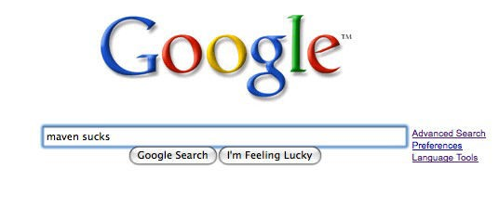
Sometimes Mave n Sucks
…returns “about 128,000”results

Slide 87
Common Critic is ms
•
Poor Documentatio n - Lo ts of Mave n’s online documentatio n is auto matically gene rate d and is gene rally pre tty hor ible
Simple things are s ometimes counte rintuitive with Mave n - E.g., copying a file
Mave n adds to the number of places you need to look when s ome thing bre aks - both your s ourc e
re pos ito ry, and the maven re pos ito ry
Eve rything bre aks if s omeone changes an artifac tId or g ro upId
•
•
•
•
Does n’t wo rk well if your ne two rk connectivity is unre liable or unavailable
Gets tangled and confus ed if one of your trans itive dependencies is n’t available in a maven re pos ito ry
•

Slide 88
(FIN)

