Slide 1
VELOOP Rewards
Product Analytics, Data Readiness & Data Management Blueprint
Data Analyst Internship, Task 01. Handover presentation
All data analysed is fictional/simulated (SIMULATED DATA - CREATED FOR ANALYTICAL TESTING)

Slide 2
What this project had to answer
• What should VELOOP collect?
• How should it be structured?
• How do we know the data is trustworthy?
• What should management measure?
• What should engineering implement?
• What should a future analytics team be able to see?
• Constraint: no real production volume exists, so the goal is a reliable, traceable foundation, not impressive numbers.
SIMULATED DATA / PROPOSED DESIGN. Not actual VELOOP results.

Slide 3
What was built
38
100
46
proposed events, object_action naming
data dictionary fields
KPIs, no invented targets
34
7
15
data quality issues found, with counts
dashboards, 28 visuals, wireframed
developer requirements with acceptance tests
SIMULATED DATA / PROPOSED DESIGN. Not actual VELOOP results.

Slide 4
What the simulated data pack contained
• Received: two workbooks. Users (clean 1,000 rows and messy 1,008 rows) and behaviour data (7,913 sessions, 35,704 events, 9,846 task attempts, 4,799 milestones).
• Not supplied: Rewards, Wallet, Withdrawals, Referrals tables. Their KPIs stay design-only.
• The behaviour file calls itself 'Task 02'; used as extra simulated data. Needs confirmation.
• Period stated in the files: 1 April to 15 September 2026.
SIMULATED DATA / PROPOSED DESIGN. Not actual VELOOP results.

Slide 5
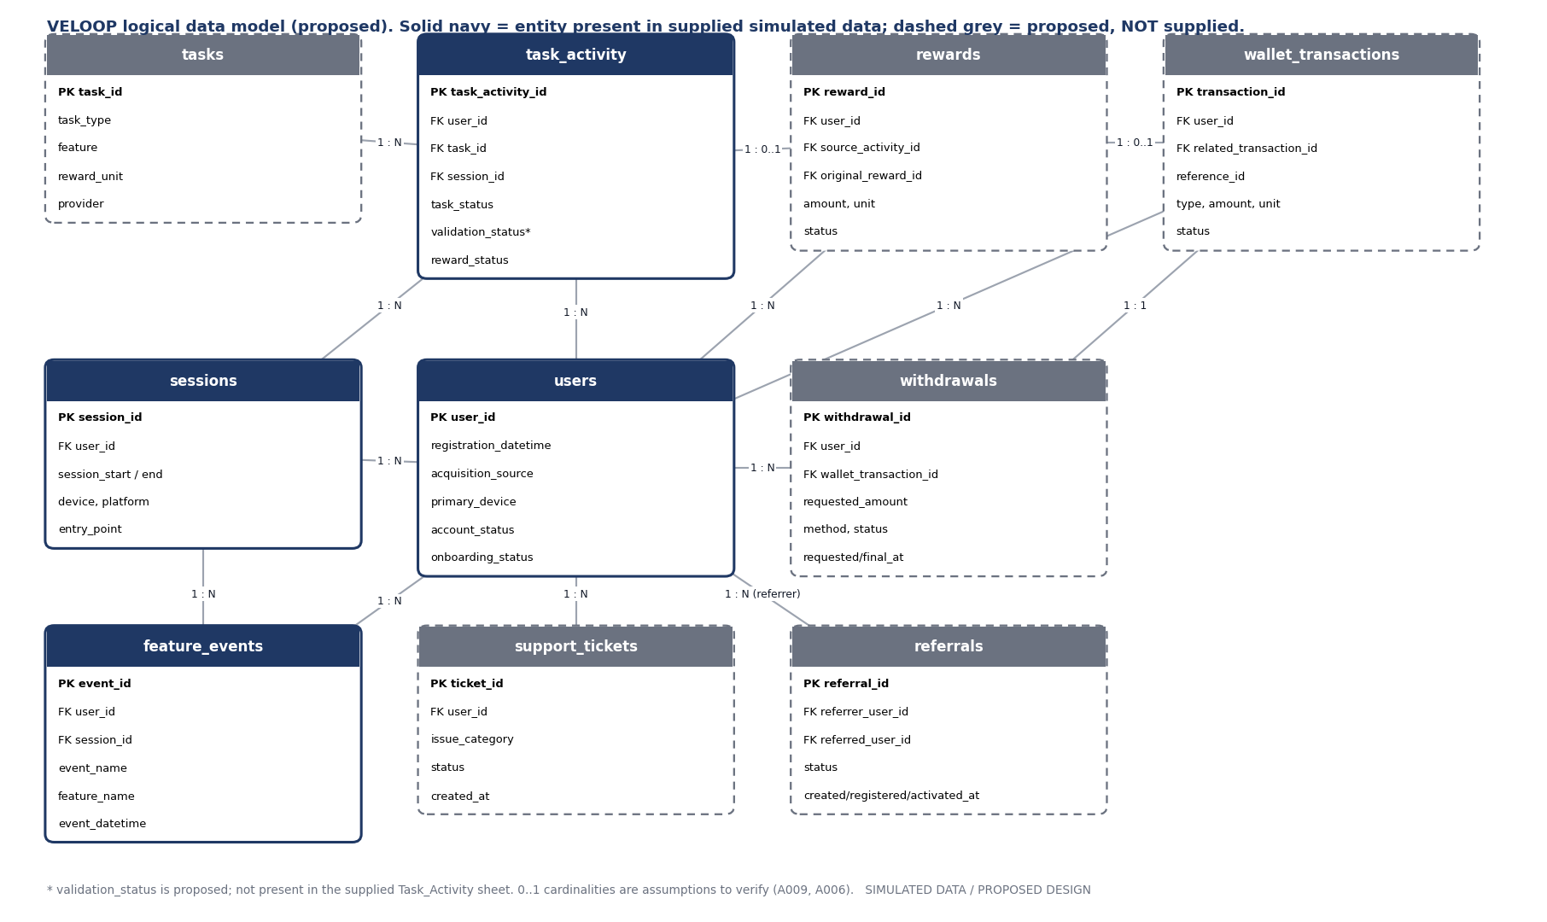
Logical data model
SIMULATED DATA / PROPOSED DESIGN. Not actual VELOOP results.

Slide 6
Key findings from profiling and audit
• Two Users tables use the same 1,000 IDs but disagree on every user's attributes. A master must be chosen.
• Relationships are sound: 0 orphan user or session references; 16 users never active.
• No reward amount or unit, and no task catalogue: all 80 task_ids map to several categories.
• Stored counts do not reconcile: events_in_session wrong for 7,537 of 7,913 sessions; 423 daily rows with completed > total tasks.
• Messy sheets: 8 duplicate users, 9 missing required values, 1 malformed date; 10 duplicate events.
• Personal data (name, email, age, gender, city) present for all users, against data minimisation.
SIMULATED DATA / PROPOSED DESIGN. Not actual VELOOP results.

Slide 7
34 data quality issues by severity
3
11
15
5
Critical
High
Medium
Low
• Every issue has detection logic, likely cause, correction, prevention and owner (sheet K_DQ_Report).
• Cleaning keeps traceability: input rows = clean + quarantined + removed duplicates. Unsafe rows are quarantined, never imputed.
• 11 automated tests pass and guard the known counts.
SIMULATED DATA / PROPOSED DESIGN. Not actual VELOOP results.

Slide 8
Can the proposed KPIs be calculated from this data?
• Yes (10 groups): registrations, DAU/WAU/MAU, returning and inactive users, task starts and completion, feature usage, activity-to-credit (count only).
• Partial (3): onboarding completion, failure analysis, pending/reversed rewards.
• No (5): reward amounts, wallet and reconciliation, withdrawals, referral funnel, support. The data to add is named for each in the workbook.
SIMULATED DATA / PROPOSED DESIGN. Not actual VELOOP results.

Slide 9
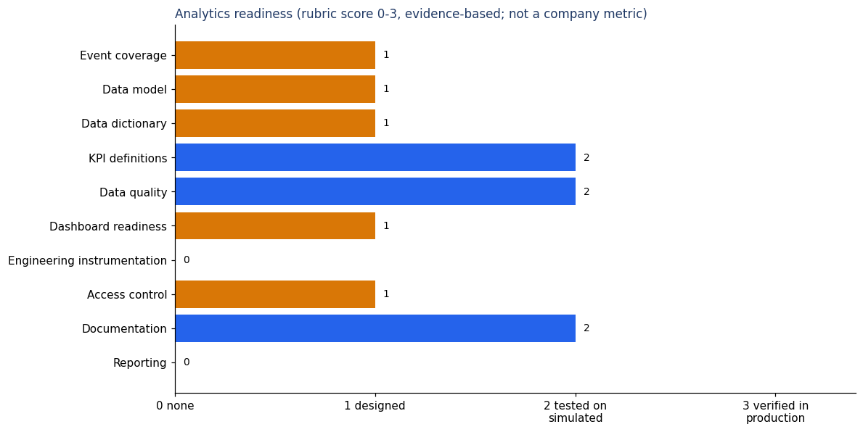
Analytics readiness scorecard
SIMULATED DATA / PROPOSED DESIGN. Not actual VELOOP results.

Slide 10
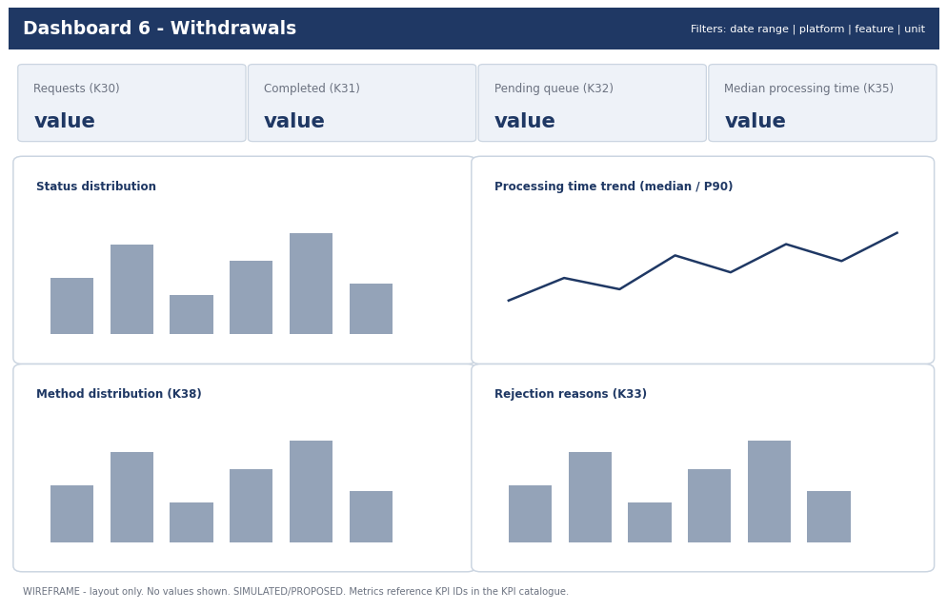
Dashboard blueprint (wireframe example)
SIMULATED DATA / PROPOSED DESIGN. Not actual VELOOP results.

Slide 11
Implementation priorities
• Critical (prelaunch): stable user_id and user master; immutable transaction_id with idempotent writes; unit and conversion rules; withdrawal state history; reward vs activity separation; events REQ-001 to 013.
• High: UTC timestamps; ingestion validation; failure classification; referral stage rules; role-based access; reward-to-wallet reconciliation.
• Medium and Low (postlaunch): session ID, acquisition source, support export, remaining dashboards, badge/level analytics.
SIMULATED DATA / PROPOSED DESIGN. Not actual VELOOP results.

Slide 12
Decisions needed and next steps
• Which Users table is the master (A016)?
• Is the 'Task 02' behaviour file intended input?
• Can the Rewards, Wallet, Withdrawals, Referrals datasets be supplied?
• Confirm the qualifying-activity list for DAU and the referral activation rule.
• Next: engineering verifies the 18 open assumptions; run the tested pipeline on production-like data when it exists; replace simulated data, never mix.
SIMULATED DATA / PROPOSED DESIGN. Not actual VELOOP results.

