Slide 1


ACIS-X
Autonomous Credit Intelligence System
Event-Driven Credit Risk Intelligence for Modern Financial Systems
MAJOR PROJECT PHASE – II
TEAM MEMBERS : Nikhil Nagendra , Nitin Bharadwaj M V S , Johan K George , Prasanna B Acharya
PROJECT GUIDE Prof. Pallavi K V (Department of CSE)

Slide 2
Abstract
The Challenge
Traditional credit monitoring systems rely on periodic evaluations and manual intervention, making them slow to respond to real-time financial risks.
Our Approach
ACIS-X is an event-driven multi-agent system that continuously monitors customer financial behavior in real time.
Critical signals such as payment delays, litigation events, and financial deterioration are often detected too late, leading to poor credit decisions and increased default risk.
It integrates internal transaction data with external intelligence
sources such as financial reports and litigation signals.
Independent agents process events like invoices, payments, and external updates, dynamically generating risk insights.
A centralized aggregation mechanism combines these signals into a unified credit risk profile, enabling faster, automated, and intelligent decision-making.
ACIS-X transforms credit risk assessment from reactive analysis to real-time intelligent monitoring.

Slide 3

Problem Statement
Limitations of Traditional Credit Risk Systems
Delayed Risk Detection
Most systems rely on periodic evaluations, causing late identification of defaults and financial stress.
Fragmented Data Sources
Financial data, payment behavior, and external signals like litigation exist in isolation, preventing holistic risk assessment.
Reactive Decision-Making
Credit decisions are made after issues arise rather than predicting and preventing them in real time.
Lack of Real-Time Intelligence
Existing systems fail to process continuous streams of events such as payments, invoices, and external financial signals.
Current systems are reactive, slow, and disconnected — creating significant financial risk.

Slide 4



Objectives
Develop a Real-Time Credit Monitoring System
Continuously track customer financial activities such as invoices and payments.
Implement Event-Driven Architecture
Enable dynamic processing of financial events using independent, scalable agents.
Integrate External Intelligence
Incorporate financial indicators and litigation signals to enhance risk visibility.
Generate Unified Risk Profiles
Combine multiple risk signals into a single, actionable credit score.
Enable Proactive Decision-Making
Allow early detection of risk and support timely credit and collection strategies.
Incorporate Self-Healing Mechanisms
Automatically detect system failures, performance issues, and overload conditions, and trigger recovery actions such as restart, scaling, or fallback.
The goal is to shift from static credit evaluation to continuous, intelligent, and resilient risk monitoring.

Slide 5

Literature Review
Paper Title | Year | Author(s) | Source | Brief Description
Fraud Detection in Credit Risk Assessment Using Supervised Learning Algorithms | 2024 | Tianyi Xu | ResearchGate | Uses supervised ML models (Random Forest, SVM, Neural Networks) for fraud detection and credit risk prediction using historical financial datasets.
Credit Risk Prediction Using Machine Learning and Deep Learning | 2024 | Victor Chang et al. | MDPI – Risks Journal | Applies ML and deep learning models to predict credit defaults based on financial indicators and borrower behavior.
A Supervised ML Algorithm for Detecting Credit Card Fraud | 2023 | Afriyie et al. | ScienceDirect | Focuses on transaction-level fraud detection using classification algorithms such as Logistic Regression and Random Forest.
Financial Fraud Detection through Machine Learning: A Systematic Review | 2024 | Hernandez Aros et al. | Nature (Humanities & Social Sciences Communications) | Reviews over 100 ML-based fraud detection approaches, highlighting challenges like data imbalance and deployment limitations.
Credit Risk Modelling and Fraud Detection: A Comprehensive Review | 2025 | Various Authors | IJERT | Surveys evolution from statistical models to ML and deep learning techniques in credit risk analysis.
Explainability in Credit Scoring Models | 2020 | Sebastian Bücker et al. | arXiv | Discusses explainable AI techniques in credit scoring and challenges of balancing interpretability with model performance.
Event-Driven Architectures with Apache Kafka | 2026 | Mandloi et al. | International Journal of Computer Applications (IJCA) | Explores real-time event-driven systems using Kafka and their role in scalable data streaming and fraud detection pipelines.
Event-Driven Design for Agents and Multi-Agent Systems | 2025 | Sean Falconer | Confluent Whitepaper | Describes how event-driven architectures enable scalable communication and coordination in multi-agent systems.

Slide 6
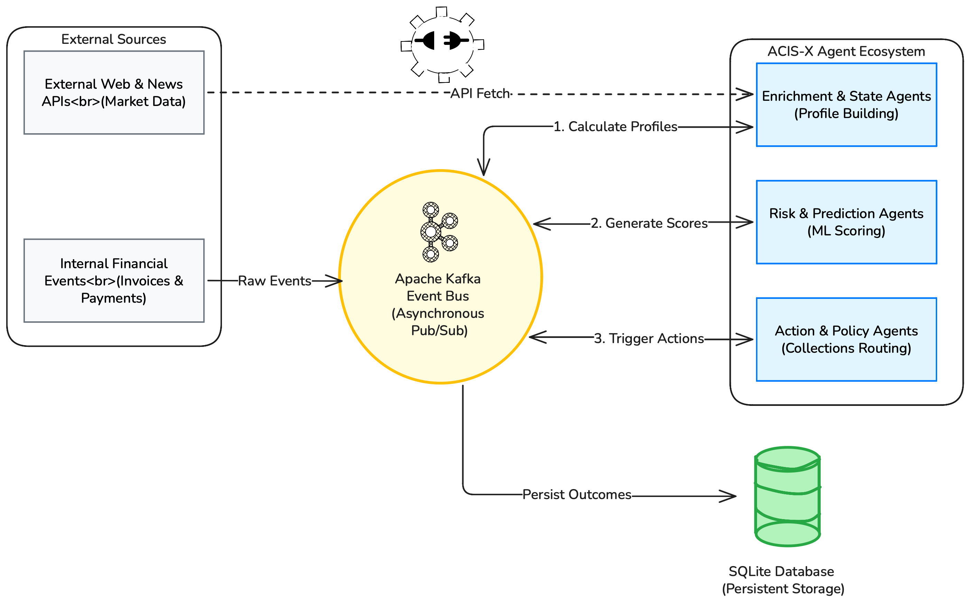
System Architecture
-> Decoupled, event-driven multi-agent architecture enabling real-time risk intelligence and system resilience.

Slide 7
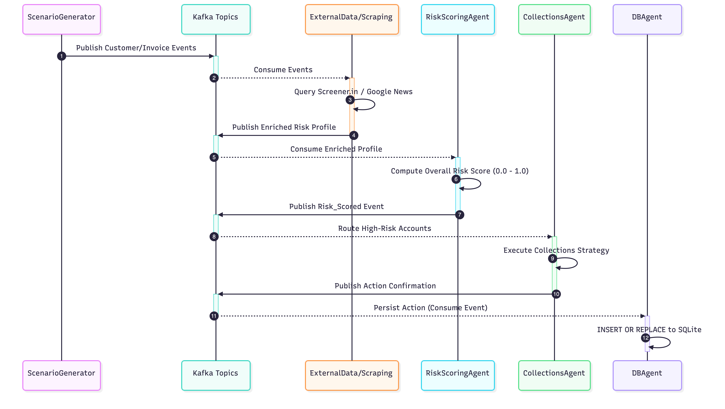
Methodology
ACIS-X processes continuous event streams to generate real-time, adaptive credit risk intelligence.

Slide 8
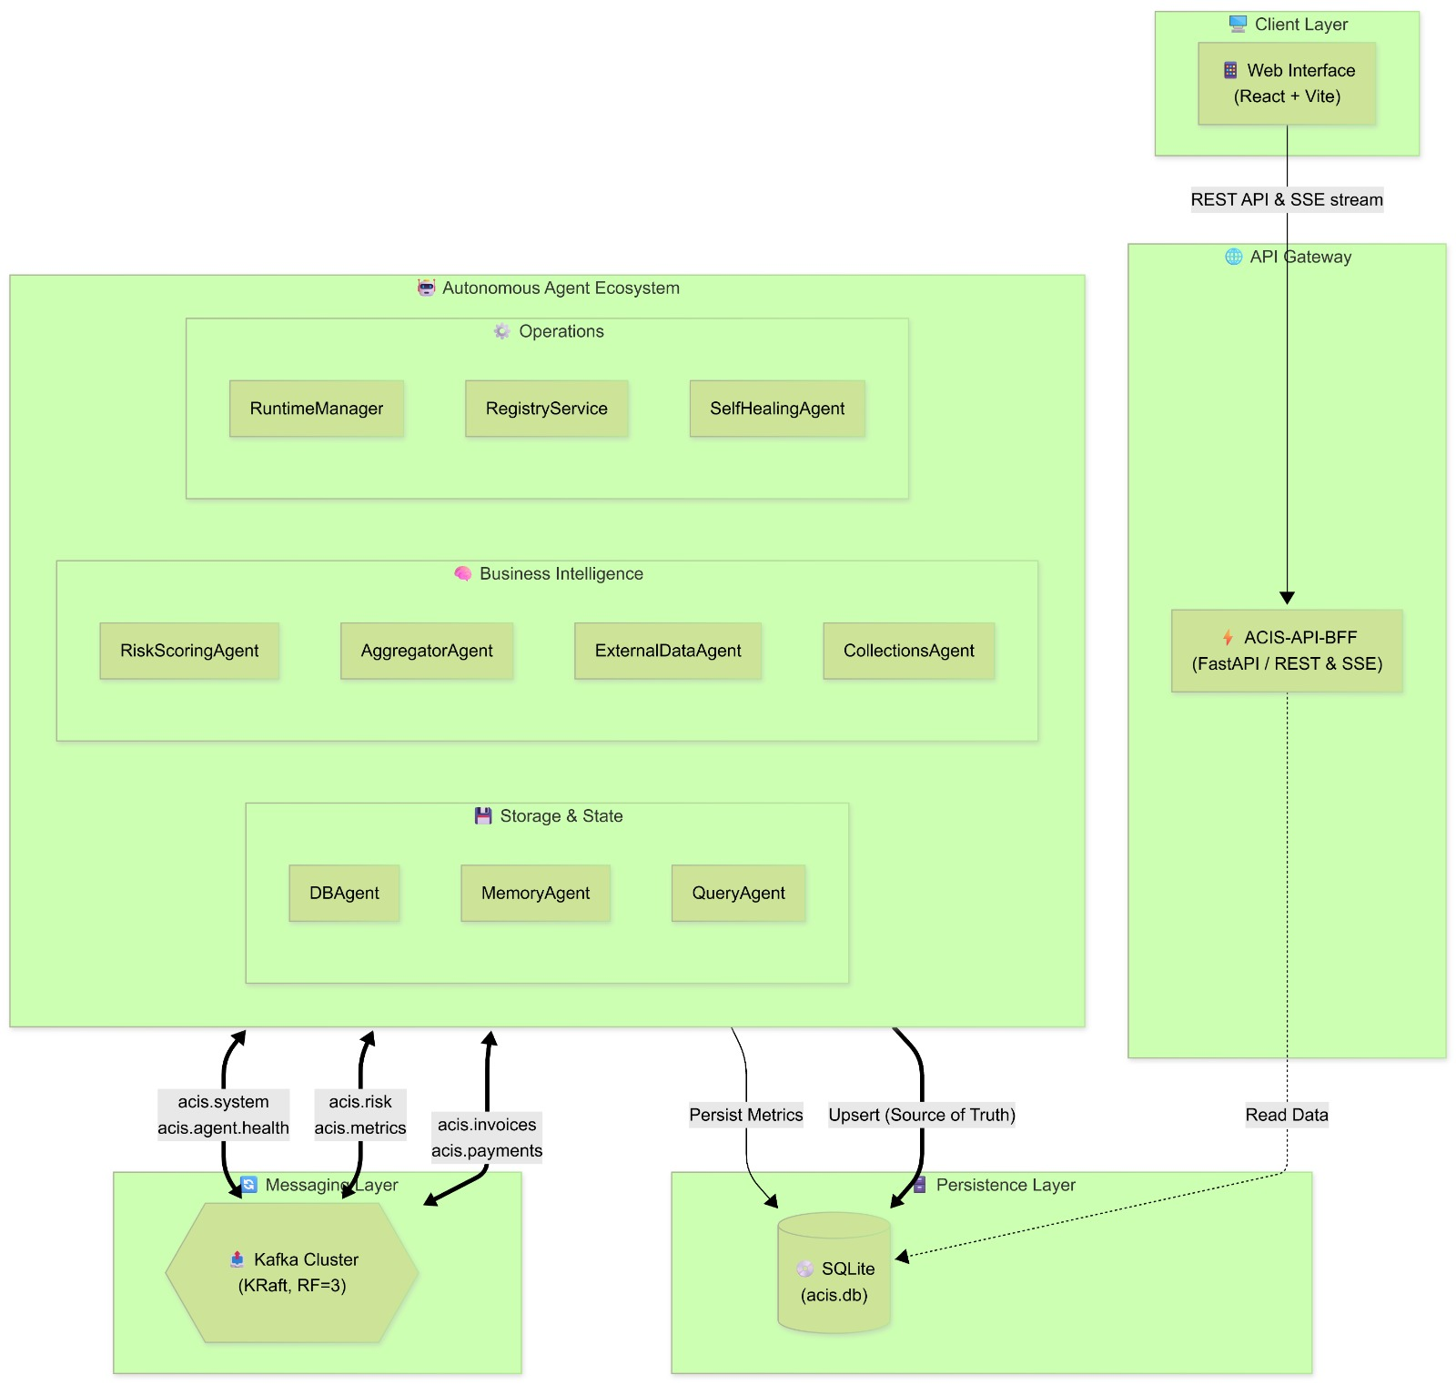
Implementation

