Slide 1
Social Network Analysis of Local Traffic Police Department
Mohammed Allama Hossain (10400114086)
Rashika Daga (10400114121)

Slide 2
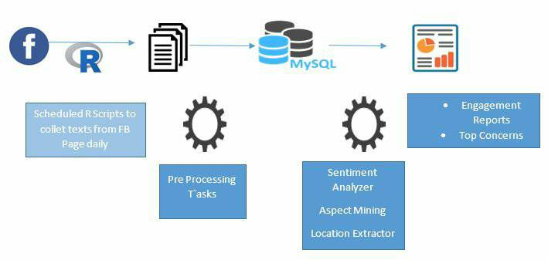
Work Flow

Slide 3
Data considered for Analysis
Posts made by the Page Owner (Traffic Police Department)
Posts made by the Visitors/Guest
User Reviews on the Page
Major Attributes of Data
Id
Message in the post
Type of post
Like, comment and share count

Slide 4
Data Extraction
Official Facebook handle of Kolkata Traffic Police Department
Package Used for Extraction: Rfacebook
Scheduling Data Extraction Daily
Data Preprocessing
De-duplication of Data
Removal of posts in vernacular languages and combination of vernacular and English language
Persistent storage of data into a database

Slide 5
Outcome of Analysis
User Engagement Statistics
Sentiment Analysis on Visitor post and reviews
Concern Mining from Reviews
Location Extraction from Page Owner posts

Slide 6
Challenges
Deduction of location based on String matching and overcoming the limitations of geocode function
Concern Mining (NLP Area)
Limitations
Algorithm is performed over sampled data extracted from Facebook
Reviews need to be manually extracted

Slide 7
THANK YOU!

