Slide 1


Sprint
Review
Sprint 13
(28 Oct – 08 Nov)

Slide 2
Livrable du sprint 12
TERMINÉ
14
TO DO
IN PROGRESS
8
5

Slide 3
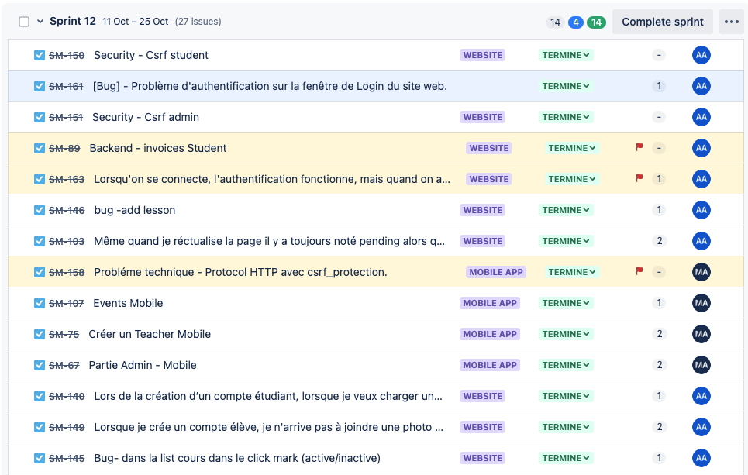
Tickets → Terminé

Slide 4
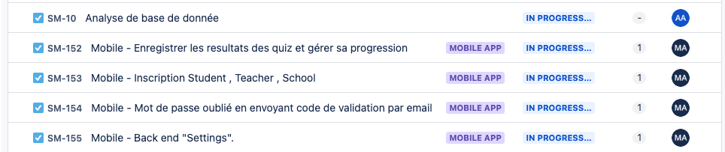
Tickets → In progress

Slide 5
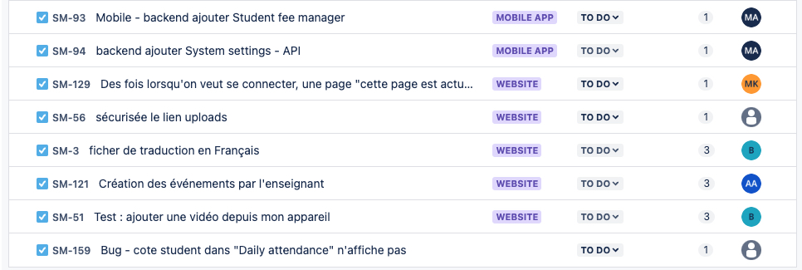
Tickets → To Do

Slide 6
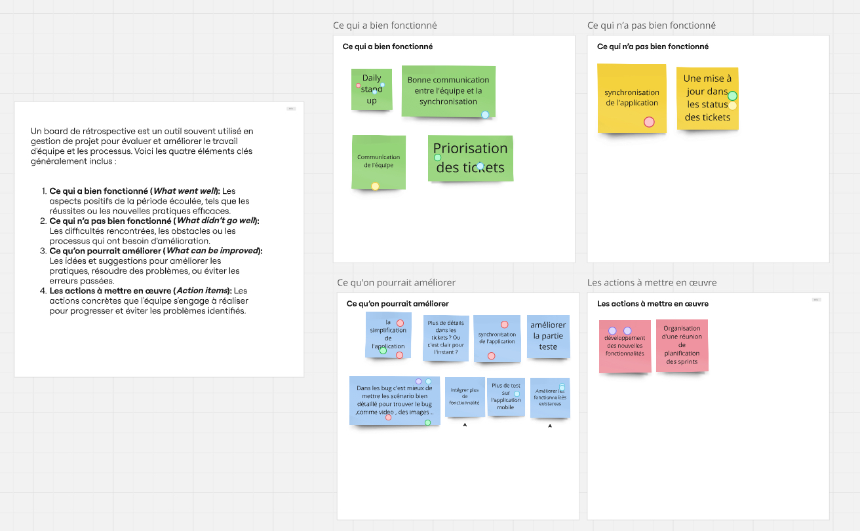
Feedback on Retrospective Meeting

Slide 7
Démo
Partie 1
WEB
ABDELFATTAH ALLAM
Partie 2
Mobile
AYMEN MESKI

Slide 8

THE END!

