Slide 1

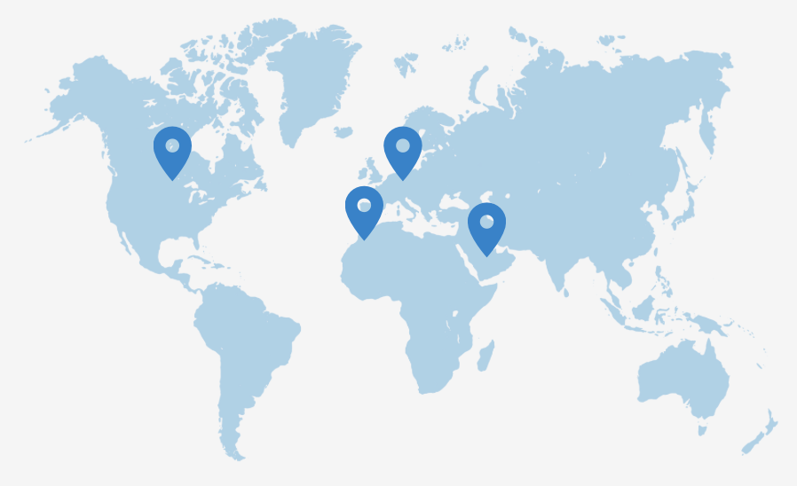
Software Expertise at Your Service
for Businesses of All Sizes and Industries

Slide 2
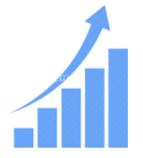


More Than 20 Satisfied Clients Worldwide
We provide tailored IT solutions for businesses at every stage of growth, from innovative startups to established enterprises.
Startup
Minimum Viable Product development
Staffing additionnal resources
Technical consulting and assistance
Scale up & SMB
Extra members to back up the core team
Dedicated developers for your products
Custom businesss automation solutions
Enterprise
Access to nearshore talent pool
Systems modernisation & integration
Data management and security implementation

Slide 3

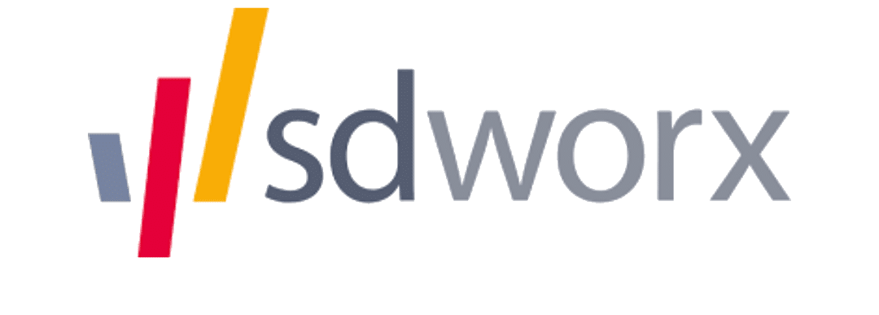





Supporting businesses across major industries
We deliver specialized IT solutions that cater to the specific needs of diverse industries, driving optimal performance and fostering growth across all sectors.

Slide 4
Cutting-Edge Technology Stack | Legal Compliance | Guaranteed Service Quality
Modern & reliable technologies to make your product effortlessly updated and maintained. | 100% compliant with industry standards including GDPR, HIPAA and ISO | 30 days of free quality assurance to ensure your product is fully functional and optimized for performance and user satisfaction
Security | Agile Management | 360° Scalability
All intellectual property belongs to you and is protected by advanced technologies | Adjustable project flow to meet urgent challenges resolve complex tasks | Scalable team structure and software to prepare your business for growth and adaptation

Slide 5
Simplify and Accelerate Your Development with Our IT Solutions
Business analysis
Project scoping and specification
Consulting on tools, technologies, and services
Tailored workflow models
UI/UX
Prototyping and wireframing
Mockups and user journeys/user flows
UI kit and style guide
QA engineering
Manual and automated testing
Documentation and reporting
Release notes and user guide
Design & Architecture
System, database and server architecture design
Development automation
Scalability and sustainability
Development
Web applications
Native & cross-platform mobile apps
CRM, ERP, HRM integration
API integration
Custom software development
DevOps Automation
Cloud infrastructure solutions
Continuous Integration (CI) and Continuous Delivery (CD)
Virtualization and auto-scaling
Test automation

Slide 6
Partnership with a Leader in Fundraising Automation
In collaboration with a leading partner in fundraising automation, Decloedt Digital Factory offers a combined solution that allows companies to raise capital more efficiently using AI and access to a global network of investors. This solution enables CEOs to focus on growth while automating the complex processes of fundraising:
35% time saved for CEOs.
$23M raised through an AI-powered platform, with access to global investors.

Slide 7
Added Value for Our Clients
Automation and AI: Data analysis, improved productivity, and optimized investor matching using AI.
Global Data API Access: Connect to strategic data platforms, facilitating introductions to relevant investors.
Proven Results: $15M in recurring annual revenue generated by portfolio companies.
Decloedt & Partner Synergy: An integrated approach combining advanced technological solutions with automated fundraising to help businesses grow faster and more efficiently.

Slide 8

Got a project in mind? Let’s make it happen together!
Let’s Talk
+32 489 00 22 82
Info@decloedt.cloud
www.decloedt.cloud

