Slide 1
GeoSeek
Alexa Montagne, Andy Santiago, Bryan Bradley, Jonathan Green

Slide 2
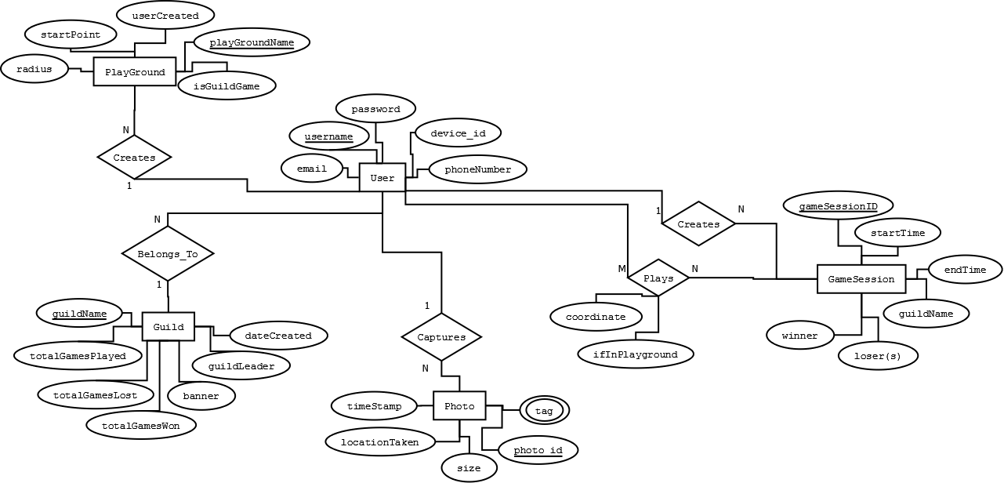
GeoSeek ER diagram

Slide 3
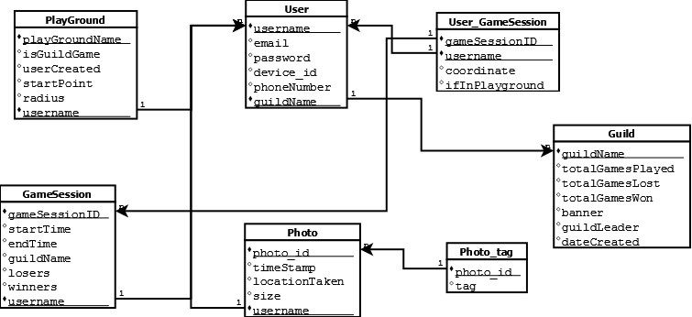
Geoseek Normalized relations

