Slide 1
GeoSeek
Alexa Montagne, Andy Santiago, Bryan Bradley, Jonathan Green

Slide 2
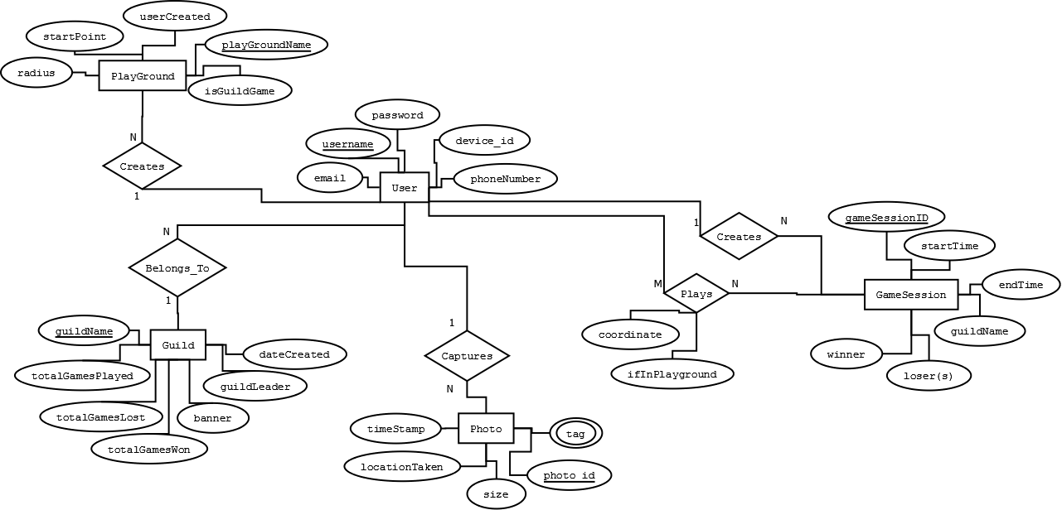
GeoSeek ER diagram
LIST OF ASSUMPTIONS
All GeoSeek Users have Android smartphones capable with the minimum requirements (running Android 4.4). All Android smartphones used by GeoSeek Users have cameras.
GeoSeek Users have smartphones that can capture Photo(s) during GeoSeek gameplay.
Some GeoSeek Users will play anonymously (non-Guild) play. All Geo-Seek Users capable of anonymous play are able to join a GeoSeek Guild.
GeoSeek Users can only join one Guild.

Slide 3
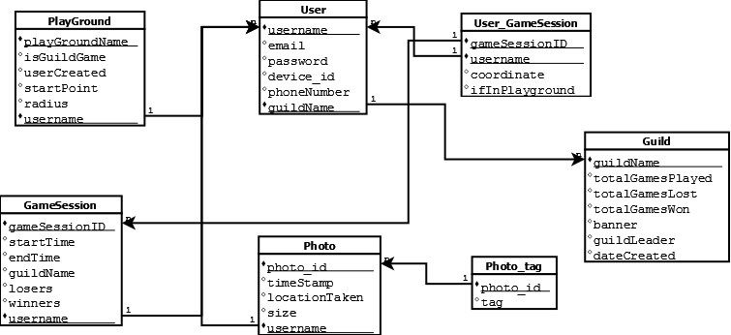
Geoseek Normalized relations

