Slide 1


AI Systems for Visual Intelligence Smart Greivace Portal
2320030424 – Allam Subhash
2320030228 – Shahid
2320030339 – Shaikshavali
2320030125 - Asif
Department of Computer Science and Engineering
KONERU LAKSHMAIAH EDUCATION FOUNDATION

Slide 2
OUTLINE
Introduction
Objectives
Literature Survey
Proposed Method
Implementation
Conclusion

Slide 3
Introduction
In today’s digital era, efficient grievance redressal systems are essential for improving communication between
citizens and authorities.
Traditional grievance systems are often slow, lack transparency, and do not provide proper tracking of complaints.
The Smart Grievance Portal is designed to address these issues by providing a modern, technology-driven solution with
features like voice-to-text input, image uploads, and real-time notifications.
Problem Being Solved:
Delays in complaint resolution
Lack of real-time updates
Difficulty in submitting complaints for non-technical users
Poor accountability and tracking
Applications:
Government and municipal services
University complaint systems
Corporate customer support platforms
Public service management systems

Slide 4
Objectives
To develop a Smart Grievance Portal that simplifies complaint registration and management
To enable voice-to-text conversion for easy complaint submission by all users
To implement image upload functionality for providing proof and better issue understanding
To provide real-time notifications and dashboard updates for complaint status tracking
To improve transparency, efficiency, and response time in grievance handling
To ensure a user-friendly and accessible system for both citizens and administrators

Slide 5
Literature Survey
.
Sl No | Year( from 2020 onwards papers) | Authors | Title of the paper | Source(Journal/Conference name) | Objectve of the paper | Techniques Used | Dataset Used | Parameters Analysed | Research Inference | Research Gap | DOI of the paper
1 | 2024 | N. V. Kamble et al. | CitizenConnect: Real-Time Grievance Management App | IARJSET Journal | Improve real-time complaint handling | Web + Mobile Application | User complaint data | Response time, user satisfaction | Faster resolution and better transparency | No AI automation, limited scalability | 10.17148/IARJSET.2024.11213
2 | 2023 | R. Karthikeyan et al. | Fix-It: Public Complaint Management System | IEEE ICCoSITE Conference | Automate complaint tracking and reporting | Mobile App, GPS tracking | Public complaint dataset | Accuracy, efficiency | Improved tracking and accessibility | No voice input, no multimedia support | 10.1109/ICCoSITE57641.2023.10127715

Slide 6
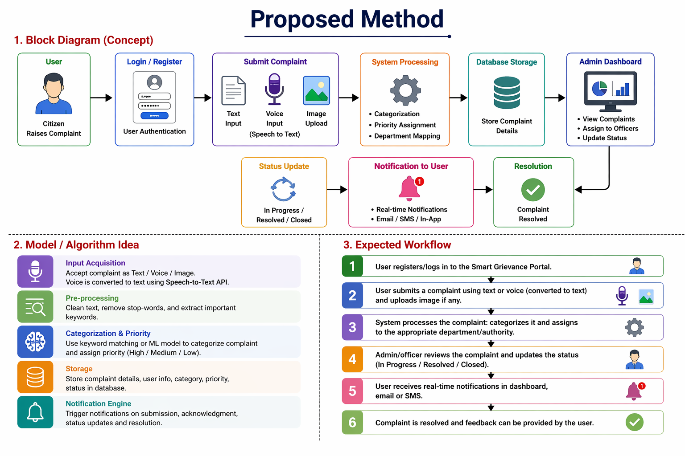
.

Slide 7
Model / Algorithm Idea
Input Acquisition: Accept complaint through text, voice, or image upload
Voice Processing: Convert speech to text using Speech-to-Text API
Pre-processing: Clean and analyze text to extract important keywords
Categorization: Classify complaint into categories (e.g., water, roads, electricity)
Priority Assignment: Assign priority level (High / Medium / Low) based on urgency
Storage: Save complaint details in the database
Notification Engine: Send updates for submission, status change, and resolution

Slide 8
Implementation
Implementation
Tools / Software Used
Frontend: HTML, CSS, JavaScript / React
Backend: Python (Flask/Django) or Java (Spring Boot)
Database: MySQL / MongoDB
APIs: Google Speech-to-Text API (for voice conversion)
Tools: VS Code, GitHub
Dataset Selection
User-generated complaint data
Fields include:
User details
Complaint description
Category & priority
Image uploads
Status (Pending / In Progress / Resolved)

Slide 9
Conclusion
The Smart Grievance Portal is a modern solution that improves complaint management by adding features like voice-to-text, image uploads, and real-time notifications. It makes the system more accessible, transparent, and efficient for users.
The portal simplifies complaint submission, provides continuous updates, and ensures accountability between users and authorities. It also reduces manual work through automation and enables faster decision-making using organized data.
Overall, the system enhances user satisfaction and governance, with future scope for AI integration and mobile support to make it more advanced and scalable.

Slide 10
References
A. Kumar et al., “Online Grievance Redressal System,” IEEE Conference, 2021
S. Reddy et al., “Smart Complaint Management System,” Springer, 2022
Google Cloud, Speech-to-Text API Documentation https://cloud.google.com/speech-to-text
MDN Web Docs – HTML, CSS, JavaScript https://developer.mozilla.org
W3Schools – Web Development Tutorials https://www.w3schools.com
GitHub – Project Repositories and Code References https://github.com
MySQL Documentation https://dev.mysql.com/doc

Slide 11
THANK YOU

