Slide 1
金融創新
新聞情緒分析應用
財金所碩二 吳豐光 r08723042

Slide 2
目錄
01
情緒分析介紹
02
實作流程
03
結果呈現
04
改進與建議

Slide 3
情緒(情感)分析已成為近年被熱烈討論議題
情緒分析介紹
運用自然語言處理、文本挖掘、計算機語言學等方法，量化和研究情感狀態和主觀資訊。
網頁資料探勘→文字探勘→情緒探勘/意見探勘→情緒分析系統
從事情緒分析的主要種類或方法：
文本情绪分析 (Document-based sentiment classification)
主管概念情緒分析 (Subjectivity and sentiment classification)
外觀（屬性）基礎情緒分析 (Aspect-based sentiment analysis)
建立情緒字匯分析 (Lexicon-based sentiment analysis)
Notes:
評等預測、意見比較、意見垃圾偵測

Slide 4

新聞情緒分析充滿商業價值
情緒分析介紹
瞭解目前市場的反應
快速解讀每日數以萬計新聞量
作為判斷大眾對於未來市場的預期
協助決策判斷，加強從事作業的信心程度

Slide 5
先爬、再斷、後分析
實作流程
Input:
外部url（新聞網）
情緒字匯 （Loughran McDonald）
爬文、斷詞斷句
from newspaper import Article
import string
import re
詞句比重分析
import nltk
import heapq
from collections import Counter
詞句情緒分析
import pandas as pd
import wordcloud
import matplotlib.pyplot as plt
Output:
文字標題、作者、時間
文章摘要
文章情緒視覺化

Slide 6
將初始檔準備成完整資料
實作流程
爬取
使用newspaper的Article套件直接將要爬取的網頁新聞按規格爬入
可直接匯出新聞標題、作者、刊登時間、新聞全文
斷詞
句
將全文特殊符號(比如註解符號)、空行排除,然後把文字以小寫呈現再斷詞
同時也另外將新聞全文以nltk套件進行斷句

Slide 7
文章摘要靠詞彙出現次數
實作流程
將stopwords排除
Stopwords(功能詞): 提升搜索效率、儲存儲存空間
斷詞
i, me, my, myself, we, our, ours, ourselves, you, you're, you've, you'll, you'd, your, yours, yourself, yourselves, he, him, his, himself, she, she's, her, hers, herself, it, it's, its, itself, they, them, their, theirs, themselves, what, which, who, whom, this, that, that'll, these, those, am, is, are, was, were, be, been, being, have, has, had, having, do, does, did, doing, a, an, the, and, but, if, or, because, as, until, while, of, at, by, for, with, about, against, between, into, through, during, before, after, above, below, to, from, up, down, in, out, on, off, over, under, again, further, then, once, here, there, when, where, why, how, all, any, both ,each, few, more, most, other, some, such, no, nor, not, only, own, same, so, than, too, very, s, t, can, will, just, don, don't, should, should've, now, d, ll, m, o, re, ve, y, ain, aren, aren't, couldn, couldn't, didn, didn't, doesn, doesn't, hadn, hadn't, hasn, hasn't, haven, haven't, isn, isn't, ma, mightn, mightn't, mustn, mustn't, needn, needn't, shan, shan't, shouldn, shouldn't, wasn, wasn't, weren, weren't, won, won't, wouldn, wouldn't
計算各詞彙出現次數
以出現次數最多的詞彙,計算個別詞彙權重
檢視各斷句總權重
斷句
產出摘要

Slide 8
情緒分7種狀態
實作流程
目前情緒分析以Loughran-McDonald的情緒字典使用較為普遍
其中共分7種情緒狀態:
Negative
Positive
Uncertainty
Litigious
Strong Modal
Weak Modal
Constraining
根據斷詞所對應到的情緒狀態進行加總計算,反應整體文章傾向。

Slide 9
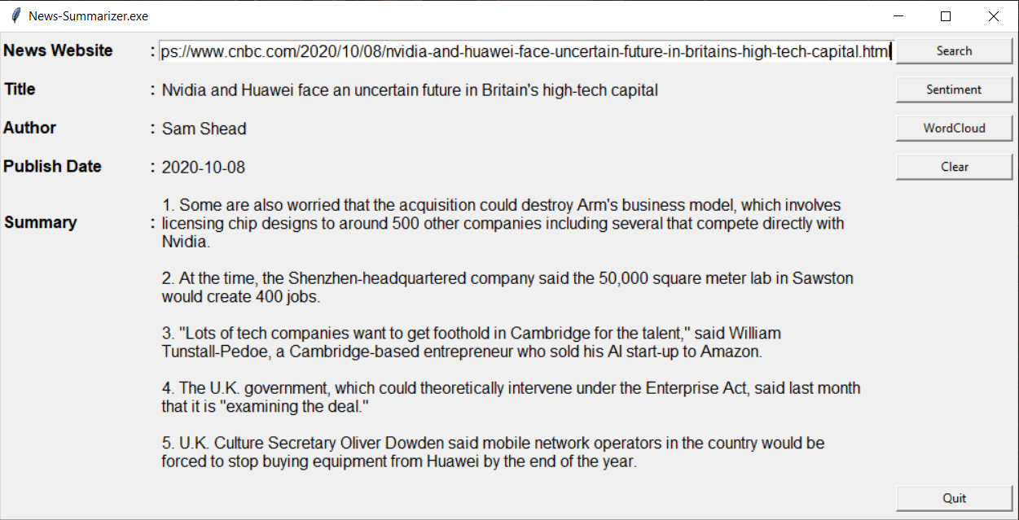
成品結果
結果呈現
本使用者介面以tkinter編寫

Slide 10
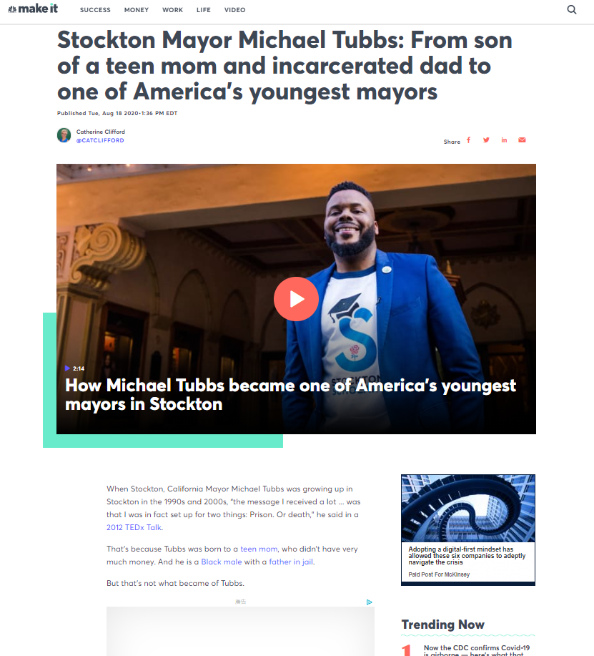
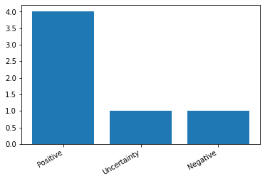
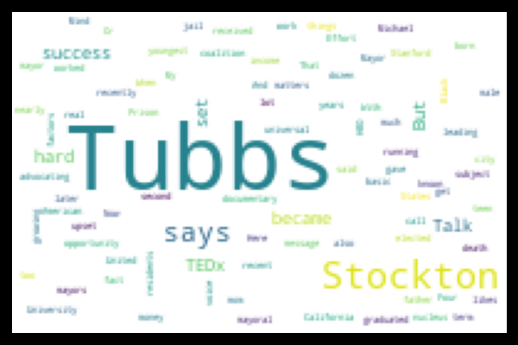
結果呈現
CNBC新聞程式分析結果：
Stockton Mayor Michael Tubbs: From son of a teen mom and incarcerated
dad to one of America's youngest mayors
['Catherine Clifford']
2020-08-18 - Tubbs is also now known as a leading voice in a coalition of nearly a dozen mayors advocating for universal basic income in the United States.
- With Tubbs' success, he says he has "upset the set up," as he likes to call it.
- Four years later, at 26, Tubbs became the youngest elected mayor of an
American city with over 100,000 residents.
- Tubbs, who is the subject of the recent HBO documentary “Stockton on My Mind,” worked hard to get where he is.
- Here are the factors Tubbs says are the “nucleus” of his success.

Slide 11
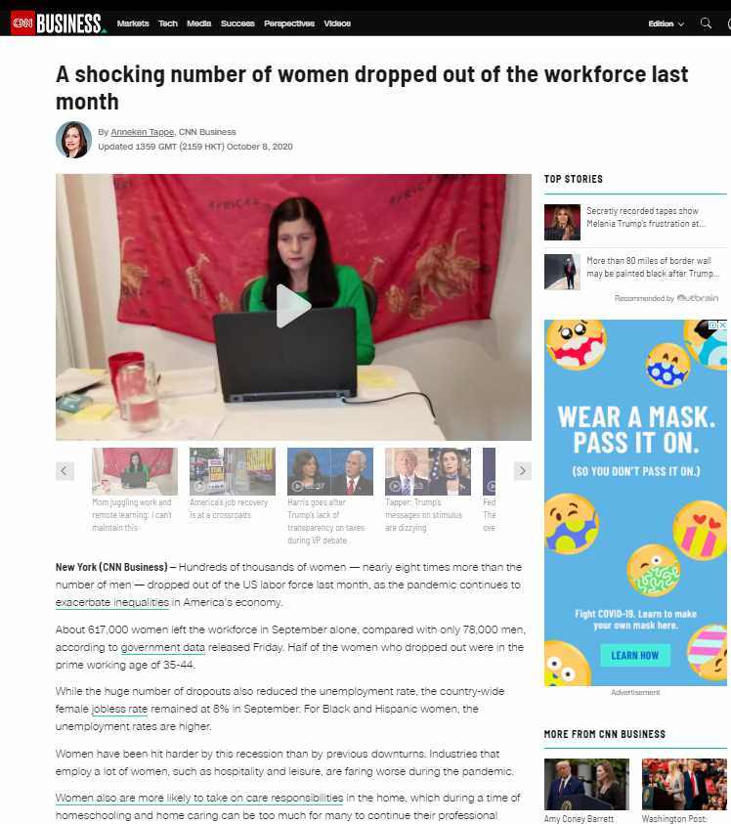
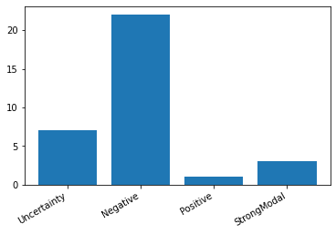
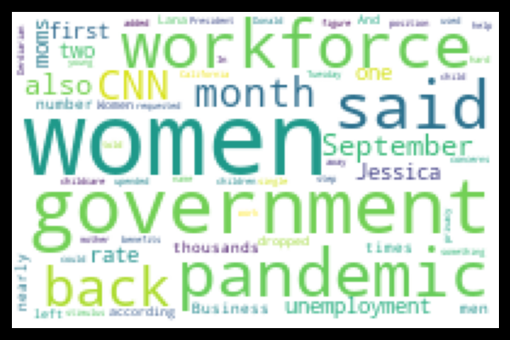
結果呈現
CNN新聞程式分析結果：
A shocking number of women dropped out of the workforce last month
['Anneken Tappe', 'Cnn Business']
2020-10-07 - Last month's massive workforce dropout rate for women is at least partially due to the lack of childcare options, said Russel Price, chief economist at
Ameriprise, in emailed comments.
- About 617,000 women left the workforce in September alone, compared
with only 78,000 men, according to government data released Friday.
- While the huge number of dropouts also reduced the unemployment rate,
the country-wide female jobless rate remained at 8% in September.
- In a household with two earners, partners may decide for the one with lower income to take a step back.
-Industries that employ a lot of women, such as hospitality and leisure, are faring worse during the pandemic.

Slide 12
加入其他相关链接提升情绪分析可信度
改進與建議
摘要的產出可以再使用其他更有效的方法，而非單純使用詞彙的頻率
情緒分析可以句子來進行，或許較單一詞彙更適合
句子和句子，段落與段落應有前後對應關係，這將有助於更有效分析各類評論
可配合大量的其他新聞做連結，可以提升分析效率

Slide 13
This is the end of presentation！
Thank You！

