Slide 1
Copilot in Test Engineering
Qiu, Guozhong
Wan, Jinzhuo
Lin, Zaidong

Slide 2
Agenda
API automation testing with Copilot in JAVA
Python with Copilot
Cypress with Copilot
Web automation testing with Copilot in JAVA
Conclusion

Slide 3
API automation testing with Copilot in JAVA
Copilot Research

Slide 4
API automation testing with Copilot in JAVA
Agenda
01.
Background
CONTENTS
02.
Session Warm-up
03.
Example
04.
Limitation

Slide 5

Background
Copilot is a new feature of GitHub that allows you to write code with the help of AI.
Github Copilot is a tool that helps you write better code, by providing suggestions as you type.IDEs like VSCode, Atom, and JetBrains IDEs are supported.
Github Copilot x(Copilot Chat) is a VSCode extension that allows you to chat with Copilot in VSCode.

Slide 6
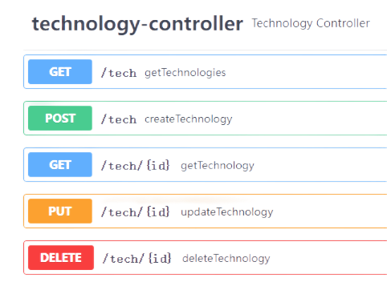










Session Warm-up
Under Test
Test Cases
Framework
Language
Single API
API Flow
create
select
update
select
delete
select
IDE
Assisitive Tool

Slide 7
Session Warm-up

Slide 8
Example - postman - Json File

Slide 9
Example - postman - Json String

Slide 10
Python with Copilot
Copilot Research

Slide 11
Python with Copilot
Agenda
01.
Python UI Automation Example
CONTENTS
02.
Copilot Demo

Slide 12
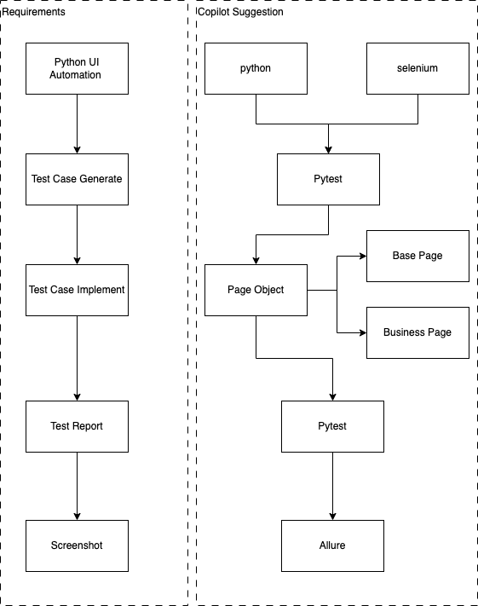
Python UI Automation Example

Slide 13
Copilot Demo

Slide 14
Copilot Demo

Slide 15
Copilot with Cypress
Copilot Research

Slide 16
Copilot with Cypress
Agenda
01.
Use case
CONTENTS
02.
Demo
03.
Copilot Usage

Slide 17
Case Study
Using Cypress automation testing framework with Copilot to complete an E2E scenario automations for online payment system.
System: online bank balance and payment transaction system.
Test Case:
Log in to system with account “Edgar Johns”
Validate current balance and note down
Click on “$ New” button and make a new transaction
Select “Kaylin Homenick” and input $100 as amount and add note “from Edgar J to Kaylin Homenick”
Click “Pay” to make payment.
Go back to Home Page and note down current “balance”
Calculate the different with “Step2” balance should be 100.
Access Rest API method http://localhost:3001/users/t45AiwidW and get user balance value should be equal to “Step7” current balance.

Slide 18
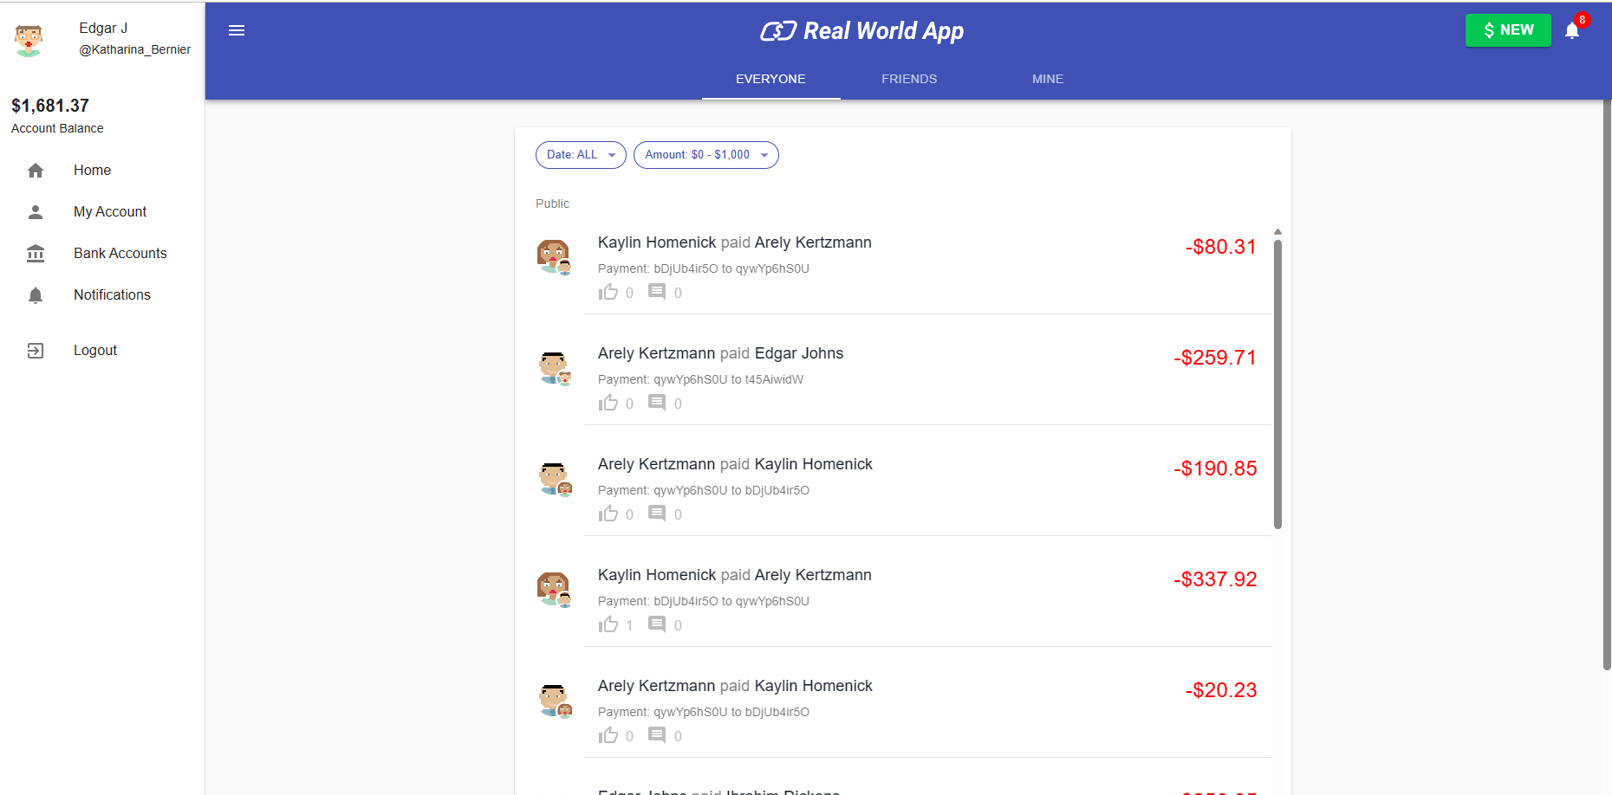
Demo

Slide 19
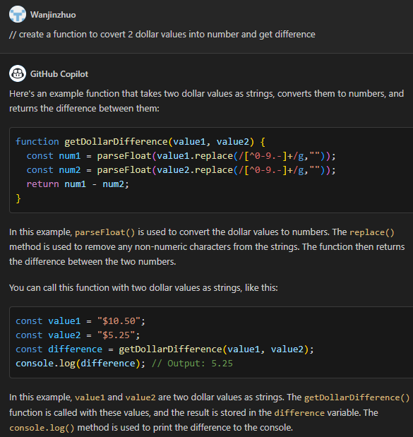

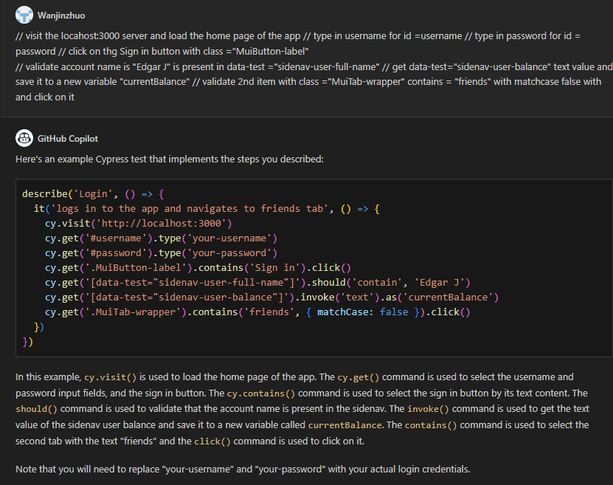
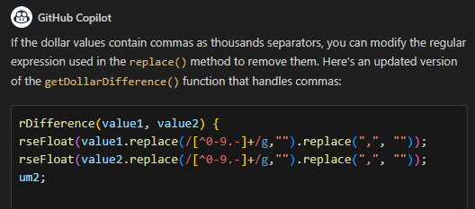
Copilot Usage
Simple
Complexity
Using Copilot Chat to generate Step 1-2 to generate simple Cypress(Typescript) scripts
Ask Copilot to generate a typescript function and covert 2 dollar values into number and get difference.
Refine my question to exclude “,” for dollar format value.
Copilot refined and tunned the existing function with correct answer
add “,” exclusion code

Slide 20
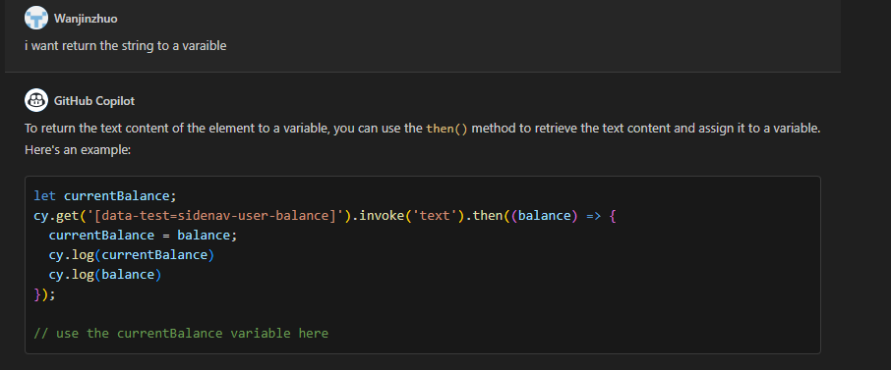
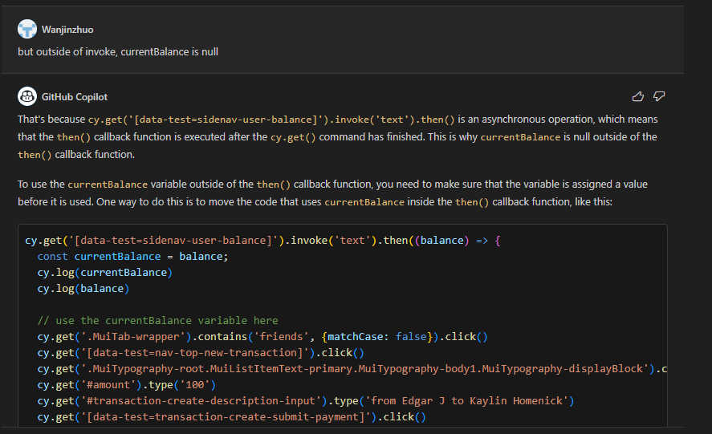
Coplit Usage
Trouble Shoot Demo
Use Copilot to fix typescript issue for “asynchronous operation” for “Step2-Step7”
Coplit provide the issue reason and resolution

Slide 21
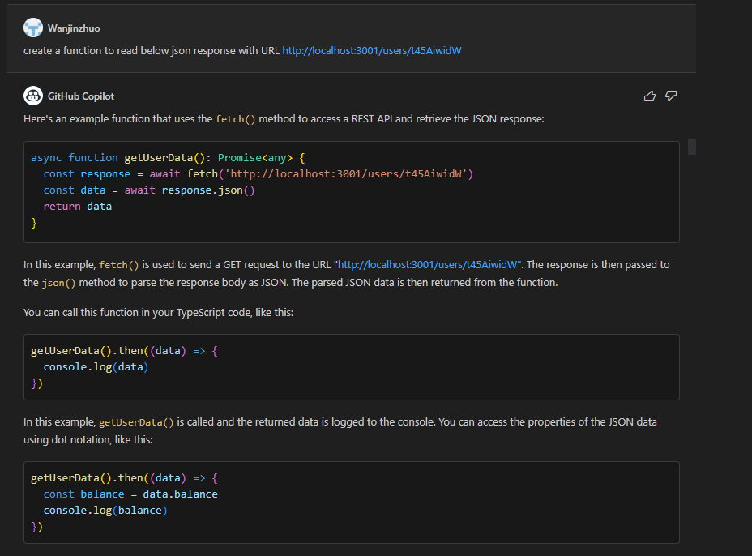
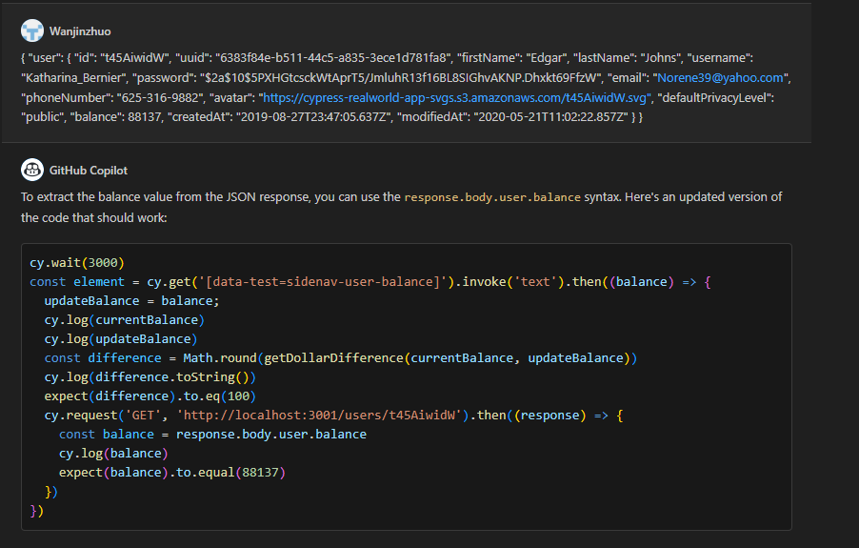
Copilot Usage
API validation Demo
Use Coplit to generate script to access REST API and get balance for “Step8”
Continue my question with providing Json format as the Coplit return wasn't correct because he doesn’t know the extract Json format. After, he gave me workable code
Coplit corrected the scripts after provided Json format

Slide 22
Web automation testing with Copilot in JAVA
Copilot Research

Slide 23
Web automation testing with Copilot in JAVA
Agenda
01.
Use case
CONTENTS
02.
Demo
03.
Copilot Usage

Slide 24
Conclusion
Advantage
Disadvantage
Strong AI coding props features
Improved working productivity and good replacement for “Stack overflow” or “GOOGLE”
Support series Q&A conversation to refine and tune coding suggestion.
Suggestion may not correct, some selenium function is not work
Only support vs code, no IntelliJ and PyCharm plugin
No concern About Version Match

