Slide 1
AI-Based Short-Term Generation Forecasting of Cascaded Hydroelectric Power Plants
Undergraduate Thesis Defense | Allan T. Aspe Jr. | Adviser: Noel R. Estoperez | May 2026
Focus: day-ahead generation forecasting for the Agus hydropower cascade
Method: Radial Basis Function Neural Network (RBFNN)
Purpose: support more reliable capacity nomination and operational planning
AI-Based Hydro Forecasting | Slide 1

Slide 2
Presentation Outline
Chapter 1: Introduction, problem, objectives, and framework
Chapter 2: Related literature and research gaps
Chapter 3: Methodology and model development
Chapter 4: Results, benchmark comparison, and system output
Chapter 5: Conclusions and recommendations
AI-Based Hydro Forecasting | Slide 2

Slide 3
Chapter 1: Background of the Study
Hydropower supports Philippine grid reliability and energy supply.
The Agus-Pulangi complex is a major Mindanao hydropower resource.
The Agus cascade includes Agus 1, 2, 4, 5, 6, and 7, with about 746.1 MW combined capacity.
Generation is hydraulically coupled: upstream releases affect downstream inflow, head, and output.
AI-Based Hydro Forecasting | Slide 3

Slide 4
Statement of the Problem
Day-ahead capacity nomination for Agus 1 to Agus 7 is frequently unstable.
Actual generation depends on hydrologic and operational variables such as elevation, outflow, gates, rainfall, and unit availability.
Incomplete or inconsistent operational inputs can lead to conservative estimates and re-nominations.
A data-driven model is needed to forecast short-term generation under nonlinear cascade behavior.
AI-Based Hydro Forecasting | Slide 4

Slide 5
Objectives of the Study
Develop an AI-based short-term generation forecasting framework for cascaded hydropower plants.
Clean and standardize historical operational and environmental data into an hourly time series.
Train and validate RBFNN models for the Agus cascade plants.
Evaluate performance using MAPE, MAE, RMSE, and R2.
Compare RBFNN results against Random Forest and XGBoost benchmark models.
AI-Based Hydro Forecasting | Slide 5

Slide 6
Significance, Scope, and Limitations
The study supports capacity nomination, short-term planning, and operational decision-making.
Scope covers Agus 1, Agus 2, Agus 4, Agus 5, Agus 6, and Agus 7.
Forecast horizon is short-term/day-ahead hourly generation forecasting.
Model performance depends on available historical data quality and recorded operational variables.
The model is a decision-support tool, not a replacement for operator judgment or physical dispatch rules.
AI-Based Hydro Forecasting | Slide 6

Slide 7
Theoretical and Conceptual Framework
Cascaded hydropower generation links upstream discharge to downstream generation potential.
Forecasting estimates future generation from current and historical operating conditions.
RBFNN maps nonlinear input-output relationships using radial basis functions and output weights.
The proposed system uses historical plant, hydrologic, temporal, and availability features to forecast generation.
AI-Based Hydro Forecasting | Slide 7

Slide 8
Chapter 2: Review of Related Literature
Short-term forecasting is important for scheduling, market participation, and grid stability.
Cascaded systems are harder to model because upstream and downstream plants are hydraulically interdependent.
Traditional statistical approaches have limitations in nonlinear, multivariable operating conditions.
AI and machine learning models can capture complex patterns in noisy operational datasets.
RBFNNs are useful for nonlinear approximation, localized learning, and efficient training.
AI-Based Hydro Forecasting | Slide 8

Slide 9
Research Gaps
Many studies treat cascaded hydropower mainly as an optimization problem rather than a forecasting problem.
There is limited work focused on one-day-ahead, hourly generation forecasting for cascaded hydropower systems.
RBFNNs are underused as the main architecture for hydropower generation forecasting.
Some AI models use simple feature sets that do not sufficiently represent cascade dependencies and operating conditions.
AI-Based Hydro Forecasting | Slide 9

Slide 10
Chapter 3: Research Design and Workflow
The study follows a quantitative, data-driven forecasting design.
Workflow: data cleaning, feature engineering, model training, validation/testing, benchmark comparison, and day-ahead forecasting.
Models are trained using chronological time-series data to preserve real forecasting order.
Outputs include performance metrics, forecast plots, benchmark comparisons, and day-ahead forecasts.
AI-Based Hydro Forecasting | Slide 10

Slide 11
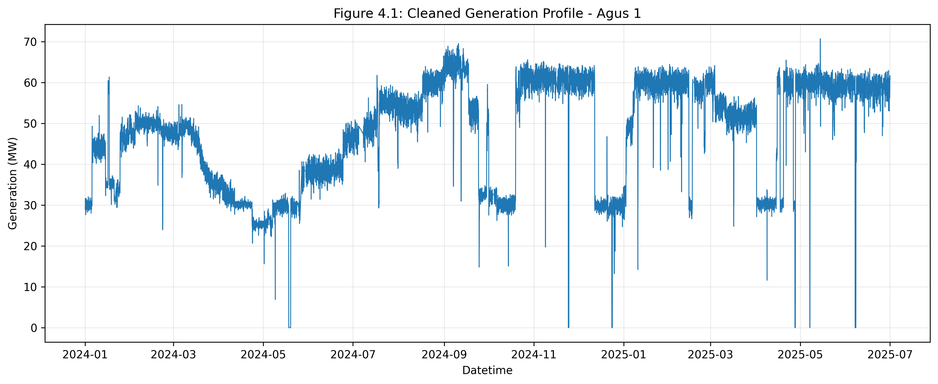
Data Collection and Processing
Historical operational and environmental data were organized into hourly records.
Data cleaning handled inconsistent headers, date-time alignment, numeric conversion, missing values, near-zero values, short zero runs, and spikes.
Plant-level generation was recalculated from cleaned unit-level generation values.
Unit outage states were converted into binary availability indicators.
AI-Based Hydro Forecasting | Slide 11

Slide 12
Feature Engineering and Dataset Split
Input features include temporal indicators, lagged generation values, rolling statistics, generation differences, hydrologic variables, gate/elevation variables, and unit availability.
Cascade-aware upstream generation features were included based on plant order.
The final cleaned dataset contains 13,128 hourly rows and 55 columns.
Chronological split: 70% training, 15% validation, and 15% testing.
Testing period represents unseen data from April 11, 2025 to June 30, 2025.
AI-Based Hydro Forecasting | Slide 12

Slide 13
Feature Engineering Inputs
Temporal features help the model learn hourly, weekly, monthly, weekend, and target-hour patterns.
Lag features use previous generation values, such as 1 hour, 24 hours, and 168 hours before the forecast.
Rolling features summarize recent behavior using moving mean, standard deviation, minimum, and maximum values.
Outage features show unit availability and number of running units, which limit possible generation.
Hydrologic features represent water-related conditions such as rainfall, outflow, elevation, gate, and spillway variables.
Upstream cascade features help downstream plants account for upstream generation and water-release effects.
AI-Based Hydro Forecasting | Slide 13

Slide 14
RBFNN Model Development
One RBFNN model was developed for each Agus plant, with one output neuron per model.
The model uses radial basis functions to represent nonlinear operating regimes.
A residual or delta formulation predicts generation changes relative to current output.
Tuned settings included the number of RBF centers, learning rate, and shrinkage value.
RBF spreads were represented by trainable gamma values, initialized at 1.0 and learned during training.
Training used standardized variables, Adam optimizer, Mean Squared Error loss, and early stopping.
AI-Based Hydro Forecasting | Slide 14

Slide 15
Benchmark Models and Evaluation Metrics
Benchmark models: Random Forest and XGBoost.
Metrics used: MAPE, MAE, RMSE, and R2.
MAPE measures relative percentage error and is easy to interpret for forecasting accuracy.
MAE and RMSE measure error magnitude in MW, with RMSE penalizing larger errors more strongly.
R2 measures how well the model explains generation variability.
AI-Based Hydro Forecasting | Slide 14

Slide 16
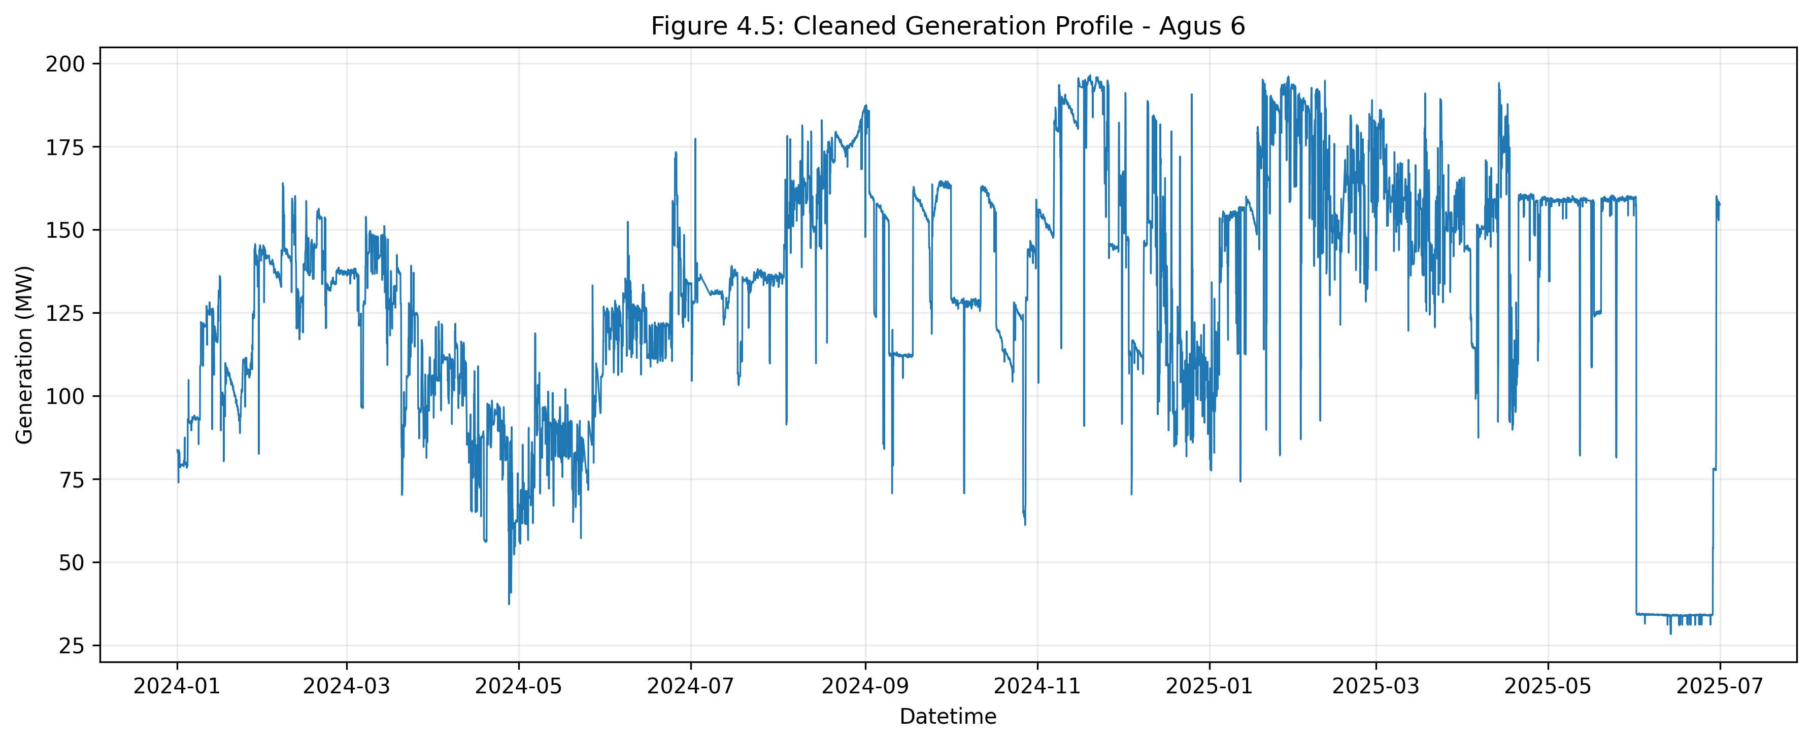
Chapter 4: Dataset Overview and Cleaned Data Results
The processed dataset provides complete hourly records for the modeled Agus plants.
Cleaned generation profiles preserve real operating patterns while reducing data quality issues.
The prepared dataset supports plant-level model training and total cascade assessment.
Input variables combine generation history, availability, hydrologic signals, and temporal patterns.
AI-Based Hydro Forecasting | Slide 15

Slide 17
RBFNN Validation Results
Average validation performance for the Agus cascade: MAPE 2.615%, MAE 1.633 MW, RMSE 3.789 MW, R2 0.878.
Training and validation loss curves showed rapid early convergence followed by stable behavior.
Validation loss remained slightly higher than training loss, which is expected for unseen data.
No severe overfitting was observed because the train-validation gap stayed small and stable.
AI-Based Hydro Forecasting | Slide 16

Slide 18
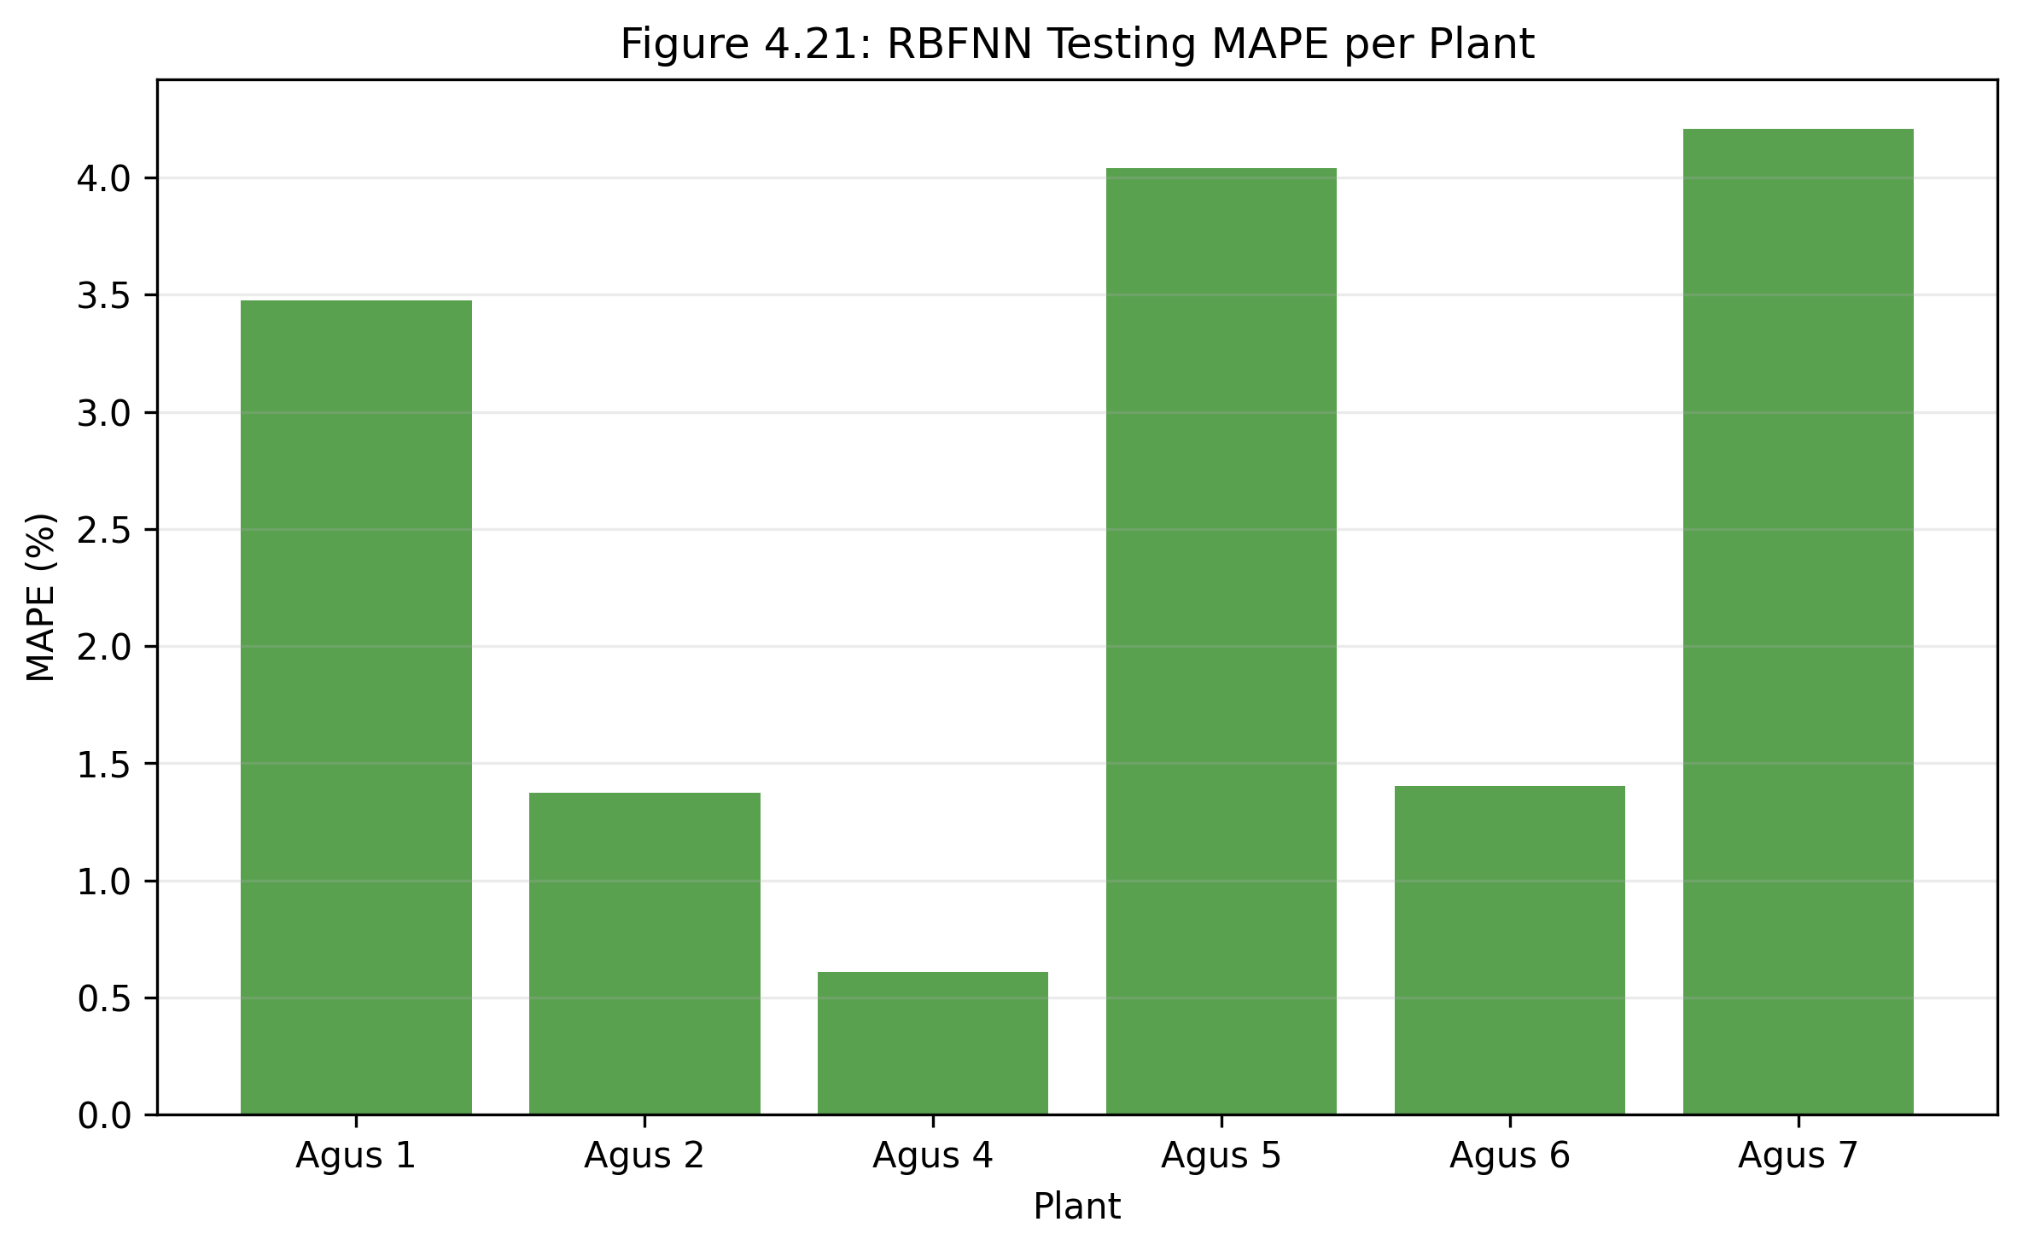
RBFNN Testing Performance
Overall testing performance: MAPE 2.519%, MAE 1.355 MW, RMSE 3.575 MW, R2 0.925.
Plant-level testing MAPE: Agus 1 = 3.476%, Agus 2 = 1.372%, Agus 4 = 0.611%, Agus 5 = 4.040%, Agus 6 = 1.405%, Agus 7 = 4.209%.
All plants remained below 10% MAPE.
Agus 4 had the lowest MAPE, while Agus 7 showed higher variability.
AI-Based Hydro Forecasting | Slide 17

Slide 19
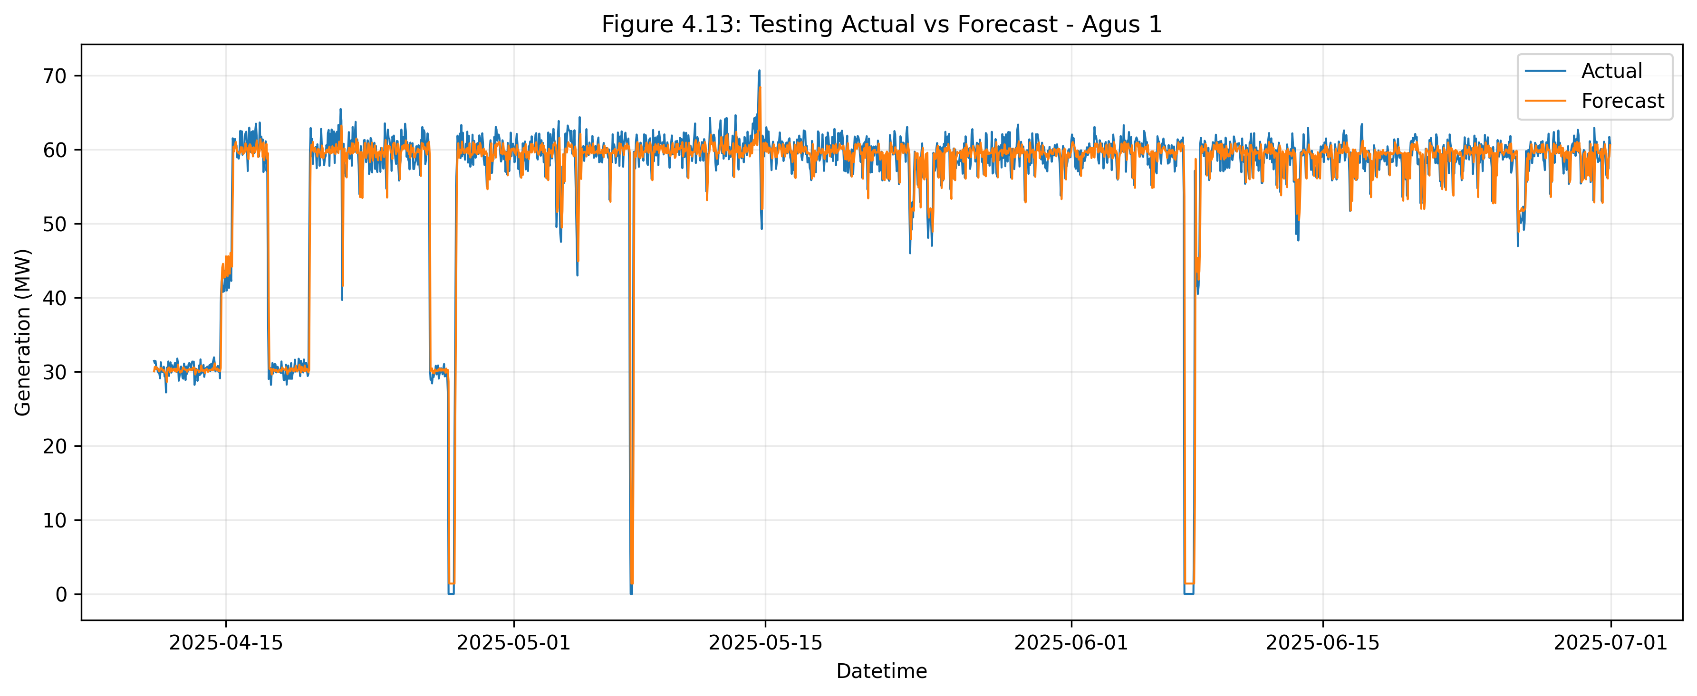
Actual vs Forecast and Error Analysis
Forecast curves closely followed actual generation patterns during the testing period.
The model captured both timing and magnitude of short-term changes.
Scatter and residual analyses showed strong agreement between actual and predicted values.
Mean residual was near zero, indicating no strong systematic overprediction or underprediction.
AI-Based Hydro Forecasting | Slide 18

Slide 20
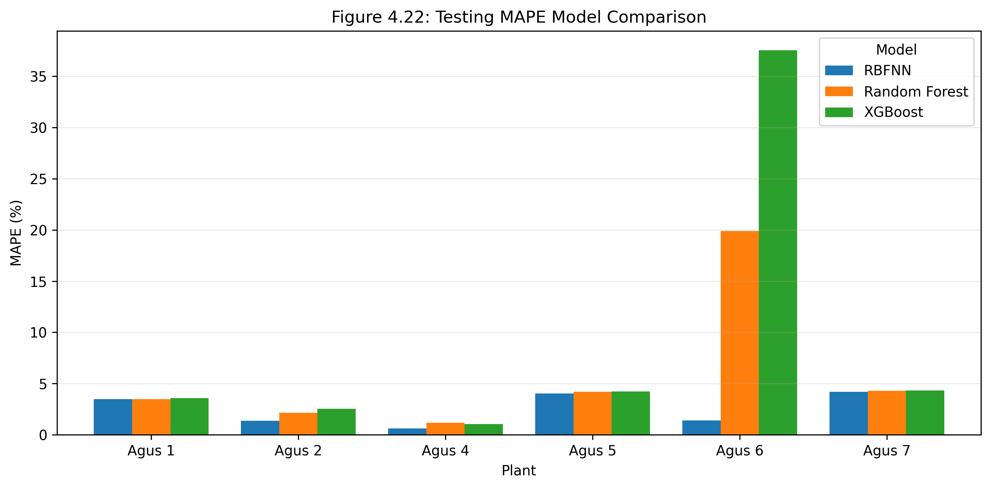
Benchmark Model Comparison
RBFNN achieved the lowest overall testing MAPE at 2.519%.
Random Forest achieved 5.864% overall testing MAPE.
XGBoost achieved 8.876% overall testing MAPE.
RBFNN also produced lower MAE and RMSE than the benchmark models.
The advantage was especially visible under complex operating behavior such as Agus 6.
AI-Based Hydro Forecasting | Slide 19

Slide 21
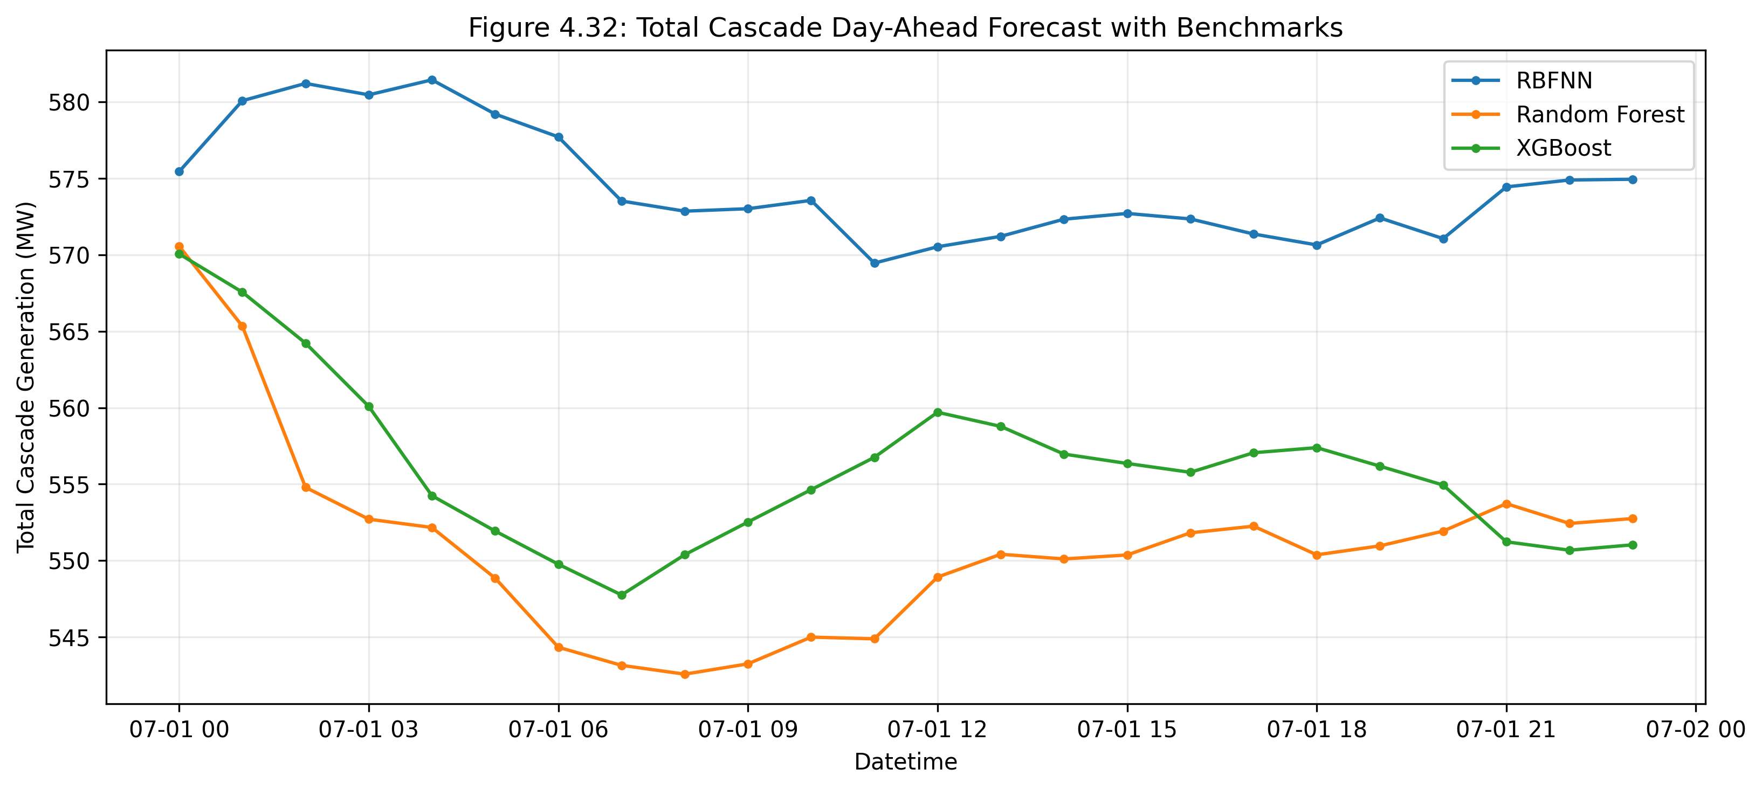
Day-Ahead Forecast and GUI Implementation
The final system generates hourly day-ahead forecasts using the trained RBFNN models.
Planned unit outage schedules are included as operational inputs.
Forecast outputs support plant-level and total cascade generation planning.
A dashboard interface was implemented to make the forecasting workflow easier to use and review.
AI-Based Hydro Forecasting | Slide 20

Slide 22
Chapter 5: Conclusions
The study successfully developed an AI-based RBFNN framework for short-term Agus cascade generation forecasting.
The cleaned and engineered dataset enabled reliable model training from historical operational data.
The RBFNN achieved accurate testing performance with 2.519% average MAPE and R2 of 0.925.
The proposed model outperformed Random Forest and XGBoost benchmark models.
The framework is suitable as a decision-support tool for day-ahead capacity nomination and short-term planning.
AI-Based Hydro Forecasting | Slide 21

Slide 23
Recommendations
Continuously update the model as new operational and hydrologic data become available.
Improve data completeness and consistency for rainfall, flows, gate operations, and unit availability.
Test the framework under more operating conditions, including unusual hydrologic events and outage scenarios.
Explore additional hybrid or optimized AI models for future comparison.
Integrate the forecasting tool further into operational planning workflows for capacity nomination support.
AI-Based Hydro Forecasting | Slide 22

