Slide 1
The Financial Risks from Climate Change

Slide 2
Summary
Presentation of the risks (slides 3-7)
An opportunity for DAPM (slides 8-10)
A quick overview of the potential implementation (slides 11-17)
Conclusion (slide 18)

Slide 3
The financial system is caught between a rock and a hard place
Mark Carney, Bank of England Governor (2013-2020):
” There are two paradoxes in managing the financial risks from climate change.
The first is that future will be past. […] Once climate change becomes a clear and present danger to financial stability it may already be too late to stabilise the atmosphere.
The second paradox is that success is failure. Too rapid a move towards a low-carbon economy could materially damage financial stability. […] “
Bank of England PRA Report, 2018

Slide 4
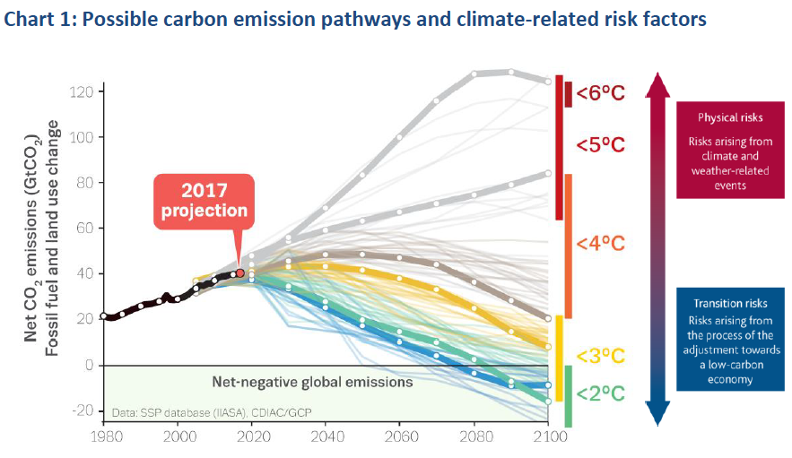
What type of risk do we prefer?
Sources: Global Carbon Project (2017), Bank of England (2018)
Basically, Mark Carney illustrates how the financial system is trapped between two kinds of risks: one from reacting too soon (transition risks), the other from reacting too late (physical risks).

Slide 5
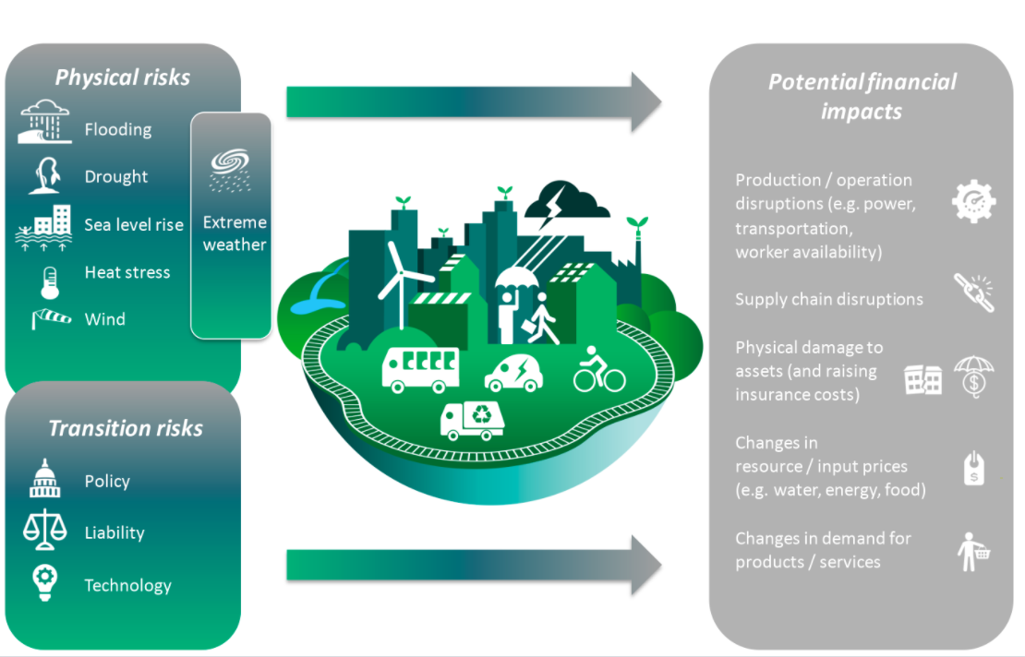
Physical & Transition Risks
« Physical risks can arise from climate and weather-related events (e.g. heatwaves, droughts, storms, floods, etc.). They can potentially result in large financial losses, impairing asset values and the creditworthiness of borrowers. » Bank of England PRA report, 2018
Transition risks are risks which would result from shifting to a low-carbon economy.

Slide 6
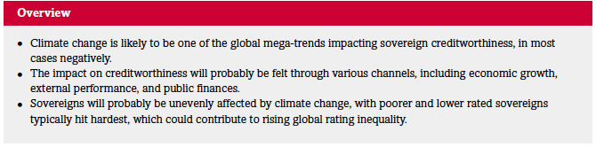
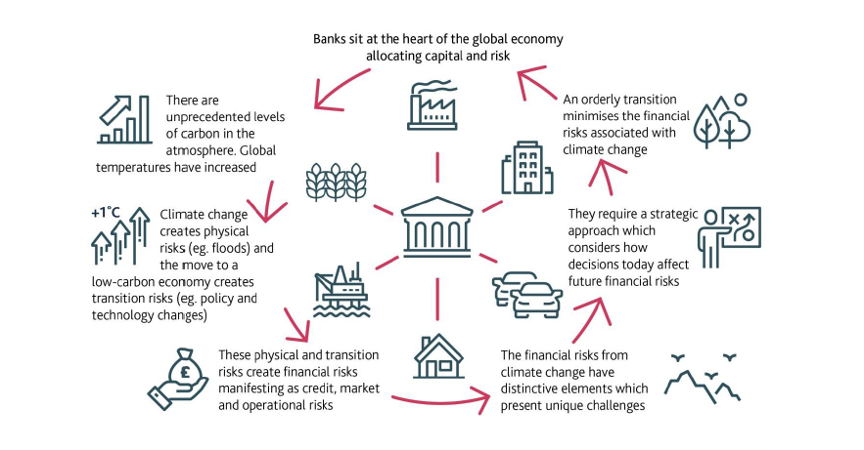
A Systemic Risk
If not anticipated, climate change related risks represent in fact a systemic risk for the economy
Source: Standard & Poors
Source: Bank of England

Slide 7
An urgent need for transparency
The takeaway here is that there is an urgent need for financial actors to consider these risks, as it may already be too late when these risks become evident to everyone.
Policy processes across a range of countries (e.g. France, Switzerland, China, etc.), and at international level (e.g. G20, TCFD, EU Non-Financial Reporting Directive) stress the importance of transparency on climate-related data and performance indicators in financial markets and public policy.
The French Energy Transition for Green Growth Law pioneered the field by requiring institutional investors to disclose climate risk in their portfolio, including both transition and physical risk.

Slide 8
How can this be interesting for DAPM?
The after-Covid world will only reinforce this need for transparence. A lot of people will be seeking for more resilience, and this of course includes private investors. They will become more and more demanding regarding such risks.
As a company which ”strives to be the world’s best financial consolidation and monitoring service”, DAPM can clearly assume this ambition by including an innovative tool in a topic that will sooner or later inevitably become preponderant in the financial industry
This new tool would allow clients to have an oversight on the physical and transition risks caused by climate change on the global assets of their portfolio

Slide 9
Considering the climate-related risks in a Portfolio
The goal would be to propose a new tool in Horizon that would allow clients to have a view at how exposed their portfolios are to climate-related risks
According to the FFA, the analysis of climate risks in a portfolio lies on three steps:
Identifying the risks: a qualitative approach aimed at defining climate risks and assessing whether a portfolio is exposed to them or not
Quantifying the risks: a quantitative approach aimed at synthesizing the risks by means of numerical indicators, for example on a scale on 1 to 100
Valuing the risks: a financial approach aimed at estimating the potential losses for the portfolio based on the identified risks by the selected criteria
The steps must be implemented for each type of risks (physical and of transition), for each asset that is part of the portfolio.
This is of course a task that will be very demanding, and we can imagine that this module will have many versions

Slide 10
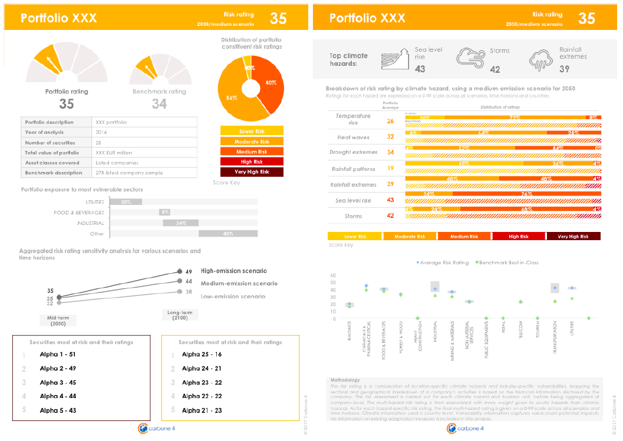
An example of the potential final output
Source: Carbone 4

Slide 11
How can this be implemented?
Each of the three steps described earlier must be implemented using a bottom-up approach, meaning each asset must be individually assessed for the climate risks associated to it, before aggregating to the portfolio level
Our methodology will be inspired by the methods used by the dominant firms in this niche sector: Carbone 4, Four Twenty Seven, Carbon Delta
The data we will need is publicly available:
Concerning risks at the country level, we will use the data provided by the World Risk Index
At the company level, we will combine the data provided by the financial sheets of the companies to the data we can find online
For now, we will focus on three kinds of assets: Stocks, Corporate Bonds and Sovereign Bonds.

Slide 12
I. The Physical Risks
STEP 1: Identifying the risks
The identification of the physical risks related to an asset lies on a combination of three factors:
Exposure: depends on geographical location for tangible assets, and on the geographical locations of the facilities of the company for equities and corporate bonds. For government bonds, we refer to the exposure to which the country issuing it is facing (see next section, Quantifying the risks)
Sensitivity: the sector and the position in the value chain of the asset will determine its sensitivity to a physical risk. For example, a vineyard will not suffer from the consequences of climate change in the same way as a company in the tourism sector
Capacity to adapt : as this factor can be very complex to capture at the company level, we will use the capacity to adapt of countries where the company has facilities as a proxy for the company’s capacity to adapt

Slide 13
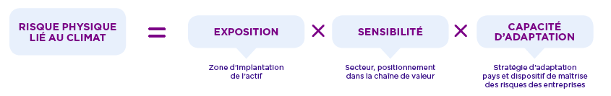
I. The Physical Risks
STEP 2: Quantifying the risks
In order to quantify the risks, we must adopt a bottom-up approach, meaning we must analyze the physical risks of each asset before synthetizing the risks to the portfolio level
For each asset, we will attribute a Physical Risk Rating, that will be a function of the three factors: Exposure, Sensitivity & Capacity to adapt
We will then aggregate those ratings to obtain a final Portfolio Physical Risk Rating.
Source: FFA

Slide 14
I. The Physical Risks
STEP 3: Valuing the risks
We could imagine of implementing a « Climate Value at Risk (VaR) », based on the method implemented by the company Carbon Delta
This climate VaR would be calculated based on the exposure, the climate hazard and the vulnerability of the asset, then aggregated at the portfolio level
We could calculate the Value at Risk using a historical method (for example, using articles of journal mentionning extreme weather events and the financial consequences associated to them to create a historical database)
Other methods for valuing the physical risks on a portfolio could include insurance models (e.g. CAT modeling)

Slide 15
II. The Transition Risks
STEP 1: Identifying the risks
For listed corporates (bonds & equities): measuring the carbon footprint of a company is a complex task that must take into consideration 3 scopes:
Induced emissions: to capture both direct & indirect emissions, need to consider the whole chain of value
Emission Savings: allows to take into consideration the efforts undertaken by a company
Future trend & alignment with a low carbon economy
For sovereign bonds: the emissions to be accounted for are the emissions of the whole country. The data is publicly disclosed by the UN and the World Bank
We would again implement a bottom-up approach in order to aggregate the risk from asset-level to portfolio-level

Slide 16
II. The Transition Risks
STEP 2: Quantifying the risks
Bottom-Up company analysis – Corporate Bonds & Equities
Induced emissions: calculations are based on disclosed data when available, and approximated by production volumes when not available
Emission savings: = Induced emission – Benchmark emissions (i.e. average emissions in the sector of the company). This allows to calculate the ratio of total emission savings to total induced emissions, allowing to compare the risk across companies
Future trend: create a rating based on company’s low-carbon CAPEX and R&D + the greenhouse gas emissions target of the firm
When aggregating the risk at the portfolio level, each asset risk is ponderated with respect to Exposure, Sensitivity & Capacity to adapt of the firm issuing it
Bottom-Up country analysis – Sovereign Bonds
Indicator of climate performance: CO2 emissions / M€GDP
Direct economic dependency on fossil fuel as a % of GDP
Ambition of the country to reduce its carbon footprint, compared to IEA ETP scenarios (°C)
All three ratings are then aggregated to obtain one rating for the country.
This rating must then take into consideration the maturity of the bond to obtain a final risk rating for the sovereign bond

Slide 17
II. The Transition Risks
STEP 3: Valuing the risks
Use of Climate VaR (only for corporate bonds & equities):
Evaluating the costs necessary to align to a low carbon economy based on exposure (= reduction objectives of each country), sensitivity ( = main sector of the company) and capacity to adapt ( = financial stability of the company)
Evaluating the potential gains for a company from a transition, mainly based on its sector and R&D investments
The VaR is then calculated as the difference between the value of a security before transition and after, when the costs and potential gains are taken into consideration

Slide 18
Conclusion
Considering climate related financial risks will become the norm in a short horizon: there is an opportunity to catch now
Capturing these risks at the asset-level is a complex task that will undoubtebly generate many difficulties along the way, but producing a V1 is accessible in the short to medium run

