Slide 1

BTW Supply Chain Platform
How it works, what we have built, and what we still need from you
BTW Global Distributors · Nihna Unique Distributors · Kivu (Volcanic Distributors) | 18 October 2026

Slide 2

WHY WE BUILT IT
One place for the whole supply chain
See every truck
Plan, then compare
Less paper
Three companies
Drivers check in at border posts and towns from the app or a simple SMS. No GPS device needed.
Plan each period as a guide, issue POs, and see planned versus actual as the goods move.
PO letters and delivery acknowledgements come out as PDFs on each company’s own letterhead.
Each company keeps its own stock, prices and staff. Directors can also see all three together.
BTW Supply Chain Platform · 2

Slide 3
WHAT CHANGES
Before and after the platform
Area
Without the platform
With the platform
Where is the truck?
Phone calls and WhatsApp to drivers
Every check-in on one live board
Orders
POs typed and sent by hand
Planner issues the PO letter on letterhead in one click
Deliveries
Paper delivery notes, shortages found late
Receiver signs on the phone; shortages recorded per leg
Three companies
Separate spreadsheets for each company
One system, each company kept apart, group view for directors
Reports
Directors wait for month-end figures
Planned versus actual and stock, any day
BTW Supply Chain Platform · 3

Slide 4
WHAT WE BUILT
Three parts, served from one place
BROWSER + PHONE
ANDROID PHONE
SERVER
Office apps
Field mobile app
Server and API
Every office role
Loader, driver, receiver
Behind the scenes
Period plans and purchase orders
Loading queues and the Truck desk
Stock, sales and reports
Team phone app: install from /app/
One job per screen, like Bolt or Uber
Big buttons, works offline
Sends when signal returns
Drivers without the app use SMS
One address serves web, app and data
Sign-in, roles and company access
SMS, email, push, PDF letters
Every change is logged
BTW Supply Chain Platform · 4

Slide 5




THREE SISTER COMPANIES
Separate books, one group view
BTW Global Distributors
Nihna Unique Distributors
Kivu – Volcanic Distributors
Group view
Buys from KBL
Buys from UBL and GBI
Buys from SBL
Directors only · read-only
Each company has its own logo, letterhead, stock, prices and staff
Staff only see the company they work for
Directors pick a company or the whole group from one menu
Group reports convert currencies and remove sales between the companies
BTW Supply Chain Platform · 5

Slide 6
THE JOURNEY
From plan to sale in seven steps
1
2
3
4
5
6
7
Plan
Order
Line up
Load
Drive
Receive
Report
Planner suggests the period plan
Planner issues the PO letter
Truck planner orders the queue
Loader loads within ±10%, hands over
Driver checks in on the road
Receiver checks and signs
Stock, sales and reports
Web
Web
Web
App
App / SMS
App
Web
Done on the phone, in the field
Done on the web, in the office
Director approval of POs is optional, a switch in the settings.
If the load differs from the PO, a PO revision (for example PO-001-rev001) is created and everyone is told.
BTW Supply Chain Platform · 6

Slide 7
PLATFORM JOURNEY
Who does what, step by step
Planner
Period plan (a suggestion)
Issue the PO, letter emailed
Web + phone
Director
Approve PO (only if switched on)
Planned vs actual
Web + phone
Truck planner
Line up trucks in the queue
Follow trucks & costs
Web + phone
Loader
Load ±10%; a change makes a PO revision
App
Driver
Check in at each stop
App / SMS
Receiver
Check, note shortages, sign
App
Accounts
Sales, costs, payments
Web + phone
BTW Supply Chain Platform · 7

Slide 8
ACTORS
Each person sees only their own work
Planner
Director
Truck planner
Accounts
Web + phone
Web + phone
Web + phone
Web + phone
Period plans (a guide)
Issues POs to suppliers
Follows PO revisions
Approves POs (optional)
One company or the group
Planned versus actual
Onboards providers and trucks
Orders the loading queues
Follows trucks and costs
Records sales and payments
Trip and extra costs
Stock value, landing cost
Loader (giver)
Driver
Receiver
Settings, not code
Director approval of POs, the loading allowance (±10%) and alternatives are switches in apps/api/config.toml.
App
App or SMS
App
Sees the loading queue
Loads within ±10%
Hands over to the driver
Sees one trip at a time
Checks in on the road
Reports a problem
Confirms the arrival
Notes shortages, signs
Sends goods onward
BTW Supply Chain Platform · 8

Slide 9
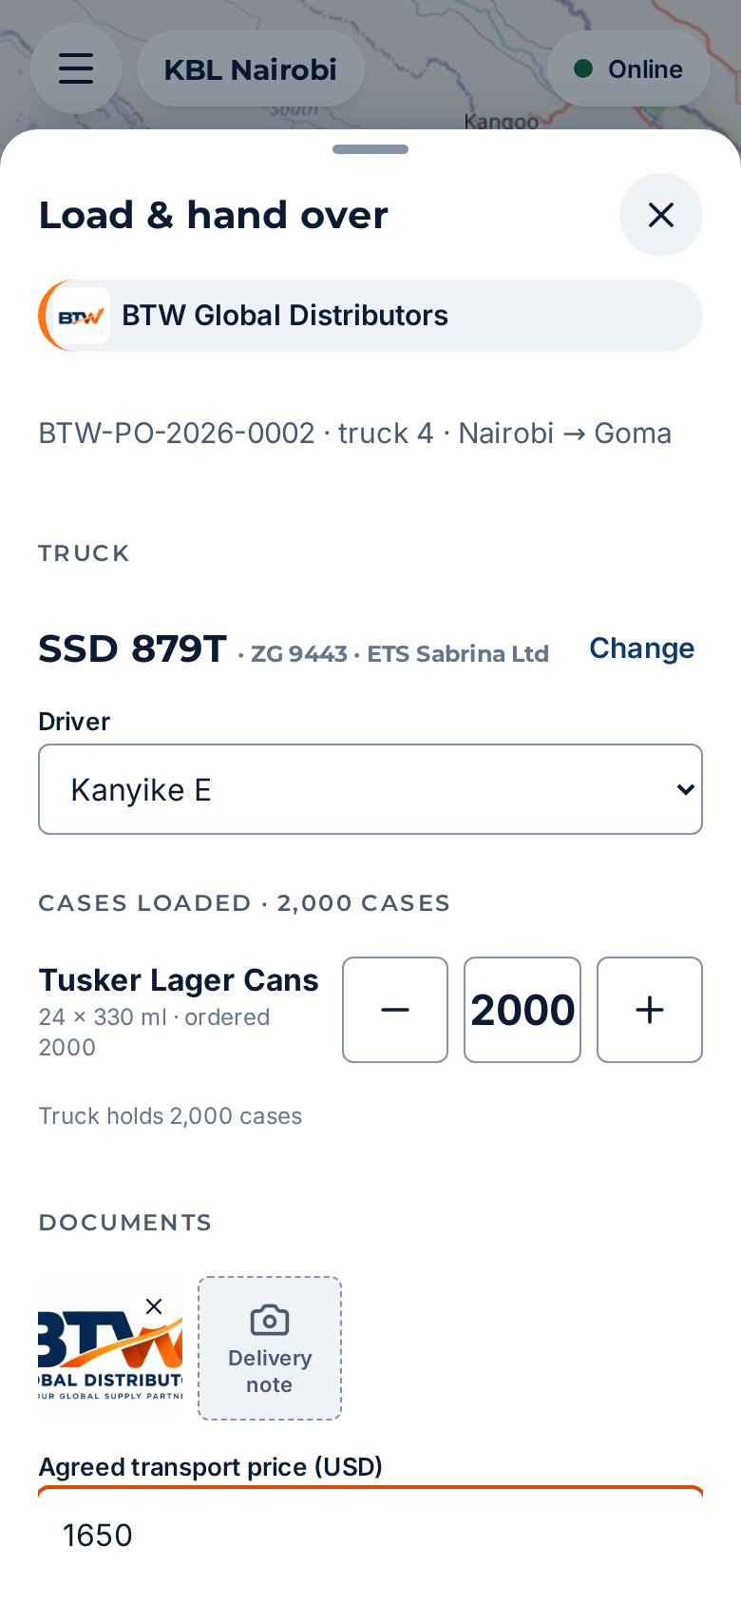
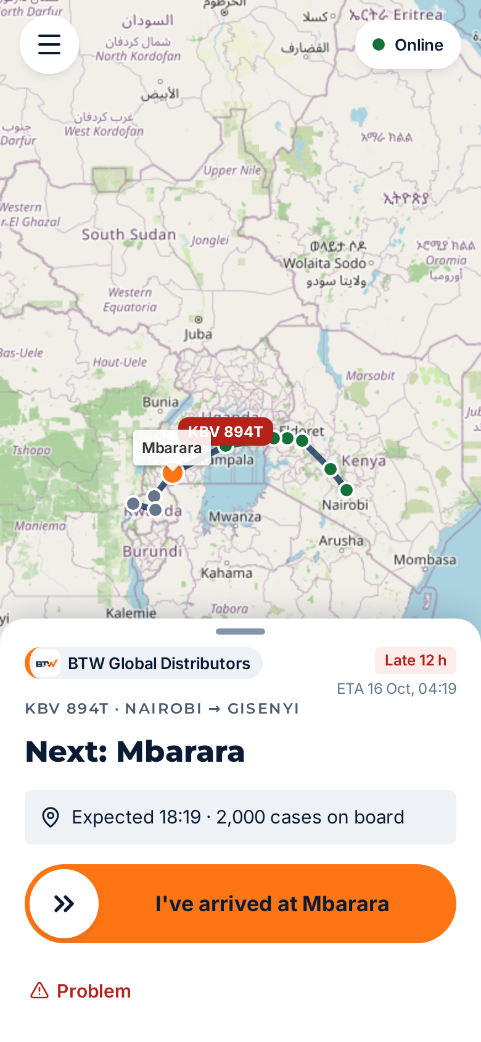
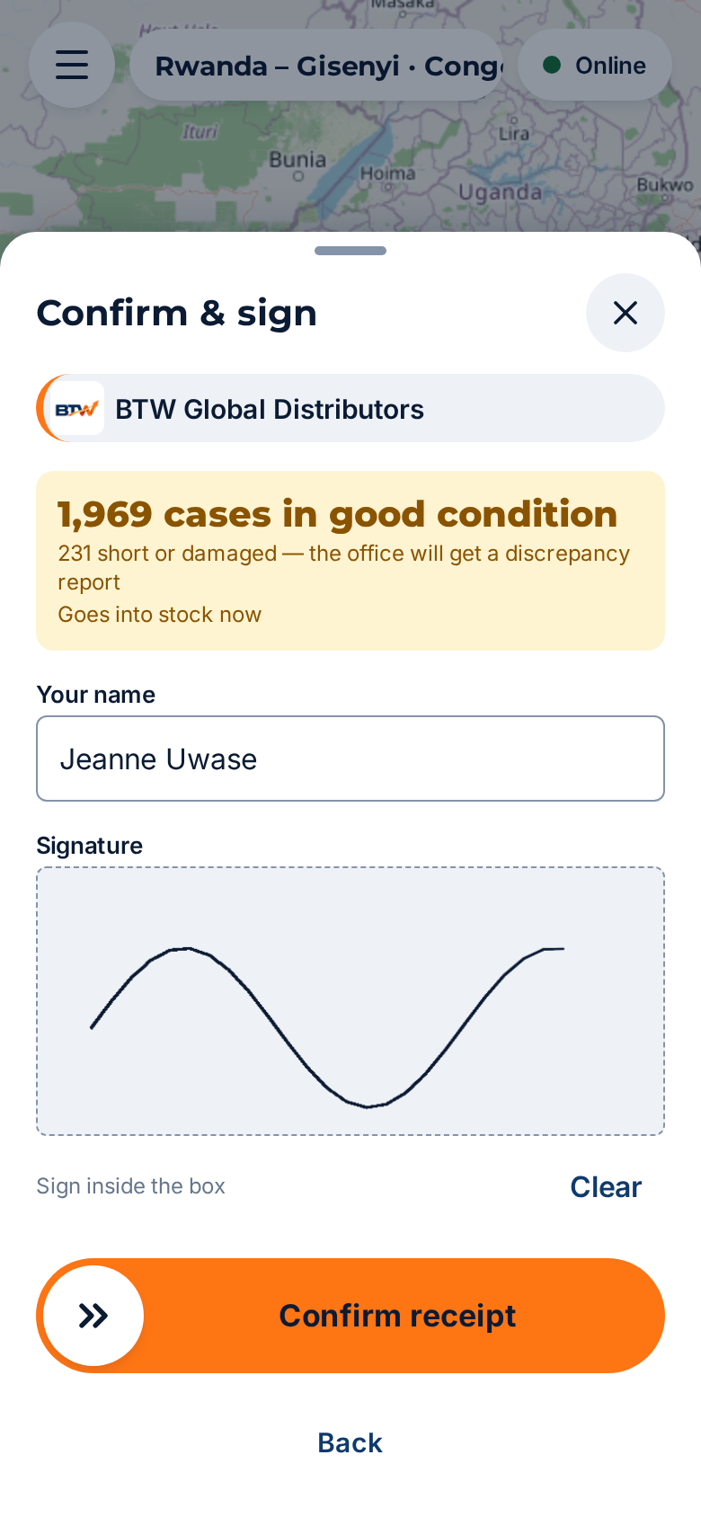
FIELD MOBILE APP
One clear job for each person
LOADER
DRIVER
RECEIVER
Sees the truck that is due, counts cases per product, and hands over to the driver.
Sees one trip. Taps “I’m here” at each checkpoint, or reports a problem.
Checks what arrived, notes any shortage, and signs. Stock updates at once.
Unchanged for field roles. Office staff who sign in at the same /app/ address get the team phone app instead (next slide).
BTW Supply Chain Platform · 9

Slide 10
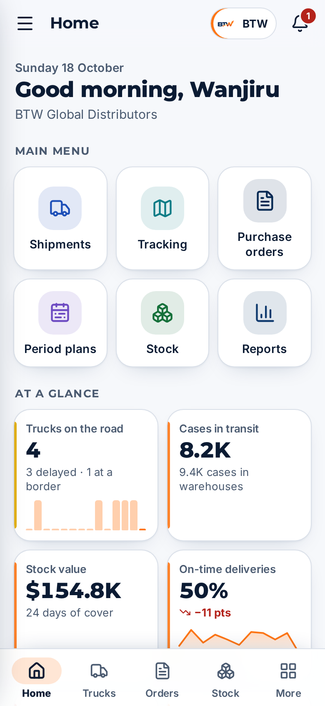
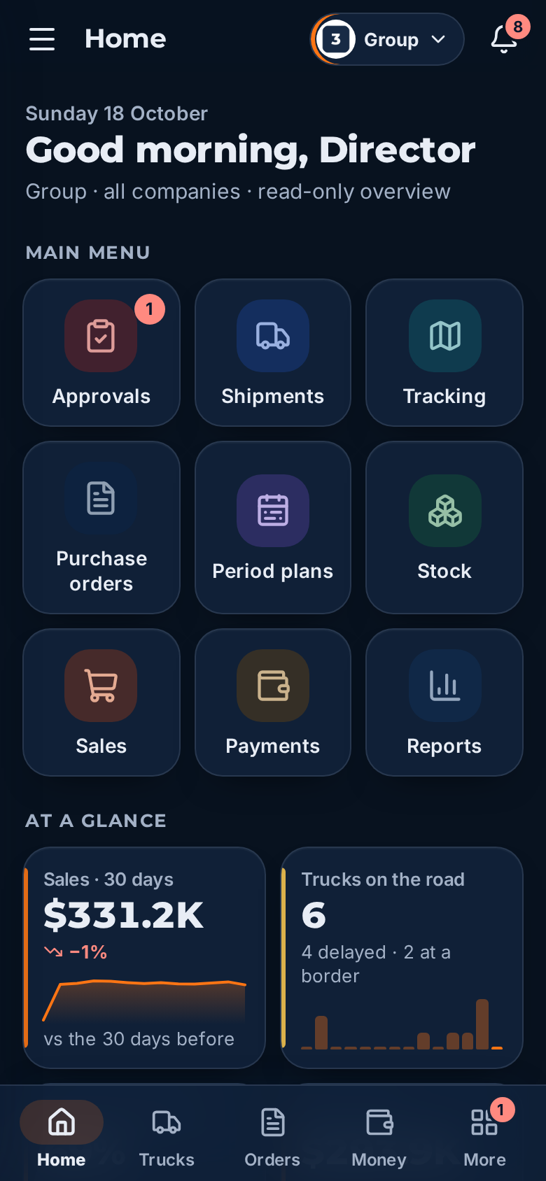
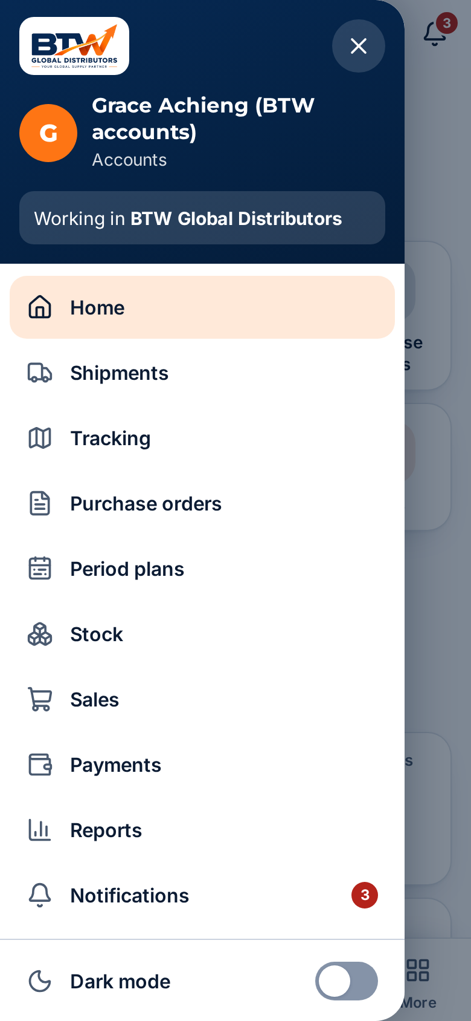
NEW · TEAM PHONE APP
Phone app for the office team
Installs from the browser at /app/, no app store
Same sign-in: phone + PIN
Home: main menu, figures at a glance, “Needs attention”
Bottom tabs per role, side drawer for every screen
Light and dark mode; works for one company or the group
BOTTOM TABS BY ROLE
Director
Home · Trucks · Orders · Money · More
Planner
Home · Trucks · Orders · Stock · More
Accounts
Home · Trucks · Orders · Money · More
Planner · home
Director · group, dark mode
Accounts · side drawer
Truck planner
Home · Queue · Trucks · Money · More
BTW Supply Chain Platform · 10

Slide 11
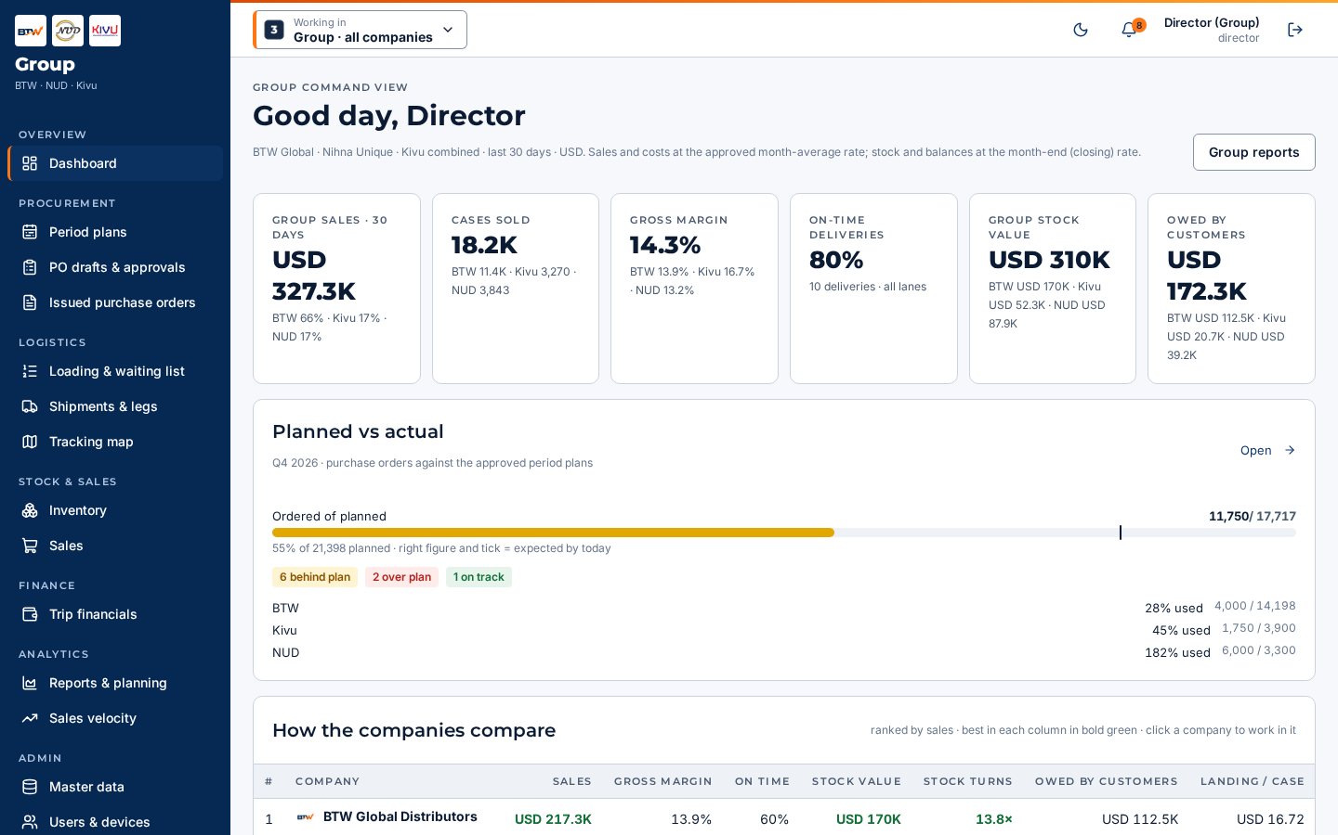
OFFICE WEB APP
Plans, orders and reports in the browser
Period plans as suggestions, no overlaps
Planners issue POs; revisions shown as a chain
Planned versus actual, with warnings
Live board of every shipment
Interactive charts you can filter and zoom
Product list and truck list from your data
Each role sees only its own screens
BTW Supply Chain Platform · 11

Slide 12
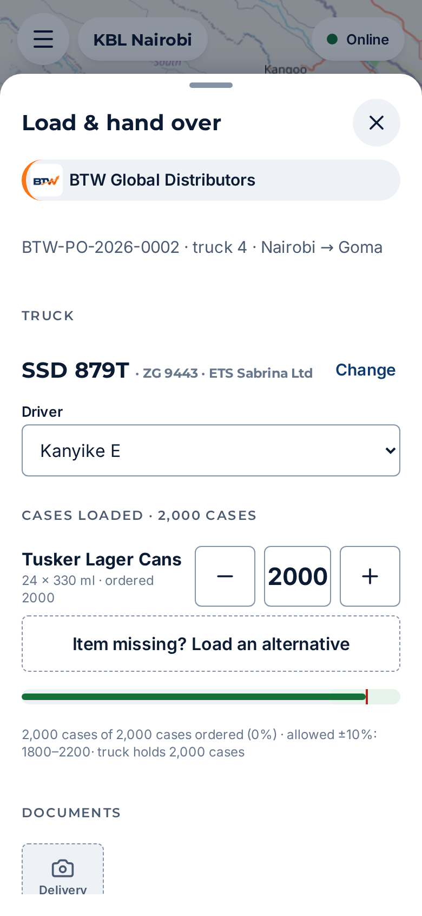
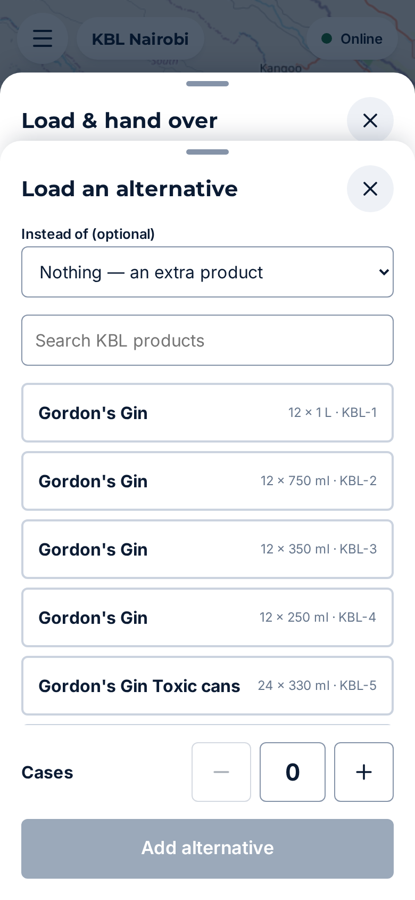
NEW · LOADING
Loading with an allowance and PO revisions
PO-001
Loader changes
PO-001-rev001
Everyone follows
Issued by the planner
a quantity, a missing item or an alternative, within ±10%
Created and issued at once, in the same step
Planners and directors told; shipments use the latest revision
Beyond ±10%, or over the truck’s size, the app refuses: ask the planner to change the PO
A second change makes -rev002, always numbered from the original
Old versions stay viewable; nothing is counted twice
SETTINGS · apps/api/config.toml
[approvals]
purchase_orders = false
[loading]
allowance_pct = 10
allow_alternatives = true
revision_suffix = "-rev"
Allowance meter
Load an alternative
BTW Supply Chain Platform · 12

Slide 13
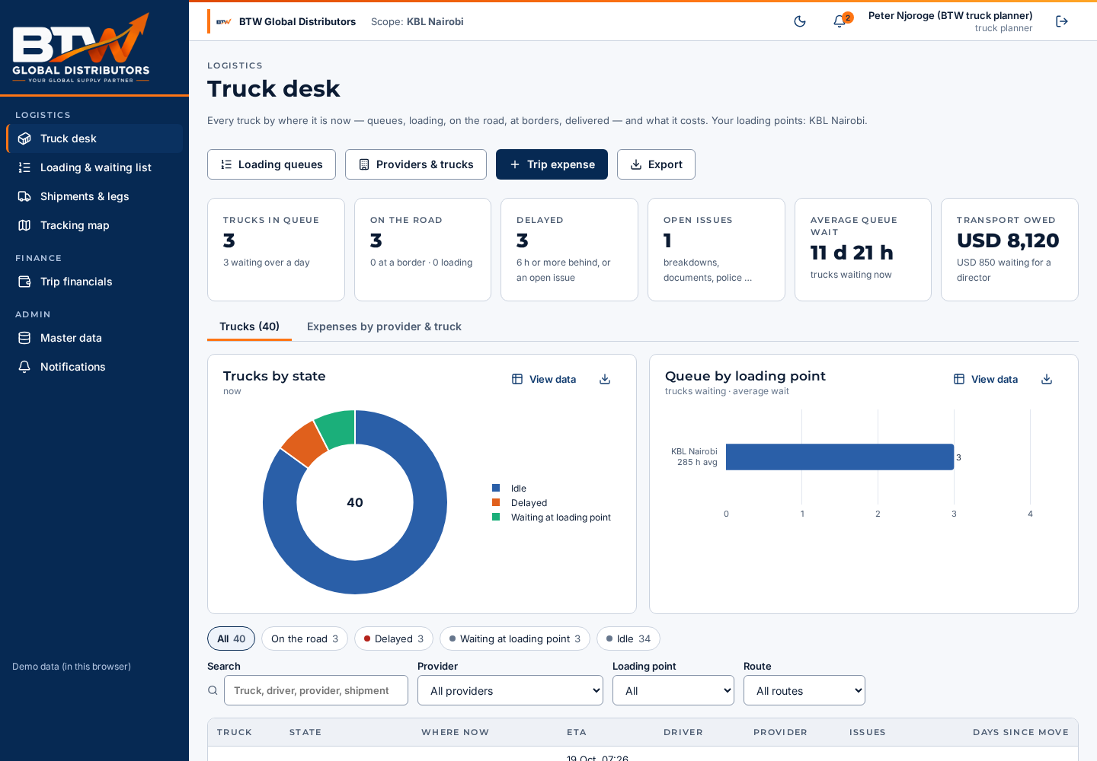
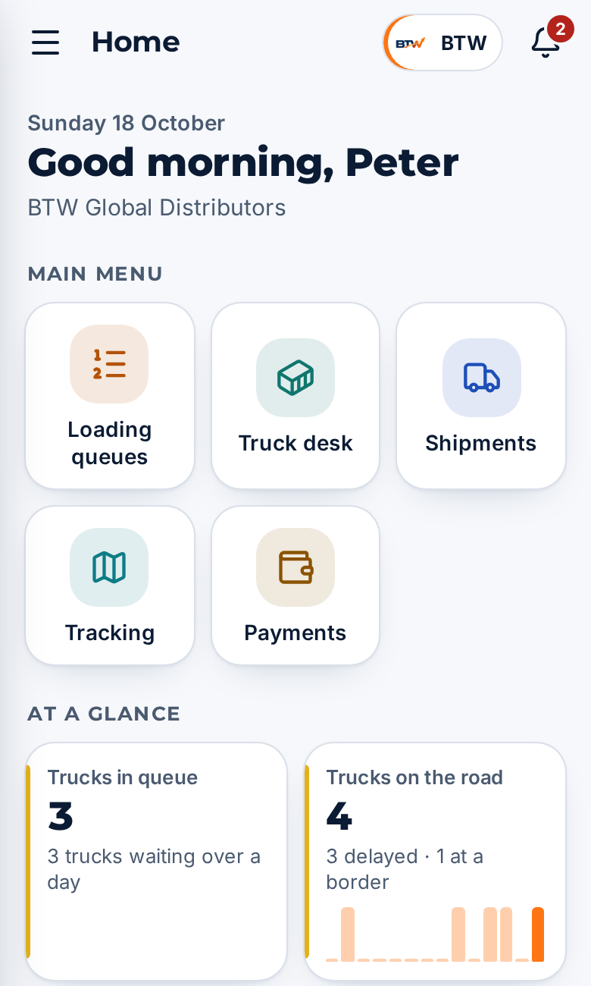
NEW · ROLE
Truck planner
Onboards providers, saccos, trucks and drivers
Orders the loading queues; loaders are told of every change
Sees where each truck is, delays and issues
Expenses per truck and per provider
No access to POs, plans or sales
DEMO SIGN-INS
btw-trucks (BTW only)
+254700000017
trucks (all three companies)
+254700000018
Truck desk on the web: every truck by state, queue waits, delays, costs
Team phone app
BTW Supply Chain Platform · 13

Slide 14
LONG TRIPS
Each leg is its own shipment
Nairobi
loading point
Shipment 1
Gisenyi
Rwanda warehouse
Shipment 2 · new truck
Goma
Congo warehouse
Arrive, then store
Send on as new
Add warehouses
When goods reach the first stop they are signed in as that warehouse’s stock.
The next leg is a new shipment with its own truck and driver, still linked to the first.
Today: Congo – Goma, Rwanda – Gisenyi, South Sudan – Juba. Owners can add more towns.
BTW Supply Chain Platform · 14

Slide 15
TECHNICAL · 1 OF 3
Architecture
CLIENTS
Office web app
Svelte 5 · about 113 KB
Team phone app (PWA)
Office roles · /app/
Field app
Capacitor 7 · Android
SMS / USSD
Africa’s Talking
Adapters
Each outside service sits behind one adapter, with a local stand-in for testing.
One server · NestJS 11 on Fastify
Serves web, apps and /v1 API · sign-in (JWT) · roles · company scope · audit log · sync · settings from config.toml
SMS and USSD: Africa’s Talking
Email: SMTP
Push: Firebase
PDF letters: Typst letterheads
Routes: OSRM
Files: local disk or cloud storage
BUSINESS MODULES
Plans
POs
Trucks
Stock
Sales
Finance
Reports
PostgreSQL 17 + PostGIS
Drizzle migrations · every record tagged by company · checkpoints as map areas
Shared package: one typed client and one set of business rules used by the web app, the field app and the server.
BTW Supply Chain Platform · 15

Slide 16
TECHNICAL · 2 OF 3
Data flow: one check-in, end to end
1
2
3
4
5
6
Driver taps
Kept offline
Sent
Checked
Saved
Shown
“I’m here”, or sends an SMS
Outbox with a unique key; works with no signal
When signal returns, in one batch to /v1/sync
Sign-in, role, company; a repeat key is ignored
Database, checkpoint map area, audit log
Office board and reports update; alerts if late
HOW THE MAIN RECORDS LINK
Period plan
PO
Loading
Shipment (each leg)
Acknowledgement
Stock moves
Sales
Each leg is its own shipment, linked to the one before. Shortages show on the leg where they happen, and costs carry forward into the final landing cost.
BTW Supply Chain Platform · 16

Slide 17
TECHNICAL · 3 OF 3
Set-up, hosting and security
HOW IT RUNS
Office browsers
HTTPS
Database
PostgreSQL + PostGIS
Security
One server
Password (web) or phone + PIN (phone apps)
Short-lived sign-in tokens; lock-out after wrong tries
Each role sees only its screens
Staff see only their company
Every change logged: who and when
Database company rules ready as a second net
Web app files
Phones
Android app · team app (PWA)
Field and team app files
/v1 API
Outside services
SMS · email · push
Basic phones
SMS / USSD
Settings: apps/api/config.toml
Scheduled checks (late trucks)
Today and at go-live
Today: runs on one machine; shared through a secure tunnel for the demo.
Go-live: the same set-up on a cloud server in a region you choose, with a fixed web address and daily backups.
Switches in apps/api/config.toml: PO approval on or off, loading allowance, alternatives, revision suffix.
BTW Supply Chain Platform · 17

Slide 18
WHY IT FITS YOU
Built for the roads you use
Works on weak signal
Light and fast
No licence fees
Ready to grow
The app saves work offline and sends it later. Drivers without a smartphone use SMS.
Web app about 113 KB, phone app about 74 KB, so it loads quickly even on slow connections.
Built on proven open-source tools. Your data stays in your own database.
Add warehouses, routes, trucks and providers yourself. GPS can be added later.
Tested before you see it
638 automated checks run against the platform, covering rules, security, each company’s data and load. All pass today.
BTW Supply Chain Platform · 18

Slide 19
PROGRESS
What is done today
131
30
638
3
products loaded from your price list
ETS Sabrina trucks and drivers
automated quality checks, all passing
companies with their own letterheads
Web app 112.7 KB · phone app 73.5 KB
Office web app, field app and server all working together
Android app built and installed on a phone
Three months of sample data, end to end
Period plans, POs and planned versus actual
Legs as new shipments, warehouses you can add
Architecture document in PDF and Word
NEW
Plans are suggestions; planners issue POs (director approval is a switch)
Loading within ±10% with automatic PO revisions
Truck planner role and the office team phone app
BTW Supply Chain Platform · 19

Slide 20
TRY IT
Demo link and sign-ins
Director | +254700000001 | all companies
Planner | btw-plan | also nud-plan, kvd-plan
Accounts | btw-acc | also nud-acc, kvd-acc
Truck planner | btw-trucks | +254700000017 · also trucks
Receiver | asie | Gisenyi and Goma
Driver | +254702750019 | Mawazi K, KBV 894T
Driver | +254701811686 | Kanyike E, SSD 879T
OFFICE WEB APP
Demo link: shared on the day
ON A PHONE (FIELD AND OFFICE TEAM)
<demo link>/app/
The link is temporary. On the web, tap a demo account to sign in: password demo1234. On a phone, sign in with the phone number and PIN 1234, including office staff.
BTW Supply Chain Platform · 20

Slide 21
NEXT PHASE
What comes after this demo
Truck planning
KBL receipt
Go live
Fill one truck from several POs, with subtotals per truck.
Match the columns and totals on the KBL receipt.
Real SMS and email accounts, hosting, then GPS trackers later.
BTW Supply Chain Platform · 21

Slide 22
Questions for you
Everything we asked since the project started and still need answered. Where we had to guess, the platform uses a safe default marked “to confirm”.
Branding · Roles · Process · Timeline and services · Data

Slide 23
QUESTIONS · 1 OF 6
Companies and branding
Some reference documents mentioned in the requirements are missing. Can you send them?
What is the platform called, and does it carry the BTW brand or a neutral one?
Can you send NUD and Kivu logos as vector files, plus dark versions?
Do you approve the dark logo versions we made?
Is there a group logo for the directors’ view?
Are Asie and Zonas separate companies, or sites of one company?
What does “branches” mean: towns, warehouses or companies?
Kivu’s letterhead shows NUD’s email. Which is correct, and what is Kivu’s full legal name?
KRA PINs and registration numbers for each company’s letters?
Correct full names for GBI and SBL?
BTW Supply Chain Platform · 23

Slide 24
QUESTIONS · 2 OF 6
People and access
Who besides the truck planner may add transport providers?
Who may remove a truck from the waiting list?
Does a loading point see only its own trucks, or all trucks?
Do drivers of market (hired) trucks get the app, or SMS only?
Whose name goes on a PO as “prepared by”?
Can you confirm which role sees which screens (our role list)?
Are staff or trucks shared between the three companies?
Should loading points see trucks already on the road?
Office phone app: Play Store, or install from the browser only?
BTW Supply Chain Platform · 24

Slide 25
QUESTIONS · 3 OF 6
How the work runs (part 1)
How is truck capacity measured: cases, weight or pallets?
How are landing costs shared across products on a truck?
Which currencies, and where do exchange rates come from?
Are sales recorded one by one or in batches?
How detailed should management accounts be?
What sales speed counts as slow-moving stock?
If two people change the same record offline, whose change wins?
How long after delivery is the transport fee followed up?
How often must reports refresh?
Loading allowance: one % for all, or per supplier?
Should a PO revision need anyone’s acknowledgement?
BTW Supply Chain Platform · 25

Slide 26
QUESTIONS · 4 OF 6
How the work runs (part 2)
How do sales between the three companies work, and at what price?
Should prices be hidden between companies?
Can customers be shared between companies?
Is Kigali a stop on the way, or a destination?
Planned versus actual warnings: we use below 85% and above 105%. OK?
A missed check-in alerts after 3 hours. OK?
Are the transfer points fixed for each route?
On an onward leg, who records the transport price?
Can the sender change the truck after loading?
Do you want subtotals per truck on the PO? What SMS short code and keywords?
BTW Supply Chain Platform · 26

Slide 27
QUESTIONS · 5 OF 6
Timeline and outside services
What is the target go-live date?
When should GPS tracking come in, and will trucks have trackers?
Should we import past records? From when?
Do signatures need a legal e-signature service?
Which SMS or WhatsApp provider, and what budget?
Where should the system be hosted? Any data-location rules?
Which accounting software must it connect to?
Which languages: English, French, Swahili?
Can we have live Africa’s Talking and Firebase accounts?
BTW Supply Chain Platform · 27

Slide 28
QUESTIONS · 6 OF 6
Data and next-phase files
Real prices for each product, and in which currency?
Truck capacity for each truck? (we assumed 2,000 cases)
Drivers’ phone country codes? (we assumed +254 Kenya)
Pack sizes for the 61 products without one?
Who drives truck 22 (UAY 563H)?
Lists for other transport providers (Joly and others)?
Please send the truck planning sheet (image)
Please send a KBL receipt so we can match its columns
Please send the newest requirements document
Sacco details: contacts and payment terms?
BTW Supply Chain Platform · 28

Slide 29
Thank you
Your answers shape the next phase.

