Slide 1
Index
What can be improved?
What variables I used?
How are variables related?
The findings
Business suggestions
Modeling approach
The selected model
Data quality

Slide 2
Data Analysis | What variables I used?
Is an order not going to be taken?
Distance to the user
Order total amount of earnings
Was there a not taken order from the same store during the previous hour?
Day of the week
2 cases with suspiciously high earning amount. 10x and 8x over all earnings mean

Slide 3
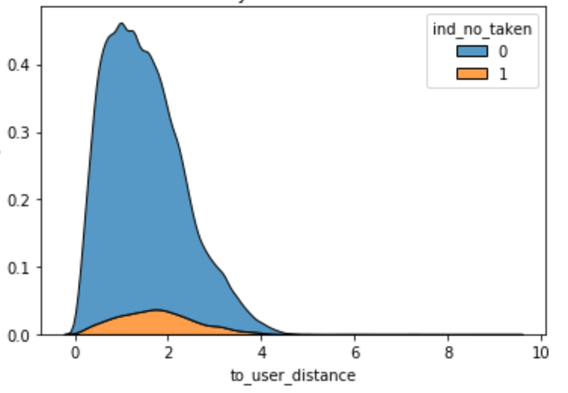
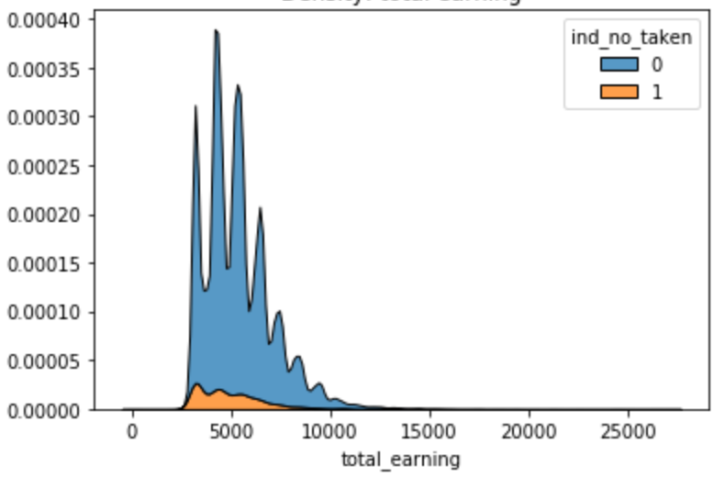
Data Analysis | How are variables related?
Distance to the user
Order total amount of earnings
1.36
1.71
$5,200
$4,700
<
>
Median
Taken orders
Median
Not taken orders
Median
Taken orders
Median
Not taken orders

Slide 4
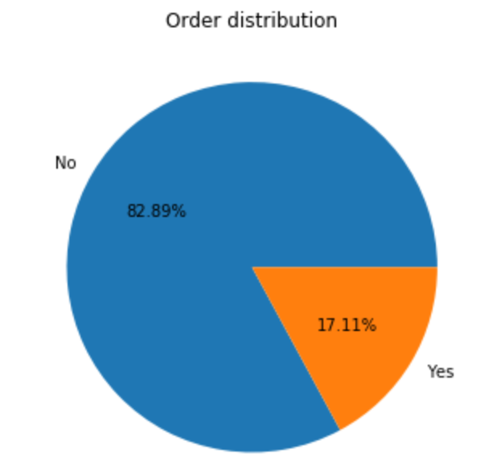
Data Analysis | How are variables related?
Was there a not taken order from the same store during the previous hour?
No
Yes
6.5%
14.2%
<
Proportion of not taken orders

Slide 5
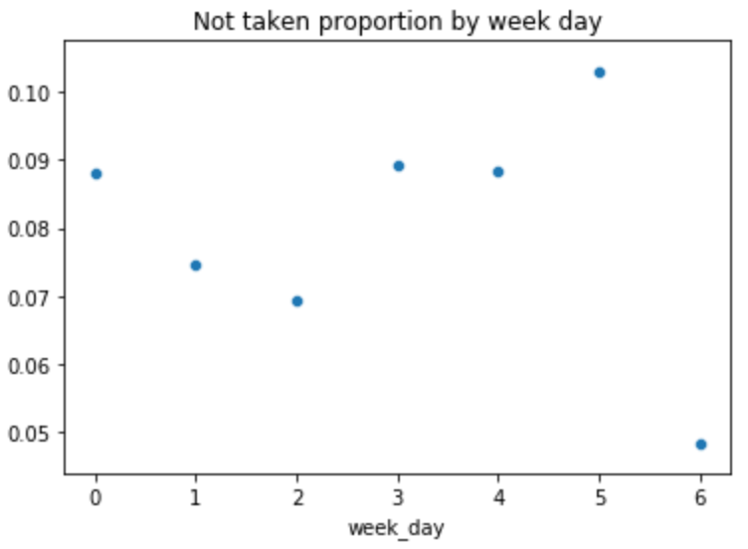
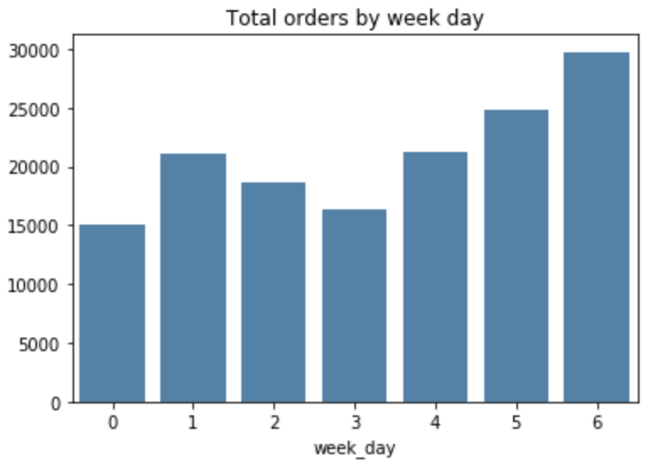
Data Analysis | How are variables related?
Day of the week
Saturday
1st day with highest proportion of not taken orders (10.3%)
2nd day with the most number of total orders

Slide 6
Data Analysis | The findings
The most non taking orders scenario
1
There was a not taken order from the same store during the previous hour
2
Distance to the user is greater than 0.9
3
Order total amount of earnings is less than $4k
76%
Relative increase in the probability that an order is not going to be taken

Slide 7
Data Analysis | Business suggestions
Distance, earnings and previous not taken orders
Adjust store suggesting rules so that user see first stores within less than 0.9
Decrease de distance ratio to which couriers are asigned to below 0.9
If not a general decrease, maybe just for orders with earnings < 4k
Increase delivery fare for orders with earnings under 4K
Increase courier incentives so they would take more orders with distance to de user greater than 0.9
Maybe just an insentive on the current order to reach the total 4k earnings threshold
Estimated model
Target orders with a probability of not being taken estimated (over a certain threshold) and offer an incentive to the courier so that he would take it

Slide 8
Data Analysis | Modeling approach
Data splitting
I separated the data into training and testing sets with 80% and 20% of the orders respectively
Over sampling
The proportion of non taken orders is small (7.8%) and could cause biased estimations
because taken orders are over represented in the sample
I did a sampling with replacement of the non taken orders in the training set in order
to have a training set with 50% of non taken orders. Just on the training set.
Keep in mind that because of over sampling, probabilities estimated in the training set
must be compared in relative terms tather than in absolute terms

Slide 9
Data Analysis | Modeling approach
Type of model
I estimated a decision tree model. It is a fast computing and easy interpretable type of model
convienient to be used in a first mvp.
Performance metric
I used the f1 score in order to select the best model. Optimizing on this score increases both
the precision and the recall of a classifier.

Slide 10
Data Analysis | Modeling approach
Concerns
I may be conserned obout how does the model works on an out of time sample as if not
done carefully, decision trees may overfit and lose prediction power.
Further improvements
More data and useful variables to include in the model.
Tune additional hyperparameters
Try boosting or random forests to have a more robust model.

Slide 11
Data Analysis | The selected model
3
52.46%
23.05%
Maximum depth
Training f1 score
Training f1 score
Model has the best testing f1 score and not at all one of the highest training f1 scores.
This helps to avoid overfitting on the training set.
The model is 185% better than a naïve estimator, which has testing f1 score of 8.08%
*keep in mind that training set is over sampled and testing set no.

Slide 12
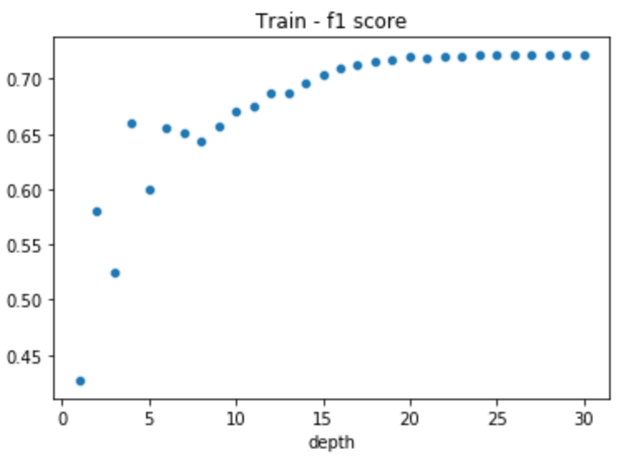
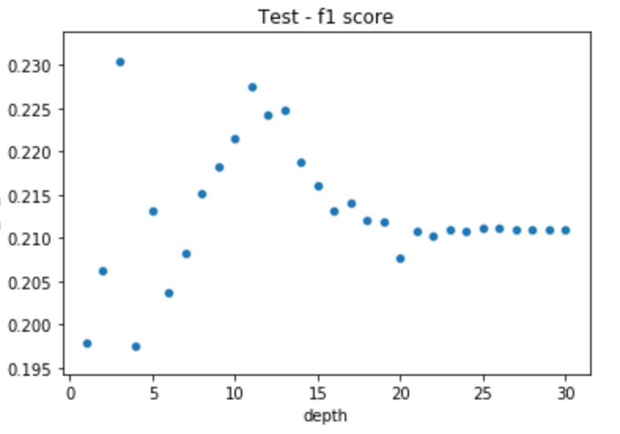
Data Analysis | The selected model
0.23
0.52

Slide 13
Data Analysis | Data quality
0
Data quality was good in general
Duplicated values were dropped and the row with the most recent date was kept
Fraud suspected cases were dropped. Had total earnings greater than 8 times the average earnings value
Null values
52
Duplicated orders
2
Fraud suspected
2 cases with suspiciously high earning amount. 10x and 8x over all earnings mean

