Slide 1

GPFS Troubleshooting & Daily Operations
Hands-On Technical Training for HPC at Keysight

Slide 2
Agenda / Index
1. Daily Operations Overview
Understand the normal state to detect failures
2. Storage Backend Troubleshooting
Investigating NetApp and LUN-related issues
3. Network Fabric Diagnostics
Ethernet, Infiniband, and Omni-Path failures
4. GPFS Services (CES, NFS/CIFS)
Diagnosing shared access issues
5. Quota & Fileset Issues
Space problems and user error resolution
6. Node Management Scenarios
Adding/Removing nodes, license handling
7. Log-Based Troubleshooting
Using logs and event history to identify root causes.
8. Q&A and Wra-Up
Open discussion and review

Slide 3

Module 1: Daily Operations Node Status & Health Checks

Slide 4
Node Status & Health Checks
Objective | Command
View full cluster status | mmgetstate –av
View node health summary | mmhealth node show
Check node health history | mmhealth node eventlog
Identify GPFS roles & license | mmlscluster, mmlsconfig
🧪 Goal: Identify if all nodes are active, and spot nodes in unknown or degraded state.
Notes:
We’ll begin with one the most common tasks: verifying the current state of our GPFS Cluster.
The first command, mmgetstate –av, shows the GPFS daemon status on every node – whether it’s active, down or unknown
If a node is marked unknown, it may be unreachable, shut down, or the GPFS daemon isn't running.
We then use mmhealth node show for a quick view of node health, and mmhealth node eventlog to see historical issues — this is really useful if something went wrong overnight.
We also use mmlscluster to confirm node roles and verify quorum and manager nodes, and mmlsconfig to view critical cluster settings like licensing, mount options, and more.
In real ops, I use this routine nearly every day, especially before or after scheduled maintenance or unexpected incidents.”
Demonstration of commands → see Notepad+ file

Slide 5
Module 2: Storage Backend Troubleshooting
Detecting LUN failures, storage disconnections, and SAN issues
📦 Focus: GPFS + NetApp E-Series (SANtricity) 📡 Tools: mmlsdisk, mmlsfs, mmlsconfig, SANtricity UI
🎯 Purpose:
Introduce how to troubleshoot issues related to storage backend, especially LUNs and NetApp (E2800/E2812), as used in your GPFS cluster.

Slide 6
Detecting LUN failures, storage disconnections, and SAN issues
Detecting LUN failures, storage disconnections, and SAN issues
📦 Focus: GPFS + NetApp E-Series (SANtricity) 📡 Tools: mmlsdisk, mmlsfs, mmlsconfig, SANtricity UI
Check | Command | Use Case
List Disks by Filesystem | mmlsfs –d | View Disk State in GPFS
To verify disk state and identity offline or missing disks | mmlsdisk gpfs –Y | Which LUNs (NSDs) are metadata vs data
Check web GUI also | https://bruclu015-e2800b.vbr.is.keysight.com/sm/en-US/#/home https://bruclu015-e2812a.vbr.is.keysight.com/sm/en-US/#/home | to verify any error in the hardware or checking the respective log in the UI
Check Physical Path (Optional) | multipath –ll lsblk | Visualize IB/OPA fabric connectivity
Notes:
“Now that we’ve covered basic node status and health checks, we’ll move into a critical layer: the storage backend.
Our GPFS cluster is connected via SAS to a NetApp E2800 and E2812. Each LUN is used in GPFS either as a data or metadata disk, and issues at this level can cause the filesystem to become slow, unresponsive, or fail to mount.
In this module, we’ll learn how to detect whether a disk is missing or failed, using both GPFS commands, such as mmlsdisk, and tools like SANtricity System Manager.
Continue in the notepad notes gpfs_commands.txt and Visual Code → let’s demonstrate now!

Slide 7
Module 3: Network Diagnostics – InfiniBand & Omni-Path

Slide 8
Main commands
Check | Command | Use Case
IB adapter status | ibstat | Verify IB card is up and active
IB ping to a node | ibping <hostname> | Test Infiniband-level connectivity
Omni-Path adapter info | opainfo | Show OPA HFI devices and port state
Show OPA HFI devices and port state | ibnetdiscover or opaquery | Visualize IB/OPA fabric connectivity
Notes:
In HPC, the network layer is just as critical as compute or storage — especially when we're using high-performance interconnects like Infiniband and Omni-Path
GPFS uses RDMA over these fabrics for metadata operations and file access across nodes. So, if a port goes down or a node loses connectivity on this layer, we may see symptoms like:
- Slurm job delays
- GPFS node in unknown state
- File system timeout or performance degradation
In our cluster, we have both Mellanox IB (mlx5_0) and Intel OPA (hfi1_0) interfaces.
We use ibstat and ibping to test Infiniband, and opainfo or opaquery for Omni-Path.
continue with lab and notepad++ Slide 9 – Line 234

Slide 9
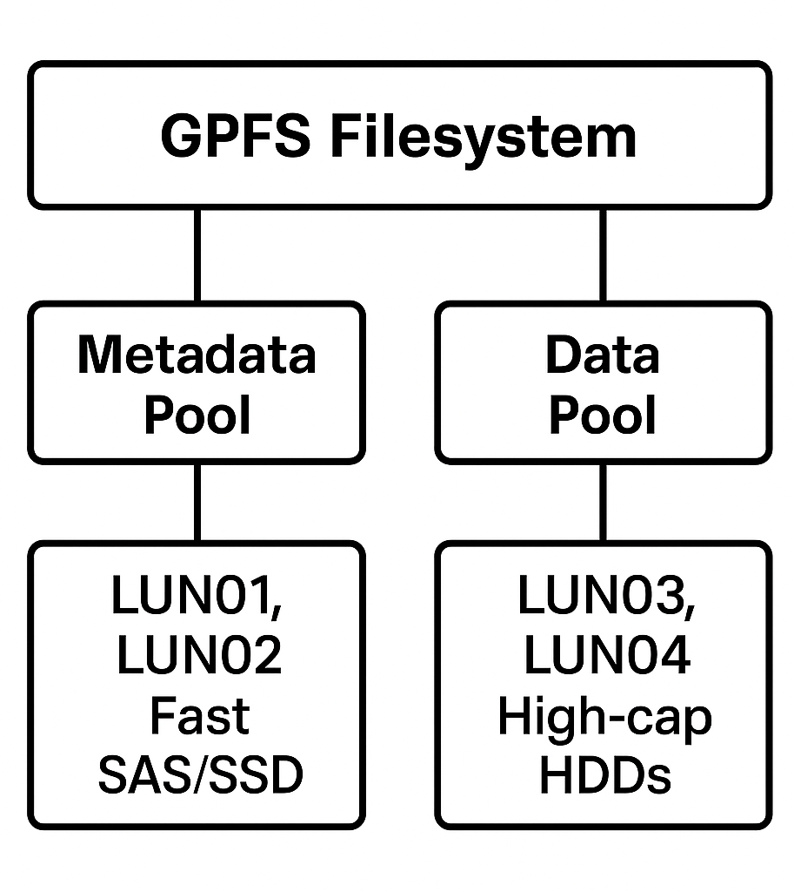
Metadata / Data Pool
Notes:
In HPC, the network layer is just as critical as compute or storage — especially when we're using high-performance interconnects like Infiniband and Omni-Path
GPFS uses RDMA over these fabrics for metadata operations and file access across nodes. So, if a port goes down or a node loses connectivity on this layer, we may see symptoms like:
- Slurm job delays
- GPFS node in unknown state
- File system timeout or performance degradation
In our cluster, we have both Mellanox IB (mlx5_0) and Intel OPA (hfi1_0) interfaces.
We use ibstat and ibping to test Infiniband, and opainfo or opaquery for Omni-Path.
In GPFS, the verbsPorts setting (visible in mmlsconfig) tells us which interface GPFS is using for RDMA communication. If a node is using the wrong port, or a port goes down, we’ll see network-level failure even if the system is otherwise healthy.”

Slide 10
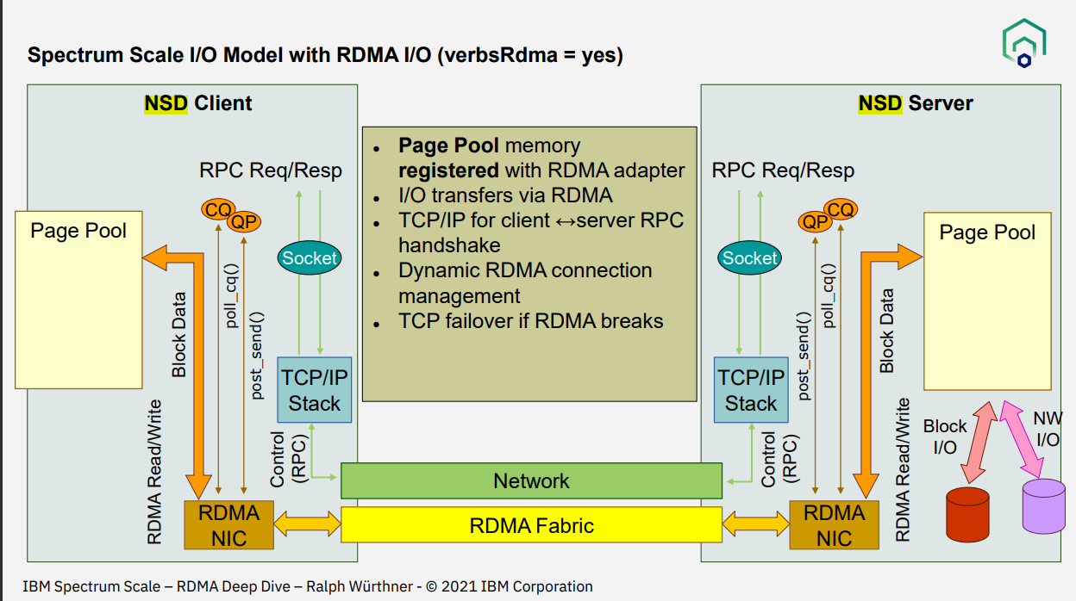
Notes:
NSD stands for Network Shared Disk — it’s a core concept in IBM Spectrum Scale (GPFS).
🔹 Definition:
An NSD is a logical representation of a physical disk that is accessible over the network.
It abstracts storage access from the physical location and allows GPFS to access disks transparently over the network, whether they are local or remote.
🧱 How It Works:
NSD Servers: Nodes that own physical access to the disk (e.g., via SAS, FC, NVMe).
NSD Clients: Nodes that access that disk over the network, not directly.
All nodes access the disk via the GPFS protocol, regardless of local or remote status.
This slide shows the internal communication flow between an NSD Client and an NSD Server when using RDMA for I/O.
On the left side, we have a client node, which is typically a compute node that doesn’t own the disk. It accesses the disk through the RDMA fabric via an NSD server, shown on the right.
Here's what's important:
GPFS uses RPC (Remote Procedure Call) requests over RDMA to talk between client and server.
Page Pool memory is used to buffer and transfer data.
With verbsRDMA enabled (as we saw in mmlsconfig | grep verbsPorts), GPFS uses specialized network interfaces like mlx5_0 or hfi1_0 for high-speed, zero-copy data transfer.
This avoids the traditional TCP/IP stack, reducing overhead.
So effectively, this model lets us do disk I/O over the network with much lower CPU usage, faster performance, and reduced latency — ideal for HPC

Slide 11
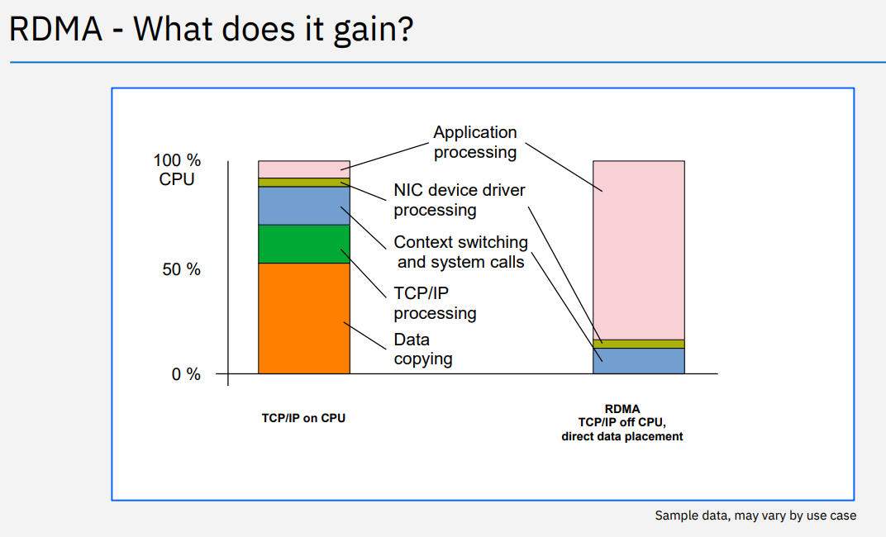
Notes:
This chart shows why RDMA is powerful. It compares traditional TCP/IP stack vs RDMA-based communication.
In a regular TCP/IP setup, you can see that a large portion of CPU time is spent on:
Memory copying
Protocol stack handling
Context switching
With RDMA, most of that work is offloaded to the NIC (Network Interface Card). The NIC can move memory between machines without CPU involvement, leading to:
Lower latency
Higher throughput
More CPU available for applications
That’s why in GPFS environments, especially at scale, using verbsRDMA is a best practice when working with NSDs over high-speed networks like InfiniBand or Omni-Path."

Slide 12

Module 4: CES Services
NFS, CIFS & Shared Access Troubleshooting
Notes:
In this module we’ll explore how GPFS integrates with CES (Cluster Export Services) to share the file system externally through NFS or CIFS.
CES runs on selected nodes and provides access to GPFS data for users and systems outside the cluster.For example, researchers may access data over NFS from analysis nodes, or users on Windows via Samba (CIFS).
CES uses floating IP’s – managed internally – and distributes the service across nodes.

Slide 13
Main commands
Learn how to verify and troubleshoot file sharing from GPFS via NFS/CIFS
Component | Command | Purpose
CES Node List | nmces node list | Show CES-enabled nodes
Address List | nmces address list | See floating IPs used by CES
CES Services | nmces service list | Show if NFS/CIFS/S3 are running
NFS Exports | nmnfs export list | Check active NFS exports
Config Check | mmlsconfig | grep ces
Notes:
Here we can see how to check which nodes run CES, what services are active, and what exports are configured.
If users report issues like “mount timeout” or “permission denied,” these commands will help us diagnose whether CES is running, which IPs it’s using, and whether exports are properly set up.

Slide 14
Module 5: Quota & Fileset Troubleshooting

Slide 15
Main commands
Check | Command | Use Case
List quota by user | mmlsquota -u <user> --block-size auto | View usage and limits per user
List quota by group | mmlsquota –g <group> --block-size auto | View usage and limits per group
Fileset-level quota | mmlsquota -j scratch-mstr gpfs | View quotas for each fileset
Fileset config | mmlsfs gpfs –Q | Show if quotas are enabled and where
Edit quota (admin only) | mmrepquota -u <user> | Set/modify quota limits
Quota report summary | mmrepquota –u –v gpfs –block-size auto | Full report of all quotas by user
Notes:
In this module, we focus on one of the most common user issues in GPFS environments: quota errors.
Many users report that they cannot write to the filesystem because of errors like ‘No space left on device,’ even though df -h shows there is plenty of free space.
That usually points to a user or group quota being exceeded — especially when quotas are configured per fileset.
We can diagnose this with mmlsquota, which lets us view the quota usage per user, group, or fileset.
The command mmlsfs -Q shows whether quotas are enabled and if they’re enforced.
We also use mmrepquota to get a full view of all users or groups across the cluster.
If needed, admins can change quota limits with mmedquota, but that must be done carefully, especially in production environments.”

Slide 16
Module 6: Node Management Scenarios
Action | Command | Purpose
List all nodes | mmlsnodeclass | View all nodes in each group from GPFS
Check node state | mmgetstate –a | Show current GPFS state of all nodes
Add a new node | mmaddnode <nodename> | Add one or more nodes to the cluster
Remove a node | mmdelnode <nodename> | Remove a node safely
Rebalance quorum | mmchnode –quorum-manager <nodename> | Set or change quorum/manager nodes
View node licenses | mmlslicense | Check GPFS licenses per node
Notes:
Node management in GPFS is critical for maintaining a healthy and scalable cluster. We start with mmlsnode and mmgetstate -a to check the role and health of each node.
If a node is unresponsive or degraded, we may need to remove it using mmdelnode. When expanding the cluster, we use mmaddnode with a config file that defines the new nodes and their roles.
It's also important to verify license usage (mmchlicense --list) especially if the number of nodes is approaching the limit. Finally, don’t forget the importance of quorum and manager roles — losing too many quorum nodes can make the cluster unavailable even if the nodes are technically up.”
Let’s go to the CLI !

Slide 17

Module 7: Log-Based Troubleshooting

Slide 18
How to check specific GPFS Logs
Log location | What to look for: | Purpose:
/var/adm/ras/mmfs.log.latest | mmfsd errors, quorum, disk issues | Main GPFS log file
/var/adm/ras/mmfs.log* | Older rotated logs (e.g. .1, .2.gz) | Look for past incidents
/var/adm/ras/log.smbd /var/adm/ras/log.winbindd | 📁 Samba/Winbind CES logs (very relevant for NFS/SMB debug)
/var/adm/ras/mmsysmonitor*.log | 📊 System monitoring logs (CPU, memory trends, alerts)
/var/adm/ras/mmwatch.log | ✅ Monitors CES-related services and GPFS runtime health checks
Notes:
In HPC, the network layer is just as critical as compute or storage — especially when we're using high-performance interconnects like Infiniband and Omni-Path
GPFS uses RDMA over these fabrics for metadata operations and file access across nodes. So, if a port goes down or a node loses connectivity on this layer, we may see symptoms like:
- Slurm job delays
- GPFS node in unknown state
- File system timeout or performance degradation
In our cluster, we have both Mellanox IB (mlx5_0) and Intel OPA (hfi1_0) interfaces.
We use ibstat and ibping to test Infiniband, and opainfo or opaquery for Omni-Path.
continue with lab and notepad++ Slide 9 – Line 234

