Slide 1
Introduction to CAN and CAN FD
Allan Chen

Slide 2
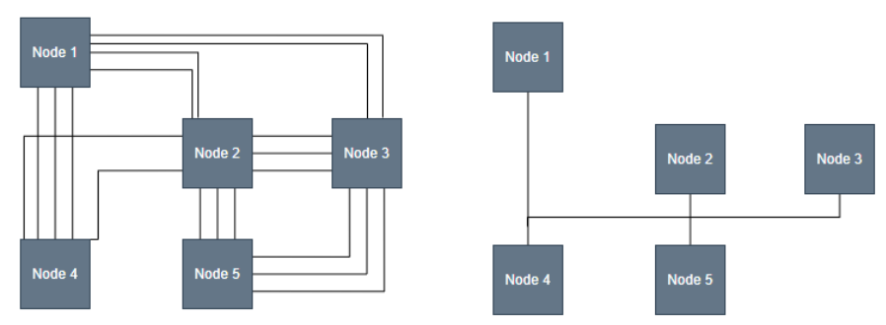
What is CAN Bus?
Definition:
  Controller Area Network
  A high-integrity, multi-master, broadcast serial bus system.
Origins: Developed by Robert Bosch GmbH in the 1980s for automotive applications.
Key Philosophy:
  To replace point-to-point wiring with a single network.
  To ensure reliable communication in electronically "noisy" environments.

Slide 3
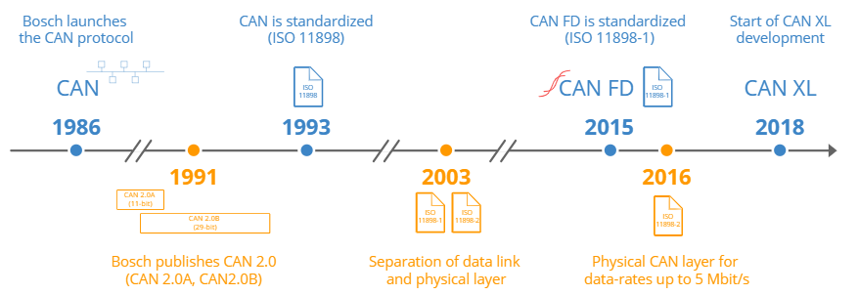
The CAN bus history in short
Pre CAN: Car ECUs relied on complex point-to-point wiring
1986: Bosch developed the CAN protocol as a solution
1991: Bosch published CAN 2.0 (CAN 2.0A: 11 bit, 2.0B: 29 bit)
1993: CAN is adopted as international standard (ISO 11898)
2003: ISO 11898 becomes a standard series
2012: Bosch released the CAN FD 1.0 (flexible data rate)
2015: The CAN FD protocol is standardized (ISO 11898-1)
2016: The physical CAN layer for data-rates up to 5 Mbit/s standardized in ISO 11898-2 (in practice up to 8 Mbit/s)
2018: CiA starts development of CAN XL
2024: CAN XL standardized (ISO 11898-1:2024, 11898-2:2024)

Slide 4
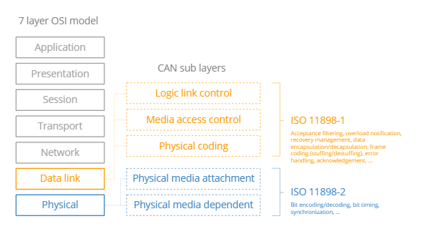
CAN in the OSI Model (Layered Architecture)
Overview: CAN covers the two lowest layers of the OSI model: Data Link and Physical.
Data Link Layer (ISO 11898-1): Handles frame formats, error handling (CRC/ACK), and arbitration.
Physical Layer (ISO 11898-2): Defines bit timing, synchronization, and electrical signal levels.

Slide 5
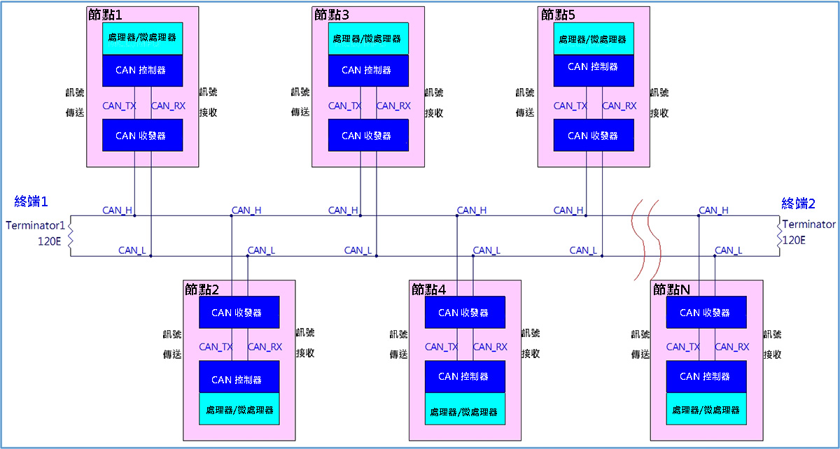
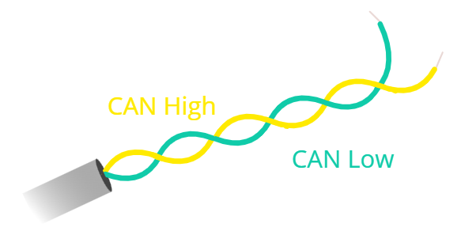
CAN Bus Topology (1/2)

Slide 6
CAN Bus Topology (2/2)
Bus Line Structure: A linear bus topology where all nodes (ECUs) are connected to a single twisted-pair cable.
Key Components:
  Main Trunk Line: The primary cable running through the system.
  Drop Lines (Stubs): Short cables connecting individual nodes to the main trunk.
Termination Resistors (120 Ω)
  Placed at the two extreme ends of the bus.
  Purpose: To match the characteristic impedance of the cable and prevent signal reflections that can cause data corruption.
Scalability: New nodes can be added easily without changing the entire wiring harness.

Slide 7
Physical Layer Constraints & Requirements
Bit Rate: Supports up to 1 Mbit/s for Classical CAN and up to 8 Mbit/s for CAN FD.
Cable Length vs. Speed: Maximum length is 500m (at 125 kbit/s) or 40m (at 1 Mbit/s).
Hardware Requirement: Each end of the bus must be terminated with a 120 Ohm resistor.

Slide 8
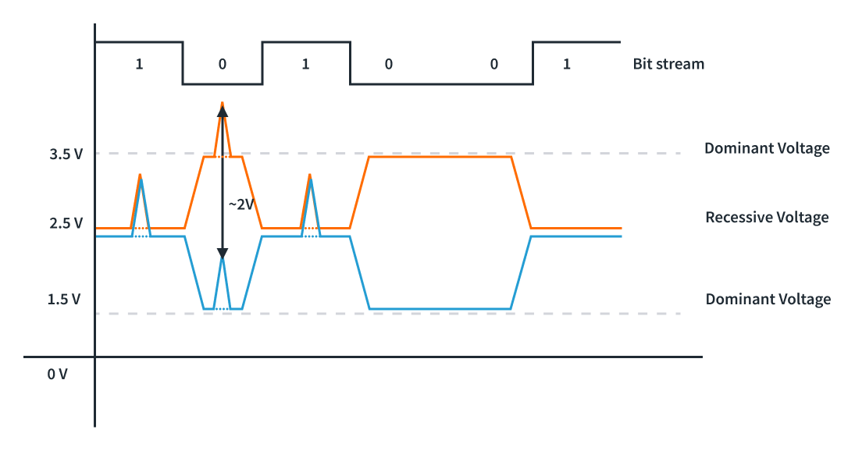
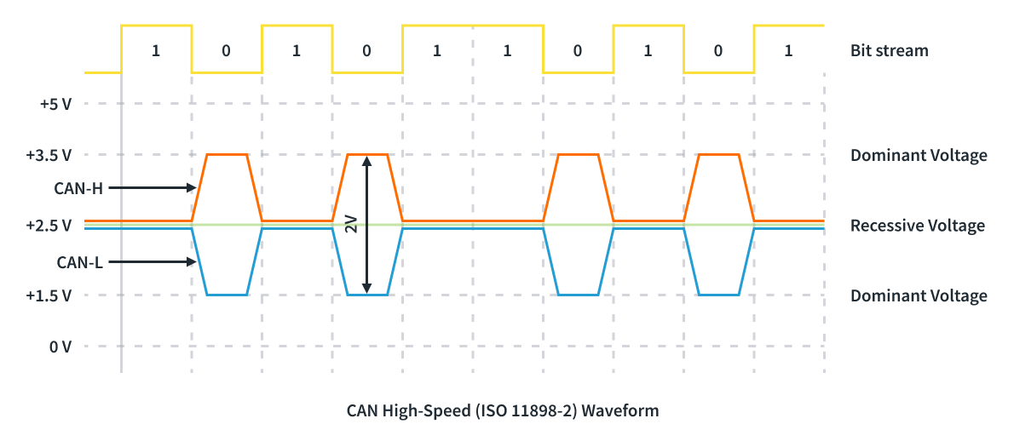
Physical Layer Signaling: Dominant vs. Recessive
Differential Signaling: Data is transmitted via a pair of wires (CAN High and CAN Low).
Logical States:
  Dominant (0): Logic '0'. The bus is actively driven; it wins over recessive bits.
  Recessive (1): Logic ‘1’. The bus is in a passive state, maintained by 120 Ω termination resistors.
Noise Immunity: Differential signals cancel out common-mode electromagnetic interference.
Fig. 1: Differential mode signal in CAN bus
Fig. 2: CAN bus noise immunity

Slide 9
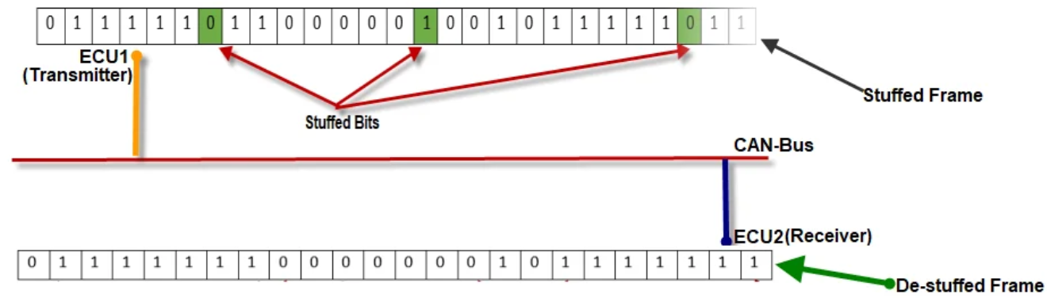
Asynchronous & Self-Synchronization
Asynchronous Nature: No dedicated clock line (saves weight and cost).
Synchronization Strategy:
  Hard Sync: Occurs on the falling edge of the Start of Frame (SOF) bit.
  Resynchronization: Maintained throughout the frame using edges created by Bit Stuffing.
Bit Stuffing Rule: After five consecutive bits of the same polarity, a bit of opposite polarity is automatically inserted.

Slide 10
CAN Frame Types
Data frame: A frame containing node data for transmission
Remote frame: A frame requesting the transmission of a specific identifier
Error frame: A frame transmitted by any node detecting an error
Overload frame: A frame to inject a delay between data or remote frame

Slide 11
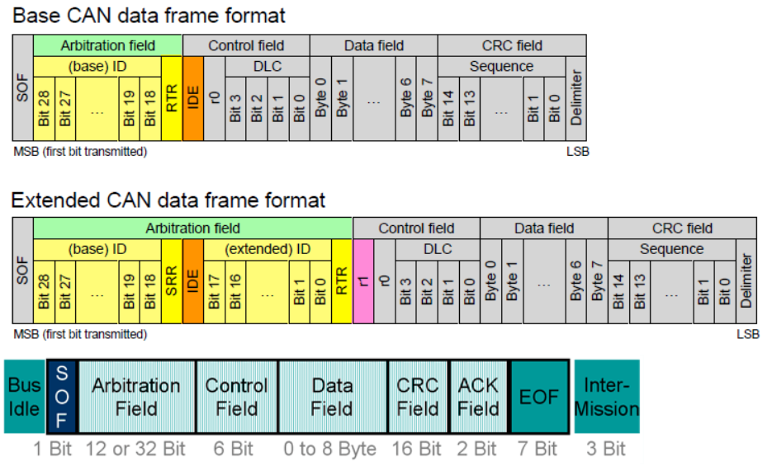
CAN Frame Types – Data Frame
CAN 2.0A
CAN 2.0B
SOF: Start of Frame

Slide 12
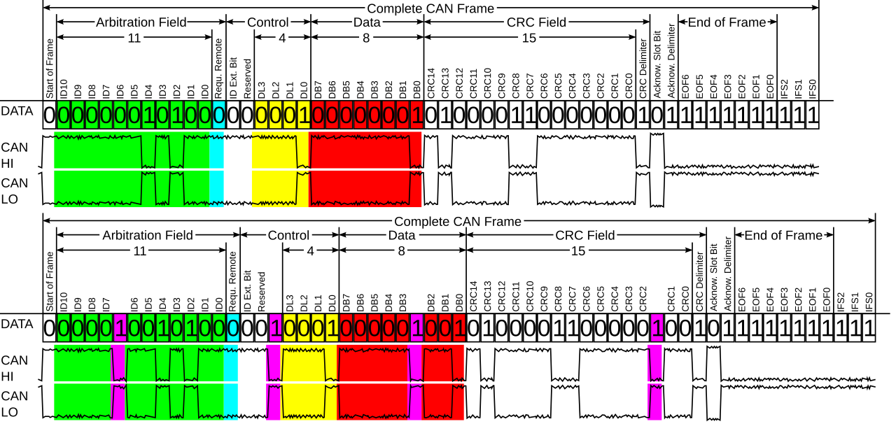
Data Frame with Bit Stuffing Example
CAN frame before and after the addition of stuff bits (in purple).

Slide 13
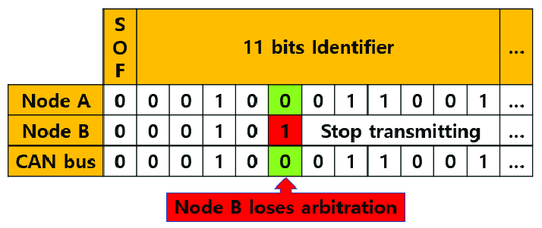
Bus Arbitration (Priority-Based)
Non-destructive: Nodes monitor the bus while sending.
Logic: If a node sends a 1 (Recessive) but hears a 0 (Dominant), it yields to the other node.
Result: The lower the ID number, the higher the priority on the bus.

Slide 14
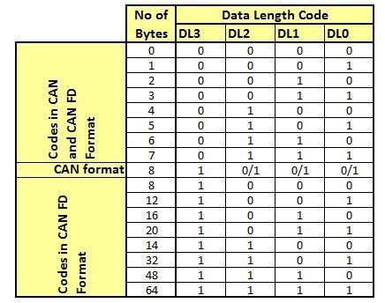
DLC (Data Length Code) for CAN and CAN FD

Slide 15
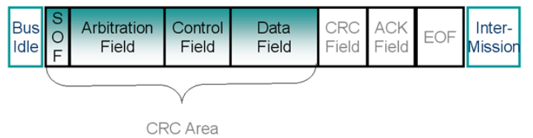
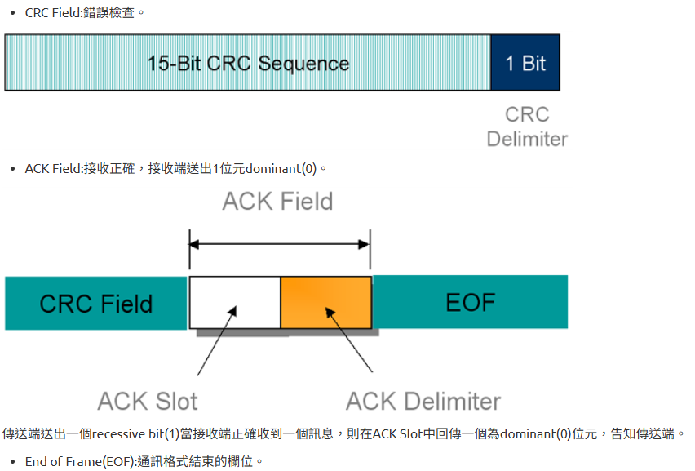
CAN Frame CRC & ACK Mechanism
Delimiters: 1-bit Recessive gaps (CRC/ACK Delimiters) for hardware processing.
ACK Mechanism: Receivers pull the bus Dominant in the ACK slot to confirm valid reception.
Error Check: If no ACK is detected, the transmitter triggers an ACK Error.

Slide 16
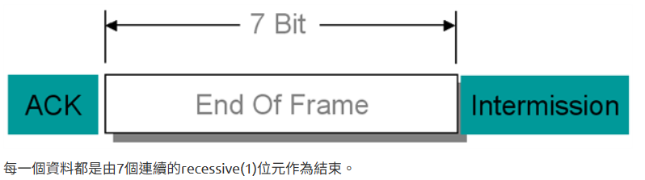
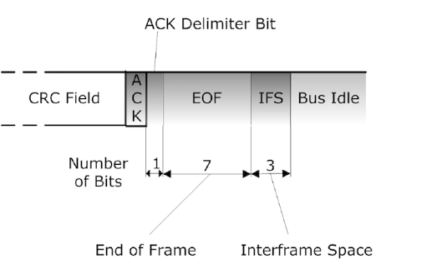
End of Frame (EOF) and Interframe Space
IFS: 3 bits, recessive

Slide 17
Five Error Detection Mechanisms
Bit Error: Sent bit doesn't match monitored bus level.
Stuff Error: Violation of the 5+1 stuffing rule.
CRC Error: Checksum mismatch.
Form Error: Dominant bit found in a fixed Recessive field (Delimiter/EOF).
ACK Error: No receiver drove the bus dominant.
# | Error 類型 | 偵測者 | 發生在哪 | 例外
1 | Bit Error | 傳送端 | 任一 bit | Arbitration stage and ACK slot
2 | Stuff Error | 接收端（所有節點） | SOF to CRC | CRC delimiter (1 bit), ACK Slot & Delimiter (2 bits), intermission, EOF
3 | CRC Error | 接收端 | SOF, Arbitration, Control, Data
4 | Form Error | 接收端 | CRC/ACK delimiter and EOF
5 | ACK Error | 傳送端 | ACK slot

Slide 18
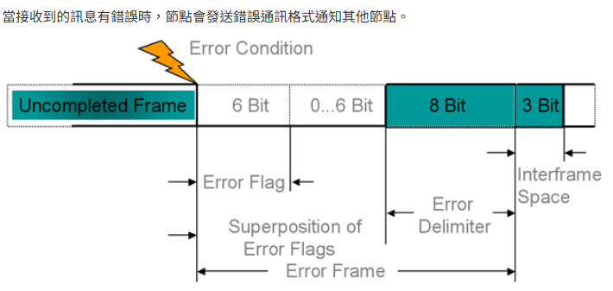
Error Frames & Propagation
Active Error Flag: 6 Dominant bits sent by healthy nodes to destroy a corrupted frame.
Passive Error Flag: 6 Recessive bits sent by degraded nodes.
Global Consistency: All nodes discard the frame if an error is detected.

Slide 19
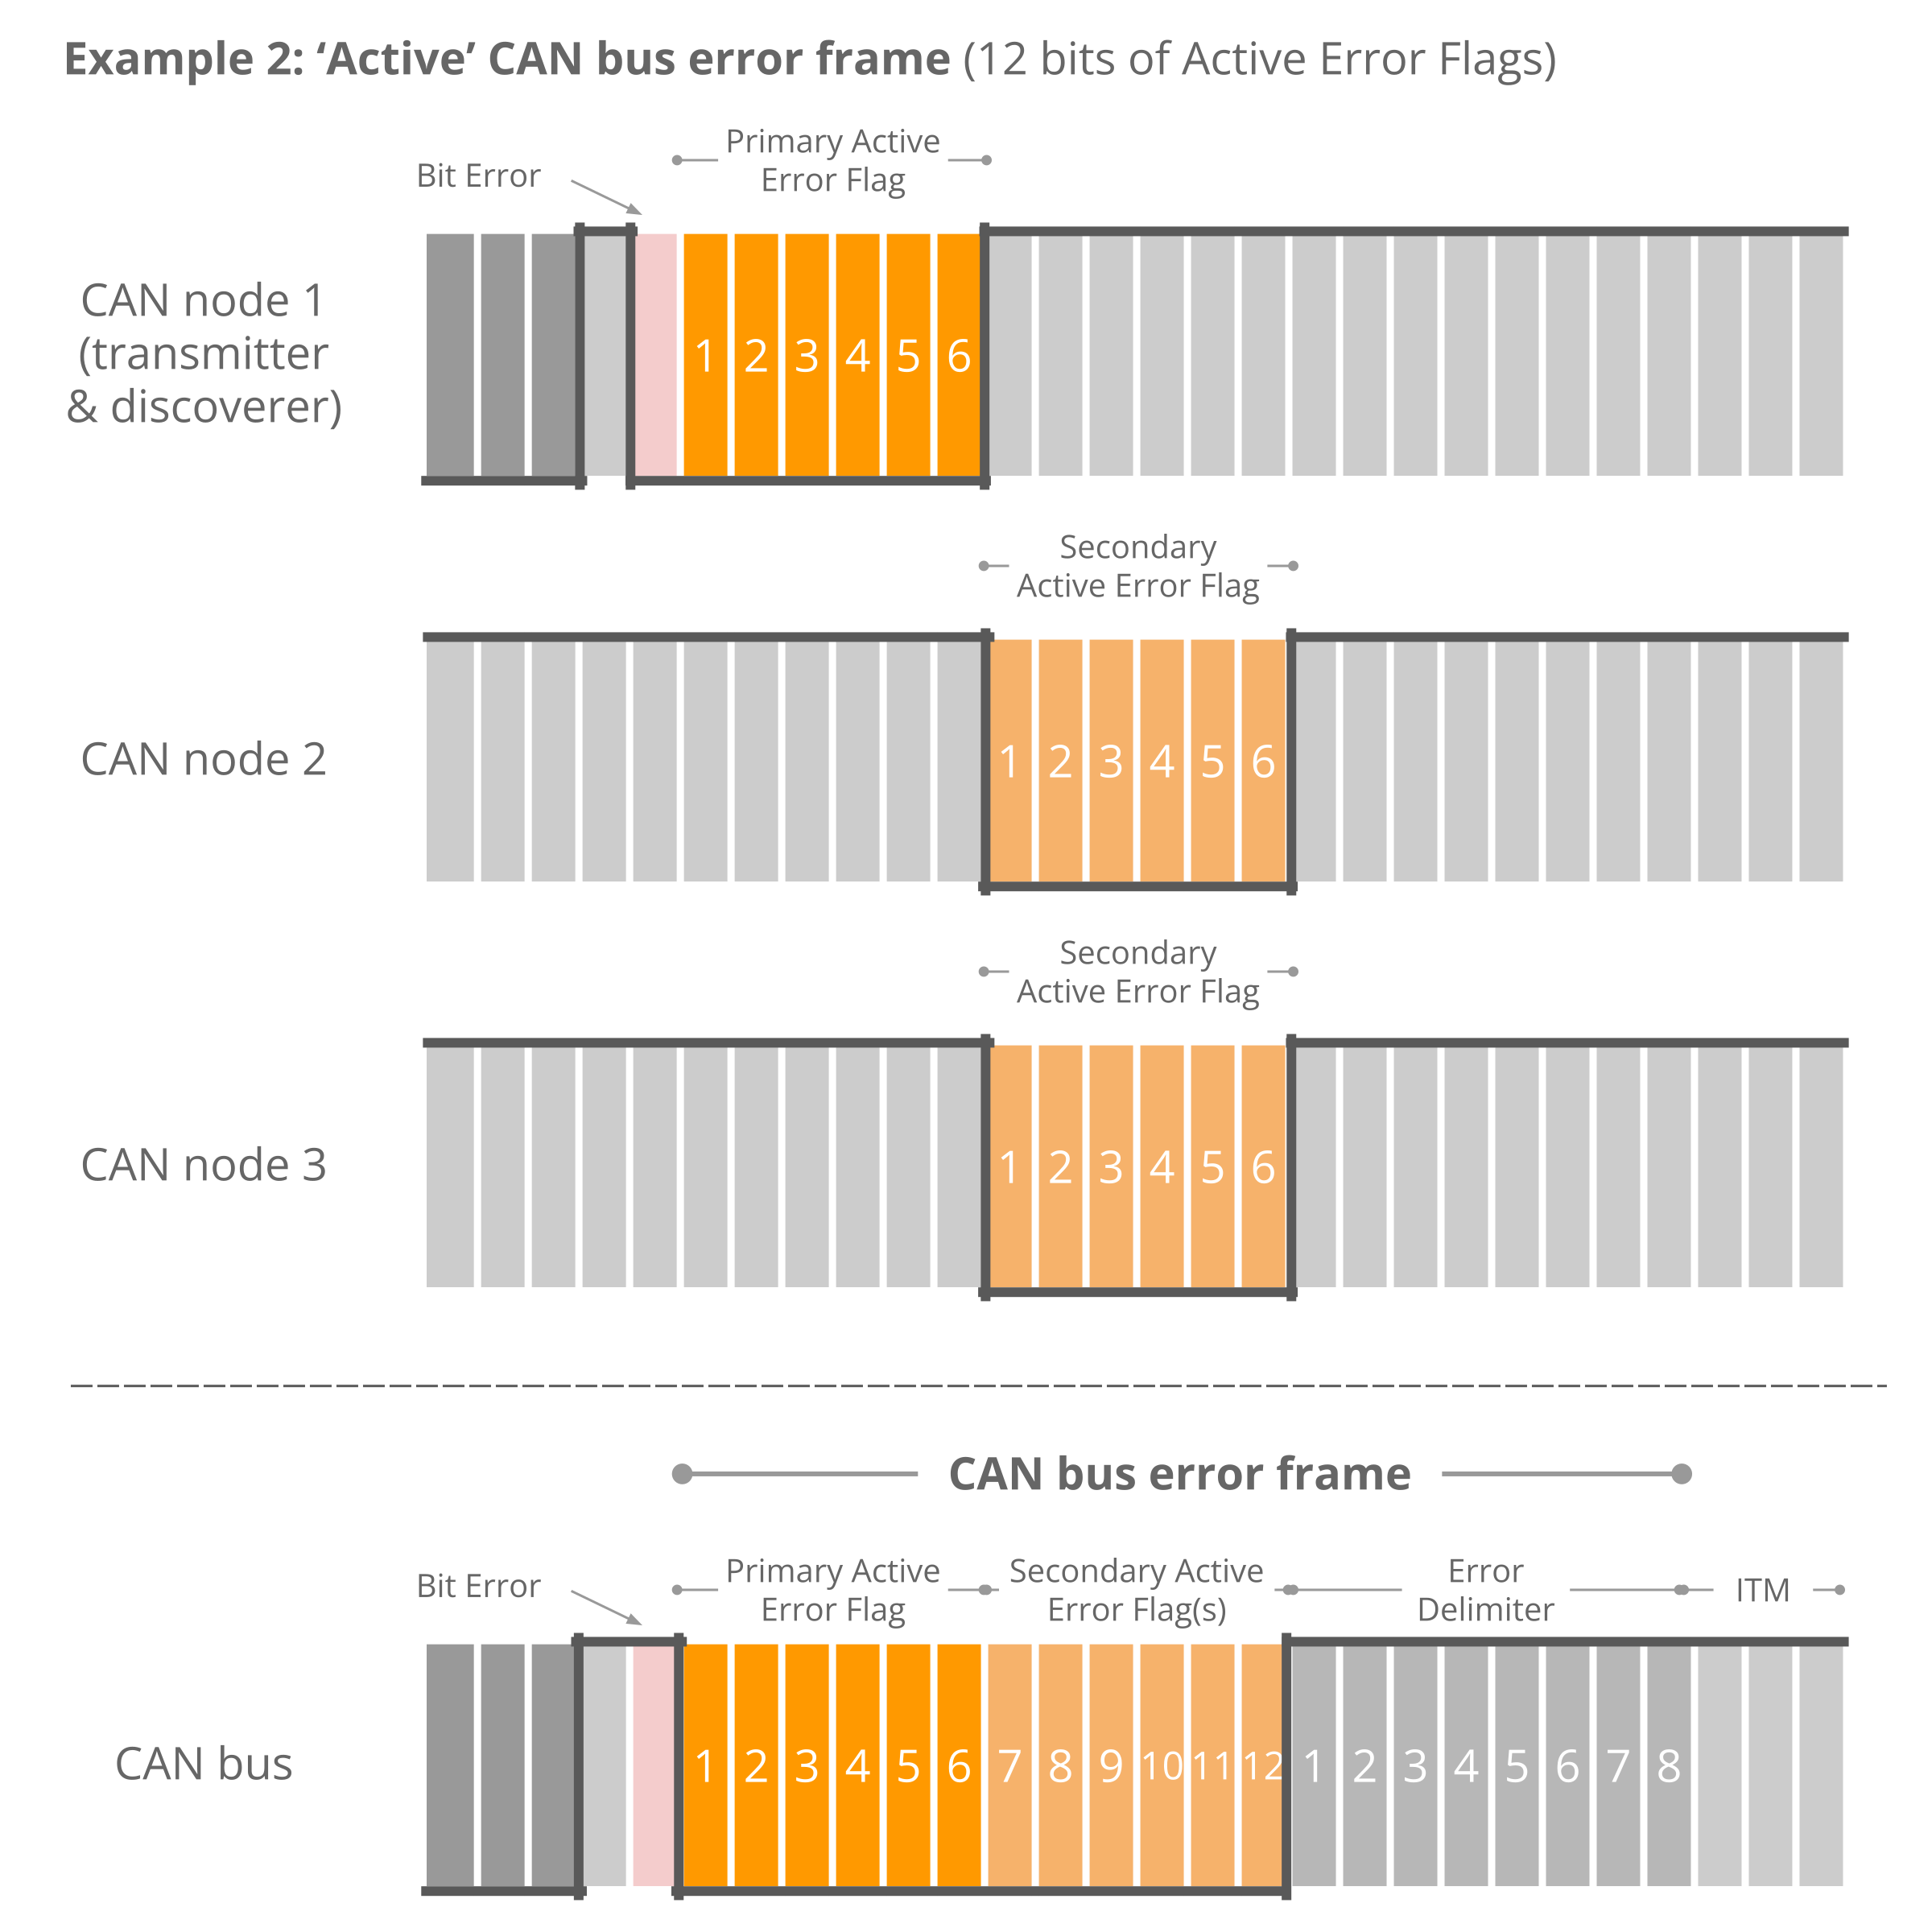
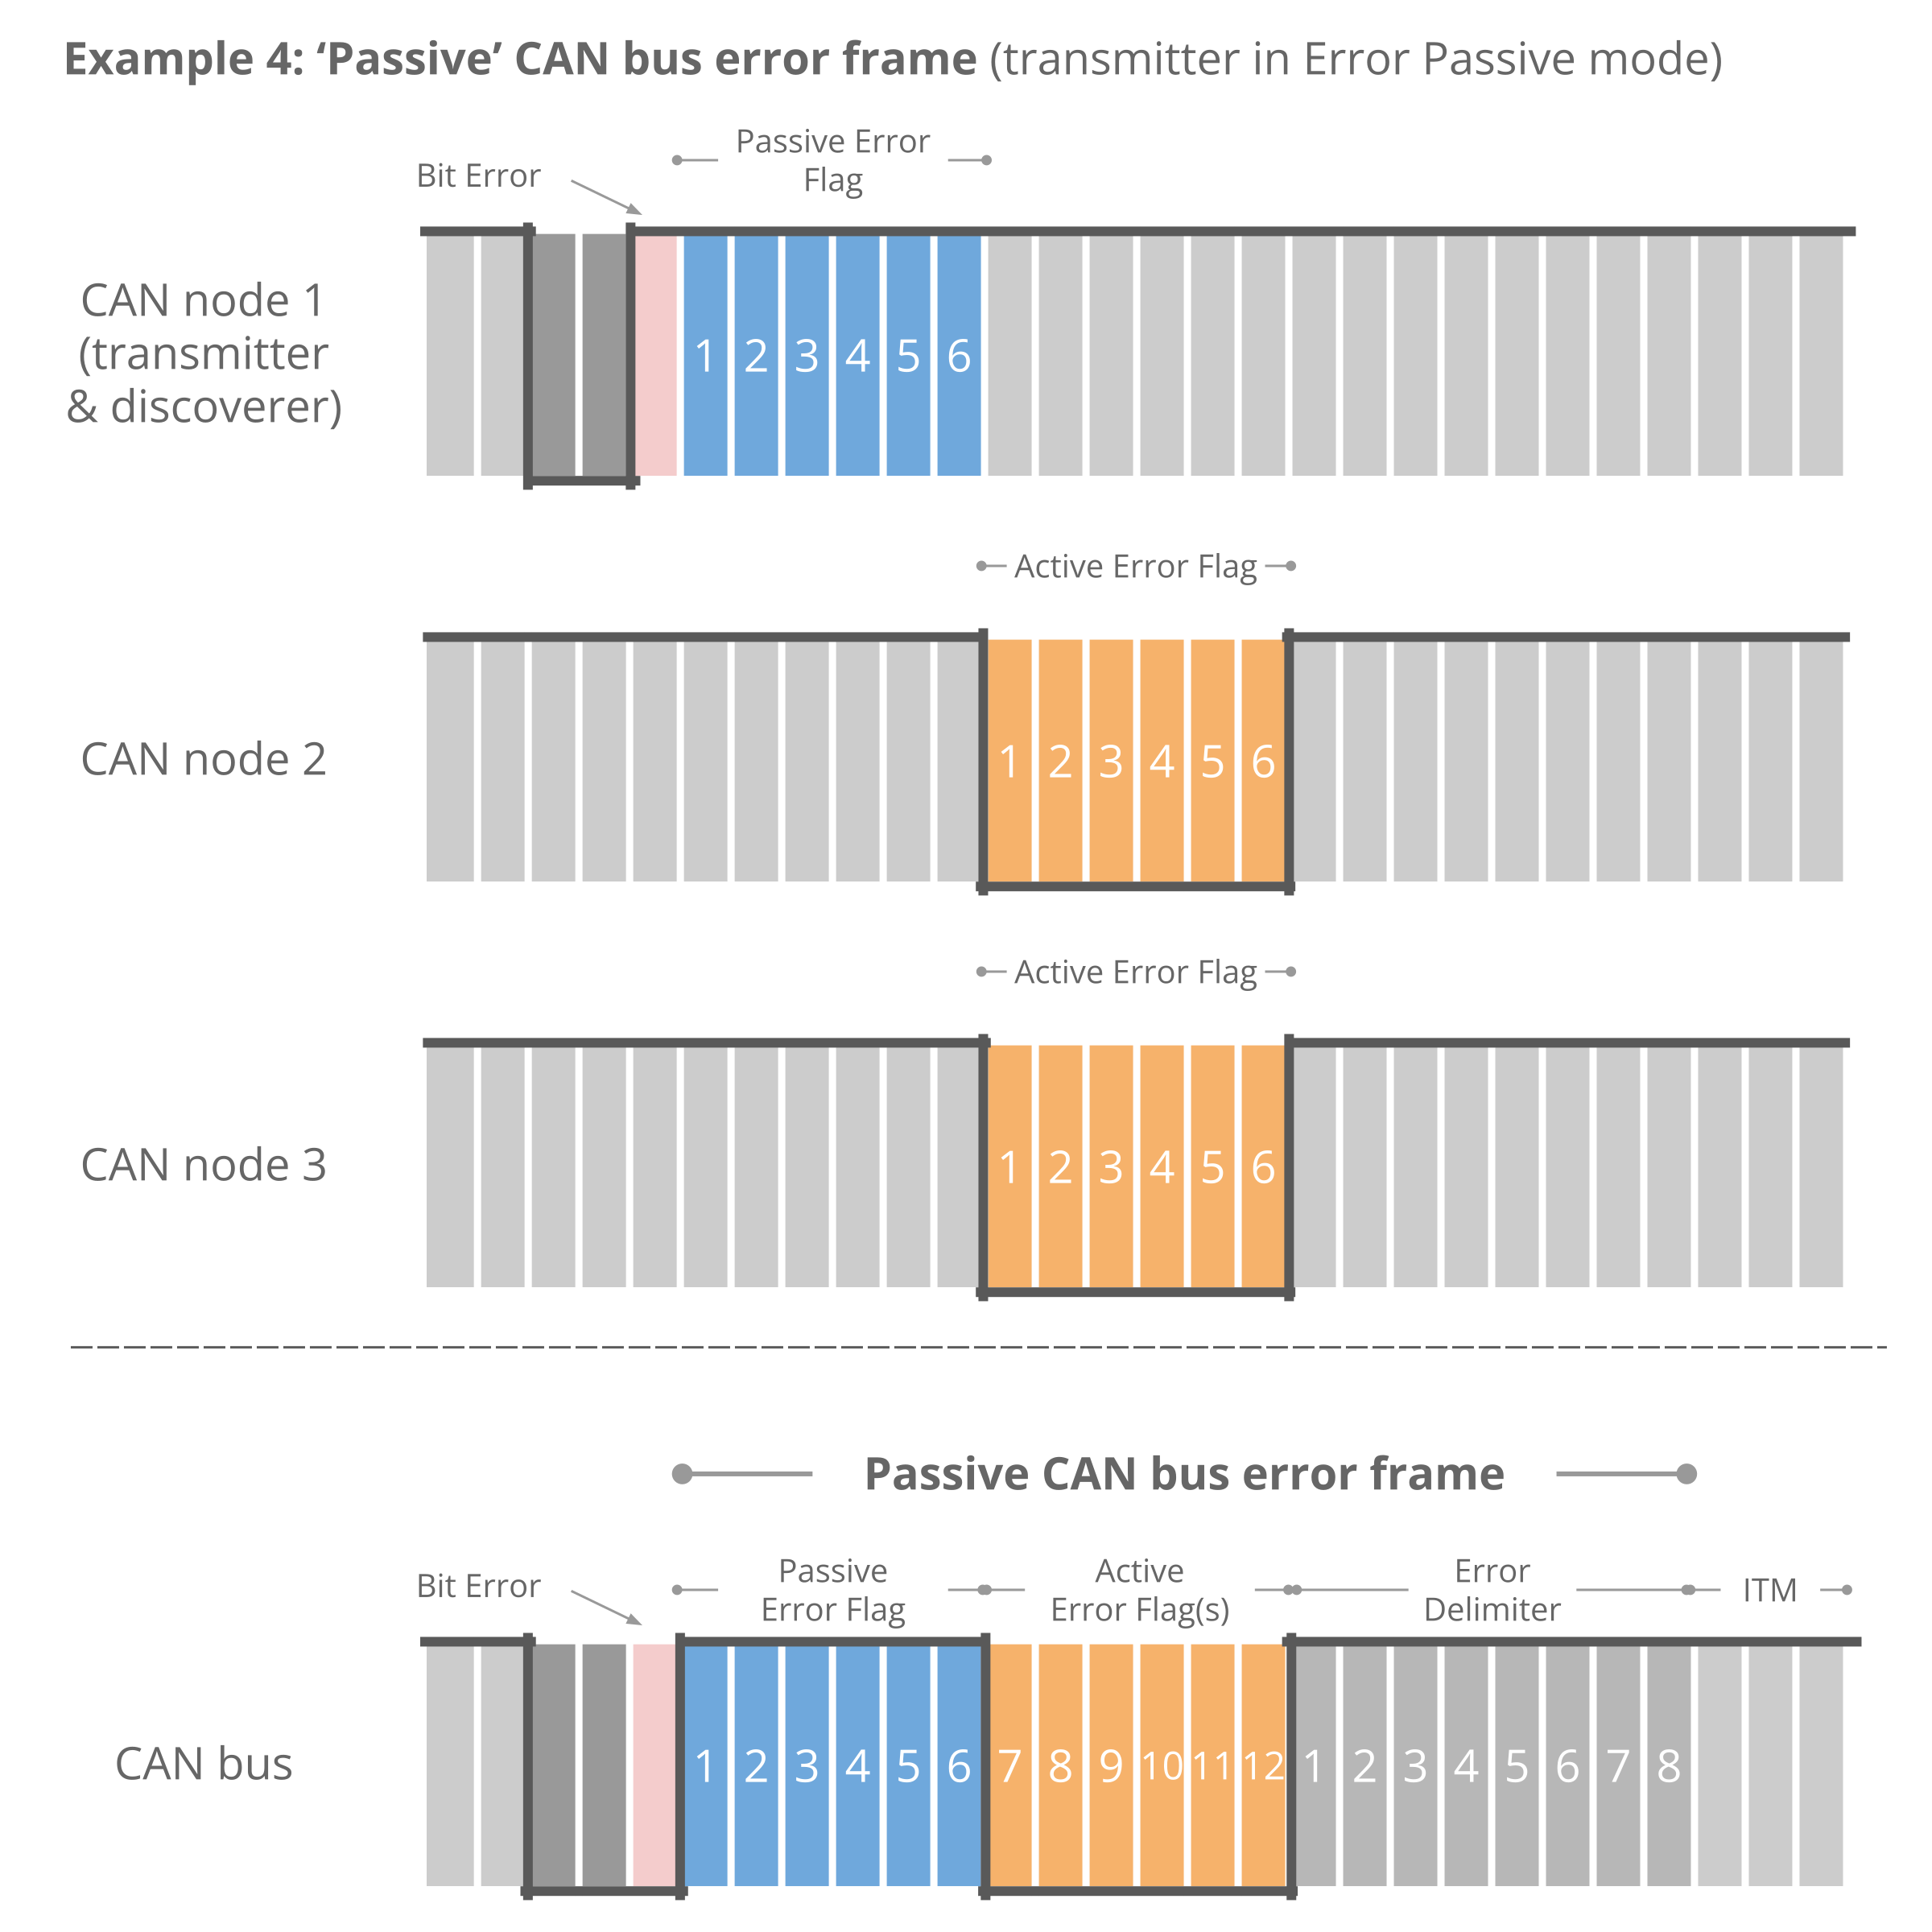
Active vs. Passive Error Frames in CAN Bus

Slide 20
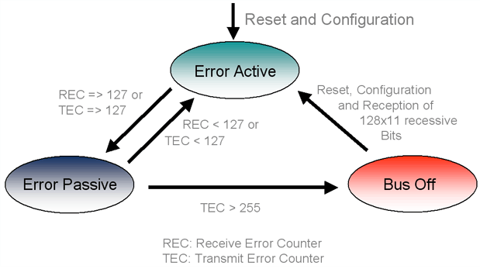
Fault Confinement & Error Management
The Core Objective:
  Isolate Faulty Nodes: Prevent a single malfunctioning node from paralyzing the entire network.
  System Resilience: Balance the need for global error notification with the need for bandwidth availability.
Error Counters: Tracking TEC (Transmit) and REC (Receive) errors.
States: Error Active (Normal), Error Passive (Degraded), and Bus Off (Isolated).
Recovery: TEC > 255 puts a node into Bus Off to protect the network.

Slide 21
CAN Fault Confinement: Error Signaling & Graceful Degradation
Active Node 報錯：發現錯誤後直接壓低總線（顯性），所有節點同步得知錯誤並重傳。
Passive Node 報錯：
  節點因自身故障想報錯，但只能發出隱性位元。
  這些隱性位元會導致總線出現連續 6 個相同電平，違反 Bit Stuffing 規則。
  健康節點 (Active) 偵測到填充錯誤，隨後發出 Active Flag 摧毀該幀。
  結果：如果只有該 Passive 節點出錯，它的隱性報錯會被淹沒，不影響正常通訊，達成「隔離」效果。
結論：優雅降級 (Graceful Degradation)
  Error Active：負責維持全網數據的一致性。
  Error Passive：限制故障節點的破壞力，將頻寬讓給健康節點。
  Bus Off：最終手段，徹底切除嚴重故障的節點，保護系統不崩潰。

Slide 22
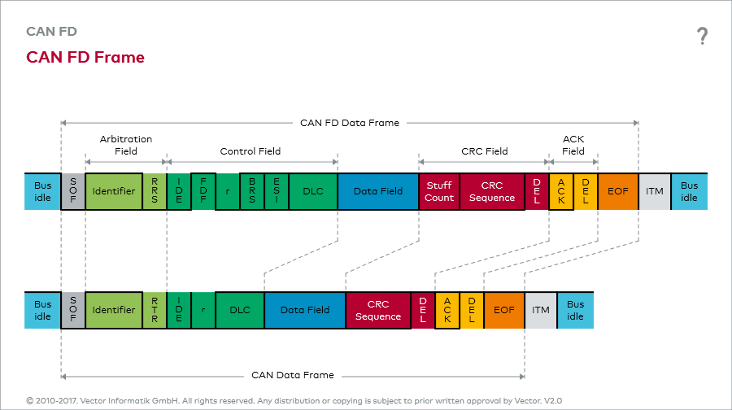
Evolution: CAN FD (Flexible Data-Rate) Features
Speed: Dual bitrate allows the data phase to run much faster than the arbitration phase.
Payload: Expands from 8 bytes to 64 bytes.
Incompatibility: Standard CAN controllers will treat CAN FD frames as errors.
STC (Stuff Count): A Gray-coded counter that ensures the number of stuff bits is correct.
ESI (Error State Indicator): A bit that tells other nodes if the sender is currently Error Active or Passive.
FDF (FD Format):
  1: CAN FD frame
  0: Classical CAN

Slide 23
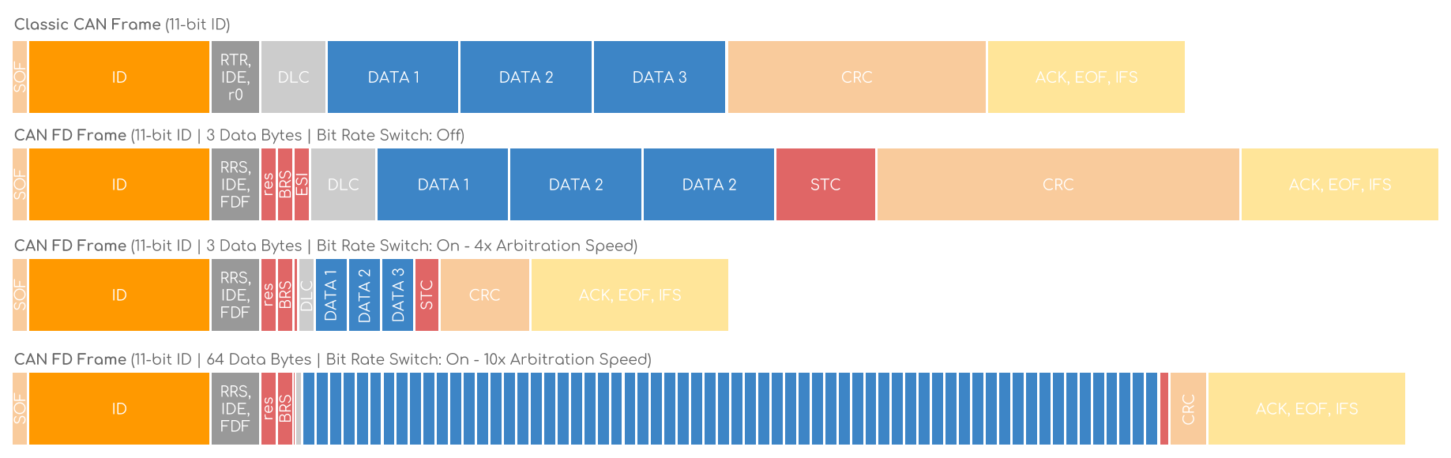
CAN FD Frame Structure with Bit Rate Switching

Slide 24
Frame Comparison: Classic CAN vs. CAN FD
Classic CAN: Fixed speed and 8-byte limit.
CAN FD (No Speed Switch): Adds new control bits (FDF, BRS, ESI) but keeps arbitration speed.: No dedicated clock line (saves weight and cost).
CAN FD (Speed Switch): Increases speed during the Data/CRC phase.
High Capacity: Supports up to 64 bytes with 10x arbitration speed in data phase.
Phase | 速度 | 為什麼
Arbitration Phase | 低速（例：500 kbps） | 為了讓所有 node 都能參與仲裁
Data Phase | 高速（例：5 Mbps） | 只要贏得仲裁即可高速傳資料

Slide 25
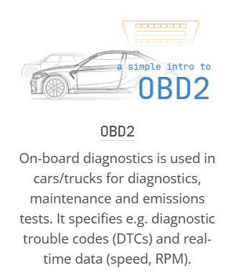
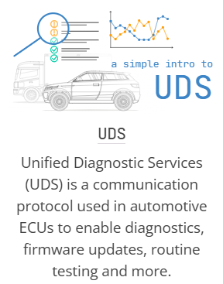

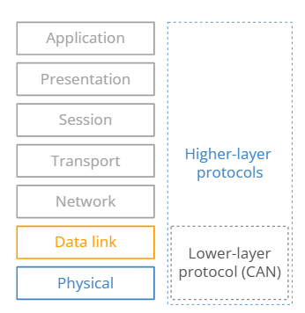
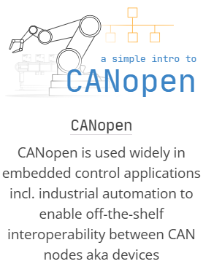
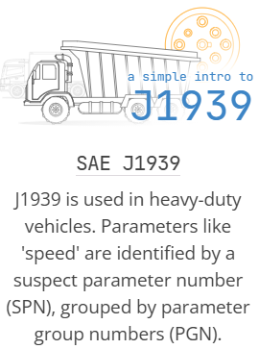
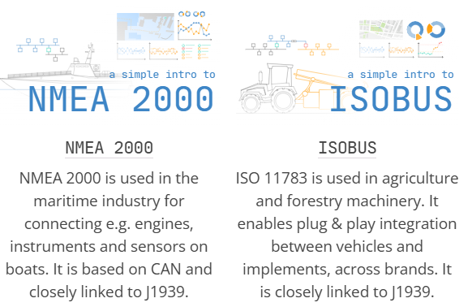
Higher-layer CAN protocols

Slide 26
OBD-II vs. UDS: Diagnostic Protocol Comparison
特性 | OBD2 (On-Board Diagnostics) | UDS (Unified Diagnostic Services)
標準規範 | ISO 15031 / SAE J1979 | ISO 14229
應用範圍 | 僅限排放相關系統 (引擎、變速箱) | 全車所有 ECU (動力、車身、底盤等)
法規強制性 | 強制性 (政府要求) | 非強制性 (車廠自主開發使用)
主要功能 | 讀取故障碼、查看即時數據、清除故障碼 | 診斷、ECU 刷寫(Flash)、參數配置、安全存取
數據識別碼 | PID (Parameter ID, 1 字節) | DID (Data ID, 2 字節)
安全性 | 較低 (任何人用標準工具皆可讀取) | 較高 (具有 Security Access 權限驗證)
物理接口 | 固定使用 16-pin OBD2 接頭 | 通常使用 OBD2 接頭，但不限於此

Slide 27
Reference
https://en.wikipedia.org/wiki/CAN_bus
https://wiki.csie.ncku.edu.tw/embedded/CAN#interframe-spacing%E9%80%9A%E8%A8%8A%E6%A0%BC%E5%BC%8F%E9%96%93%E9%9A%94
https://www.winstar.com.tw/zh-tw/can-bus-interface-communication
https://wellstsai.com/post/can-protocol/
https://www.circuitbread.com/tutorials/understanding-can-a-beginners-guide-to-the-controller-area-network-protocol
https://www.csselectronics.com/pages/can-bus-simple-intro-tutorial
https://www.systemaccess.com.tw/page/about/index.aspx?kind=1164

