Slide 1
Presentation of the Activity: “SISO PID tuning”
Name : Allan Christian Krainski Ferrari

Slide 2
Introduction to the problem
The work chossen is entitled “Grey Wolf Optimization Algorithm based PID controller design for AVR Power system” from 2nd International Conference on Power Energy, Environment and Intelligent Control [1].
It’s relevant because the Grey Wolf Optimization (GWO) is a recent metaheuristic and PID control is the most used in industry;
This paper uses the Grey Wolf Optimization algorithm to tune the gains of PID Control of AVR Power system;

Slide 3
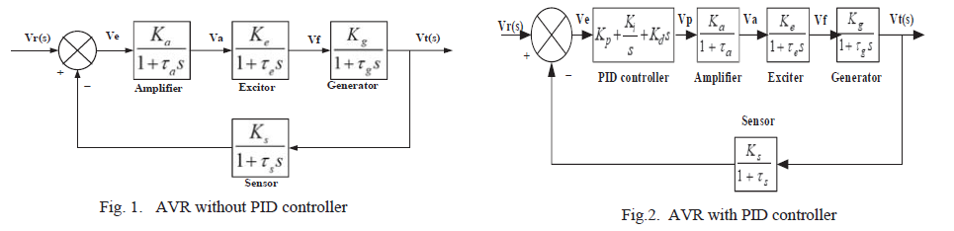
Data technical description
The automatic voltage regulator (AVR) system aim conserve the terminal voltage of the employing synchronous generator despite load variation.

Slide 4
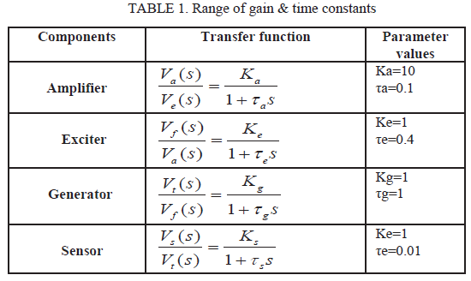
Data technical description

Slide 5
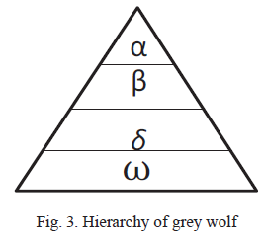
Tools and methods to employ
Grey Wolf Optimization (GWO) was proposed by Mirjalili et. al [2] aiming global optimization. The GWO is inspired in wild life of the grey wolves that live in social hierarchy.

Slide 6
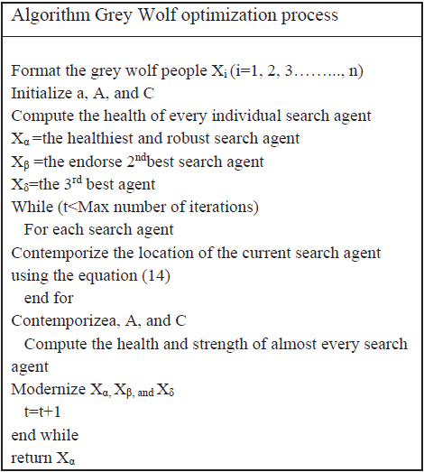
Tools and methods to employ
The alpha wolf leads the hunting process while beta and delta wolves help the alpha. The positions of the omega wolves is adjusted in function of the alpha, beta and delta wolves.

Slide 7
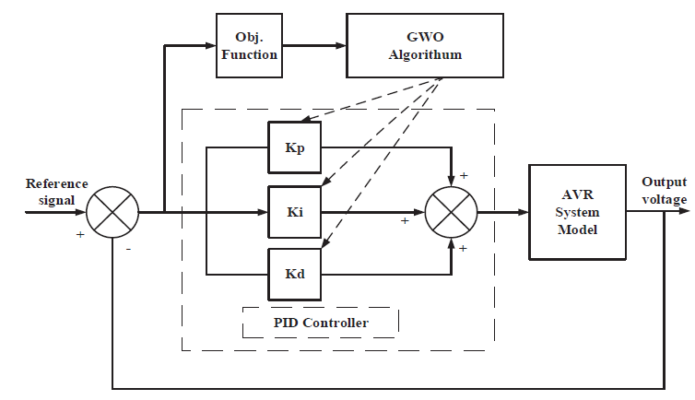

Tools and methods to employ
The feedback control system was used as objective function. This problem is of minimization.

Slide 8
Results and discussion
The GWO was compared with Monarch Butterfly Optimization (MBO) [3] and Water Cycle Algorithm (WCA) [4].
The algorithms were compared in function of the ISE, IAE and ITAE performance values.
The results show that GWO is the best algorithm in tuning process of the gains of the PID control.

Slide 9
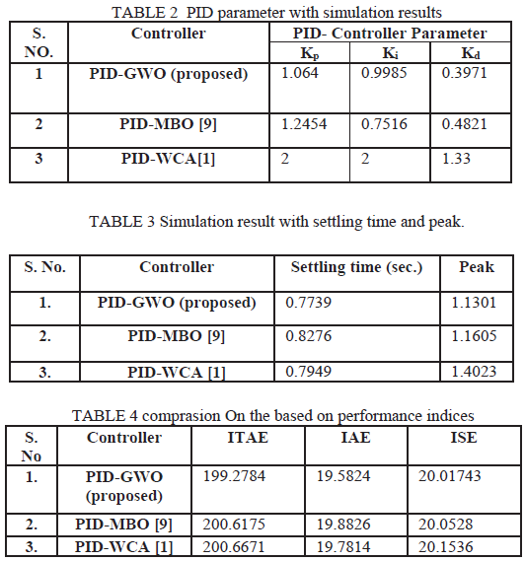
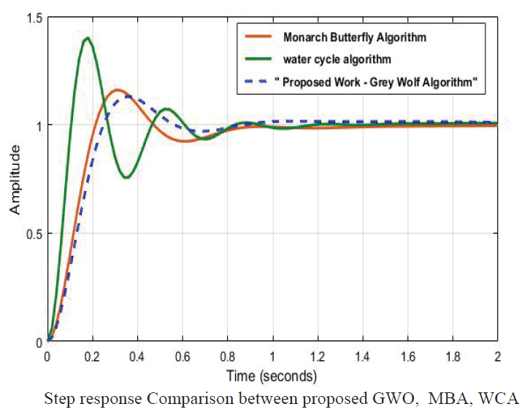
Results and discussion

Slide 10
Personal conclusion
The proposal of the article is clearly, is easy to do its implementation.
The authors could be applied other metaheuristics too. The comparison could be more interesting.
There isn't statistical tests to validate the results obtained.
Many information are hidden.
When I was tried to reproduce the same results, I found some mistakes in article.
If I test new metaheuristics in system control AVR, I could obtain publications in congresses.

Slide 11
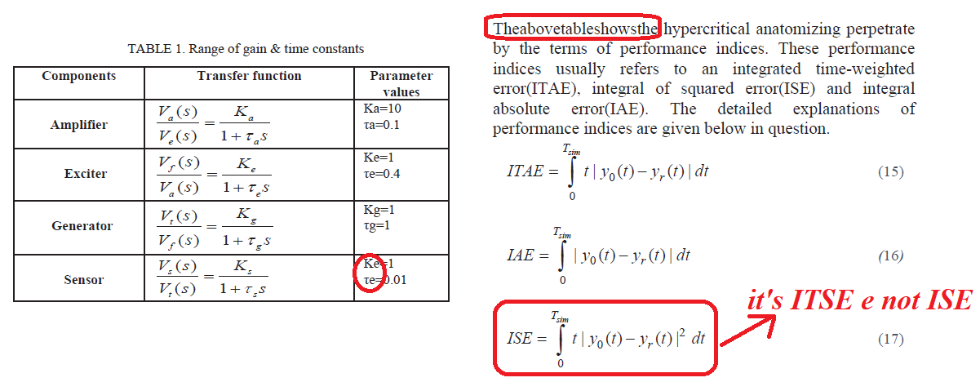
Personal conclusion
Examples of mistakes found in article:

Slide 12
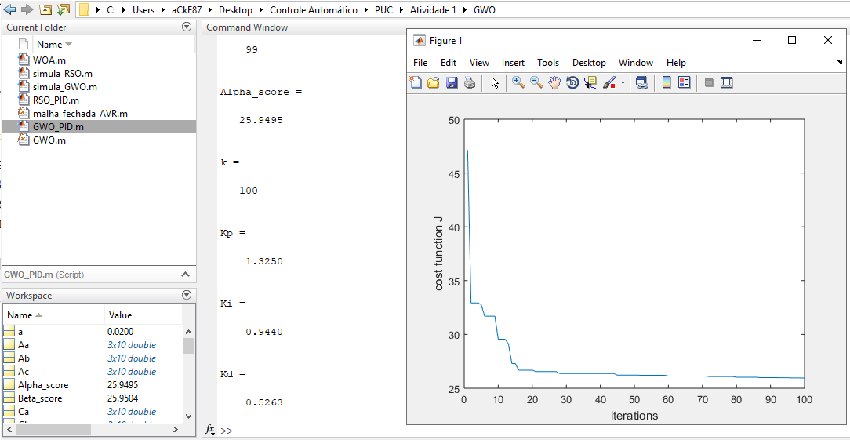
Points to earn:
I did a implementation with GWO (Run: “GWO_PID.m”).

Slide 13
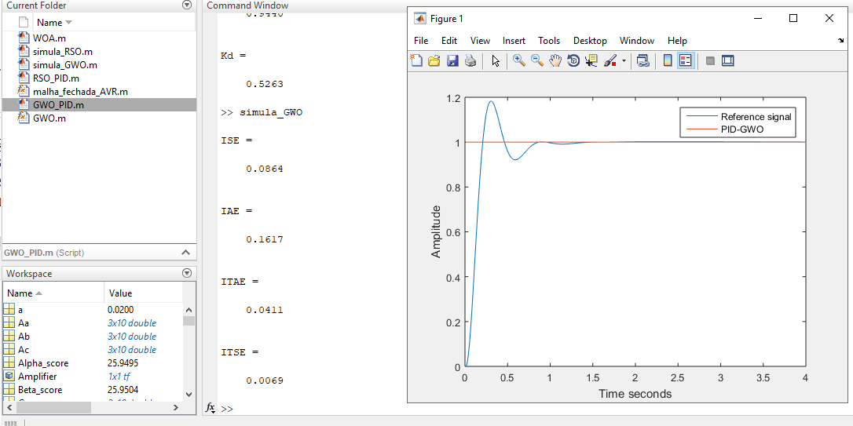
Points to earn:
After, it’s made simulation of system control AVR (Run: “simula_GWO.m”).

Slide 14
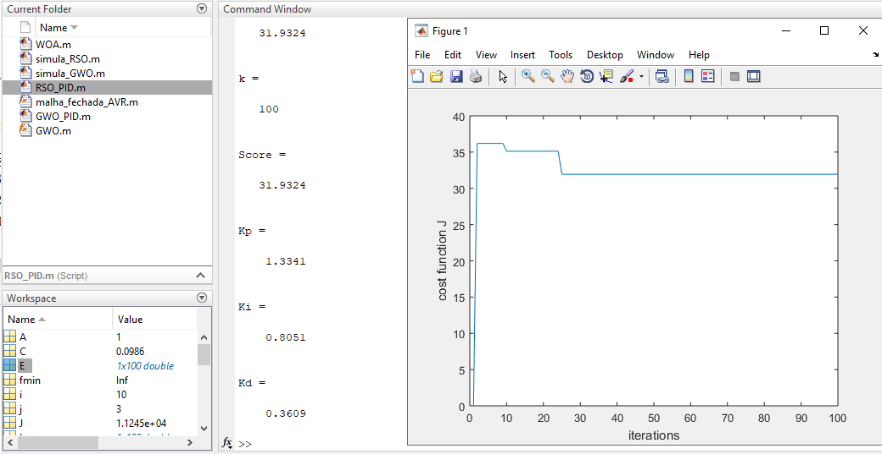
Points to earn:
I did a implementation with new metaheuristic RSO (Rat- Swarm Optimization) proposed by Dhiman et. al [5]:

Slide 15
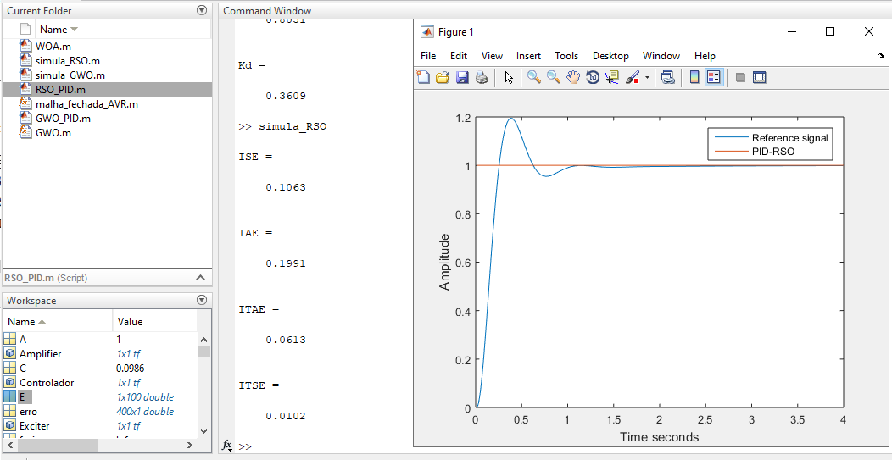
Points to earn:
After, it’s made simulation of system control AVR (Run: “simula_RSO.m”).

Slide 16
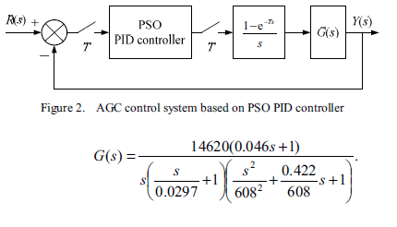
Points to earn:
Other application, it’s made implementation in Cold Strip Mill (CSM) system that is used in work of Chen et. al [6].

Slide 17
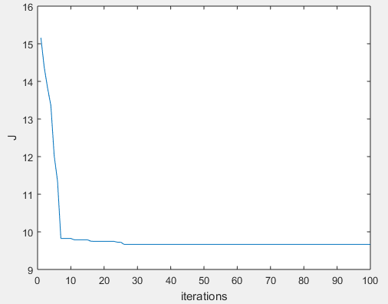
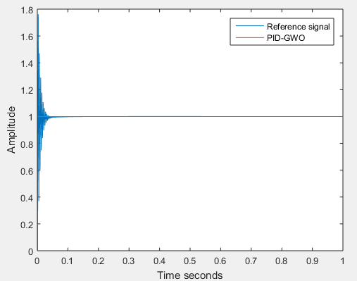
Points to earn:
GWO:

Slide 18
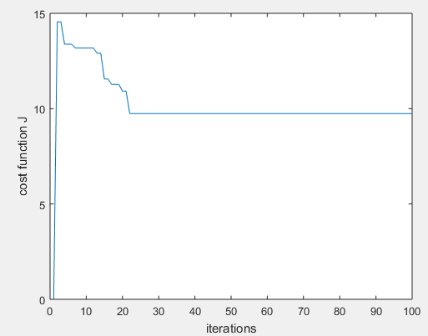
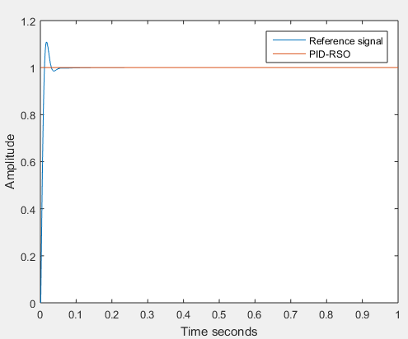
Points to earn:
RSO:

Slide 19
Points to earn:
The codes are available in:
https://github.com/allanckferrari87/Trabalho-1-Intelligent-Control-

Slide 20
References
[1] R. k. Kuri, D. Paliwal and D. K. Sambariya, "Grey Wolf Optimization Algorithm based PID controller design for AVR Power system," 2019 2nd International Conference on Power Energy, Environment and Intelligent Control (PEEIC), 2019, pp. 233-237.
[2] Mirjalili, S., Mirjalili, S.M., and Lewis, A. (2014). Grey wolf optimizer. Advances in Engineering Software, 69, 44-61.
[3] Wang, GG., Deb, S. & Cui, Z. Monarch butterfly optimization. Neural Comput & Applic 31, 1995–2014 (2019).
[4] H. Eskandar, A. Sadollah, A. Bahreininejad, M. Hamdi, Water cycle algorithm – A novel metaheuristic optimization method for solving constrained engineering optimization problems, Computers & Structures, 111, 2012, pp. 151-166.
[5] Dhiman, G., Garg, M., A., Kumar, V., and Dehghani, M. (2020). A novel algorithm for global optimization: Rat swarm optimizer. Journal of Ambient Intelligence and Humanized Computing, 1-26.
[6] D. Chen, G. Zhang and C. Yao, "PSO algorithm based PID parameters optimization of hydraulic screwdown system of cold strip mill," Proceedings of 2011 International Conference on Fluid Power and Mechatronics, 2011, pp. 113-116.

