Slide 1
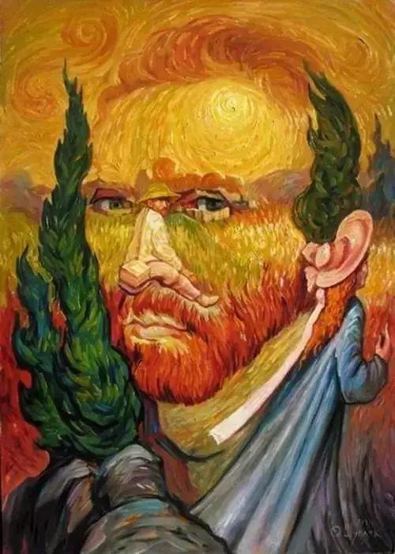
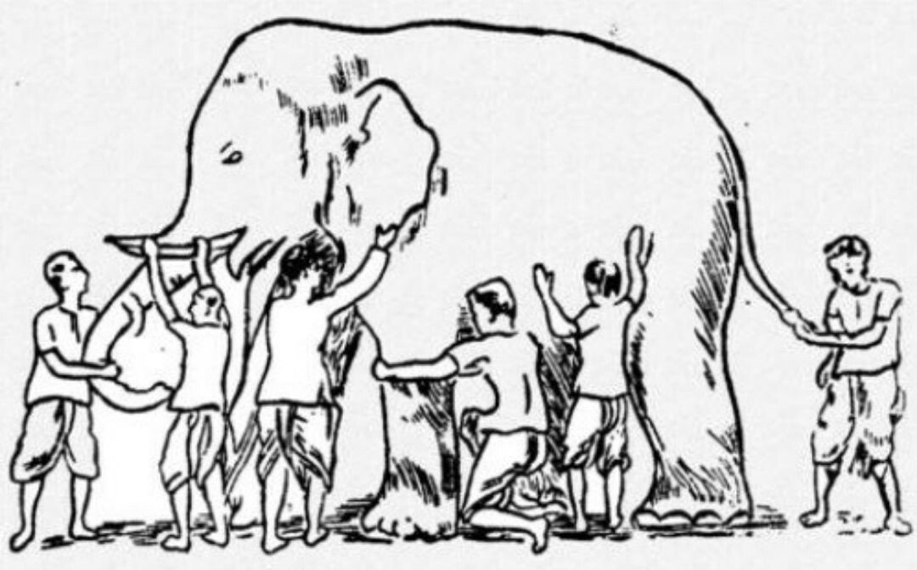
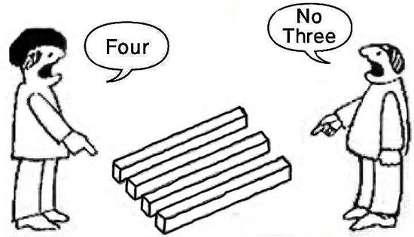
IJCAI 2020
^{Tutorial}
Robust Multi-view Visual Learning
A Knowledge Flow Perspective
Yokohama, Japan

Slide 2




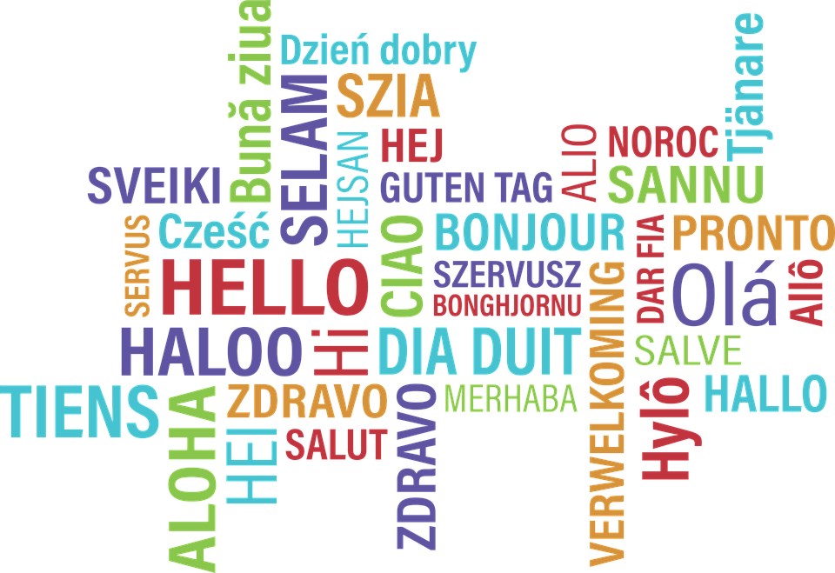



IJCAI 2020
^{Tutorial}
Robust Multi-view Visual Learning
A Knowledge Flow Perspective
Yokohama, Japan

