Slide 1

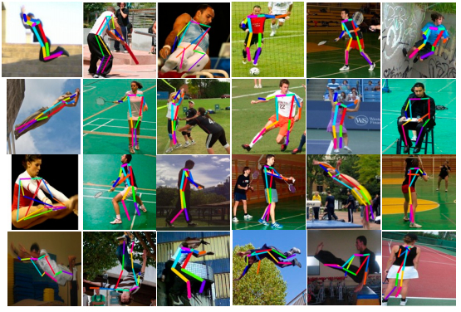

AMFG
²⁰¹⁷
IEEE Workshop on Analysis and Modeling of Faces and Gestures
In conjunction with ICCV 2017, Venice, Italy

Slide 2
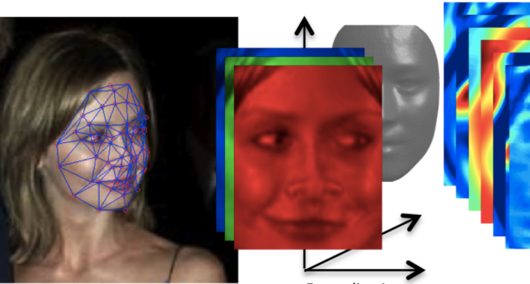
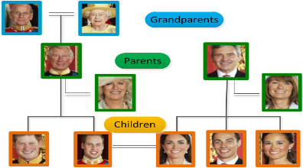
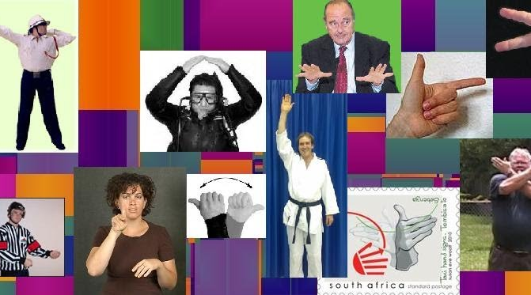
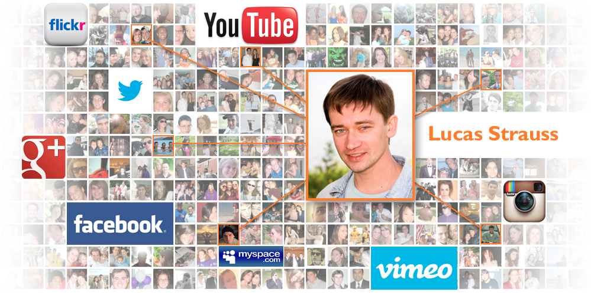
AMFG
²⁰¹⁷
IEEE Workshop on Analysis and Modeling of Faces and Gestures
In conjunction with CVPR 2015, June 12, Boston, USA

