Slide 1
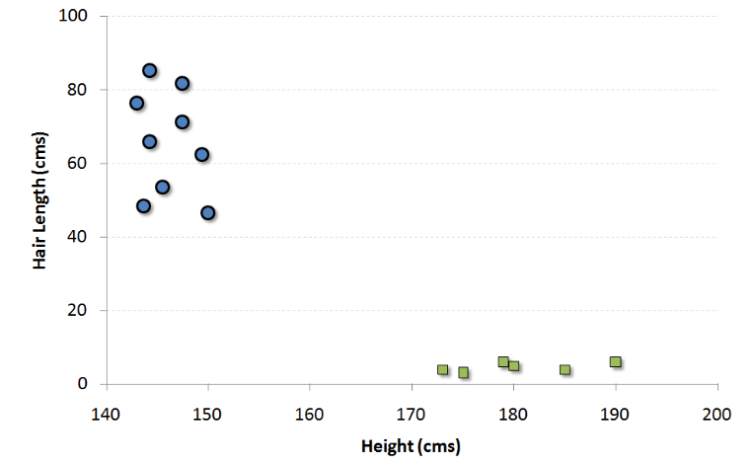
Support vector machine – Source --https://www.analyticsvidhya.com/blog/2014/10/support-vector-machine-simplified/
What is classification analysis -- We have a population composed of 50%-50% Males and Females. Using a sample of this population, you want to create some set of rules which will guide us the gender class for rest of the population. So here height and weight are called features and male/female are classes . So blue circles has long hairs so they are females and square ones are males
So what is support vector Is coordination of individual observation. For example, (45,150) is a support vector which corresponds to a female. In this case, the two classes are well separated from each other, hence it is easier to find a SVM. Support Vector Machine is a frontier which best segregates the Male from the Females

Slide 2
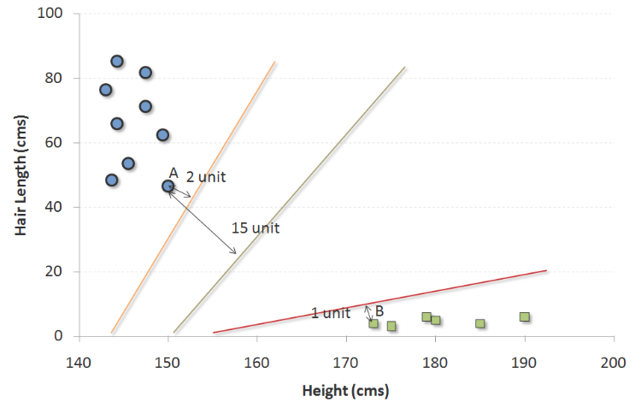
Support vector machine
So there are many possible frontier which can classify the problem in hand. Following are the three possible frontiers so which is best to frontier for this problem statement ? Out of the three shown frontiers (hyper-plane or SVM ) , we see the black frontier is farthest from nearest support vector (i.e. 15 units). We have to choose frontier with the maximum distance from the closest support vector. “Select the hyper-plane which segregates the two classes better”.

Slide 3
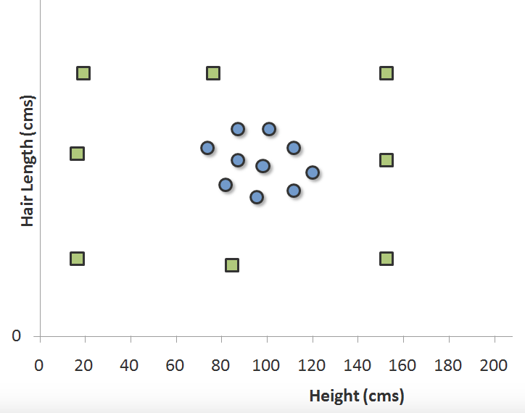
Support vector machine
What if the distribution looked something like as follows :
In such cases, we do not see a straight line frontier directly in current plane which can serve as the SVM. In such cases, we need to map these vector to a higher dimension plane so that they get segregated from each other. such transformation will result into following type of SVM.

Slide 4
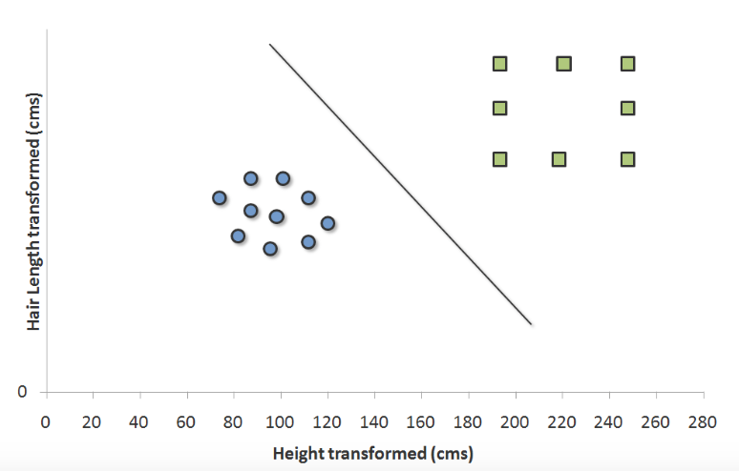
Support vector machine
Each of the green square in original distribution is mapped on a transformed scale. And transformed scale has clearly segregated classes.

Slide 5
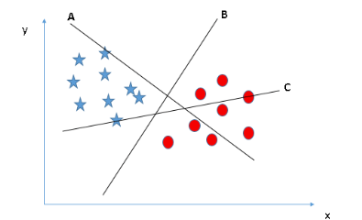
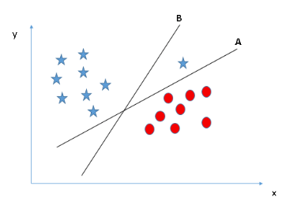
Support vector machine
Here hyper-plane “B” is best hyper-plane. Distance between B and star or dot is called margin. Higher margin from all the classes is better accuracy in calculation
Some of you may have selected the hyper-plane B as it has higher margin compared to A. But, here is the catch, SVM selects the hyper-plane which classifies the classes accurately prior to maximizing margin. Here, hyper-plane B has a classification error and A has classified all correctly. Therefore, the right hyper-plane is A.

Slide 6
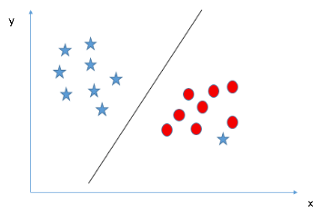
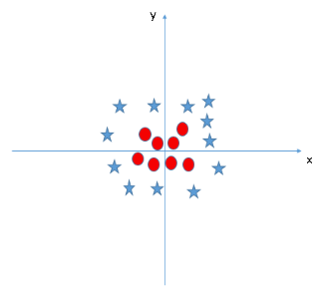
Support vector machine
one star at other end is like an outlier for star class. SVM has a feature to ignore outliers and find the hyper-plane that has maximum margin. Hence, we can say, SVM is robust to outliers.
In the scenario below, we can’t have linear hyper-plane between the two classes, so how does SVM classify these two classes? Till now, we have only looked at the linear hyper-plane. It solves this problem by introducing additional feature. Here, we will add a new feature z=x^2+y^2. Now, let’s plot the data points on axis x and z:

Slide 7
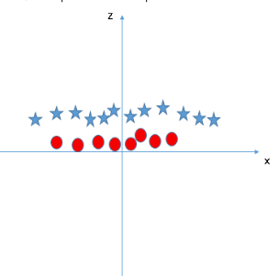
Support vector machine
In the scenario below, we can’t have linear hyper-plane between the two classes, so how does SVM classify these two classes? Till now, we have only looked at the linear hyper-plane. It solves this problem by introducing additional feature. Here, we will add a new feature z=x^2+y^2. Now, let’s plot the data points on axis x and z.
In above plot, points to consider are:
All values for z would be positive always because z is the squared sum of both x and y
In the original plot, red circles appear close to the origin of x and y axes, leading to lower value of z and star relatively away from the origin result to higher value of z.
In SVM, it is easy to have a linear hyper-plane between these two classes.

Slide 8
Support vector machine
SVM has a technique called the kernel trick These are functions which takes low dimensional input space and transform it to a higher dimensional space i.e. it converts not separable problem to separable problem, these functions are called kernels. It is mostly useful in non-linear separation problem. Simply put, it does some extremely complex data transformations, then find out the process to separate the data based on the labels or outputs you’ve defined.

