Slide 1
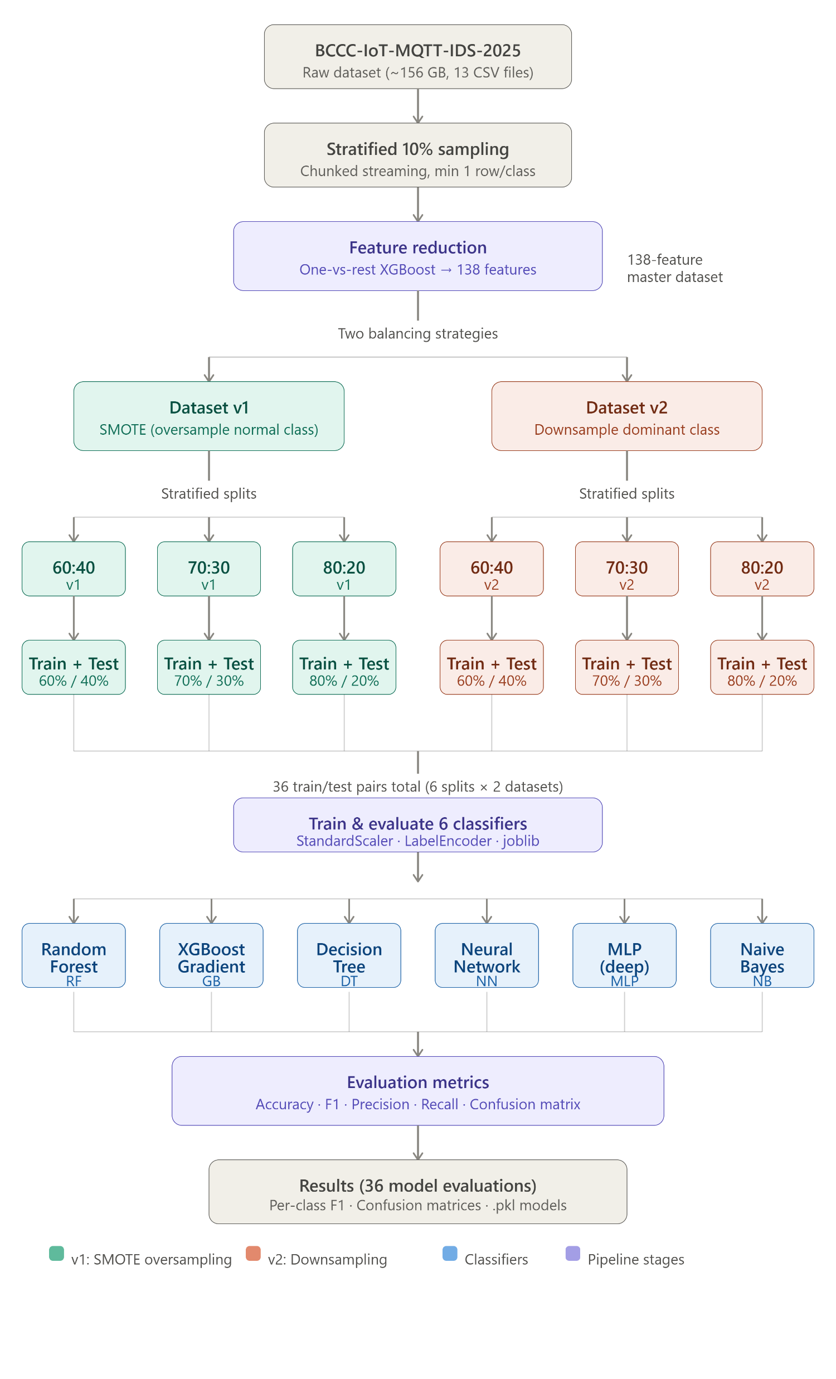

Slide 2
Which is the Best
Dataset v2(Downsampled Dominant Class)
Fixed the Security Gaps: * SYN TCP Flooding F1 Score jumps from 0.32 → 0.62
Basic Connect Flooding F1 Score improves to 0.68–0.69
Why It Works: Downsampling rebalances the class boundaries naturally without introducing deceptive synthetic noise.

Slide 3
Why the Other set Failed
Deceptive Performance: Boosts a high overall accuracy (~92%), but fails at its core job: catching attacks.
Critical Blind Spots: * SYN TCP Flooding: F1 Score= 0.32(Over 50% of these attacks slip through undetected as "normal").
Basic Connect Flooding: Struggles significantly (F1 Score= 0.59).
The Root Cause: SMOTE aggressively amplified the "normal" class boundary, forcing the model to classify ambiguous traffic as safe.

Slide 4
What changed:
Effect | v1 | v2
Model focus | Learns dominant classes well | Forced to learn all classes
syn tcp flooding recall | 13–25% | 70–74%
basic connect flooding recall | 48–52% | 63–72%
Overall accuracy | 0.92 | 0.88
Real-world usefulness | ❌ Dangerous | ✅ Much safer

Slide 5
Summary
 | Dataset v1 | Dataset v2
High accuracy because... | Dominated by 2 easy majority classes | Genuinely learns all 8 classes
High F1 because... | Weighted average hides minority class failures | More honest — minority classes have more weight
Real-world danger | Misses 87% of SYN TCP floods | Misses only ~29% of SYN TCP floods
Verdict | Looks great, dangerously blind | Looks worse, actually works

Slide 8
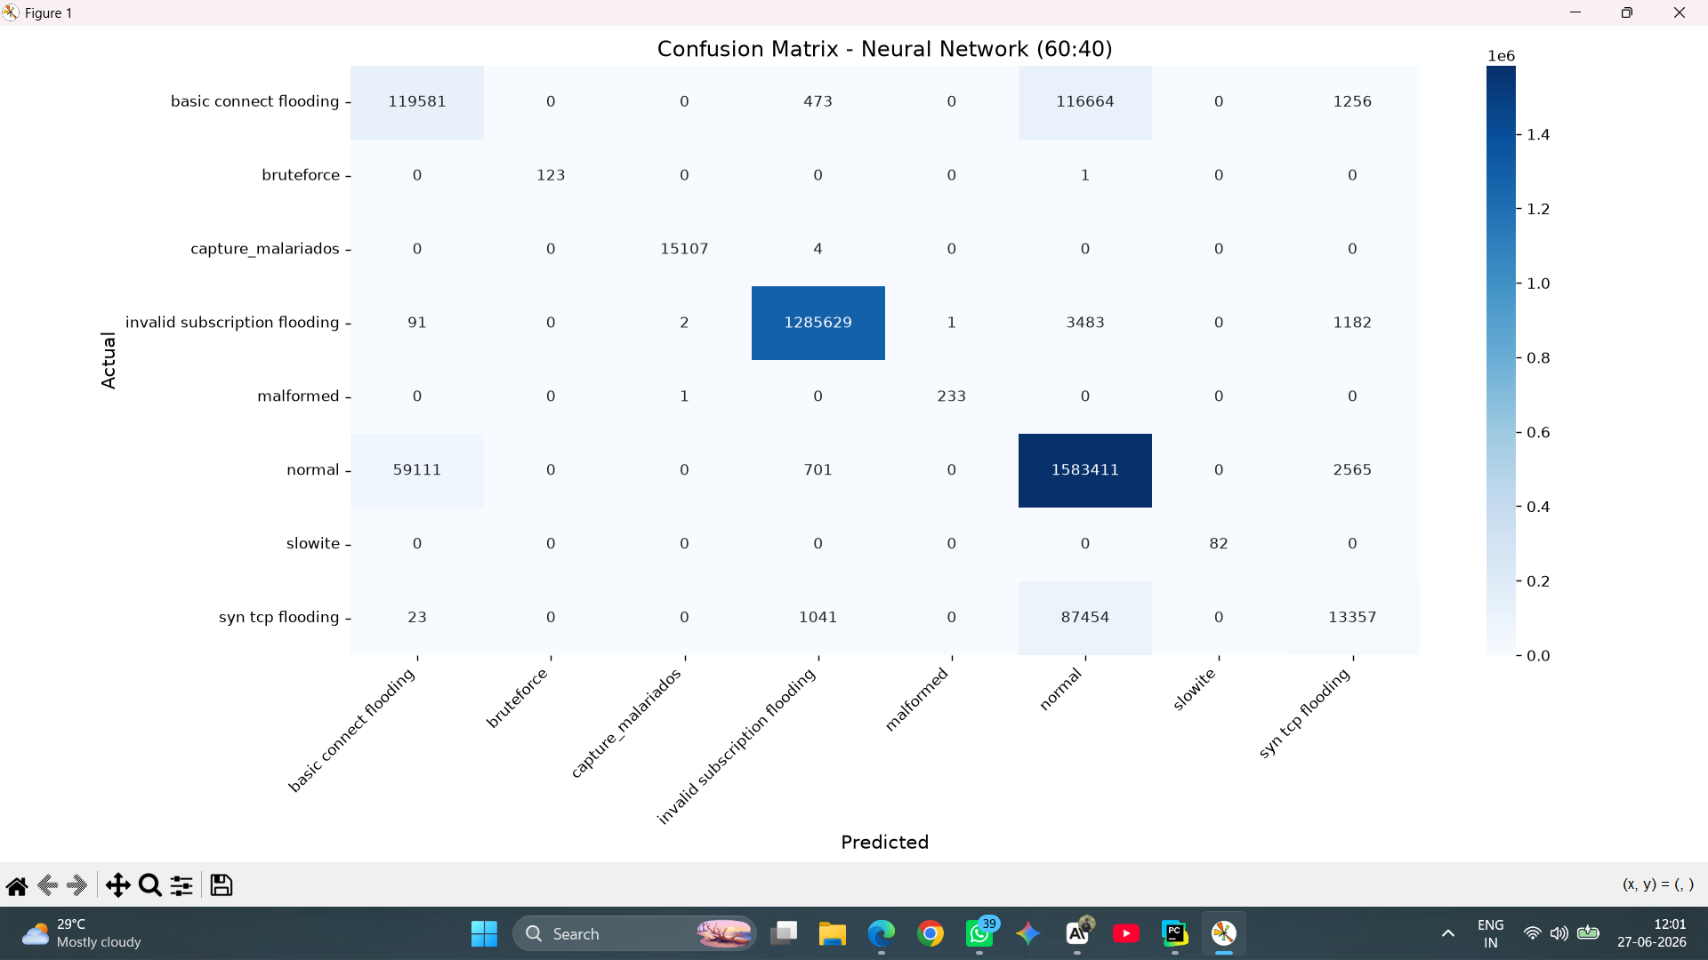

Slide 9
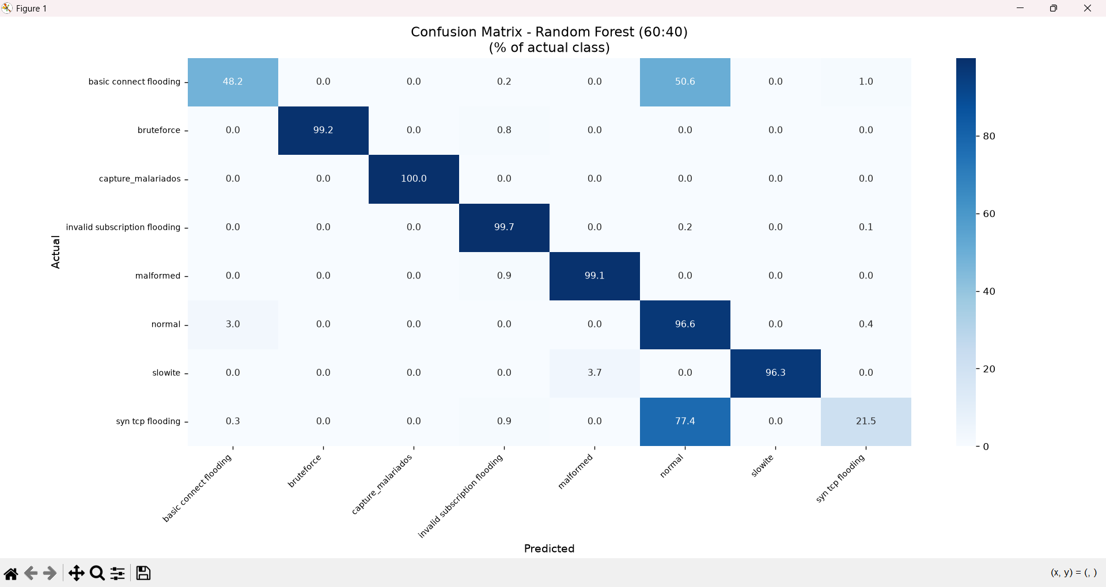

Slide 10
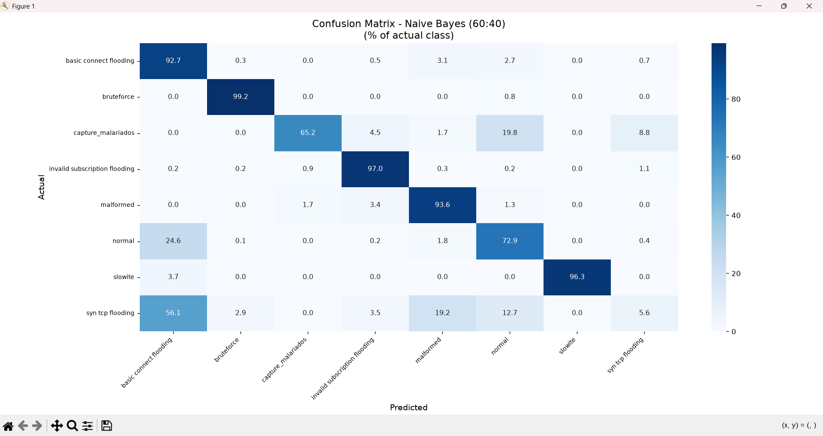

Slide 11
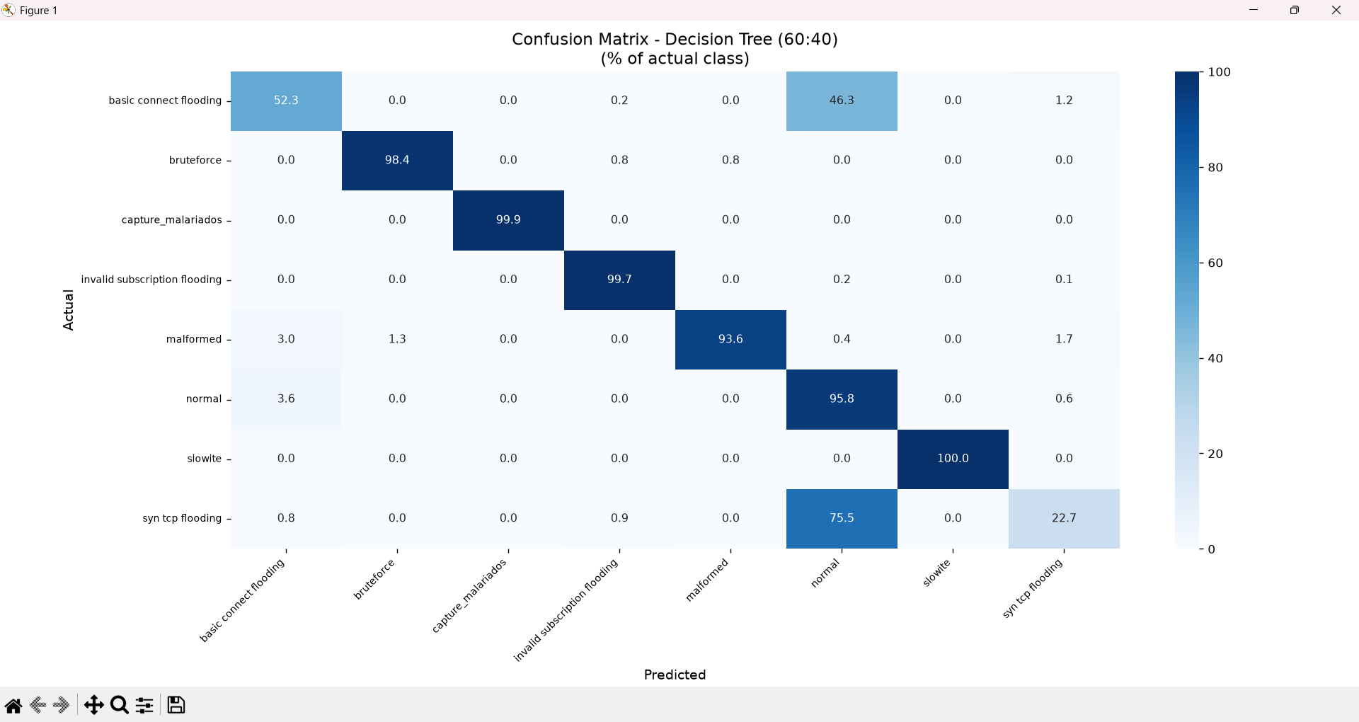

Slide 12


Slide 13
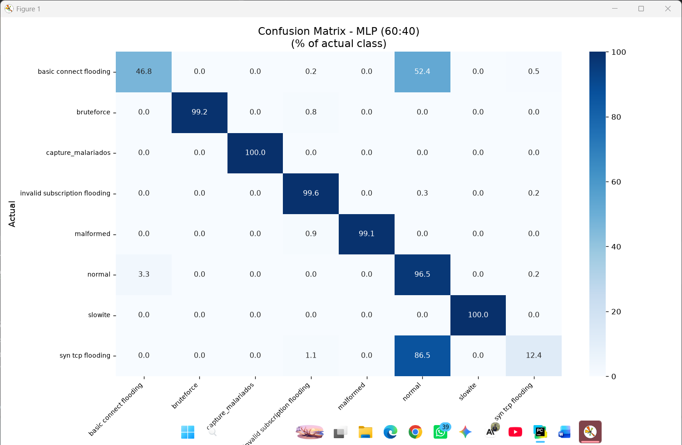

Slide 14


Slide 15


Slide 17
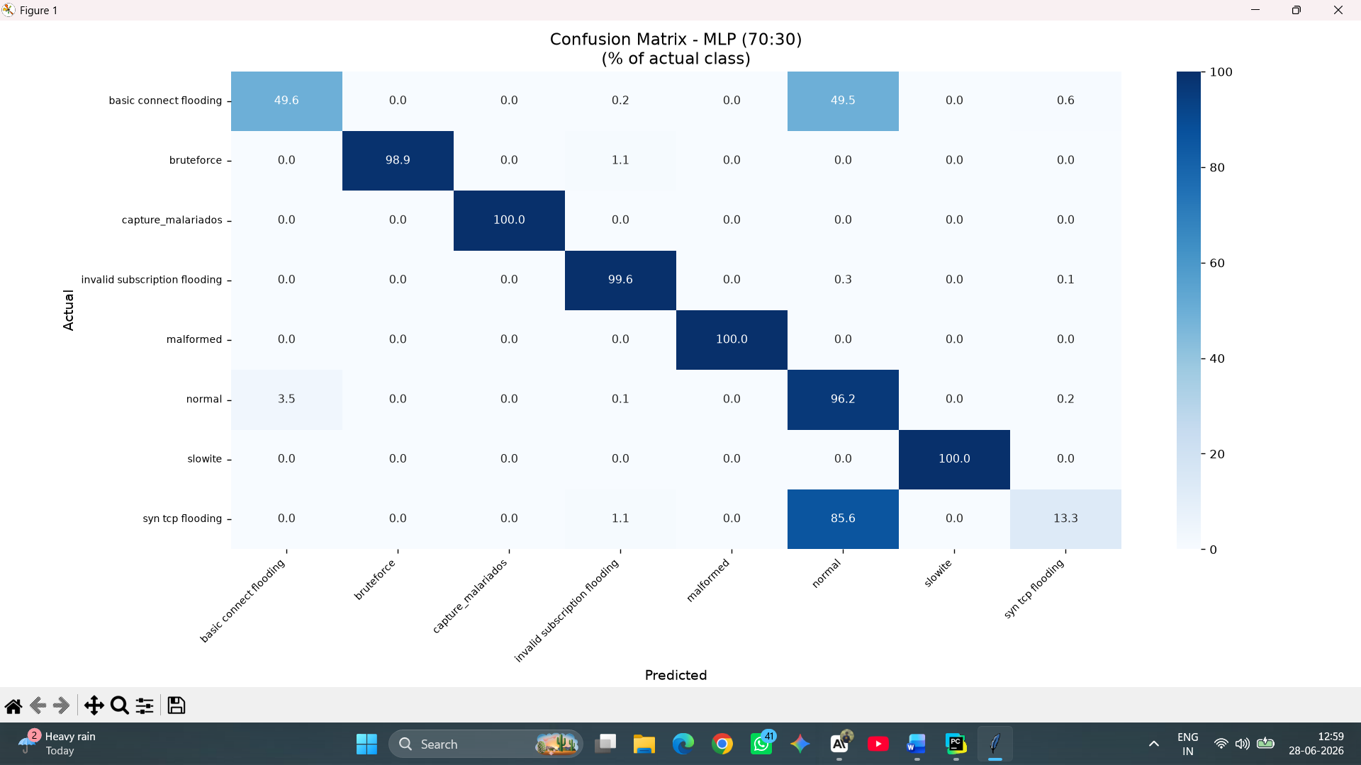

Slide 18
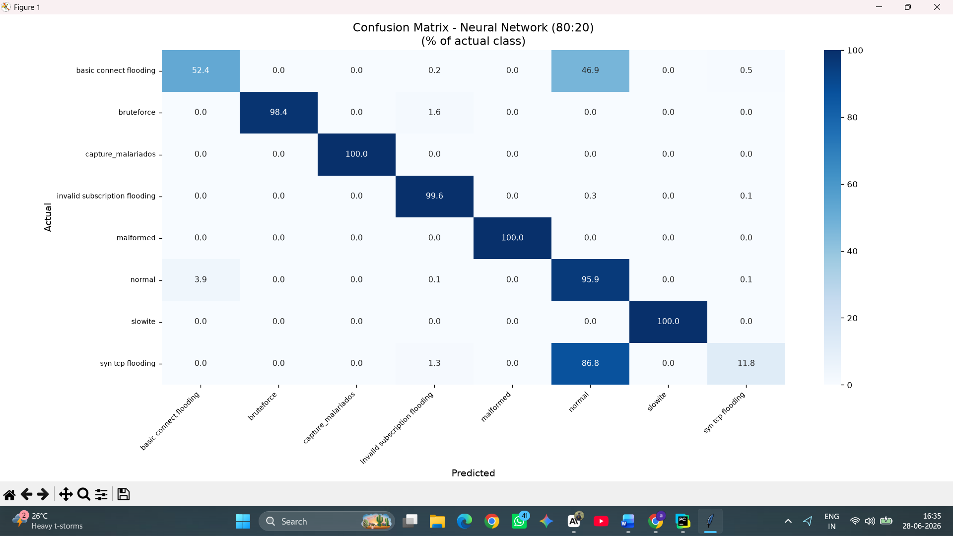

Slide 19


Slide 20
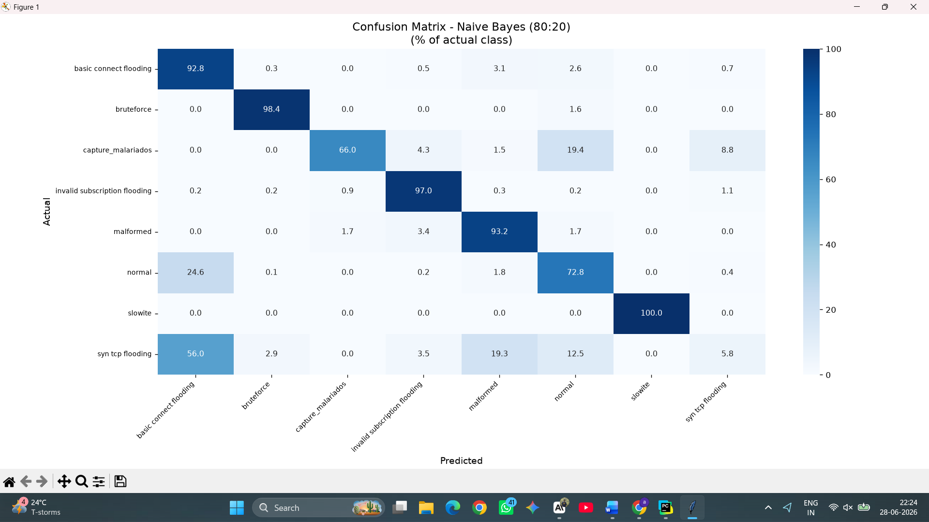

Slide 22
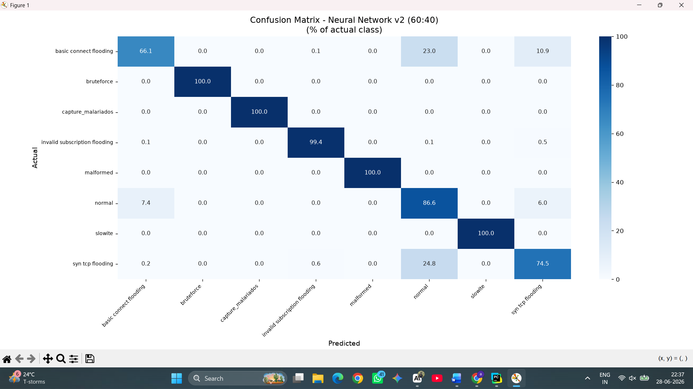

Slide 23


Slide 24
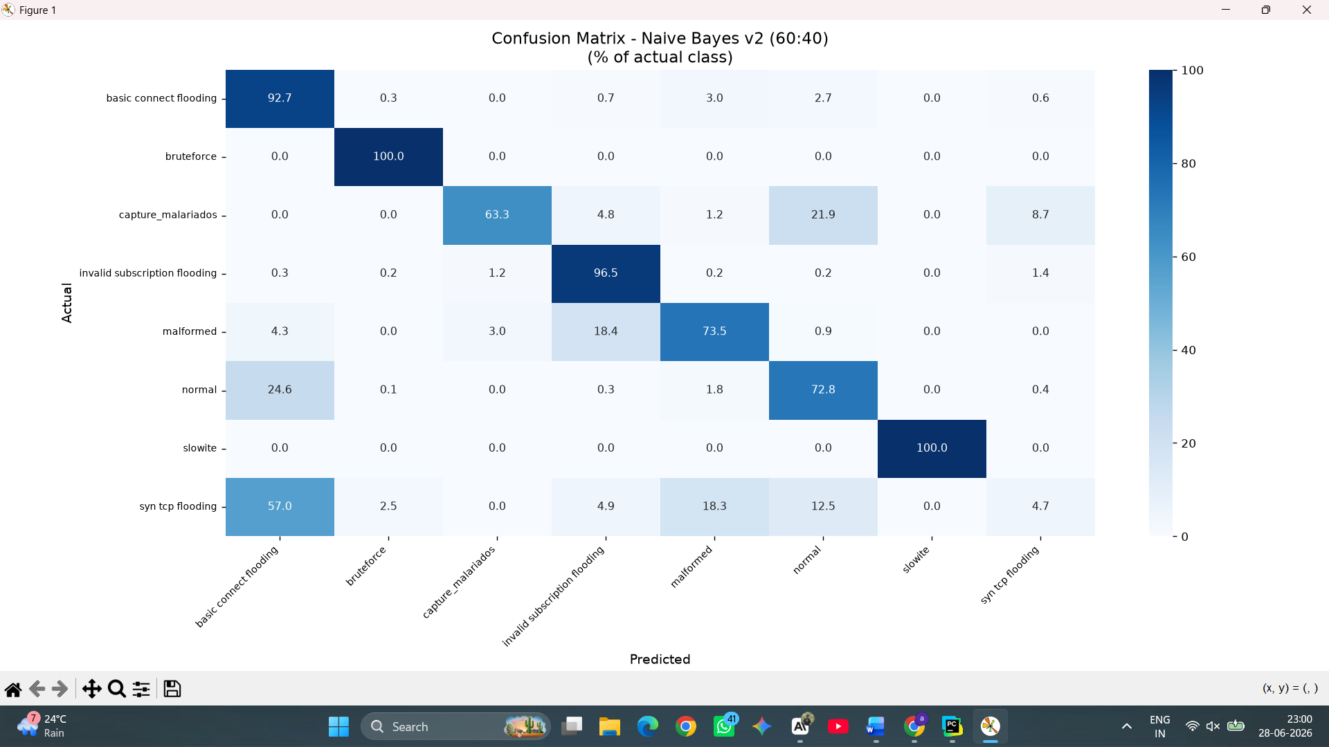

Slide 25


Slide 27


Slide 28
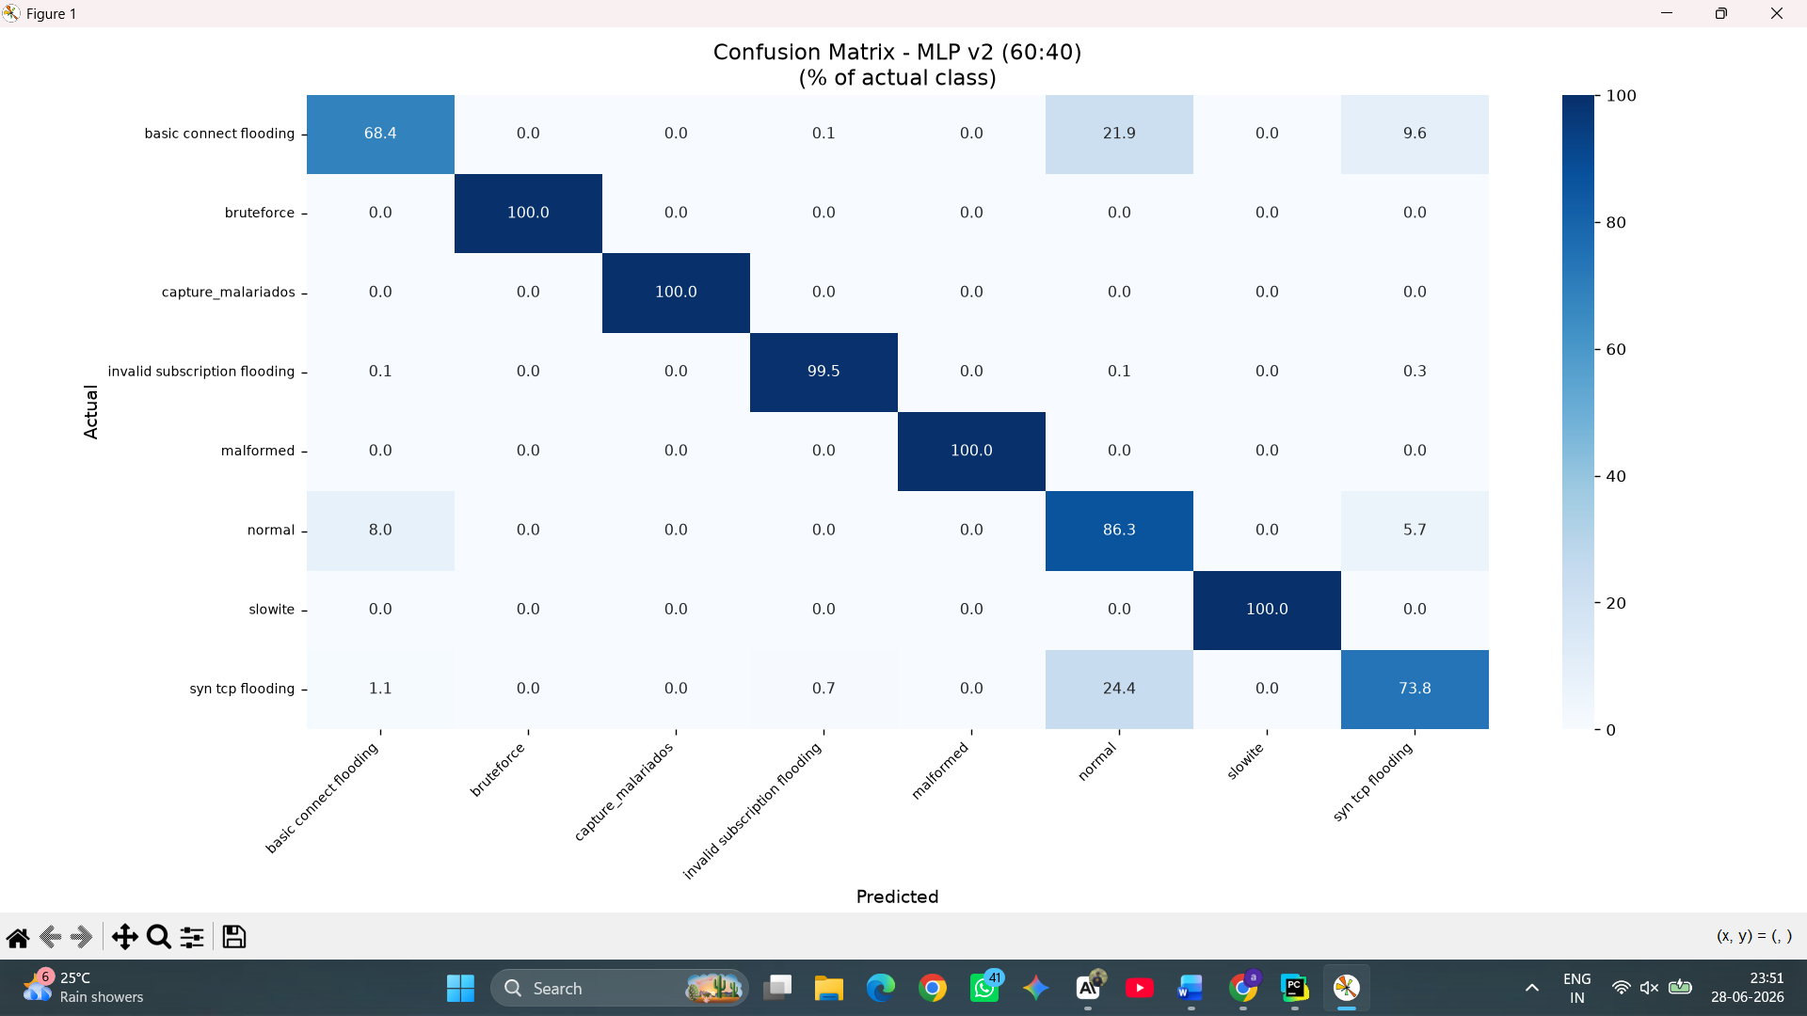

Slide 29
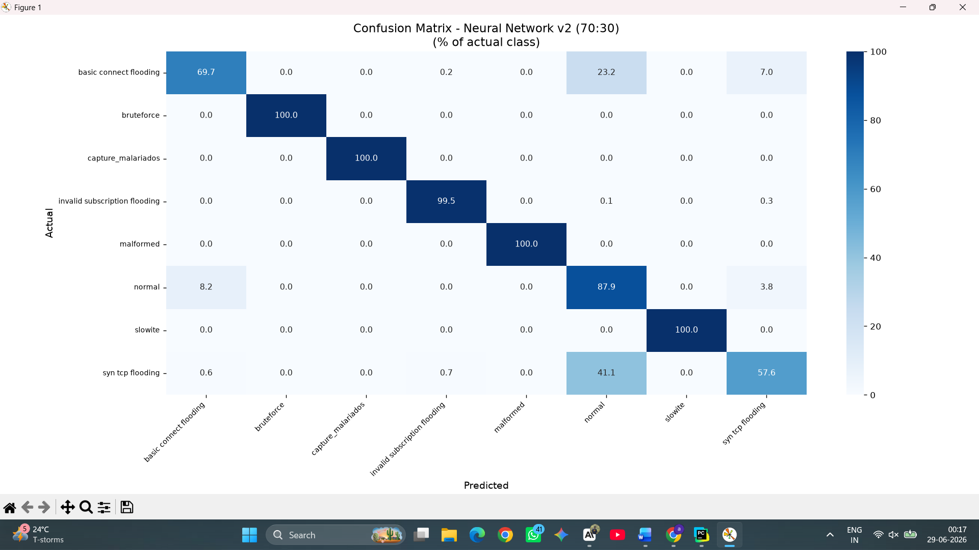

Slide 30


Slide 31
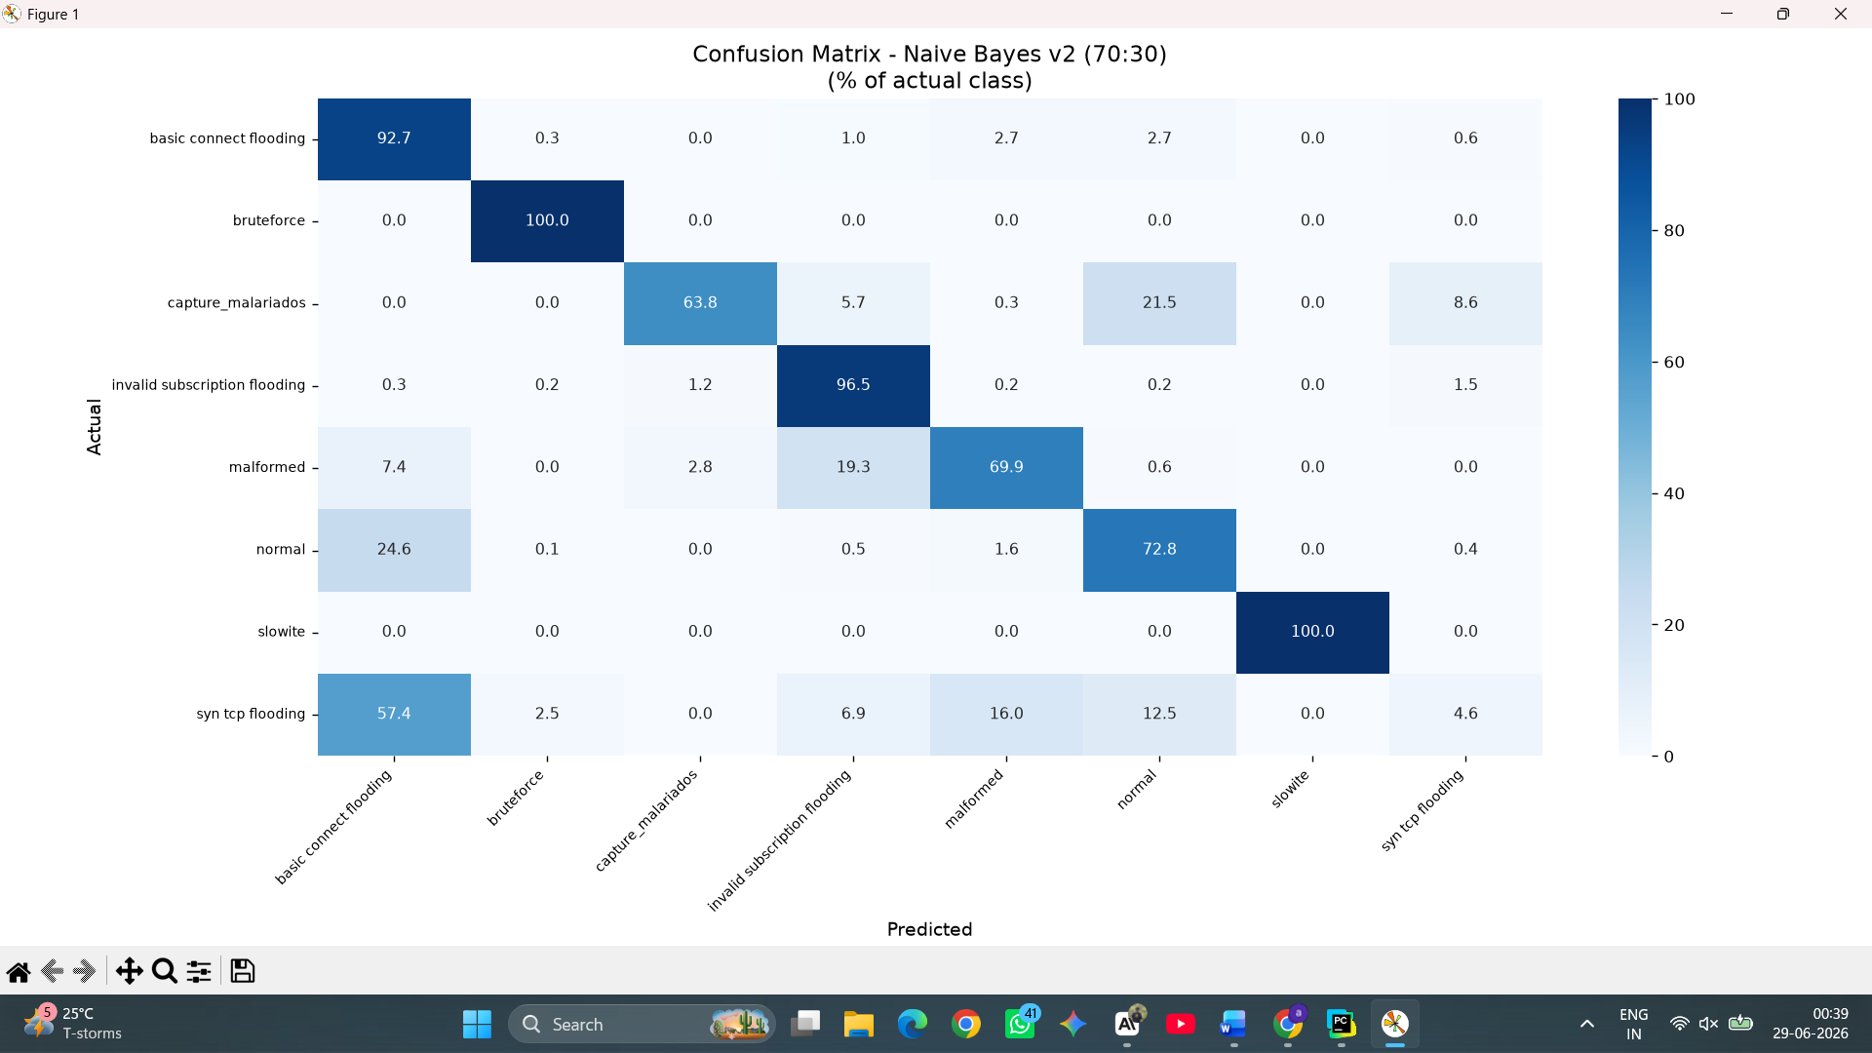

Slide 32


Slide 34


Slide 35


Slide 36


Slide 37


Slide 39


