Slide 1


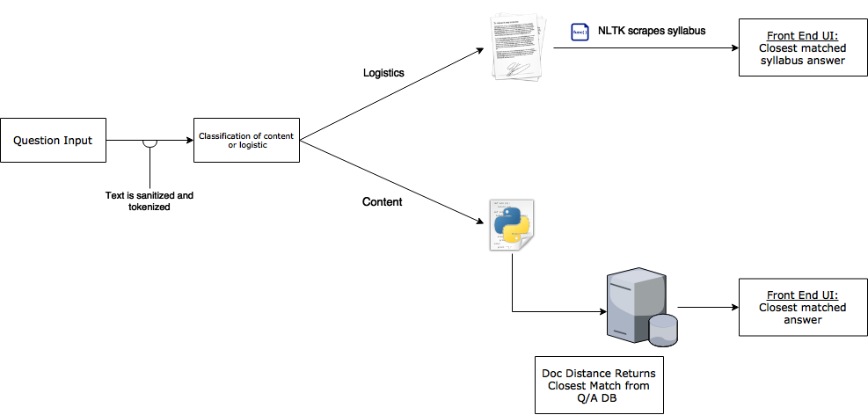
Using smart ed tech to build an accessible course assistant
Allan Chen, Abbey Warren, Jess Brown
University of Michigan, School of Information
SI 485 Information Analytics Project
Introduction
Professor Perry Samson (University of Michigan) has created a study tool called LectureTools: an NSF-backed, student response, note-taking, and inquiry system that allows students in large lectures to interact closely with the professor – which was later acquired by Echo360
Dr. Samson and the Echo360 team use Active Learning Platform data to build predictive machine learning grade models for students to forecast their final grade
Our team has been tasked with developing technology to be used as part of an “early warning system”, wherein student guidance is quasi-automated and informed by the analysis of student behaviors germane to learning.
Data
We had access to over 400 rows of question/answer data that was collected over the course of one semester in Professor Samson’s AOSS 102 class.
Text Classification
Training data: 50 questions marked as content or logistic
Used scikit-learn and nltk to create classifier
87% accuracy when testing on 100 questions
Document Distance
Compares similarity of the input question to pre-existing question, and returns the corresponding answer
Used a gensim tf_idf model and matrix similarity
Word tokens from NLTK determine document distance
Design Architecture
Conclusion & Looking Forward
Through the creation of this virtual tutor, students now have to ability to study and learn class material at any time of day without having to email their professor questions.
In the future, more Q/A datasets can be added to the database, and the chatbot will become a more complete source for student use.
For course logistic questions, the ability to scrape a syllabus can be added to this product with little changes to other aspects of the program.
402 rows of questions
50 training questions
Create text classifier
352 questions for testing
Check accuracy of classifier on 100 questions from testing data
Question | Question Type
Is soil-moisture measured during dry or wet conditions? Or is it an average? | Course content
Is there any way Exam #3 can be taken at a later date? | Course logistics
What does it mean for a front to be stable vs. not? | Course content
Is there a separate assignment for submitting our own personal weather experience? | Course logistics
questionId | sectionId | lessonId | questionBody | questionResponse | Questionlikecount | Responselikecount | Response count | isEndorsed | include | questionDate
00a712ff-e146-437a-877c-4802ea0e5822 | 3603bfd4-7c3a-427f-b0ba-8a344025f329 | G_98cb3946-2c76-45d8-b588 | Do we need to remember the numbers of how much energy is absorbed/emited by each? Or should we just have a general idea that a lot of energy absorbed by atmo, temperature equilibriam as a whole? | General idea! And what potential effects that could alter it like greenhouse gases etc. | 0 | 0 | 1 | 0 | 0 | 2017-09-18 14:24:33
00f8ce11-8d85-40bb | 3603bfd4-7c3a-427f | G_98cb3946-2c76 | are the exams going to be at office hours today | As stated in the canvas announcement, yes they will be. The office hours are 12-2 | 1 | 0 | 2 | 0 | 0 | 2017-10-18 14:03:46
402 questions & answers
Student’s inputted question
questionBody | questionResponse
What was the definition of albedo? | The amount of sunlight that is reflected off the earth back to space. | https://mail.esr.org/outreach/glossary/albedo.html
If we get 6 days of unexcused absence, does that just drop the 6 lowest participation scores? | Yes
Is humid heat fatal than dry heat? | Don't know if this has been specifically quantified with death toll but humid heat feels heavier. It contains more moisture therefore the heat index makes the "feels like" temperature higher. Because our bodies can't evaporate the water as easily. Also makes it harder to breathe
Would derechos act like hurricanes and strengthen as they travel over water? | No... a derecho is a line of strong thunderstorms that regenerate and form a bow-echo shape that has extremely strong winds. These form over lands because of all the reasons we have learned regarding low pressure systems and storms
Corpus of word and how many times it appears in data
Corpus of word and how many times it appears in question
Tf-idf model of (number of questions, number of tokens)
Conversion to tf-idf model
Acknowledgments
We would like to thank Professor Samson for the opportunity to work on this project over the past two semesters, and Professor Kevyn Collins-Thompson for all of his work to coordinate the BSI IA Capstone projects.
Matrix similarity Model
Return closest matched answer

