Slide 1
From mobile phone data to the spatial structures of cities
By Stanway liau

Slide 2
Introduction
Analyzed anonymous mobile phone traces in 31 Spanish cities during weekdays for 55 days
Detect individual mobility patterns, urban land use, and locations of communities
Characterize city by landscape density, space consumption, activity centers, and degree of polycentrism
Gives a dynamic analysis as opposed to using census data
E.g. changes throughout the day
Goal is to characterize the spatial structure of cities quantitatively

Slide 3
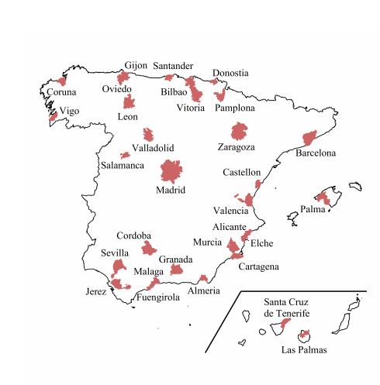
Collecting data
Cities diverse in geography
E.g. port, island, or central cities
Plot the time evolution of number of users along the day
Peaks at 12pm and 6pm in all cities
Scale results by number of cell phone users to compare different cities
Results show a common thread

Slide 4
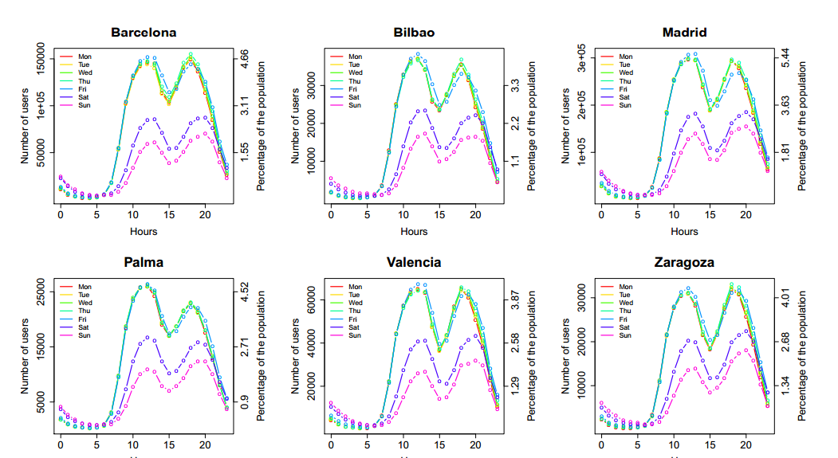
Number of users per hour per day

Slide 5
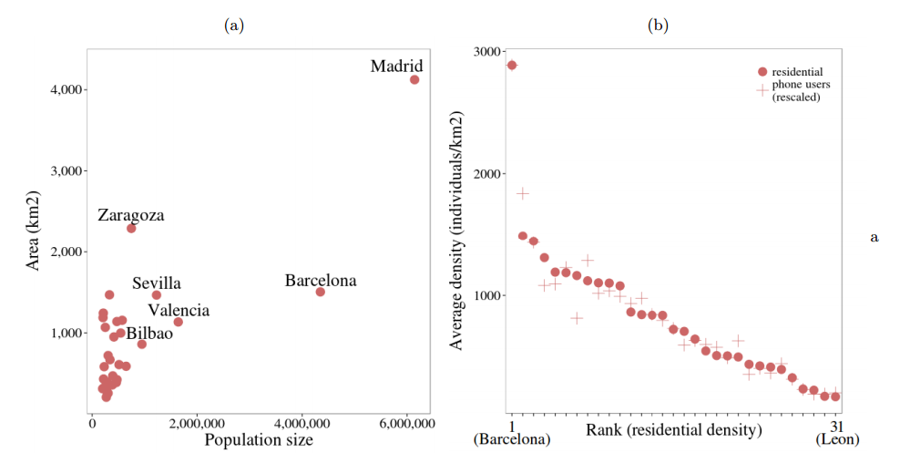
Users vs. population size
-No correlation between population size and physical size of city (left graph)
-However, the percentage of population using a phone compared to population size holds at a constant ratio (right graph)

Slide 6
Data analysis
Mobile phone data gives the function p(i, t) – the density of users at location i at time t
Two ways of analyzing data:
Identify the local maxima and minima of p(i, t) to find hotspots
Gives a more “local” look at different parts of the city
Define global indicators that consider all points and weigh them by user density
Informs us about the “global” properties of the city as a whole

Slide 7
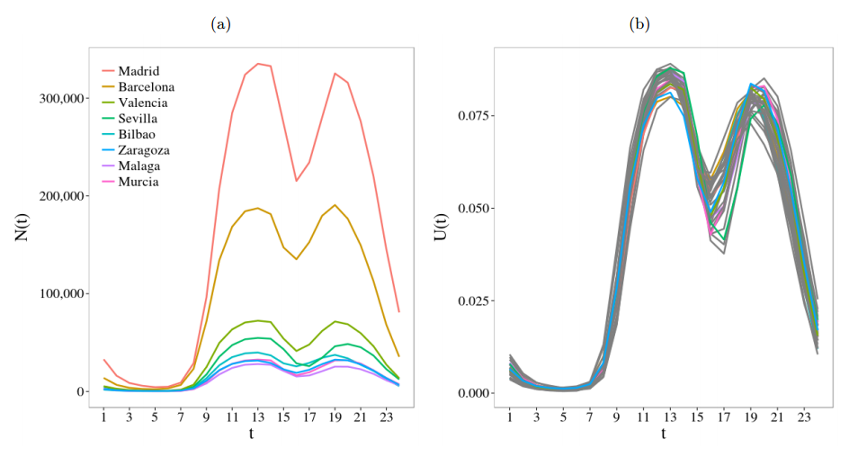
Global analysis
Average cell phone users per hour during an average day for the 8 biggest cities (left graph)
Same data but rescaled for all 31 cities (right graph)
Rescaled by dividing the number of users in city i at time t by the total number of users in city i during the entire day
There’s a common “rhythm” to all cities

Slide 8
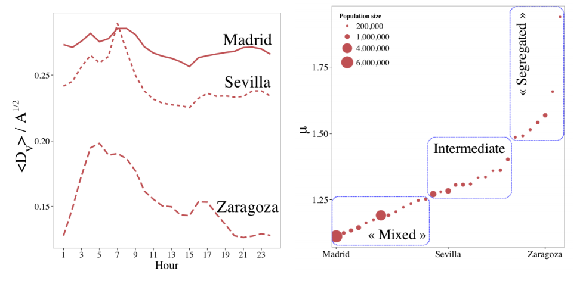
Density Analysis
The average weighted distance between users, D, tells a lot about the organization of a city
Normalized for density of each cell
Data normalized for the location of the scattered locations of the cell towers
People cluster together at different times of the day (left graph)
Dilation index u defined as D_max/D_min
Plotted on right graph
Tells about how “spatially segregated” a city is
Lower value corresponds to businesses being mixed with residential areas

Slide 9
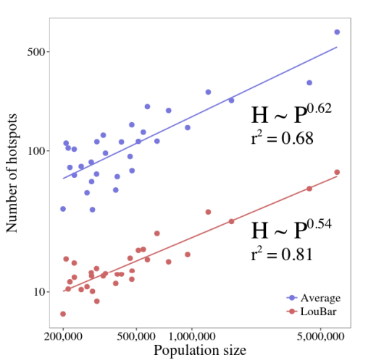
Hotspot analysis
Determine some threshold value that when crossed, indicates above average traffic
d_min: average value of traffic
d_max: reasonable max value using the LouBar method
Regardless of choice of threshold, results should be robust, indicating some intrinsic property of the city
Shown that number of activity centers N_a in the US scales as N_a ~ P^b, where b = 0.64
Exponent is affected by choice of spatial boundaries
“Urban areas” should fit the pattern while official city boundaries may not

Slide 10
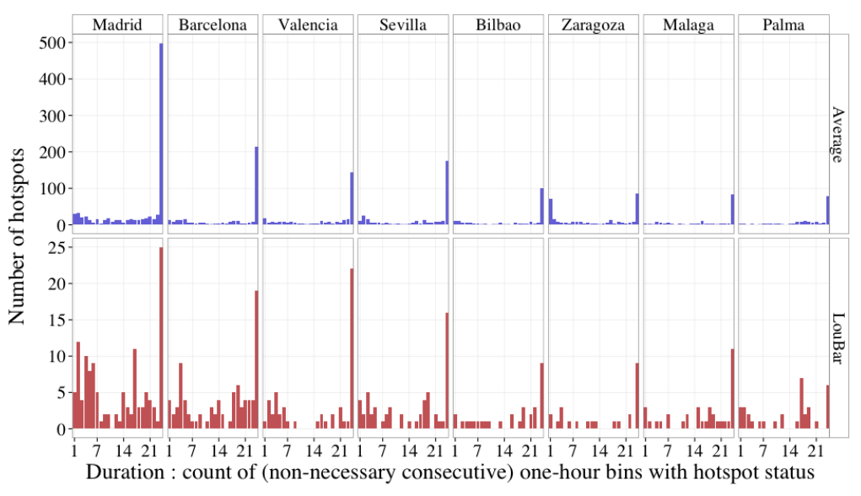
Hotspots stability
Inspect the stability of the hotspots and their evolution throughout the day
Divide a city into cells and count the number of one hour periods that that cell has been a hotspot
Permanent, intermediate, and intermittent hotspots
Results robust for whichever threshold value chosen
Kendall tau value T(t) for permanent hotspots shows they are very stable throughout time and space

Slide 11

Spatial structure of hotspots
Look at permanent hotspots from LouBar criteria and compare how distant they are from each other, D_per(i), compared to the city’s area A_i
Compacity value $C\left(i\right)=\left(\frac{D_{per\left(i\right)}}{A_{i}^{0.5}}\right)$
Shows how compact a city’s core is by seeing how hotspots are distributed
Values close to 0 indicate a tight central core/hub
Values close to 1 indicate more sprawl
Compacity increase with population size
Consistent with idea that a larger city is more polycentric

Slide 12
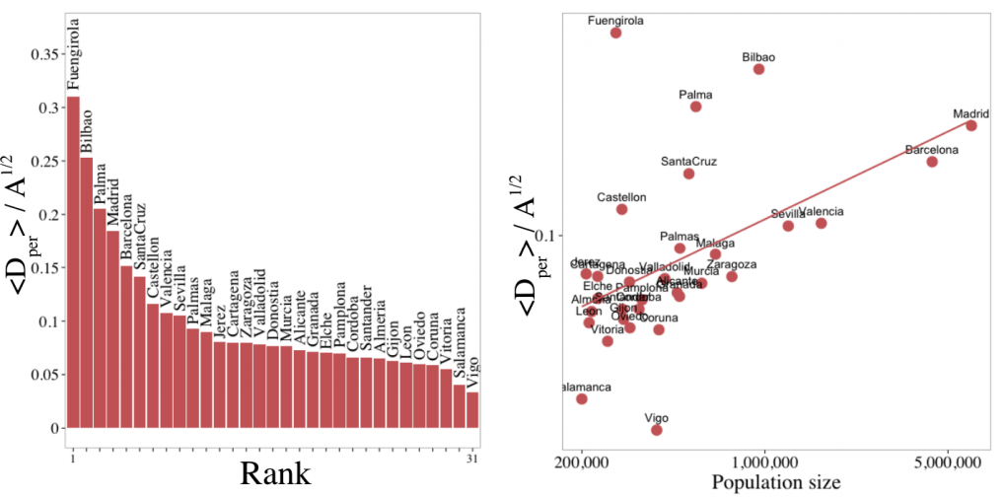
Compacity for 31 cities
-Can see that compacity generally decreases with population

Slide 13
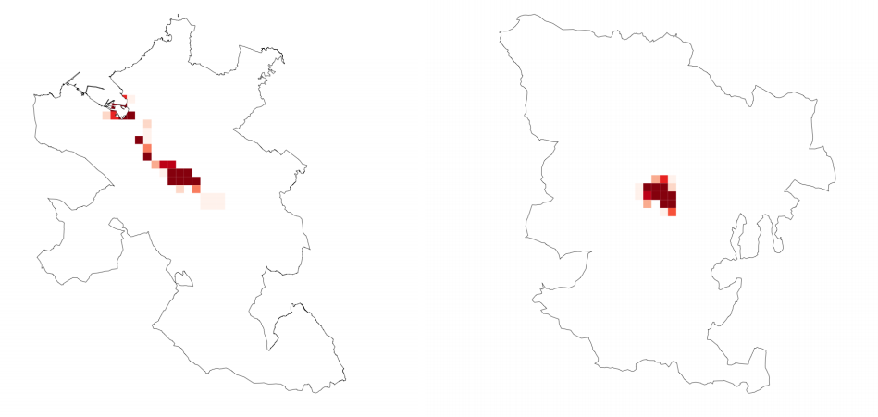
Hotspot distribution example
Bilbao (population 950,000)
-polycentric
Vitoria (population 250,000)
-monocentric
-Spatial distribution of 1 km^2 hotspots in Bilbao and Vitoria

Slide 14
Conclusion
Researchers found that the intermittent and intermediate hotspots have a high compacity value, meaning they are pretty much spread out everywhere
So more significant to look at differences in spatial organization of permanent vs. nonpermanent hotspots
Possible to characterize a city based on its dynamical properties using the indices in the study
Step towards a quantitative typology of cities
Possible applications are where to focus efforts on infrastructure, traffic analysis
Study shows a good application of big data

Slide 15
References
http://arxiv.org/pdf/1401.4540v1.pdf
http://www.technologyreview.com/view/523926/how-a-new-science-of-cities-is-emerging-from-mobile-phone-data-analysis/

Slide 16
Q&A

